Slide 1
A clique-covering sufficient condition for hamiltonicity of graphs
Alain Bretto,Thierry Vallee
Information Processing Letters 109 (2009) 1156–1160
Presenter: Kai-Yu Chen
Date: Jan. 19, 2010

Slide 2
ABSTRACT
A graph is hamiltonian if it contains a cycle which goes through all vertices exactly once. Determining if a graph is hamiltonian is known as NP-complete problem and no satisfactory characterization for hamiltonian graphs has been found. There are several necessary conditions for hamiltonicity and since the seminal work of Dirac in 1952, many sufficient conditions were found. These conditions are usually expressed in terms of node degree, connectivity, density, toughness, independent sets, regularity and forbidden subgraphs.
In this article we give an extended clique decomposition condition ensuring the hamiltonicity of a large class of graphs. Then we discuss briefly the possibility of broader extensions as well as algorithmic issues.

Slide 3
1.Introduction and preliminaries
A clique-covering is a decomposition of the graph into complete subgraphs (cliques).
The (open) neighborhood is defined by:
N(x) = { y: {x, y} ∈ E } and the closed neighborhood by : N[x] = {x} ∪ N(x).
A vertex x of a graph G is simplicial if N(x) is a clique or equivalently if N[x] is a maximal clique of G. We denote by S(G) the set of simplicial vertices of G and by NS(G) the set of non-simplicial vertices of G.

Slide 4
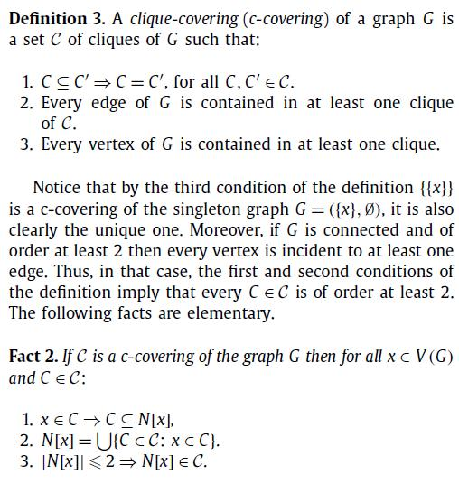
2. Clique-coverings of graphs

Slide 5
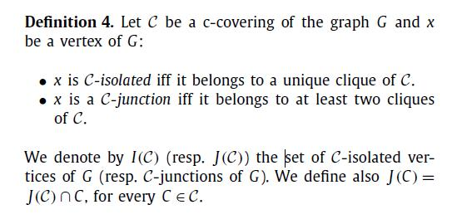
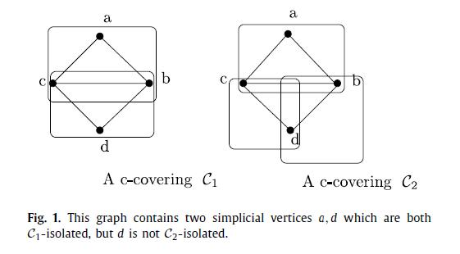
2. Clique-coverings of graphs

Slide 6
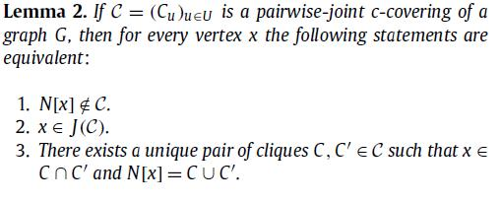
2. Clique-coverings of graphs
Definition 5 (Eulerian c-covering). A c-covering C of a graph G is:
1. pairwise-joint if each vertex is contained in no more than two cliques.
2. evenly-joint if each clique contains an even number of C-junctions.
3. eulerian if it is pairwise-joint and evenly-joint.

Slide 7
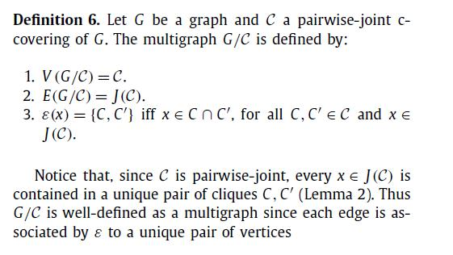
3. Eulerian c-covering and hamiltonicity
In this section, we show that every eulerian coverable connected graph is hamiltonian.
Firstly, we associate to every graph G and every pairwise-joint clique covering C of G a multigraph G/C.
Secondly, we prove in Theorem 1 that if G/C is eulerian then G is hamiltonian.

Slide 8
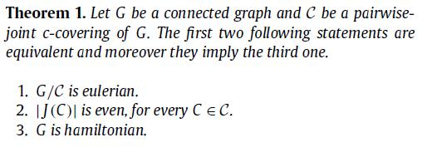
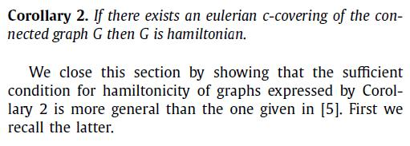
3. Eulerian c-covering and hamiltonicity

Slide 9
Conclusion
To find some general transformation of pairwise-joint c-coverable graphs into eulerian c-coverable graphs, transformation which preserves hamiltonicity of graphs. This transformation may then be used to get a broader notion of eulerian c-coverings in order to generalize Corollary 2.

Slide 10
