Slide 1
Fast Pattern Matching on Indeterminate Strings
J. Holub, W. F. Smyth, S. Wang
Journal of Discrete Algorithms, Vol. 6, pp. 37-50, 2008
Presenter: Chiou-Ting Tseng
Date: Mar. 16, 2010

Slide 2
Abstract
In a string x on an alphabet Σ, a position i is said to be indeterminate iff x[i] may be any one of a specified subset {λ₁,λ₂, . . . , λ_{j} } of Σ, 2 ≤ j ≤ |Σ|. A string x containing indeterminate positions is therefore also said to be indeterminate. Indeterminate strings can arise in DNA and amino acid sequences as well as in cryptological applications and the analysis of musical texts. In this paper we describe fast algorithms for finding all occurrences of a pattern p = p[1..m] in a given text x = x[1..n], where either or both of p and x can be indeterminate.

Slide 3
Abstract
Our algorithms are based on the Sunday variant of the Boyer–Moore pattern matching algorithm, one of the fastest exact pattern-matching algorithms known. The methodology we describe applies more generally to all variants of Boyer–Moore (such as Horspool’s, for example) that depend only on calculation of the δ (“rightmost shift”) array: our method therefore assumes that Σ is indexed (essentially, an integer alphabet), a requirement normally satisfied in practice.

Slide 4
Indeterminate
一個位置可以有很多種可能
例: 注音文，ㄇ={媽妹嗎}
T=你媽媽跟你哥沒帶你妹嗎
P=你ㄇㄇ
你ㄇㄇ

Slide 5
Types of Indeterminate
(X1)(no constraint, quorum)一次match中相同的indeterminate alphabet可以對應到不同的determinate alphabet. Ex: 你妹嗎
(X2)(local constraint, deterministic)一次match中相同的indeterminate alphabet要對應到相同的determinate alphabet. Ex: 你媽媽
(X3)(global constraint)所有match中相同的indeterminate alphabet要對應到相同的determinate alphabet.

Slide 6
Alphabet Set
我們的alphabet set必須要是“finite and indexed”，就是說給一個alphabet我們可以用它來在陣列中定位。
w.l.o.g we assume our alphabet set is formed by {1, 2, …, k, k+1, k+2, …, K} where 1~k are fixed and k+1~K are subsets of 1~k.

Slide 7
Boyer-Moore Algorithm
Bad character rule
s
s +j -1
T |  |  | x | t
P |  | x |  | y | t
1
c
j
m
Shift
P |  | x |  | y | t
1
j
m

Slide 8
Boyer-Moore Algorithm
Good Suffix rule
s
s+j-1
T |  |  | x | t
P |  | z | t |  | y | t
1
j’-m+j
j’
j
m
Shift
P |  | z | t |  | y | t
1
j’-m+j
j’
j
m
z≠y
因為indeterminate不好計算good suffix，所以本篇論文只用bad character rule

Slide 9
Boyer-Moore Algorithm
 | 1 | 2 | 3 | 4 | 5 | 6 | 7 | 8 | 9 | 10 | 11 | 12 | 13 | 14 | 15 | 16 | 17 | 18 | 19 | 20 | 21 | 22 | 23 | 24
T | G | A | T | C | G | A | T | C | A | C | A | T | A | T | C | A | C | A | T | C | A | T | C | A
mismatch
P | A | T | C | A | C | A | T | C | A | T | C | A
 | 1 | 2 | 3 | 4 | 5 | 6 | 7 | 8 | 9 | 10 | 11 | 12
P | A | T | C | A | C | A | T | C | A | T | C | A
 | 1 | 2 | 3 | 4 | 5 | 6 | 7 | 8 | 9 | 10 | 11 | 12
Shift
j | 1 | 2 | 3 | 4 | 5 | 6 | 7 | 8 | 9 | 10 | 11 | 12
P | A | T | C | A | C | A | T | C | A | T | C | A
G’ | 8 | 8 | 8 | 8 | 8 | 8 | 3 | 8 | 11 | 6 | 11 | 1
Σ | A | C | G | T
B | 12 | 11 | 0 | 10

Slide 10
Boyer-Moore Algorithm
 | 1 | 2 | 3 | 4 | 5 | 6 | 7 | 8 | 9 | 10 | 11 | 12 | 13 | 14 | 15 | 16 | 17 | 18 | 19 | 20 | 21 | 22 | 23 | 24
T | G | A | T | C | G | A | T | C | A | C | A | T | A | T | C | A | C | A | T | C | A | T | C | A
mismatch
P | A | T | C | A | C | A | T | C | A | T | C | A
 | 1 | 2 | 3 | 4 | 5 | 6 | 7 | 8 | 9 | 10 | 11 | 12
Shift
P | A | T | C | A | C | A | T | C | A | T | C | A
 | 1 | 2 | 3 | 4 | 5 | 6 | 7 | 8 | 9 | 10 | 11 | 12
Shift
P | A | T | C | A | C | A | T | C | A | T | C | A
 | 1 | 2 | 3 | 4 | 5 | 6 | 7 | 8 | 9 | 10 | 11 | 12

Slide 11
Horspool Algorithm
Suffix search
Text
α
ß
Pattern
σ
match
Text
ß
Safe shift
ß
no ß in this part

Slide 12
Sunday Algorithm
1 | 2 | 3 | 4 | 5 | 6 | 7 | 8 | 9 | 10 | ...
a | d | d | a | b | d | a | b | c | b | a
a | b | c | a | b
 |  |  | a | b | c | a | b
1 | 2 | 3 | 4 | 5 | 6 | 7 | 8 | 9 | 10 | ...
a | d | d | a | b | d | a | b | c | b | a
a | b | c | a | b
 |  |  |  |  |  | a | b | c | a | b

Slide 13
Models of the Problem
(M1) The only indeterminate letter is the don’t-care ∗, whose occurrences may be in either p or x, or both.
(M2) Arbitrary indeterminate letters can occur, but only in p (like agrep).
(M3) Indeterminate letters can occur in both p and x.

Slide 14
Scratch of BMS Algorithm
Find all occurrences of p = p[1..m] in x = x[1..n]
if m<1 then return
i₀ = m; m’ = m−1
while i₀ ≤ n do
L = hctam(i₀,m)
if L = 0 then output i₀ − m’
I₀ = i₀ +Δ[x[i₀ + 1]]

Slide 15
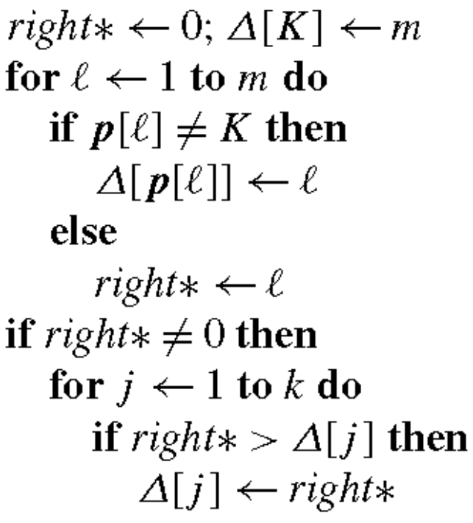
Shift Function-M1
每次頂多可以shift到*在的位置
若p有*則O(m+k) time, 否則θ(m) time

Slide 16
Shift Function – M1
1 | 2 | 3 | 4 | 5 | 6 | 7 | 8 | 9 | 10 | ...
a | d | d | a | b | d | a | b | c | b | a
a | b | c | a | b
 |  |  |  |  |  | a | b | c | a | b
Σ | a | b | c | d
S | 2 | 1 | 3 | 6
1 | 2 | 3 | 4 | 5 | 6 | 7 | 8 | 9 | 10 | ...
a | d | c | a | b | d | a | b | c | b | a
a | b | * | a | b
 |  |  | a | b | * | a | b
Σ | a | b | c | d
S | 2 | 1 | 3 | 3

Slide 17
Shift Function – M2
1 | 2 | 3 | 4 | 5 | 6 | 7 | 8 | 9 | 10 | ...
a | d | d | a | b | d | a | b | c | b | a
c | b | c | a | b
 |  |  |  |  |  | a | b | c | a | b
Σ | a | b | c | d
S | 2 | 1 | 3 | 6
Σ | a | b | c | d
S | 2 | 1 | 5 | 6
1 | 2 | 3 | 4 | 5 | 6 | 7 | 8 | 9 | 10 | ...
a | d | c | a | b | d | a | b | c | b | a
c | ■ | Δ | a | b
 |  |  |  | a | ■ | Δ | a | b
Σ | a | b | c | d
S | 2 | 1 | 3 | 6
Δ
Σ | a | b | c | d
S | 2 | 1 | 3 | 4
■
■ ={b, d}, Δ={b, c}

Slide 18
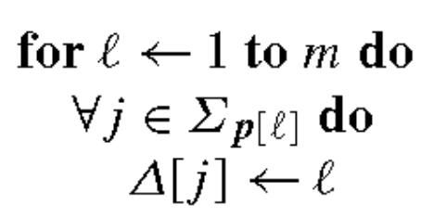
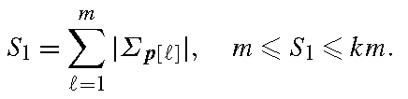
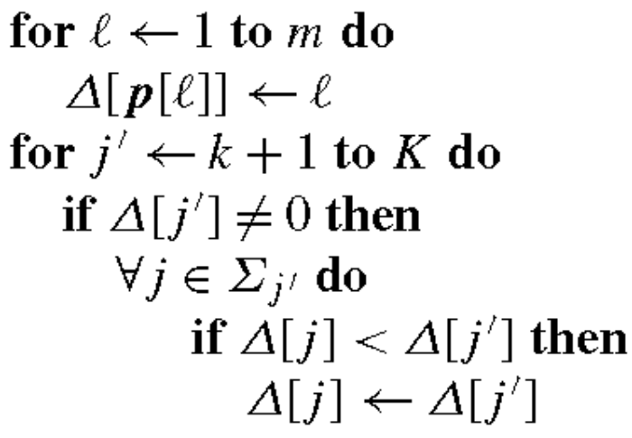
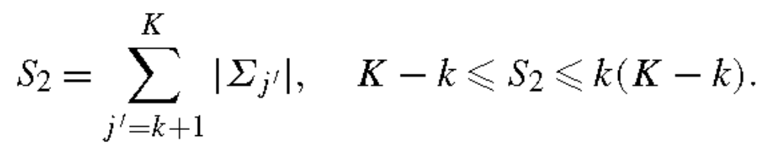
Shift Function – M2
Method 1
以pattern的每個字為中心更新，用在pattern短的情況
Time 1
以未定字為中心更新，用在未定字少的情況
Method 2
Time 2

Slide 19
Shift Function – M3
1 | 2 | 3 | 4 | 5 | 6 | 7 | 8 | 9 | 10 | ...
a | d | c | a | b | ■ | a | b | c | b | a
c | a | Δ | a | b
 |  |  | c | a | Δ | a | b
Σ | a | b | c | d | ■ | Δ
S | 2 | 1 | 3 | 6 | 3 | 1
■ ={c, d}, Δ={b, c}

Slide 20
Shift Function – M3-1
1 | 2 | 3 | 4 | 5 | 6 | 7 | 8 | 9 | 10 | ...
a | d | c | a | b | ■ | a | b | c | b | a
c | a | Δ | a | b
 |  |  | c | a | Δ | a | b
Σ | a | b | c | d | ■ | Δ
S |  |  | 5 |  | 5 | 5
Σ | a | b | c | d | ■ | Δ
S | 4 |  | 5 |  | 5 | 5
■ ={c, d}, Δ={b, c}
Σ | a | b | c | d | ■ | Δ
S | 4 | 3 | 3 |  | 3 | 3
Σ | a | b | c | d | ■ | Δ
S | 2 | 3 | 3 |  | 3 | 3
Σ | a | b | c | d | ■ | Δ
S | 2 | 1 | 3 | 6 | 3 | 1

Slide 21
Shift Function – M3-2
1 | 2 | 3 | 4 | 5 | 6 | 7 | 8 | 9 | 10 | ...
a | d | c | a | b | ■ | a | b | c | b | a
c | a | Δ | a | b
 |  |  | c | a | Δ | a | b
■ ={c, d}, Δ={b, c}
Σ | a | b | c | d | ■ | Δ | a₀ | b₀ | c₀ | d₀ | ₀ | Δ₀
S | 2 | 1 | 5 | 6 | 6 | 3 | 2 | 1 | 5 | 6 | 6 | 3
Σ | a | b | c | d | ■ | Δ | a₀ | b₀ | c₀ | d₀ | ₀ | Δ₀
S | 2 | 1 | 5 | 6 | 5 | 3 | 2 | 1 | 5 | 6 | 6 | 3
■
Σ | a | b | c | d | ■ | Δ | a₀ | b₀ | c₀ | d₀ | ₀ | Δ₀
S | 2 | 1 | 3 | 6 | 3 | 1 | 2 | 1 | 5 | 6 | 6 | 3
Δ

Slide 22
Bit Array Method
對每個alphabet j都建立一個bit array b_{j}
b_{j} [ j’ ] = 1 ⇐⇒ j’ ∈ Σ_{j}
For j ≤ k, totally O(k⎡k/w⎤+k) time.
For j > k, totally O(K⎡k/w⎤+(K-k+1)k) time.
Two alphabet match if their “AND” is non-empty.

Slide 23
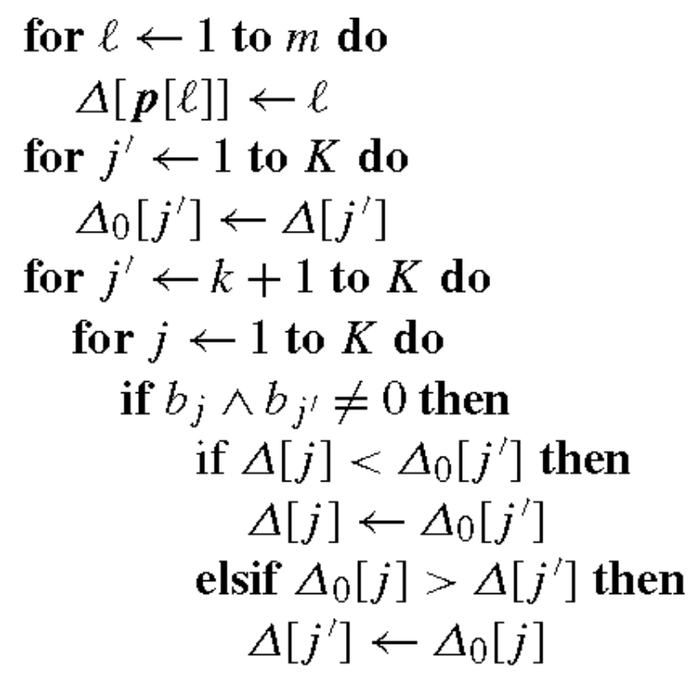
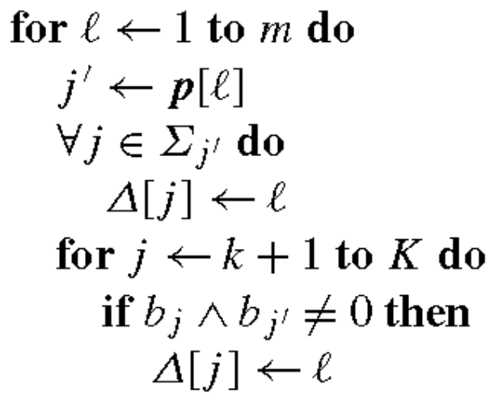


Shift Function – M3
Method 1
Method 2
Time 1
Time 2

Slide 24
Types of Indeterminate
(X1)(no constraint, quorum)一次match中相同的indeterminate alphabet可以對應到不同的determinate alphabet. Ex: 你妹嗎
(X2)(local constraint, deterministic)一次match中相同的indeterminate alphabet要對應到相同的determinate alphabet. Ex: 你媽媽
(X3)(global constraint)所有match中相同的indeterminate alphabet要對應到相同的determinate alphabet.

Slide 25
Hctam Function
對於quorum就是用一般的交集看有沒有match
對於deterministic就是對每個indeterminate alphabet紀錄之前剩下的可能性，碰到第二次出現除了跟text有交集之外還要跟之前的可能性有交集才算match
對於global constraint，沒有成果

Slide 26
Experimental Resluts
Compare with BNDM (Nrgrep)
Input
  More than 15000 eBooks, randomly select 10 of them
  Human DNA
  Protein

Slide 27
Text Length
Input: 200 texts formed by English with 85 ASCII characters.
Pattern: _of _th, of _the, f _the_, _that_ , _and_, _this_, n_the_

Slide 28
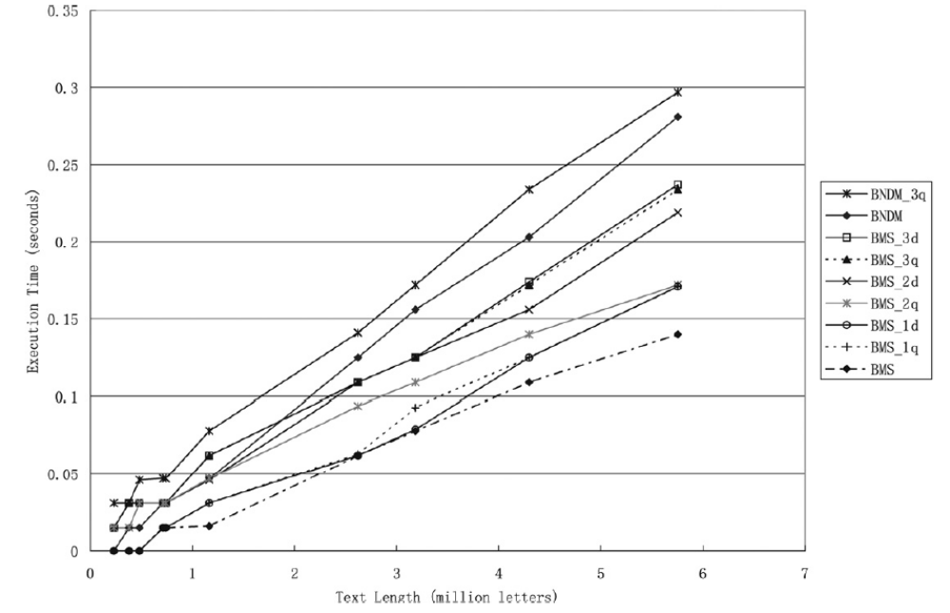
Text Length

Slide 29
Frequency of Occurrence
Input: 200 texts formed by English with 85 ASCII characters.
Pattern: better, enough, govern, public, someth, system, though
About 0.1 frequency of the previous one.
Identical to the previous result.

Slide 30
Pattern Length
Ten groups of 9 equal-length patterns, ranging from 3 to 100 letters.

Slide 31
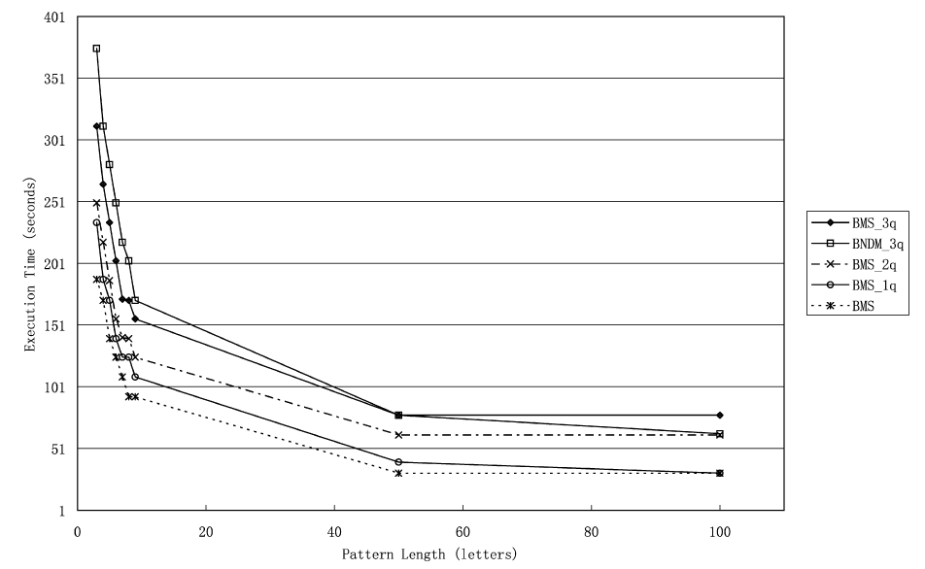
Pattern Length

Slide 32
Alphabet Size
We test against files whose effective alphabet size ranges from 4 (DNA sequences), through 20 (protein sequences) and 85 (English texts), to 250 or so (object files).

Slide 33
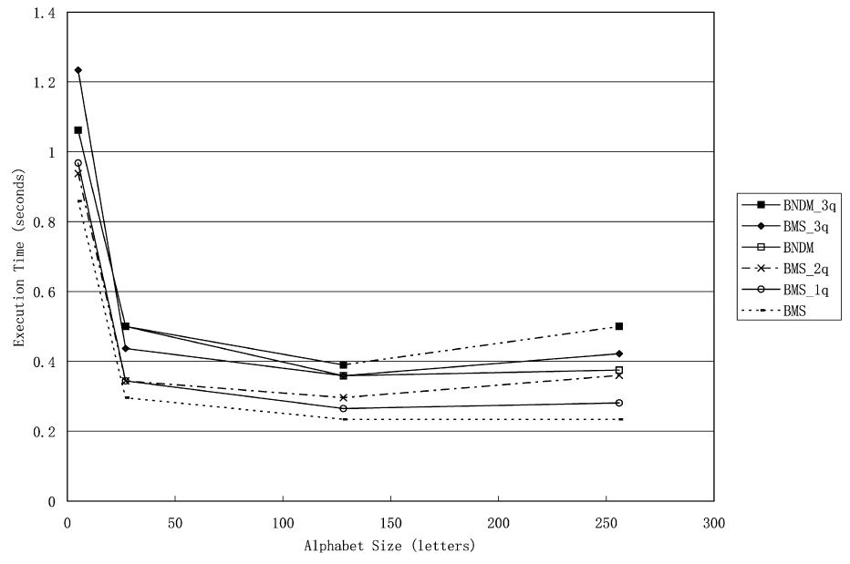
Alphabet Size

Slide 34
Frequency of Indeterminate Alphabets in Pattern
Indeterminate alphabet can only appear in pattern (Type M2)
^ is the only indeterminate alphabet which matches half of the lower case English alphabets.

Slide 35
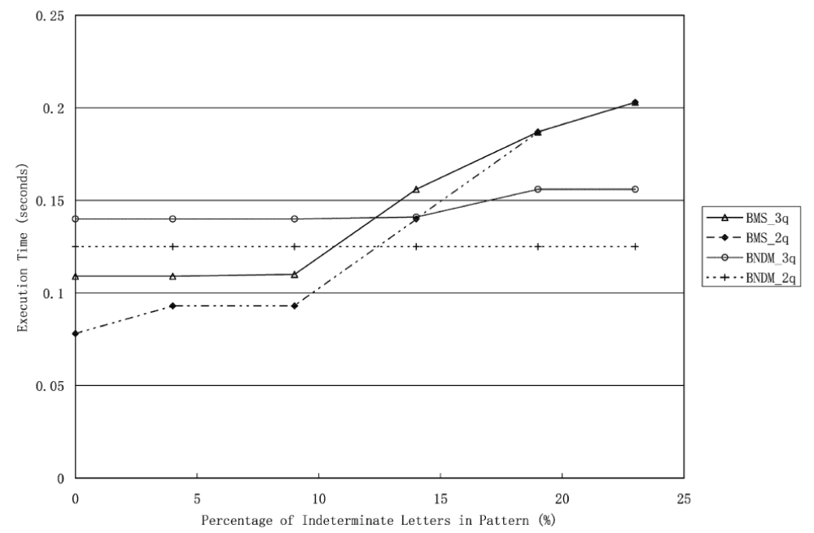
Frequency of Indeterminate Alphabets in Pattern

Slide 36
Frequency of Indeterminate Alphabets in Text
Indeterminate alphabet can only appear in text.
These letters match ¼ of the lower case English alphabets.

Slide 37
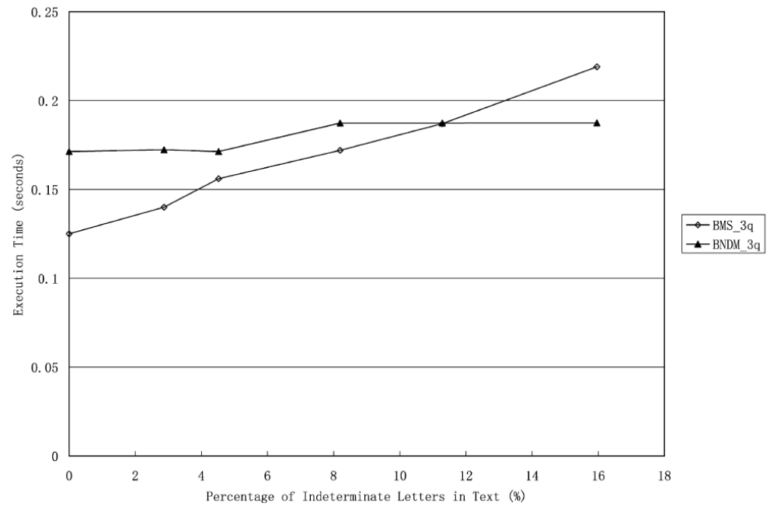
Frequency of Indeterminate Alphabets in Text

Slide 38
Frequency of Indeterminate Alphabets in Alphabet
Add some indeterminate alphabets which do not occur in the pattern or text.

Slide 39
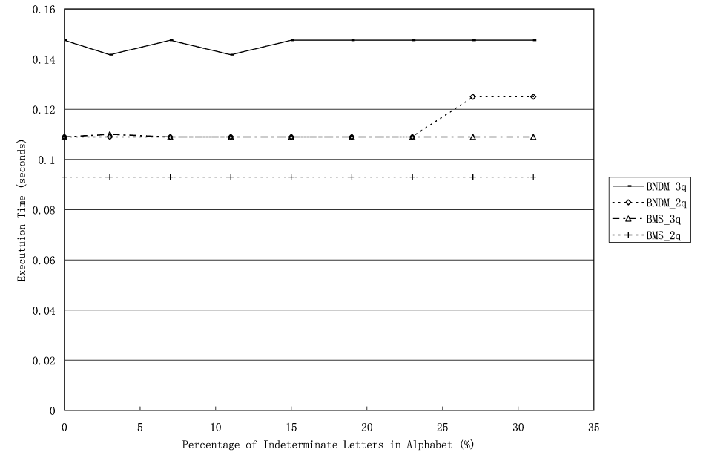
Frequency of Indeterminate Alphabets in Alphabet

