Slide 1
CUDA compatible GPU cards as efficient hardware accelerators for
Smith-Waterman sequence alignment
Svetlin A Manavski, and Giorgio Valle
BMC Bioinformatics 2008, 9(Suppl 2):S10 doi:10.1186/1471-2105-9-S2-S10
Presenter: Kai-Yu Chen
Date: June 1, 2010

Slide 2
Abstract(1/3)
Background: Searching for similarities in protein and DNA databases has become a routine procedure in Molecular Biology. The Smith-Waterman algorithm has been available for more than 25 years. It is based on a dynamic programming approach that explores all the possible alignments between two sequences; as a result it returns the optimal local alignment. Unfortunately, the computational cost is very high, requiring a number of operations proportional to the product of the length of two sequences. Furthermore, the exponential growth of protein and DNA databases makes the Smith-Waterman algorithm unrealistic for searching similarities in large sets of sequences. For these reasons heuristic approaches such as those implemented in FASTA and BLAST tend to be preferred, allowing faster execution times at the cost of reduced sensitivity. The main motivation of our work is to exploit the huge computational power of commonly available graphic cards, to develop high performance solutions for sequence alignment.

Slide 3
Abstract(2/3)
Results: In this paper we present what we believe is the fastest solution of the exact Smith-Waterman algorithm running on commodity hardware. It is implemented in the recently released CUDA programming environment by NVidia. CUDA allows direct access to the hardware primitives of the last-generation Graphics Processing Units (GPU) G80. Speeds of more than 3.5 GCUPS (Giga Cell Updates Per Second) are achieved on a workstation running two GeForce 8800 GTX. Exhaustive tests have been done to compare our implementation to SSEARCH and BLAST, running on a 3 GHz Intel Pentium IV processor. Our solution was also compared to a recently published GPU implementation and to a Single Instruction Multiple Data (SIMD) solution. These tests show that our implementation performs from 2 to 30 times faster than any other previous attempt available on commodity hardware.

Slide 4
Abstract(3/3)
Conclusions: The results show that graphic cards are now sufficiently advanced to be used as efficient hardware accelerators for sequence alignment. Their performance is better than any alternative available on commodity hardware platforms. The solution presented in this paper allows large scale alignments to be performed at low cost, using the exact Smith-Waterman algorithm instead of the largely adopted heuristic approaches.

Slide 5
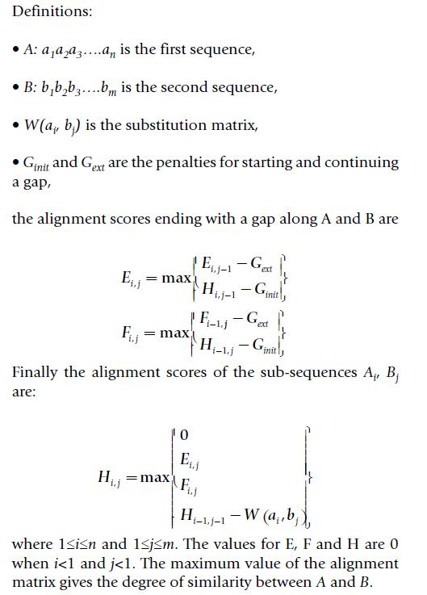

Background(1/2)
The Smith-Waterman algorithm

Slide 6


Background(2/2)
The Smith-Waterman algorithm

Slide 7
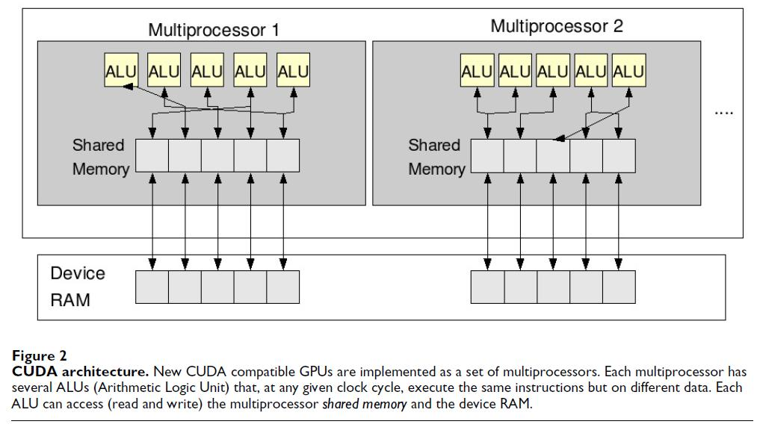
CUDA programming model
Scatter is the ability to randomly access any memory cell for writing. The unavailability of scatter was one of the major limitations of OpenGL when applied to GPGPU applications.
The main point in approaching CUDA is that the overall performance of the applications dramatically depends on the management of the memory, which is much more complex than in the CPUs.

Slide 8
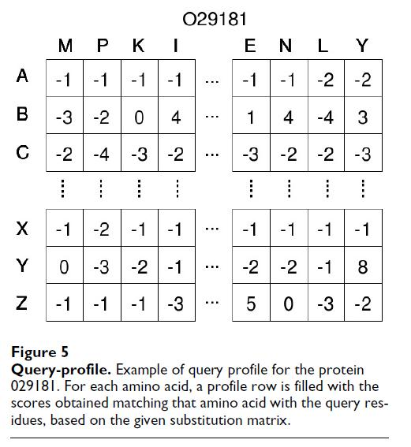
Method
The query profile, shown in Figure 5, can be considered as a query-specific substitution matrix computed only once for the entire database.

Slide 9
Smith-Waterman in CUDA
The strategy adopted in our implementation in CUDA was to make each GPU thread compute the whole alignment of the query sequence with one database sequence.
In order to make the most efficient use of the GPU resources the computing time of all the threads in the same grid must be as near as possible. For this reason we found it was important to pre-order the sequences of the database in function of their length.
For each alignment the matrix is computed column by column in order parallel to the query sequence.
The GPU is able to read and write up to 128 bits of the local memory with a single instruction. So each thread reads at once four H and four E values (16 bits long) from the loading buffer plus the respective four values from the profile.

Slide 10
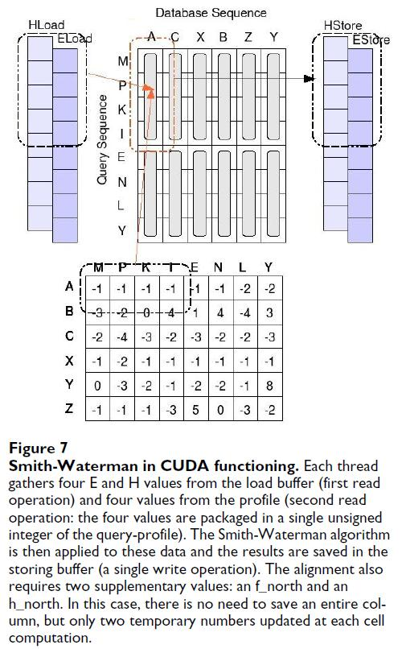

Smith-Waterman in CUDA

Slide 11
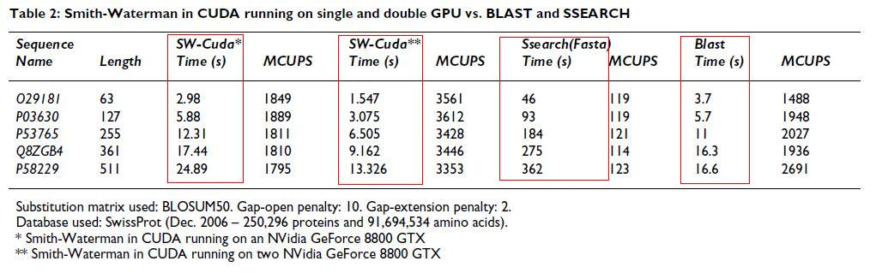
Results

Slide 12
http://www.nvidia.com/object/cuda_gpus.html#Q1support%20list
http://www.nvidia.com/page/geforce_8800.html
CUPS – Cells Updates Per Second

Slide 13
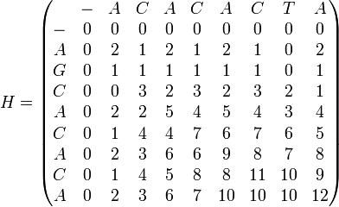

Background(2/2)
The Smith-Waterman algorithm
Ex.
Sequence 1 = ACACACTA
Sequence 2 = AGCACACA
w(match) = +2
w(a, − ) = w( − ,b) = w(mismatch) = − 1
Sequence 1 = A-CACACTA Sequence 2 = AGCACAC-A

