Slide 1
Counting distinct palindromes in a word in linear time
Richard Groult, Élise Prieur , Gwénaël Richomme
Information Processing Letters, Vol. 110, pp. 908–912, 2010
Speaker: Kai-Yuan Cheng
Date: Oct. 26, 2010

Slide 2
Abstract
We design an algorithm to count the number of distinct palindromes in a word w in time O(|w|), by adapting an algorithm to detect all ccurrences of maximal palindromes in a given word and using the longest previous factor array. As a direct consequence, this shows that the plindromic richness (or fullness) of a word can be checked in linear time.

Slide 3
Longest Palindromic Suﬃx(LPS)
Let w be a word. For all i such that 1 ≦ i ≦ |w|,
we let LPS[i] denote the length of the longest palindromic suﬃx ending at position i.
LPS[i] = max{ l | w[i-l+1….i] is a palindrome. }

Slide 4
Longest Palindromic Suﬃx(LPS)
K2
K3
K1 = 12
a | b | b | b | b | a | b | b | b | b | a | b | b | b | a
P1
P2
P3

Slide 5
Proposition 1. The number of distinct palindromes in w is equal to the number of preﬁxes of w having a unioccurrent longest palindromic suﬃx.

Slide 6
K2
K3
K1
a | b | b | b | b | a | b | b | b | b | a | b | b | b | a
P1
b | b | b | a | b | b | b | b | a | b | b | b
~
P2 = P2
b | b | b
P2
b | b | b
P3
b | b | b | a | b | b | b
~
P3 = P3
b | b | b | a | b | b | b

Slide 7
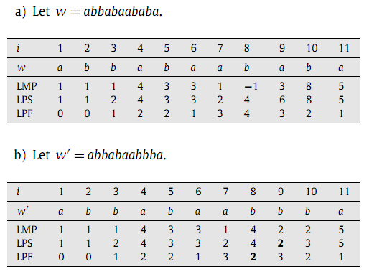
Compute LPS in linear time
LPS[i] = max(LMP[i], LPS[i +1]−2)

Slide 8
Longest Maximal Palindrome(LMP)
Given a word w = w₁ ···w_{n} with each w_{i} in A and integers i, j with 1 ≦ i ≦ j ≦ n, we let w[i.. j] denote the factor w_{i} w_{i+1} ···w _{j−1}w _{j} . (An occurrence of) a palindrome
p = w[i.. j] is said to be maximal in w if p is a preﬁx or a suﬃx of w (that is i = 1 or j = n), or if w[i − 1.. j + 1] is not a palindrome.
LMP[i] = max{ l | {−1} ∪ w[i-l+1….i] is a maximal palindrome in w. }

Slide 9
Longest Previous Factor(LPF)
For each position i in a word w (1 ≦ i ≦ |w|), LPF[i] denotes the length of the longest previous factor at position i, which is the length of the longest factor of w starting at position i that previously occurs in w.
LPF[i] = max{ l | w[i…i+l-1] is a factor of
w[i…i+l-2] ∪{ 0 }. }

Slide 10
Longest Previous Factor(LPF)
i | 1 | 2 | 3 | 4 | 5 | 6 | 7 | 8 | 9 | 10 | 11
w | a | b | b | a | b | a | a | b | a | b | a
LPF | 0 | 0 | 1 | 2 | 2 | 1 | 3 | 4 | 3 | 2 | 1
a | b
a | b
b | a | b | a
b | a | b | a

Slide 11

Suffix Array of “abbaabbbaaabab”
SA[i] | LCP[i] | suf_{SA[i]} | Prev<[SA[i]] | Prev<[SA[i]] | LPF[SA[i]] | PrevOcc[SA[i]]
8 | 0 | aaabab | -1 | 3 | 2 | 3
9 | 2 | aabab | 8 | 3 | 3 | 3
3 | 3 | aabbbaaabab | -1 | 0 | 1 | 0
12 | 1 | ab | 3 | 10 | 2 | 10
10 | 2 | abab | 3 | 0 | 2 | 0
0 | 2 | abbaabbbaaabab | -1 | -1 | 0 | -1
4 | 3 | abbbaaabab | 0 | 2 | 3 | 0
13 | 0 | b | 4 | 7 | 1 | 7
7 | 1 | baaabab | 4 | 2 | 3 | 2
2 | 3 | baabbbaaabab | 0 | 1 | 1 | 1
11 | 2 | bab | 2 | 6 | 2 | 2
6 | 1 | bbaaabab | 2 | 1 | 4 | 1
1 | 4 | bbaabbbaaabab | 0 | -1 | 0 | -1
5 | 2 | Bbbaaabab | 1 | -1 | 2 | 1

Slide 12
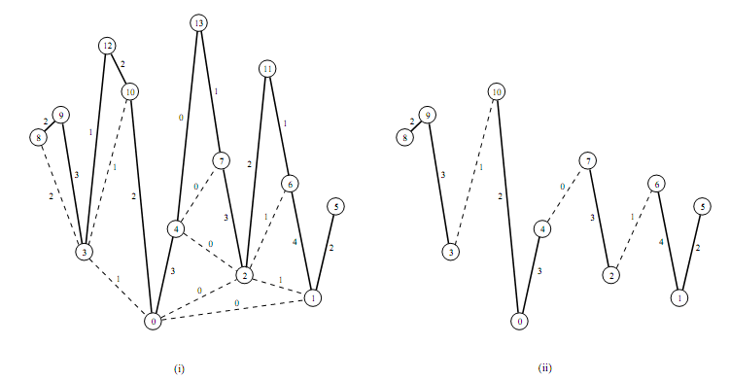
Compute LPF in linear time

Slide 13
Fact 8. For each i, 1 ≦ i ≦ |w|,the palindrome
w[i − LPS[i]+1..i] is unioccurrent in w[1..i] if and only if LPF[i − LPS[i]+1] < LPS[i].
Corollary 9. The number of non-empty distinct palindromes in w is
#{ i | 1 ≦ i ≦ |w| and LPF[i − LPS[i]+1] < LPS[i]}

Slide 14
i | 1 | 2 | 3 | 4 | 5 | 6 | 7 | 8 | 9 | 10 | 11
w | a | b | b | a | b | a | a | b | b | a | a
LPS | 1 | 1 | 2 | 4 | 3 | 3 | 2 | 4 | 2 | 1 | 5
LPF | 0 | 0 | 1 | 2 | 2 | 1 | 3 | 4 | 3 | 2 | 1
w[i − LPS[i]+1..i]
( for i = 6)
a | b | a
LPS[i] = LPS[6] = 3
a | b
LPF[i − LPS[i]+1] = LPF[4]= 2
LPS[i] = LPS[9] = 2
w[i − LPS[i]+1..i]
( for i = 9)
b | b
b | b | a | a
LPF[i − LPS[i]+1] = LPF[8]= 4

Slide 15
Thank you!

