Slide 1
Chih-Fong Tsai (蔡志豐), Yu-Chieh Hsiao (蕭鈺潔) Department of Information Management, National Central University, Taiwan
Combining multiple feature selection methods for stock prediction: Union, intersection, and multi-intersection approaches
Decision Support Systems, In Press, Available on line August 17, 2010
Presenter: Hung-Hsin Chen
Date: Oct. 26, 2010

Slide 2
Abstract
To effectively predict stock price for investors is a very important research problem. In literature, data mining techniques have been applied to stock (market) prediction. Feature selection, a pre-processing step of data mining, aims at filtering out unrepresentative variables from a given dataset for effective prediction. As using different feature selection methods will lead to different features selected and thus affect the prediction performance, the purpose of this paper is to combine multiple feature selection methods to identify more representative variables for better prediction. In particular, three well-known feature selection methods, which are Principal Component Analysis (PCA), Genetic Algorithms (GA) and decision trees (CART), are used. The combination methods to filter out unrepresentative variables are based on union, intersection, and multi-intersection strategies. For the prediction model, the back-propagation neural network is developed. Experimental results show that the intersection between PCA and GA and the multi-intersection of PCA, GA, and CART perform the best, which are of 79% and 78.98% accuracy respectively. In addition, these two combined feature selection methods filter out near 80% unrepresentative features from 85 original variables, resulting in 14 and 17 important features respectively. These variables are the important factors for stock prediction and can be used for future investment decisions.

Slide 3
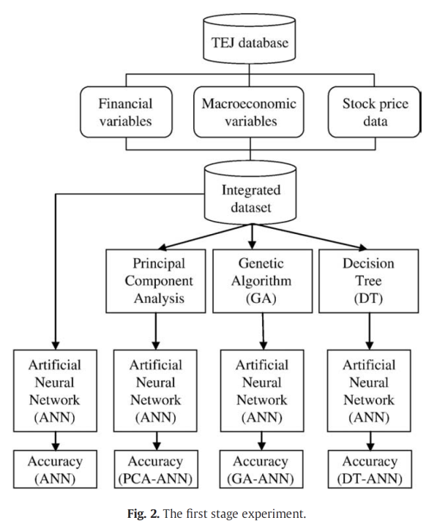
Feature selection
Prediction

Slide 4
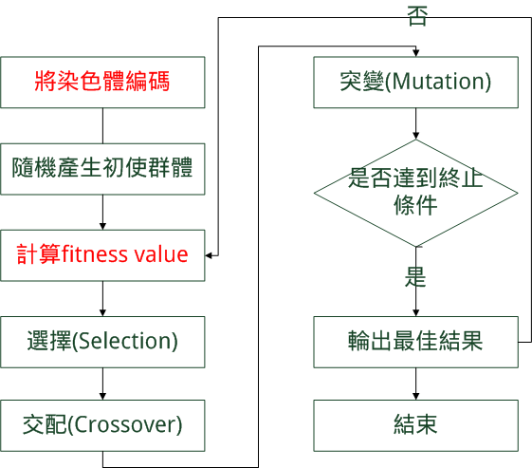
Genetic Algorithm (GA)
Parameters in this paper:
Population size: 20
Crossover rate: 60%
Mutation rate: 3.3%

Slide 5






T個training samples, c為class
每個sample有k個attributes
Goal: Learn concepts that can cover all of the positive examples without covering the negative examples.
Concept Ω為DNF型式
δ_{i}由k個attributes組成, ζ_{j,i} is a closed interval [a_{i}, b_{j}]
we called δ_{i} covers an example E_{t}
fitness function:
α: total number of partial matches
C: constant
k: the number of attributes
p: the number of positive examples covered by the rule
n: the number of negative examples covered by the rule
R. Sikora, S. Piramuthu, Framework for efficient feature selection in genetic algorithm based data mining, European Journal of Operational Research 180 (2) (2007), 723-737.

Slide 6
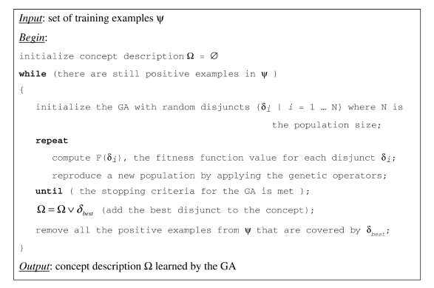

Slide 7
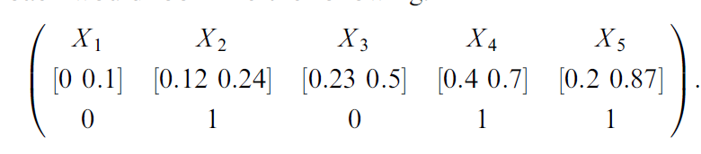
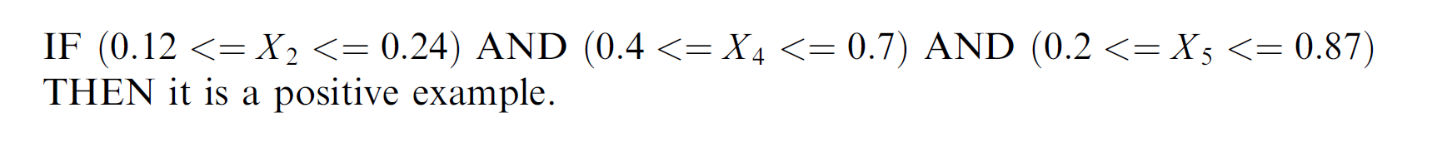
5 attributes in the original feature set example:
A feature is selected if the corresponding bit is 1, else the bit is 0.

Slide 8
Principal Component Analysis (PCA)
A way of reducing the dimensionality of a dataset
Step：
Get data set
Subtract the mean (Normalization)
Calculate the covariance matrix
Calculate the eigenvectors and eigenvalues of the covariance matrix
Choose components and form a feature vector

Slide 9
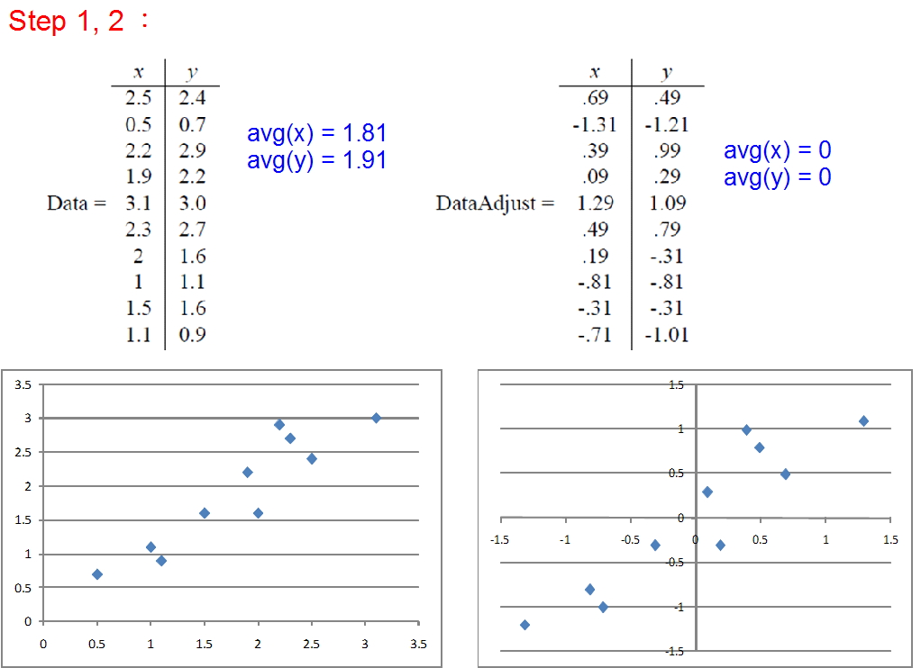

Slide 10
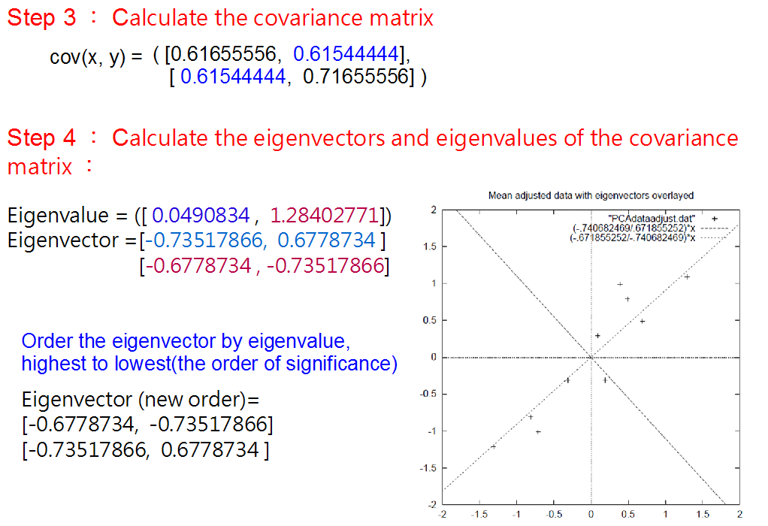

Slide 11
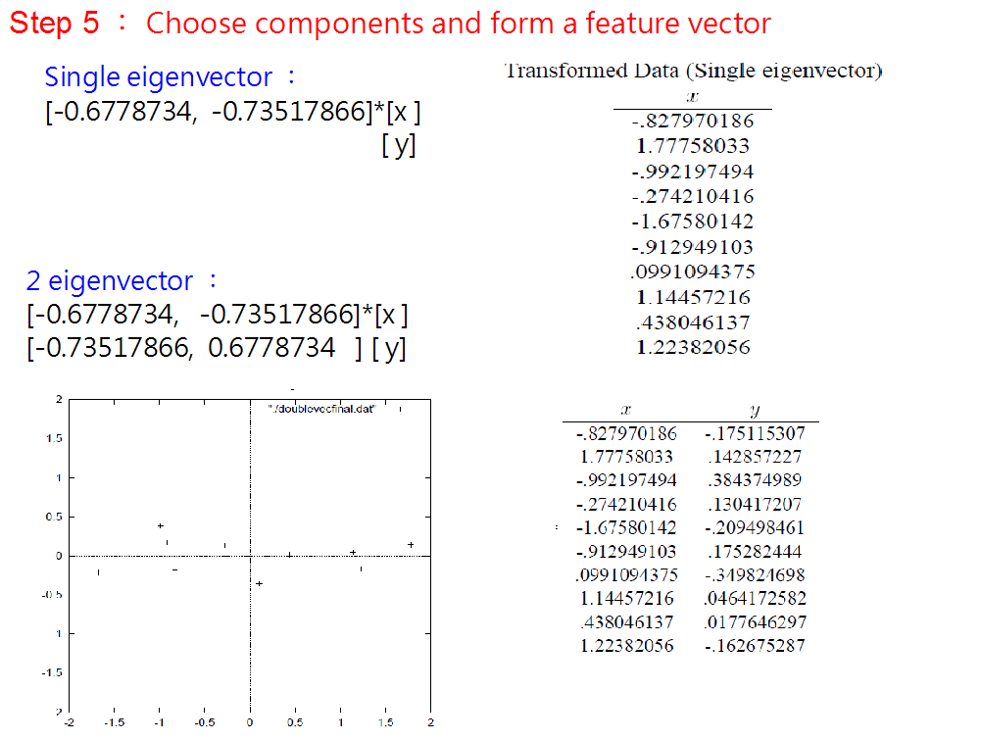

Slide 12
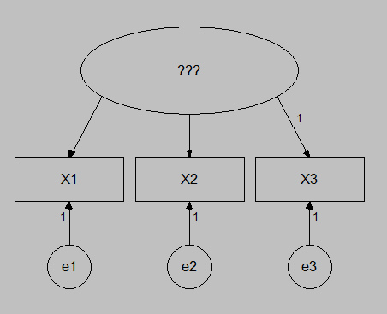
Factor analysis
Factor analysis的目的是以少數幾個因素(factor)來解釋一群相互有關係的變數，而又能保有原來最多的資訊
相互有關的變數受共同因素(common factor)及獨特因素(specific factor)的影響
假設common factor有k個(自訂)
變數有n個，每個變數有t個屬性
Factor analysis即求出每一個common factor對每一個變數之屬性的影響值(loading)
店名 | 品項齊全度 | 氣氛 | 親切感 | 寬闊感
1 | 20 | 20 | 30 | 70
2 | 15 | 25 | 25 | 15
3 | 60 | 70 | 60 | 30
4 | 70 | 50 | 60 | 40
5 | 30 | 35 | 55 | 80
6 | 50 | 85 | 85 | 80
7 | 80 | 65 | 70 | 30
8 | 30 | 65 | 75 | 80
9 | 60 | 20 | 50 | 40
10 | 25 | 25 | 50 | 25
變數名稱 | 因素1 | 因素2
品項齊全度 | 0.68 | -0.48
氣氛 | 0.92 | -0.03
接近性 | 0.91 | 0.21
寬闊感 | 0.25 | 0.67
此篇paper使用PCA中eigenvalues > 1的因子個數(k)，且計算出loading後，經由varimax法旋轉後保留loading > 0.5的features.

Slide 13
Classification and Regression Trees (CART)
A binary decision tree.
Splits based only on one variable
Example: Can the high risk(heart attack, will not survive 30 days) patients be identified?
Is the minimum systolic blood pressure (收縮壓) over the last 24 hours>91?
Construction a tree:
Growing
Stopping
Pruning
Is age>62.5?
H
Is sinus tachycardia (心跳過速) present?
L
H
L

Slide 14
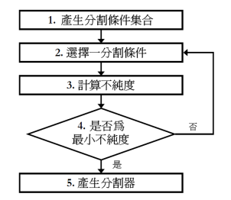
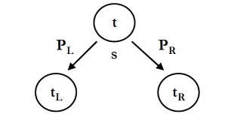
Tree growing:
Gini impurity (不純度 ) index:
在節點t的不純度，為兩種不相同種類的樣本比率相乘之和
當t的不純度越小時，表示t點的純度越高，反之
目標：找出不純度下降最大的分割條件 (即最有效提高純度的方法)

Slide 15
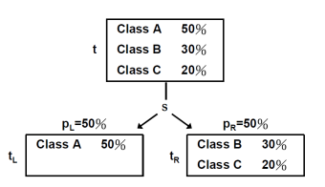
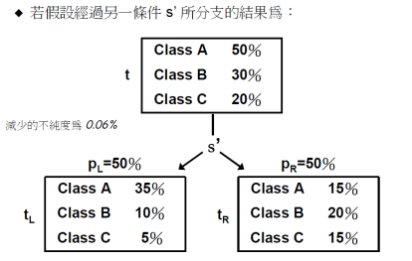
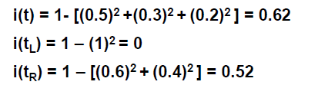

Slide 16
Tree stopping:
Differences between resulting nodes is not significant
Tree depth
n of nodes
Tree pruning:
Eliminate spurious branches
Example all subtrees of full tree
Compare error rates of subtrees

Slide 17
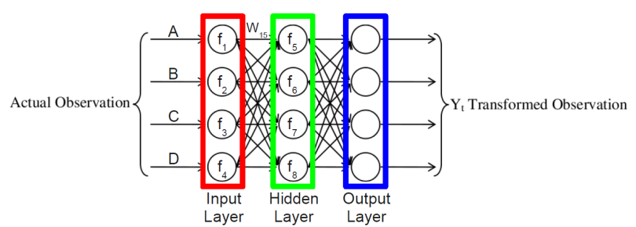
Artificial Neural Network (ANN)
Use multi-layer perceptron (MLP) with back-propagation learning method
There are weights for each arc between layers.
Ex: The output of node 5 is
Y₅ = f₅(w₁₅*f₁(A) + w₂₅*f₂(B) + w₃₅*f₃(C) + w₄₅*f₄(D)

Slide 18
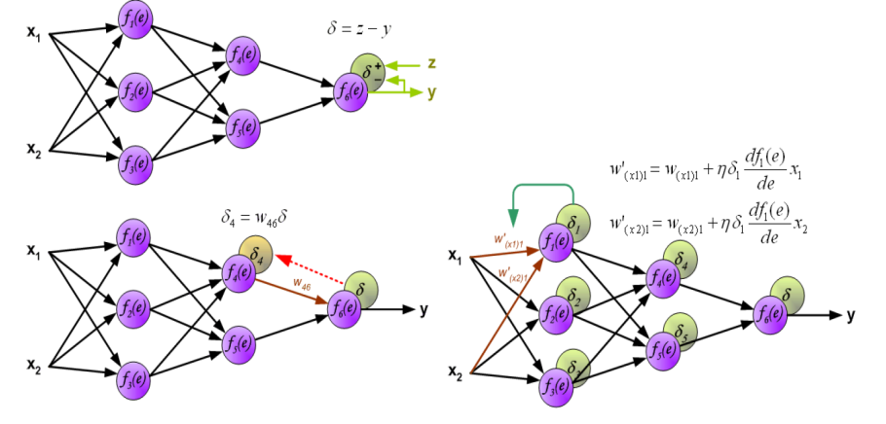
http://galaxy.agh.edu.pl/~vlsi/AI/backp_t_en/backprop.html
Parameters in this paper:
Learning rate η (eta): 0.9 is recommended
Hidden layer: one hidden layer
Hidden layer node: use 6, 12 and 18 to find the optimal number of nodes
Training epoch: use 100, 300, 500, and 1000 to find the best training epoch

Slide 19
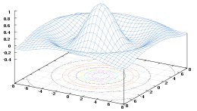


The results of the processed data can easily calculated by using software WEKA (R or Octave).
Wiki: Weka (Waikato Environment for Knowledge Analysis) is a popular suite of machine learning software written in Java, developed at the University of Waikato, New Zealand.
Wiki: R is a programming language and software environment for statistical computing and graphics.
Wiki: Octave is high-level language, mostly compatible with MATLAB.
All are free software.

Slide 20
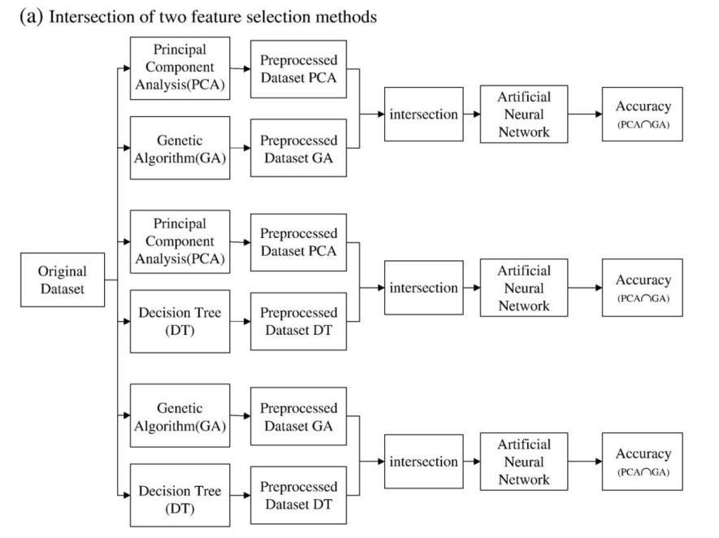

Slide 21
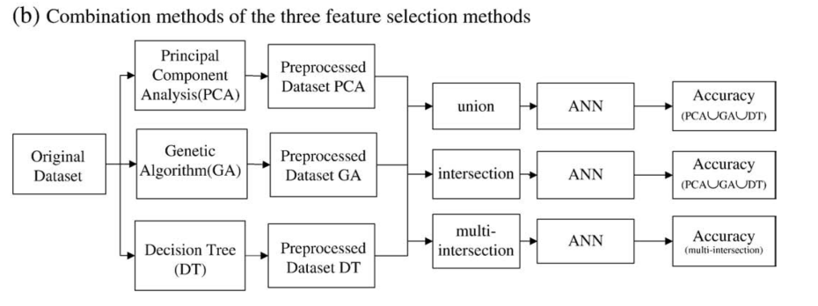
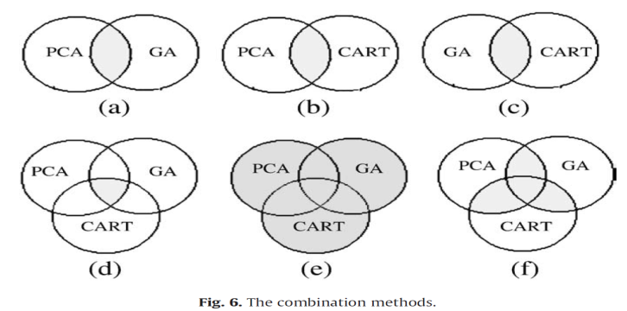

Slide 22
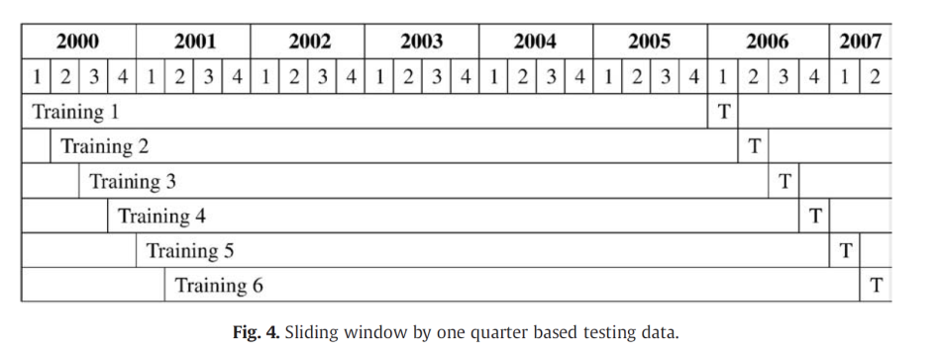
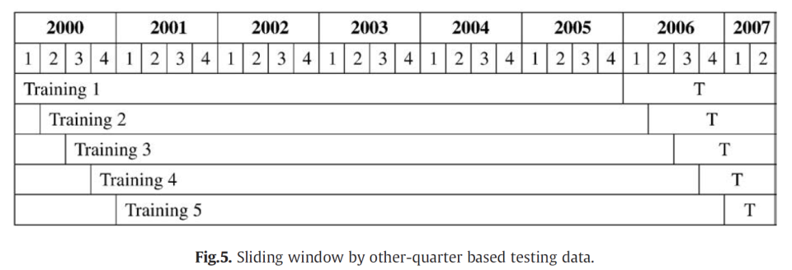

Slide 23
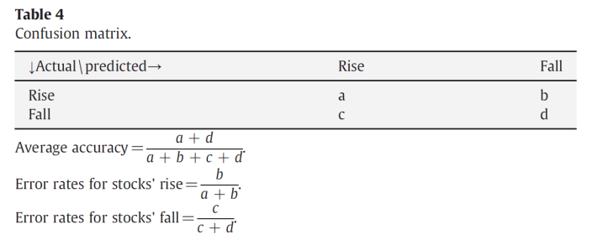
Data set
Data source is based on the Taiwan Economic Journal (TEJ).
Only considered the listed electronic corporations in Taiwan Stock Exchange.
From 2000 Q1 to 2007 Q2. Seasonal data are considered. Mainly based on months of 3, 6, 9 ,12. (For financial reports).
4140 data samples (i.e. case companies) composed of 2117 and 2023 for stocks’ rise and fall respectively.
TP
FN
FP
TN

Slide 25
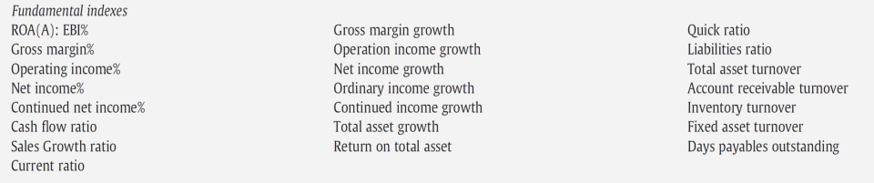
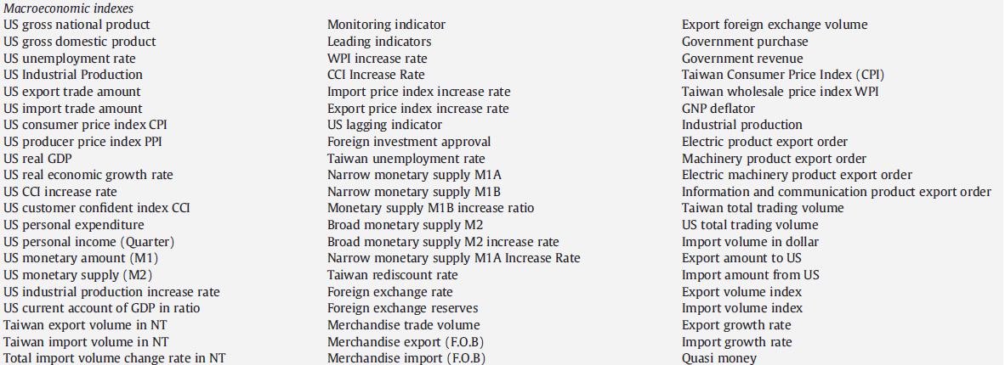
22
63

Slide 26
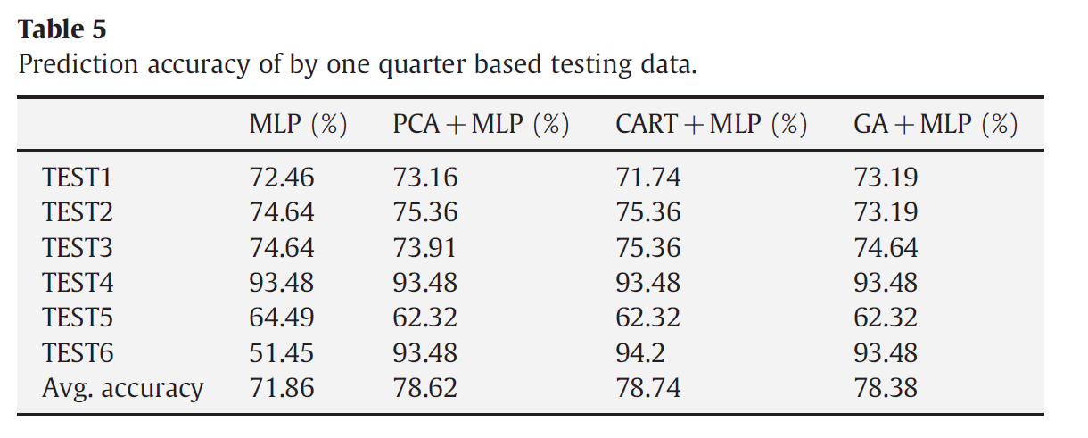
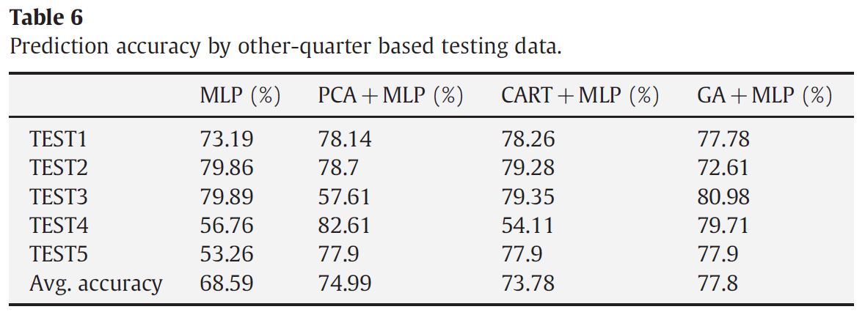

Slide 27
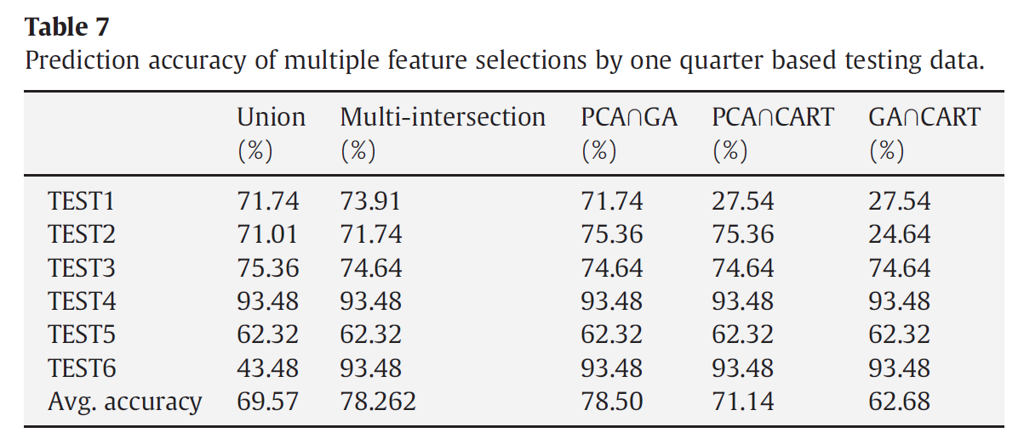
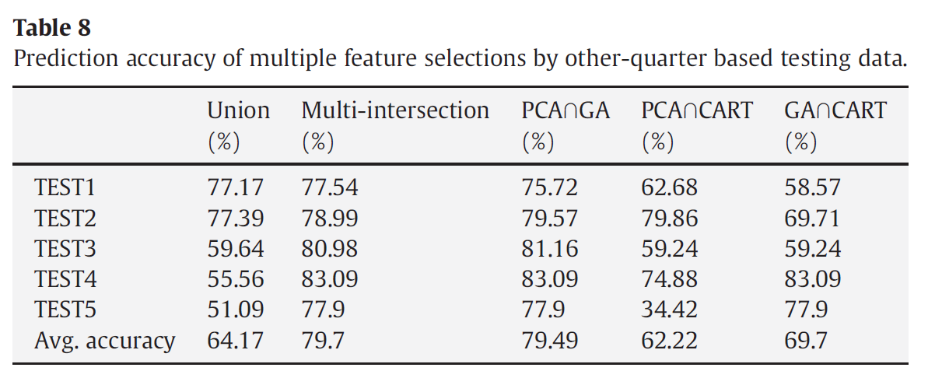

Slide 28
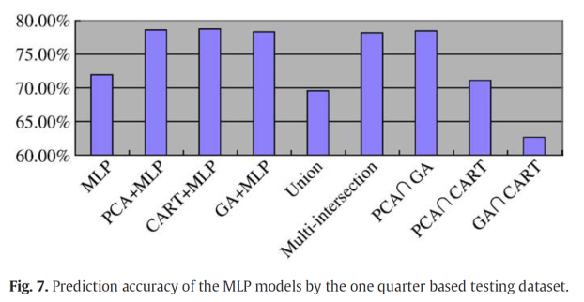
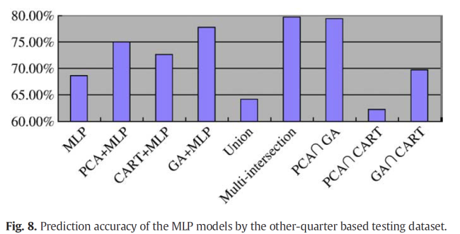

Slide 29
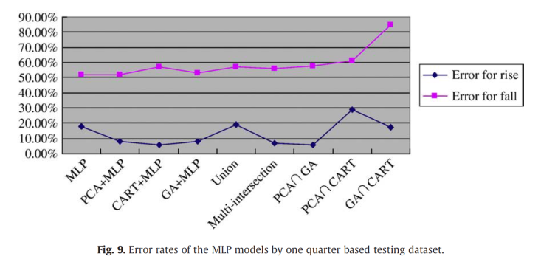
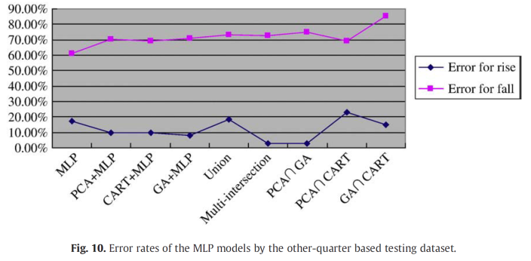

Slide 30
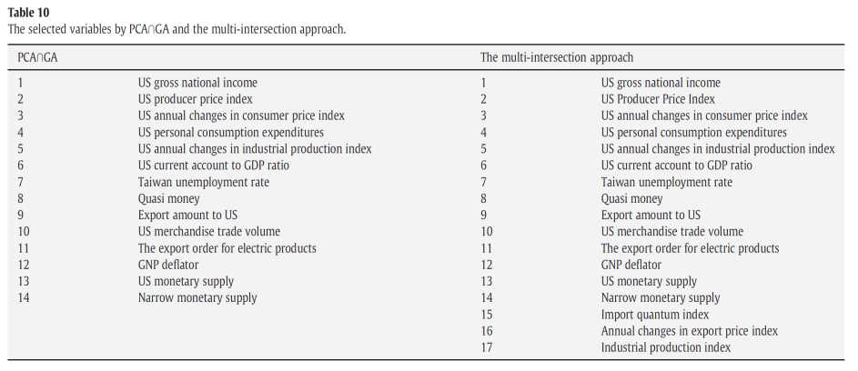
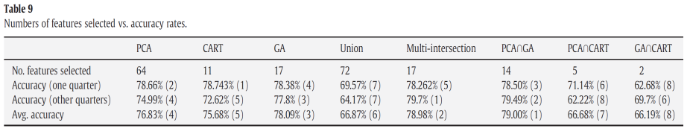

Slide 31
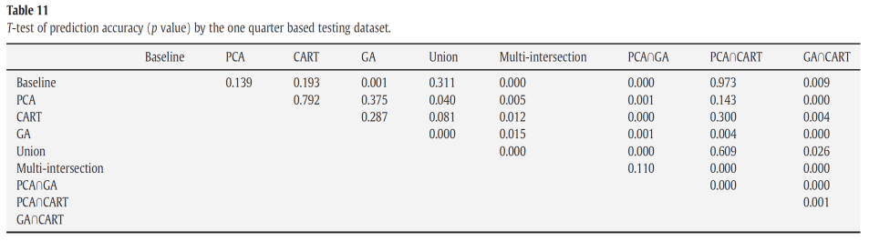
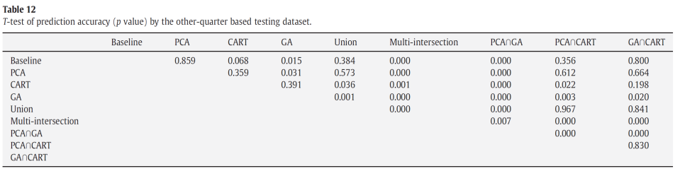

Slide 32
Thank you!!

