Slide 1
A New Approach for Approximating the Transposition Distance
M. E. M. T. Walter, Z. Dias, J. Meidanis
Seventh International Symposium on String Processing and Information Retrieval, pp. 199-208(2000)
Presenter: Shian-Liang Lin

Slide 2
Abstract
One of the proposed ways to compare genomes or other large DNA molecules is by computing a rearrangement distance, defined as the minimum number of rearrangement events necessary to transform one molecule into another, taking into account only the relative order of similar genes.
In this work we study the problem of computing the transposition distance between two linear gene orders, represented by permutations. To help solve it, we present a very simple structure, the breakpoint diagram, and a 2.25-approximation algorithm for the problem based on this structure. While there are better approximation algorithms, they are based on more complex data structures. Our algorithm was implemented in the C programming language and we show experimental results obtained with it on all permutations of up to 11 genes, plus selected permutations of higher size.

Slide 3


Transposition over permutations
S: | 0 | 4 | 2 | 1 | 3 | 5
$$\text{Transposition}$$
$$[1,3,5]$$
S’: | 0 | 1 | 3 | 4 | 2 | 5
$$\text{Transposition}$$
$$[2,3,5]$$
T: | 0 | 1 | 2 | 3 | 4 | 5
Transposition distance
(the minimum number of transpositions)
=2

Slide 4

Definition of breakpoint for transpositions
A pair of adjacent elements that $πi+1−πi≠1$
($0≤i≤ n).$
S: | 0 | 4 | 2 | 1 | 3 | 5
Breakpoints

Slide 5
Breakpoints diagram
S: | 0 | 4 | 2 | 1 | 3 | 5
-2-transposition
0,4
4,2
2,1
1,3
3,5
$$An edge pi pj when si−1−sj=1 and n+\text{1 }\text{∉}sj .$$
$$An edge pi pj when sj−1−si=1.$$

Slide 6

Breakpoints diagram
S: | 0 | 1 | 3 | 4 | 2 | 5
-3-transposition
1,3
4,2
2,5
$$An edge pi pj when si−1−sj=1 and \text{0 }\text{∉}si−1 .$$
$$An edge pi pj when si−1−sj=1 and n+\text{1 }\text{∉}sj .$$
$$An edge pi pj when sj−1−si=1.$$

Slide 7
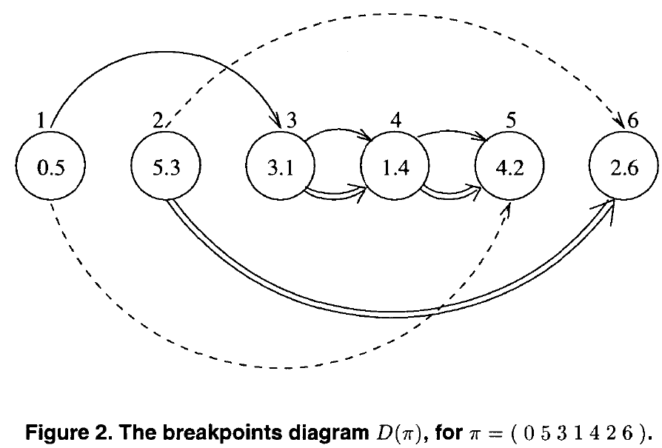

Slide 8
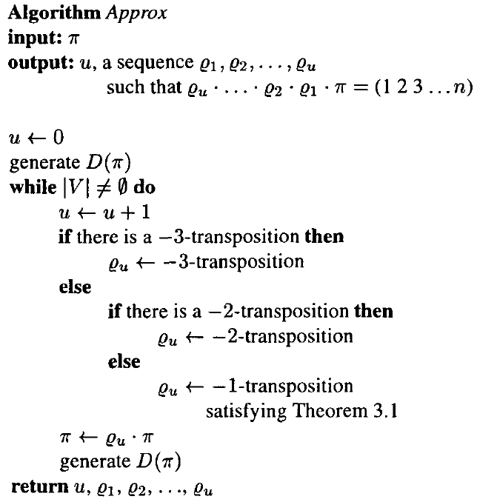
A approximation algorithm with factor 2.25

Slide 9
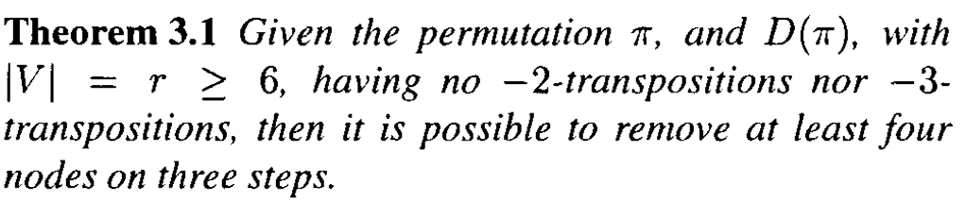
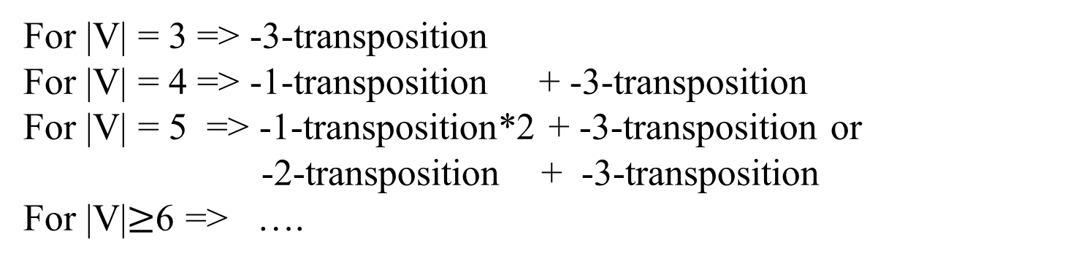
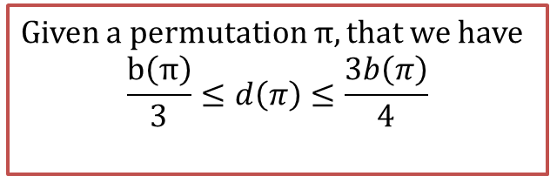
A approximation algorithm with factor 2.25
Given a permutation $π$, that we have
$$\frac{b\left(π\right)}{3}≤d\left(π\right)≤\frac{3b\left(π\right)}{4}$$
For |V| = 3 => -3-transposition
For |V| = 4 => -1-transposition + -3-transposition
For |V| = 5 => -1-transposition*2 + -3-transposition or
-2-transposition + -3-transposition
For |V|$≥$6 => ….

Slide 10
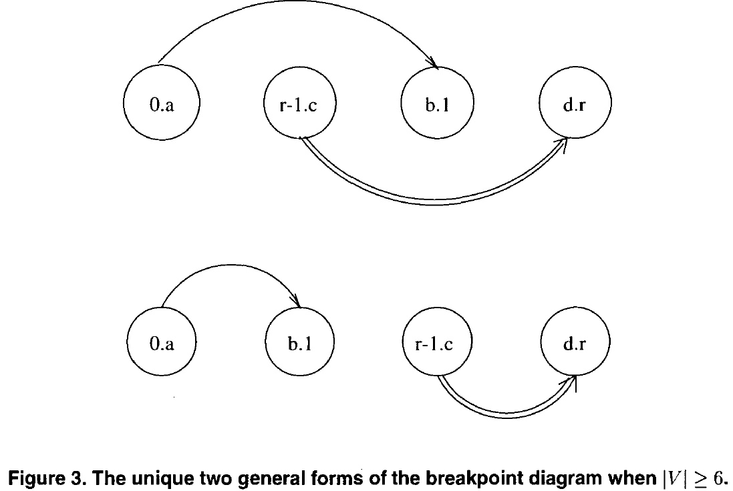

Slide 11
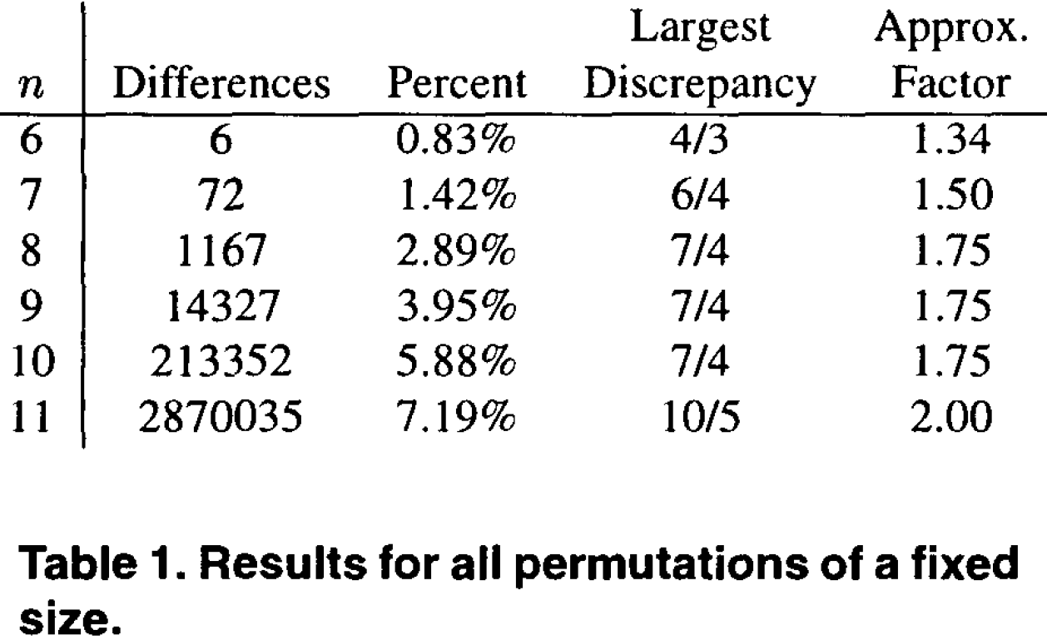
Experiments
Table 1 contains the results, listing the number of permutations for which our algorithms did not get the exact distance, which percent of the total this represents, and what was the larger discrepancy in these cases.

Slide 12
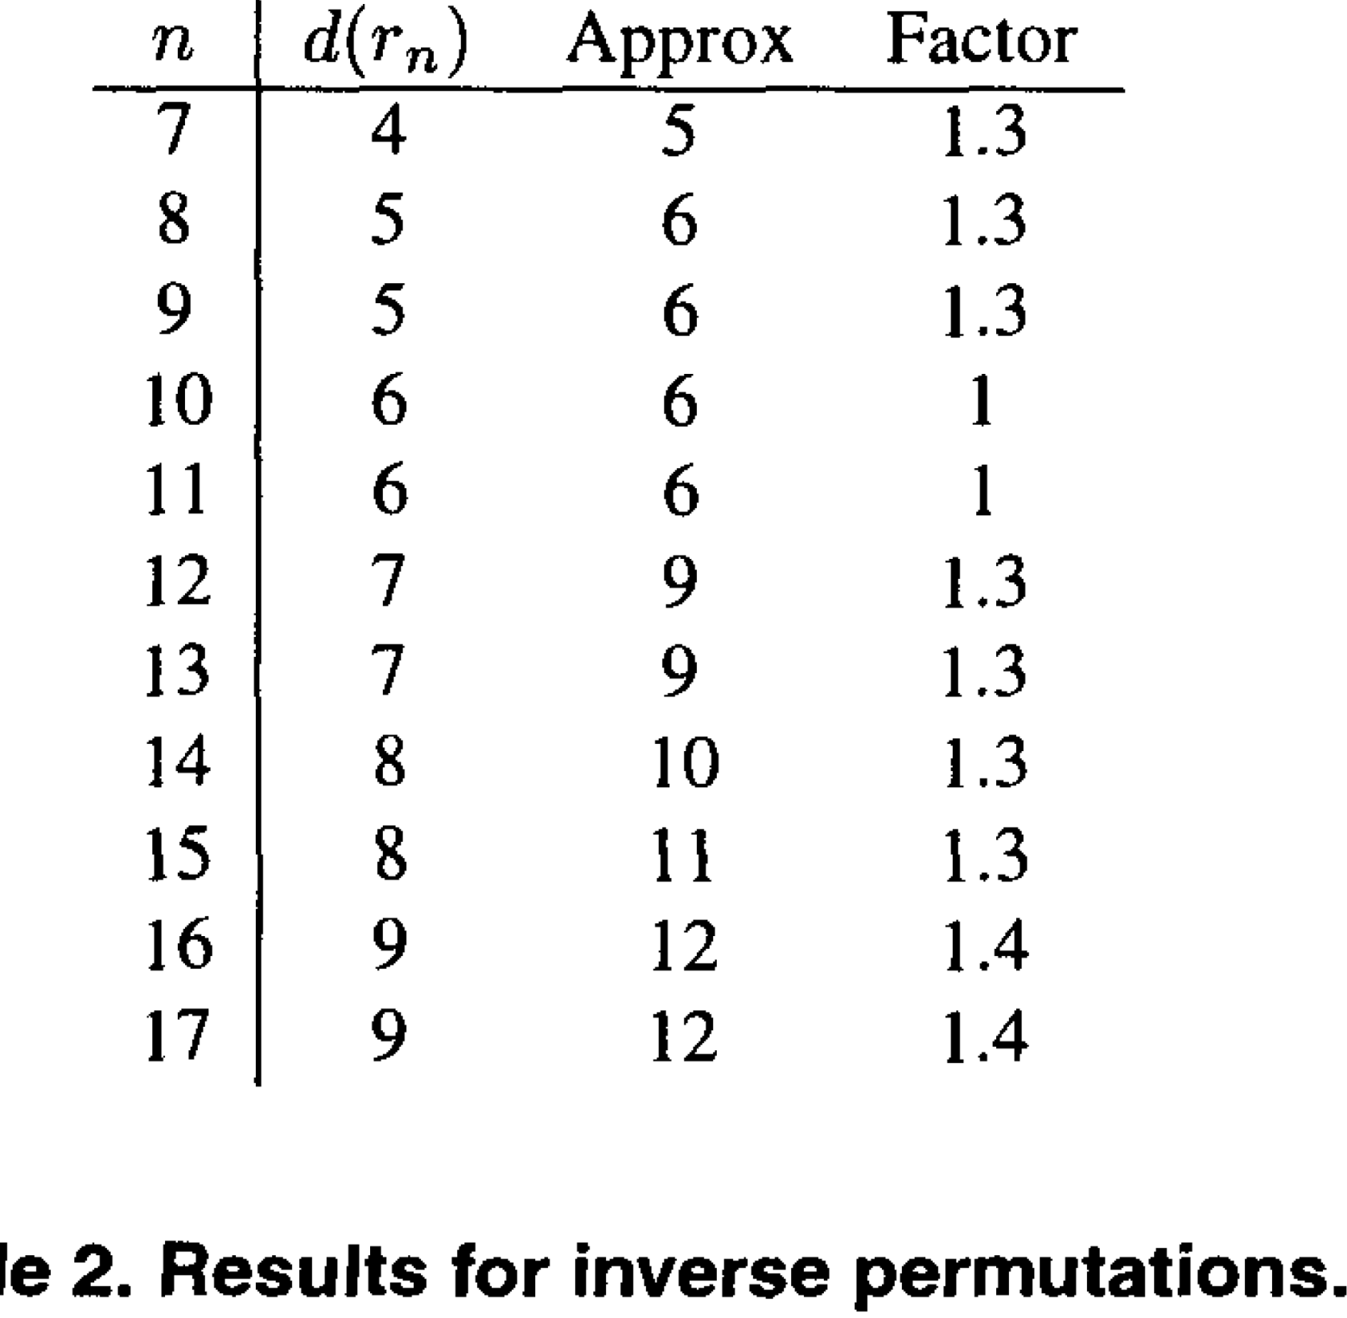
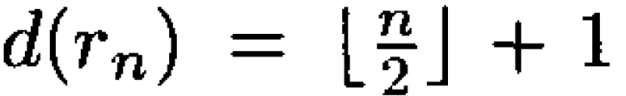

Slide 13
Thanks for listening.

