Slide 1
Integrating a Piecewise Linear Representation Method and a Neural Network Model for Stock Trading Points Prediction
Pei-Chann Chang, Chin-Yuan Fan, and Chen-Hao Liu
Yuan Ze University
IEEE TRANSACTIONS ON SYSTEMS, MAN, AND CYBERNETICS—PART C: APPLICATIONS AND REVIEWS, 2009
pp. 80 – 92
Presenter : Yao-Chou Tsai
Date: 2016/01/12

Slide 2
Abstract (1/2)
Recently, the piecewise linear representation (PLR) method has been applied to the stock market for pattern matching. As such, similar patterns can be retrieved from historical data and future prices of the stock can be predicted according to the patterns retrieved. In this paper, a different approach is taken by applying PLR to decompose historical data into different segments. As a result, temporary turning points (trough or peak) of the historical stock data can be detected and inputted to the backpropagation neural network (BPN) for supervised training of the model. After this, a new set of test data can trigger the model when a buy or sell point is detected by BPN. An intelligent PLR (IPLR) model is further developed by integrating the genetic algorithm with the PLR to iteratively improve the threshold value of the PLR. Thus, it further increases the profitability of the model.

Slide 3
Abstract (2/2)
The proposed system is tested on three different types of stocks, i.e., uptrend, steady, and downtrend. The experimental results show that the IPLR approach can make significant amounts of profit on stocks with different variations. In conclusion, the proposed system is very effective and encouraging in that it predicts the future trading points of a specific stock.

Slide 4

Pei-Chann Chang (張百棧)
學歷:
美國理海大學工業工程博士, June 1989 美國理海大學工業工程碩士, October 1985 國立清華大學工業工程學士, June 1979
經歷:
元智大學教務長
國科會工業工程學門計劃複審委員及規劃委員
專業領域:
生產排程、人工智慧應用、ERP、全球運籌、企業改造

Slide 5
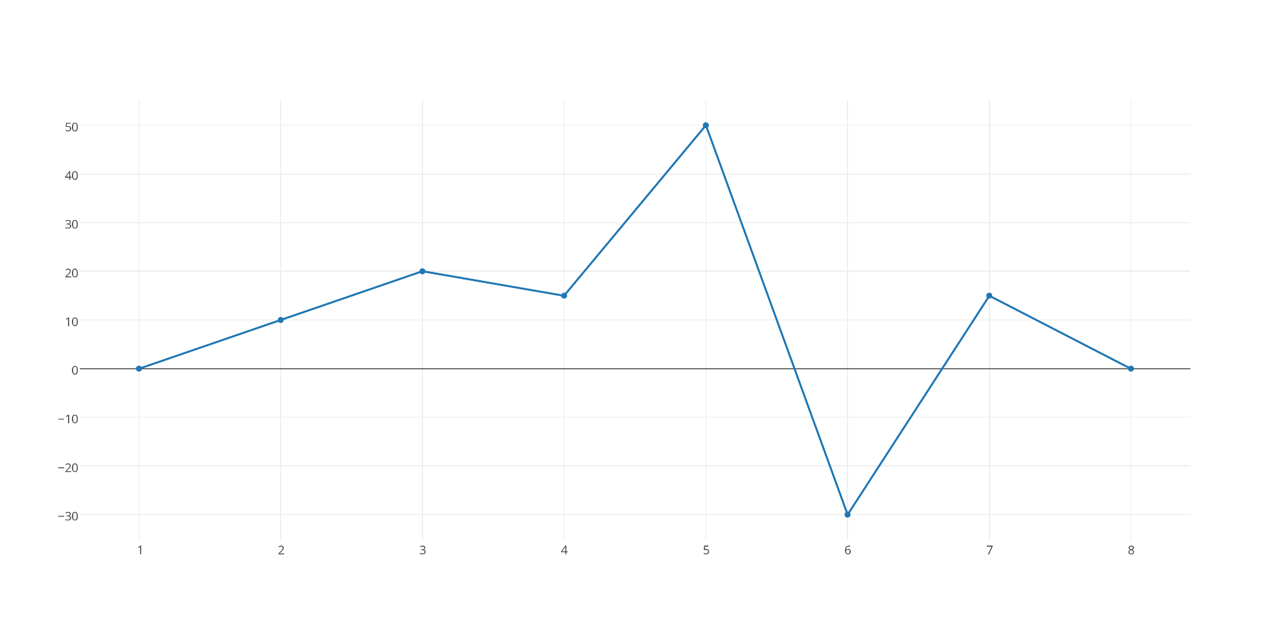
Piecewise Linear Representation(1/8)
Day | 1 | 2 | 3 | 4 | 5 | 6 | 7 | 8
Price | 0 | 10 | 50 | 15 | 50 | -30 | 15 | 0

Slide 6
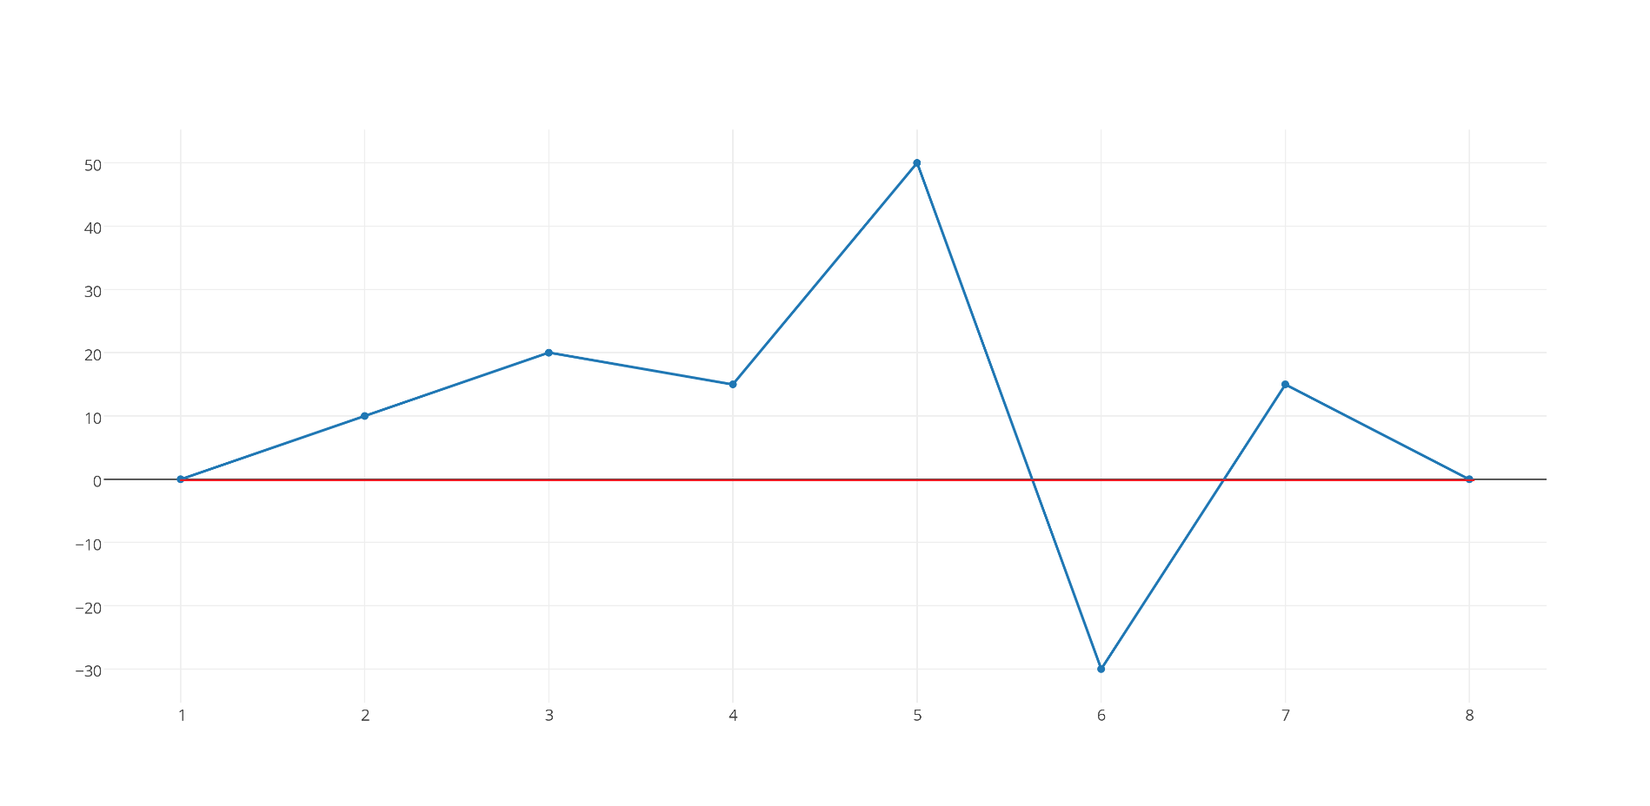
Piecewise Linear Representation
Step1:
Threshold = 2
Day(x) | 1 | 2 | 3 | 4 | 5 | 6 | 7 | 8
Price(Y) | 0 | 10 | 50 | 15 | 50 | -30 | 15 | 0

Slide 7
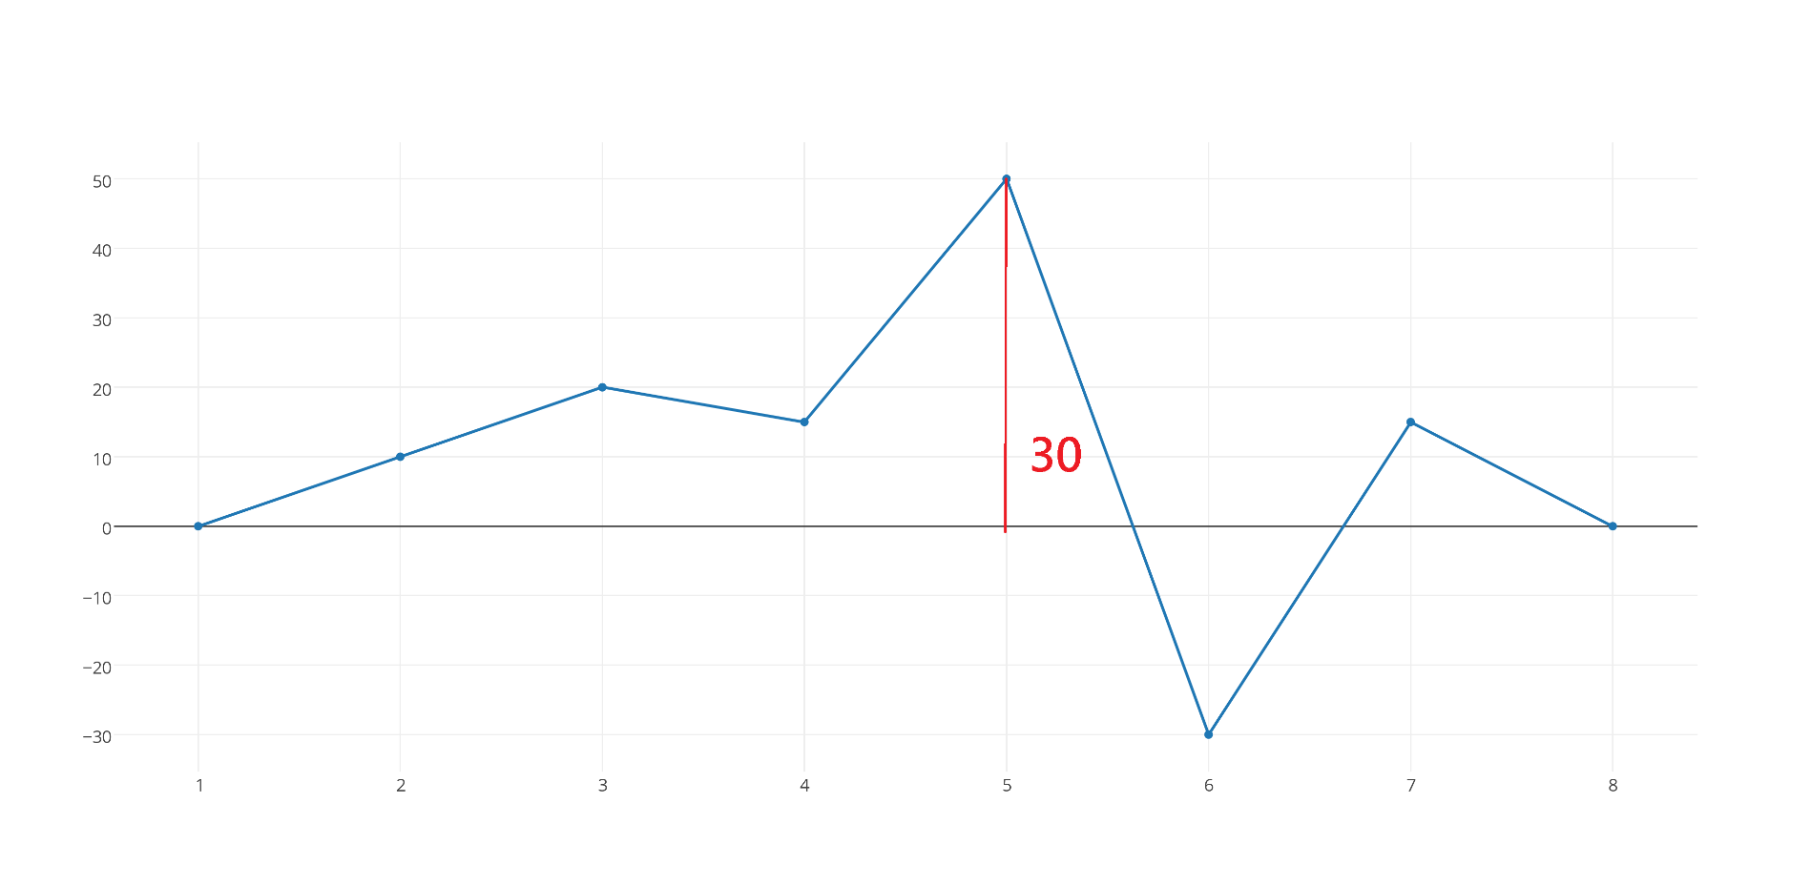
Piecewise Linear Representation
Step2:
Threshold = 2
Day(x) | 1 | 2 | 3 | 4 | 5 | 6 | 7 | 8
Price(Y) | 0 | 10 | 50 | 15 | 50 | -30 | 15 | 0

Slide 8
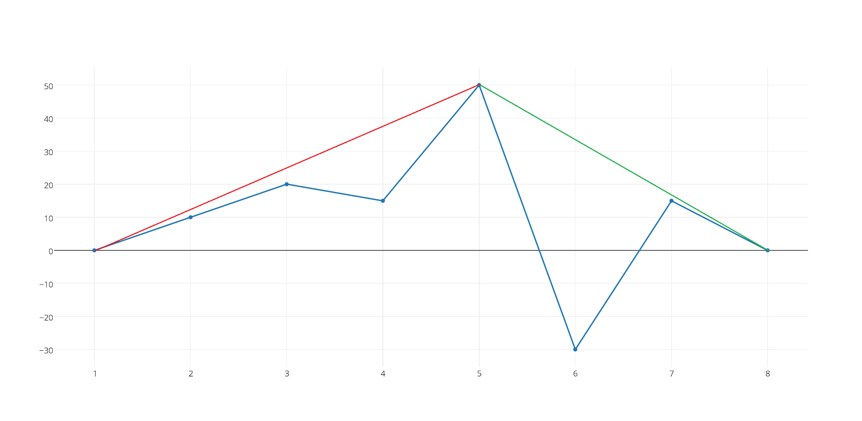
Piecewise Linear Representation
Step3:
Threshold = 2
Day(x) | 1 | 2 | 3 | 4 | 5 | 6 | 7 | 8
Price(Y) | 0 | 10 | 50 | 15 | 50 | -30 | 15 | 0

Slide 9
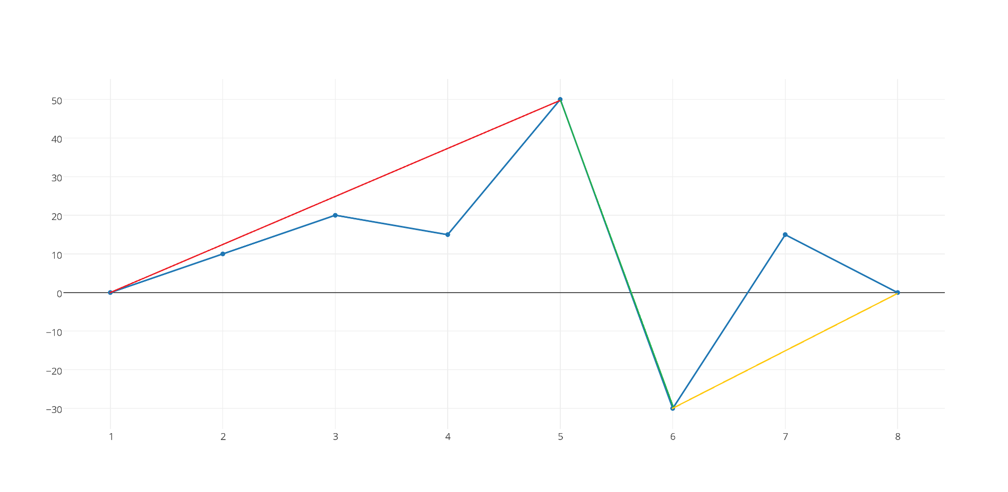
Piecewise Linear Representation
Step4:
Threshold = 2
Day(x) | 1 | 2 | 3 | 4 | 5 | 6 | 7 | 8
Price(Y) | 0 | 10 | 50 | 15 | 50 | -30 | 15 | 0
Turning point

Slide 10
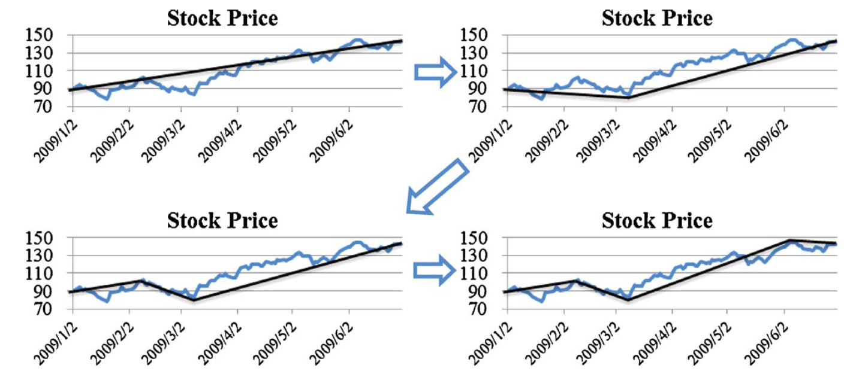
Piecewise Linear Representation
PLR in real case

Slide 11
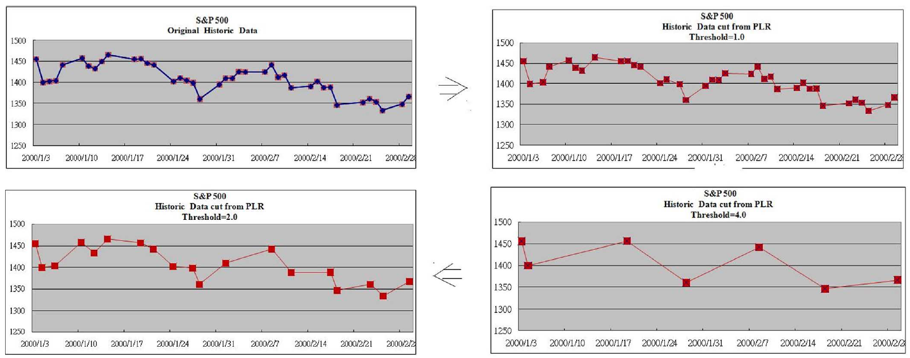
Piecewise Linear Representation
Original
Threshold=1.0
Threshold=2.0
Threshold=3.0
Threshold higher ➔ Number of segments smaller

Slide 12
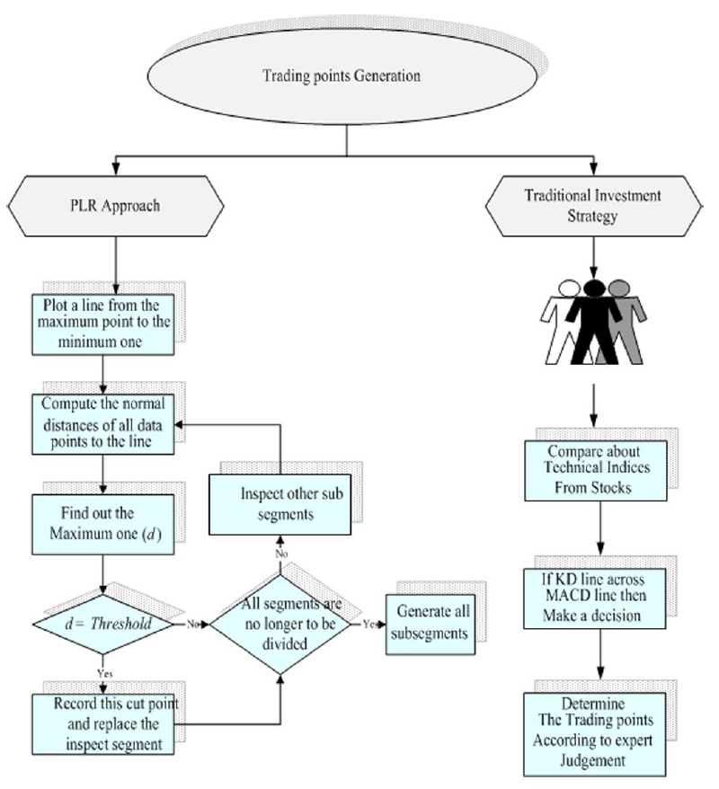
Piecewise Linear Representation
PLR 方法
專家決策
比較各種技術指標
使用某種交易策略
討論出是何買賣時機

Slide 13
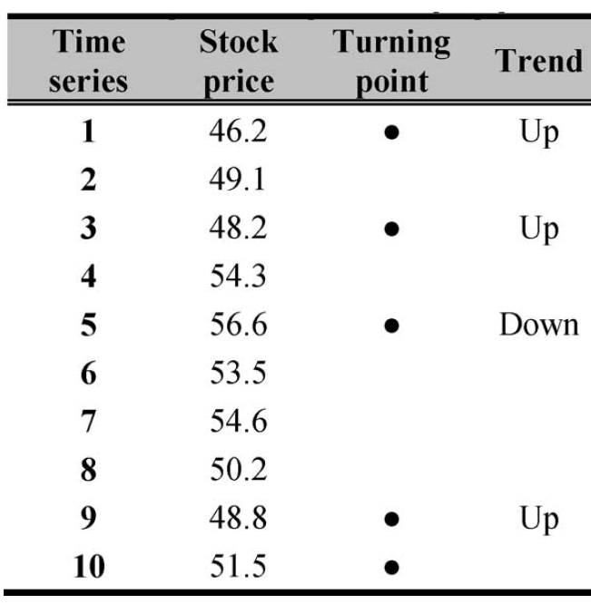
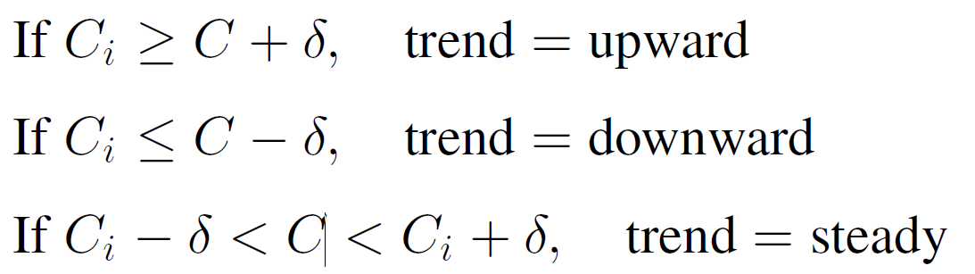
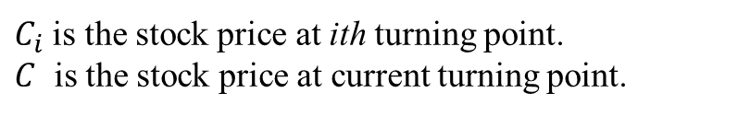
Piecewise Linear Representation
Generate trading signal
$C_{i}$ is the stock price at ith turning point.
$C$ is the stock price at current turning point.
Assume threshold = 1

Slide 14
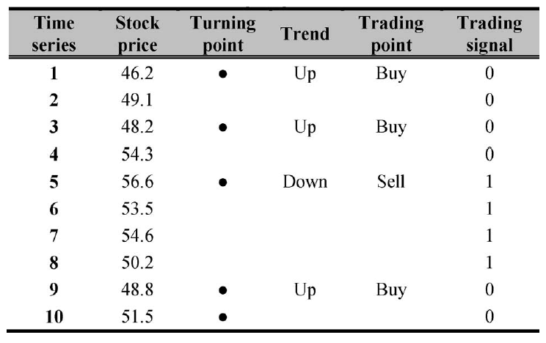
Piecewise Linear Representation
Generate trading signal
UP ➔ DOWN = 1 (Sell signal)
DOWN ➔ UP = 0 (Buy signal)

Slide 15
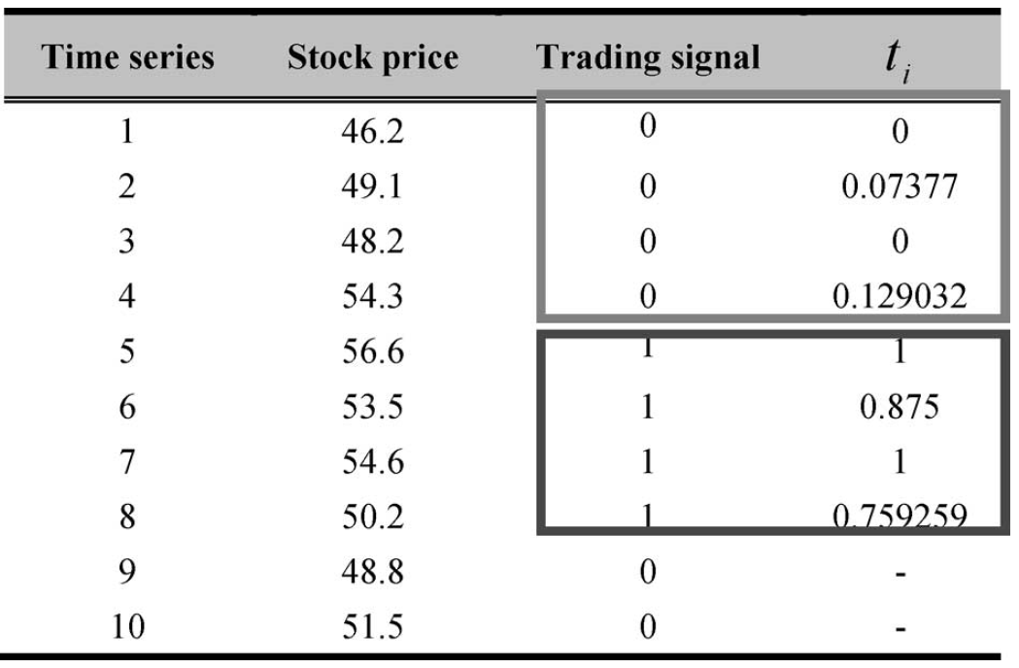
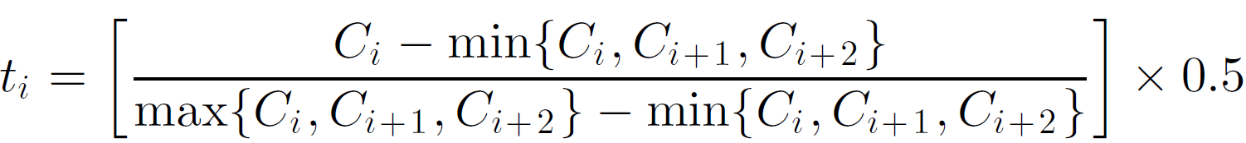
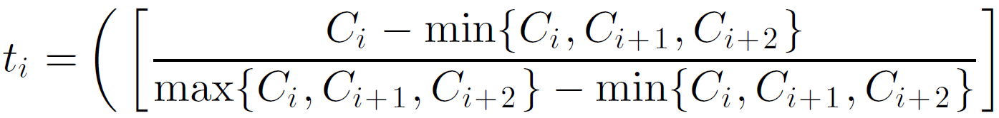
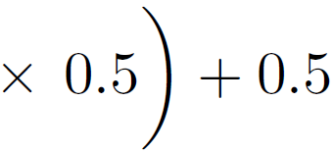
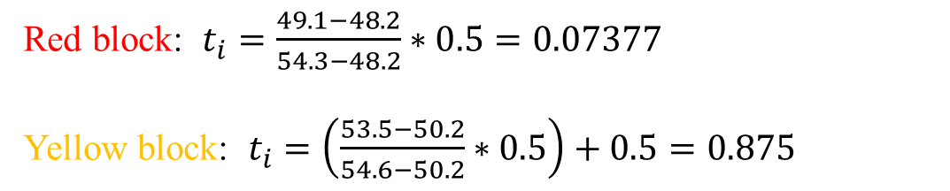
Piecewise Linear Representation
Generate trading signal
If stock in uptrend
If stock in downtrend
Green block ➔ Up Trend
Blue block ➔ Down Trend
Red block: $t_{i}=\frac{49.1−48.2}{54.3−48.2}∗0.5=0.07377$
Yellow block: $t_{i}=\left(\frac{53.5−50.2}{54.6−50.2}∗0.5\right)+0.5=0.875$

Slide 16

Flow chart #1
Candidate Stocks Screening
Selected stock
GA
$$δ$$
PLR
Turning point
Trading signal

Slide 17

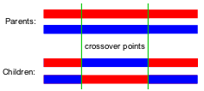
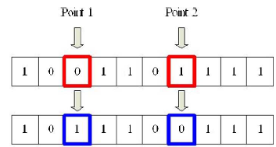
Genetic Programming
Initialization
Randomly generate initial population
1 | 0 | … | 0 | 1
Selection
Fitness function
Reproduction
Crossover
Two-point Mutation
Termination
# of generation , reach the best fitness value , …

Slide 18
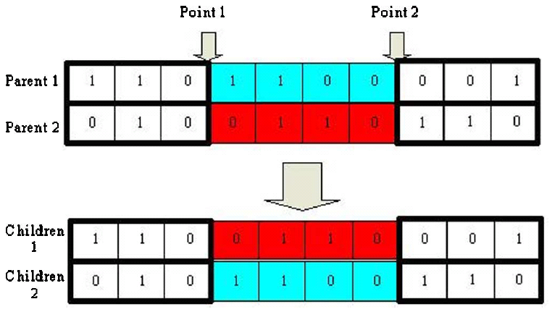
Genetic Programming
Crossover

Slide 19
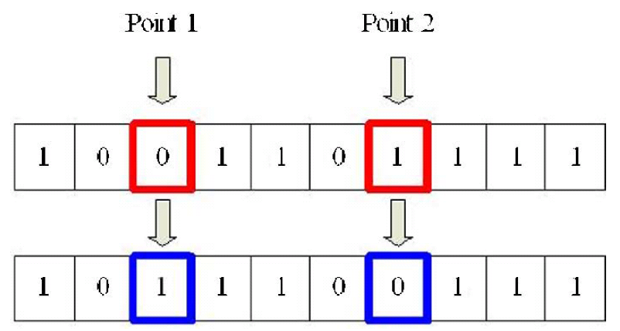
Genetic Programming
Mutation

Slide 20
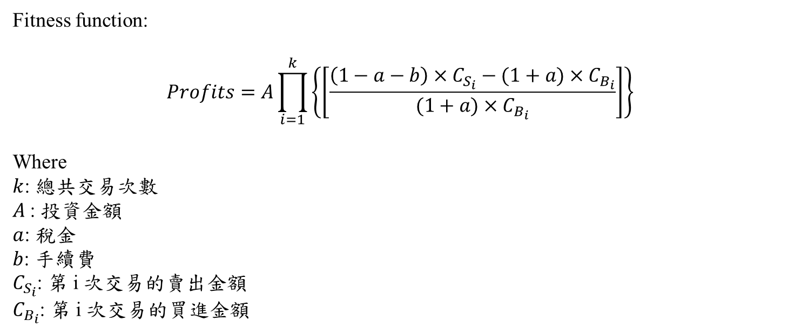
Genetic Programming
Fitness function:
$$Profits=A\prod_{i=1}^{k}{\left\{\left[\frac{\left(1−a−b\right)×C_{S_{i}}−(1+a)×C_{B_{i}}}{(1+a)×C_{B_{i}}}\right]\right\}}$$
Where
$k$: 總共交易次數
$A$: 投資金額
$a$: 稅金
$b$: 手續費
$C_{S_{i}}$: 第 i 次交易的賣出金額
$C_{B_{i}}$: 第 i 次交易的買進金額

Slide 21
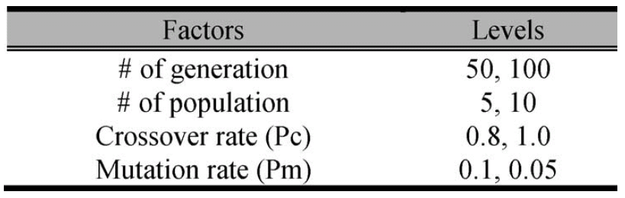
Genetic Programming

Slide 22
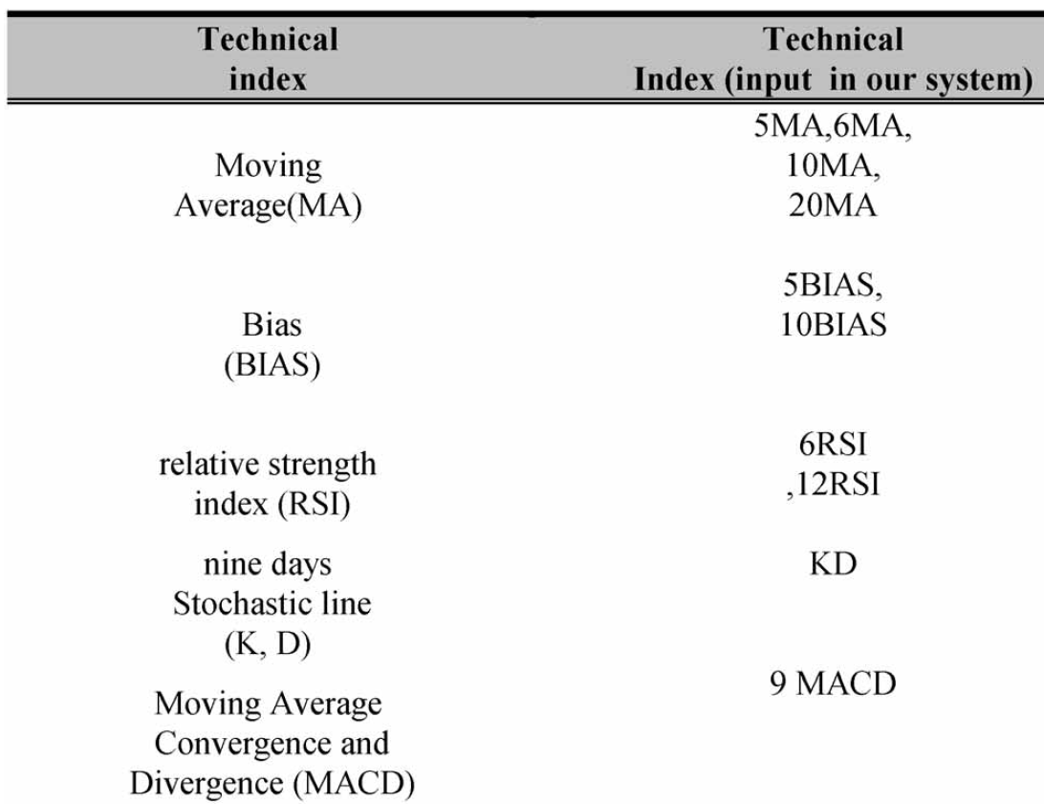
Technical Indicators(1/2)

Slide 23
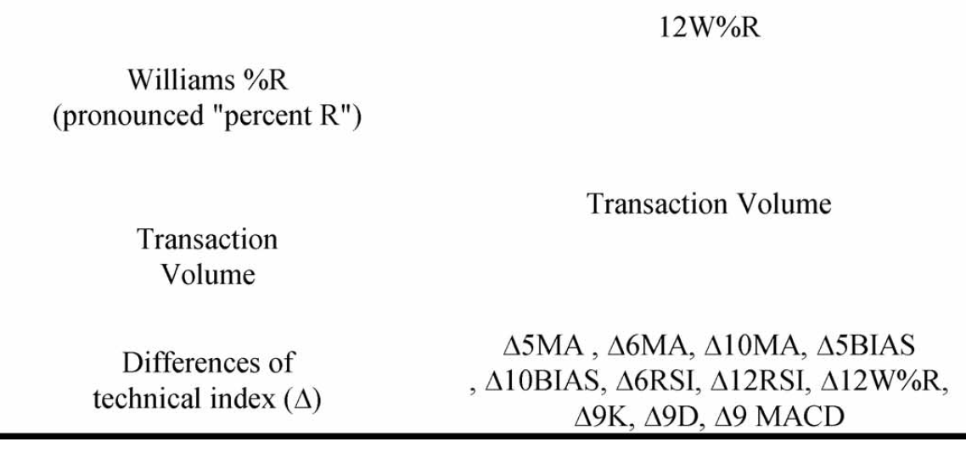
Technical Indicators(2/2)

Slide 24

Relative Strength Index (1/2)
Definition:
$$RSI=100−(\frac{100}{1+RS})$$
$$RS=\frac{UP}{DOWN}$$
Example:
$$UP=\frac{2+2+2+4}{6}=1.667$$
$$DOWN=\frac{2+2}{6}=0.667$$
$$RSI=100−\left(\frac{100}{1+\frac{1.667}{0.667}}\right)=71.42$$
Day1 | Day2 | Day3 | Day4 | Day5 | Day6 | Day7
10 | 12 | 14 | 12 | 14 | 18 | 16
2
2
2
2
4
2

Slide 25
Relative Strength Index (2/2)
指標說明:
RSI越大表示過去n天中的趨勢為上漲，可推測未來上漲機率較大。反之亦然
RSI超過70表示超買，低於30表示超賣
通常以50為界線，高於50為平均收益高於平均損失，看漲信號，反之看跌信號。

Slide 26
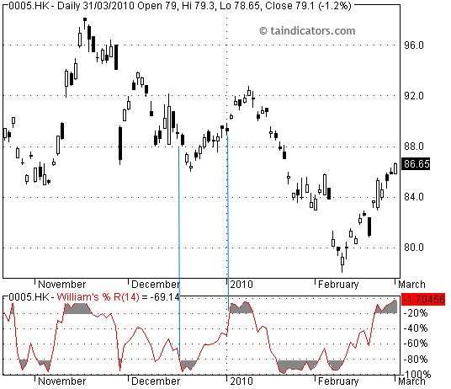

William's % R 威廉%R (1/2)
Definition:
$$\%R=\frac{當天最低價−n天內最低價}{n天內最高價−n天內最低價}$$
Example:

Slide 27
William's % R 威廉%R (2/2)
指標說明:
當%R達-80%表示超賣，當%R達-20%表示超買
當%R由下往上突破-50%表示買進，反之賣出

Slide 28

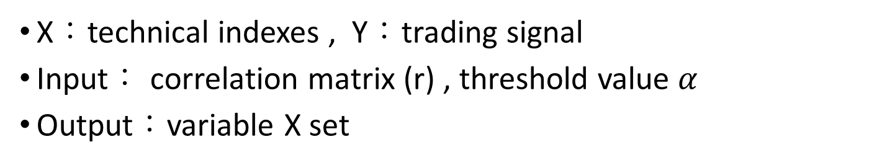
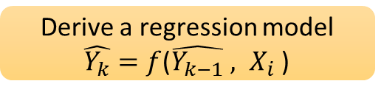


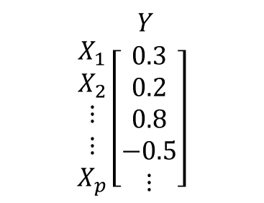

Stepwise Regression Algorithm
X：technical indexes , Y：trading signal
Input： correlation matrix (r) , threshold value $α$
Output：variable X set
$Y$
$$\begin{matrix}X_{1} \\ X_{2} \\ \begin{aligned}⋮ \\ ⋮ \\ X_{p}\end{aligned}\end{matrix}\left[\begin{aligned}0.3 \\ 0.2 \\ 0.8 \\ −0.5 \\ ⋮\end{aligned}\right]$$
Choose $X_{i}$with largest $r^{2}$
Derive a regression model
$\hat{Y_{k}}=f$($\hat{Y_{k−1}} , X_{i}$ )
Calculate the significant value S
yes
S Larger than $α$ ?
no
X₁
X₂
Y
Accept the variable $X_{i}$
Remove the variable $X_{i}$
X₃
X₄
Last X ?
no
X₅
yes
X_{p}
Output

Slide 29

Flow chart #2
Candidate Stocks Screening
Selected stock
GA
Technical indexes
SRA
Related input variable
$$δ$$
PLR
Turning point
Trading signal
Expect output
input
BP(train)

Slide 30
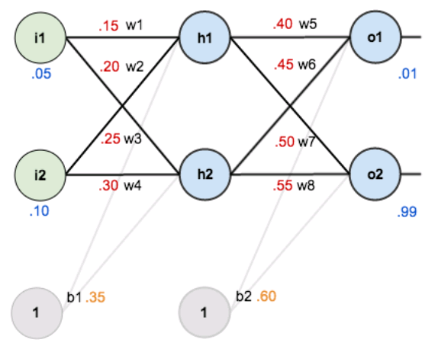
BPN
Name: Backpropagation Neural Network (倒傳遞類神經網路)
Example:

Slide 31
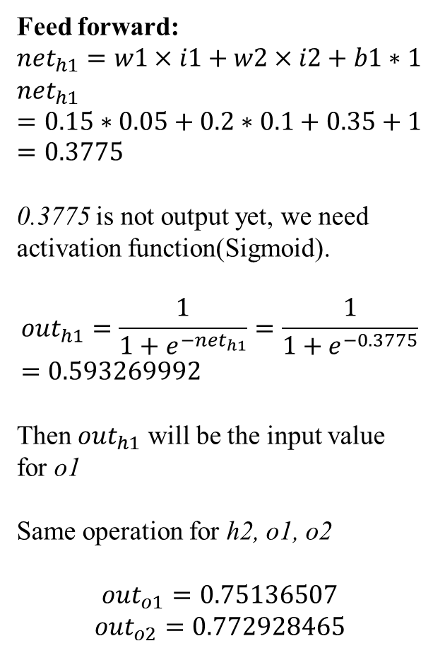
BPN
Example:
Feed forward:
$${net}_{h1}=w1×i1+w2×i2+b1∗1$$
$${net}_{h1}=0.15∗0.05+0.2∗0.1+0.35+1=0.3775$$
0.3775 is not output yet, we need activation function(Sigmoid).
$${out}_{h1}=\frac{1}{1+e^{−{net}_{h1}}}=\frac{1}{1+e^{−0.3775}}=0.593269992$$
Then ${out}_{h1}$ will be the input value for o1
Same operation for h2, o1, o2
$${out}_{o1}=0.75136507$$
$${out}_{o2}=0.772928465$$

Slide 32
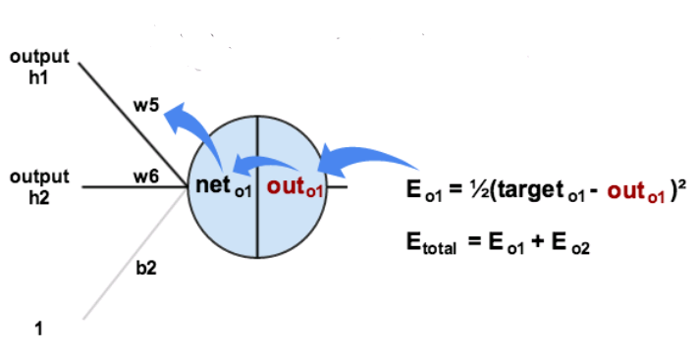
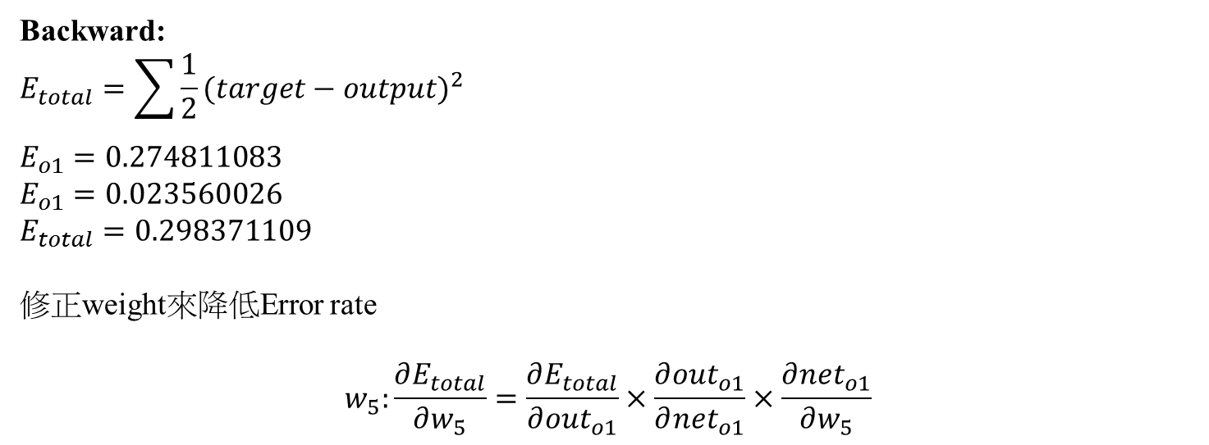
BPN
Backward:
$$E_{total}=\sum{\frac{1}{2}{(target−output)}^{2}}$$
$$E_{o1}=0.274811083$$
$$E_{o1}=0.023560026$$
$$E_{total}=0.298371109$$
修正weight來降低Error rate
$$w_{5}:\frac{∂E_{total}}{∂w_{5}}=\frac{∂E_{total}}{∂{out}_{o1}}×\frac{∂{out}_{o1}}{∂{net}_{o1}}×\frac{∂{net}_{o1}}{∂w_{5}}$$

Slide 33
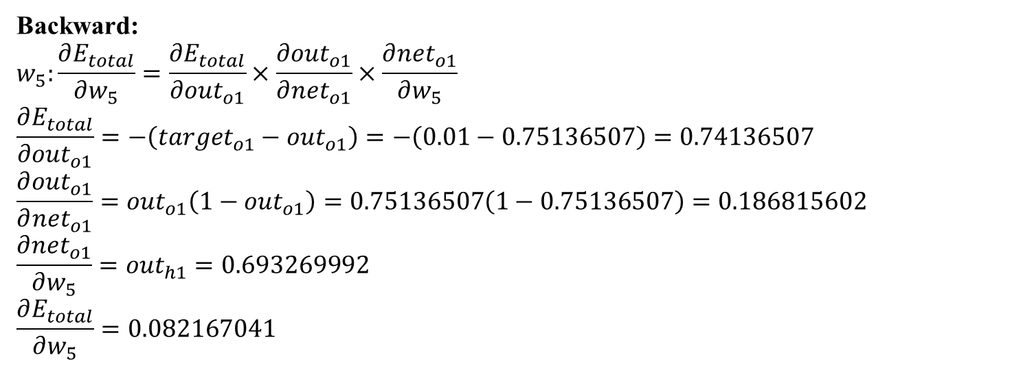
BPN
Backward:
$$w_{5}:\frac{∂E_{total}}{∂w_{5}}=\frac{∂E_{total}}{∂{out}_{o1}}×\frac{∂{out}_{o1}}{∂{net}_{o1}}×\frac{∂{net}_{o1}}{∂w_{5}}$$
$$\frac{∂E_{total}}{∂{out}_{o1}}=−\left({target}_{o1}−{out}_{o1}\right)=−\left(0.01−0.75136507\right)=0.74136507$$
$$\frac{∂{out}_{o1}}{∂{net}_{o1}}={out}_{o1}\left(1−{out}_{o1}\right)=0.75136507\left(1−0.75136507\right)=0.186815602$$
$$\frac{∂{net}_{o1}}{∂w_{5}}={out}_{h1}=0.693269992$$
$$\frac{∂E_{total}}{∂w_{5}}=0.082167041$$

Slide 34
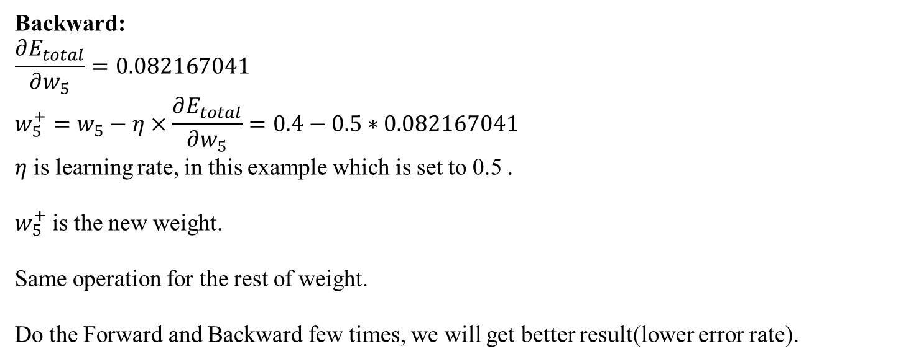
BPN
Backward:
$$\frac{∂E_{total}}{∂w_{5}}=0.082167041$$
$$w_{5}^{+}=w_{5}−η×\frac{∂E_{total}}{∂w_{5}}=0.4−0.5∗0.082167041$$
$η$ is learning rate, in this example which is set to 0.5 .
$w_{5}^{+}$ is the new weight.
Same operation for the rest of weight.
Do the Forward and Backward few times, we will get better result(lower error rate).

Slide 35
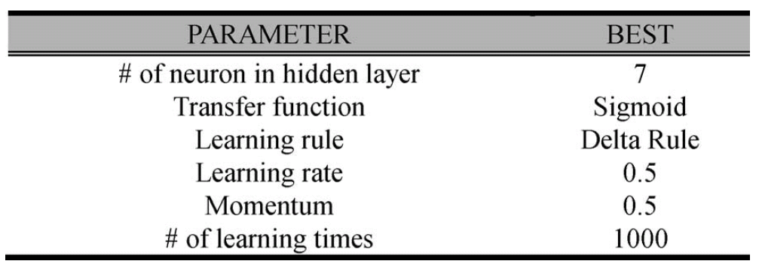
BPN

Slide 36
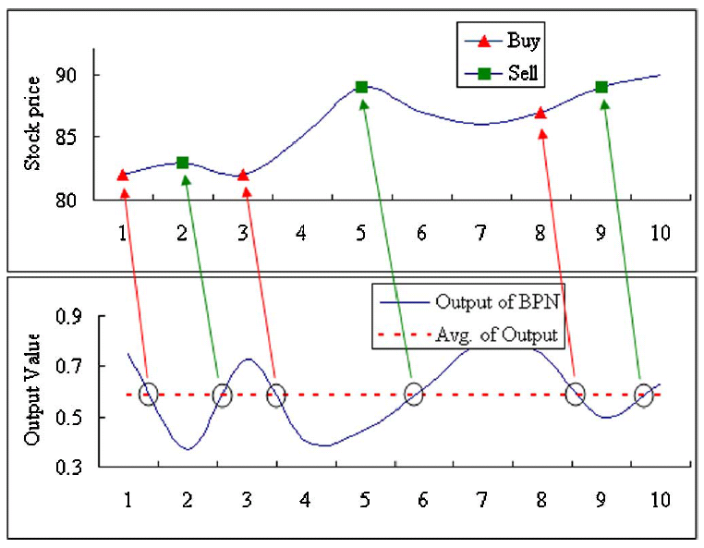
BPN

Slide 37



Flow chart #3
Candidate Stocks Screening
Selected stock
GA
Technical indexes
SRA
Related input variable
$$δ$$
PLR
Turning point
Trading signal
no
Reach number of generation ?
Keep the
$δ$ with best
profit
input
Expect output
Calculate profit
Test
BP(train)
yes
End
$$δ$$
Related input variables

Slide 38
Experiment
[Dataset]
Time period: 2004/01/02 ~ 2006/04/12
Training period: 2004/01/ ~ 2005/09/30
Testing period: 2005/10/01 ~ 2006/04/12
AUO (友達光電, 2409)
Epistar (晶圓光電, 2448)
GP (金山工業, 0040) ➔ 不確定
SiS (矽統科技, 2363)
SENAO (神腦國際, 2450)
D-LINK(友訊科技, 2332)
Foxlink (正崴精密工業, 2392)
Compal (仁寶電腦, 2324)
UMC (聯華電子, 2303)

Slide 39
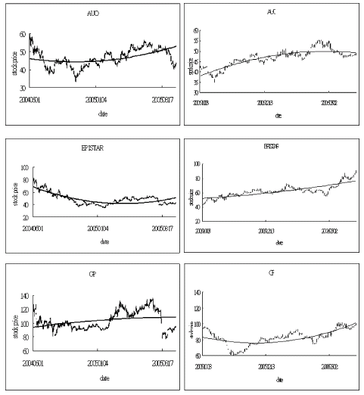
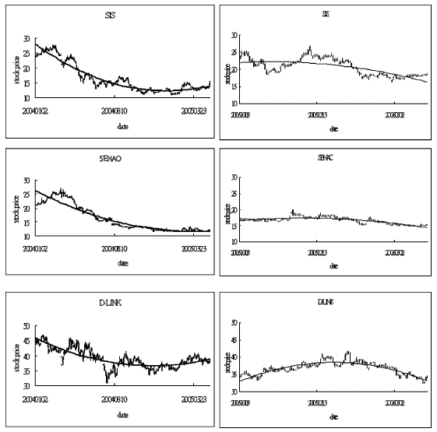
Experiment
UP Trend
DOWN Trend

Slide 40
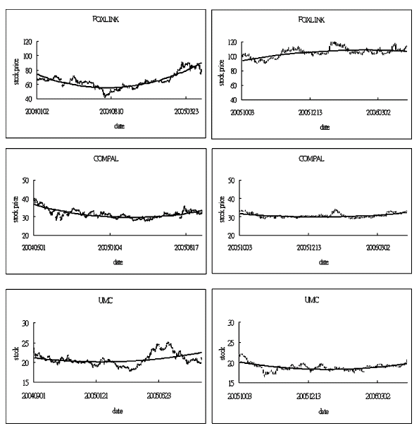
Experiment
Steady Trend

Slide 41
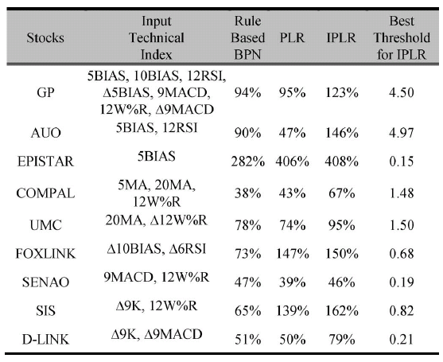
Experiment
UP
Steady
DOWN

Slide 42
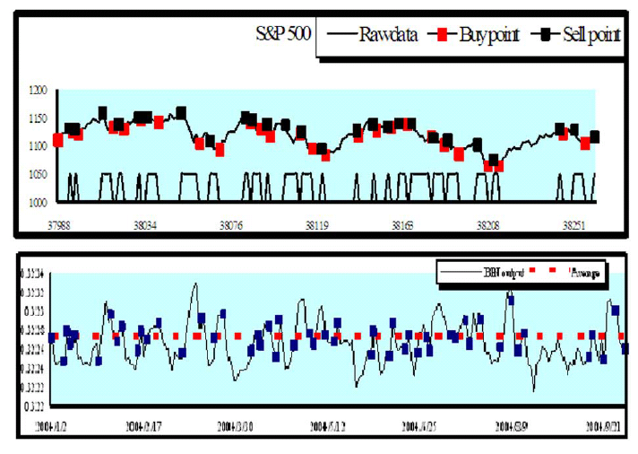
Experiment

