Slide 1
Order preserving pattern matching revisited
Pattern Recognition Letters
volume 55
(2015) 15–21
Md.MahbubulHasan,
A.S.M.ShohidullIslam,
MohammadSaifurRahman,
M.SohelRahman
Presenter: Shu-Kai Hung Date:2015/12/15
Notes:
http://www.sciencedirect.com/science/journal/01678655/55

Slide 2
Abstract
In this paper , we study the order preserving pattern matching(OPPM) problem, which is a very recent variant of the classic pattern matching problem. We revisit this variant, present a new interesting pattern matching algorithm and for the first time consider string regularities from this new perspective.

Slide 3
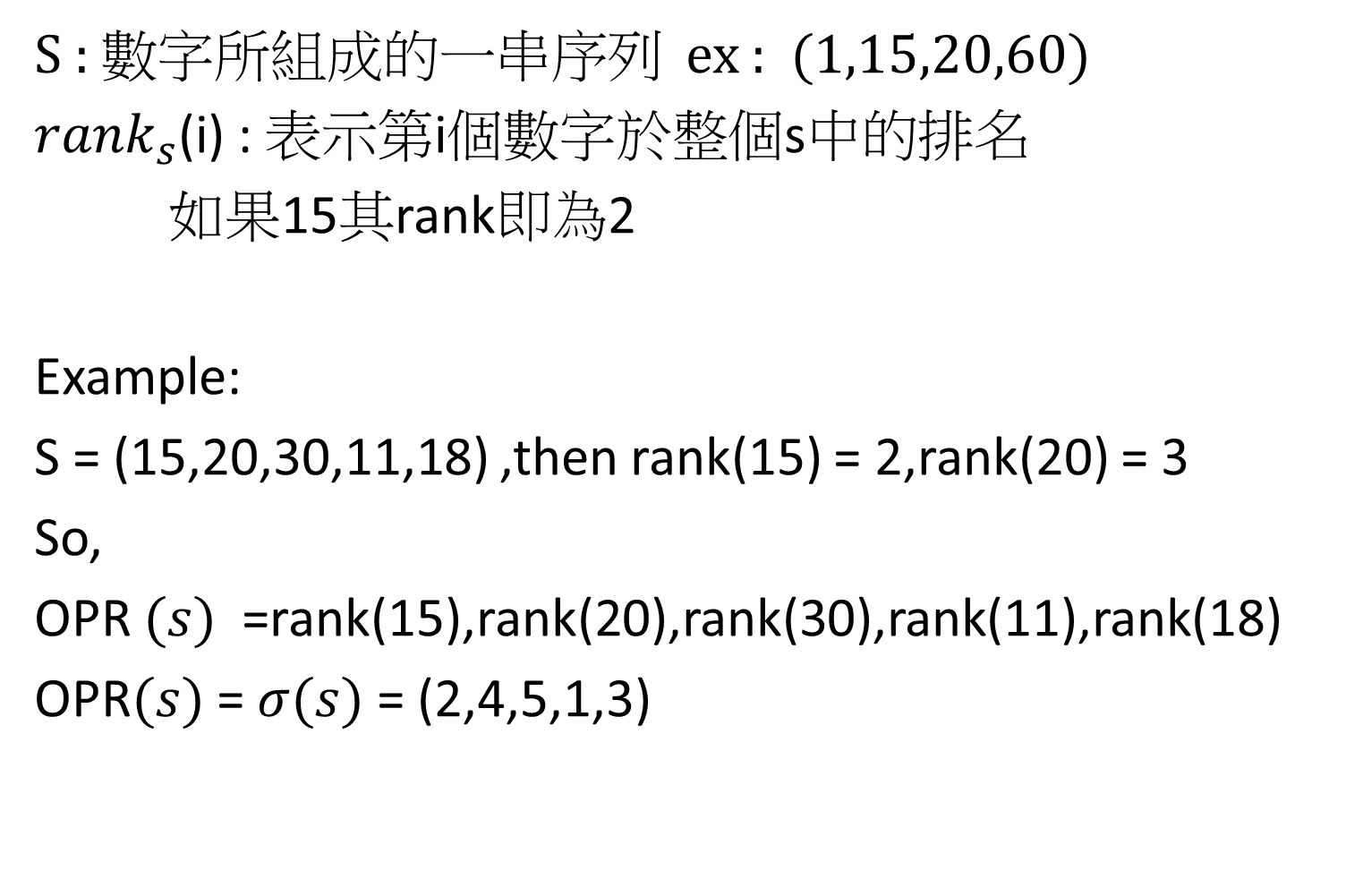
Order preserving representation(OPR)
S : 數字所組成的一串序列 ex : (1,15,20,60)
${rank}_{s}$(i) : 表示第i個數字於整個s中的排名
如果15其rank即為2
Example:
S = (15,20,30,11,18) ,then rank(15) = 2,rank(20) = 3
So,
OPR $(s)$ =rank(15),rank(20),rank(30),rank(11),rank(18)
OPR$(s)$ = $σ(s)$ = (2,4,5,1,3)

Slide 4
Order-Isomorphic
若有兩字串S1,S2且σ(S1)=σ(S2)
則稱S1,S2 OPR-equal 或 Order-Isomorphic
Example:
(4,1,2,3)～(63,12,23,42)

Slide 5
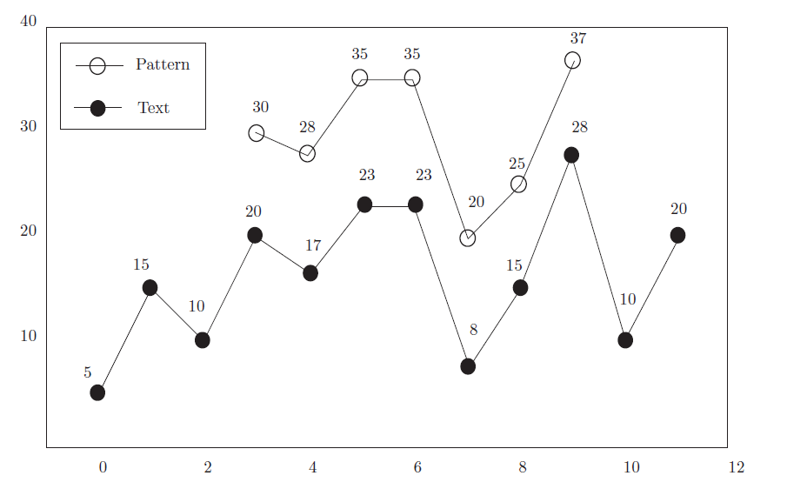

order preserving pattern matching(OPPM)
Input: text($t_{1}$, $t_{2},…..,t_{n}$) and pattern($p_{1},p_{2},….,p_{m}$)
Output: is there i such that ($t_{i}$, $t_{i+1},…..,t_{i+m−1}$) ～ ($p_{1},p_{2},….,p_{m}$)
Time complexity : O(n + sort(m) )

Slide 6
Gusfield's Algorithm （ Z Algorithm ）
z(i): Refers to the string by the s [i] beginning, and s [0] string can be matched to the start how long.(string s , s[i] : the i th value)
※ compare with prefix
Example:
S[i] | A | C | A | G | G | T | A | C | A | G | A | C
Z(i) | 1 | 0 | 1 | 0 | 0 | 0 | 4 | 0 | 1 | 0 | 2 | 0

Slide 7

Modified Z - function
To useful from the order preserving point of view
Example:
Time complexity : $O(n^{2})$
S[i] | 11 | 18 | 24 | 26 | 20 | 25 | 23 | 29 | 30
Z(i) | 9 | 3 | 2 | 1 | 2 | 1 | 3 | 2 | 1

Slide 8
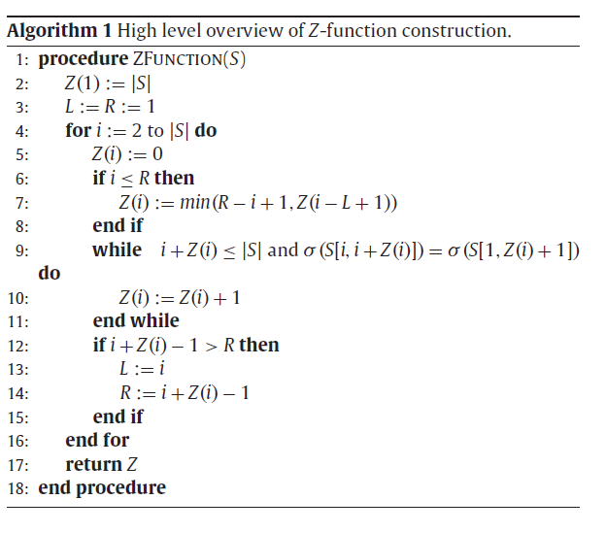


Slide 9
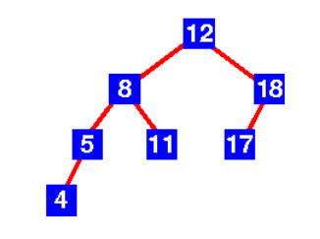
Balance binary search tree
A binary search tree is a binary tree where, for each node m, the left sub-tree only has nodes with keys smaller than the key of m, while the right sub-tree only has nodes with keys larger than the key of m.

Slide 10
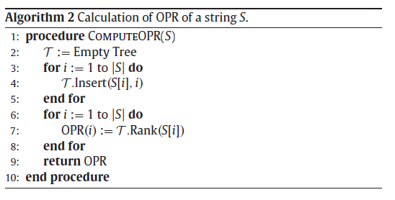

Algorithm 2(with Algorithm 1)
Time Complexity : $O\left(nlogn\right)$
Checking equality of two OPRs:$O(n)$
Constructing Tree(include insert(x,i) , Rank(x) )
example:
S = (11,18,24,20,25,29) OPRs = (1,2,4,3,5,6)
24
18
25
11
20
29

Slide 11
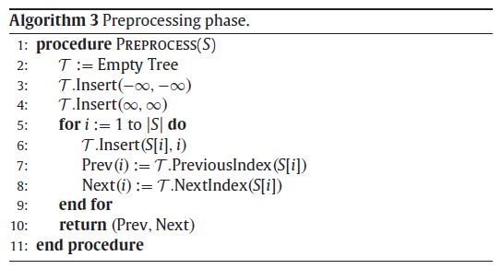

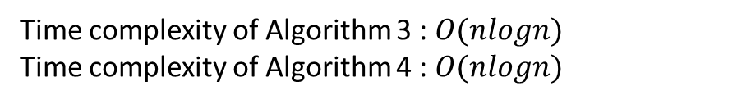
Algorithm3 & 4
Two new operation :
PreviousIndex(x) : Finds the value of pair having largest key less than x
NextIndex(x) : Finds the value of pair having smallest key greater than x
Time complexity of Algorithm 3 : $O(nlogn)$
Time complexity of Algorithm 4 : $O(nlogn)$
Array Prev , Array Next can check the equality of two OPRs in constant time

Slide 12
Example:
S=(11,18,24,20,25,29) Z(S) = (6,2,1,3,2,1)
Prev(i) = (-∞,1,2,2,3,5)
Next(i) = (∞, ∞, ∞,3, ∞, ∞)
11
11
18
18
18
11
24
11
24
18
24
20
11
24
18
25
20
25
11
20
29

Slide 13
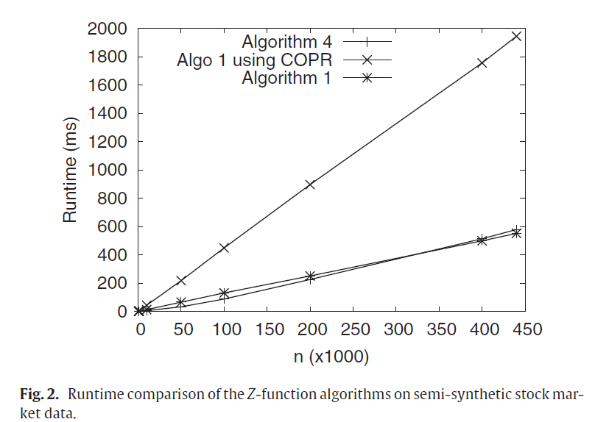
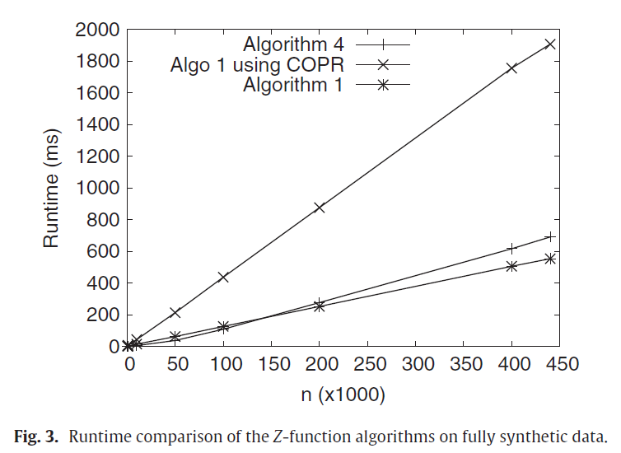
Experiments

Slide 14
