Slide 1
Navneet Dalal and Bill Triggs Proceedings of Computer Vision and Pattern Recognition(CVPR 2005), San Diego, CA, USA, pp. 886-893, June 25, 2005
Histogram of Oriented Gradients for Human Detection
Presenter：Wei-Hao, Fu
Date：105/ 03/ 01
Notes:
1

Slide 2
Abstract(1/3)
We study the question of feature sets for robust visual object recognition, adopting linear SVM based human detection as a test case.
After reviewing existing edge and gradient based descriptors, we show experimentally that grids of Histograms of Oriented Gradient (HOG) descriptors significantly outperform existing feature sets for human detection.

Slide 3
Abstract(2/3)
We study the influence of each stage of the computation on performance, concluding that fine-scale gradients, fine orientation binning, relatively coarse spatial binning, and high-quality local contrast normalization in overlapping descriptor
blocks are all important for good results.

Slide 4
Abstract(3/3)
The new approach gives near-perfect separation on the original MIT pedestrian database, so we introduce a more challenging dataset containing over 1800 annotated human images with a large range of pose variations and backgrounds.

Slide 5
Histogram of Oriented Gradient
目的：計算局部圖像梯度方向訊息的統計值。
Cell：由好幾個像素(pixel)組成的單位，利用這些像素來決定該Cell的梯度方向。
Block：數個Cell所組成，Block彼此間可以重疊，用來描述影像的局部邊緣資訊。

Slide 6
Method flow chart
Input
Image
Normalize
gamma &
colour
Weighted vote
Into spatial &
Orientation cells
Contrast normalize
Over overlapping
Spatial blocks
Collect HOG’s
Over detection
window
Compute
gradients
Person or
Non-person
classification
Linear
SVM

Slide 7



Gradient Computation
透過Gaussian Smoothing和一個特定的Derivative mask後，再利用edge detection做Gradient的計算。

Slide 8
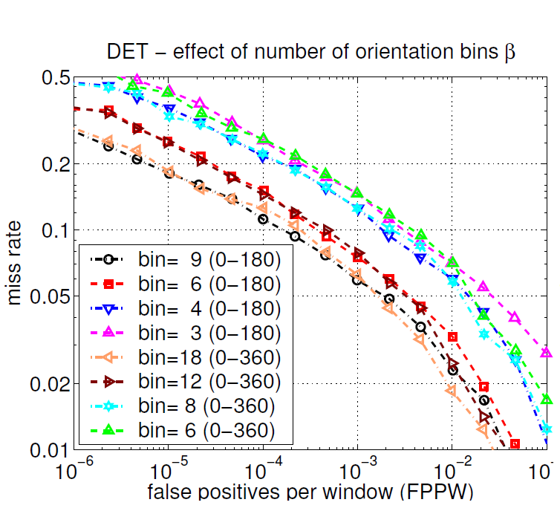
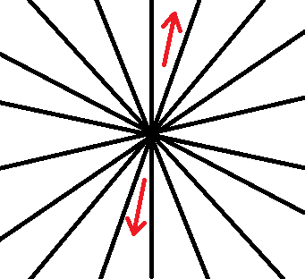
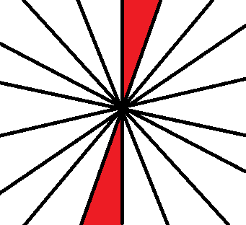
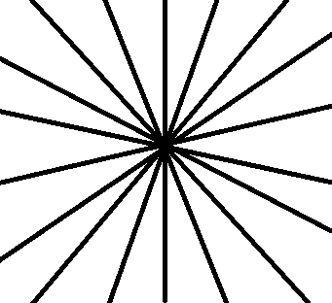
Spatial/Orientation Binning
Orientation bins分成0度到180度（兩方向若相差180度則視為同個角度）或是0度到360度兩種方式。

Slide 9
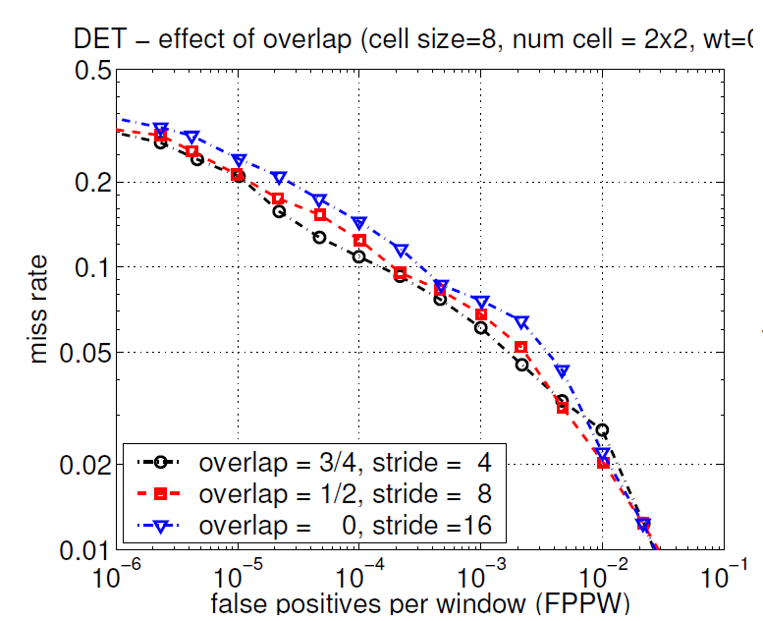
Descriptor Blocks
R-HOG：Block為矩形的HOG。
C-HOG：Block為圓形的HOG。
人的辨識以R-HOG為基礎，Block大小為3*3個Cell及Cell大小為6*6像素為最佳。

Slide 10
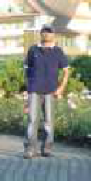
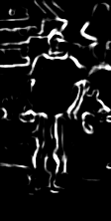

Slide 11

          
          
          
          
          
          

