Slide 1
An improved algorithm for computing the edit distance of run-length coded strings
H. Bunke, J. Csirik
Information Processing Letters volume 54, Issue 2, pp.93-96(1995)
Presenter: Shian-Liang Lin

Slide 2
Abstract
Depending on the particular application, it can be an advantage to use a special representation or coding method for the strings to be compared. One well known method that has been widely used, for example in image processing, is run-length coding.
In this paper, we propose a different approach for run-length coding strings. Our new algorithm will be also based on a division of the edit matrix into blocks. However, no subdivision of these blocks will ever be required. It will be shown that it is sufficient, in order to get the edit distance of two run-length coded strings, to compute for each block only its last row and column in the edit matrix. The new algorithm is restricted, however, to the special cost function under which the cost of any insertion and deletion is equal to 1, and the cost of any substitution is equal to 2.

Slide 3
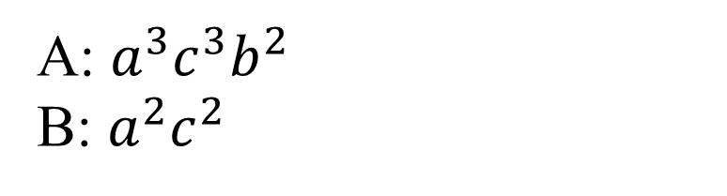
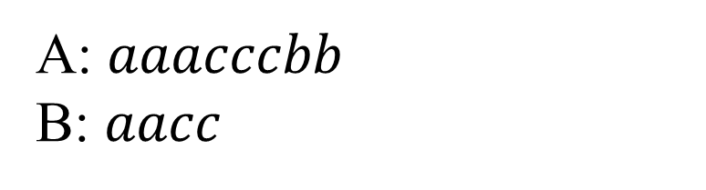
Run-length-encoded(RLE) string
A: $aaacccbb$
B: $aacc$
A: $a^{3}c^{3}b^{2}$
B: $a^{2}c^{2}$

Slide 4
Subdivision of DP lattice
 | - | a | a | c | c
-
a
a
a
c
c
c
b
b
 | - | a a | c c
-
a a a
c c c
b b

Slide 5
Calculated parts in DP lattice
 | - | a a | c c
-
a a a
c c c
b b
 | c | c
-
 | a | a
a
a
a
 | c | c
b
b

Slide 6

Calculated parts in DP lattice
 | - | a | a | c | c
- | 0 | 1 | 2 | 3 | 4
a | 1 |  | 1
a | 2 |  | 0
a | 3 | 2 | 1
c
c
c
b
b
Cost function
insertion | 1
deletion | 1
replacement | 2

Slide 7
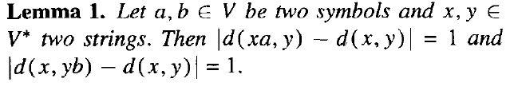
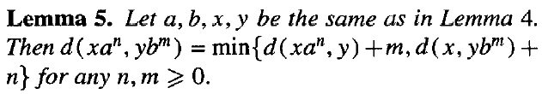
Calculated parts in DP lattice
 | - | a | a | c | c
- | 0 | 1 | 2 | 3 | 4
a | 1 |  | 1 |  | 3
a | 2 |  | 0 |  | 2
a | 3 | 2 | 1 | 2 | 3
c
c
c
b
b
Cost function
insertion | 1
deletion | 1
replacement | 2

Slide 8
Calculated parts in DP lattice
 | - | a | a | c | c
- | 0 | 1 | 2 | 3 | 4
a | 1 |  | 1 |  | 3
a | 2 |  | 0 |  | 2
a | 3 | 2 | 1 | 2 | 3
c | 4 5 6 |  | 2 |  | 4
c |  |  | 3 |  | 5
c |  | 5 | 4 | 5 | 6
b | 7 8 |  | 5 |  | 7
b |  | 7 | 6 | 7 | 8

Slide 9
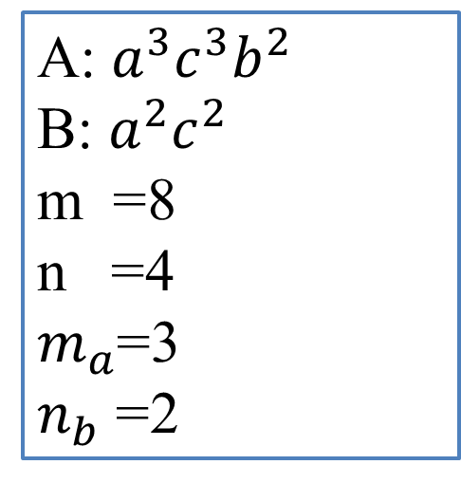
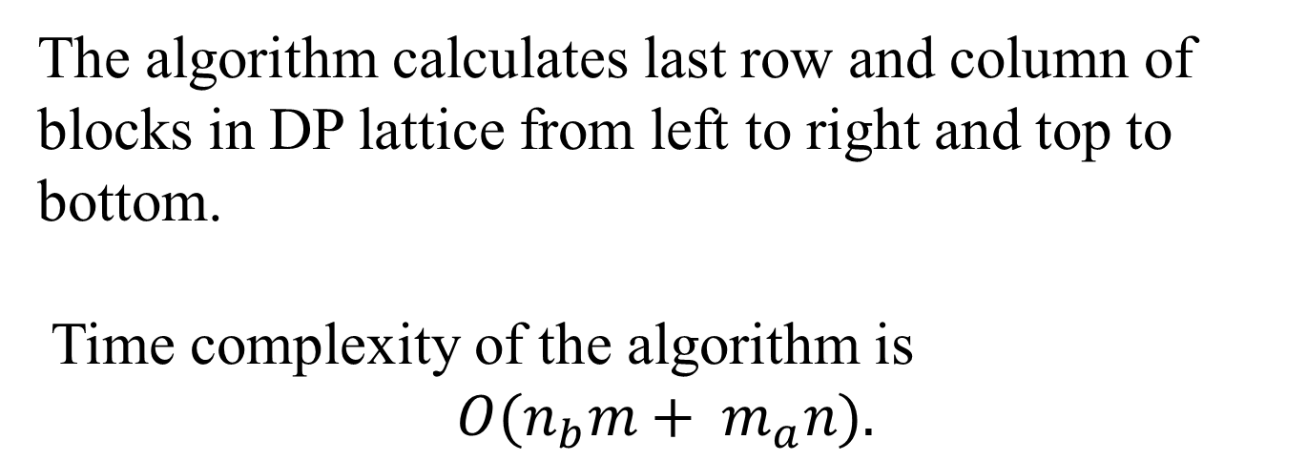
Time complexity
The algorithm calculates last row and column of blocks in DP lattice from left to right and top to bottom.
Time complexity of the algorithm is
$$O(n_{b}m+ m_{a}n).$$
Example:
A: $a^{3}c^{3}b^{2}$
B: $a^{2}c^{2}$
m =8
n =4
$m_{a}$=3
$n_{b}$ =2

Slide 10
Thanks for listening.

