Slide 1
A Bit-String Longest-Common-Subsequence Algorithm
Lloyd Allison, Trevor I. Dix Information Processing Letters
Volume 23, Issue 5, 24 November 1986, Pages 305-310
Shie-Yan Lee
2016/10/25

Slide 2
Abstract
A longest-common-subsequence algorithm is described which operates in terms of bit or bit-string operations. It offers a speedup of the order of the word-length on a conventional computer.

Slide 3
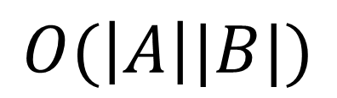
LCS matrix
A : TCCTAG
B : CACGTA
 | C | A | C | G | T | A
T | 0 | 0 | 0 | 0 | 1 | 1
C | 1 | 1 | 1 | 1 | 1 | 1
C | 1 | 1 | 2 | 2 | 2 | 2
T | 1 | 1 | 2 | 2 | 3 | 3
A | 1 | 2 | 2 | 2 | 3 | 4
G | 1 | 2 | 2 | 3 | 3 | 4
$$O(\left|A\right||B|)$$

Slide 4
LCS matrix
A : TCCTAG
B : CACGTA
4 | 3 | 3 | 2 | 2 | 1 | G
4 | 3 | 2 | 2 | 2 | 1 | A
3 | 3 | 2 | 2 | 1 | 1 | T
2 | 2 | 2 | 2 | 1 | 1 | C
1 | 1 | 1 | 1 | 1 | 1 | C
1 | 1 | 0 | 0 | 0 | 0 | T
A | T | G | C | A | C

Slide 5
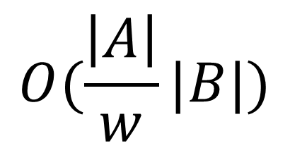
Bit-string matrix
A : TCCTAG
B : CACGTA
4
1 | 0 | 1 | 0 | 1 | 1 | G
1 | 1 | 0 | 0 | 1 | 1 | A
0 | 1 | 0 | 1 | 0 | 1 | T
0 | 0 | 0 | 1 | 0 | 1 | C
0 | 0 | 0 | 0 | 0 | 1 | C
0 | 1 | 0 | 0 | 0 | 0 | T
A | T | G | C | A | C
$$O(\frac{\left|A\right|}{w}|B|)$$
4
3
2
1
1

Slide 6
Bit-string algorithm
Define alphabet-strings
A | T | G | C | A | C
1 | 0 | 0 | 0 | 1 | 0
0 | 0 | 0 | 1 | 0 | 1
0 | 0 | 1 | 0 | 0 | 0
0 | 1 | 0 | 0 | 0 | 0
A-string
C-string
G-string
T-string

Slide 7
Bit-string algorithm
2.Calculate Matrix
Row5
 |  |  |  |  |  | A
0 | 1 | 0 | 1 | 0 | 1 | T
0 | 0 | 0 | 1 | 0 | 1 | C
0 | 0 | 0 | 0 | 0 | 1 | C
0 | 1 | 0 | 0 | 0 | 0 | T
A | T | G | C | A | C
Row4
Row3
Row2
Row1

Slide 8
Bit-string algorithm
2.Calculate Matrix
Row4 | 0 | 1 | 0 | 1 | 0 | 1
A-string | 1 | 0 | 0 | 0 | 1 | 0

Slide 9
Bit-string algorithm
2.Calculate Matrix
Row4 | 0 | 1 | 0 | 1 | 0 | 1
A-string | 1 | 0 | 0 | 0 | 1 | 0

Slide 10
Bit-string algorithm
2.Calculate Matrix
Row4 | 0 | 1 | 0 | 1 | 0 | 1
A-string | 1 | 0 | 0 | 0 | 1 | 0
Row5 | 1 | 1 | 0 | 0 | 1 | 1

Slide 11

Bit-string algorithm
2.Calculate Matrix
Row4 | 0 | 1 | 0 | 1 | 0 | 1
A-string | 1 | 0 | 0 | 0 | 1 | 0
$$OR$$
x | 1 | 1 | 0 | 1 | 1 | 1

Slide 12

Bit-string algorithm
2.Calculate Matrix
x | 1 | 1 | 0 | 1 | 1 | 1
Row4 << 1 | 1 | 0 | 1 | 0 | 1 | 1
Row4 | 0 | 1 | 0 | 1 | 0 | 1
$$−$$
 | 0 | 0 | 1 | 1 | 0 | 0

Slide 13
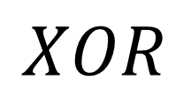
Bit-string algorithm
2.Calculate Matrix
 | 0 | 0 | 1 | 1 | 0 | 0
x | 1 | 1 | 0 | 1 | 1 | 1
$$XOR$$
 | 1 | 1 | 1 | 0 | 1 | 1

Slide 14

Bit-string algorithm
2.Calculate Matrix
 | 1 | 1 | 1 | 0 | 1 | 1
x | 1 | 1 | 0 | 1 | 1 | 1
$$AND$$
 | 1 | 1 | 0 | 0 | 1 | 1

Slide 15
Bit-string algorithm
2.Calculate Matrix
 | 1 | 1 | 1 | 0 | 1 | 1
x | 1 | 1 | 0 | 1 | 1 | 1
$$AND$$
Row5 | 1 | 1 | 0 | 0 | 1 | 1

Slide 16

Bit-string algorithm
2.Calculate Matrix
$${row}_{i}=x AND ( \left(x−{row}_{i−1}≪1\right) XOR x)$$
where $x={row}_{i−1} OR b_{i}$-string

Slide 17
Bit-string matrix
A : TCCTAG
B : CACGTA
1 | 0 | 1 | 0 | 1 | 1 | G
1 | 1 | 0 | 0 | 1 | 1 | A
0 | 1 | 0 | 1 | 0 | 1 | T
0 | 0 | 0 | 1 | 0 | 1 | C
0 | 0 | 0 | 0 | 0 | 1 | C
0 | 1 | 0 | 0 | 0 | 0 | T
A | T | G | C | A | C

Slide 18
Bit-string matrix
A : TCCTAG
B : CACGTA
1 | 0 | 1 | 0 | 1 | 1 | G
1 | 1 | 0 | 0 | 1 | 1 | A
0 | 1 | 0 | 1 | 0 | 1 | T
0 | 0 | 0 | 1 | 0 | 1 | C
0 | 0 | 0 | 0 | 0 | 1 | C
0 | 1 | 0 | 0 | 0 | 0 | T
A | T | G | C | A | C
$$O(\frac{\left|A\right|}{w}|B|)$$

Slide 19
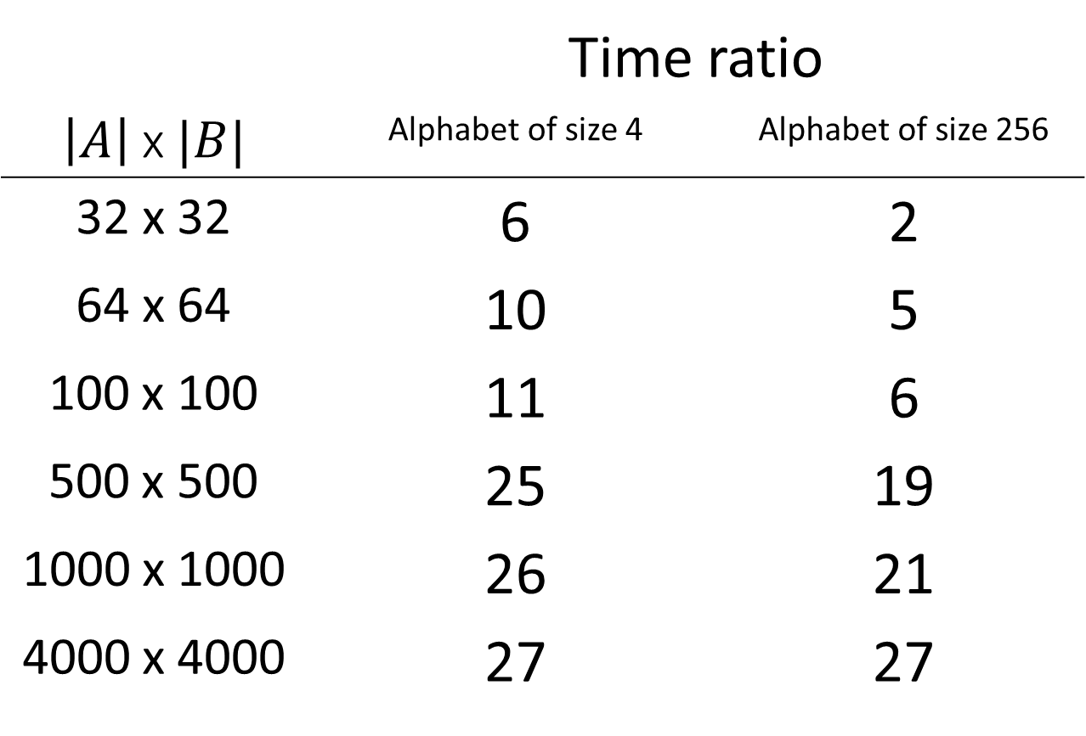
Simulation results on a 32-bit computer
 | Time ratio
$\left|A\right|$ x $|B|$ | Alphabet of size 4 | Alphabet of size 256
32 x 32 | 6 | 2
64 x 64 | 10 | 5
100 x 100 | 11 | 6
500 x 500 | 25 | 19
1000 x 1000 | 26 | 21
4000 x 4000 | 27 | 27

