Slide 1
The LCA Problem Revisited
Michael A. Bender and Martin Farach-Colton
LATIN Proceedings of the 4th Latin American Symposium on Theoretical Informatics, 2000, Pages 88-94
Presenter: Bi-Shiang Lin
Date:2016/10/25

Slide 2
Abstract
We present a very simple algorithm for the Least Common Ancestors problem. We thus dispel the frequently held notion that optimal LCA computations is unwieldy and unimplementable. Interestingly, this algorithm is a sequentialization of a previously known PRAM algorithm.

Slide 3

Least Common Ancestor Problem
The problem is to answer the LCA queries for any pairs $(u,v)$with a rooted tree$T$.
w
u
v

Slide 4
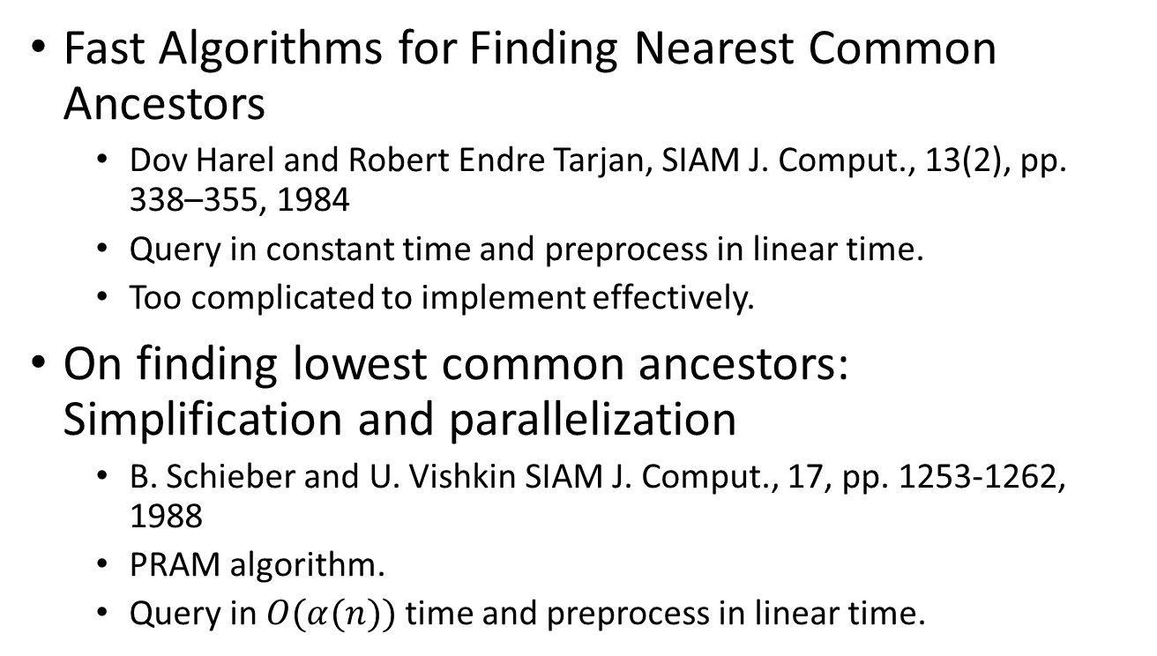
Previous Research
Fast Algorithms for Finding Nearest Common Ancestors
Dov Harel and Robert Endre Tarjan, SIAM J. Comput., 13(2), pp. 338–355, 1984
Query in constant time and preprocess in linear time.
Too complicated to implement effectively.
On finding lowest common ancestors: Simplification and parallelization
B. Schieber and U. Vishkin SIAM J. Comput., 17, pp. 1253-1262, 1988
PRAM algorithm.
Query in $O(α(n))$time and preprocess in linear time.

Slide 5
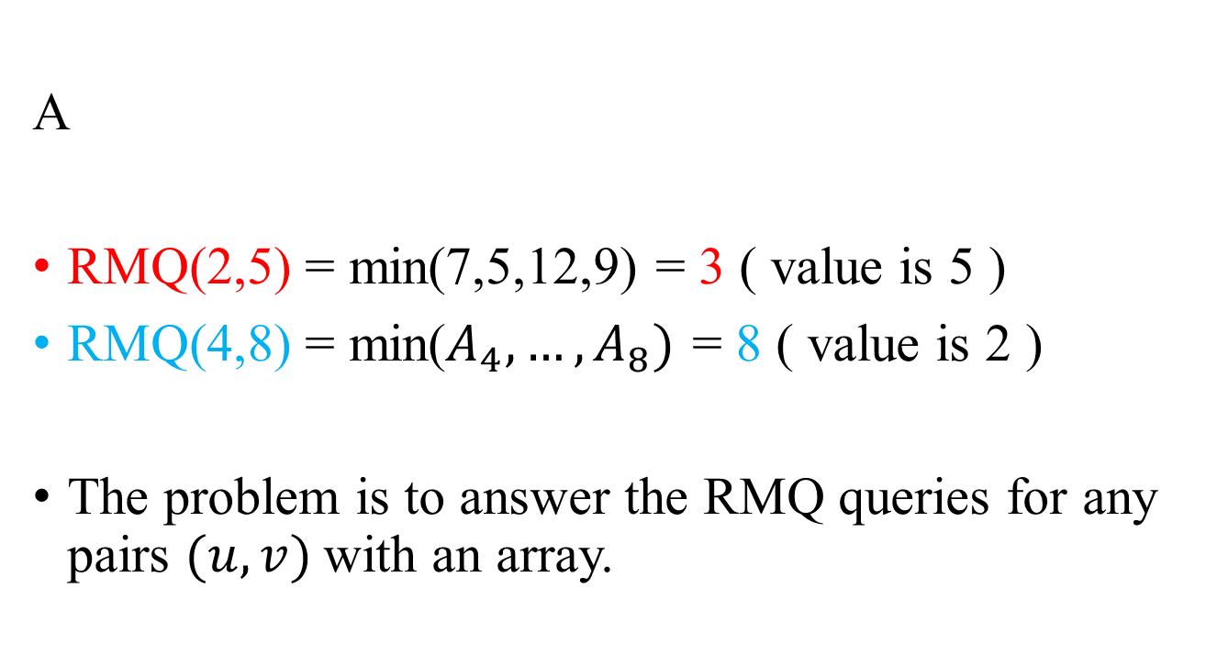
Range Minimum Query Problem
A
RMQ(2,5) = min(7,5,12,9) = 3 ( value is 5 )
RMQ(4,8) = min($A_{4},…,A_{8})$ = 8 ( value is 2 )
The problem is to answer the RMQ queries for any pairs $(u,v)$with an array.
Index | 1 | 2 | 3 | 4 | 5 | 6 | 7 | 8 | 9
value | 3 | 7 | 5 | 12 | 9 | 4 | 10 | 2 | 1

Slide 6
Reduce LCA prob. to RMQ prob.
1
6
4
LCA Query(3,7)
= E[RMQ(3,6)]
= E[4]
= 6
LCA Query(1,8)
= E[RMQ(1,15)]
= E[1]
= 1
3
2
9
8
7
5
1 | 2 | 3 | 4 | 5 | 6 | 7 | 8 | 9 | 10 | 11 | 12 | 13 | 14 | 15 | 16 | 17
1 | 6 | 3 | 6 | 2 | 7 | 2 | 5 | 2 | 6 | 9 | 6 | 1 | 4 | 8 | 4 | 1
E
L
R
1 | 2 | 3 | 4 | 5 | 6 | 7 | 8 | 9 | 10 | 11 | 12 | 13 | 14 | 15 | 16 | 17
0 | 1 | 2 | 1 | 2 | 3 | 2 | 3 | 2 | 1 | 2 | 1 | 0 | 1 | 2 | 1 | 0
1 | 2 | 3 | 4 | 5 | 6 | 7 | 8 | 9
1 | 5 | 3 | 14 | 8 | 2 | 6 | 15 | 11

Slide 7
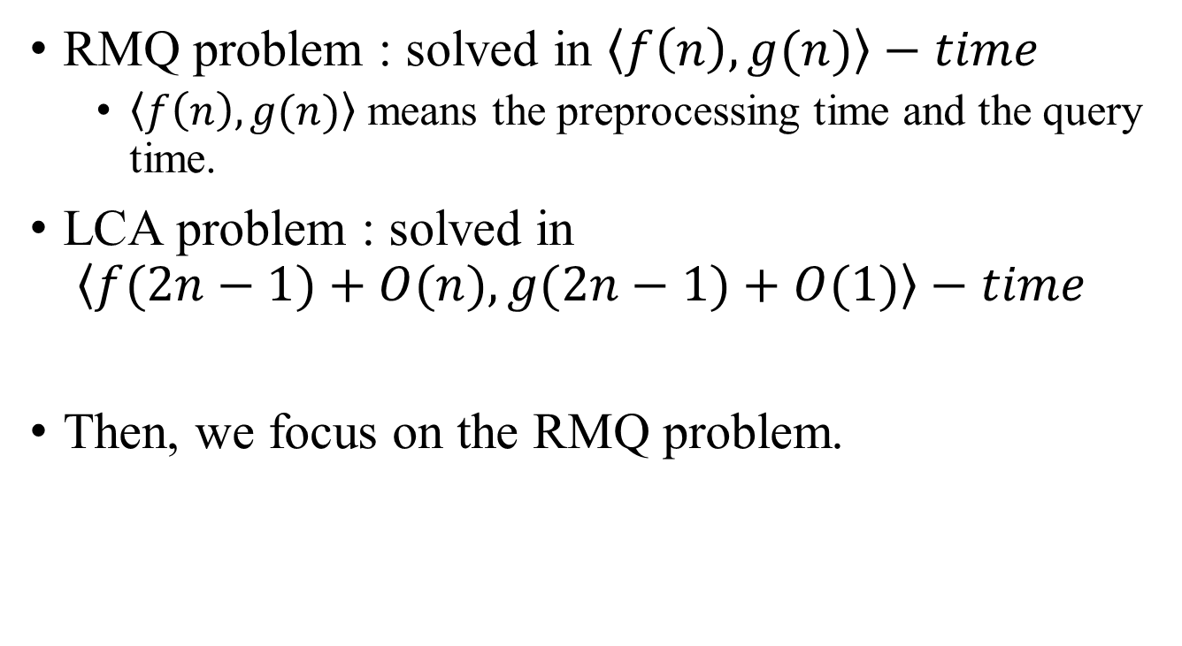
Reduce LCA prob. to RMQ prob.
RMQ problem : solved in $\left\langle f\left(n\right),g(n)\right\rangle −time$
$\left\langle f\left(n\right),g(n)\right\rangle$ means the preprocessing time and the query time.
LCA problem : solved in $\left\langle f(2n−1)+O(n), g(2n−1)+O(1)\right\rangle −time$
Then, we focus on the RMQ problem.

Slide 8
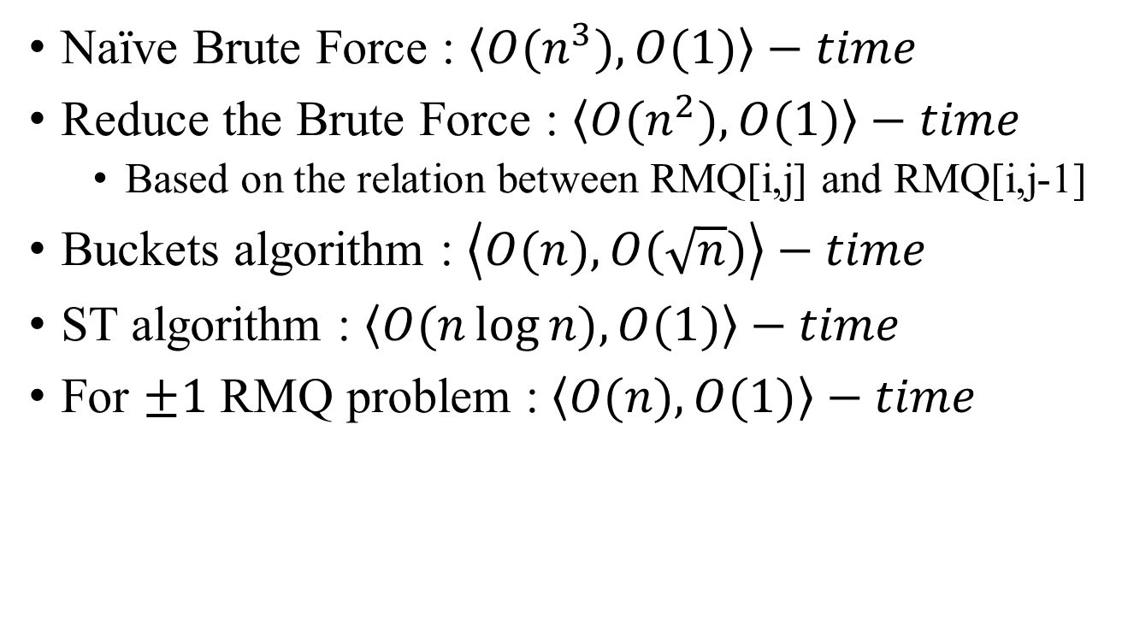
RMQ problem
Naïve Brute Force : $\left\langle O(n^{3}),O(1)\right\rangle −time$
Reduce the Brute Force : $\left\langle O(n^{2}),O(1)\right\rangle −time$
Based on the relation between RMQ[i,j] and RMQ[i,j-1]
Buckets algorithm : $\left\langle O(n),O(\sqrt{n})\right\rangle −time$
ST algorithm : $\left\langle O(n\log{n}),O(1)\right\rangle −time$
For $±1$ RMQ problem : $\left\langle O(n),O(1)\right\rangle −time$

Slide 9
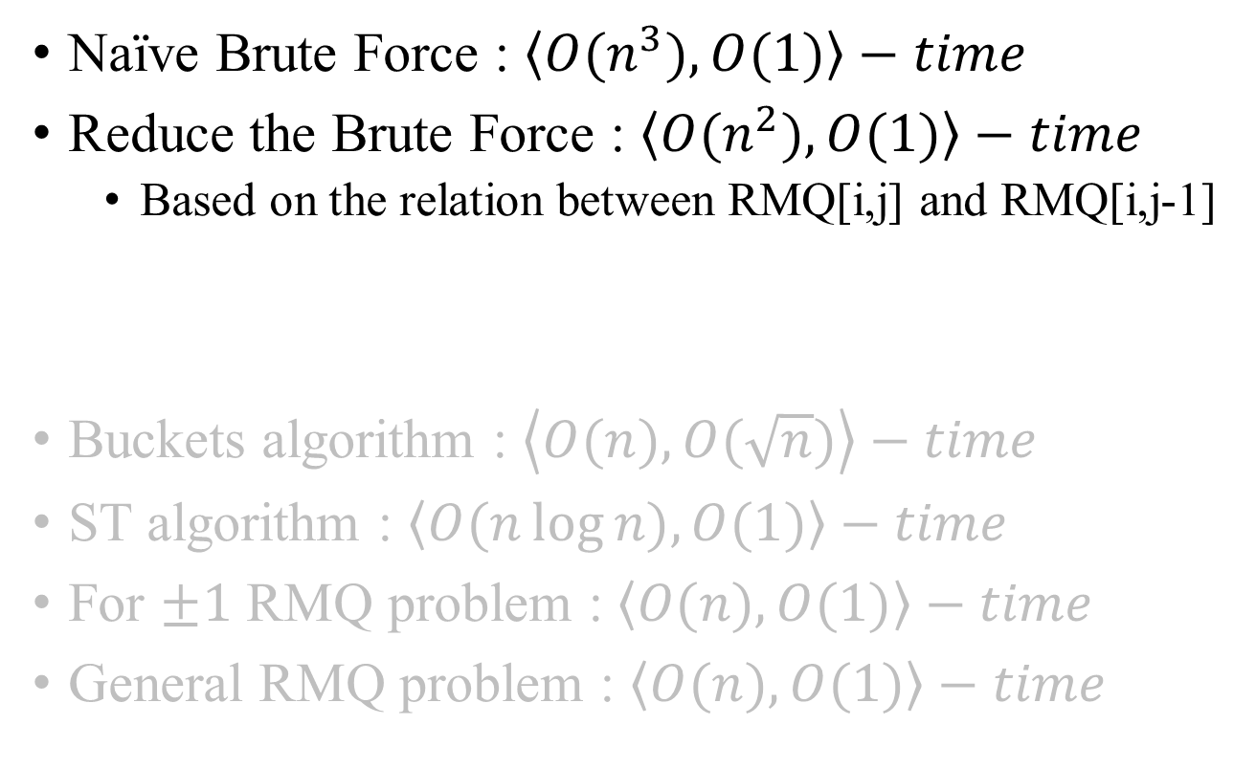
RMQ problem
Naïve Brute Force : $\left\langle O(n^{3}),O(1)\right\rangle −time$
Reduce the Brute Force : $\left\langle O(n^{2}),O(1)\right\rangle −time$
Based on the relation between RMQ[i,j] and RMQ[i,j-1]
Buckets algorithm : $\left\langle O(n),O(\sqrt{n})\right\rangle −time$
ST algorithm : $\left\langle O(n\log{n}),O(1)\right\rangle −time$
For $±1$ RMQ problem : $\left\langle O(n),O(1)\right\rangle −time$
General RMQ problem : $\left\langle O(n),O(1)\right\rangle −time$
Index | 1 | 2 | 3 | 4 | 5 | 6 | 7 | 8 | 9
value | 3 | 7 | 5 | 12 | 9 | 4 | 10 | 2 | 1

Slide 10
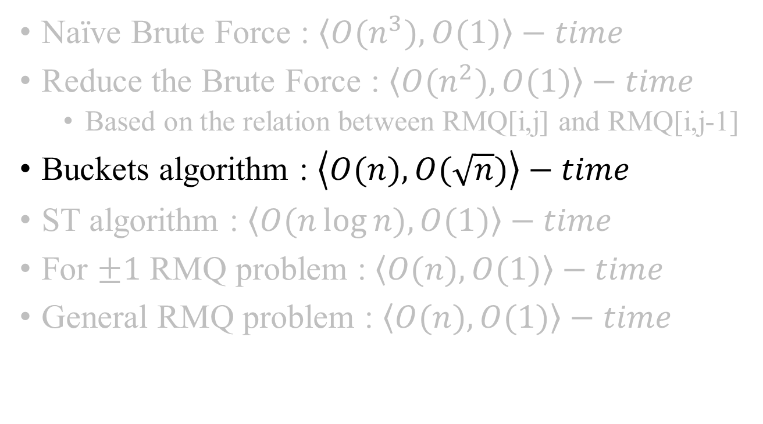
RMQ problem
Naïve Brute Force : $\left\langle O(n^{3}),O(1)\right\rangle −time$
Reduce the Brute Force : $\left\langle O(n^{2}),O(1)\right\rangle −time$
Based on the relation between RMQ[i,j] and RMQ[i,j-1]
Buckets algorithm : $\left\langle O(n),O(\sqrt{n})\right\rangle −time$
ST algorithm : $\left\langle O(n\log{n}),O(1)\right\rangle −time$
For $±1$ RMQ problem : $\left\langle O(n),O(1)\right\rangle −time$
General RMQ problem : $\left\langle O(n),O(1)\right\rangle −time$

Slide 11


$$\text{Buckets} \text{algorithm}$$
A
Split the array in $\sqrt{n}$ pieces.
Query costs no more than $3∗\sqrt{n}$ operations.
$\left\langle O(n),O(\sqrt{n})\right\rangle −time$
Index | 1 | 2 | 3 | 4 | 5 | 6 | 7 | 8 | 9
value | 3 | 7 | 5 | 12 | 9 | 4 | 10 | 2 | 1
RMQ | 1 |  |  | 6 |  |  | 9

Slide 12
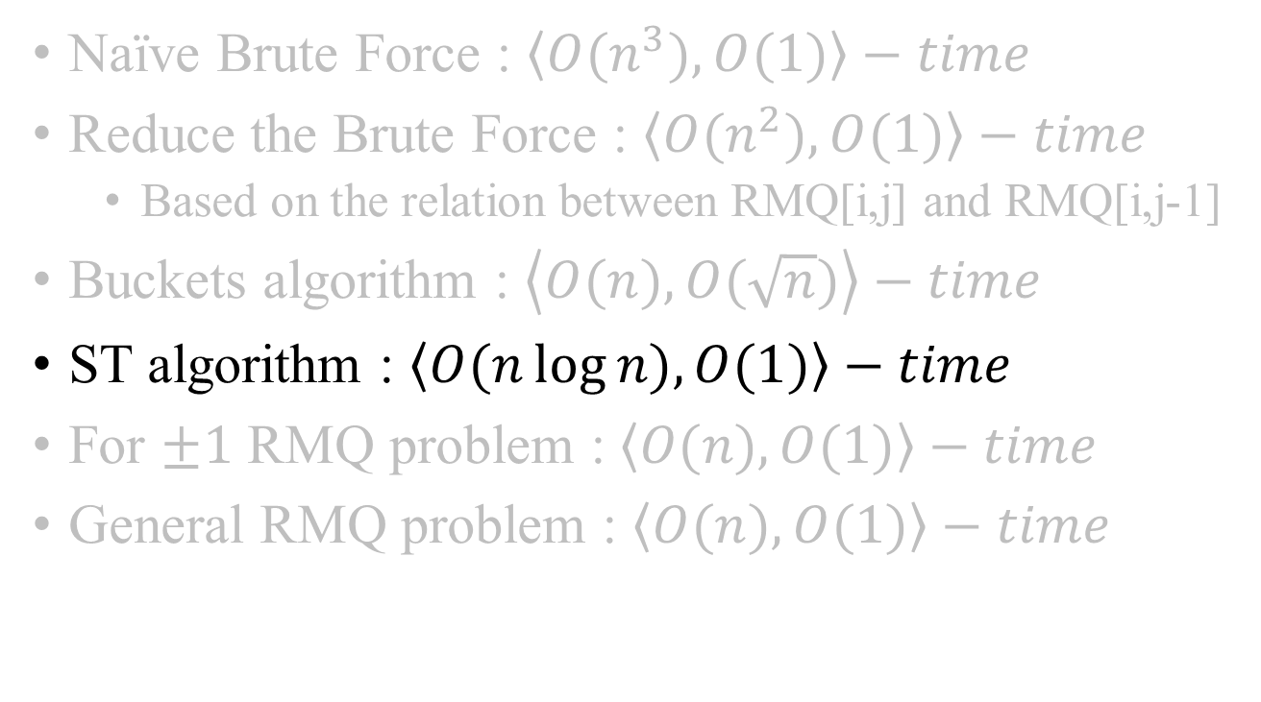
RMQ problem
Naïve Brute Force : $\left\langle O(n^{3}),O(1)\right\rangle −time$
Reduce the Brute Force : $\left\langle O(n^{2}),O(1)\right\rangle −time$
Based on the relation between RMQ[i,j] and RMQ[i,j-1]
Buckets algorithm : $\left\langle O(n),O(\sqrt{n})\right\rangle −time$
ST algorithm : $\left\langle O(n\log{n}),O(1)\right\rangle −time$
For $±1$ RMQ problem : $\left\langle O(n),O(1)\right\rangle −time$
General RMQ problem : $\left\langle O(n),O(1)\right\rangle −time$

Slide 13
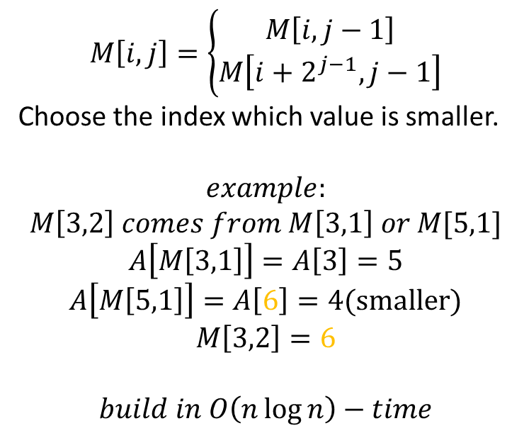
ST algorithm
Index | 1 | 2 | 3 | 4 | 5 | 6 | 7 | 8
value | 3 | 7 | 5 | 12 | 9 | 4 | 10 | 2
A
M
 | 0 | 1 | 2 | 3
1 | 1 | 1 | 1 | 8
2 | 2 | 3 | 3 | 8
3 | 3 | 3 | 6 | 8
4 | 4 | 5 | 6 | 8
5 | 5 | 6 | 8 | 8
6 | 6 | 6 | 8 | 8
7 | 7 | 8 | 8 | 8
8 | 8 | 8 | 8 | 8
$$M\left[i,j\right]=\left\{\begin{aligned}M\left[i,j−1\right] \\ M\left[i+2^{j−1},j−1\right]\end{aligned}\right.$$
Choose the index which value is smaller.
$$example:$$
$$M\left[3,2\right] comes from M\left[3,1\right] or M[5,1]$$
$$A\left[M\left[3,1\right]\right]=A\left[3\right]=5$$
$$A\left[M\left[5,1\right]\right]=A\left[6\right]=4(smaller)$$
$$M\left[3,2\right]=6$$
$$build in O\left(n\log{n}\right)−time$$

Slide 14
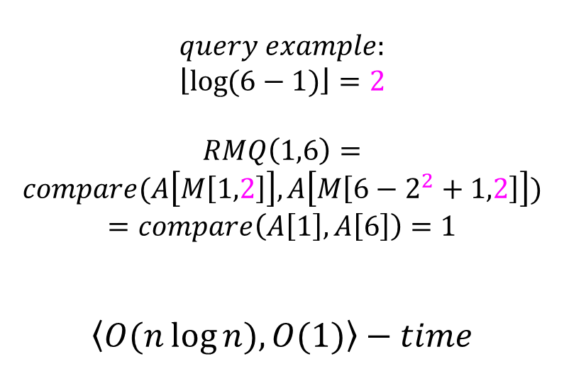
ST algorithm
Index | 1 | 2 | 3 | 4 | 5 | 6 | 7 | 8
value | 3 | 7 | 5 | 12 | 9 | 4 | 10 | 2
A
M
 | 0 | 1 | 2 | 3
1 | 1 | 1 | 1 | 8
2 | 2 | 3 | 3 | 8
3 | 3 | 3 | 6 | 8
4 | 4 | 5 | 6 | 8
5 | 5 | 6 | 8 | 8
6 | 6 | 6 | 8 | 8
7 | 7 | 8 | 8 | 8
8 | 8 | 8 | 8 | 8
$$query example:$$
$$\left\lfloor \left.\log{(6−1)}\right\rfloor \right.=2$$
$$RMQ\left(1,6\right)=$$
$$compare(A\left[M\left[1,2\right]\right],A\left[M\left[6−2^{2}+1,2\right]\right])$$
$$=compare\left(A\left[1\right],A\left[6\right]\right)=1$$
$$\left\langle O(n\log{n}),O(1)\right\rangle −time$$

Slide 15
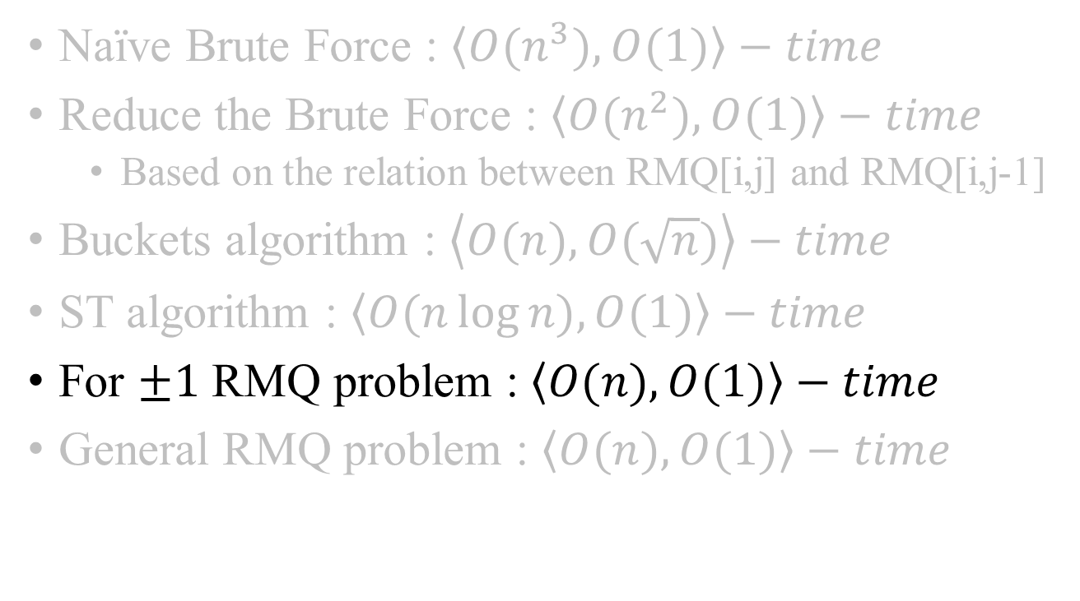
RMQ problem
Naïve Brute Force : $\left\langle O(n^{3}),O(1)\right\rangle −time$
Reduce the Brute Force : $\left\langle O(n^{2}),O(1)\right\rangle −time$
Based on the relation between RMQ[i,j] and RMQ[i,j-1]
Buckets algorithm : $\left\langle O(n),O(\sqrt{n})\right\rangle −time$
ST algorithm : $\left\langle O(n\log{n}),O(1)\right\rangle −time$
For $±1$ RMQ problem : $\left\langle O(n),O(1)\right\rangle −time$
General RMQ problem : $\left\langle O(n),O(1)\right\rangle −time$

Slide 16
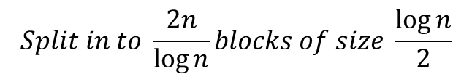
Faster RMQ problem
1 | 2 | 3 | 4 | 5 | 6 | 7 | 8 | 9 | 10 | 11 | 12 | 13 | 14 | 15 | 16
10 | 7 | 5 | 12 | 13 | 6 | 9 | 2 | 1 | 3 | 19 | 8 | 11 | 16 | 4 | 18
A
$$Split in to \frac{2n}{\log{n}}blocks of size \frac{\log{n}}{2}$$
1 | 2
10 | 7
3 | 4
5 | 12
…
…
1 | 2 | …
7 | 5 | …
1 | 2 | …
2 | 3 | …
A’
B

Slide 17
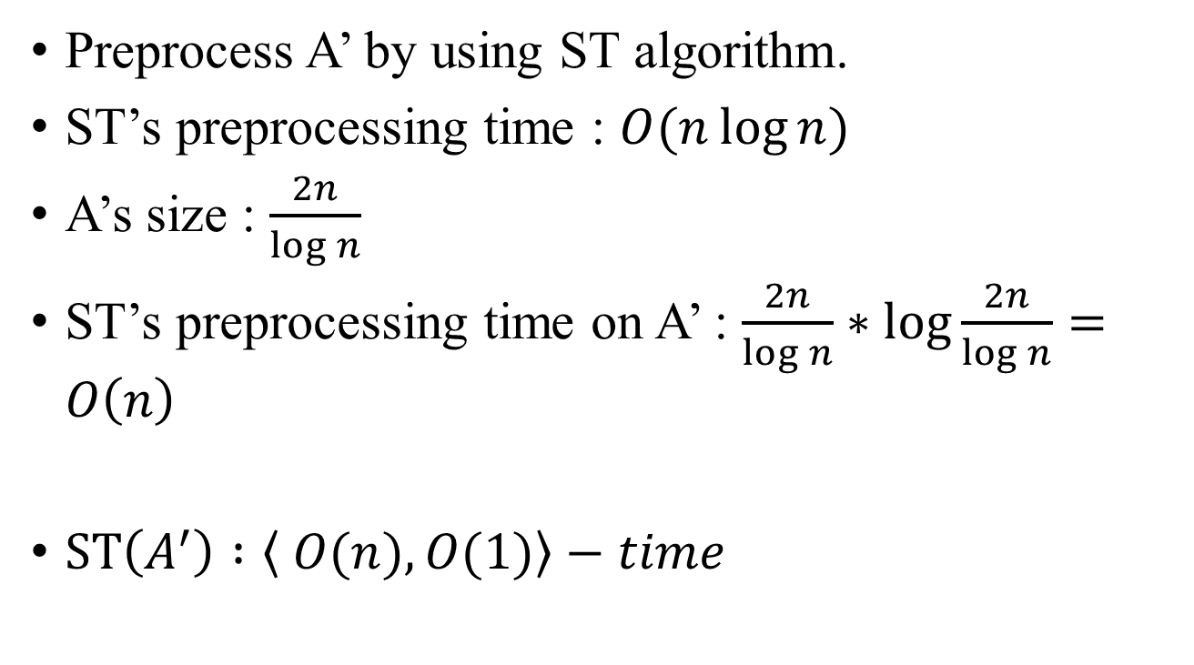
Faster RMQ problem
Preprocess A’ by using ST algorithm.
ST’s preprocessing time : $O(n\log{n})$
A’s size : $\frac{2n}{\log{n}}$
ST’s preprocessing time on A’ : $\frac{2n}{\log{n}}∗\log{\frac{2n}{\log{n}}}=O\left(n\right)$
$ST\left(A^{′}\right) :\left\langle O(n),O(1)\right\rangle −time$

Slide 18
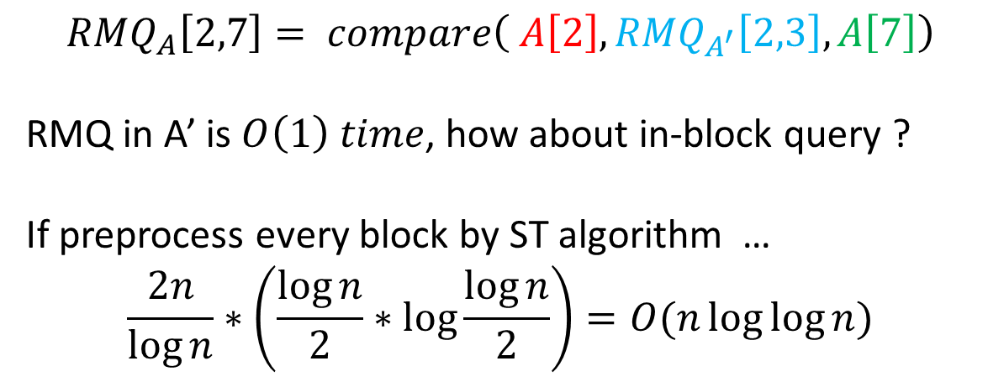
How about queries ?
1 | 2 | 3 | 4 | 5 | 6 | 7 | 8 | 9 | 10 | 11 | 12 | 13 | 14 | 15 | 16
10 | 7 | 5 | 12 | 13 | 6 | 9 | 2 | 1 | 3 | 19 | 8 | 11 | 16 | 4 | 18
A
1 | 2 | …
7 | 5 | …
1 | 2 | …
2 | 3 | …
A’
B
$${RMQ}_{A}\left[2,7\right]= compare\left( A\left[2\right], {RMQ}_{A^{′}}\left[2,3\right], A\left[7\right]\right)$$
RMQ in A’ is $O\left(1\right) time$, how about in-block query ?
If preprocess every block by ST algorithm …
$$\frac{2n}{\log{n}}∗\left(\frac{\log{n}}{2}∗\log{\frac{\log{n}}{2}}\right)=O(n\log{\log{n}})$$

Slide 19
Recall …
1
6
4
3
2
9
8
7
5
1 | 2 | 3 | 4 | 5 | 6 | 7 | 8 | 9 | 10 | 11 | 12 | 13 | 14 | 15 | 16 | 17
1 | 6 | 3 | 6 | 2 | 7 | 2 | 5 | 2 | 6 | 9 | 6 | 1 | 4 | 8 | 4 | 1
E
L
R
1 | 2 | 3 | 4 | 5 | 6 | 7 | 8 | 9 | 10 | 11 | 12 | 13 | 14 | 15 | 16 | 17
0 | 1 | 2 | 1 | 2 | 3 | 2 | 3 | 2 | 1 | 2 | 1 | 0 | 1 | 2 | 1 | 0
1 | 2 | 3 | 4 | 5 | 6 | 7 | 8 | 9
1 | 5 | 3 | 14 | 8 | 2 | 6 | 15 | 11

Slide 20
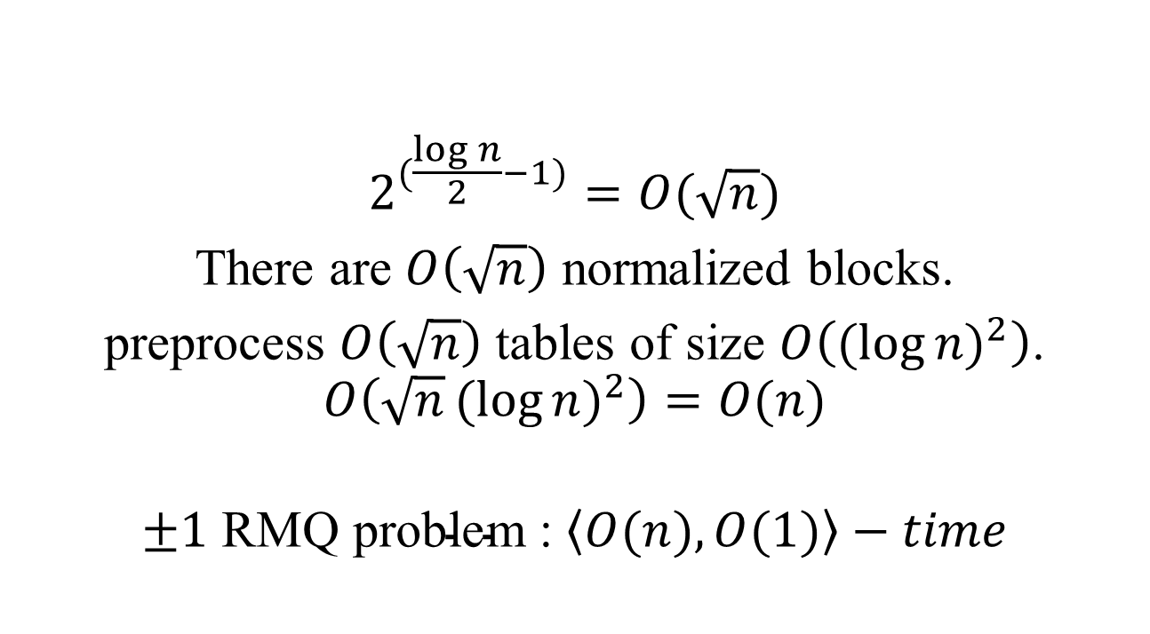
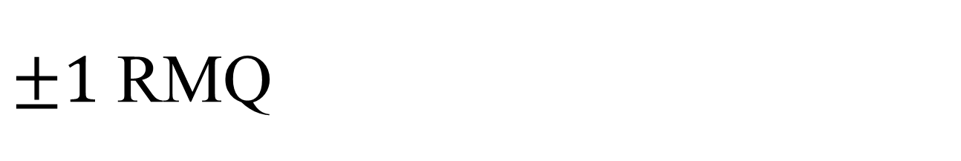
$±1$ RMQ
1 | 2 | 3 | 4 | 5 | 6 | 7 | 8 | 9 | 10 | 11 | 12 | 13 | 14 | 15 | 16
0 | 1 | 2 | 1 | 2 | 3 | 2 | 3 | 2 | 1 | 2 | 1 | 0 | 1 | 2 | 1
 | +1 | +1 | -1 | +1 | +1 | -1 | +1 | -1 | -1 | +1 | -1 | -1 | +1 | +1 | -1
$$2^{(\frac{\log{n}}{2}−1)}=O(\sqrt{n})$$
There are $O\left(\sqrt{n}\right)$ normalized blocks.
preprocess $O\left(\sqrt{n}\right)$ tables of size $O\left({(log{n})}^{2}\right)$.
$$O\left(\sqrt{n}{(log{n})}^{2}\right)=O(n)$$
$$±1 \text{RMQ} \text{problem}\text{ : }\left\langle O(n),O(1)\right\rangle −time$$

Slide 21
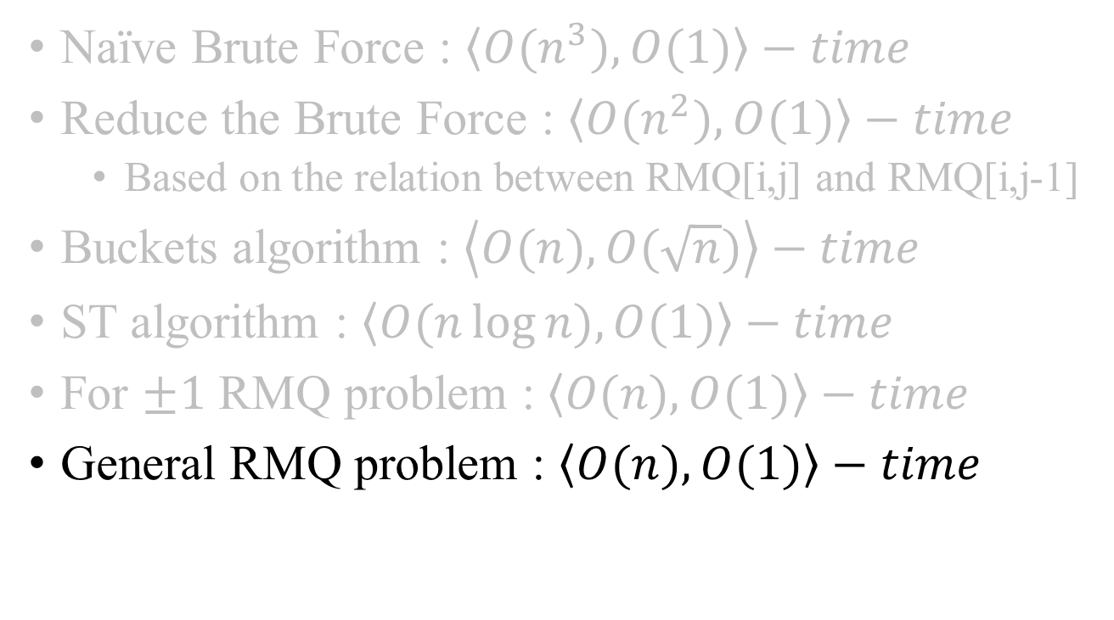
RMQ problem
Naïve Brute Force : $\left\langle O(n^{3}),O(1)\right\rangle −time$
Reduce the Brute Force : $\left\langle O(n^{2}),O(1)\right\rangle −time$
Based on the relation between RMQ[i,j] and RMQ[i,j-1]
Buckets algorithm : $\left\langle O(n),O(\sqrt{n})\right\rangle −time$
ST algorithm : $\left\langle O(n\log{n}),O(1)\right\rangle −time$
For $±1$ RMQ problem : $\left\langle O(n),O(1)\right\rangle −time$
General RMQ problem : $\left\langle O(n),O(1)\right\rangle −time$

Slide 22
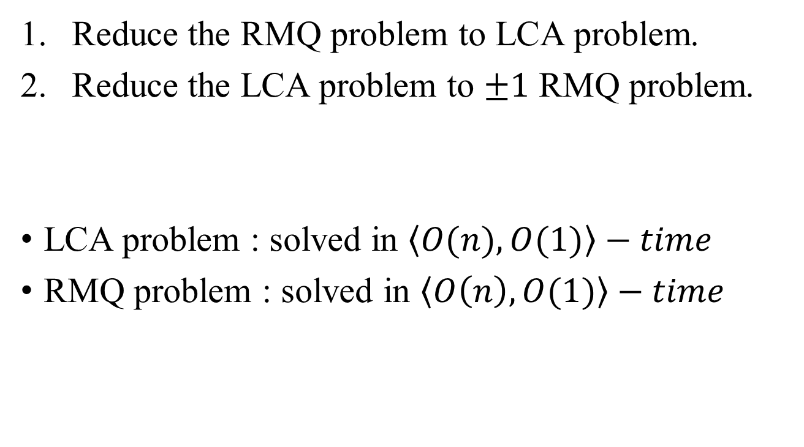
General RMQ problem
Reduce the RMQ problem to LCA problem.
Reduce the LCA problem to $±1$ RMQ problem.
LCA problem : solved in $\left\langle O(n), O(1)\right\rangle −time$
RMQ problem : solved in $\left\langle O\left(n\right),O(1)\right\rangle −time$

Slide 23
Cartesian tree
1 | 2 | 3 | 4 | 5 | 6 | 7 | 8 | 9
10 | 24 | 13 | 7 | 19 | 15 | 20 | 12 | 88
top
10

Slide 24
Cartesian tree
1 | 2 | 3 | 4 | 5 | 6 | 7 | 8 | 9
10 | 24 | 13 | 7 | 19 | 15 | 20 | 12 | 88
top
10
24

Slide 25
Cartesian tree
1 | 2 | 3 | 4 | 5 | 6 | 7 | 8 | 9
10 | 24 | 13 | 7 | 19 | 15 | 20 | 12 | 88
top
10
13
24

Slide 26
Cartesian tree
1 | 2 | 3 | 4 | 5 | 6 | 7 | 8 | 9
10 | 24 | 13 | 7 | 19 | 15 | 20 | 12 | 88
top
7
10
13
24

Slide 27
Cartesian tree
1 | 2 | 3 | 4 | 5 | 6 | 7 | 8 | 9
10 | 24 | 13 | 7 | 19 | 15 | 20 | 12 | 88
top
7
10
19
13
24

Slide 28
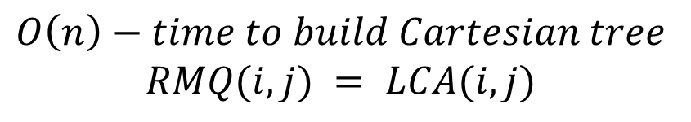
Cartesian tree
1 | 2 | 3 | 4 | 5 | 6 | 7 | 8 | 9
10 | 24 | 13 | 7 | 19 | 15 | 20 | 12 | 88
top
7
10
12
13
15
88
24
19
20
$$O\left(n\right)−time to build Cartesian tree$$
$$RMQ(i,j) = LCA(i,j)$$

Slide 29
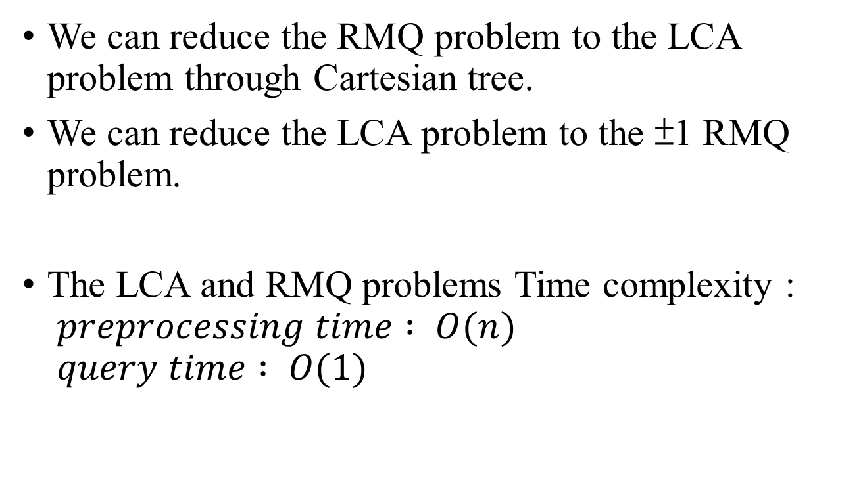
Conclusion
We can reduce the RMQ problem to the LCA problem through Cartesian tree.
We can reduce the LCA problem to the ±1 RMQ problem.
The LCA and RMQ problems Time complexity : $preprocessing time : O(n)$ $query time : O(1)$

