Slide 1
Approximation Algorithms for Combinatorial Problems
David S. Johnson
Journal of Computer and System Sciences, Vol.9, pp.256-278 (1974)
Presenter: Shiou-Zong Chiou
Date:2016/11/08

Slide 2
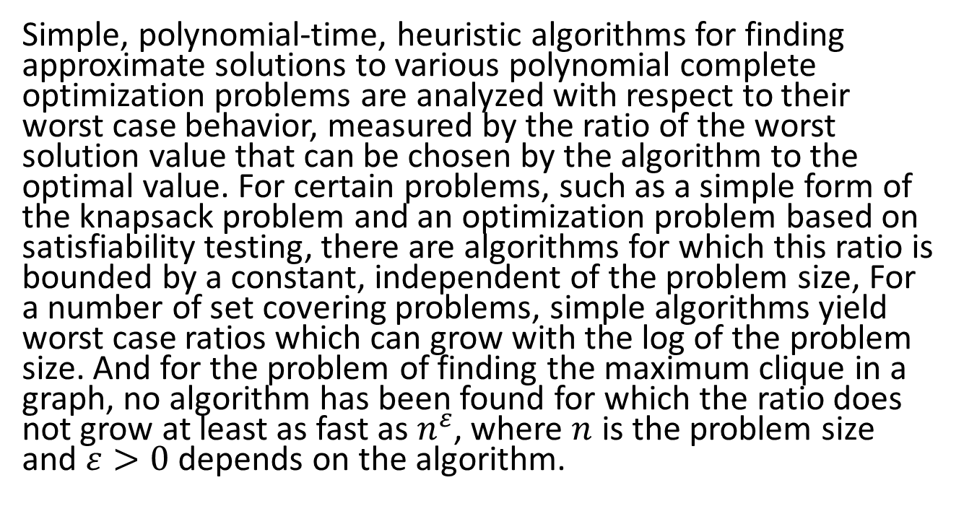
Abstract
Simple, polynomial-time, heuristic algorithms for finding approximate solutions to various polynomial complete optimization problems are analyzed with respect to their worst case behavior, measured by the ratio of the worst solution value that can be chosen by the algorithm to the optimal value. For certain problems, such as a simple form of the knapsack problem and an optimization problem based on satisfiability testing, there are algorithms for which this ratio is bounded by a constant, independent of the problem size, For a number of set covering problems, simple algorithms yield worst case ratios which can grow with the log of the problem size. And for the problem of finding the maximum clique in a graph, no algorithm has been found for which the ratio does not grow at least as fast as $n^{ε}$, where $n$ is the problem size and $ε>0$ depends on the algorithm.

Slide 3
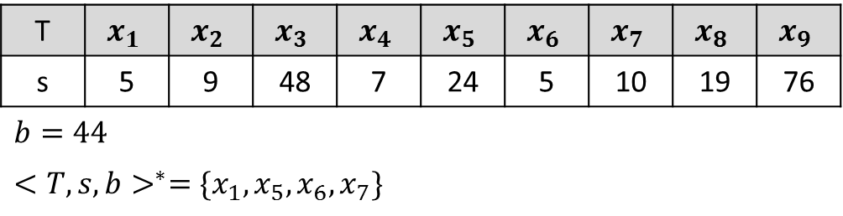

Subset-Sum
${INPUT}_{SS}=\{<T,s,b>\}$
${SOL}_{SS}\left(<T,s,b>\right)=\{T^{′}⊆T:\sum_{x∈T^{′}}{s(x)}≤b\}$
${<T,s,b>}^{∗}=MAX\left\{m\left(T^{′}\right):T^{′}⊆T and m(T′)≤b\right\}$
$m_{SS}\left(T^{′}\right)=\sum_{x∈T^{′}}{s(x)}$
T | $$x_{1}$$ | $$x_{2}$$ | $$x_{3}$$ | $$x_{4}$$ | $$x_{5}$$ | $$x_{6}$$ | $$x_{7}$$ | $$x_{8}$$ | $$x_{9}$$
s | 5 | 9 | 48 | 7 | 24 | 5 | 10 | 19 | 76
$b=44$
${<T,s,b>}^{∗}=\{x_{1},x_{5},x_{6},x_{7}\}$

Slide 4
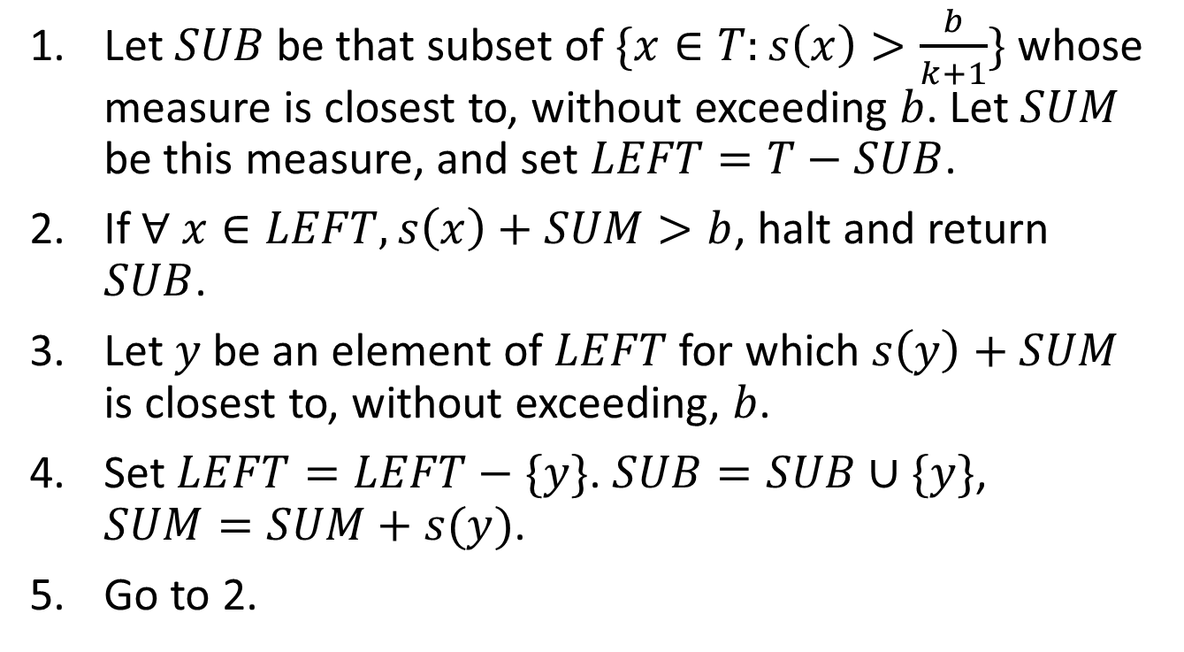
Subset-Sum
Let $SUB$ be that subset of $\{x∈T:s\left(x\right)>\frac{b}{k+1}\}$ whose measure is closest to, without exceeding $b$. Let $SUM$ be this measure, and set $LEFT=T−SUB$.
If $∀ x∈LEFT, s\left(x\right)+SUM>b$, halt and return $SUB$.
Let $y$ be an element of $LEFT$ for which $s\left(y\right)+SUM$ is closest to, without exceeding, $b$.
Set $LEFT=LEFT−\{y\}$. $SUB=SUB∪\{y\}$, $SUM=SUM+s(y)$.
Go to 2.

Slide 5
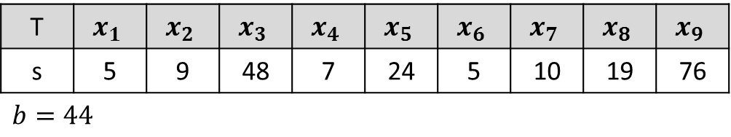

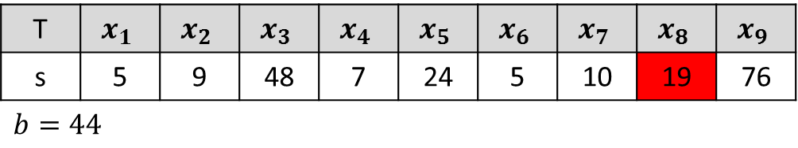
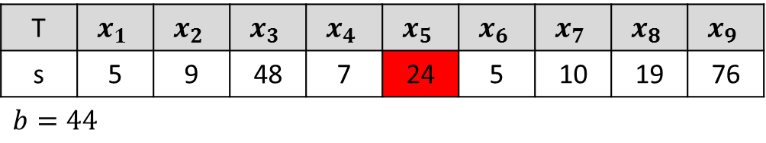
Subset-Sum
$A_{1}$：
$SUB=\{x_{5}\}$, $SUM=24$
$SUB=\{x_{5},x_{8}\}$, $SUM=43$
T | $$x_{1}$$ | $$x_{2}$$ | $$x_{3}$$ | $$x_{4}$$ | $$x_{5}$$ | $$x_{6}$$ | $$x_{7}$$ | $$x_{8}$$ | $$x_{9}$$
s | 5 | 9 | 48 | 7 | 24 | 5 | 10 | 19 | 76
$b=44$
T | $$x_{1}$$ | $$x_{2}$$ | $$x_{3}$$ | $$x_{4}$$ | $$x_{5}$$ | $$x_{6}$$ | $$x_{7}$$ | $$x_{8}$$ | $$x_{9}$$
s | 5 | 9 | 48 | 7 | 24 | 5 | 10 | 19 | 76
$b=44$
T | $$x_{1}$$ | $$x_{2}$$ | $$x_{3}$$ | $$x_{4}$$ | $$x_{5}$$ | $$x_{6}$$ | $$x_{7}$$ | $$x_{8}$$ | $$x_{9}$$
s | 5 | 9 | 48 | 7 | 24 | 5 | 10 | 19 | 76
$b=44$

Slide 6
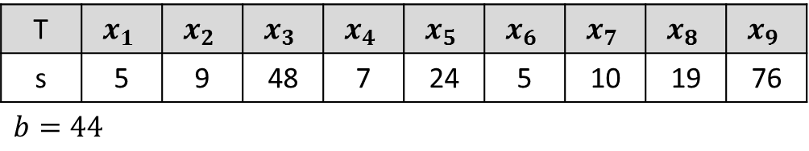
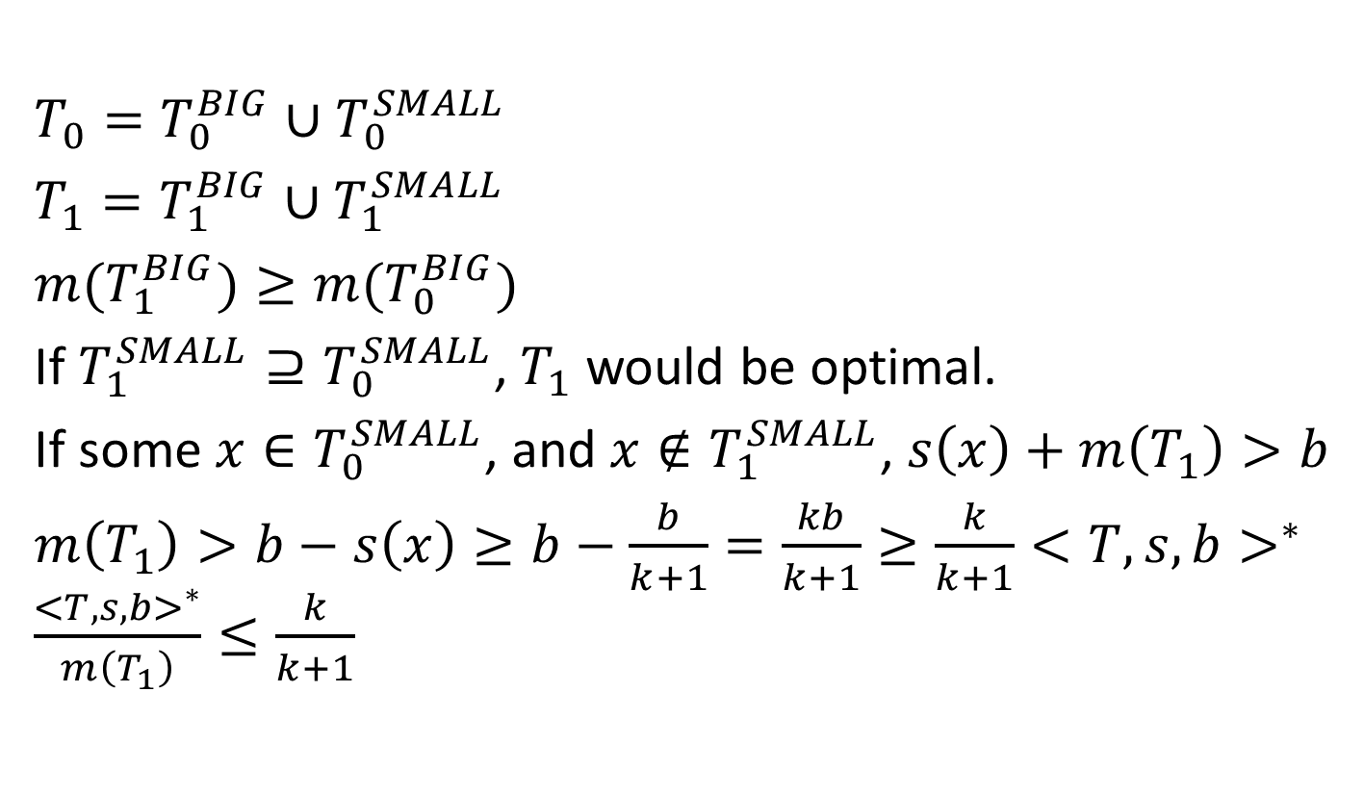
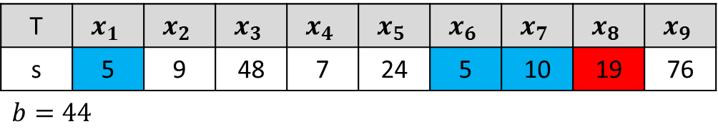
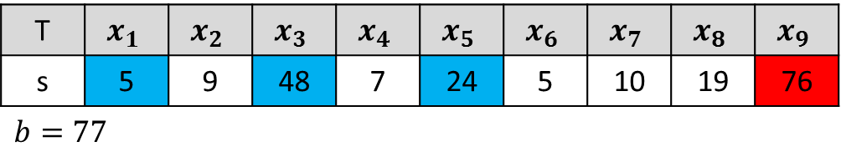
Subset-Sum
T | $$x_{1}$$ | $$x_{2}$$ | $$x_{3}$$ | $$x_{4}$$ | $$x_{5}$$ | $$x_{6}$$ | $$x_{7}$$ | $$x_{8}$$ | $$x_{9}$$
s | 5 | 9 | 48 | 7 | 24 | 5 | 10 | 19 | 76
$b=44$
T | $$x_{1}$$ | $$x_{2}$$ | $$x_{3}$$ | $$x_{4}$$ | $$x_{5}$$ | $$x_{6}$$ | $$x_{7}$$ | $$x_{8}$$ | $$x_{9}$$
s | 5 | 9 | 48 | 7 | 24 | 5 | 10 | 19 | 76
$b=77$
T | $$x_{1}$$ | $$x_{2}$$ | $$x_{3}$$ | $$x_{4}$$ | $$x_{5}$$ | $$x_{6}$$ | $$x_{7}$$ | $$x_{8}$$ | $$x_{9}$$
s | 5 | 9 | 48 | 7 | 24 | 5 | 10 | 19 | 76
$b=44$
$T_{0}=T_{0}^{BIG}∪T_{0}^{SMALL}$
$T_{1}=T_{1}^{BIG}∪T_{1}^{SMALL}$
$m(T_{1}^{BIG})≥m(T_{0}^{BIG})$
If $T_{1}^{SMALL}⊇T_{0}^{SMALL}$, $T_{1}$ would be optimal.
If some $x∈T_{0}^{SMALL}$, and $x∉T_{1}^{SMALL}$, $s\left(x\right)+m\left(T_{1}\right)>b$
$m\left(T_{1}\right)>b−s\left(x\right)≥b−\frac{b}{k+1}=\frac{kb}{k+1}≥\frac{k}{k+1}{<T,s,b>}^{∗}$ $\frac{{<T,s,b>}^{∗}}{m\left(T_{1}\right)}≤\frac{k}{k+1}$

Slide 7
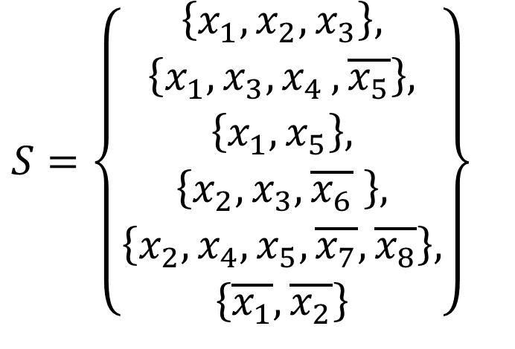
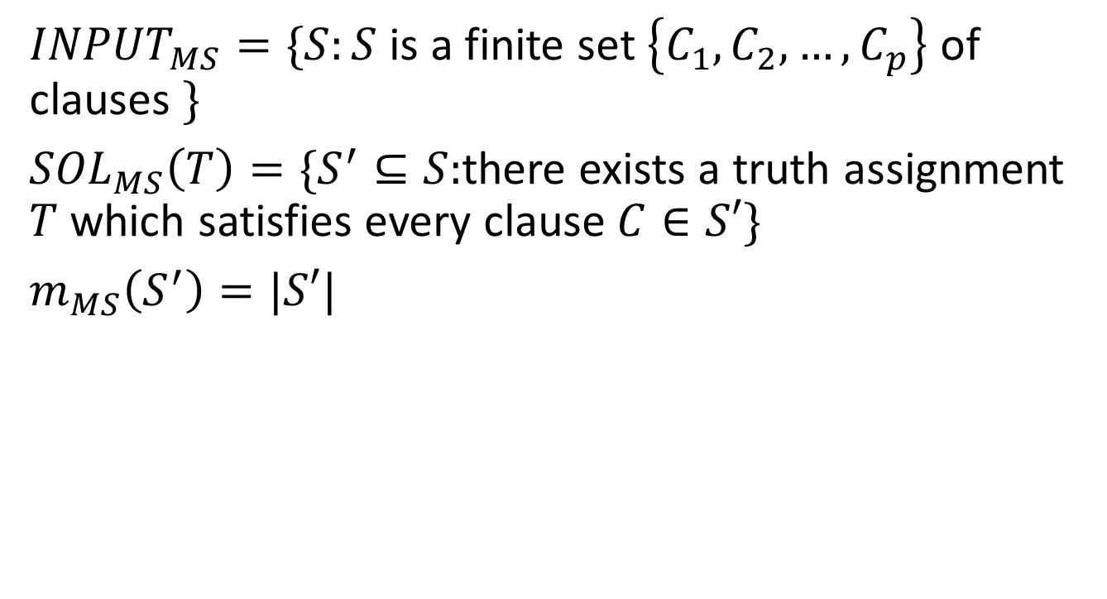
Maximum Satisfiability
${INPUT}_{MS}=\{S:S$ is a finite set $\left\{C_{1},C_{2},…,C_{p}\right\}$ of clauses $\}$
${SOL}_{MS}\left(T\right)=\{S^{′}⊆S:$there exists a truth assignment $T$ which satisfies every clause $C∈S′\}$
$m_{MS}\left(S^{′}\right)=|S′|$
$S=\left\{\begin{aligned}\left\{x_{1},x_{2},x_{3}\right\}, \\ \left\{x_{1},x_{3}{,x}_{4},\overline{x_{5}}\right\}, \\ \left\{x_{1},x_{5}\right\}, \\ \left\{x_{2},x_{3},\overline{x_{6}} \right\}, \\ \left\{x_{2},x_{4},x_{5},\overline{x_{7}},\overline{x_{8}}\right\}, \\ \left\{\overline{x_{1}},\overline{x_{2}}\right\}\end{aligned}\right\}$

Slide 8
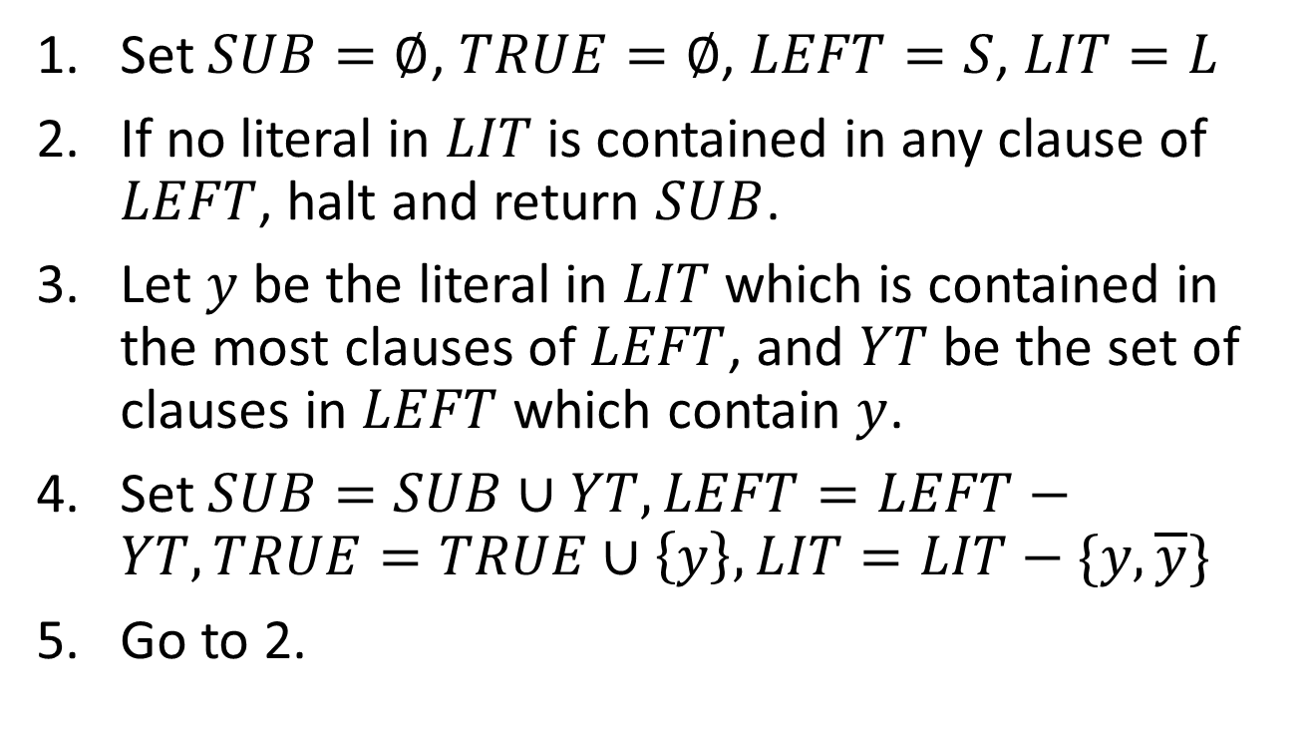
Maximum Satisfiability
Set $SUB=∅$, $TRUE=∅$, $LEFT=S$, $LIT=L$
If no literal in $LIT$ is contained in any clause of $LEFT$, halt and return $SUB$.
Let $y$ be the literal in $LIT$ which is contained in the most clauses of $LEFT$, and $YT$ be the set of clauses in $LEFT$ which contain $y$.
Set $SUB=SUB∪YT, LEFT=LEFT−YT, TRUE=TRUE∪\left\{y\right\}, LIT=LIT−\{y,\overline{y}\}$
Go to 2.

Slide 9



Maximum Satisfiability
$S=\left\{\begin{aligned}\left\{x_{1},x_{2},x_{3}\right\}, \\ \left\{x_{1},x_{3}{,x}_{4},\overline{x_{5}}\right\}, \\ \left\{x_{1},x_{5}\right\}, \\ \left\{x_{2},x_{3},\overline{x_{6}} \right\}, \\ \left\{x_{2},x_{4},x_{5},\overline{x_{7}},\overline{x_{8}}\right\}, \\ \left\{\overline{x_{1}},\overline{x_{2}}\right\}\end{aligned}\right\}$
$S=\left\{\begin{aligned}\left\{x_{1},x_{2},x_{3}\right\}, \\ \left\{x_{1},x_{3}{,x}_{4},\overline{x_{5}}\right\}, \\ \left\{x_{1},x_{5}\right\}, \\ \left\{x_{2},x_{3},\overline{x_{6}} \right\}, \\ \left\{x_{2},x_{4},x_{5},\overline{x_{7}},\overline{x_{8}}\right\}, \\ \left\{\overline{x_{1}},\overline{x_{2}}\right\}\end{aligned}\right\}$
$S=\left\{\begin{aligned}\left\{x_{1},x_{2},x_{3}\right\}, \\ \left\{x_{1},x_{3}{,x}_{4},\overline{x_{5}}\right\}, \\ \left\{x_{1},x_{5}\right\}, \\ \left\{x_{2},x_{3},\overline{x_{6}} \right\}, \\ \left\{x_{2},x_{4},x_{5},\overline{x_{7}},\overline{x_{8}}\right\}, \\ \left\{\overline{x_{1}},\overline{x_{2}}\right\}\end{aligned}\right\}$

Slide 10
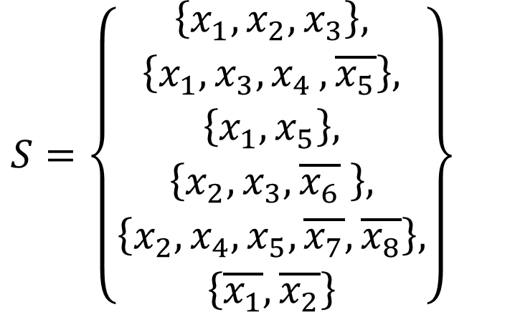

Maximum Satisfiability
$\left|SUB\right|≥k∙\left|LEFT\right|$
$S^{∗}≤\left|S\right|=\left|SUB\right|+|LEFT|≤\frac{k+1}{k}∙|SUB|$
$\frac{S^{∗}}{|SUB|}≤\frac{k+1}{k}$
$S=\left\{\begin{aligned}\left\{x_{1},x_{2},x_{3}\right\}, \\ \left\{x_{1},x_{3}{,x}_{4},\overline{x_{5}}\right\}, \\ \left\{x_{1},x_{5}\right\}, \\ \left\{x_{2},x_{3},\overline{x_{6}} \right\}, \\ \left\{x_{2},x_{4},x_{5},\overline{x_{7}},\overline{x_{8}}\right\}, \\ \left\{\overline{x_{1}},\overline{x_{2}}\right\}\end{aligned}\right\}$

Slide 11
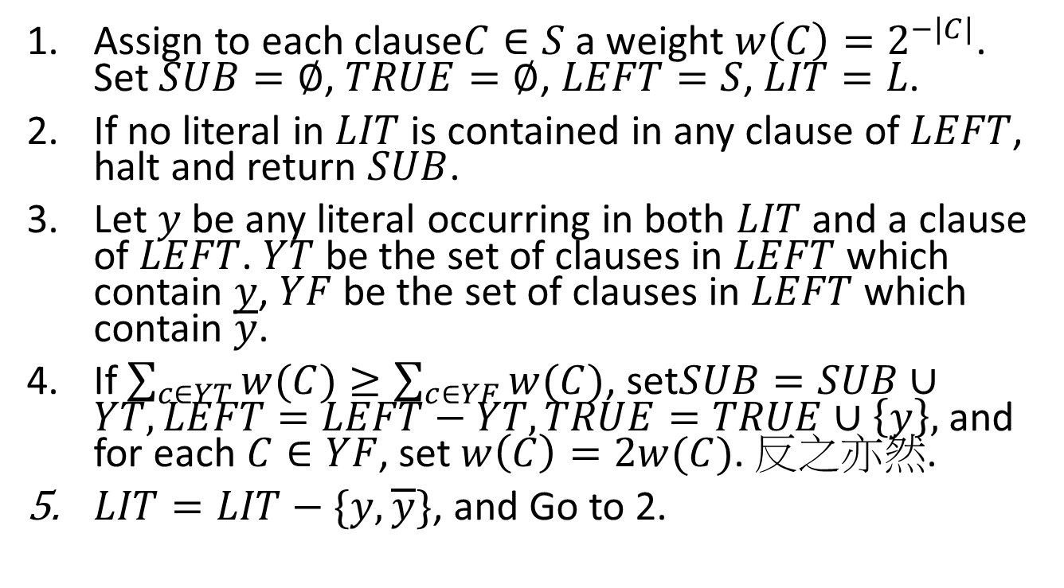
Maximum Satisfiability
Assign to each clause$C∈S$ a weight $w\left(C\right)=2^{−|C|}$. Set $SUB=∅$, $TRUE=∅$, $LEFT=S$, $LIT=L$.
If no literal in $LIT$ is contained in any clause of $LEFT$, halt and return $SUB$.
Let $y$ be any literal occurring in both $LIT$ and a clause of $LEFT$. $YT$ be the set of clauses in $LEFT$ which contain $y$, $YF$ be the set of clauses in $LEFT$ which contain $\overline{y}$.
If $\sum_{c∈YT}{w(C)}≥\sum_{c∈YF}{w(C)}$, set$SUB=SUB∪YT, LEFT=LEFT−YT, TRUE=TRUE∪\left\{y\right\},$ and for each $C∈YF$, set $w\left(C\right)=2w(C)$. 反之亦然.
$LIT=LIT−\{y,\overline{y}\}$, and Go to 2.

Slide 12
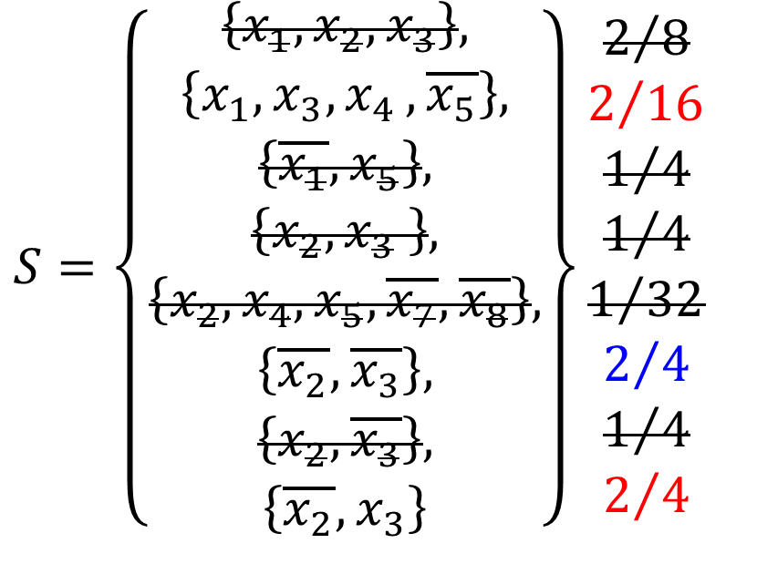
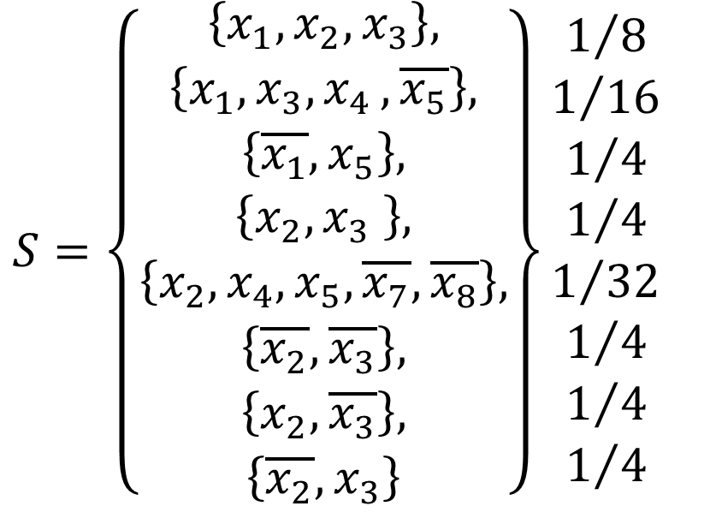
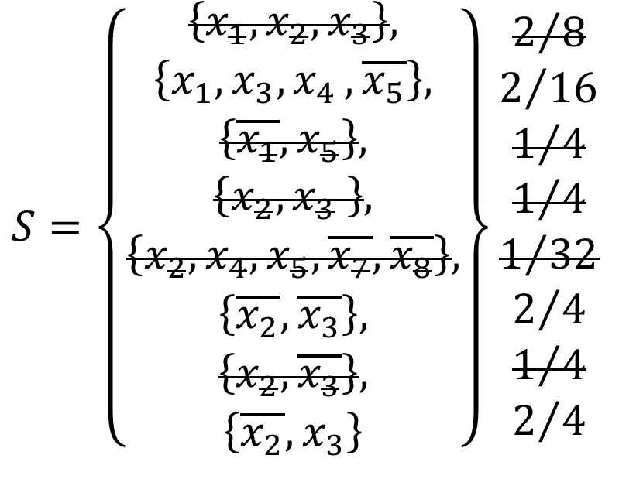

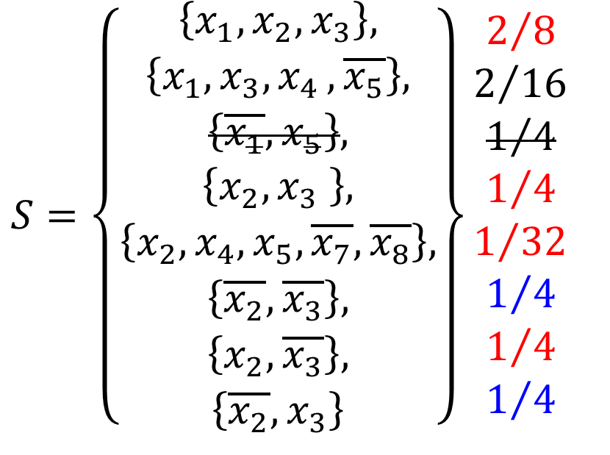
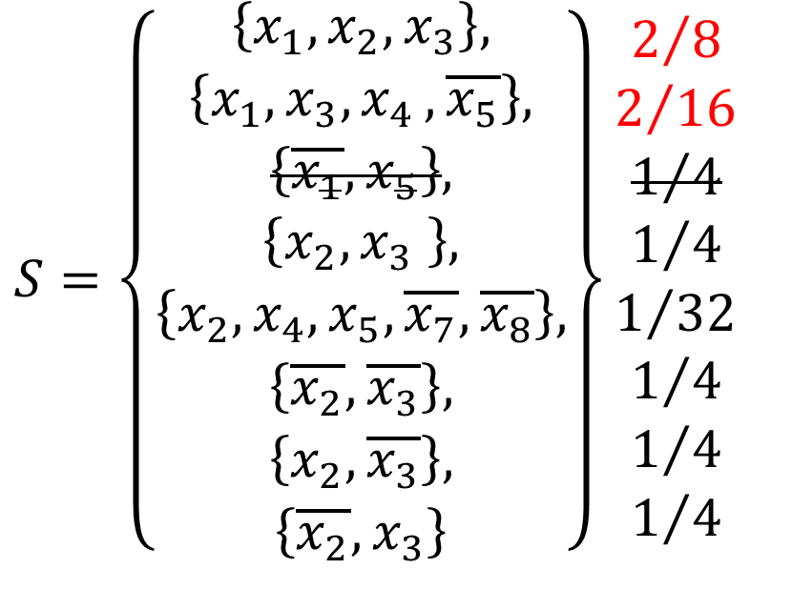
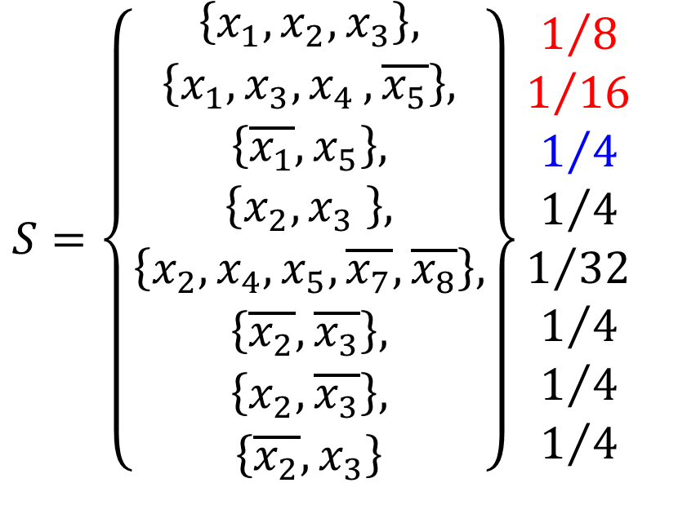
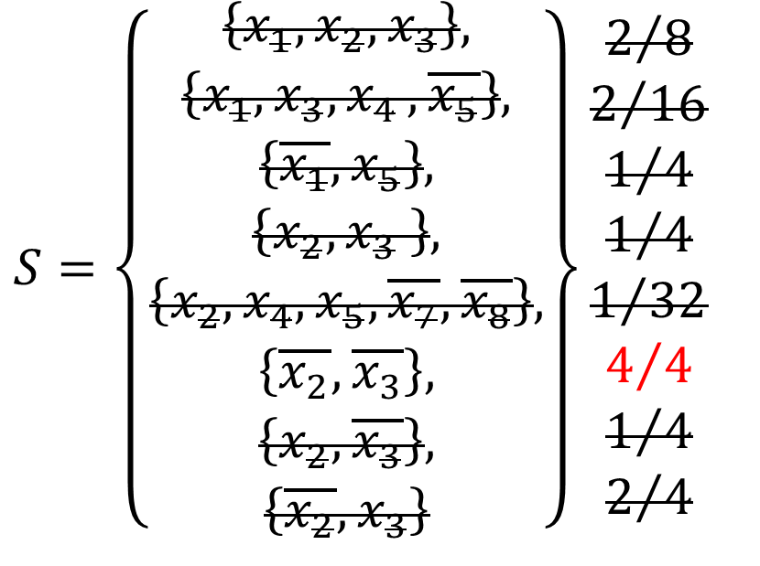
Maximum Satisfiability
Each $w\left(C\right)≤2^{−k}$.
Initially, the total weight of all the clauses in $LEFT$ cannot exceed $\frac{|S|}{2^{k}}$.
$|LEFT|≤\frac{|S|}{2^{k}}$
$\left|SUB\right|≥\left|S\right|(1−\frac{1}{2^{k}})$
$\frac{S^{∗}}{|SUB|}≤\frac{|S|}{|SUB|}≤\frac{2^{k}}{2^{k}−1}$
$S=\left\{\begin{aligned}\left\{x_{1},x_{2},x_{3}\right\}, \\ \left\{x_{1},x_{3}{,x}_{4},\overline{x_{5}}\right\}, \\ \left\{\overline{x_{1}},x_{5}\right\}, \\ \left\{x_{2},x_{3} \right\}, \\ \left\{x_{2},x_{4},x_{5},\overline{x_{7}},\overline{x_{8}}\right\}, \\ \left\{\overline{x_{2}},\overline{x_{3}}\right\}, \\ \left\{x_{2},\overline{x_{3}}\right\}, \\ \left\{\overline{x_{2}},x_{3}\right\}\end{aligned}\right\}\begin{matrix}2/8 \\ 2/{16} \\ \begin{aligned}1/4 \\ 1/4 \\ 1/{32} \\ 2/4 \\ 1/4 \\ 2/4\end{aligned}\end{matrix}$
$S=\left\{\begin{aligned}\left\{x_{1},x_{2},x_{3}\right\}, \\ \left\{x_{1},x_{3}{,x}_{4},\overline{x_{5}}\right\}, \\ \left\{\overline{x_{1}},x_{5}\right\}, \\ \left\{x_{2},x_{3} \right\}, \\ \left\{x_{2},x_{4},x_{5},\overline{x_{7}},\overline{x_{8}}\right\}, \\ \left\{\overline{x_{2}},\overline{x_{3}}\right\}, \\ \left\{x_{2},\overline{x_{3}}\right\}, \\ \left\{\overline{x_{2}},x_{3}\right\}\end{aligned}\right\}\begin{matrix}1/8 \\ 1/{16} \\ \begin{aligned}1/4 \\ 1/4 \\ 1/{32} \\ 1/4 \\ 1/4 \\ 1/4\end{aligned}\end{matrix}$
$S=\left\{\begin{aligned}\left\{x_{1},x_{2},x_{3}\right\}, \\ \left\{x_{1},x_{3}{,x}_{4},\overline{x_{5}}\right\}, \\ \left\{\overline{x_{1}},x_{5}\right\}, \\ \left\{x_{2},x_{3} \right\}, \\ \left\{x_{2},x_{4},x_{5},\overline{x_{7}},\overline{x_{8}}\right\}, \\ \left\{\overline{x_{2}},\overline{x_{3}}\right\}, \\ \left\{x_{2},\overline{x_{3}}\right\}, \\ \left\{\overline{x_{2}},x_{3}\right\}\end{aligned}\right\}\begin{matrix}1/8 \\ 1/{16} \\ \begin{aligned}1/4 \\ 1/4 \\ 1/{32} \\ 1/4 \\ 1/4 \\ 1/4\end{aligned}\end{matrix}$
$S=\left\{\begin{aligned}\left\{x_{1},x_{2},x_{3}\right\}, \\ \left\{x_{1},x_{3}{,x}_{4},\overline{x_{5}}\right\}, \\ \left\{\overline{x_{1}},x_{5}\right\}, \\ \left\{x_{2},x_{3} \right\}, \\ \left\{x_{2},x_{4},x_{5},\overline{x_{7}},\overline{x_{8}}\right\}, \\ \left\{\overline{x_{2}},\overline{x_{3}}\right\}, \\ \left\{x_{2},\overline{x_{3}}\right\}, \\ \left\{\overline{x_{2}},x_{3}\right\}\end{aligned}\right\}\begin{matrix}2/8 \\ 2/{16} \\ \begin{aligned}1/4 \\ 1/4 \\ 1/{32} \\ 1/4 \\ 1/4 \\ 1/4\end{aligned}\end{matrix}$
$S=\left\{\begin{aligned}\left\{x_{1},x_{2},x_{3}\right\}, \\ \left\{x_{1},x_{3}{,x}_{4},\overline{x_{5}}\right\}, \\ \left\{\overline{x_{1}},x_{5}\right\}, \\ \left\{x_{2},x_{3} \right\}, \\ \left\{x_{2},x_{4},x_{5},\overline{x_{7}},\overline{x_{8}}\right\}, \\ \left\{\overline{x_{2}},\overline{x_{3}}\right\}, \\ \left\{x_{2},\overline{x_{3}}\right\}, \\ \left\{\overline{x_{2}},x_{3}\right\}\end{aligned}\right\}\begin{matrix}2/8 \\ 2/{16} \\ \begin{aligned}1/4 \\ 1/4 \\ 1/{32} \\ 1/4 \\ 1/4 \\ 1/4\end{aligned}\end{matrix}$
$S=\left\{\begin{aligned}\left\{x_{1},x_{2},x_{3}\right\}, \\ \left\{x_{1},x_{3}{,x}_{4},\overline{x_{5}}\right\}, \\ \left\{\overline{x_{1}},x_{5}\right\}, \\ \left\{x_{2},x_{3} \right\}, \\ \left\{x_{2},x_{4},x_{5},\overline{x_{7}},\overline{x_{8}}\right\}, \\ \left\{\overline{x_{2}},\overline{x_{3}}\right\}, \\ \left\{x_{2},\overline{x_{3}}\right\}, \\ \left\{\overline{x_{2}},x_{3}\right\}\end{aligned}\right\}\begin{matrix}2/8 \\ 2/{16} \\ \begin{aligned}1/4 \\ 1/4 \\ 1/{32} \\ 2/4 \\ 1/4 \\ 2/4\end{aligned}\end{matrix}$
$S=\left\{\begin{aligned}\left\{x_{1},x_{2},x_{3}\right\}, \\ \left\{x_{1},x_{3}{,x}_{4},\overline{x_{5}}\right\}, \\ \left\{\overline{x_{1}},x_{5}\right\}, \\ \left\{x_{2},x_{3} \right\}, \\ \left\{x_{2},x_{4},x_{5},\overline{x_{7}},\overline{x_{8}}\right\}, \\ \left\{\overline{x_{2}},\overline{x_{3}}\right\}, \\ \left\{x_{2},\overline{x_{3}}\right\}, \\ \left\{\overline{x_{2}},x_{3}\right\}\end{aligned}\right\}\begin{matrix}2/8 \\ 2/{16} \\ \begin{aligned}1/4 \\ 1/4 \\ 1/{32} \\ 4/4 \\ 1/4 \\ 2/4\end{aligned}\end{matrix}$

Slide 13
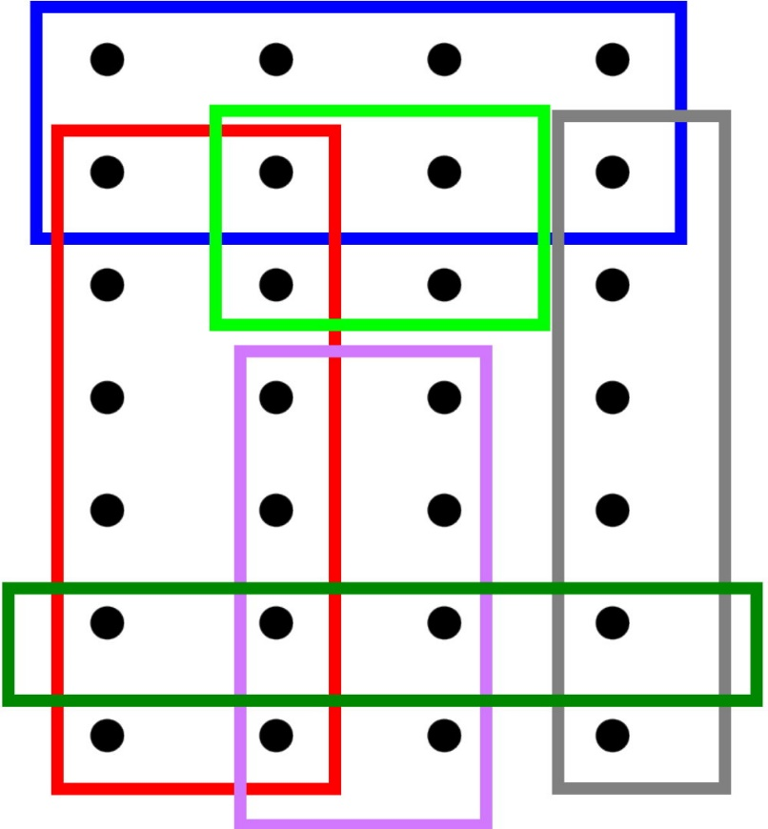

Set Covering I
${INPUT}_{SC}=\{F:F$ is a finite family $\{S_{1},S_{2},…,S_{p}\}$ of finite sets$\}$
${SOL}_{SC}\left(F\right)=\{F^{′}⊆F:\bigcup_{S∈F^{′}}{S}=\bigcup_{S∈F}{S}\}$
$m_{SC}\left(F^{′}\right)=|F^{′}|$

Slide 14
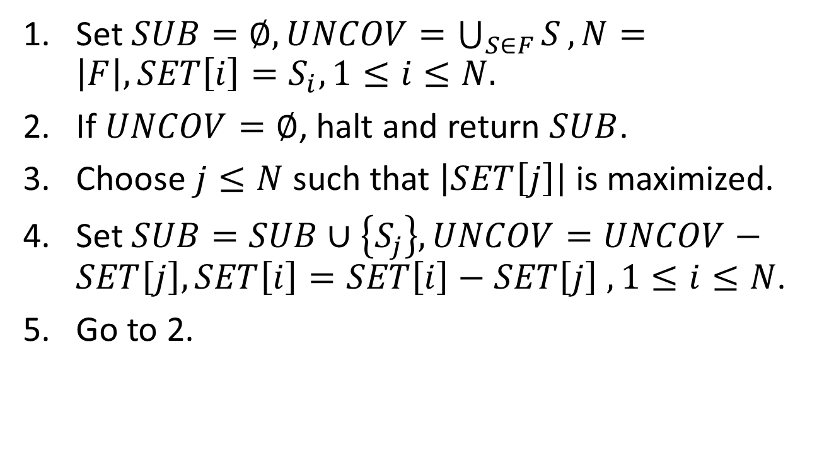
Set Covering I
Set $SUB=∅, UNCOV=\bigcup_{S∈F}{S}, N=\left|F\right|, SET\left[i\right]=S_{i}, 1≤i≤N.$
If $UNCOV=∅$, halt and return $SUB$.
Choose $j≤N$ such that $\left|SET\left[j\right]\right|$ is maximized.
Set $SUB=SUB∪\left\{S_{j}\right\}, UNCOV=UNCOV−SET\left[j\right], SET\left[i\right]=SET\left[i\right]−SET\left[j\right] ,1≤i≤N$.
Go to 2.

Slide 15
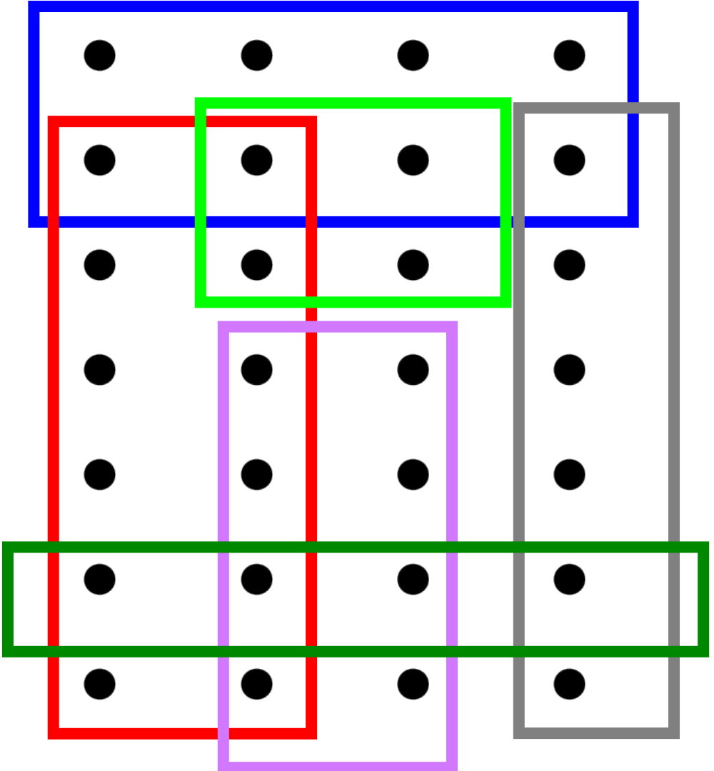
Set Covering I

Slide 16
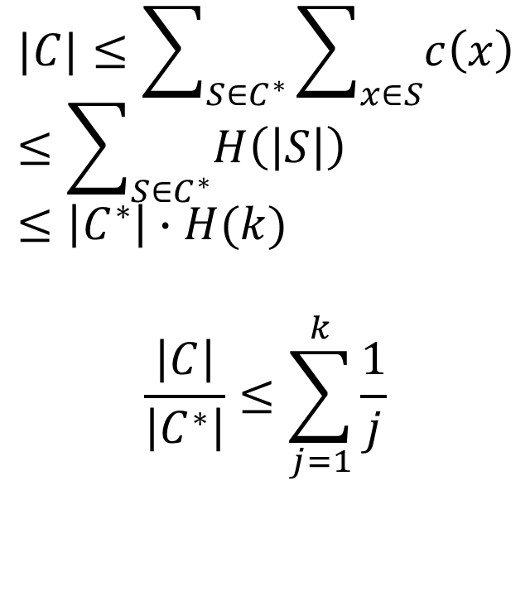

Set Covering I
$$\frac{1}{6}$$
$$|C|≤\sum_{S∈C^{∗}}{\sum_{x∈S}{c\left(x\right)}}≤\sum_{S∈C^{∗}}{H\left(\left|S\right|\right)}≤\left|C^{∗}\right|∙H(k)$$
$$\frac{\left|C\right|}{\left|C^{∗}\right|}≤\sum_{j=1}^{k}{\frac{1}{j}}$$
$$\frac{1}{1}$$
$$\frac{1}{12}$$
$$\frac{1}{5}$$
$$\frac{1}{4}$$

Slide 17

Set Covering II
${INPUT}_{EC}=\{F:F$ is a finite family $\{S_{1},S_{2},…,S_{p}\}$ of finite sets$\}$
${SOL}_{EC}\left(F\right)=\{F^{′}⊆F:\bigcup_{S∈F^{′}}{S}=\bigcup_{S∈F}{S}\}$
$m_{EC}\left(F^{′}\right)=|S|$

Slide 18
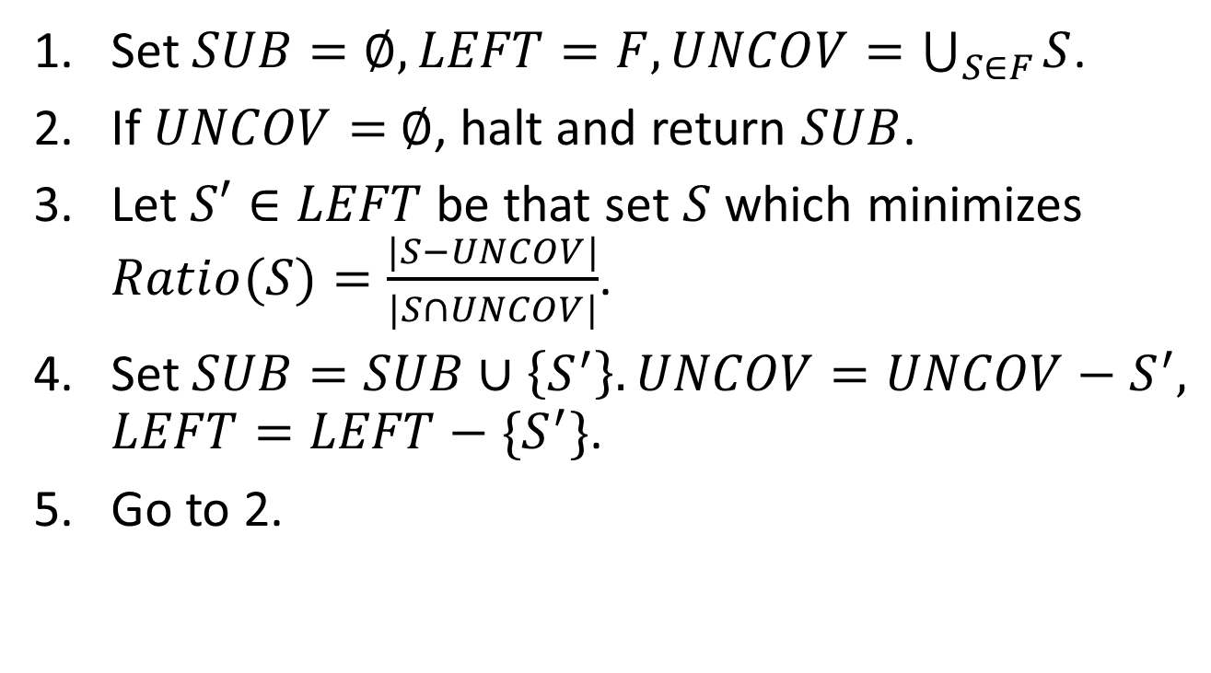
Set Covering II
Set $SUB=∅, LEFT=F, UNCOV=\bigcup_{S∈F}{S}$.
If $UNCOV=$ $∅$, halt and return $SUB$.
Let $S′∈LEFT$ be that set $S$ which minimizes $Ratio(S)=\frac{|S−UNCOV|}{|S∩UNCOV|}$.
Set $SUB=SUB∪\left\{S^{′}\right\}. UNCOV=UNCOV−S^{′},$ $LEFT=LEFT−\{S^{′}\}$.
Go to 2.

Slide 19




Set Covering II
$$\frac{3}{5}$$
$$\frac{2}{2}$$
$$\frac{3}{1}$$
$$\frac{4}{4}$$
$$\frac{4}{4}$$
$$\frac{2}{2}$$
$$\frac{3}{1}$$

Slide 20
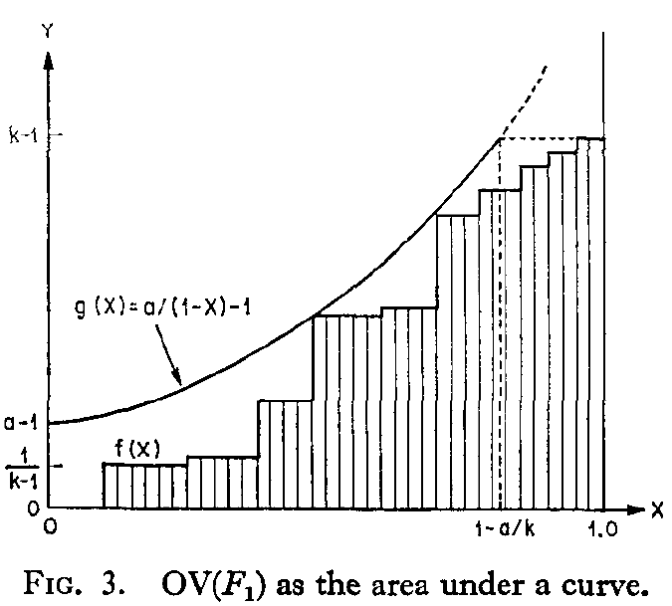
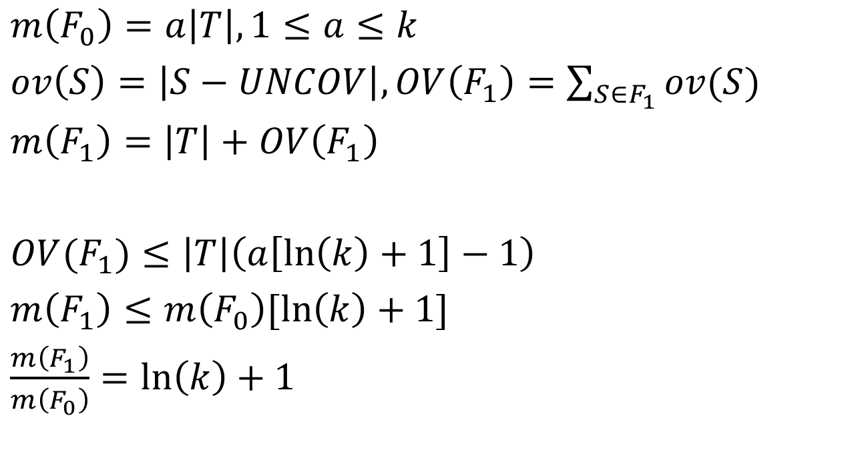
Set Covering II
$m\left(F_{0}\right)=a\left|T\right|, 1≤a≤k$
$ov\left(S\right)=\left|S−UNCOV\right|, OV\left(F_{1}\right)=\sum_{S∈F_{1}}{ov(S)}$
$m\left(F_{1}\right)=\left|T\right|+OV\left(F_{1}\right)$
$OV(F_{1})≤\left|T\right|\left(a\left[\ln\left(k\right)+1\right]−1\right)$
$m\left(F_{1}\right)≤m\left(F_{0}\right)[\ln\left(k\right)+1]$
$\frac{m\left(F_{1}\right)}{m\left(F_{0}\right)}=\ln\left(k\right)+1$
X軸為已經COVER的元素比例
Y軸為當下選的Ratio(S‘)

Slide 21

Graph Coloring
${INPUT}_{GC}=\{G=\left(V,E\right):G$ is a finite undirected graph with nodes $V$ and edge $E\}$.
${SOL}_{GC}=\{c:V→\left\{1,2,…,\left|V\right|\right\}:$ if there is an edge between nodes $x$ and $y$, $c(x)≠c(y)\}$.
$m_{GC}\left(c\right)=|z:z=c\left(x\right),$ for some $x∈V\}|$.

Slide 22
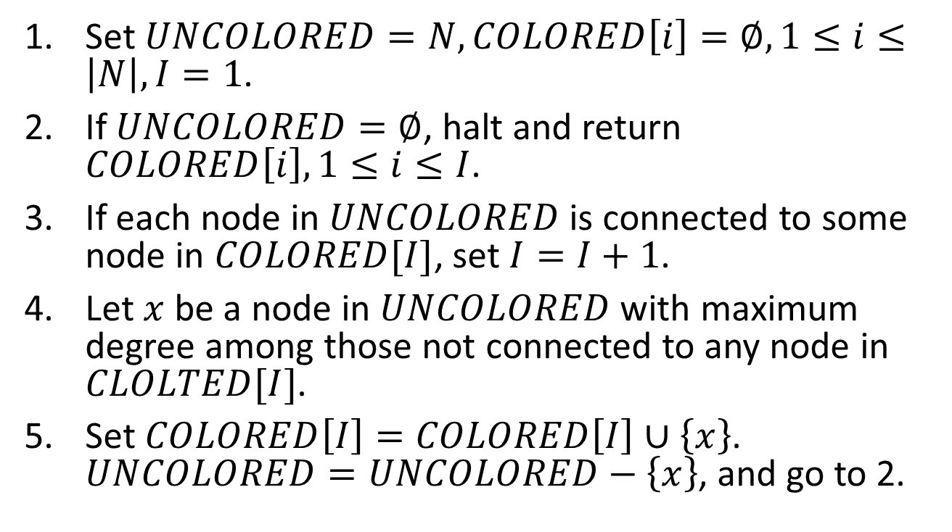
Graph Coloring
Set $UNCOLORED=N, COLORED\left[i\right]=∅, 1≤i≤\left|N\right|, I=1$.
If $UNCOLORED=∅$, halt and return $COLORED\left[i\right], 1≤i≤I$.
If each node in $UNCOLORED$ is connected to some node in $COLORED[I]$, set $I=I+1$.
Let $x$ be a node in $UNCOLORED$ with maximum degree among those not connected to any node in $CLOLTED[I]$.
Set $COLORED\left[I\right]=COLORED\left[I\right]∪\left\{x\right\}$. $UNCOLORED=UNCOLORED−\left\{x\right\}$, and go to 2.

Slide 23
Graph Coloring

Slide 24

Graph Coloring
Let $POSS$ be that subset of $UNCOLORED$ made up of all the points not connected to any member of $COLORED[I]$. Let $x$ be the node in $POSS$ connected to the fewest other nodes in $POSS$.

Slide 25
Graph Coloring

Slide 26
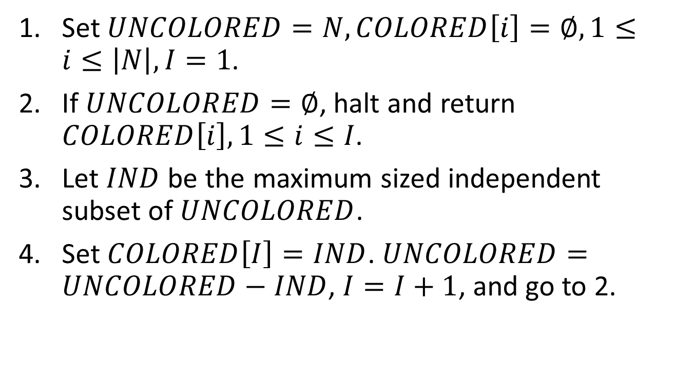
Graph Coloring
Set $UNCOLORED=N, COLORED\left[i\right]=∅, 1≤i≤\left|N\right|, I=1$.
If $UNCOLORED=∅$, halt and return $COLORED\left[i\right], 1≤i≤I$.
Let $IND$ be the maximum sized independent subset of $UNCOLORED$.
Set $COLORED\left[I\right]=IND$. $UNCOLORED=UNCOLORED−IND$, $I=I+1$, and go to 2.

Slide 27
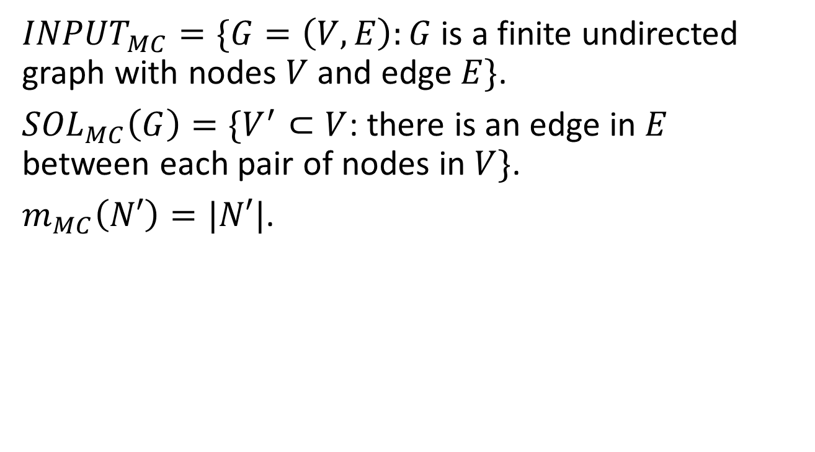
Maximum Clique
${INPUT}_{MC}=\{G=\left(V,E\right):G$ is a finite undirected graph with nodes $V$ and edge $E\}$.
${SOL}_{MC}\left(G\right)=\{V^{′}⊂V$: there is an edge in $E$ between each pair of nodes in $V\}$.
$m_{MC}\left(N′\right)=|N′|$.

Slide 28
Maximum Clique

Slide 29
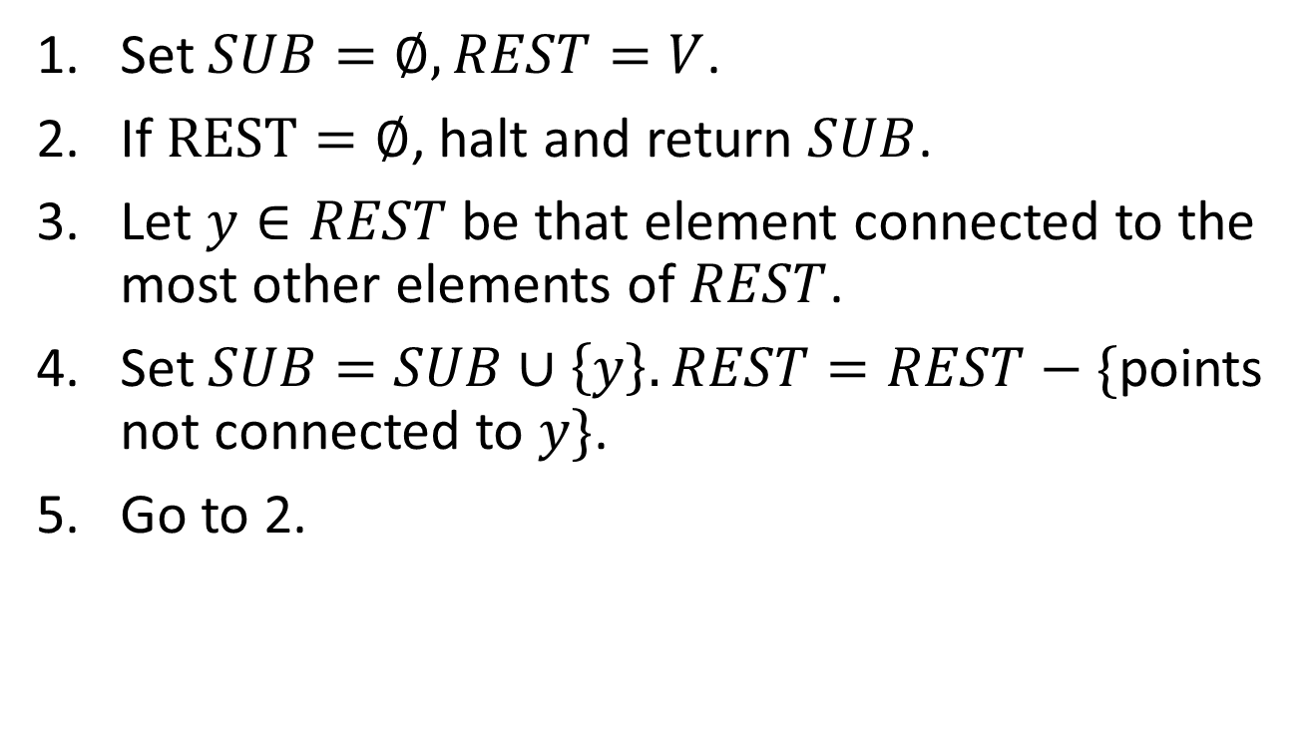
Maximum Clique
Set $SUB=∅, REST=V$.
If $REST=∅$, halt and return $SUB$.
Let $y∈REST$ be that element connected to the most other elements of $REST$.
Set $SUB=SUB∪\left\{y\right\}. REST=REST−\{$points not connected to $y\}$.
Go to 2.

Slide 30
Maximum Clique

Slide 31
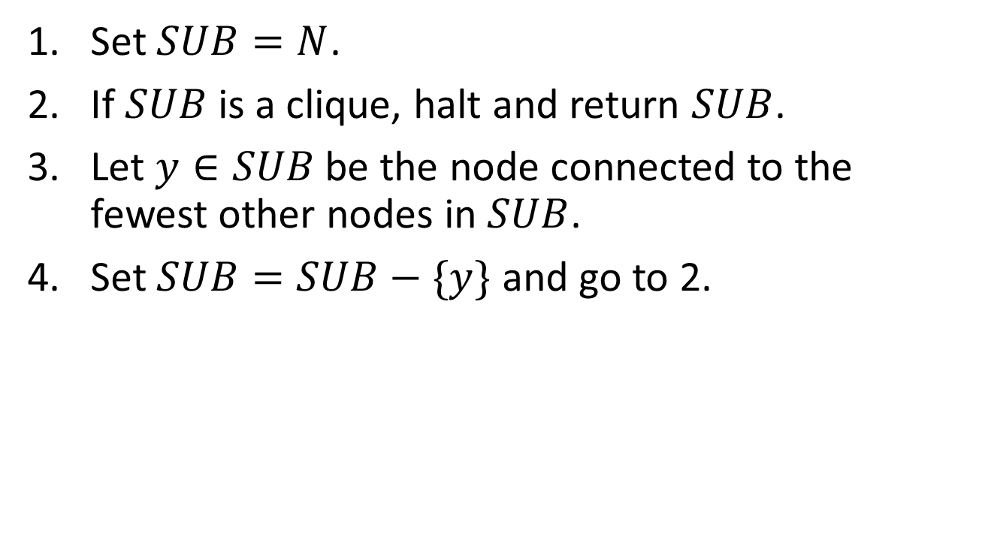
Maximum Clique
Set $SUB=N$.
If $SUB$ is a clique, halt and return $SUB$.
Let $y∈SUB$ be the node connected to the fewest other nodes in $SUB$.
Set $SUB=SUB−\{y\}$ and go to 2.

Slide 32
Maximum Clique

