Slide 1
Quadratic-time Algorithm for a String Constrained LCS Problem
Sebastian Deorowicz
Information Processing Letters Vol. 112, 2012, 423-426
Silesian University of Technology, Institute of Informatics, Akademicka 16, Gliwice, Poland
Presenter：Siang-Huai Hung
Date：2016/11/8

Slide 2
Abstract
The problem of finding a longest common subsequence of two main sequences with some constraint that must be a substring of the result (STR-IC-LCS) was formulated recently. It is a variant of the constrained longest common subsequence problem. As the known algorithms for the STR-IC-LCS problem are cubic-time, the presented quadratic-time algorithm is significantly faster.

Slide 3
Constrained LCS
A = tagtcacg
B = agactgtc
P = at
LCS = agacg
CLCS = agtg

Slide 4
STR-IC-LCS
A = ctctgcga
B = tcttgacg
P = cta
LCS = tctgcg or cttgcg
CLCS = tcta

Slide 5
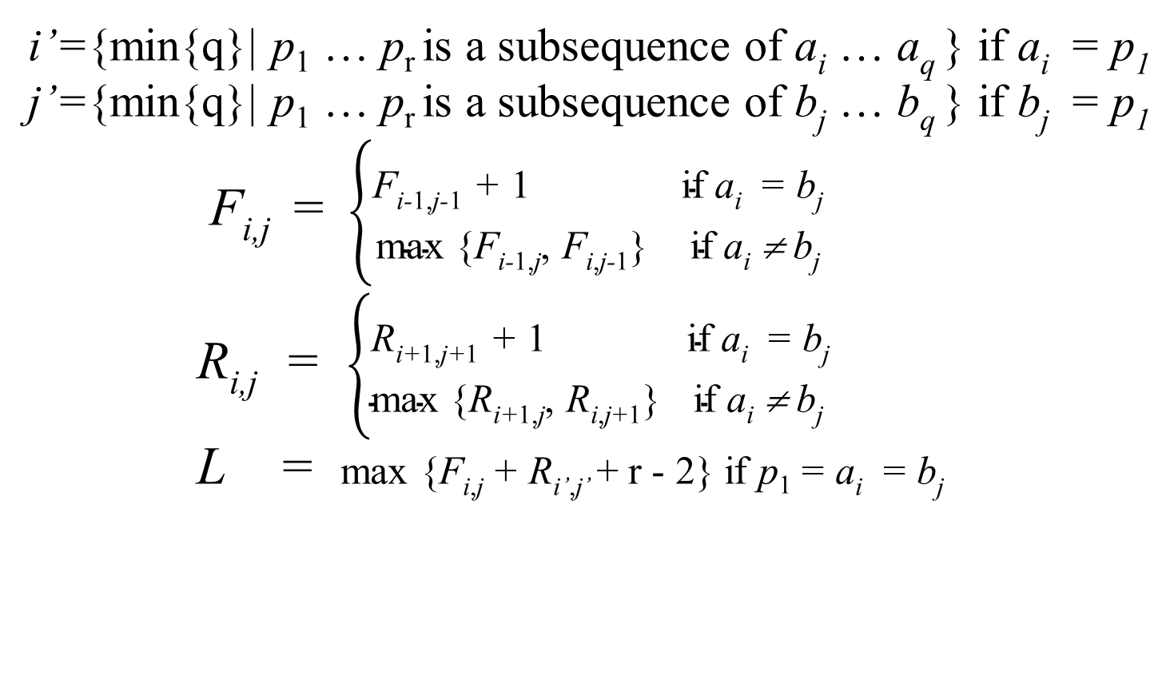
Algorithm(1/2)
i’={min{q}| p₁ … p_{r} is a subsequence of a_{i} … a_{q} } if a_{i} = p₁
j’={min{q}| p₁ … p_{r} is a subsequence of b_{j} … b_{q} } if b_{j} = p₁
F_{i,j} = $\left\{\begin{aligned}\text{F}\text{i}\text{−}\text{1,}\text{j}\text{−}\text{1}\text{ + }\text{1} \text{if} \text{ai}\text{ =} \text{bj} \\ \text{max}\text{ \{}\text{F}\text{i}\text{−}\text{1,}\text{j}\text{,} \text{Fi}\text{,}\text{j}\text{−}\text{1}\text{\}} \text{if} \text{ai}\text{ ≠ }\text{bj} \end{aligned}\right.$
R_{i,j} = $\left\{\begin{aligned}\text{R}\text{i}\text{+}\text{1,}\text{j}\text{+}\text{1}\text{ + }\text{1} \text{if} \text{ai}\text{ =} \text{bj} \\ \text{max}\text{ \{}\text{R}\text{i}\text{+}\text{1,}\text{j}\text{,} \text{Ri}\text{,}\text{j}\text{+}\text{1}\text{\}} \text{if} \text{ai}\text{ ≠ }\text{bj} \end{aligned}\right.$
L = max {F_{i,j} + R_{i’,j’} + r - 2} if p₁ = a_{i} = b_{j}

Slide 6
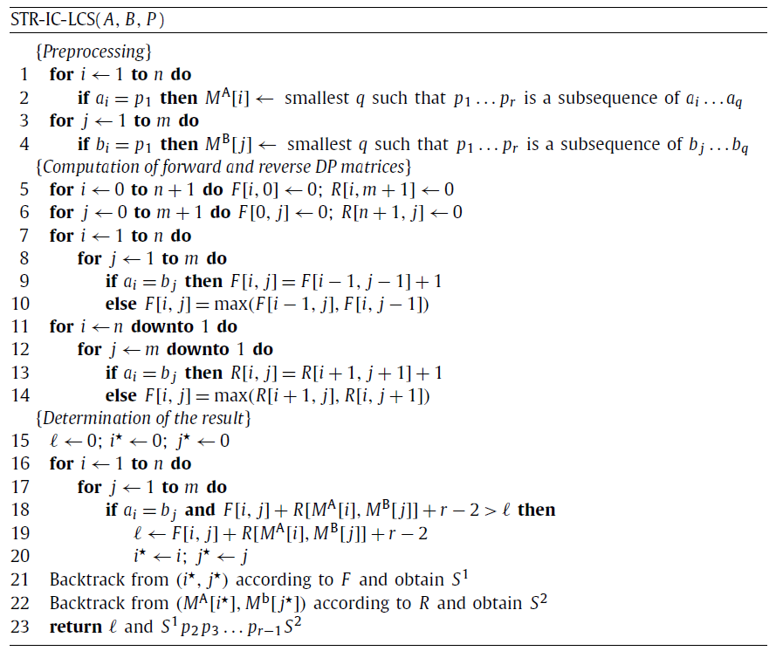
Algorithm(2/2)

Slide 7
Example
Forward matrix
Reverse matrix
 |  | t | c | t | t | g | a | c | g
 | 0 | 0 | 0 | 0 | 0 | 0 | 0 | 0 | 0 | 0
c | 0 | 0 | 1 | 1 | 1 | 1 | 1 | 1 | 1 | 1
t | 0 | 1 | 1 | 2 | 2 | 2 | 2 | 2 | 2 | 2
c | 0 | 1 | 2 | 2 | 2 | 2 | 2 | 3 | 3 | 3
t | 0 | 1 | 2 | 3 | 3 | 3 | 3 | 3 | 3 | 3
g | 0 | 1 | 2 | 3 | 3 | 4 | 4 | 4 | 4 | 4
c | 0 | 1 | 2 | 3 | 3 | 4 | 4 | 5 | 5 | 5
g | 0 | 1 | 2 | 3 | 3 | 4 | 4 | 5 | 6 | 6
a | 0 | 1 | 2 | 3 | 3 | 4 | 5 | 5 | 6 | 6
 | 0 | 1 | 2 | 3 | 3 | 4 | 5 | 5 | 6 | 6
 |  | t | c | t | t | g | a | c | g
 | 6 | 6 | 6 | 5 | 4 | 3 | 2 | 2 | 1 | 0
c | 6 | 6 | 6 | 5 | 4 | 3 | 2 | 2 | 1 | 0
t | 6 | 6 | 5 | 5 | 4 | 3 | 2 | 2 | 1 | 0
c | 5 | 5 | 5 | 4 | 4 | 3 | 2 | 2 | 1 | 0
t | 4 | 4 | 4 | 4 | 4 | 3 | 2 | 2 | 1 | 0
g | 3 | 3 | 3 | 3 | 3 | 3 | 2 | 2 | 1 | 0
c | 3 | 3 | 3 | 2 | 2 | 2 | 2 | 2 | 1 | 0
g | 2 | 2 | 2 | 2 | 2 | 2 | 1 | 1 | 1 | 0
a | 1 | 1 | 1 | 1 | 1 | 1 | 1 | 0 | 0 | 0
 | 0 | 0 | 0 | 0 | 0 | 0 | 0 | 0 | 0 | 0
S₁
S₂
Find max L, L = S₁ + S₂ + r – 2 ,STR-IC-LCS is tcta

Slide 8
Complexity
Time complexity: O(mn)
Space complexity: O(mn)

Slide 9
Thanks for listening

