Slide 1
Robust incremental growing multi-experts network
Chu Kiong Loo, Mandava Rajeswar, M.V.C. Rao
Applied Soft Computing 6 (2006) 139–153
Reporter: Chiou-Yi Hor
Date: Apr. 9, 2008

Slide 2
Abstract-1
Most supervised neural networks are trained by minimizing the mean square error (MSE) of the training set. In the presence of outliers, the resulting neural network model can differ significantly from the underlying model that generates the data. This paper outlines two robust learning methods for a dynamic structure neural network called incremental growing multi-experts network (IGMN).

Slide 3
Abstract-2
It is convincingly shown by simulation that by using a scaled robust objective function instead of the least squares function, the influence of the outliers in the training data can be completely eliminated. The network generates a much better approximation in the neighborhood of outliers. Thus, the two proposed robust learning methods namely robust least mean squares (RLMSs) and least mean log squares (LMLSs) are insensitive to the presence of outliers unlike the least mean squares (LMSs) cost function. Moreover, various types of supervised learning algorithms can easily adopt LMLS, which is a parameter free method.

Slide 4
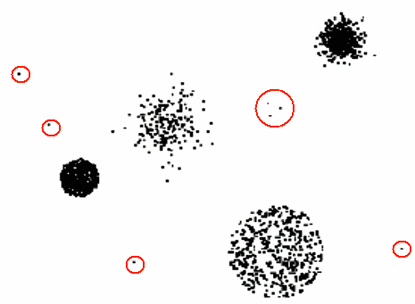
Why Robust learning
Anomalies/outliers
  The set of data points that are considerably different than the remainder of the data.
In traditional MLP and RBF networks, the least squares (LSs) is selected as the objective function for network learning.
They suffer from substantial deterioration as LS criterions response improperly to the outliers.
During the learning process, the outliers are detected and their negative influence is removed automatically.

Slide 5
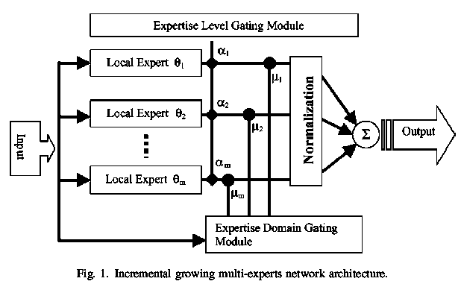
IGMN architecture
IGMN (incremental / sequential growing multi-experts network)
Three main modules
  expertise domain
  expertise level
  local experts

Slide 6

Local experts
Being a linear model
θ_{k} : the output of the k-th local expert
x : the input vector
b : the feature vector of the k-th local expert
Input vector: x
Local expert 2: b₂
Local expert 1: b₁
Local expert 2 output θ₂
Local expert 1 output θ₁

Slide 7
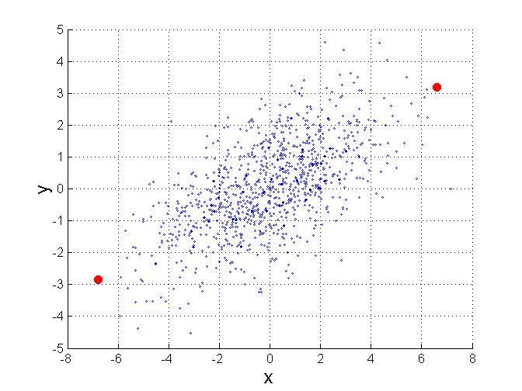
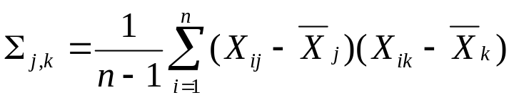
Mahalanobis Distance
Σ is the covariance matrix of the input data X
For red points, the Euclidean distance is 14.7, Mahalanobis distance is 6.

Slide 8
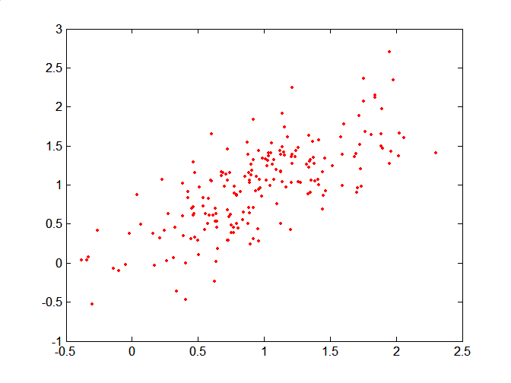
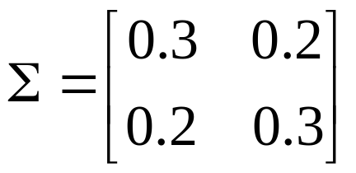
Mahalanobis Distance
Covariance Matrix:
C
B
A: (0.5, 0.5)
B: (0, 1)
C: (1.5, 1.5)
Mahal(A,B) = 5
Mahal(A,C) = 4
A

Slide 9
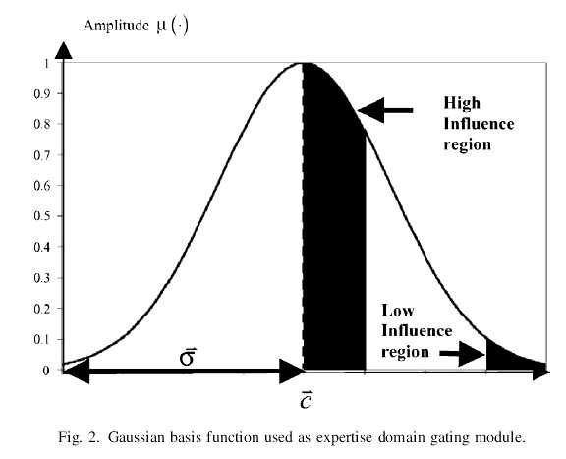
Expertise domain

Slide 10

Expertise domain
Defining influence regions
  By Gaussian basis function
  c_{k}: the center vector
  σ_{k}: the covariance matrix
Output μ_{k} : indicating the validity of the input vector
  The influence ↓ exponential as Mahalanobis Distance ↑.
σ₂
Local expert 1’s center
Input vector: x
Local expert 1: b1
Local expert 2’s center

Slide 11
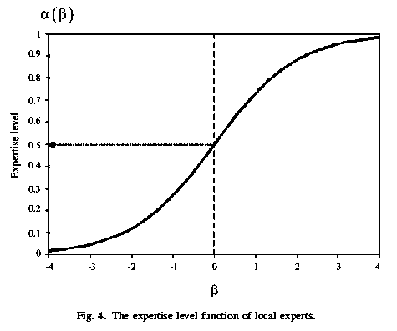

Expertise level
Defining local experts’ competency[勝任，能力]
  Each expertise domain is multiplied by a weighting factor called expertise level functions α_{k}
  Local experts’ competency depends on their importance β_{k}
  The expertise level function is a logistic sigmoid function of β_{k}

Slide 12


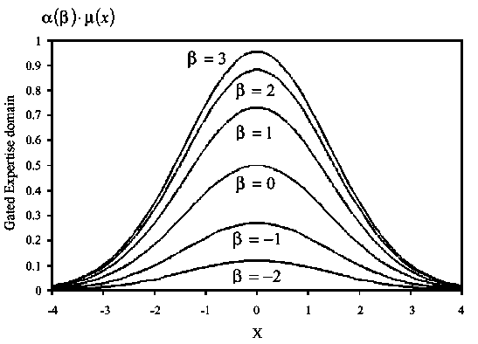

Normalization & overall output
Normalization on all α_{k}×μ_{k}
So that their summation is:
The overall output
θ₁
Φ₁
θ₂
×
Φ₂
= ŷ
θ_{m}
Φ_{m}

Slide 13
IGMN learning algorithm
x(t): input, y(t): desired out put, t: index
For each training sample (x(t),y(t))
  Find the best & second-best matching local experts and allocate a connection between them
  Calculate the certainty factor CF(t), sliding window root mean squared error e_{rms}(t)
    If CF(t)<δ_{CF} & e_{rms}(t)> e_{rms}(t-1), allocate a new local expert.(當可靠度低於某門檻且誤差變大，則新增一local expert以記住此新pattern)
    Else update the IGMN parameter by momentum-based gradient descent algorithm.(修正學習參數，讓誤差減少)
  Delete redundant local experts and obsolete edges.(刪除多餘的local experts以及被刪除local experts間的connections)
Output: IGMN

Slide 14
Best matching local experts and connection allocation
Calculate local response θ_{k}
The larger θ_{k} the better match between the k-th local expert & input x
Allocate an edge between 1st and 2nd match local expert
(表示第k及n個local expert相似)
Local expert i: b_{i}
output θ_{k}
Input vector: x
Local expert n: b_{n}
output θ_{i}
output θ_{n}

Slide 15

Certainty factor
Calculate and sort the activation value μ_{k} from the expertise domain in descending order
  μ₁ > μ₂ >… > μ_{k}… > μ_{m}
Accumulate the certainty factor CF(t) by

Slide 16
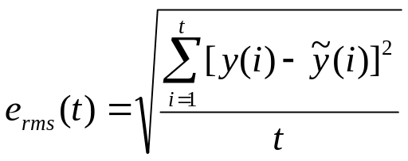
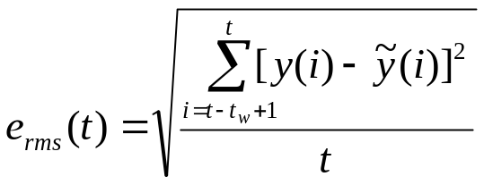
Sliding window root mean squared error
Conventional RMS error
Desired output: y(1), y(2), y(3), …,y(t-t_{w}+1), y(t-t_{w}+2), …, y(t)
Actual output: ŷ(1), ŷ(2), ŷ(3), …, ŷ(t-t_{w}+1), ŷ(t-t_{w}+2), …, ŷ(t)
Forgetting Zone
Sliding window RMS error

Slide 17
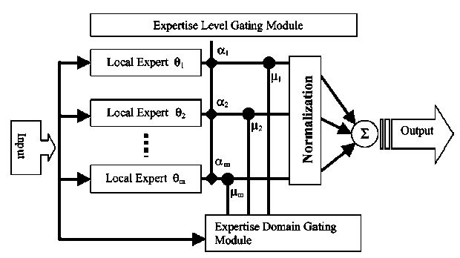
Insertion criterion
When to allocate a new local expert
  certainty factor CF(t)<δ_{CF}
  sliding window RMS e_{rms}(t)> e_{rms}(t-1)
  即當可靠度低於某門檻且誤差變大，則新增一local expert以記住此新pattern。
Local Expert θ_{m+1}

Slide 18
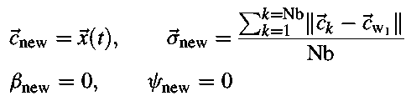
Initialization of the new node
x(t) : the input vector
c_{new}: the center of the new local expert
σ_{new}: the influence region of the new local expert
c_{w1}: the nearest neighbor of the new local expert
Nb: # neighbors (with connections) of c_{w1}
ψ_{new} : the new influence function (will be mentioned later)
β_{new} : the importance region of the new local expert

Slide 19
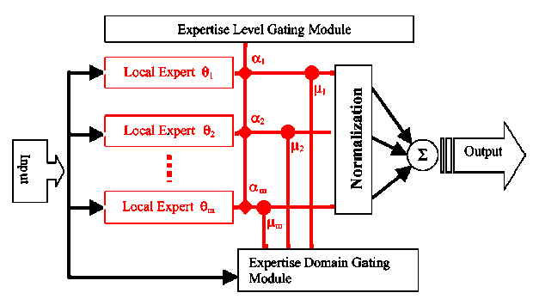
Parameter update criterion
When not to allocate a new local expert
  certainty factor CF(t)>δ_{CF}
  sliding window RMS e_{rms}(t)< e_{rms}(t-1)
  即當可靠度夠高且誤差下降，則表示既有local experts足以表示此新pattern，僅需修正參數(紅色部份) ，讓誤差更小。
共兩種修正方法
α,μ,σ: momentum-based gradient descent
Local expert parameter b: recursive least square

Slide 20
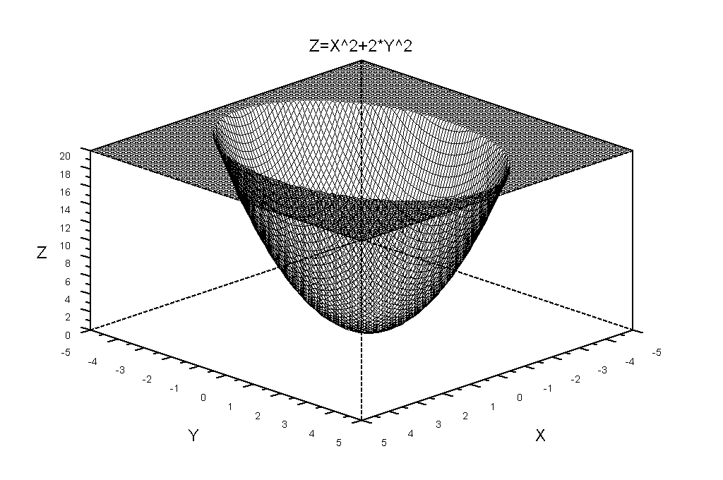
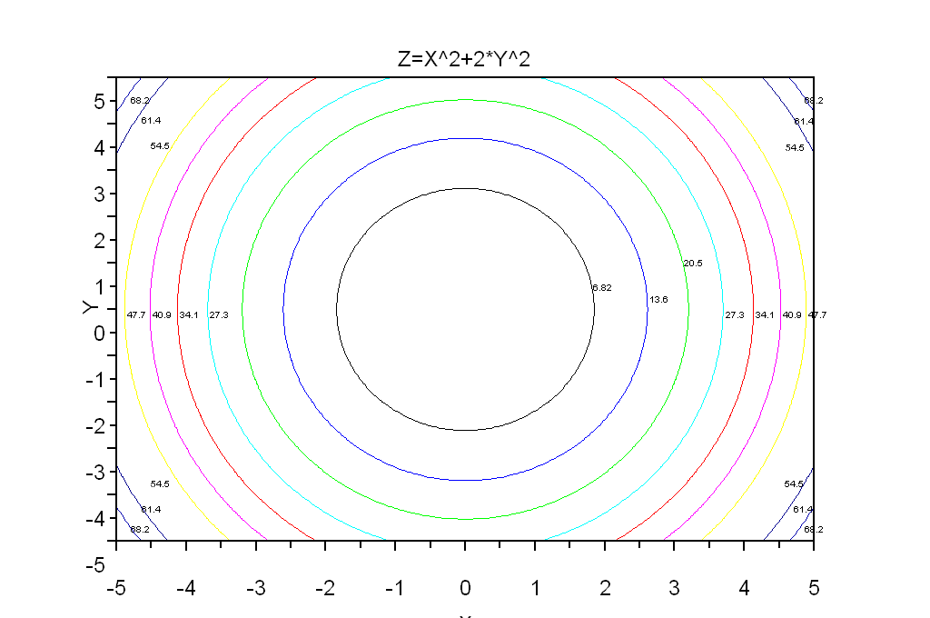
Gradient descent to find minimum of z=x²+2*y²
Step0: [x0,y0]=[2,2], ▽z0=[əz/əx, əz/əy]= [2x, 4y] = [4, 8] , Learning rate η=0.2
Step1: [x1,y1]=[2,2]- η▽z0=[1.2, 0.4], ▽z1=[2.4, 1.6]
Global min at [x,y]=[0,0]
只要一直往負梯度方向修正，誤差(函數值)會越來越小
Step2: [x2,y2]=[1.2,0.4]- η▽z1=[0.72, 0.08], ▽z2=[1.44, 0.32]
Step3: [x3,y3]=[0.72,0.08]- η▽z2=[0.432, 0.016], ▽z3=[0.864, 0.064]
Step4: [x4,y4]=[0.432,0.016]- η▽z3=[0.2592, 0.0032], ▽z4=[0.5184, 0.0128]
Step5: [x5,y5]=[0.432,0.016]- η▽z4=[0.15552, 0.00064], ▽z5=[0.31104, 0.00256]

Slide 21
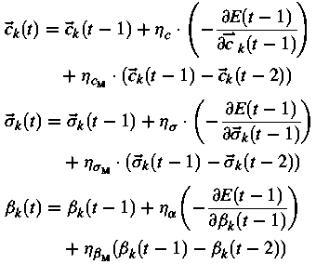
Momentum-based gradient descent
To sustain the movement of a particular weight based on its individual history
  Avoiding the noisy input to bias the gradient descent too much
  Accelerate convergence
Previous step
Gradient at the current step
(too small a step)
Momentum-based gradient descent Accelerate convergence
Global min
Gradient at the current step (noisy input)
Momentum-based gradient descent
Sustain it correct direction
Momentum from the previous step
Previous step
Gradient descent
Momentum

Slide 22
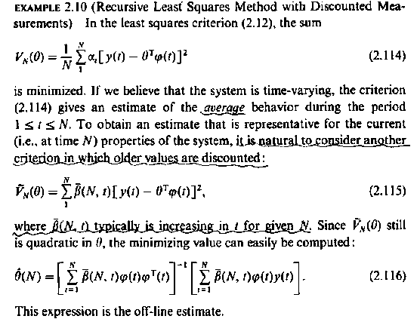
Recursive least square
V:總誤差，
y(t):desired output，
θ相當於本文中之ξ，為local expert 參數，
φ(t)為輸入相當於本文中之x

Slide 23
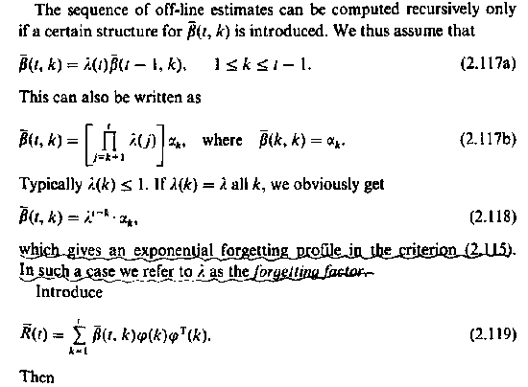
Recursive least square
λ:為forget factor 參數，為輸入和本文相同，值越大表過去的輸入x在Least square計算中權重越小，值越小表記住越多過去的輸入

Slide 24
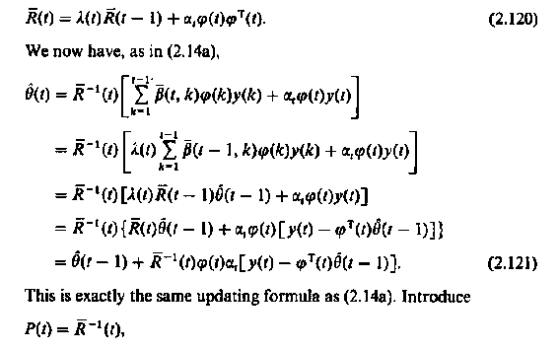
Recursive least square

Slide 25
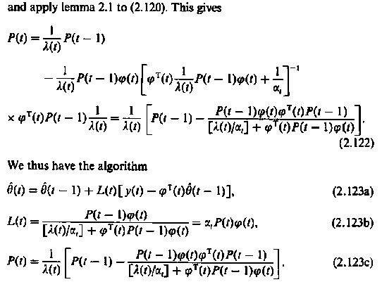
Recursive least square
本文使用公式

Slide 26
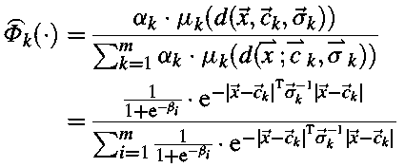





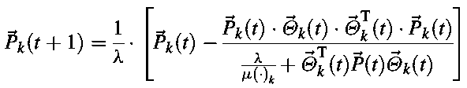
Updating local experts’ parameters by recursive least square
For k-th local expert, update criterion is
誤差、可靠度及影響力越大，修正越多

Slide 27

Deletion criterion
When a new local expert’s relative importance goes below a threshold
Local Expert θ_{k}

Slide 28
Output residual
output: ŷ(t)
input: x(t)
Desired output: y(1), y(2), y(3), …,y(t-t_{w}+1), y(t-t_{w}+2), …, y(t)
Actual output: ŷ(1), ŷ(2), ŷ(3), …, ŷ(t-t_{w}+1), ŷ(t-t_{w}+2), …, ŷ(t)
Define Residual r(k) = y(k)- ŷ(k), k=1~t

Slide 29



Cost functions of learning
The cost function E is defined as a function (ρ) of residuals r and parameters ω
The learning process guides the parameter to make the cost function decrease. So we can take advantage of the gradient descent algorithm.
The ψ is the influence function. It measures the degree of the total error’s change as output residuals are changed.

Slide 30






Cost functions of learning
In this paper, the author proposes two new cost function robust least mean squares (RLMS) and least mean log squares (LMLS),and compares with the conventional least mean squares (LMS). The residual r(•) = (desired output – actual output)
LMS
RLMS
LMLS

Slide 31
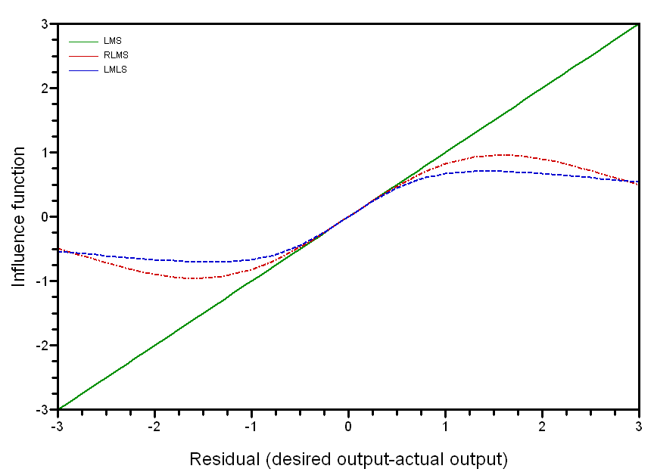
Comparison of influence functions
The LMS method is extremely sensitive to gross errors.
The impact of outliers on LMLS/RLMS is limited.

Slide 32
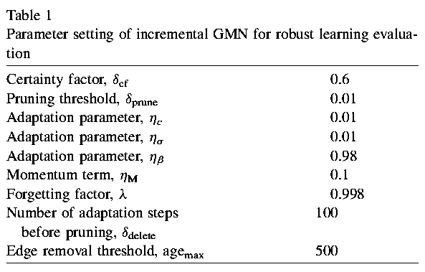
IGMN parameters for experiment

Slide 33
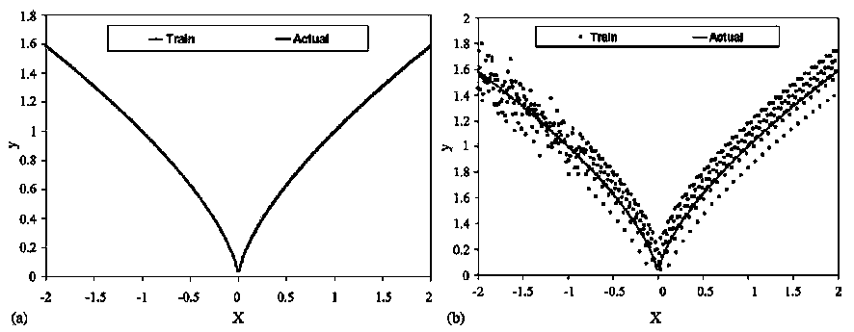
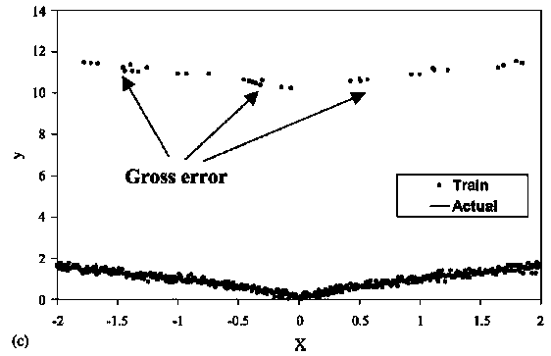
Experiment 1~3: y=x^{2/3} regression
Experiment 1 Input: 500 y=x^{2/3} perfect data [-2,2]
Experiment 2 Input: 500 y=x^{2/3} perfect data [-2,2] with Gaussian N(0,0.1) noises added
Experiment 3 Input: 500 y=x^{2/3} perfect data [-2,2] with 95% Gaussian N(0,0.1) & 5% Gaussian N(10,0.1) noises added

Slide 34
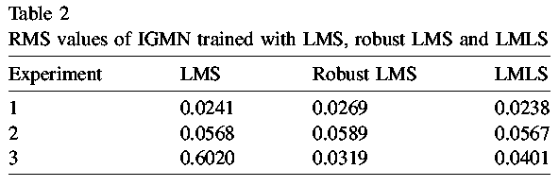
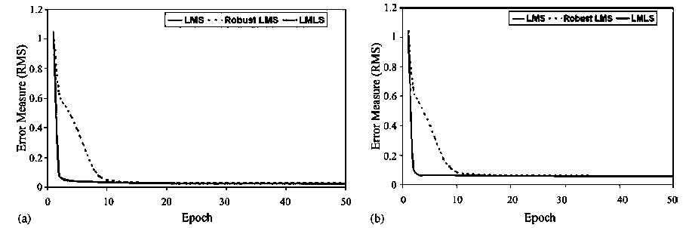
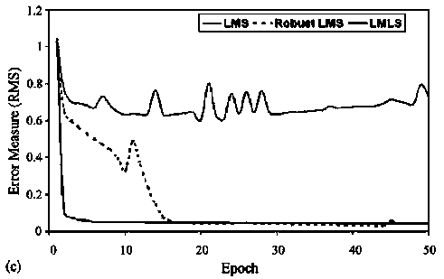
Experiment 1~3: y=x^{2/3} regression
RMS results:
LMS
Convergence:

Slide 35
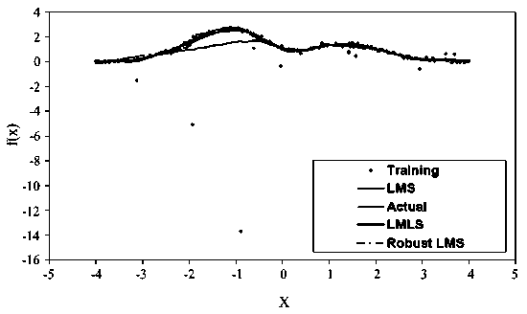
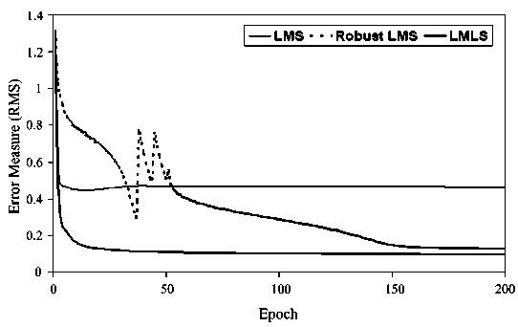
Experiment 4:
Hermite polynomial regression
Target function Hermite polynomial
  f(x) = 1.1(1-x-2x²)exp(-0.5x²)
Input data [-4,4] contaminated with Cauchy distribution noises, location 0 & scale 0.1
Regression result & convergence:
LMS

Slide 36
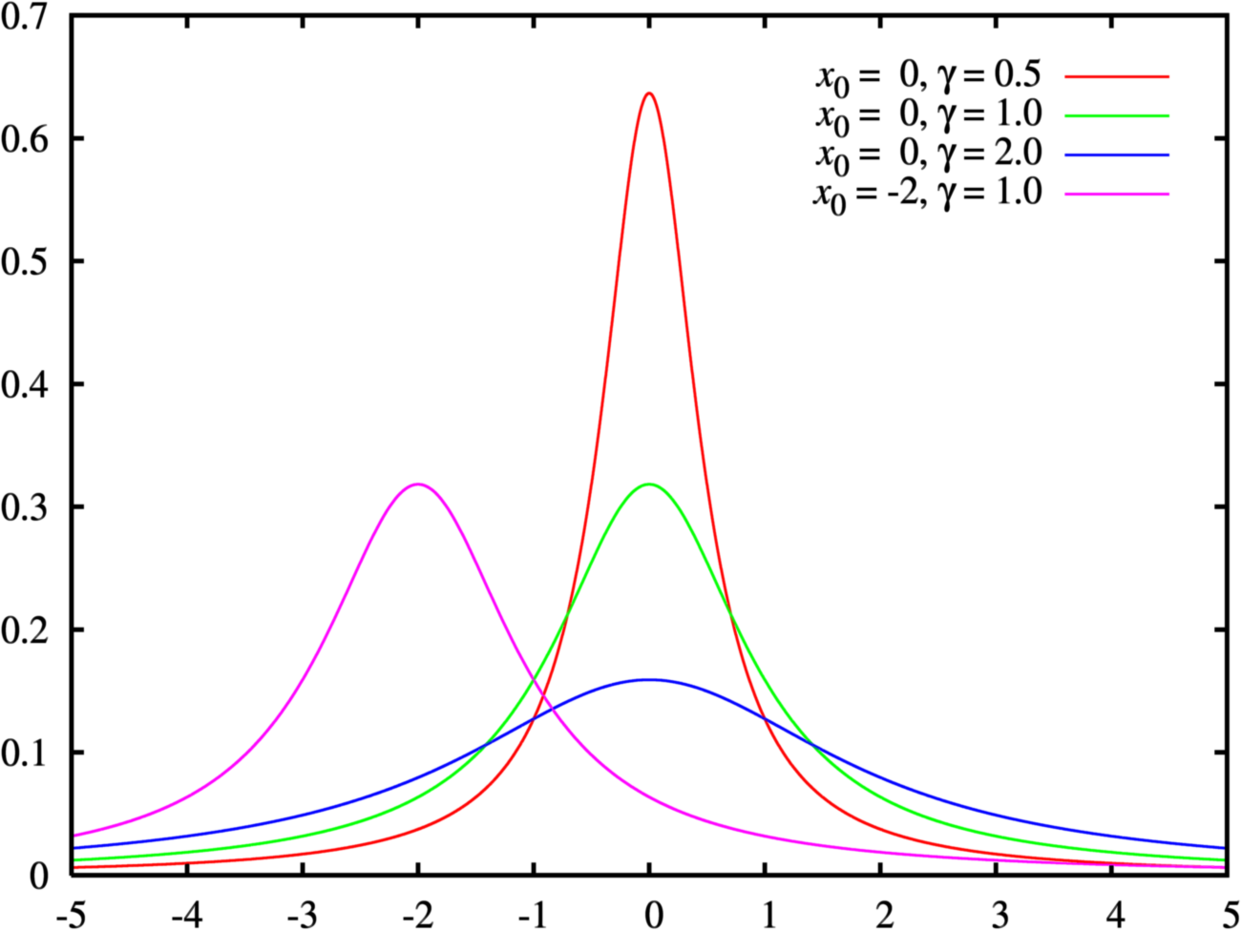
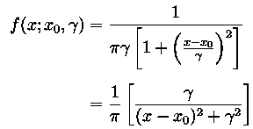
Cauchy distribution
From http://en.wikipedia.org/wiki/Cauchy_distribution
where x₀ is the location parameter, specifying the location of the peak of the distribution, and γ is the scale parameter which specifies the half-width at half-maximum (HWHM).

Slide 37
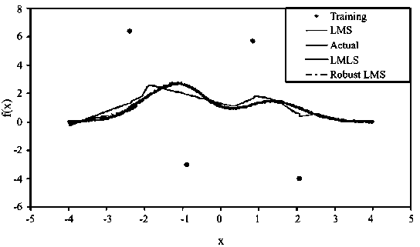
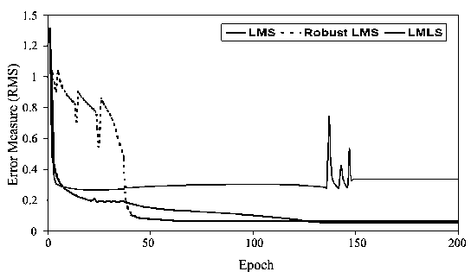
Experiment 5:
Hermite polynomial regression
Target function Hermite polynomial
  f(x) = 1.1(1-x-2x²)exp(-0.5x²)
Input data [-4,4] contaminated with 4 synthetic noises
Regression result & convergence:
LMS

Slide 38
Comparison with ART
ART : Adaptive resonance theory
  an unsupervised vector classifier that accepts input vectors that are classified according to the stored pattern they most resemble
  It provides a mechanism that adapts to the input.
  The ART network can adaptively create a new neuron corresponding to an input pattern if it is determined to be “sufficiently” different from existing clusters. This determination, called the vigilance[警戒] test, is incorporated into the adaptive backward network.

Slide 39
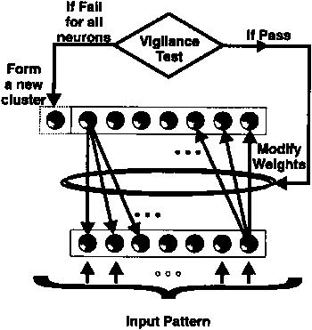
Comparison with ART

