Slide 1
Incremental training of support vector machines using hyper-spheres
Shinya Katagiri, Shigeo Abe
Pattern Recognition Letters 27 (2006) 1495–1507
Reporter: Chiou-Yi Hor
Date: June 11, 2008

Slide 2
Abstract
In the conventional incremental training of support vector machines, candidates for support vectors tend to be deleted if the separating hyperplane rotates as the training data are added. To solve this problem, in this paper, we propose an incremental training method using one-class support vector machines. First, we generate a hypersphere for each class. Then, we keep data that exist near the boundary of the hypersphere as candidates for support vectors and delete others. By computer simulations for two-class and multi-class benchmark data sets, we show that we can delete data considerably without deteriorating the generalization ability.

Slide 3
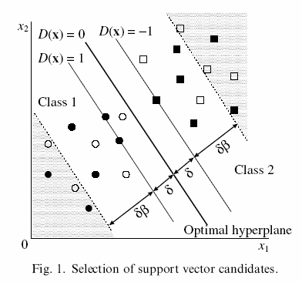
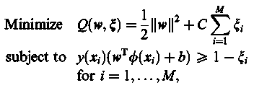
Support Vector Machines
■●: Original data
δ: Optimal separating hyperplane
□: Newly added data
δβ: Tolerance margin

Slide 4
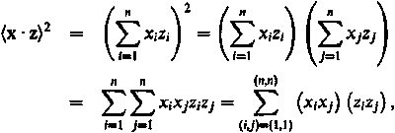
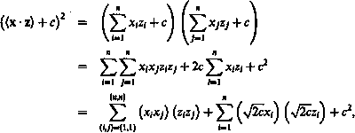
How to map x to φ(x)?
For polynomial kernel
  Define H(x,y)=(x·y+1)^{d} = φ(x) ·φ(y)
  Totally features for x=(x₁,x₂)

Slide 5
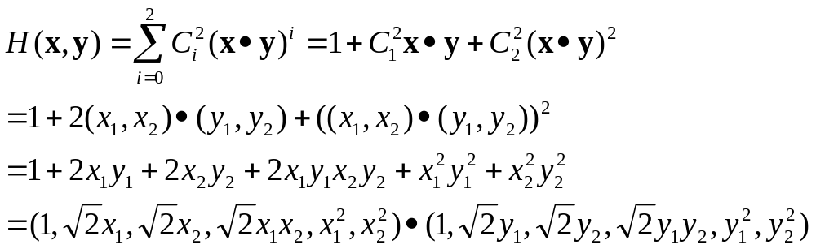
How to map x to φ(x)?
Polynomial kernel example
  If x=(x₁,x₂), d=2, H(x,y)=(x·y+1)²

Slide 6
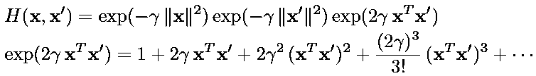
How to map x to φ(x)?
Radial basis function (RBF) kernels
  H(x,x’)=exp(-γ||x-x’||²)

Slide 7
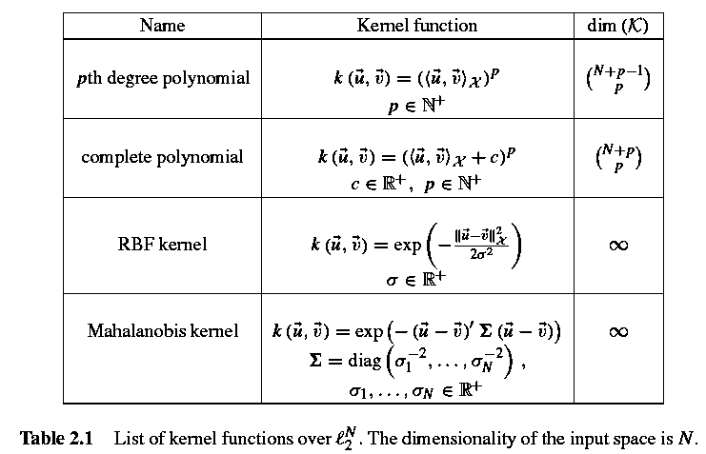
How to map x to φ(x)?

Slide 8
Methods to preserve data near the separating hyper-planes
y=+1
f(x) > β+1
f(x) > +1
f(x) = β+1
Preserving data
y*f(x)≤ (β+1)
y=-1
f(x) < -(β+1)
f(x) < -1
f(x) = -β-1
f(x) = +1
f(x) = -1
Decision function f(x) = 0

Slide 9
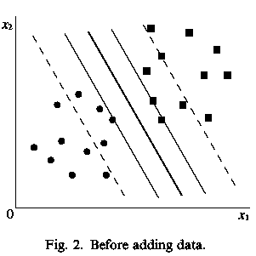
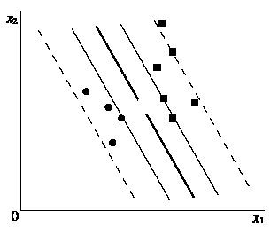
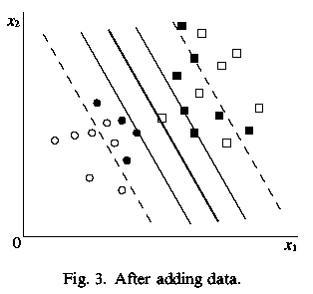
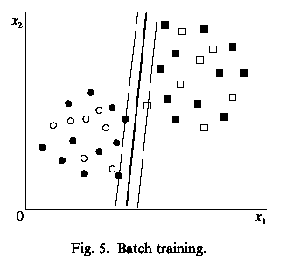
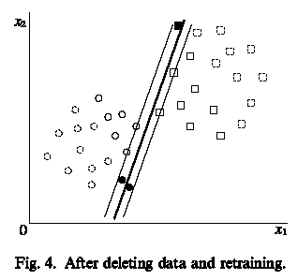
Problems
Different !
The optimal separating hyper-plane rotate!

Slide 10
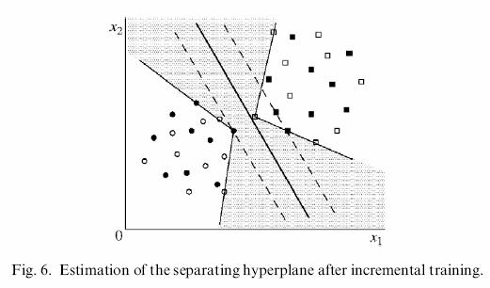
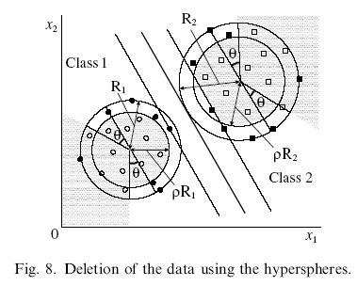


Method proposed in this paper
ψ>θ
Data to delete:
The distance to class center is too short
The angle between the hyper-plane is too large

Slide 11
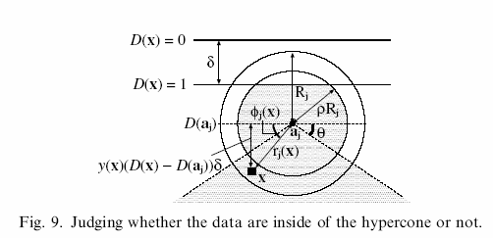
Method proposed in this paper
Data to delete:
The distance to class center is too short
The angle between the hyper-plane is too large

Slide 12
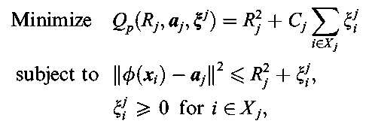
Calculation of the optimal radius
To generate the minimum-volume hyper-sphere that includes the data for class j, we need to solve the following optimization problem:
We hope that
The radius is minimal.
the number of data outside the circle are minimal.

Slide 13
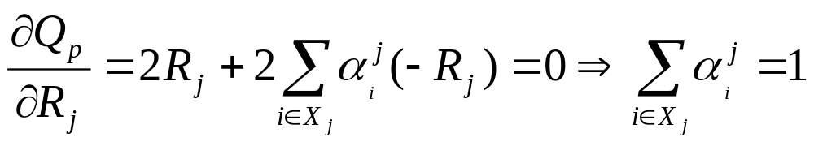
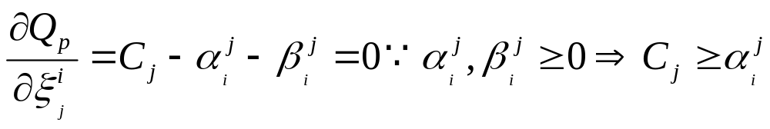
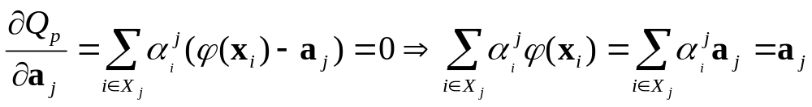
Calculation of the optimal radius
To get R_{j} , ξ_{i}^{j} and a_{j}, we need to derive Qp with respect to them

Slide 14
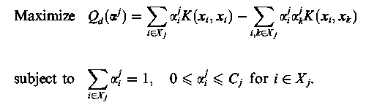

Calculation of the optimal radius
We get
The radius is (for point inside the hyper-sphere that is ξ=0

Slide 15
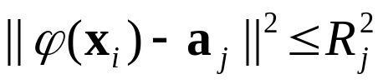
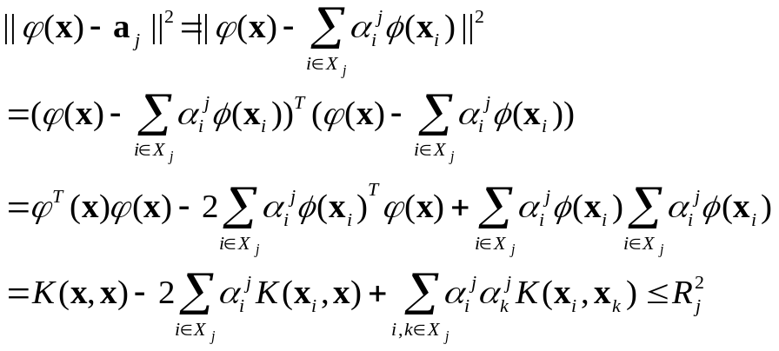

To determine if a point is inside the hyper-sphere
Assume a point x has its mapping in the hyper space φ(x)
If a point’s mapping is inside the hyper-sphere, then
Expand the above equation, we have

Slide 16
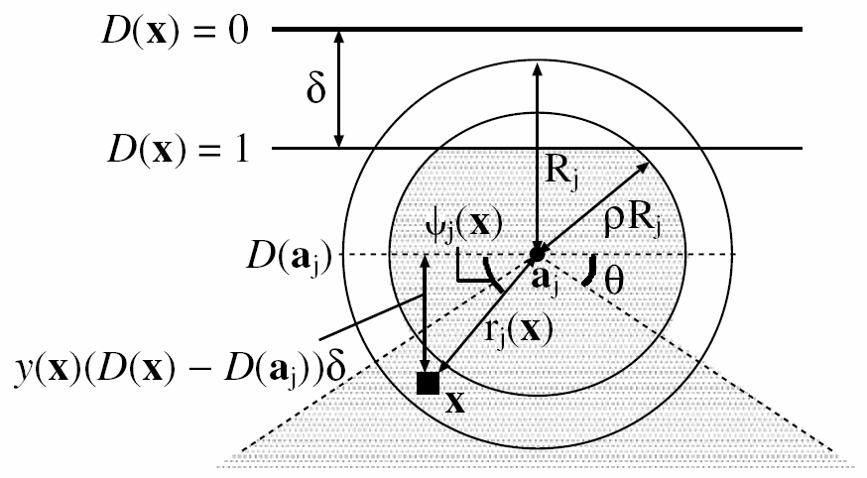
To determine ψ_{j}(x)

Slide 17
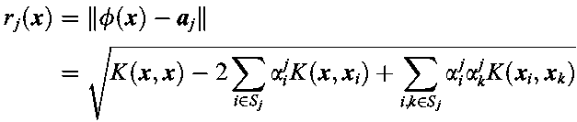

To determine ψ_{j}(x)
The distance r_{j}(x) between φ(x) and the center of the hyper-sphere is given by
The the value of the decision function f at the center (a_{j}) of the hyper-sphere is given by

Slide 18


To determine ψ_{j}(x)
The distance between φ(x) and the separating hyper-plane f(x)=0 is given by
φ(x)
w
Here we let δ be
f(x)=w·φ(x)+b=0

Slide 19
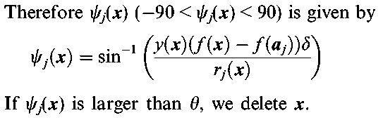
To determine ψ_{j}(x)
Here, f(x)=D(x)

Slide 20
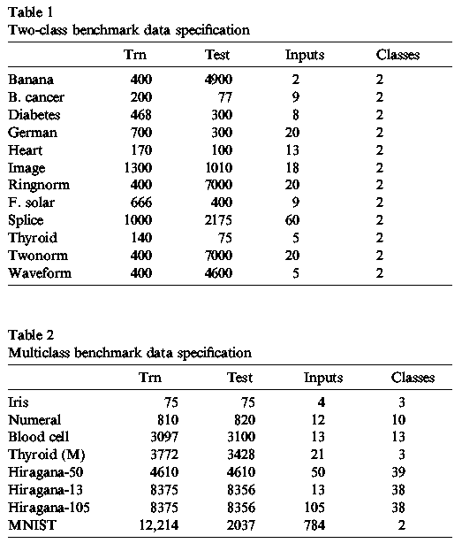
Experiment settings
The data set is normalized to [0,1] and one-against-all SVM is used for multi-class experiments.

Slide 21
Experiment settings
For two-class problems, we randomly generate one incremental training data set for each of 100 (or 20) training data sets, dividing the training data set into the subsets whose size is about 5% of the total number.
In the incremental training, we add one of the subsets to the training set at each step.
Likewise for multi-class problems, for each training data set we randomly generate 100 incremental training data sets.
The recognition rates of the test data, after incremental training is finished, are compared with those by batch training using all the training data.

Slide 22
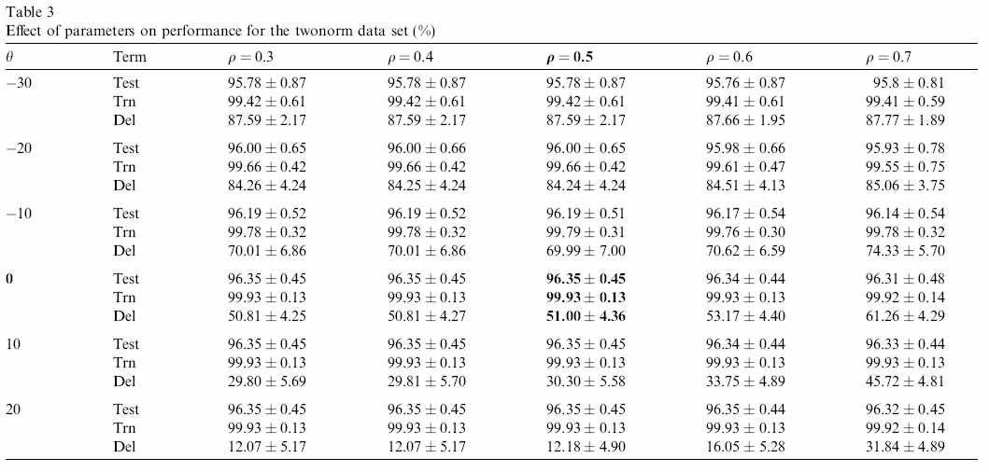
Determine the optimal parameters

Slide 23
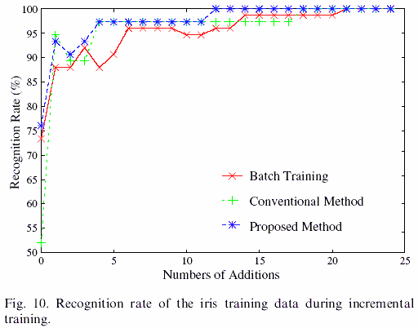
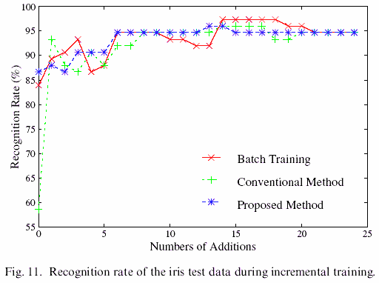
Recognition rate with iris data
We use polynomial kernels with d = 3 and set the regularization parameter C = 10,000.
For the conventional training method we set β = 1 and for the proposed method ρ = 0.5, θ = 0.

Slide 24
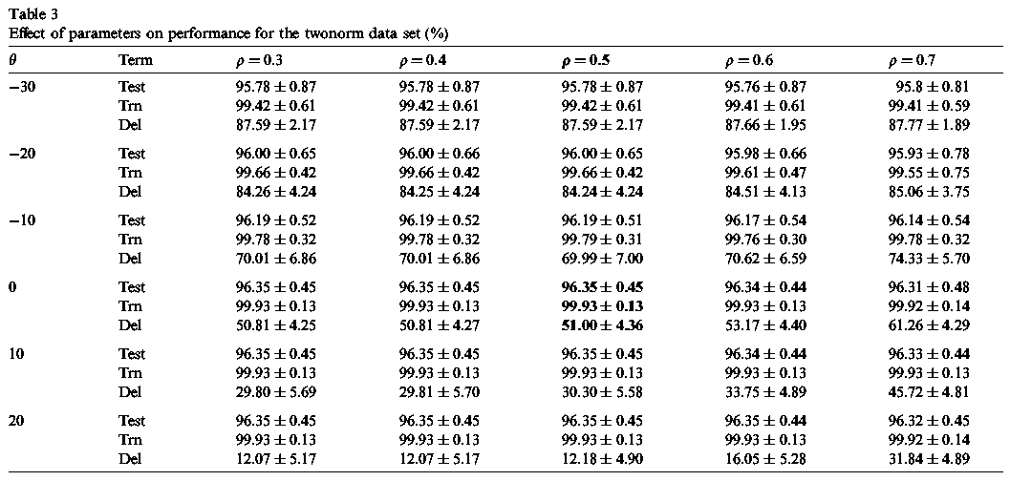
Recognition rate with twonorm data
We use polynomial kernels with d = 4 and set the regularization parameter C = 10,000.
“Test”, “Trn”, and “Del” denote the recognition rate of the test data, that of the training data, and deletion ratio

Slide 25
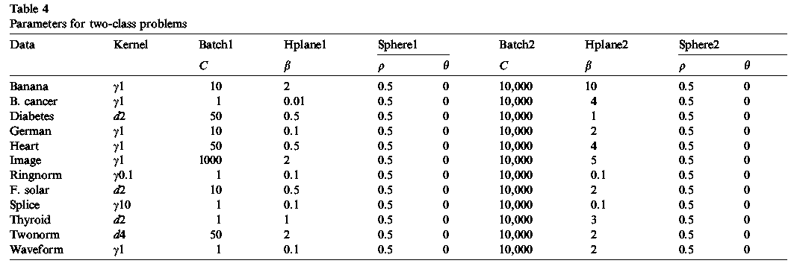
Parameters for two-class problem

Slide 26
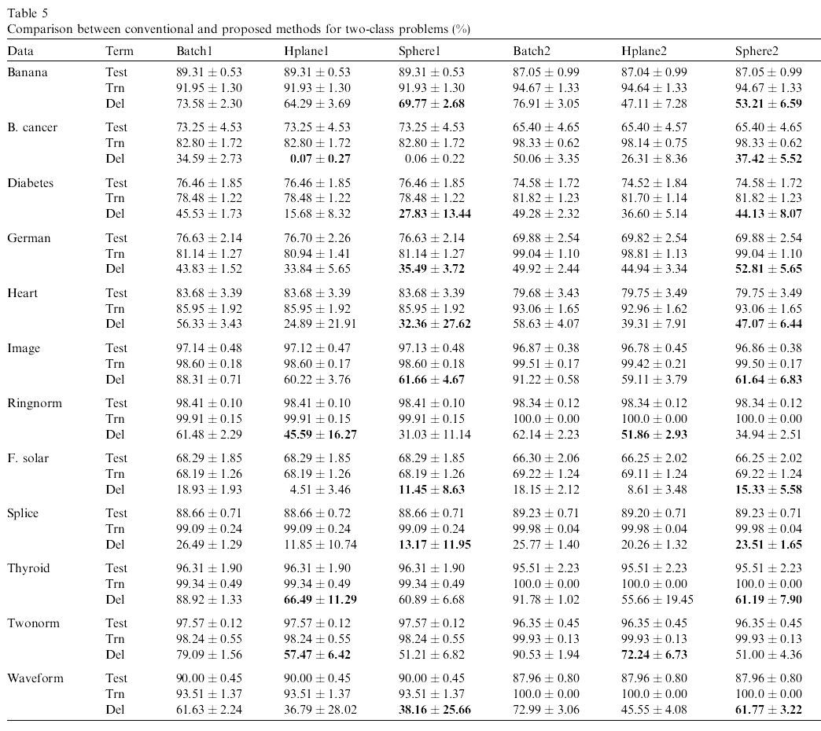
Recognition comparison for two-class problem

Slide 27
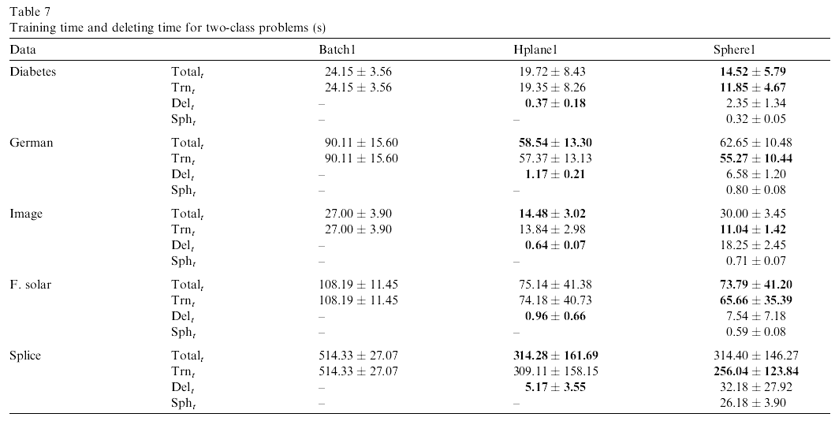
Recognition time for two-class problem

Slide 28
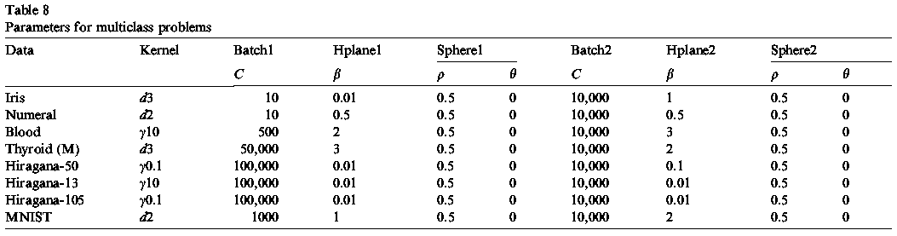
Parameters for multi-class problem

Slide 29
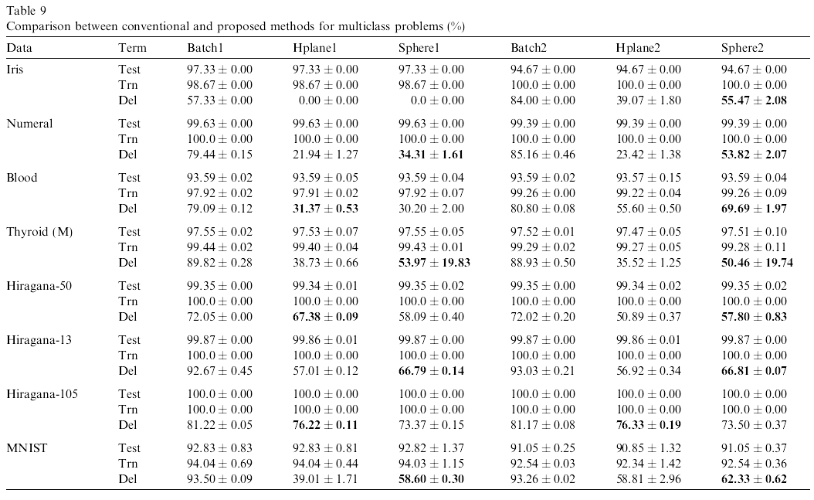
Recognition comparison for multi-class problem

Slide 30
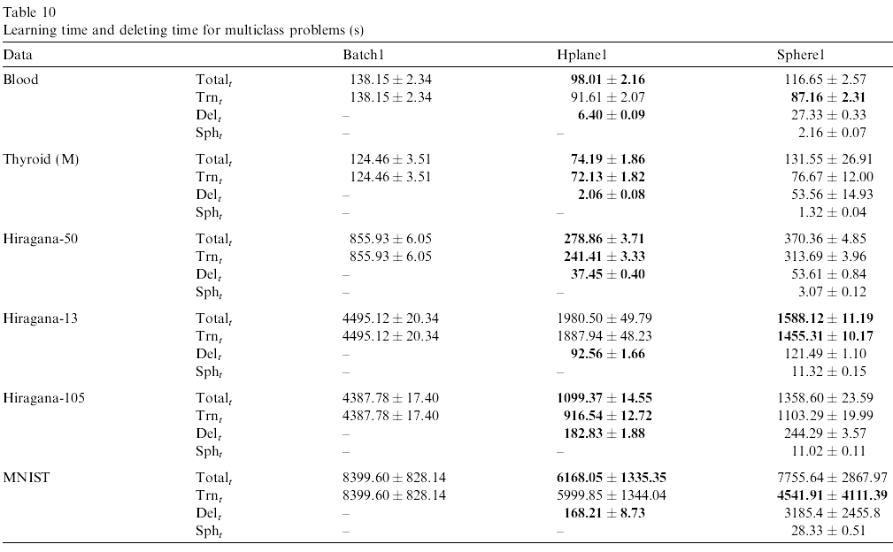
Recognition time for multi-class problem

