Slide 1
Quick-MLCS: a new algorithm for the multiple longest common subsequence problem Majid Sazvar, Mahmoud Naghibzadeh, Nayyereh Saadati
Proceedings of the Fifth International C* Conference on Computer Science and Software Engineering, June 2012, Pages 61–66
Presenter : Yu-Ju, Liao
Date : Jan. 12, 2021

Slide 2
Abstract
Finding the longest common subsequence (LCS) of multiple strings is a well-known problem that has many applications in various fields, such as computational biology and computational genomics. This problem has been studied by a number of researchers and over the years, its complexity has been improved from various aspects. This paper presents a new algorithm for the general case of multiple LCS (MLCS) which is based on one of the fastest existing algorithms. The proposed algorithm is founded on the dominant point approach and uses a linear sorting technique to minimize the dominant points set. The main idea is that, after linearly sorting dominant points, a one-pass linear algorithm can minimize the dominant points set. The results of theoretical and experimental evaluations indicate that the efficiency of the newly proposed algorithm in different scenarios is better than the fastest existing algorithm.

Slide 3
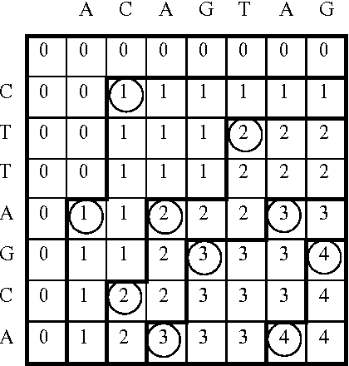
D^{k}
D⁰
D¹
D²
D³
D⁴

Slide 4
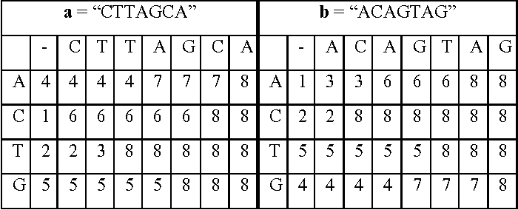
Successor Table

Slide 5
Successor Table

Slide 6
Successor Table

Slide 7
Successor Table

Slide 8
Succ(D^{k},∑)
D⁰
D¹
D²
D³
D⁴

Slide 9
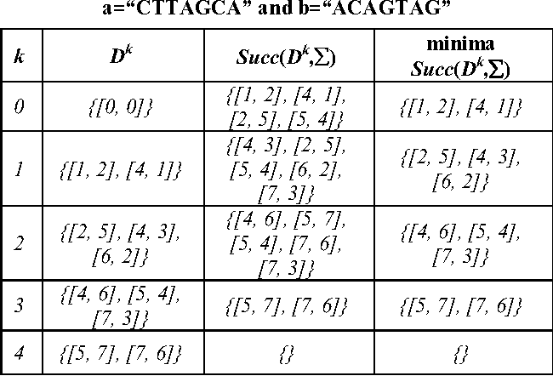
Succ(D^{k},∑)

Slide 10
Succ(D^{k},∑)

Slide 11
Succ(Dk,∑)

Slide 12
Minima Succ(Dk,∑)
{[1, 2], [4, 1], [2, 5], [5, 4]}
=> {[1, 2], [2, 5], [4, 1], [5, 4]}
=>MIN: {[1, 2],

Slide 13
Minima Succ(Dk,∑)
{[1, 2], [4, 1], [2, 5], [5, 4]}
=> {[1, 2], [2, 5], [4, 1], [5, 4]}
=>MIN: {[1, 2], [4, 1]}

Slide 14
D^{k}

Slide 15
D^{k}

Slide 16
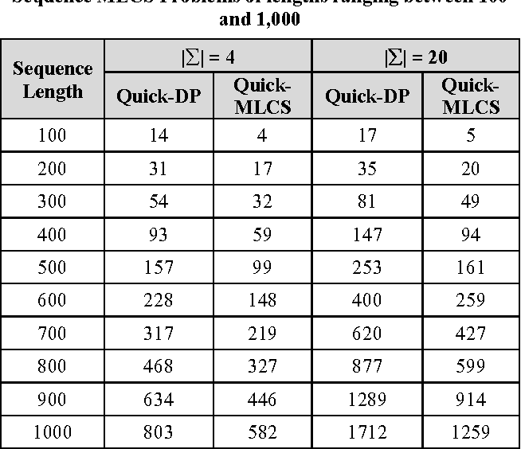
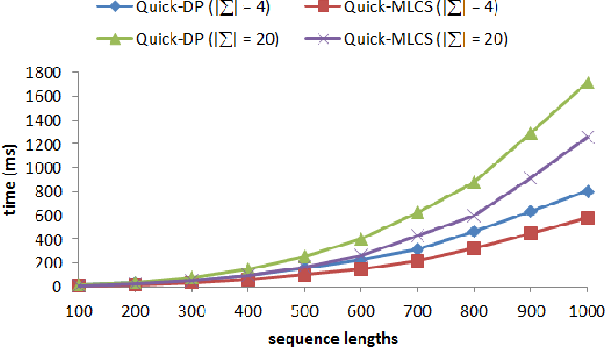
Experimental Evaluation

