Slide 1
An improved algorithm for the longest common subsequence problem
Sayyed Rasoul Mousavi and Farzaneh Tabataba
Computers & Operations Research, Volume 39, Issue 3,
March 2012, Pages 512-520.
Presenter: Shin-Cheng Lin
Date: Jan. 12, 2021

Slide 2
Abstract(1/3)
The Longest Common Subsequence problem seeks a longest subsequence of every member of a given set of strings. It has applications, among others, in data compression, FPGA circuit minimization, and bioinformatics. The problem is NP-hard for more than two input strings, and the existing exact solutions are impractical for large input sizes.

Slide 3
Abstract(2/3)
Therefore, several approximation and (meta) heuristic algorithms have been proposed which aim at finding good, but not necessarily optimal, solutions to the problem. In this paper, we propose a new algorithm based on the constructive beam search method. We have devised a novel heuristic, inspired by the probability theory, intended for domains where the input strings are assumed to be independent.
Notes:
3

Slide 4
Abstract(3/3)
Special data structures and dynamic programming methods are developed to reduce the time complexity of the algorithm. The proposed algorithm is compared with the state-of-the-art over several standard benchmarks including random and real biological sequences. Extensive experimental results show that the proposed algorithm outperforms the state-of-the-art by giving higher quality solutions with less computation time for most of the experimental cases.
Notes:
4

Slide 5
Beam search algorithm
A tree search but only keeps β leaves.
When β is large enough, keep all the leaves.
Notes:
5

Slide 6

: s1 is a subsequence of s2
S={s₁…..s_{n}} : the input strings
m_{i} : │s_{i}│and assume m_{i} > 0
Σ : alphabet
Notes:
6

Slide 7
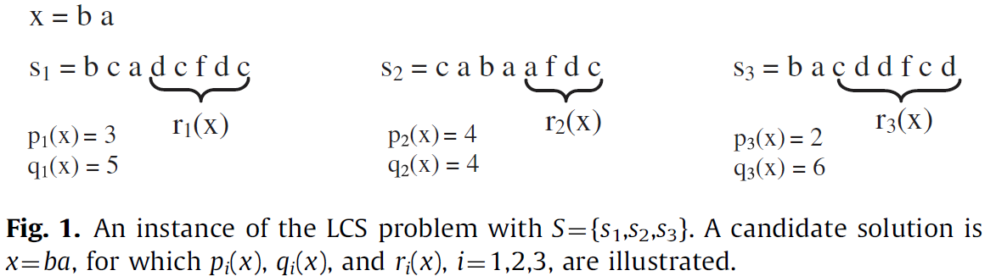
x : A feasible candidate solution
B : The set of candidate solutions
h(.): a heuristic function to evaluate the candidate solutions.
p_{i}(x), q_{i}(x), r_{i}(x) : see Fig. 1
Notes:
7

Slide 8
Step 1
Append at end a character drawn from Σ to every x_{i} in B.
Only the feasible ones determined using the function feasible(.), are kept in the set C.
The set C contains at most │B│*│Σ│ candidate solutions.
Σ : {a,b}
x₁ : aa → aaa, aab
x₂ : bb → bba, bbb
Notes:
8

Slide 9
Step 2
Each of the candidate solutions in C is evaluated using the heuristic function h().
Notes:
9

Slide 10
Step 3
A list k-best is constructed which consists of the k best candidate solutions.
Each candidate solution in C is then checked for being dominated by any member of k-best and removed if so.
If p_{i} (x_{j}) ≧ pi(x_{k}), i=1,2,…,n , x_{j} is dominated by x_{k}
The best β of the remaining ones in C are selected to make the new set B
Notes:
10

Slide 11
Steps 1–3 are repeated within the while loop until C is empty.
Notes:
11

Slide 12

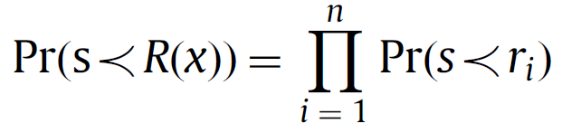
Heuristic function h()
h_{k}(x) is the probability for , where s is a random string of length k.
Assume the strings in S are ‘independent’.
Notes:
12

Slide 13
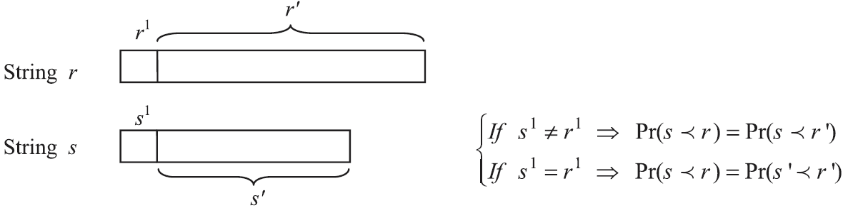
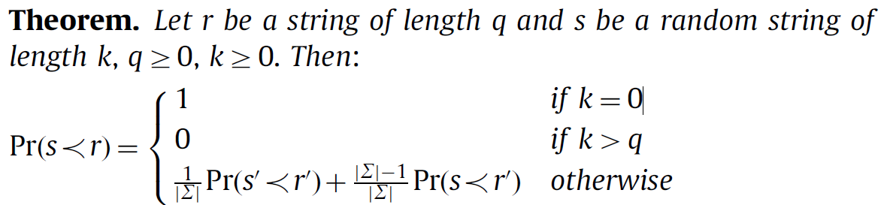



A string can not be a subsequence of a shorter one.
Case (i): s¹＝r¹, if and only if
Case (ii): s¹ ≠ r¹, if and only if

Slide 14
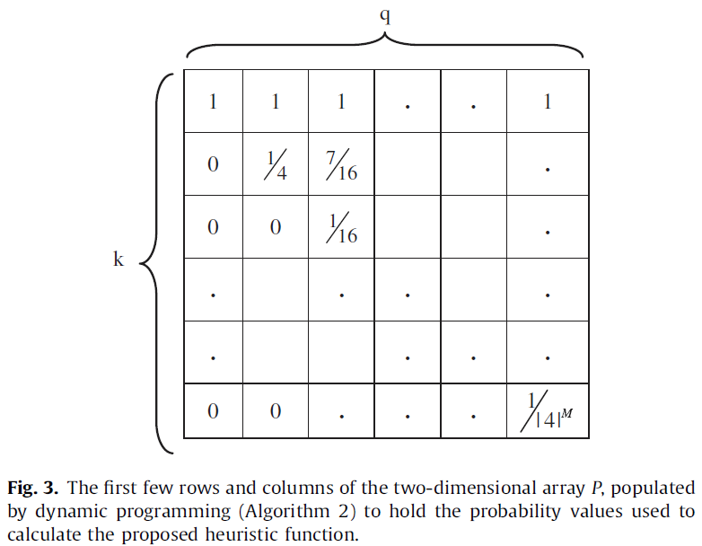
q : │r_{i}│
k : min{q_{i}(x), i=1,2, … ,n, x in C}/│Σ│
But how to find the best value for k still remains as an open question.

Slide 15
Time complexity
Two data structures are populated before loop:
First : A three-dimensional (n*m*│Σ│) array populated in O(nm │Σ│).
the next occurrence of each alphabet letter in the strings
in order to check the feasibility in O(n).
Second : The two-dimensional array P populated in O(m²).
used to keep all possible values of P(k,q)
Notes:
15

Slide 16
Time complexity
Step 1: O( β│Σ│n )
Most β candidate solutions in B
Each is extended by Σ.
Each feasibility check in O(n).
Step 2: O( β│Σ│n )
Most β feasible solutions in C
Multiplication of n probability values retrieved from the two-dimensional array P
Notes:
16

Slide 17
Time complexity
Step 3:
O( k*log(β│Σ│))+ O(k β│Σ│n) +O( β*log(β│Σ│))
The selection of k best candidate solutions require O( k*log(β│Σ│)) using red-black trees
Dominance checks in O(k β│Σ│n)
The best β members of C are selected to construct the new set B require O( β*log(β│Σ│)) using red-black trees.
Notes:
17

Slide 18
Time complexity
The while loop iterates L times.
L is the length of the LCS returned by the algorithm.
So the algorithm is run in:
O(m²+nm│Σ│+ L*(β*log(β)+ kβ│Σ│n) )
Notes:
18

