Slide 1
Ngila: Global Pair-wise Alignments with Logarithmic and Affine Gap Costs
Reed A. Cartwright
Bioinformatics. 2007 Jun 1; 23(11): 1427–1428.
Presenter: Yuan-Hsiu Tsai
Date: Jan. 12, 2021

Slide 2
Abstract
Summary
Ngila is an application that will find the best alignment of a pair of sequences using log-affine gap costs, which are the most biologically realistic gap costs.
Availability
Portable source code for Ngila can be downloaded from its development website, http://scit.us/projects/ngila/. It compiles on most operating systems.

Slide 3
Introduction – History
年代 | 作者 | 貢獻 | Time Complexity
1970 | Needleman-Wunsch | Use DP for global alignment | O(mn)
1976 | Smith-Waterman | Arbitrary gap penalties | O(mn(m+n))
1982 | Gotoh | Arbitrary Linear affine gap penalties | O(mn)
1984 | Waterman | Propose convex gap penalties
1988 | Miller-Myers | Refined 1984`s function in some condition | O(mn)
1988 | Miller-Myers | Use Hirschberg`s and 1984`s algorithm to compute convex gap penalties | O(mn log(m+n)) Space: O(m)

Slide 4
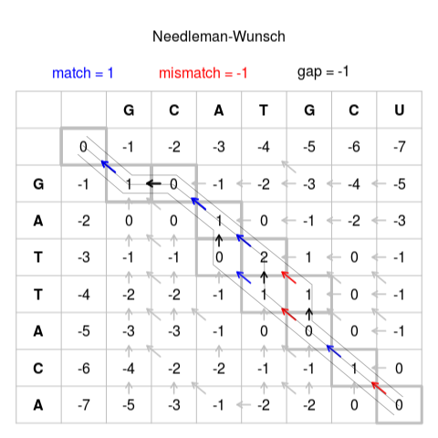
Algorithm – Needleman-Wunsch

Slide 5
Algorithm – Smith-Waterman
Do not use gap extension
Use gap extension

Slide 6
Example
Match:1
Mismatch:-6
Gap opening:-3
Gap extension:-1
 |  | C | C | G | A
 | 0 | -4 | -5 | -6 | -7
C | -4
A | -5
A | -6
G | -7
A | -8

Slide 7
Example
Match:1
Mismatch:-6
Gap opening:-3
Gap extension:-1
 |  | C | C | G | A
 | 0 | -4 | -5 | -6 | -7
C | -4 | 1
A | -5
A | -6
G | -7
A | -8

Slide 8
Example
Match:1
Mismatch:-6
Gap opening:-3
Gap extension:-1
 |  | C | C | G | A
 | 0 | -4 | -5 | -6 | -7
C | -4 | 1 | 1-4
A | -5
A | -6
G | -7
A | -8

Slide 9
Example
Match:1
Mismatch:-6
Gap opening:-3
Gap extension:-1
 |  | C | C | G | A
 | 0 | -4 | -5 | -6 | -7
C | -4 | 1 | -3 | 1-5
A | -5
A | -6
G | -7
A | -8

Slide 10
Example
Match:1
Mismatch:-6
Gap opening:-3
Gap extension:-1
 |  | C | C | G | A
 | 0 | -4 | -5 | -6 | -7
C | -4 | 1 | -3 | -4 | 1-6
A | -5
A | -6
G | -7
A | -8

Slide 11
Example
Match:1
Mismatch:-6
Gap opening:-3
Gap extension:-1
 |  | C | C | G | A
 | 0 | -4 | -5 | -6 | -7
C | -4 | 1 | -3 | -4 | -5
A | -5 | -3
A | -6
G | -7
A | -8

Slide 12
Example
Match:1
Mismatch:-6
Gap opening:-3
Gap extension:-1
 |  | C | C | G | A
 | 0 | -4 | -5 | -6 | -7
C | -4 | 1 | -3 | -4 | -5
A | -5 | -3 | -5
A | -6
G | -7
A | -8

Slide 13
Example
Match:1
Mismatch:-6
Gap opening:-3
Gap extension:-1
 |  | C | C | G | A
 | 0 | -4 | -5 | -6 | -7
C | -4 | 1 | -3 | -4 | -5
A | -5 | -3 | -5 | -8 | -3
A | -6
G | -7
A | -8

Slide 14
Example
Match:1
Mismatch:-6
Gap opening:-3
Gap extension:-1
 |  | C | C | G | A
 | 0 | -4 | -5 | -6 | -7
C | -4 | 1 | -3 | -4 | -5
A | -5 | -3 | -5 | -8 | -3
A | -6 | -4 | -8 | -9 | -7
G | -7
A | -8

Slide 15
Example
Match:1
Mismatch:-6
Gap opening:-3
Gap extension:-1
 |  | C | C | G | A
 | 0 | -4 | -5 | -6 | -7
C | -4 | 1 | -3 | -4 | -5
A | -5 | -3 | -5 | -8 | -3
A | -6 | -4 | -8 | -9 | -7
G | -7 | -5 | -9 | -7 | -8
A | -8

Slide 16
Example
Match:1
Mismatch:-6
Gap opening:-3
Gap extension:-1
 |  | C | C | G | A
 | 0 | -4 | -5 | -6 | -7
C | -4 | 1 | -3 | -4 | -5
A | -5 | -3 | -5 | -8 | -3
A | -6 | -4 | -8 | -9 | -7
G | -7 | -5 | -9 | -7 | -8
A | -8 | -6 | -10 | -11 | -6

Slide 17
Algorithm -- Gotoh
Smith-Waterman
Gotoh

Slide 18
Example
Match:1
Mismatch:-6
Gap opening:-3
Gap extension:-1
P |  | A | A
 |  | -∞ | -∞
T
T
H |  | A | A
 | 0 | -4 | -5
T | -4
T | -5
Q |  | A | A
T | -∞
T | -∞

Slide 19
Example
Match:1
Mismatch:-6
Gap opening:-3
Gap extension:-1
P |  | A | A
 |  | -∞ | -∞
T |  | -8
T
H |  | A | A
 | 0 | -4 | -5
T | -4
T | -5
Q |  | A | A
T | -∞ | -8
T | -∞

Slide 20
Example
Match:1
Mismatch:-6
Gap opening:-3
Gap extension:-1
P |  | A | A
 |  | -∞ | -∞
T |  | -8
T
H |  | A | A
 | 0 | -4 | -5
T | -4 | -6
T | -5
Q |  | A | A
T | -∞ | -8
T | -∞

Slide 21
Example
Match:1
Mismatch:-6
Gap opening:-3
Gap extension:-1
P |  | A | A
 |  | -∞ | -∞
T |  | -8 | -9
T
H |  | A | A
 | 0 | -4 | -5
T | -4 | -6 | -9
T | -5
Q |  | A | A
T | -∞ | -8 | -9
T | -∞

Slide 22
Example
Match:1
Mismatch:-6
Gap opening:-3
Gap extension:-1
P |  | A | A
 |  | -∞ | -∞
T |  | -8 | -9
T |  | -9
H |  | A | A
 | 0 | -4 | -5
T | -4 | -6 | -9
T | -5 | -9
Q |  | A | A
T | -∞ | -8 | -9
T | -∞ | -9

Slide 23
Example
Match:1
Mismatch:-6
Gap opening:-3
Gap extension:-1
P |  | A | A
 |  | -∞ | -∞
T |  | -8 | -9
T |  | -9 | -10
H |  | A | A
 | 0 | -4 | -5
T | -4 | -6 | -9
T | -5 | -9 | -10
Q |  | A | A
T | -∞ | -8 | -9
T | -∞ | -9 | -10

Slide 24
Example
Match:1
Mismatch:-6
Gap opening:-3
Gap extension:-1
P |  | A | A
 |  | -∞ | -∞
T |  | -8 | -9
T |  | -9 | -10
H |  | A | A
 | 0 | -4 | -5
T | -4 | -6 | -9
T | -5 | -9 | -10
Q |  | A | A
T | -∞ | -8 | -9
T | -∞ | -9 | -10
A A _ _
_ _ T T
Score is -10

Slide 25
Introduction – History
年代 | 作者 | 貢獻 | Time Complexity
1970 | Needleman-Wunsch | Use DP for global alignment | O(mn)
1976 | Smith-Waterman | Arbitrary gap penalties | O(mn(m+n))
1982 | Gotoh | Arbitrary Linear affine gap penalties | O(mn)
1984 | Waterman | Propose concave gap penalties
1988 | Miller-Myers | Refined 1984`s function in some condition | O(mn)
1988 | Miller-Myers | Use Hirschberg`s and 1984`s algorithm to compute concave gap penalties | O(mn log(m+n)) Space: O(m)

Slide 26
Introduction – convex
What is convex gap? For example, g(k) = a + b ln(k)
It has a characteristic : 「The longer the continuous gap, the less the increasing penalty. 」

Slide 27
Why use convex gap?
When continuous gap is longer, linear gap penalty will cause worse alignment.

Slide 28
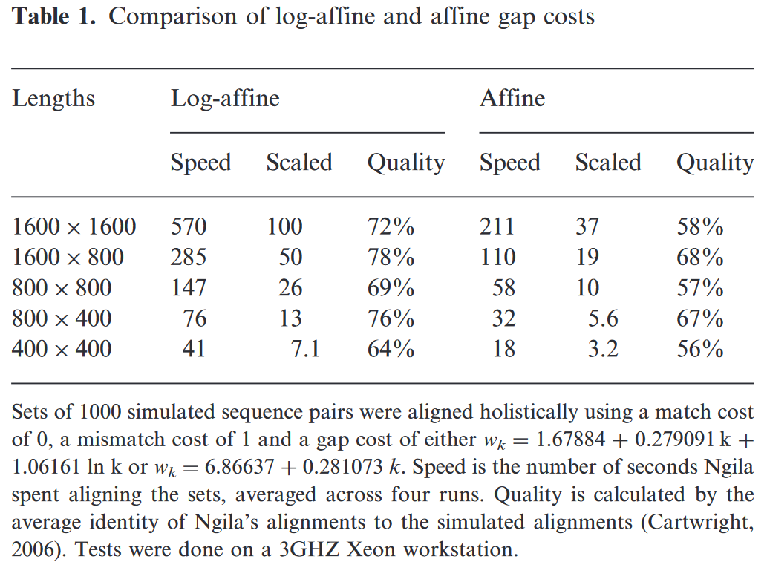
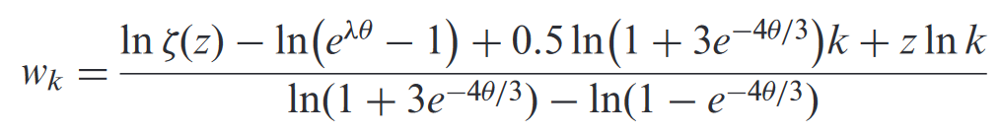
Performance

Slide 29
相關研究
中華大學-第19屆組數研討會 生物序列比對問題上考慮凸形間隔處罰函數的一些 O(nm)演算法
中華大學-2015 考慮凹形間隔處罰函數之有效率生物序列比對演算法
常見的演算法– 1997 Gusfield algorithm

Slide 30
A Basic Analysis Toolkit for Biological Sequences
Raffaele Giancarlo, Alessandro Siragusa,
Enrico Siragusa and Filippo Utro
Algorithms for Molecular Biology, Volume 2,
Article number: 10 (2007)
Presenter: Yuan-Hsiu Tsai
Date: Jan. 12, 2021

Slide 31
Abstract(1/2)
This paper presents a software library, nicknamed BATS, for some basic sequence analysis tasks. Namely, local alignments, via approximate string matching, and global alignments, via longest common subsequence and alignments with affine and concave gap cost functions. Moreover, it also supports filtering operations to select strings from a set and establish their statistical significance, via z-score computation. None of the algorithms is new, but although they are generally regarded as fundamental for sequence analysis, they have not been implemented in a single and consistent software package, as we do here.

Slide 32
Abstract(2/2)
Therefore, our main contribution is to fill this gap between algorithmic theory and practice by providing an extensible and easy to use software library that includes algorithms for the mentioned string matching and alignment problems. The library consists of C/C++ library functions as well as Perl library functions. It can be interfaced with Bioperl and can also be used as a stand-alone system with a GUI. The software is available at http://www.math.unipa.it/~raffaele/BATS/ under the GNU GPL.

Slide 33
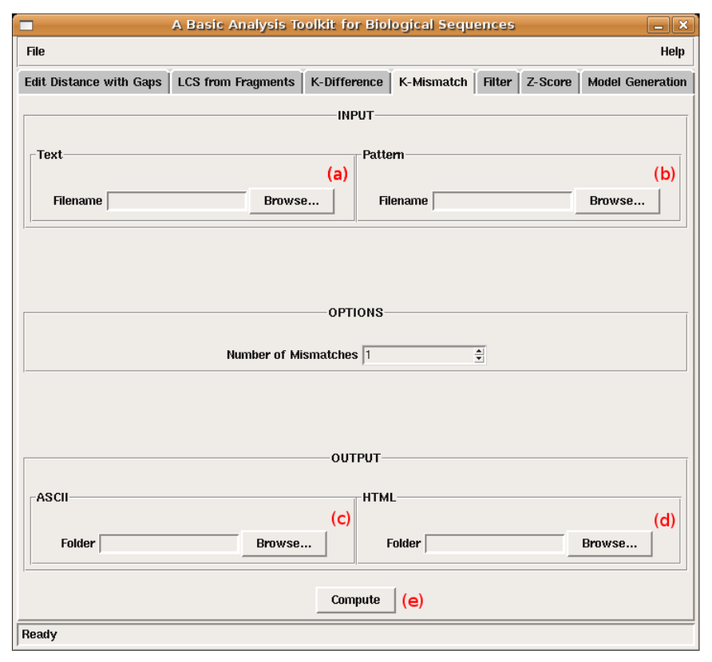
Introduction – K-Mismatch

Slide 34
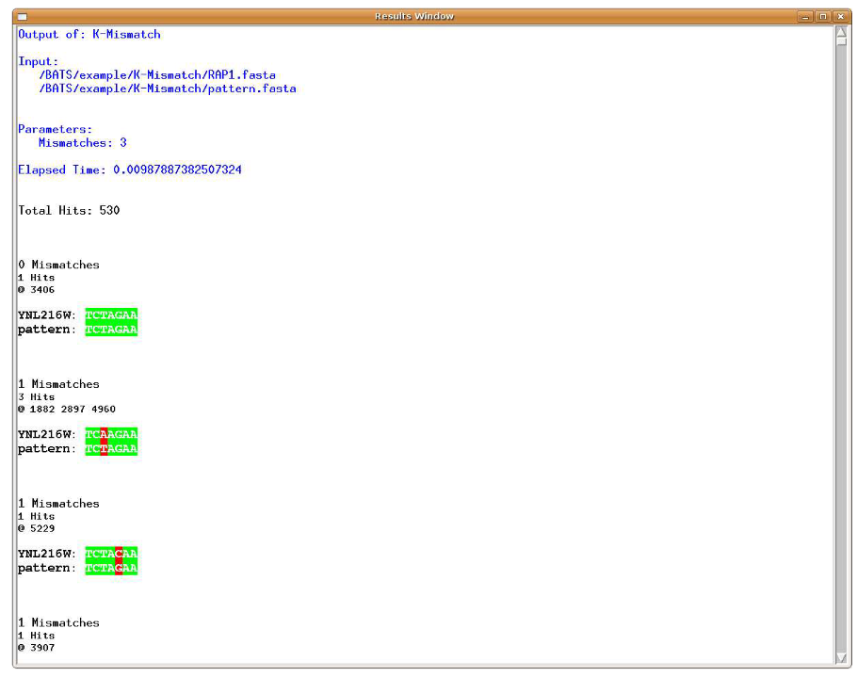
Introduction – K-Mismatch

Slide 35
Introduction – K-Mismatch
Find all seeds in the text with at most k mismatchs.
Use 1. Suffix tree 2. Lowest common Ancestor
Time complexity : O(m+n+nk)

Slide 36
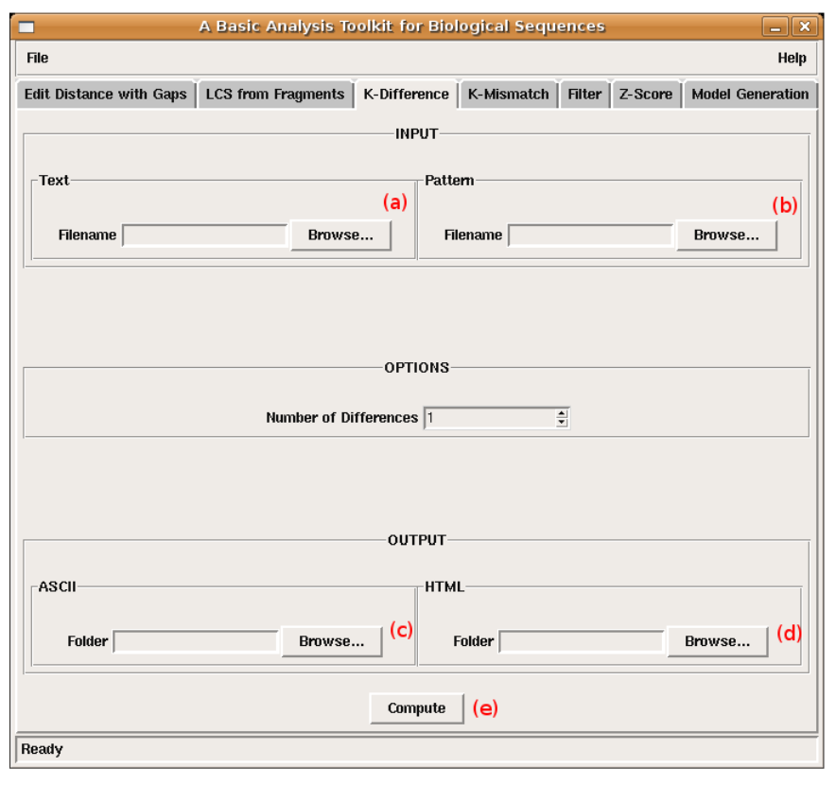
Introduction – K-Difference

Slide 37
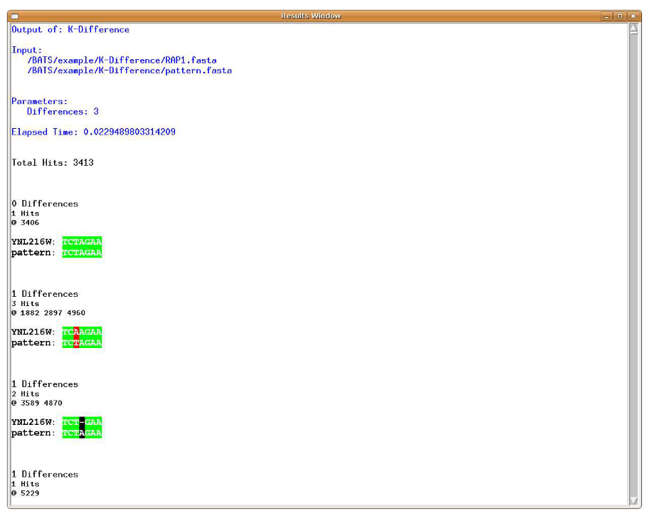
Introduction – K-Difference

Slide 38
Introduction – K-Difference
Find all seeds in the text with at most k differences. Difference have insert, delete and replace.
Use 1. Dynamic programming
Time complexity : O(m+n+nk)

Slide 39
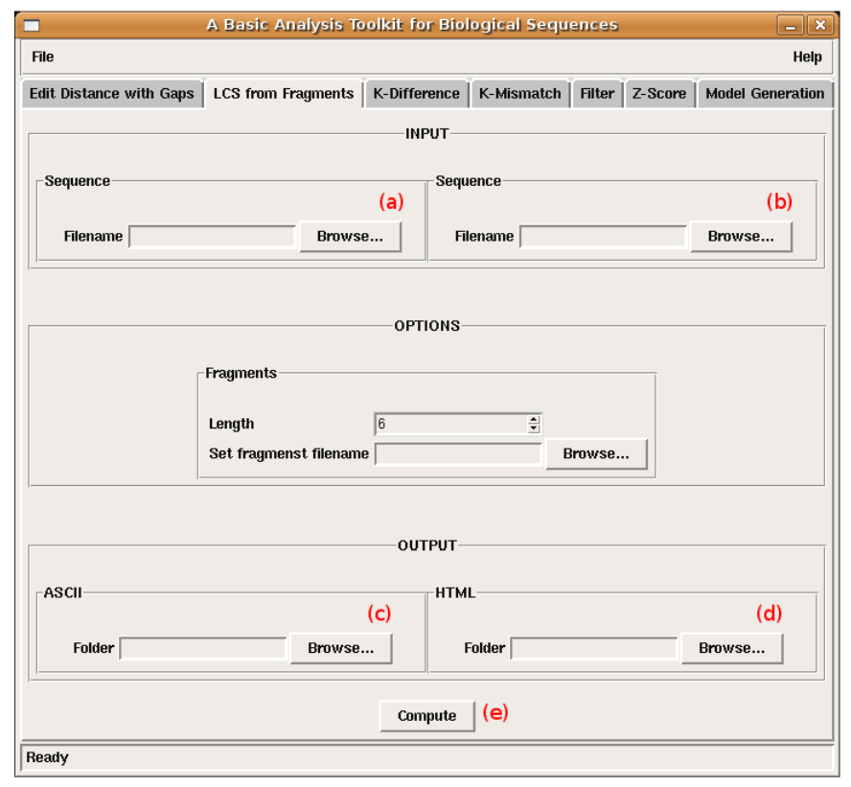
Introduction – LCS from Fragments

Slide 40
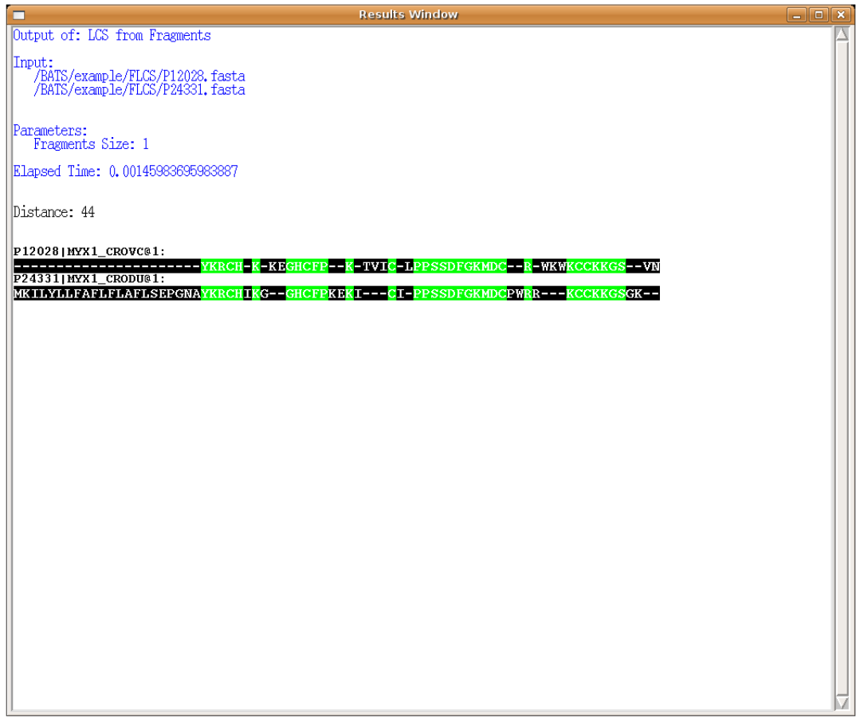
Introduction – LCS from Fragments

Slide 41
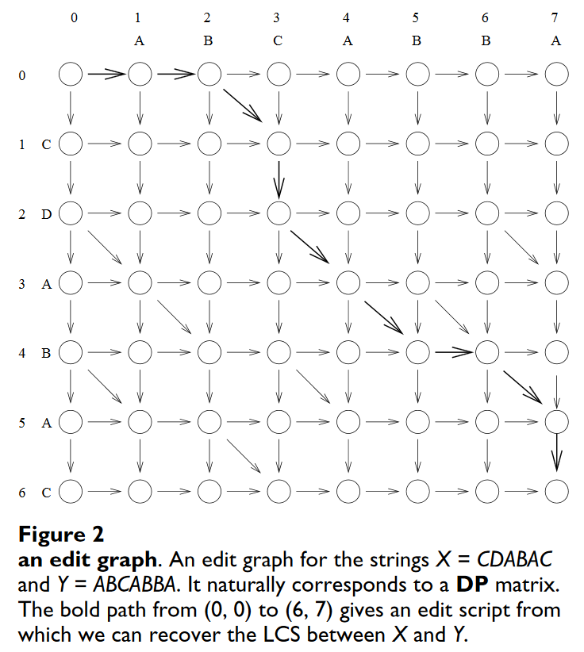
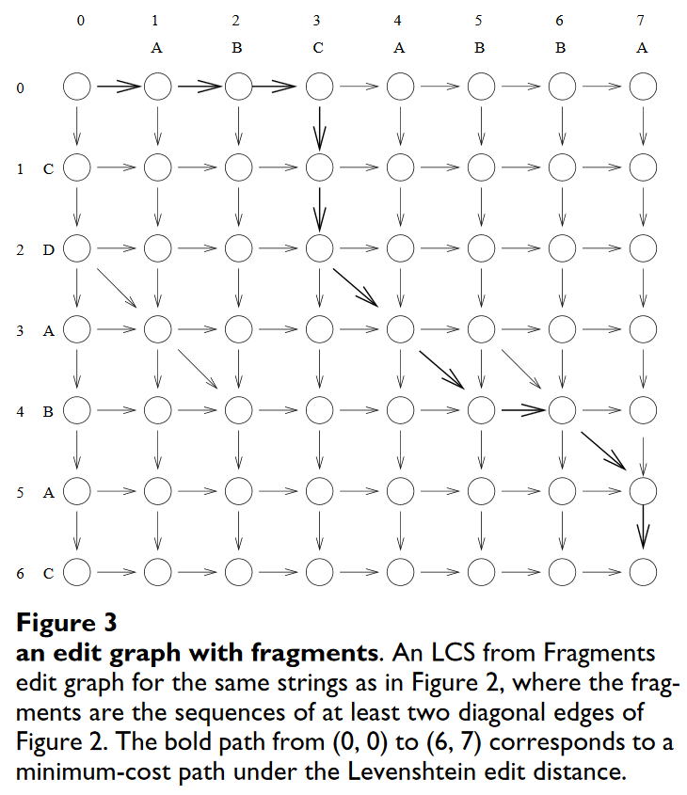
Introduction – LCS from Fragments

Slide 42
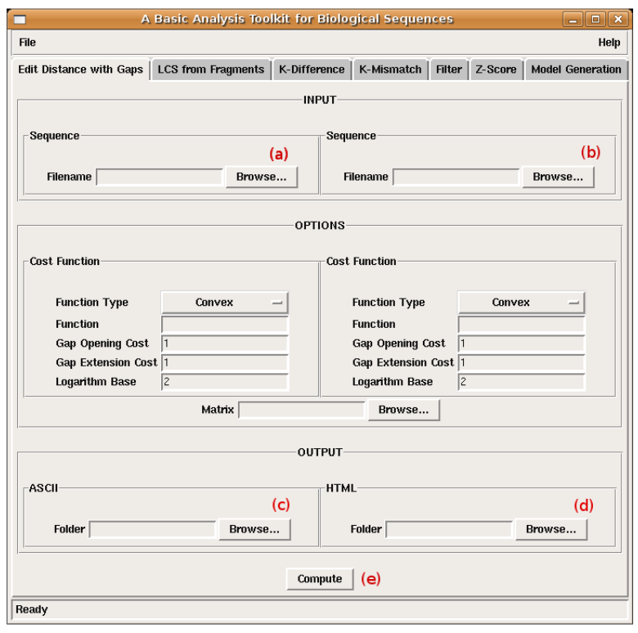
Introduction – Edit distance with gaps

Slide 43
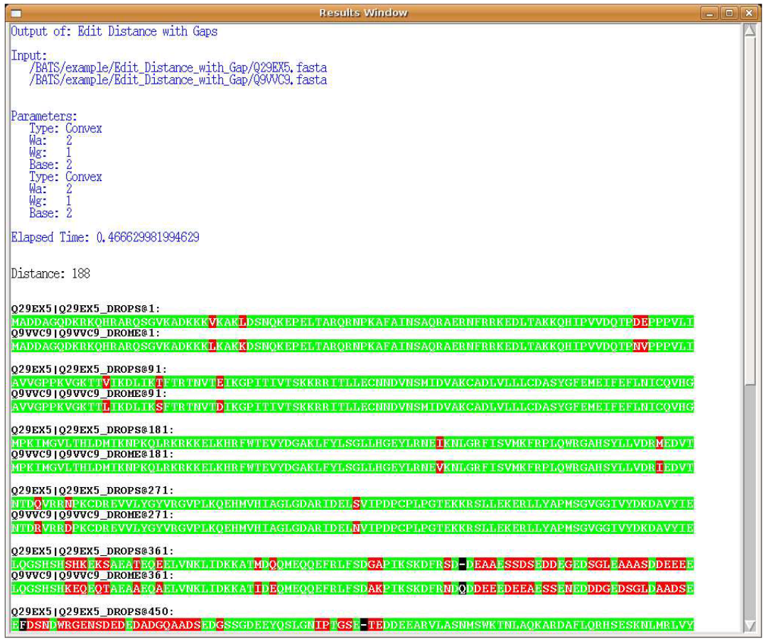
Introduction – Edit distance with gaps

Slide 44
Introduction – Edit distance with gaps
Use affine or concave function of the gap
Use Galil and Giancarlo algorithm
Time complexity : O(mn log max(m, n))

Slide 45
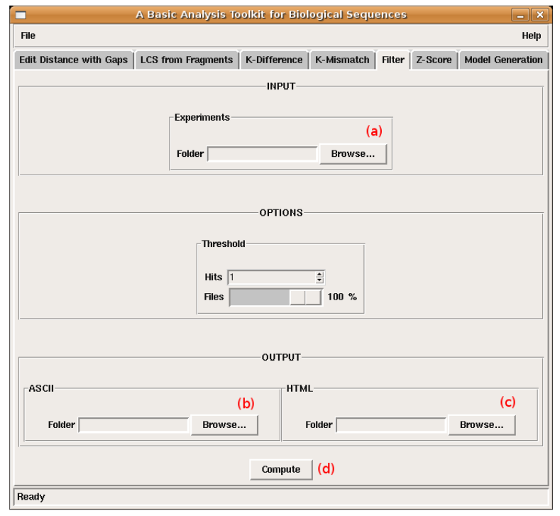
Introduction – Filter

Slide 46
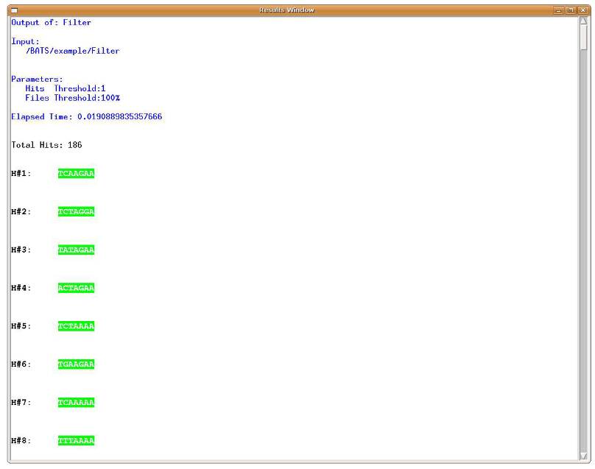
Introduction – Filter

Slide 47
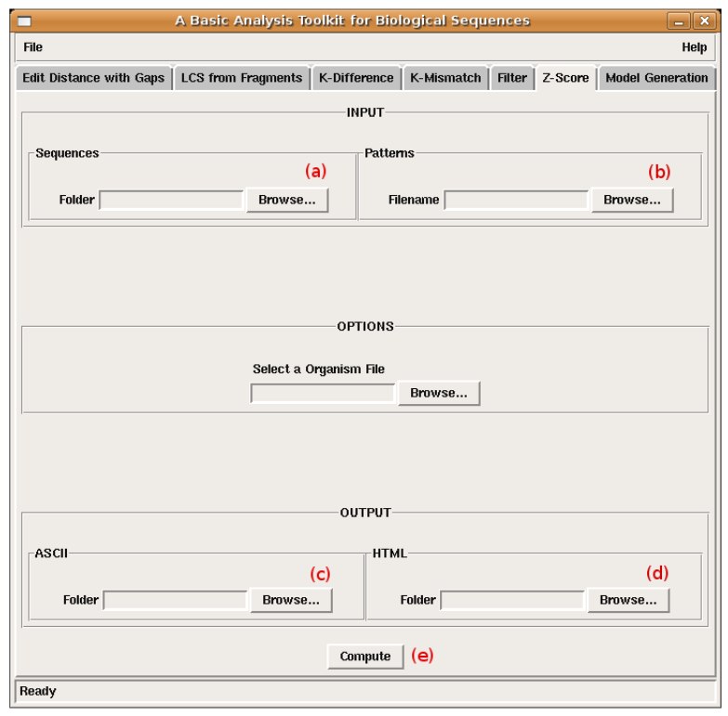
Introduction – Z-Score

Slide 48
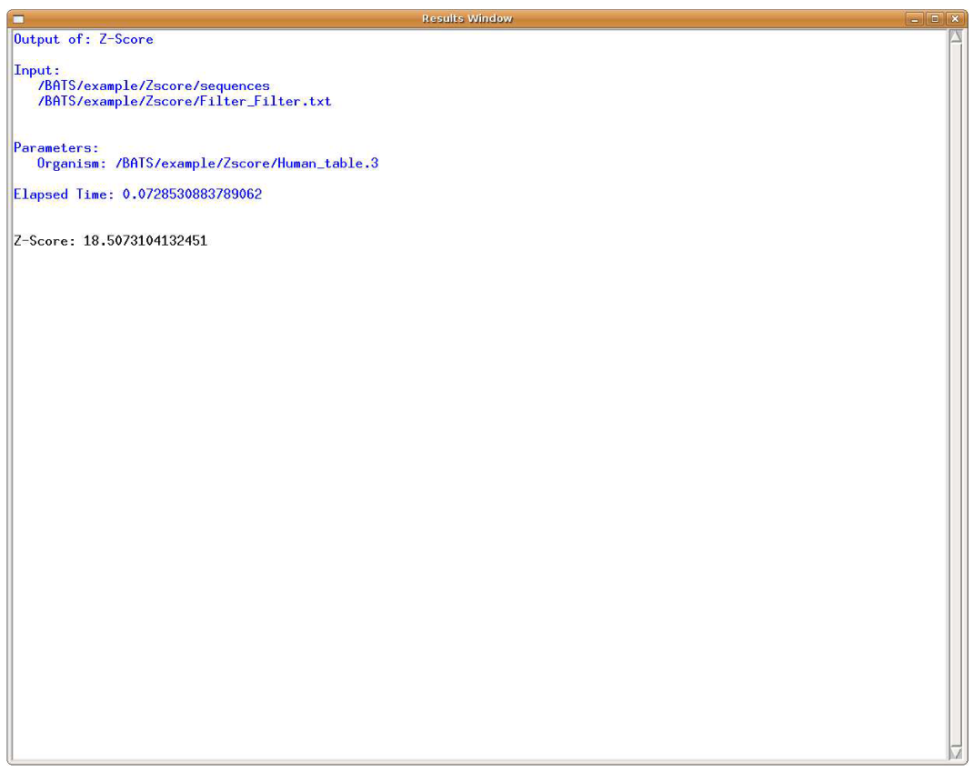
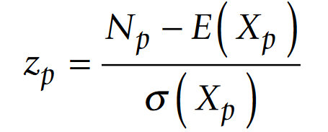
Introduction – Z-Score

