Slide 1
On the Complexity of Sequence-to-graph Alignment
Chirag Jain, Haowen Zhang, Yu Gao, and Srinivas Aluru
Journal of Computational Biology
Volume 27, Number 0, 2020, Pages 1-15
Presenter：Yu-Cheng Chang
Date：Jan. 26, 2021

Slide 2
Abstract (1/2)
Availability of extensive genetic data across multiple individuals and populations is driving the growing importance of graph-based reference representations. Aligning sequences to graphs is a fundamental operation on several types of sequence graphs (variation graphs, assembly graphs, pan-genomes, etc.) and their biological applications. Although research on sequence-to-graph alignments is nascent, it can draw from related work on pattern matching in hypertext. In this article, we study sequence-to-graph alignment problems under Hamming and edit distance models, and linear and affine gap penalty functions, for multiple variants of the problem that allow changes in query alone, graph alone, or in both.

Slide 3
Abstract (2/2)
We prove that when changes are permitted in graphs either standalone or in conjunction with changes in the query, the sequence-to-graph alignment problem is NP-complete under both Hamming and edit distance models for alphabets of size ≥ 2. For the case where only changes to the sequence are permitted, we present an O(|V| + m|E|) time algorithm, where m denotes the query size, and V and E denote the vertex and edge sets of the graph, respectively. Our result is generalizable to both linear and affine gap penalty functions, and improves upon the runtime complexity of existing algorithms.

Slide 4
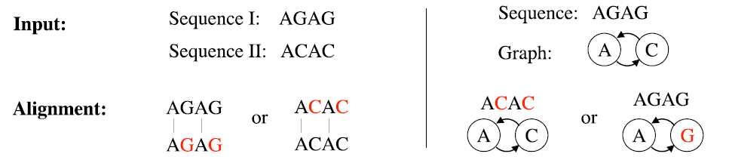
Sequence-to-graph alignment
sequence-to-sequence
sequence-to-graph
2 substitutions
2 substitutions
1 substitution

Slide 5
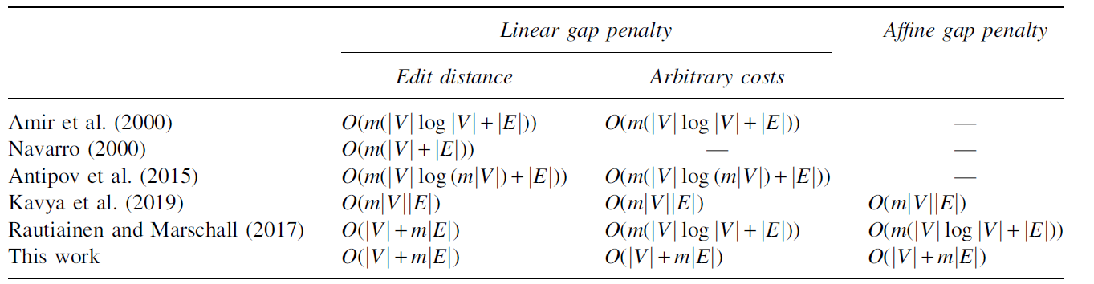
Complexity of related algorithms
a b _ _ a b _ c c c a b _ _ _ a b c c c
linear gap penalty: -4*3 = -12
affine gap penalty: -4-2*2 + -4-2*1 = -14 -4-2*3 = -10

Slide 6
Hardness
Variants of sequence-to-graph alignment
Hamming distance model：
Changes to graph alone
Changes to both graph and query
Changes to query alone
Edit distance model：
Changes to graph alone
Changes to both graph and query
Changes to query alone
NP-complete
NP-complete

Slide 7
Hamming distance model
Theorem 3.1：
The problem “Can we substitute a total of ≤ d characters in graph G and query q such that q will have a matching path in G?” is NP-complete for |Σ| ≥ 2
Corollary 3.1.1：
The problem “Can we substitute a total of ≤ d characters in graph G such that q will have a matching path in G?” is NP-complete for |Σ| ≥ 2

Slide 8
Hamming distance model
directed Hamiltonian cycle ∝ sequence-to-graph alignment
label：α^{n} t_{i}： α^{n-i-1}βα^{i} q： ( t₀t₁t₂…t_{n-1} )^{2n+2}
G’(V,E)
G(V,E,σ)
αααα
αααα
αααα
αααα
q: (αααβ ααβα αβαα βααα )¹⁰

Slide 9
Hamming distance model
directed Hamiltonian cycle ∝ sequence-to-graph alignment => suppose there is a Hamiltonian cycle in G’(V,E)
G(V,E,σ)
G(V,E,σ)
αααα
αααα
αααβ
ααβα
4 substitutions
αααα
αααα
βααα
αβαα
q: (αααβ ααβα αβαα βααα )¹⁰

Slide 10
Hamming distance model
directed Hamiltonian cycle ∝ sequence-to-graph alignment <= q_{sub}：t₀t₁t₂…t_{n-1}t₀t₁ ( a directed Hamiltonian cycle problem if t_{i}(0 ≤ i ≤ n-1) are unique )
there are n+1 nonoverlapping instances of q_{sub} in q
at most n substitutions. Even if all occur in the query, at least one instance of q_{sub} must remain unchanged.
Accordingly, q_{sub} must match corrected G(V,E,σ).
q：( t₀t₁t₂…t_{n-1} )^{2n+2}
q_{sub} |  |  |  |  |  |  |  |  |  | q_{sub} |  |  |  |  |  |  |  |  |  | …
t₀ | t₁ | t₂ | … | t_{n-1} | t₀ | t₁ | t₂ | … | t_{n-1} | t₀ | t₁ | t₂ | … | t_{n-1} | t₀ | t₁ | t₂ | … | t_{n-1} | t₀ | t₁
… |  |  | q_{sub} |  |  |  |  |  |  |  |  |  | q_{s..} |  | … |  | q_{sub}
 |  |  | t₀ | t₁ | t₂ | … | t_{n-1} | t₀ | t₁ | t₂ | … | t_{n-1} | t₀ | t₁ | t₂ | … | t₀ | t₁ | t₂ | … | t_{n-1}

Slide 11
Edit distance model
Theorem 3.2：
The problem “Can we perform a total of ≤ d edits in graph G and query q such that q will match in G?” is NP-complete for |Σ| ≥ 2
Corollary 3.2.1：
The problem “Can we perform a total of ≤ d edits in graph G such that q will match in G?” is NP-complete for |Σ| ≥ 2

Slide 12
Edit distance model
directed Hamiltonian cycle ∝ sequence-to-graph alignment
label：α^{2n}β ^{2n}α^{2n} t_{i}： α^{2n}β ^{i}αβ ^{2n-1-i}α^{2n} q： ( t₀t₁t₂…t_{n-1} )^{2n+2}
G’(V,E)
G(V,E,σ)
α⁸β ⁸α⁸
α⁸β ⁸α⁸
α⁸β ⁸α⁸
α⁸β ⁸α⁸
q: (α⁸αβ⁷α⁸ α⁸βαβ⁶α⁸ α⁸β²αβ⁵α⁸ α⁸β³αβ⁴α⁸ )¹⁰

Slide 13
Edit distance model
directed Hamiltonian cycle ∝ sequence-to-graph alignment => if there is a Hamiltonian cycle
G(V,E,σ)
G(V,E,σ)
α⁸β ⁸α⁸
α⁸β ⁸α⁸
4 substitutions
α⁸αβ ⁷α⁸
α⁸βαβ ⁶α⁸
α⁸β ⁸α⁸
α⁸β ⁸α⁸
α⁸β ³αβ ⁴α⁸
α⁸β ²αβ ⁵α⁸
q: (α⁸αβ ⁷α⁸ α⁸βαβ ⁶α⁸ α⁸β ²αβ ⁵α⁸ α⁸β ³αβ ⁴α⁸ )¹⁰

Slide 14
Edit distance model
directed Hamiltonian cycle ∝ sequence-to-graph alignment <= q_{sub}：t₀t₁t₂…t_{n-1}t₀
there are n+1 nonoverlapping instances of q_{sub} in q
at most n substitutions. Even if all occur in the query, at least one instance of q_{sub} must remain unchanged.
Accordingly, q_{sub} must match corrected G(V,E,σ).

Slide 15
Edit distance model
directed Hamiltonian cycle ∝ sequence-to-graph alignment <= t_{i}： α^{2n}β ^{i}αβ ^{2n-1-i}α^{2n}，length of kernel(β ^{i}αβ ^{2n-1-i}) is 2n
a kernel must be matched entirely within a vertex
Since any vertex label cannot shrink from length 6n to < 5n，a kernel cannot be matched to an entire vertex after the edits. It implies that a kernel must match to ≤ 2 vertices.
6n：origin vertex label
5n：shrank vertex label
2n：kernel

Slide 16
Edit distance model
q: (α⁸αβ ⁷α⁸ α⁸βαβ ⁶α⁸ α⁸β ²αβ ⁵α⁸ α⁸β ³αβ ⁴α⁸ )¹⁰
directed Hamiltonian cycle ∝ sequence-to-graph alignment <= t_{i}： α^{2n}β ^{i}αβ ^{2n-1-i}α^{2n}，length of kernel(β ^{i}αβ ^{2n-1-i}) is 2n
a kernel must be matched entirely within a vertex
if a kernel aligns across two vertices, (2n-1) α will be replaced with β, > n edits
Origin : α⁸β⁸αααααααα ααααααααβ⁸α⁸
Kernel₁: α⁸β⁸αααααααα βββββββαβ⁸α⁸
Kernel₂: α⁸β⁸ααααααβα ββββββα²β⁸α⁸
Kernel₃: α⁸β⁸αααααββα βββββα³β⁸α⁸
Kernel₄: α⁸β⁸ααααβββα ββββα⁴β⁸α⁸

Slide 17
Summary of hardness
It is straightforward to prove that other problem variants, for example, with linear gap penalty or affine gap penalty scoring functions are at least as hard as the edit distance-based formulations. Therefore, the sequence-to-graph alignment problem remains NP-complete even on constant sized alphabets for these classes of scoring functions, and also if changes are permitted in the graph. Finally, we note that all the above problems remain equally hard even for planar sequence graphs of max-degree 3, as is true for the Hamiltonian cycle problem.

Slide 18
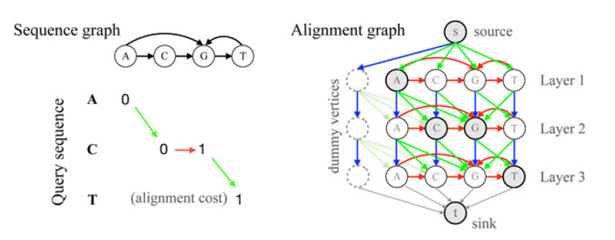
Sequence-to-graph alignment
 |  | A | C | G | T
 | 0 | 1 | 2 | 3 | 4
A | 1 | 0 | 1 | 2 | 3
C | 2 | 1 | 0 | 1 | 2
T | 3 | 2 | 1 | 1 | 1
sequence-to-sequence alignment： DP shortest-path problem
sequence-to-graph alignment： DP：only for DAG (Directed Acyclic Graph) shortest-path problem
polynomially solvable when changes are allowed in the query sequence alone

Slide 19
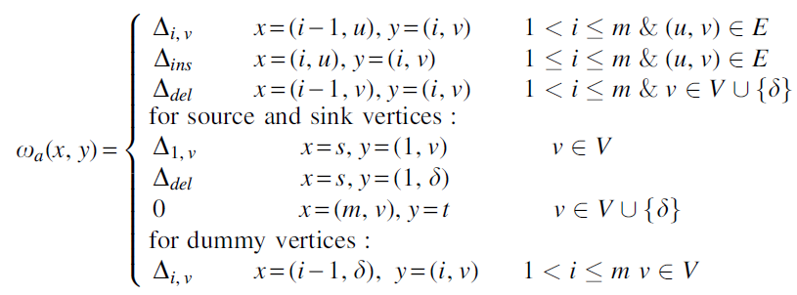

Sequence-to-graph alignment
deletion
substitution
insertion

Slide 20
Sequence-to-graph alignment
Use Dijkstra’s algorithm to solve shortest path： O(|V|²) or O(|V|log|V| + |E|) with Fibonacci heap
=> O(m|V|log(m|V|) + m|E|)
Proposed algorithm： => O(|V| + m|E|)

Slide 21
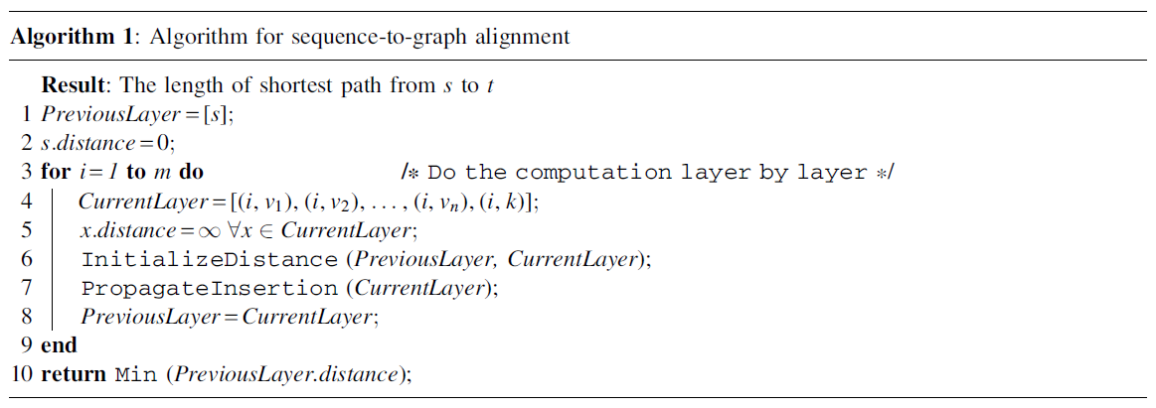
Sequence-to-graph alignment
O(|V| + |E|) + O(|V|)
O(|V| + |E|)

Slide 22
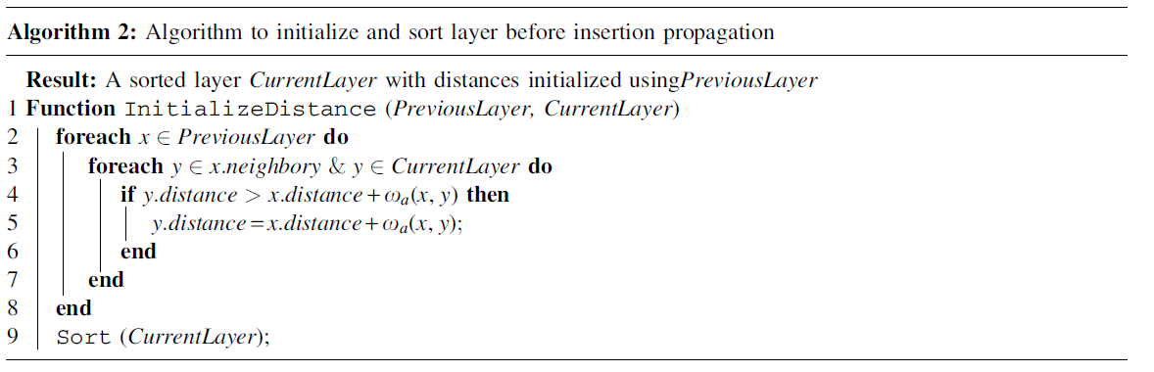
InitializeDistance()
O(|V|)
deletion
compute
first
substitution

Slide 23
Sort()
v.distance | 0 (A)
v.distance + Δ_{sub} | 1 (C) | 1 (G) | 1 (T)
v.distance + Δ_{del} | 1 (dummy)
v
merge them in O(|V|)
so, time complexity of InitializeDistance() is O(|V| + |E|)
Notes:
其實只有5個 (|V|) 再用，因為 y.distance > x.distance + w(x,y)，更新為Optimal之後就不會更新了

Slide 24
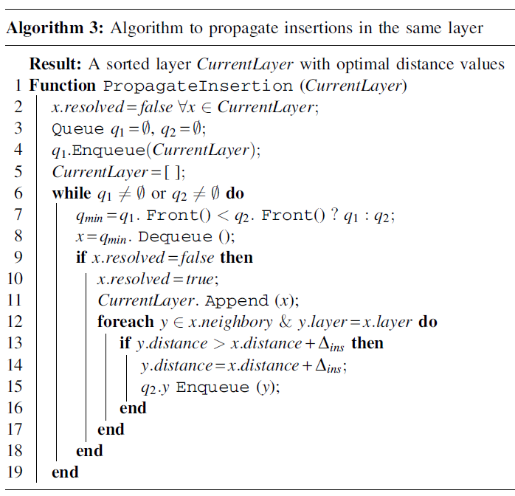
PropagateInsertion()
the distance of a vertex can be updated at most once => max number of enqueue operations is O(|V|)
O(|V|)
amortized O(|V| + |E|)
compute
insertion

Slide 25
Sequence-to-graph alignment
O(|V| + |E|) + O(|V|)
O(|V| + |E|)
O(|V| + |E|) preprocessing
O(m(|V| + |E|))
O(|V| + m|E|)

Slide 26

Preprocessing
Mikko Rautiainen and Tobias Marschall － Aligning sequences to general graphs in O(|V| + m|E|) time － bioRxiv. DOI: 10.1101/216127. This step transforms the sequence graph by merging all vertices with 0 in-degree (and the same node label) into ≤ |Σ| vertices. As a result, the preprocessing ensures that the count of vertices in the new graph is no more than |E| + |Σ| without affecting the correctness
InitializeDistance() takes O(|E|)
PropagateInsertion() takes O(|E|)
total： O(|V| + |E|) + O(m|E|) = O(|V| + m|E|)
0 in-degree vertex

Slide 27
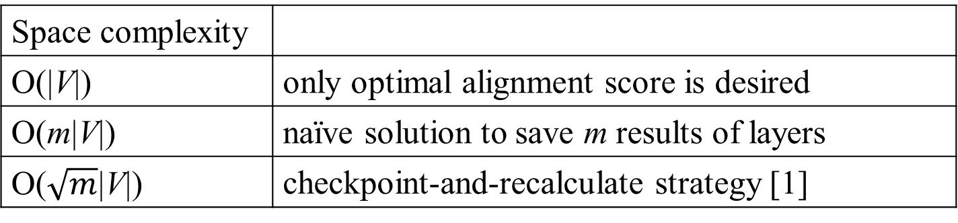
Traceback
Space complexity
O(|V|) | only optimal alignment score is desired
O(m|V|) | naïve solution to save m results of layers
O($\sqrt{m}$|V|) | checkpoint-and-recalculate strategy [1]
Space requirement can be further reduced, but at the cost of increased time complexity [1]
[1] J.Alicia Grice, Richard Hughey, Don Speck － Reduced space sequence alignment － Bioinformatics, Volume 13, Issue 1, February 1997, Pages 45–53

Slide 28
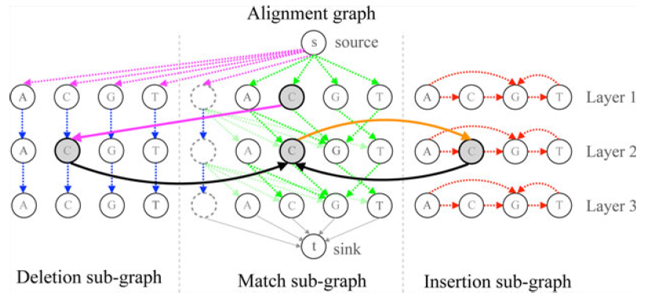
General to affine gap penalty
2 stages ( InitializeDistance & PropagateInsertion ) → 5 stages ( 4 * InitializeDistance & PropagateInsertion )

Slide 29
General to affine gap penalty
initializing optimal distances of vertices in the deletion layer using distances of vertices in the above match and deletion layers

Slide 30
General to affine gap penalty
initialize distances of vertices in the current match layer using distances of vertices in the current deletion layer and the above match layer

Slide 31
General to affine gap penalty
the distances of vertices in the current match layer are then utilized to initialize the current insertion layer

Slide 32
General to affine gap penalty
resolve distances in the current insertion layer using the insertion propagation algorithm (algorithm 3)

Slide 33
General to affine gap penalty
the distances of vertices in the current insertion layer are used to make a final update to the current match layer

Slide 34
Lower bounds
the sequence-to-sequence alignment problem is a special case of the sequence-to-graph alignment problem because a sequence can be represented as a directed chain graph with character labels. As a result, existence of either O(m^{1-ε}|E|) or O(m|E|^{1- ε})‚ ε > 0 time algorithm for solving the sequence-to-graph alignment problem (for both acyclic or cyclic graphs) is unlikely because it would also yield a strongly subquadratic algorithm for solving the sequence-to-sequence alignment problem

Slide 35
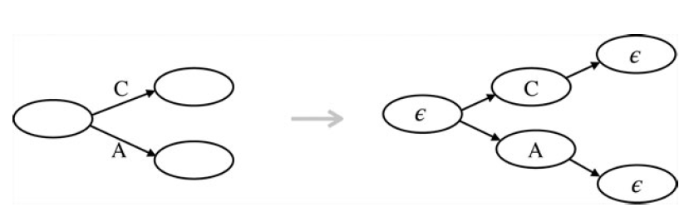
Generalization to commonly used graphs
Directed graphs with labeled edges：
|V ’| = |E| + |V|
|E’| = 2|E|
G(V,E)
G’(V’,E’)

Slide 36
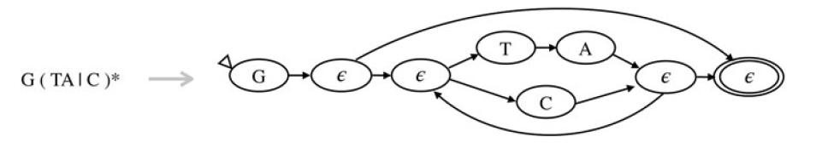
Generalization
Regular expression：
Seek a minimum-cost set of edits that converts a sequence to match a regular expression.
Convert R into an ε-labeled nondeterministic automaton is linear in |R| [2]
Solve sequence to regular expression alignment in O(m|R|)
R
[2] Eugene W.Myers and Webb Miller － Approximate matching of regular expressions － Bulletin of Mathematical Biology
Volume 51, Issue 1, 1989, Pages 5-37

Slide 37
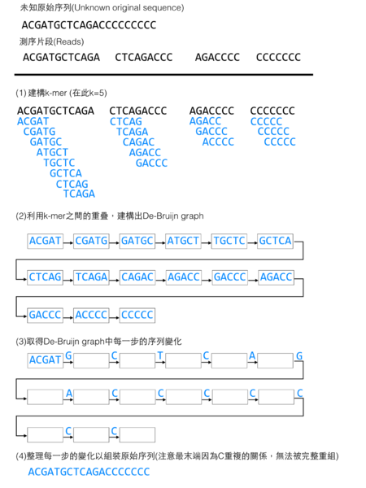
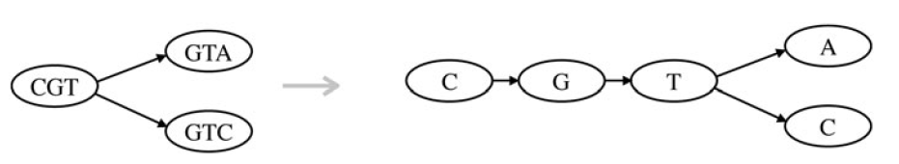
Generalization
Directed assembly graphs：
De Bruijn graphs ( used for sequence assembly )

