Slide 1
Beam search for the longest common subsequence problem
Christian Blum, Maria J. Blesa and
Manuel López-Ibáñez
Computers & Operations Research, Volume 36, Issue 12,
December 2009, Pages 3178-3186.
Presenter: Shin-Cheng Lin
Date: Jan. 26, 2021

Slide 2
Abstract
The longest common subsequence problem is a classical string problem that concerns finding the common part of a set of strings. It has several important applications, for example, pattern recognition or computational biology. Most research efforts up to now have focused on solving this problem optimally. In comparison, only few works exist dealing with heuristic approaches. In this work we present a deterministic beam search algorithm. The results show that our algorithm outperforms the current state-of-the-art approaches not only in solution quality but often also in computation time.

Slide 3
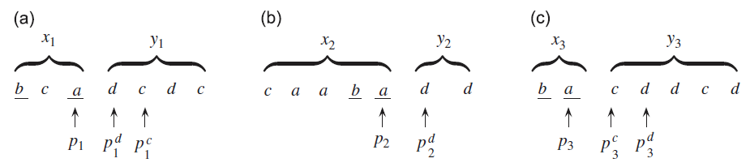
k_{bw}=2, μ=1.5
Each step choose maximally 2*1.5=3 extensions of the subsequences that are in the beam B.

Slide 4
Step 1
Choose the three extensions of the empty string with minimal rank-sum.

Slide 5
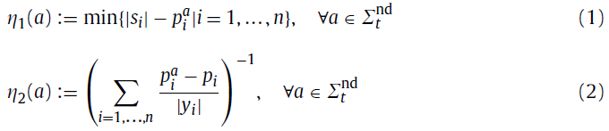
Greedy function
(1):The minimum number of remaining characters
(2):The reciprocal of the sum of usage rates
Larger is better

Slide 6

Rank
The order of Greedy function values
s1 = bcadcdc
s2 = caabadd
s3 = bacddcd
T=∅
η(T+a)=4, rank(ta)=1
η(T+b)=3, rank(tb)=3
η(T+c)=4, rank(tc)=2
η(T+d)=1, rank(td)=4

Slide 7

Rank-sum
Used to compare the extensions of different subsequences
Smaller is better
t=∅
v(ta)=r(t₀)+r(ta)=0+1=1
v(tb)=r(t₀)+r(tb)= 0+3=3
v(tc)=r(t₀)+r(tc)= 0+2=2
v(td)=r(t₀)+r(td)= 0+4=4

Slide 8
Step 1
v(ta)=r(t0)+r(ta)=0+1=1
v(tb)=r(t0)+r(tb)= 0+3=3
v(tc)=r(t0)+r(tc)= 0+2=2
v(td)=r(t0)+r(td)= 0+4=4
C={a,b,c}

Slide 9
Step 2
C={a,b,c}
k_{bw}=2, the beam width is two, so we have to discard one of the chosen extensions with the minimum upper bound.

Slide 10

Upper bound
s1 = bcadcdc
s2 = caabadd
s3 = bacddcd
t={∅}
UB(a)=|a|+0+0+0+2=3

Slide 11
Upper bound
s1 = bcadcdc
s2 = caabadd
s3 = bacddcd
t={∅}
UB(b)=|b|+1+0+0+2=4

Slide 12
Upper bound
s1 = bcadcdc
s2 = caabadd
s3 = bacddcd
t={∅}
UB(c)=|c|+0+0+0+2=3

Slide 13
Step 2
C={a,b,c}
k_{bw}=2, the beam width is two, so we have to discard one of the chosen extensions with the minimum upper bound.
UB(a)=3
UB(b)=4
UB(c)=3
T={a,b}

Slide 14
Step 3
Repeat step 1 and step 2 until B={∅}

Slide 15
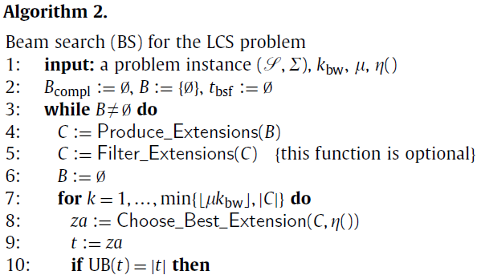
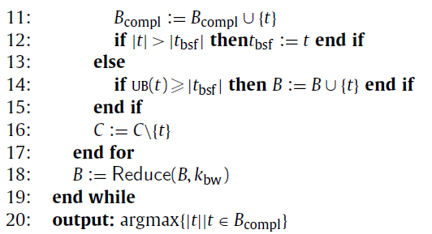

Slide 16
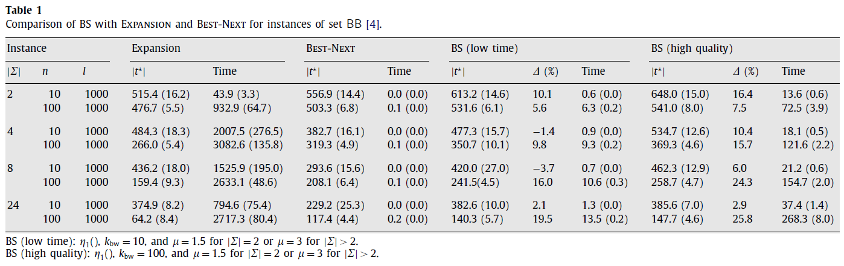

Slide 17
