Slide 1
Computing a longest common almost-increasing subsequence (LCaIS)of two sequences
Theoretical Computer Science Volume 854, 16 January 2021, Pages 44-51
Toan-Thang Ta, Yi-Kung Shieh, Chin-Lung Lu
Persenter : Jue-Jun Wu
Date : Jan. 26th , 2021

Slide 2
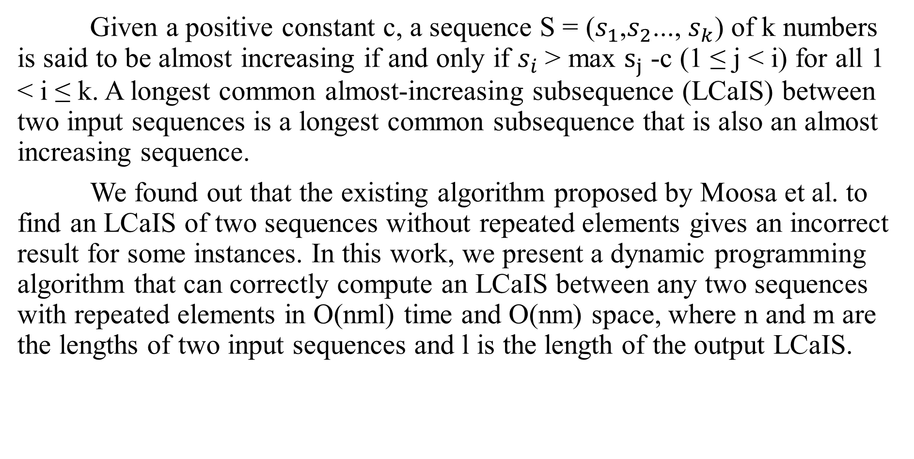
Abstract
Given a positive constant c, a sequence S = ($s_{1}$,$s_{2}$..., $s_{k}$) of k numbers is said to be almost increasing if and only if $s_{i}$> max $s_{j}$ -c (1 ≤ j < i) for all 1 < i ≤ k. A longest common almost-increasing subsequence (LCaIS) between two input sequences is a longest common subsequence that is also an almost increasing sequence.
We found out that the existing algorithm proposed by Moosa et al. to find an LCaIS of two sequences without repeated elements gives an incorrect result for some instances. In this work, we present a dynamic programming algorithm that can correctly compute an LCaIS between any two sequences with repeated elements in O(nml) time and O(nm) space, where n and m are the lengths of two input sequences and l is the length of the output LCaIS.
Notes:
文獻[1]發現兩個序列的LCaIS沒有重複的元素在某些情況下給出了錯誤的結果。
這項工作中，我們提出了一種動態規划算法，該算法可以正確計算任意兩個具有O（nml）時間和O（nm）空間中重複元素的序列之間的LCaIS，其中n和m是兩個輸入序列的長度，而l是 輸出LCaIS的長度。

Slide 3
Motivates
Note that the LCaIS problem considered by Moosa et al. requires no repeated elements in each input sequence.
Length of two input sequence be same size.
Moosa et al. removing the sequence of larger ending value when there exist more than one sequence of equal length was not strictly proved in Moosa.
Notes:
這驅使我們用一個正確的演算法來解答

Slide 4
Moosa
A,B | 9 | 8 | 11 | 7 | 6
11 |  |  | *
7 |  |  |  | *
9 | *
8 |  | *
6 |  |  |  |  | *

Slide 5
Moosa
A,B | 9 | 8 | 11 | 7 | 6
11 |  |  | *
7 |  |  |  | *
9 | *
8 |  | *
6 |  |  |  |  | *
length 1: <11> <9>

Slide 6
A,B | 9 | 8 | 11 | 7 | 6
11 |  |  | *
7 |  |  |  | *
9 | *
8 |  | *
6 |  |  |  |  | *
length 2: <11, 7> <9, 8>

Slide 7
A,B | 9 | 8 | 11 | 7 | 6
11 |  |  | *
7 |  |  |  | *
9 | *
8 |  | *
6 |  |  |  |  | *
length 1: <11> <9>
length 2: <11, 7> <9, 8>
Keeps the sequence of the smallest ending value among sequences having the same length for later computation.

Slide 8
A,B | 9 | 8 | 11 | 7 | 6
11 |  |  | *
7 |  |  |  | *
9 | *
8 |  | *
6 |  |  |  |  | *
length 1: <11> <9> <9>
length 2: <11, 7> <9, 8> <11, 7>
Keeps the sequence of the smallest ending value among sequences having the same length for later computation.

Slide 9
A,B | 9 | 8 | 11 | 7 | 6
11 |  |  | *
7 |  |  |  | *
9 | *
8 |  | *
6 |  |  |  |  | *
length 3: <11, 7, 6>

Slide 10
A,B | 9 | 8 | 11 | 7 | 6
11 |  |  | *
7 |  |  |  | *
9 | *
8 |  | *
6 |  |  |  |  | *
length 3: <11, 7, 6> <9, 8, 6>
Notes:
當Moosa中沒有嚴格證明存在多個相同長度的序列時，刪除較大終止值的序列。
這促使我們設計出正確的算法來解決這項工作中的LCaIS問題。

Slide 11
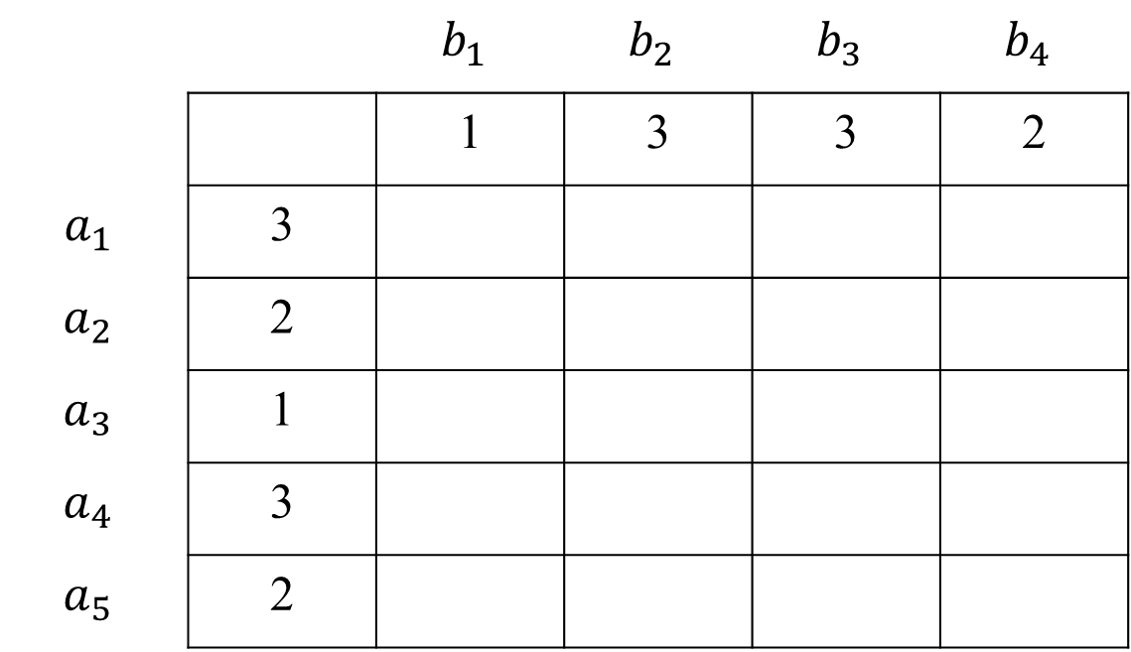
Algorithm of author
 |  | $$b_{1}$$ | $$b_{2}$$ | $$b_{3}$$ | $$b_{4}$$
 |  | 1 | 3 | 3 | 2
$$a_{1}$$ | 3
$$a_{2}$$ | 2
$$a_{3}$$ | 1
$$a_{4}$$ | 3
$$a_{5}$$ | 2
Notes:
我們的問題是等價的做一個二維的matching table T 來找到 longest almost increasing path

Slide 12
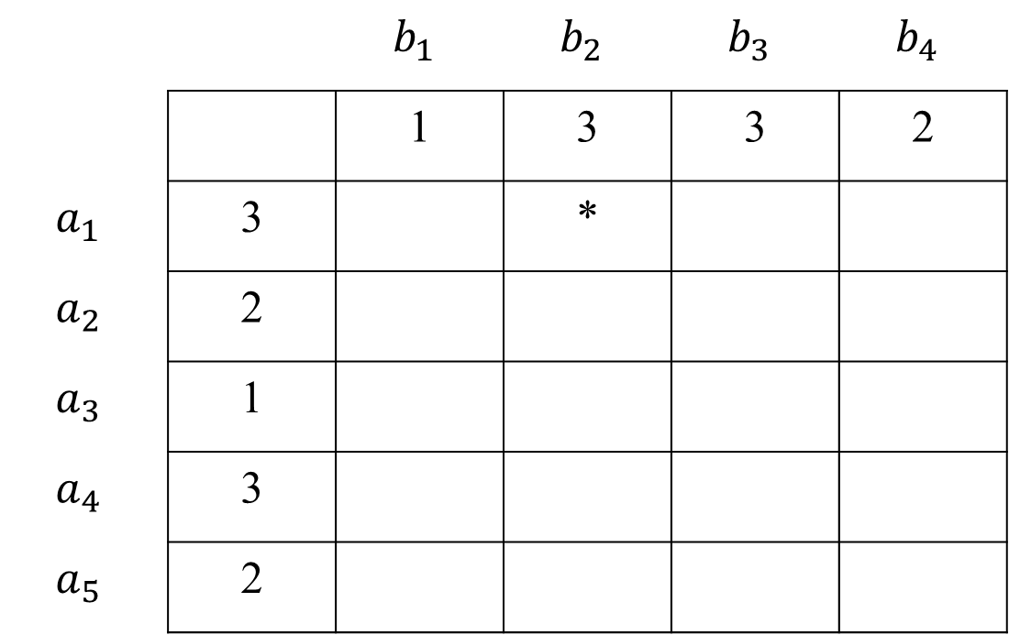
 |  | $$b_{1}$$ | $$b_{2}$$ | $$b_{3}$$ | $$b_{4}$$
 |  | 1 | 3 | 3 | 2
$$a_{1}$$ | 3 |  | *
$$a_{2}$$ | 2
$$a_{3}$$ | 1
$$a_{4}$$ | 3
$$a_{5}$$ | 2

Slide 13
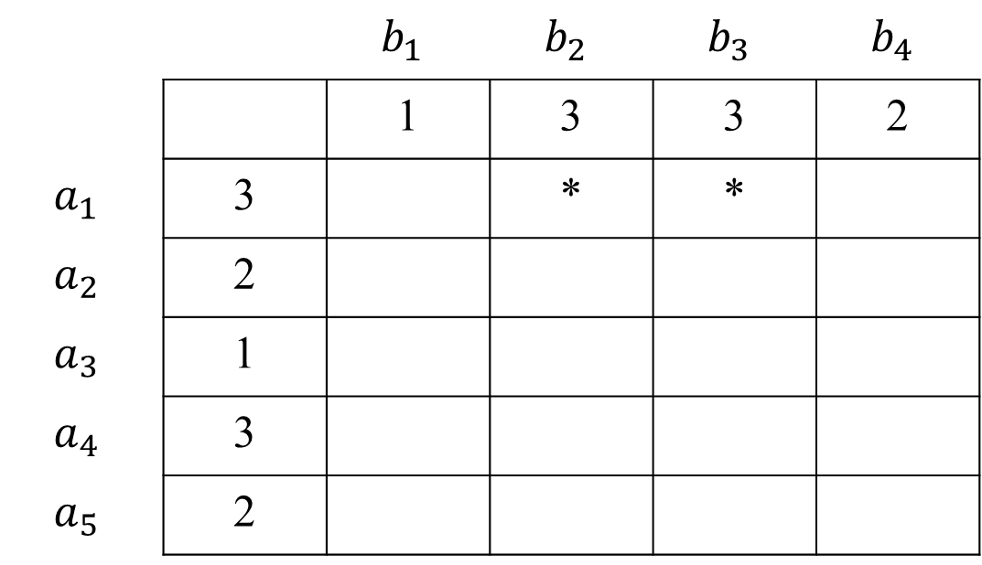
 |  | $$b_{1}$$ | $$b_{2}$$ | $$b_{3}$$ | $$b_{4}$$
 |  | 1 | 3 | 3 | 2
$$a_{1}$$ | 3 |  | * | *
$$a_{2}$$ | 2
$$a_{3}$$ | 1
$$a_{4}$$ | 3
$$a_{5}$$ | 2

Slide 14
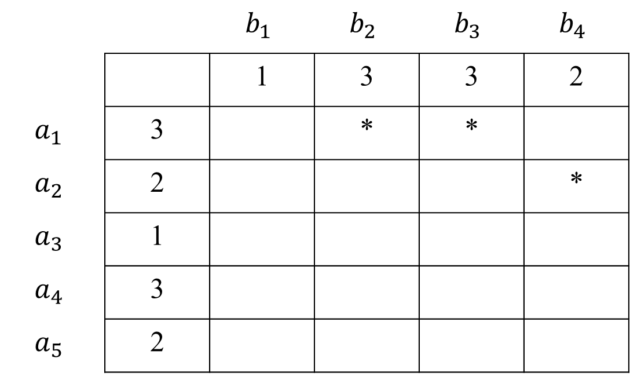
 |  | $$b_{1}$$ | $$b_{2}$$ | $$b_{3}$$ | $$b_{4}$$
 |  | 1 | 3 | 3 | 2
$$a_{1}$$ | 3 |  | * | *
$$a_{2}$$ | 2 |  |  |  | *
$$a_{3}$$ | 1
$$a_{4}$$ | 3
$$a_{5}$$ | 2

Slide 15
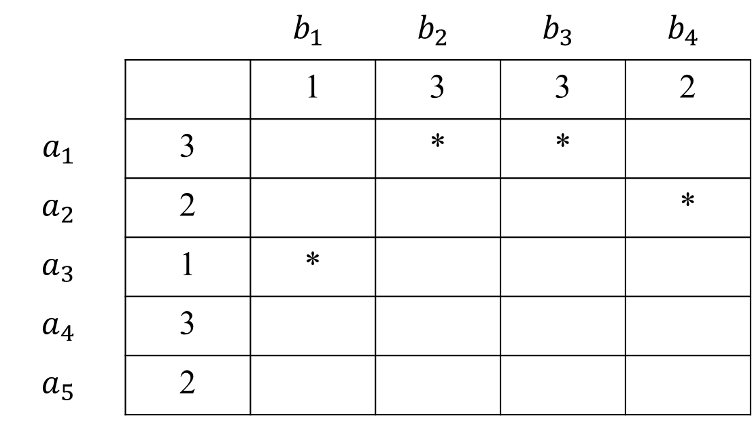
 |  | $$b_{1}$$ | $$b_{2}$$ | $$b_{3}$$ | $$b_{4}$$
 |  | 1 | 3 | 3 | 2
$$a_{1}$$ | 3 |  | * | *
$$a_{2}$$ | 2 |  |  |  | *
$$a_{3}$$ | 1 | *
$$a_{4}$$ | 3
$$a_{5}$$ | 2

Slide 16
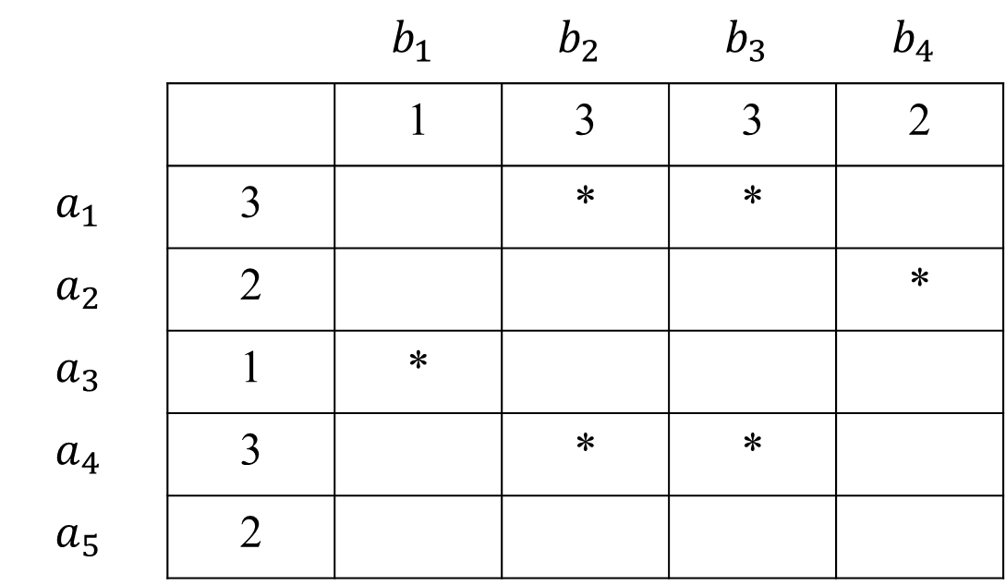
 |  | $$b_{1}$$ | $$b_{2}$$ | $$b_{3}$$ | $$b_{4}$$
 |  | 1 | 3 | 3 | 2
$$a_{1}$$ | 3 |  | * | *
$$a_{2}$$ | 2 |  |  |  | *
$$a_{3}$$ | 1 | *
$$a_{4}$$ | 3 |  | * | *
$$a_{5}$$ | 2

Slide 17
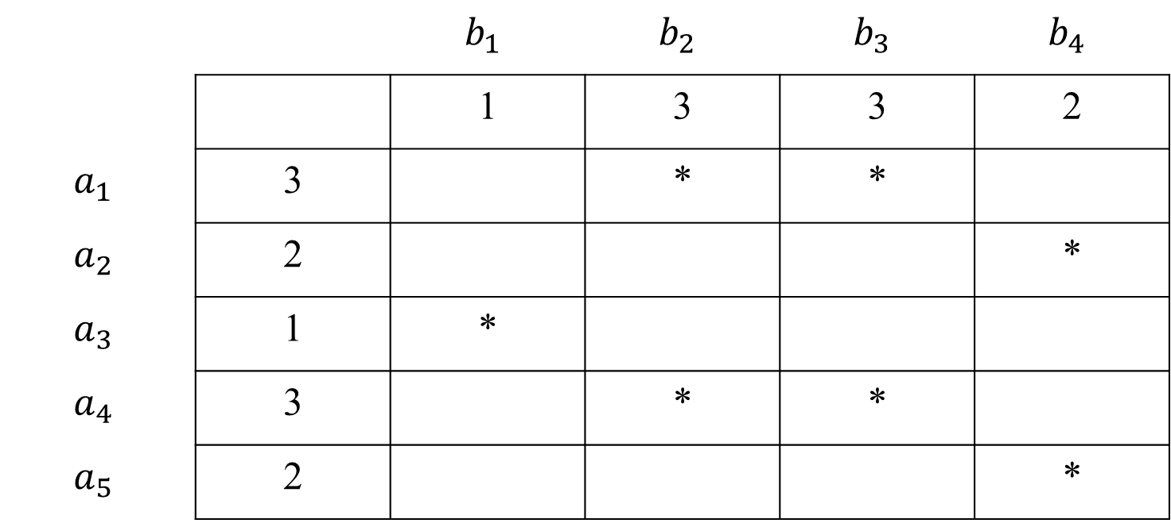
 |  | $$b_{1}$$ | $$b_{2}$$ | $$b_{3}$$ | $$b_{4}$$
 |  | 1 | 3 | 3 | 2
$$a_{1}$$ | 3 |  | * | *
$$a_{2}$$ | 2 |  |  |  | *
$$a_{3}$$ | 1 | *
$$a_{4}$$ | 3 |  | * | *
$$a_{5}$$ | 2 |  |  |  | *
Notes:
我們的問題是等價的作揖一個二維的matching table T 來找到 longest almost increasing path

Slide 18
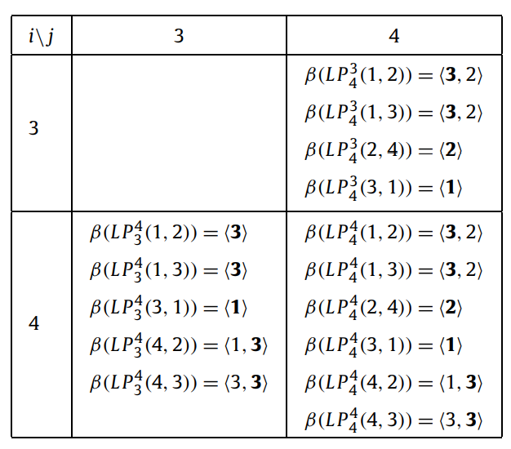
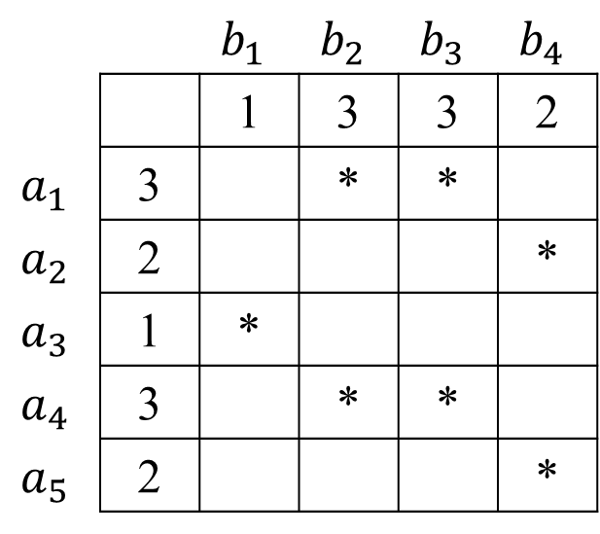
Case 1: T (i, j) is an empty entry.
 |  | $$b_{1}$$ | $$b_{2}$$ | $$b_{3}$$ | $$b_{4}$$
 |  | 1 | 3 | 3 | 2
$$a_{1}$$ | 3 |  | * | *
$$a_{2}$$ | 2 |  |  |  | *
$$a_{3}$$ | 1 | *
$$a_{4}$$ | 3 |  | * | *
$$a_{5}$$ | 2 |  |  |  | *
Notes:
β(P) = 路徑上所有連結的點值

Slide 19
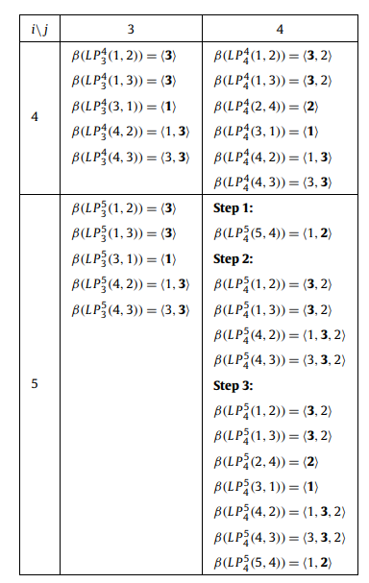
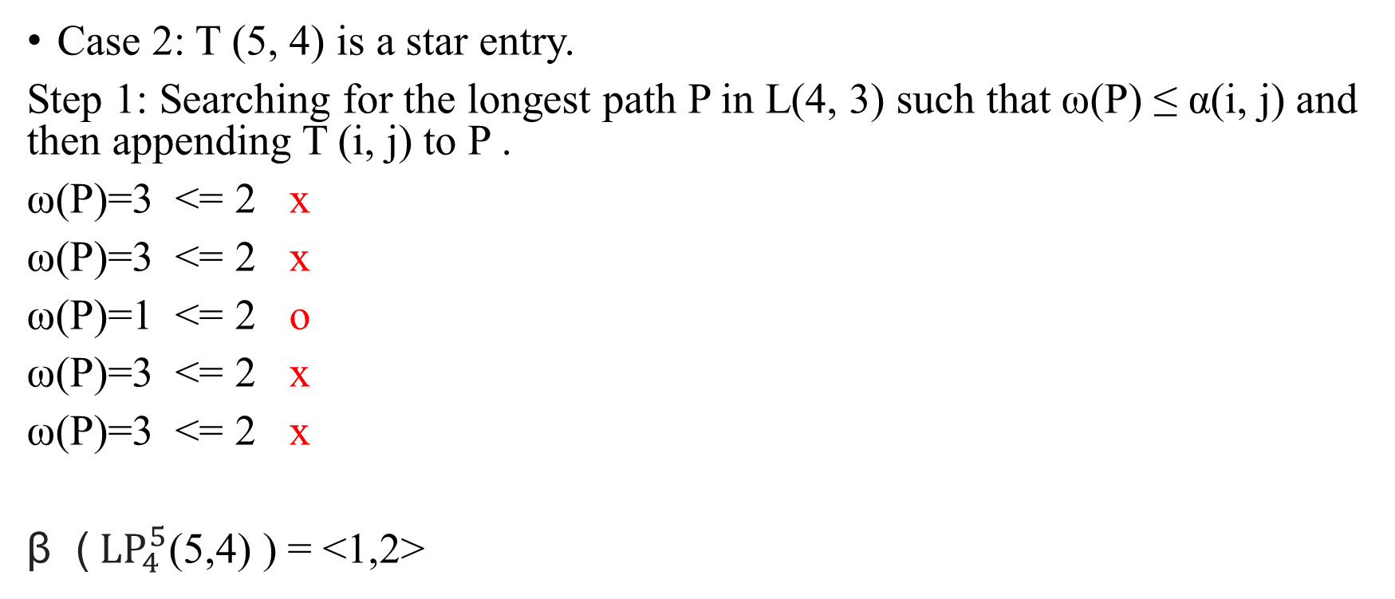
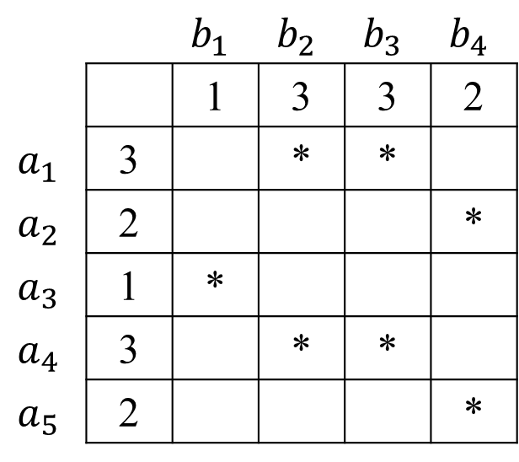
Case 2: T (5, 4) is a star entry.
Step 1: Searching for the longest path P in L(4, 3) such that ω(P) ≤ α(i, j) and then appending T (i, j) to P .
ω(P)=3 <= 2 x
ω(P)=3 <= 2 x
ω(P)=1 <= 2 o
ω(P)=3 <= 2 x
ω(P)=3 <= 2 x
β (${LP}_{4}^{5}$(5,4) ) = <1,2>
 |  | $$b_{1}$$ | $$b_{2}$$ | $$b_{3}$$ | $$b_{4}$$
 |  | 1 | 3 | 3 | 2
$$a_{1}$$ | 3 |  | * | *
$$a_{2}$$ | 2 |  |  |  | *
$$a_{3}$$ | 1 | *
$$a_{4}$$ | 3 |  | * | *
$$a_{5}$$ | 2 |  |  |  | *
Notes:
α(i, j) =目前那一格的值 ω(P)=路徑上某點的最大值
搜尋 路進最長的L(i − 1, j − 1) 條件 ω(P) ≤ α(i, j) 成立接上去T (i, j) to P .

Slide 20
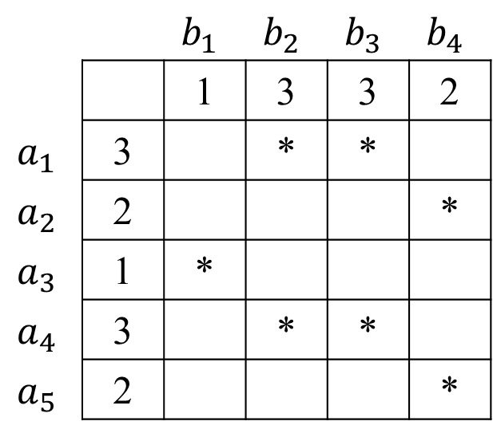
Step 2: Appending T (5, 4)=2 to every path P in L(4, 3) satisfying
α(i, j) < ω(P) < α(i, j) + c
2 < 3 < 2+2 o
2 < 3 < 2+2 o
2 < 1 < 2+2 x
2 < 3 < 2+2 o
2 < 3 < 2+2 o
 |  | $$b_{1}$$ | $$b_{2}$$ | $$b_{3}$$ | $$b_{4}$$
 |  | 1 | 3 | 3 | 2
$$a_{1}$$ | 3 |  | * | *
$$a_{2}$$ | 2 |  |  |  | *
$$a_{3}$$ | 1 | *
$$a_{4}$$ | 3 |  | * | *
$$a_{5}$$ | 2 |  |  |  | *
Notes:
α(i, j) =目前那一格的值 ,,, ω(P)=路徑上某點的最大值
接下來，我們討論如何有效地實現上述基本思想來解決LCaIS問題。

Slide 21
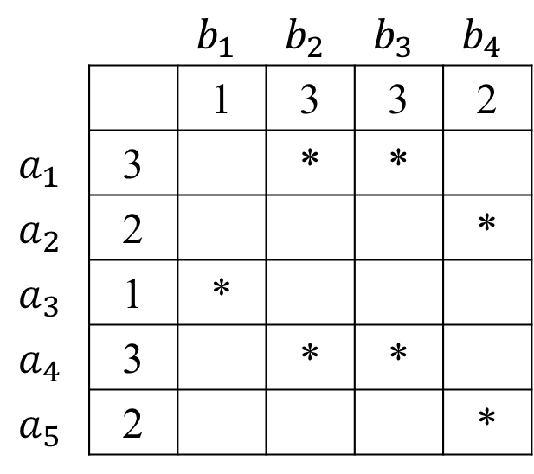
Let L’(i, j) denote the set of all paths obtained in the above two steps.
Step 3: Adding the longest path among all paths in
L(4, 4) ∪ L(5, 3) ∪ L’ (5, 4)
 |  | $$b_{1}$$ | $$b_{2}$$ | $$b_{3}$$ | $$b_{4}$$
 |  | 1 | 3 | 3 | 2
$$a_{1}$$ | 3 |  | * | *
$$a_{2}$$ | 2 |  |  |  | *
$$a_{3}$$ | 1 | *
$$a_{4}$$ | 3 |  | * | *
$$a_{5}$$ | 2 |  |  |  | *

Slide 22
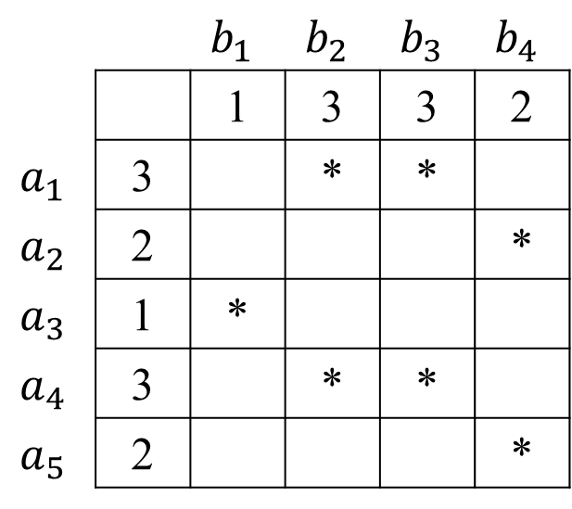
Searching for the longest path P in L(i − 1, j − 1) such that ω(P) ≤ α(i, j) and then appending T (i, j) to P .
Appending T (i, j) to every path P in L(i − 1, j − 1) satisfying α(i, j) < ω(P) < α(i, j) + c.
Adding the longest path among all paths in L(i − 1, j) ∪ L(i, j − 1) ∪ L (i, j)
 |  | $$b_{1}$$ | $$b_{2}$$ | $$b_{3}$$ | $$b_{4}$$
 |  | 1 | 3 | 3 | 2
$$a_{1}$$ | 3 |  | * | *
$$a_{2}$$ | 2 |  |  |  | *
$$a_{3}$$ | 1 | *
$$a_{4}$$ | 3 |  | * | *
$$a_{5}$$ | 2 |  |  |  | *
Notes:
接下來，我們討論如何有效地實現上述基本思想來解決LCaIS問題。

Slide 23
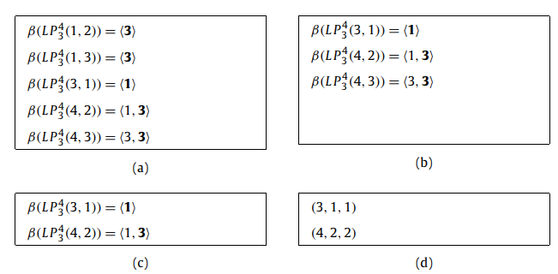
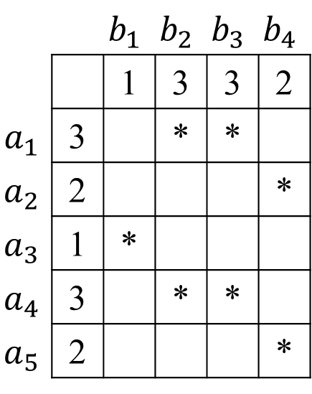
Definition 1.
Let P and Q be two almost increasing paths in a sub-table Ti,j .
We say that P dominates Q if and only if ω(P) ≤ ω(Q ) and |P| > |Q |
e.g.,
Simplifying L(4, 3) =（u，v，| L（u，v）|）
Satisfied: α(u, v) < α(u’, v’) if and only if k < k’
 |  | $$b_{1}$$ | $$b_{2}$$ | $$b_{3}$$ | $$b_{4}$$
 |  | 1 | 3 | 3 | 2
$$a_{1}$$ | 3 |  | * | *
$$a_{2}$$ | 2 |  |  |  | *
$$a_{3}$$ | 1 | *
$$a_{4}$$ | 3 |  | * | *
$$a_{5}$$ | 2 |  |  |  | *
Notes:
ω(P):路徑的最大值
長度相同，且長度為α（u1，v1） ）≤α（u2，v2）≤...≤α（uk，vk），則
我們保留地一個 L（u1，v1）並從L（i，j）中除去k − 1條剩餘路徑。
最大長度的3元組對應於匹配表T中LCaIS。
還可以觀察到 長度| L（u，v）|不同 ，這意味著簡化的L（i，j）的基數最多為l，其中l表示LCaIS問題的輸出長度。
在過程1中，我們描述了一種簡化L（i，j）直接來自簡化的L（i-1，j-1）。

Slide 24

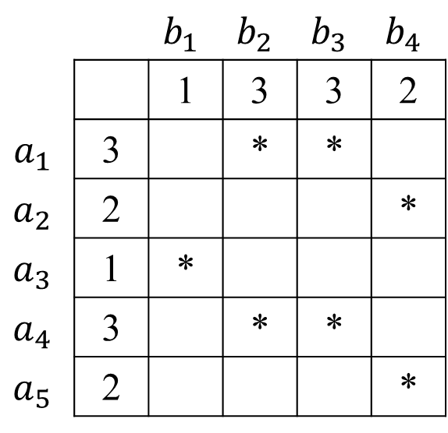
β (${LP}_{4}^{5}$(3,1) ) = <1> (3,1,1)
β (${LP}_{4}^{5}$(5,4) ) = <1,2> (5,4,2)
β (${LP}_{4}^{5}$(4,2) ) = <1,3,2> (4,2,3)
 |  | $$b_{1}$$ | $$b_{2}$$ | $$b_{3}$$ | $$b_{4}$$
 |  | 1 | 3 | 3 | 2
$$a_{1}$$ | 3 |  | * | *
$$a_{2}$$ | 2 |  |  |  | *
$$a_{3}$$ | 1 | *
$$a_{4}$$ | 3 |  | * | *
$$a_{5}$$ | 2 |  |  |  | *

Slide 25

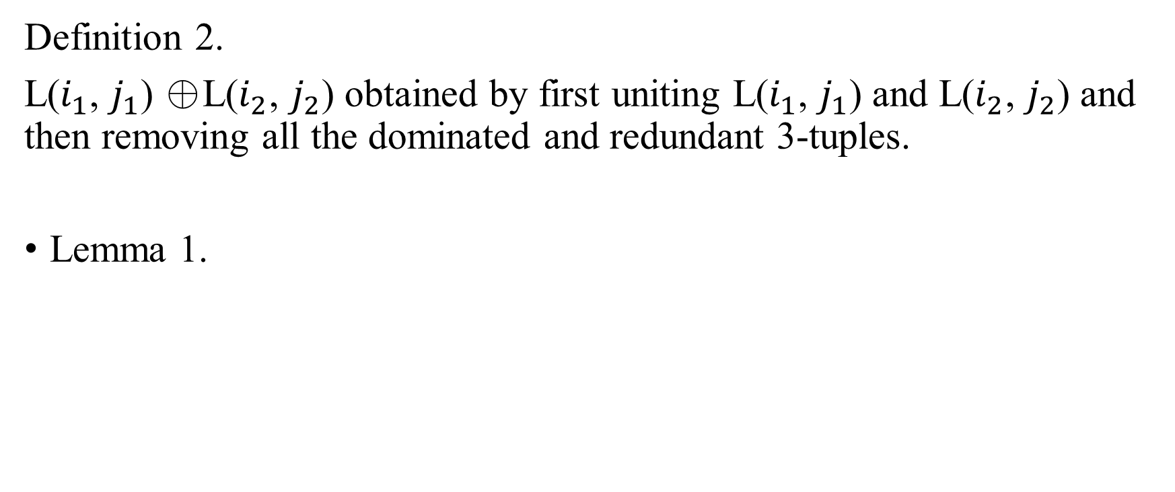
Definition 2.
L($i_{1}$, $j_{1}$) ⊕L($i_{2}$, $j_{2}$) obtained by first uniting L($i_{1}$, $j_{1}$) and L($i_{2}$, $j_{2}$) and then removing all the dominated and redundant 3-tuples.
Lemma 1.
Notes:
merging operation :⊕
等於通過首先將L（i1，j1）和L（i2，j2） 任兩個合併然後刪除所有主導和冗餘的三元組而獲得的集合。
(3,1,1)
(5,4,2)
(4,2,3)

Slide 26
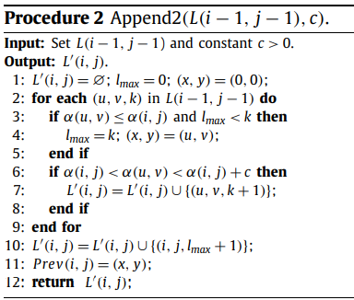
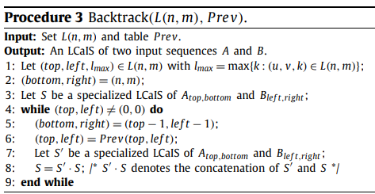

Prev(x1, y1) = (x2, y2).
Notes:
Prev表只能構建兩個輸入序列的LCaIS的部分結果
通過Prev表獲得的T(xk，yk），T（xk-1，yk-1），...，T（x1，y1）構成P1的部分結果（即β（P1）的子序列）。
恢復完整結果，我們需要解決另一個問題，即專用LCaIS問題
假設Prev（x1，y1）=（x2，y2）。T(x1，y1)是P1中的代表項。
我們利用Prev（x1，y1）的值在P1中找到另一個T（x2，y2），
令P’1是從T的位置（x1，y1）到P1的末尾的P1的子路徑，並且P2 = P1- P’1
T（x2，y2）成為P2的代表項，P’1是一種特殊的幾乎增加的子路徑，其代表是P’1的第一項。
Recrsive 我們實際上可以將P1劃分為幾個子路徑，這樣每個P’i都是一個特殊的幾乎增加的子路徑，而且通過Prev表獲得的T(xk，yk），T（xk-1，yk-1），...，T（x1，y1）構成P1的部分結果（即β（P1）的子序列）。
因此，如步驟3所述，要恢復P1的完整結果，我們需要解決另一個問題，即專用LCaIS問題。
Specialized LCaIS problem Input:
Two sequences A = $a_{1}{,a}_{2}$, $a_{3} …a_{n}$and B = $b_{1}, b_{2}… b_{m}$ with $a_{1}= b_{1}$ and a constant c > 0.
Output: T (1, 1) is its representative point.
Let δ(i, j) be the length of (${LP}_{j}^{i}$(1,1) in sub-table Ti,j . According to Lemma 1, we can solve the specialized LCaIS problem by the following recursive formula. For all 2 ≤ i ≤ n and 2 ≤ j ≤ m,

Slide 27
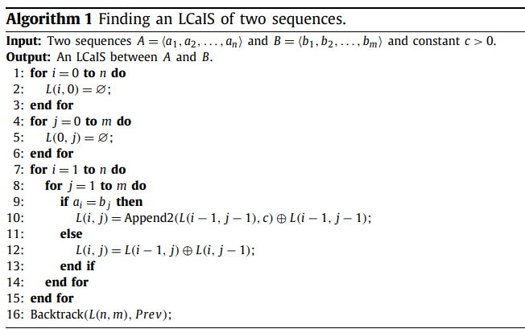
Space
O(m) × O(l) + O(nm) = O(nm)
Time
O(nm) × O(l) + O(nm) = O(nml)
Notes:
每個L（i，j）的空間為O（l），其中l表示兩個輸入序列的LCaIS的長度。
由於我們可以使用兩個替代行來填充整個表L，
並且表Prev的大小為O（nm）
無論（i，j）是否為匹配對，用於構造L（i，j）的時間均為O（l）。此外，用於獲取專用LCaIS的回溯過程需要O（nm）時間。
請注意，如果僅計算兩個輸入序列之間的LCaIS長度，那麼不難看出
算法僅使用O（l min（m，n））空間即可完成這項工作。

Slide 28
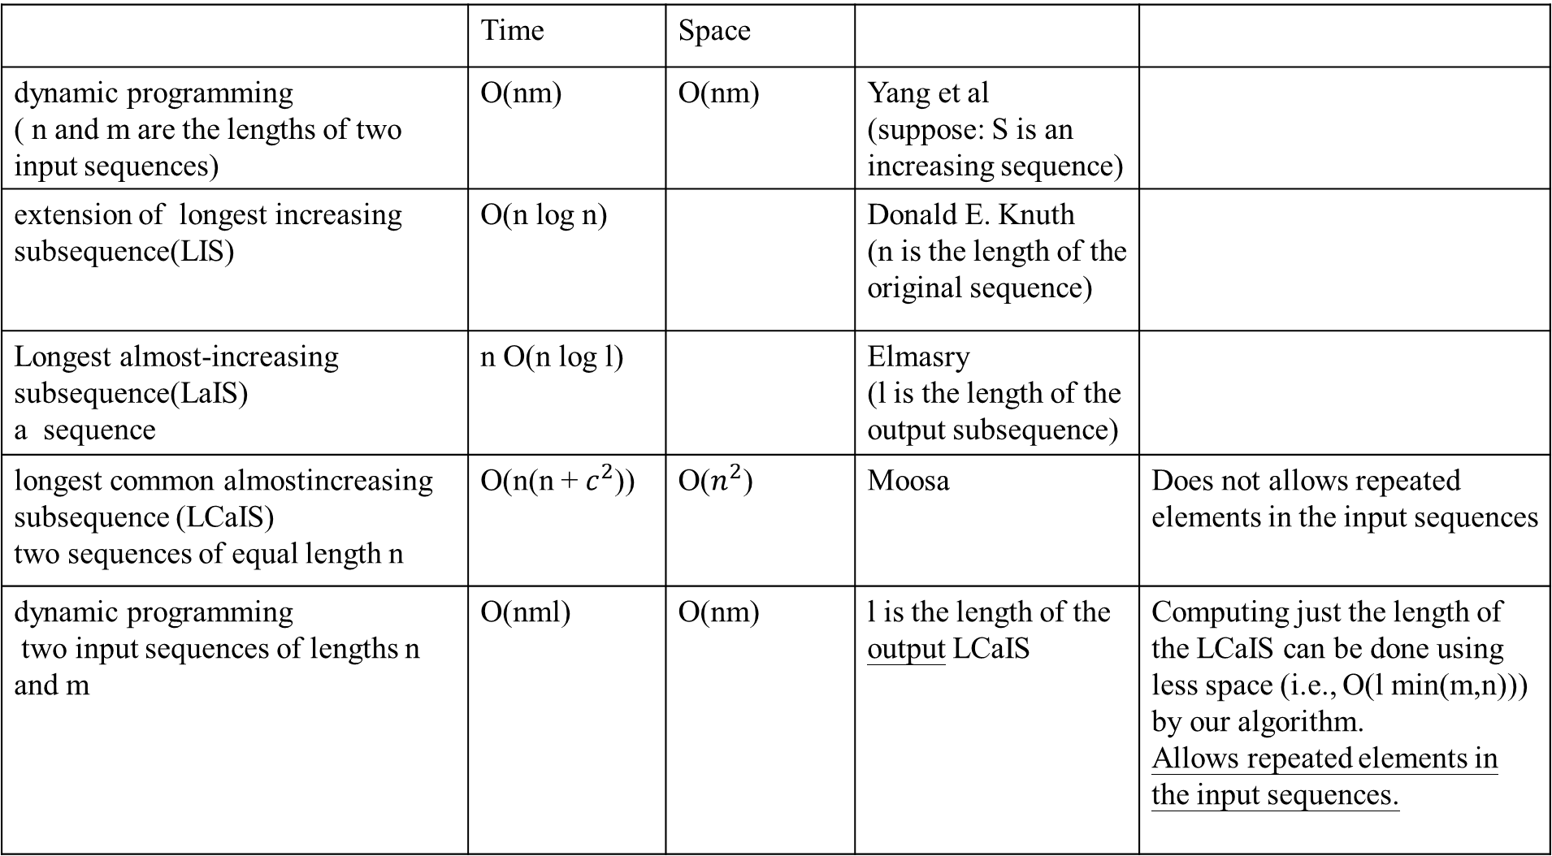
 | Time | Space
dynamic programming ( n and m are the lengths of two input sequences) | O(nm) | O(nm) | Yang et al (suppose: S is an increasing sequence)
extension of longest increasing subsequence(LIS) | O(n log n) |  | Donald E. Knuth (n is the length of the original sequence)
Longest almost-increasing subsequence(LaIS) a sequence | n O(n log l) |  | Elmasry (l is the length of the output subsequence)
longest common almostincreasing subsequence (LCaIS) two sequences of equal length n | O(n(n + $c^{2}$)) | O($n^{2}$) | Moosa | Does not allows repeated elements in the input sequences
dynamic programming two input sequences of lengths n and m | O(nml) | O(nm) | l is the length of the output LCaIS | Computing just the length of the LCaIS can be done using less space (i.e., O(l min(m,n))) by our algorithm. Allows repeated elements in the input sequences.

Slide 29
Conclusion
Recall that according to the definition of the LCaIS problem, the input parameter c is required to be positive (i.e., c > 0). However, if it is allowed to be zero (i.e., c = 0), then the LCaIS problem becomes the LCIS problem.
In the matching table, moreover, the representative entry of an increasing path for the LCIS problem is always at the last position of the path, while the representative entry of an almost increasing path for the LCaIS problem can be at any position.
LCIS problem is already known to be solvable in O(nm) time. Therefore, it will be interesting in future to study how to design more time efficient algorithms to solve the LCaIS problem.
Notes:
從這個角度來看，LCIS問題可以視為LCaIS問題的特例。 此外，在匹配表中，用於LCIS問題的增加路徑的點都會在路徑的最後位置，而LCaIS問題的幾乎增加路徑的可以位於任何位置。 當前，已經知道LCIS問題可以在O（nm）時間內解決[6]。 因此，將來研究如何設計更省時的算法來解決LCaIS問題將是有趣的。

Slide 30
Thanks for listening.

