Slide 1
Predicting essential genes based on network and sequence analysis
Yih-Chii Hwang(黃奕綺) , Chen-Ching Lin(陳景林), Jen-Yun Chang(江俊彥), Hirotada Mori,
Hsueh-Fen Juan(阮雪芬) and Hsuan-Cheng Huang(黃宣誠)
The Royal Society of Chemistry 2009
Molecular BioSystems, 2009, 5, 1672–1678
Presenter:Zih-Jie Yang
Date: September 14th,2010

Slide 2
Abstract(1/3)
Essential genes are indispensable to the viability of an organism. Identification and analysis of essential genes is key to understanding the systems level organization of living cells. On the other hand, the ability to predict these genes in pathogens is of great importance for directed drug development. Global analysis of protein interaction networks provides an effective way to elucidate the relationships between genes. It has been found that essential genes tend to be highly connected and generally have more interactions than nonessential ones.

Slide 3
Abstract(2/3)
With recent large-scale identifications of essential genes and protein–protein interactions in Saccharomyces cerevisiae(酵母菌) and Escherichia coli(大腸桿菌), we have systematically investigated the topological properties of essential and nonessential genes in the protein–protein interaction networks. Essential genes tend to play topologically more important roles in protein interaction networks. Many topological features were found to be statistically discriminative between essential and nonessential genes.

Slide 4
Abstract(3/3)
In addition, we have also examined sequence properties such as open reading frame length, strand, and phyletic retention for their association with the gene essentiality. Employing the topological features in the protein interaction network and the sequence properties, we have built a machine learning classifier capable of predicting essential genes. Computational prediction of essential genes circumvents expensive and difficult experimental screens and will help antimicrobial drug development.

Slide 5
必要性蛋白質（essential protein）
必要性蛋白質（essential protein）為當此蛋白質在蛋白質複合體中遭到基因剔除式突變(null mutation)去除後，會危及很多重要的生化反應路徑(biologically important pathways)，進而造成蛋白質複合體的功能喪失，致使生物體無法生存(inviable)。因此瞭解必要性蛋白質的特性，並預測某些蛋白質是否為必要性蛋白質是很重要的課題。

Slide 6
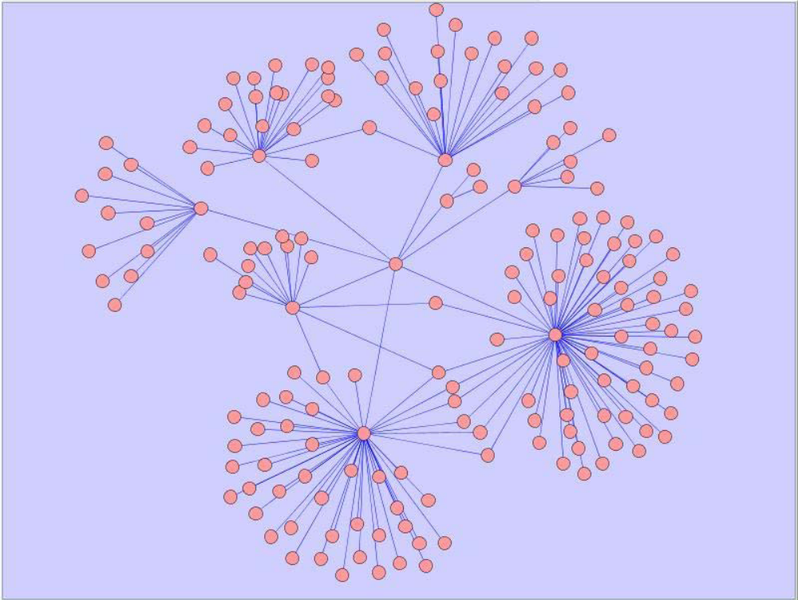
蛋 白 質 交 互 作 用 (Protein-protein interaction)
每一個點為一個蛋白質，每一個邊所連結的兩的點則代表這兩個蛋白質之間有交互作用。

Slide 7
Topological properties
1. Clustering coefficient (CCo)
2. Betweenness centrality (BC)
3. Closeness centrality (CC)
4. Clique Level (KL)
5. Essentiality index (EI)

Slide 8
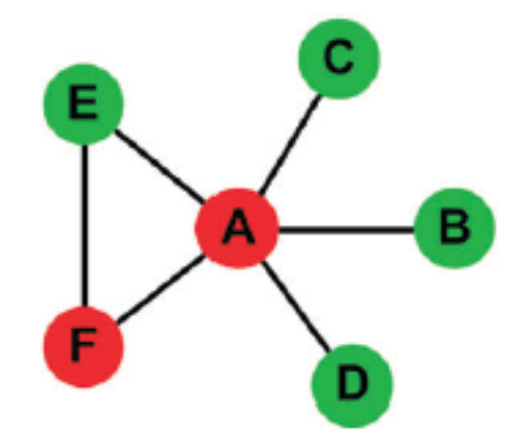
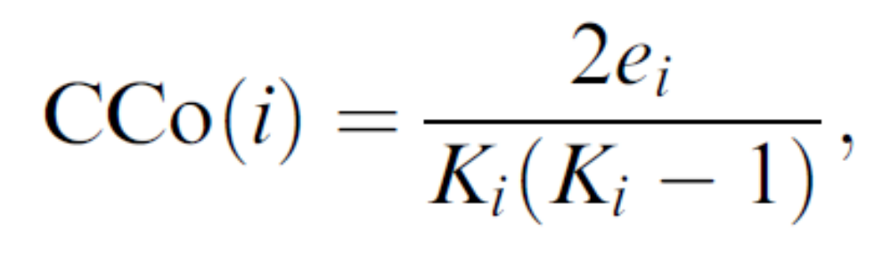
Clustering coefficient (CCo)
群聚係數
Node i的群聚係數定義為其鄰居彼此間也是鄰居的程度
CCo(i)=e_{i}/C(K_{i},2)
e_{i}為鄰居之間的邊數(NID(i))
K_{i}為node i的degree
e_{A} =1
K_{A}=5
CCo(A)=2*1/(5*4)
Larger clustering coefficient mean that many of their interacting partners interact with each other.

Slide 9
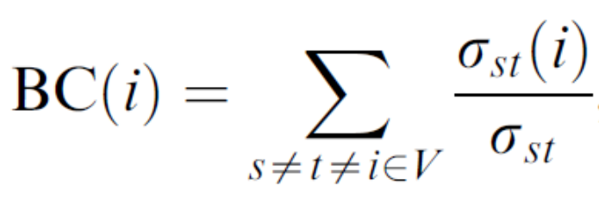
Betweenness centrality (BC)
The betweenness centrality (BC) of a node i measures the ratio of the shortest paths going through a node i.
where δ_{st} is the number of shortest paths from node s to node t, and δ_{st}(i) is the number of shortest paths from s to t that pass through node i.
larger betweeness centrality represent the bottlenecks on the interaction network or pathways they participate in

Slide 10
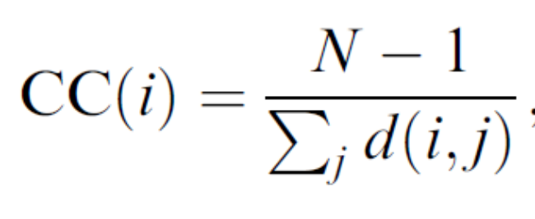
Closeness centrality (CC)
Closeness centrality (CC) of a node i is the reciprocal of the sum of average shortest distances from all other nodes in the network to node i.
where N is the total number of nodes in the network, and d(i,j) is the length of the shortest path from node i to node j.
CC(A)=(6-1)/(1+1+1+1+1)=1

Slide 11
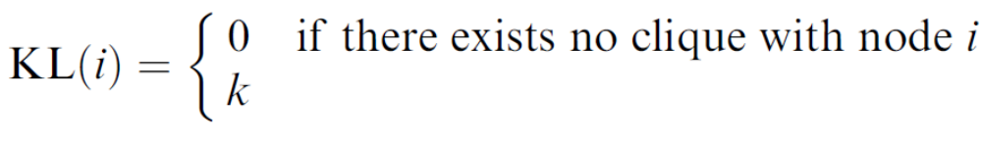
Clique Level (KL)
A clique is a complete graph
KL(i) is defined as the largest size of cliques that a node i can join, which ranges either from 3 to the size of the largest clique.
KL(A)=3
We identify all the cliques in the protein interaction networks. In E. coli, the maximal clique is of size 7; and in yeast, it is 10.

Slide 12
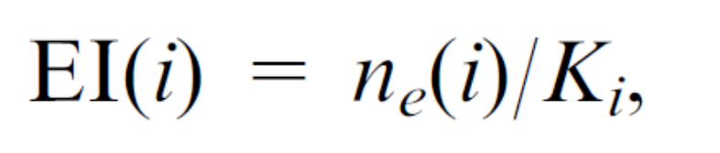
Essentiality index (EI)
To understand whether essential proteins tend to cluster together, we defined the essentiality index (EI) as the proportion of essential proteins interacting with a node (protein) i.
where n_{e}(i) represents the number of essential proteins among the adjacent nodes and K_{i} is the degree of node i.

Slide 13
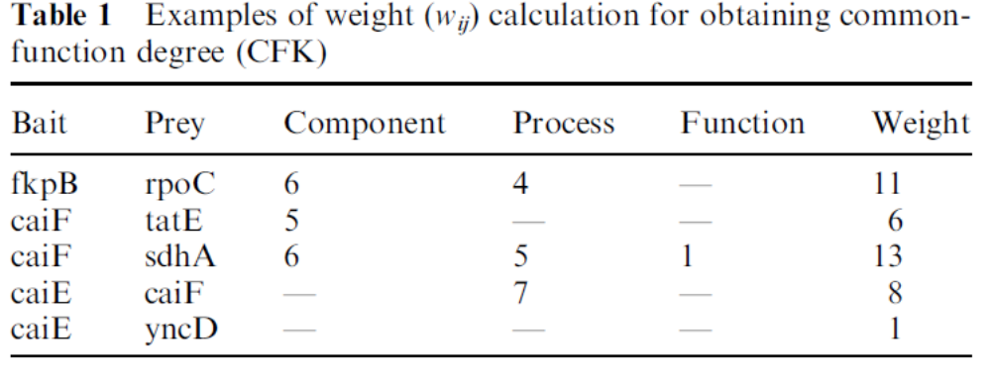
common-function degree (CFK)
Based on the Gene Ontology annotation, we assigned weight to each edge according to the ontology depth of shared functions between two connected nodes

Slide 14
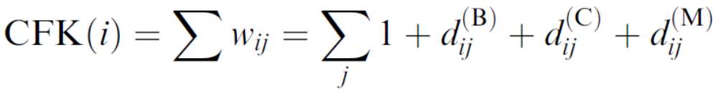
common-function degree (CFK)
where j represents any node adjacent to node i and d_{ij}^{(B,C,M)} the ontology depth of common function shared by i and j in the category of biological process (B), cellular component (C),
and molecular function (M), respectively.

Slide 15
Sequence-related properties
1. open reading frames length (ORFL)蛋白質長度
2. Strand
3. Phyletic Retention

Slide 16
open reading frames length (ORFL)蛋白質長度
It has been found that the genes with protein products of longer amino acid chains, that is, with longer sequences of open reading frames (ORF), tend to be essential

Slide 17
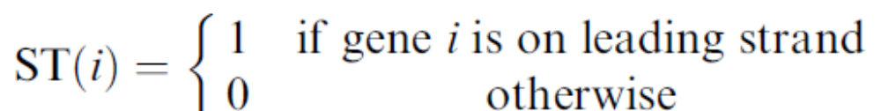
Strand
Since the genes located on a leading strand are more efficiently transcribed into proteins, an essential gene prefers to be located in the leading strand rather than in the lagging one

Slide 18
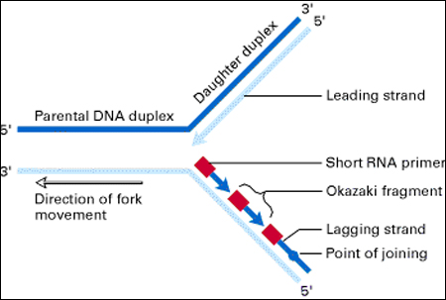
leading strand
DNA在複製時分別以兩股拆開的單股為模板進行複製但是由於DNA複製時只能用特定方向複製(5'~3')而雙股DNA的兩股方向是相反的所以在拆開複製時一股會是很順暢的由5'複製到3'而另一股就只能生成一堆小小的5'到3'片段將那些小片段連接起來很順暢的那股在複製時就叫leading strand因為只能生成小片段而LAG的就叫lagging strand

Slide 19
Phyletic Retention
此蛋白質在演化上面被保留的程度
PR(i), as the number of organisms in which an ortholog is present.
For E. coli, we compared it with 374 complete bacteria genomes available in the NCBI Genome database.
An ortholog of gene i in genome M must satisfy the following criteria: (1) bidirectional best hit, which means that not only the ortholog must be the best match of gene i to genome M but gene i must also be the best hit of the ortholog, as identified by BLAST searches; (2) minimal sequence conservation of 40% between them; and (3) the difference in length between the two sequences should not exceed 30%.

Slide 20
Model organism data sets of Saccharomyces cerevisiae
S. cerevisiae were from DIP and use ScereCR20070107 which consisted of 4873 proteins and 17166 interactions.
There were 981 essential proteins and 3892 nonessential proteins in the yeast.

Slide 21
Model organism data sets of Escherichia coli
There were 3039 proteins and 11477 interactions among them in this network
There were 260 essential and 2779 nonessential genes producing proteins in the largest connected component of E. coli

Slide 22
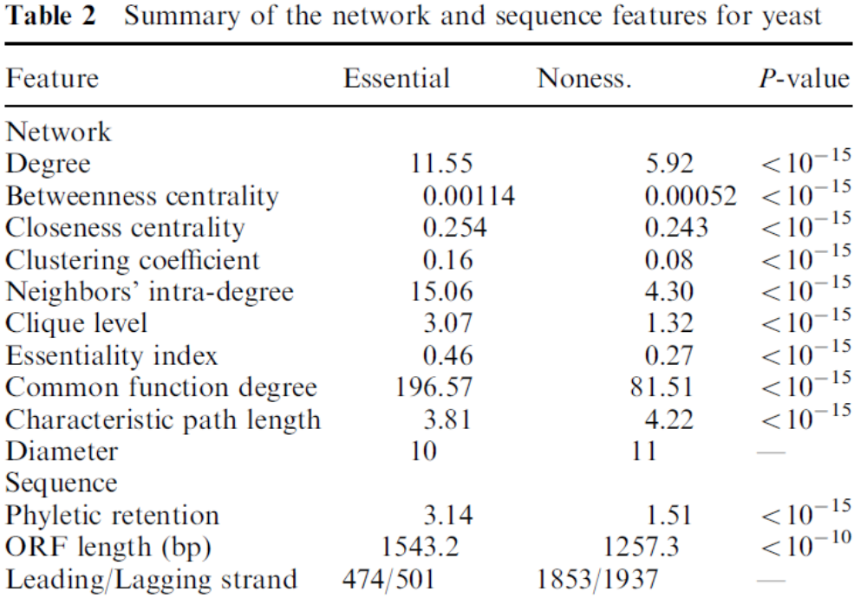
Analysis of essential yeast
特徵路徑長度（characteristic path length）是定義為任兩節點之最短路徑的平均值。

Slide 23
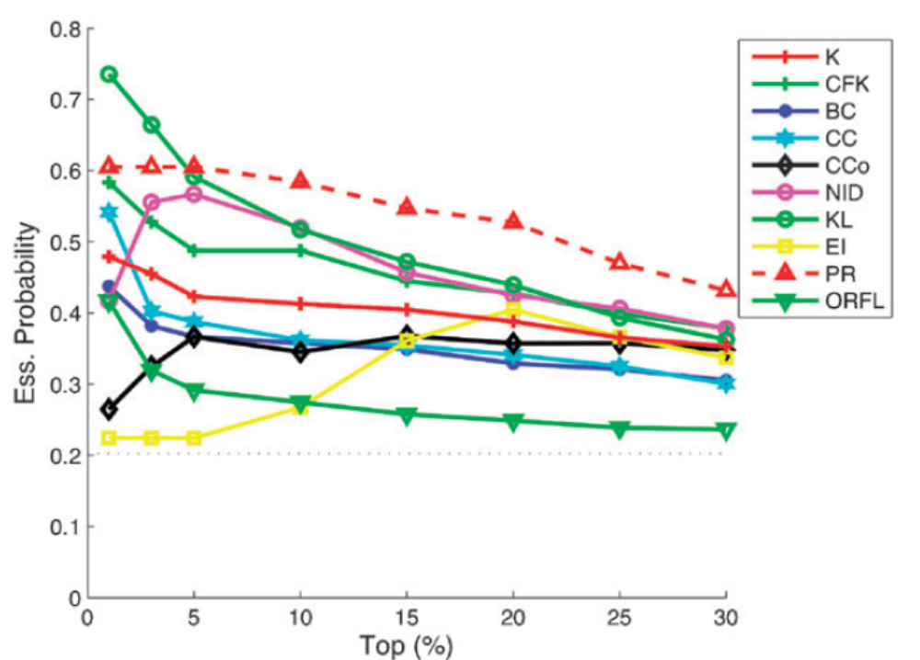
Analysis of essential yeast

Slide 24
Example
If a gene with K = 1, its EI can only be either 1 or 0, depending on whether it interacts with an essential or nonessential one. Since there are an abundance of genes with K = 1 and the essential genes tend to have larger values of K, there exist many nonessential genes with K=1andEI=1. Similarly, there are also a lot nonessential genes with K = 2 and EI = 1 (or 0.5). Note that the averaged EI of essential genes is 0.46. As a result, while ranked by EI, genes with EI = 1 are listed at the top but consist of more nonessential than essential ones. For clustering coefficients a similar singularity happens for genes with very low degree. For K = 2, the CCo value can only be either 1 or 0, depending on whether the two interacting partners of the gene interact with each other or not.

Slide 25
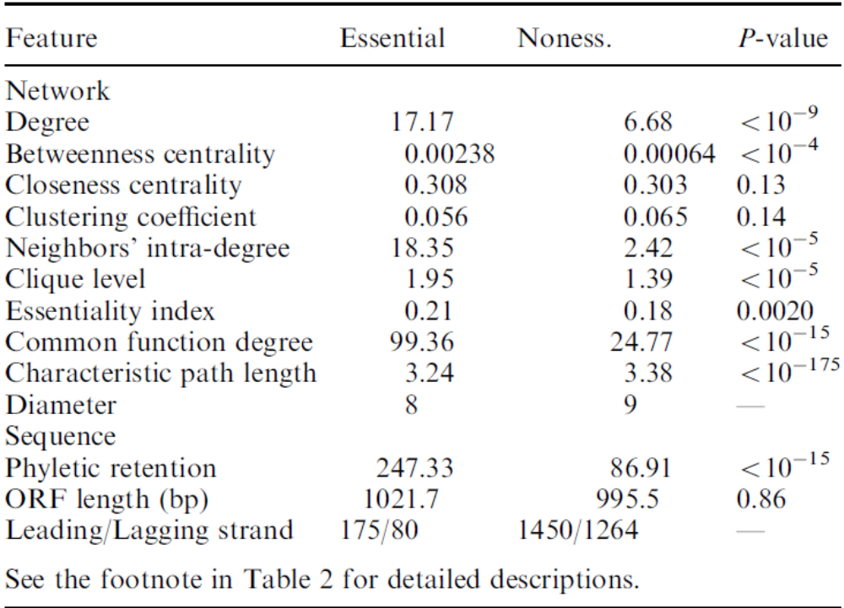
Analysis of essential E. coli

Slide 26
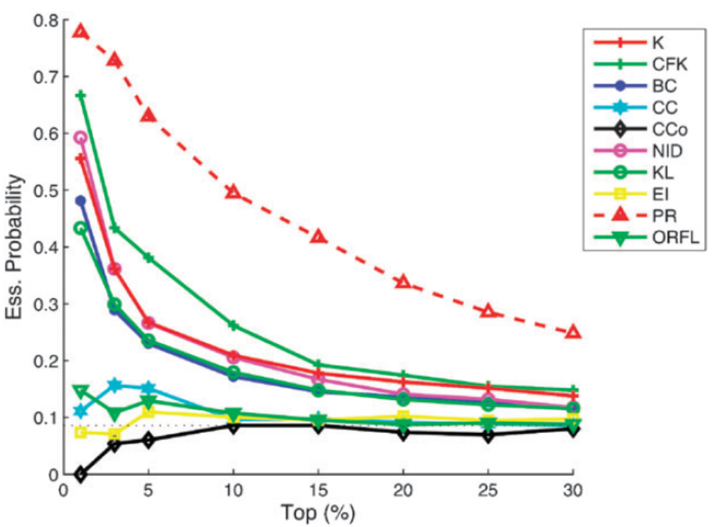
Analysis of essential E. coli

Slide 27
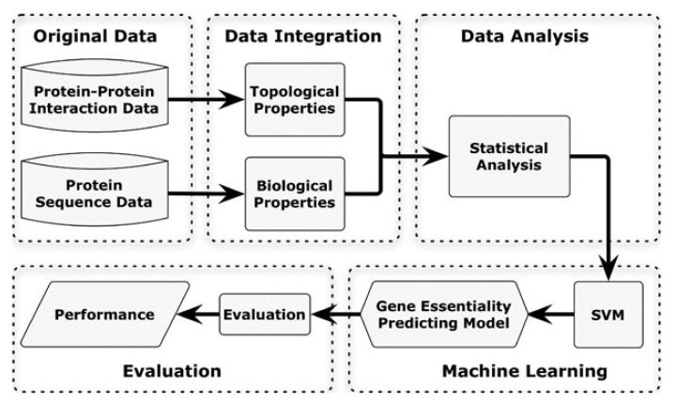
Classification model

Slide 28
Data Balance
The amounts of essential genes and nonessential genes, in yeast, have apparent disproportion (ess : noness=975 : 3840), and so do those in E. coli (ess : noness = 256 : 2718).
To deal with the amount imbalance, we randomly selected a balanced subsample of nonessential genes with the same amount of essential genes and repeated the procedure 10 times to evaluate the performance in average.

Slide 29
Performance measures
The performance of the SVM classifier was measured as an average value in a 10-fold cross-validation analysis, where each dataset was randomly divided into 10 parts—9 parts for model learning (training) and the remaining part for validation (testing).

Slide 30
Performance measures
In a classification problem, a prediction can either be a true or false positive, or true or false negative. From the counts of each case (TP, FP, TN, and FN), four performance measures were used: precision (P), recall (R), F-measure (F), and Matthews Correlation Coefficent (MCC)

Slide 31
Performance measures
 |  | Pre-condition
 |  | True | False
prediction | positive | True positive (TP) | False positive (FP) | precision
 | negative | False negative (FN) | True negative (TN)
 |  | recall

Slide 32
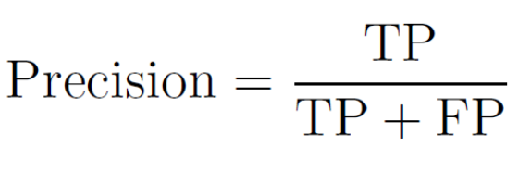
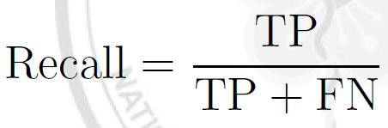
Performance measures
Precision is the proportion of cases that the real positive of all the predicted positive cases
Recall is the proportion of cases that tested positive of all the positive cases

Slide 33
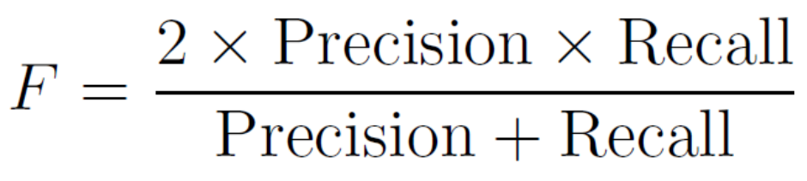
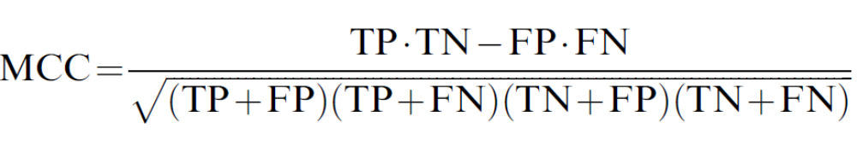
Performance measures
The F-measure is used to integrate the result of Precision and Recall, and get a more comprehensive measurement
MCC is generally regarded as a balanced measure which can be used for comparison of the results with different positive-tonegative ratios, whereas precision and recall (and hence F-measure) are sensitive to dataset imbalance

Slide 34
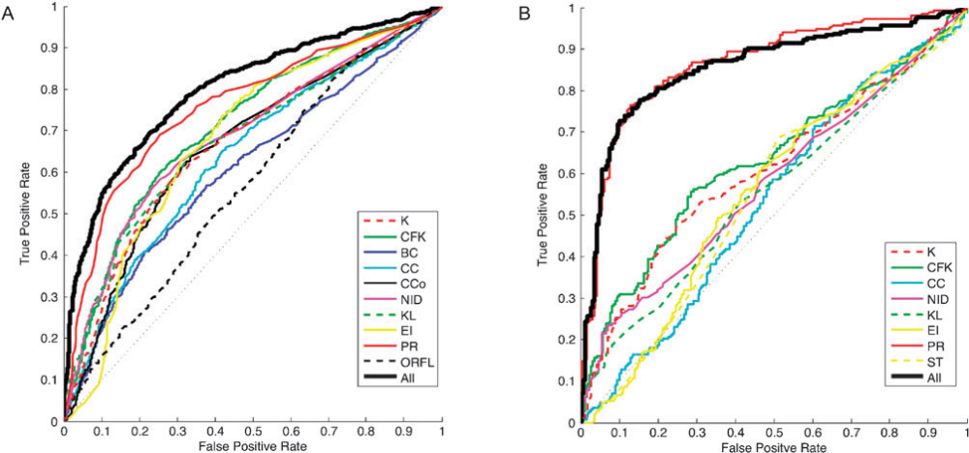
Performance of essential gene prediction

Slide 35
Performance of essential gene prediction
True positive rate = TP/(TP+FN) 是指目標樣本分類正確的樣本數目比率
False positive rate = FP/(FP+TN) 是指非目標樣本分類成目標樣本的錯誤樣本數目比率
Receiver operating characteristic (ROC)圖形通常被用來觀察該分類器 True positive rate 與 False positive rate 的損益平衡情形,Y軸為 True positive rate ,X軸為 False positive rate. 每一個分類器的分類結果,就會得到一組由(True positive rate, False positive rate)所配對組成的操作點.左下角(0,0)代表分類器絕對不會將資料分類到目標樣本. 相反的,右上角(1,1)則是代表分類器一定會將資料分類到目標樣本,左上角(0,1)操作點代表一個完美的分類器 .若將所有相關操作點集合起來,可行成一條ROC曲線.藉由曲線的形狀可觀察該分類器的損益平衡情形. 一般而言,以曲線下方面積做為ROC區先評估的準則,此數值若越大,代表越佳的分類器.

Slide 36
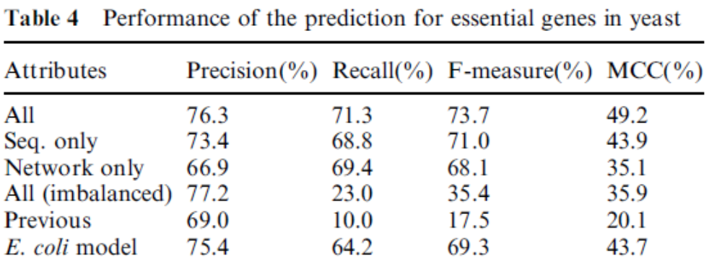
Performance of essential gene prediction

Slide 37
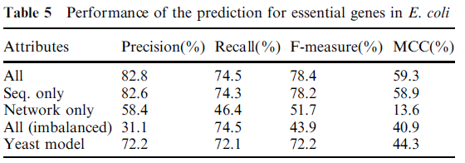
Performance of essential gene prediction

