Slide 1
Investigating technical trading strategy via an multi-objective evolutionary platform
S.C. Chiam (Swee Chiang Chiam), K.C. Tan (Kay Chen Tan, 陳家進) , A. Al Mamum
Department of Electrical and Computer Engineering National University of Singapore
Expert Systems with Applications, Vol. 36 (2009), pp. 10408-10423
Presenter: Hung-Hsin Chen
Date: Sept. 21, 2010

Slide 2
Abstract
Conventional approach in evolutionary technical trading strategies adopted the raw excess returns as the sole performance measure, without considering the associated risk involved. However, every individual has a different degree of risk averseness and thus different preferences between risk and returns. Acknowledging that these two factors are inherently conflicting in nature, this paper considers the multi-objective evolutionary optimization of technical trading strategies, which involves the development of trading rules that are able to yield high returns at minimal risk. Popular technical indicators used commonly in real-world practices are used as the building blocks for the strategies, which allow the examination of their trading characteristics and behaviors on the multi-objective evolutionary platform. While the evolved Pareto front accurately depicts the inherent tradeoff between risk and returns, the experimental results suggest that the positive correlation between the returns from the training data and test data, which is generally assumed in the single-objective approach of this optimization problem, does not necessarily hold in all cases.

Slide 3

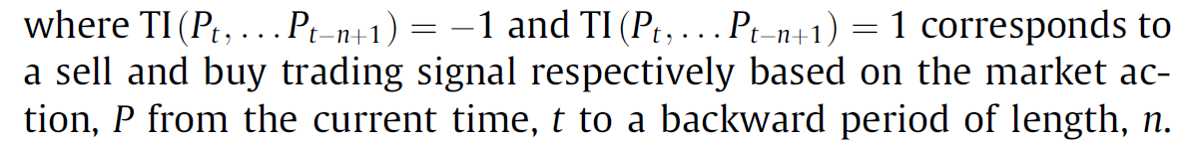
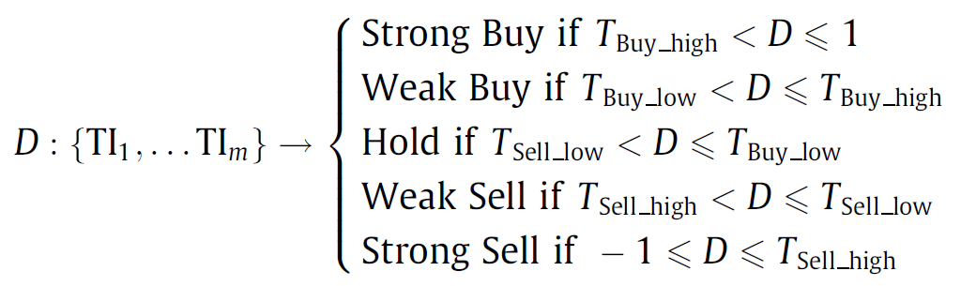
Technical trading strategies (TTS)
Technical indicators
Note:
1. P can refer to the closing, opening, highest, or lowest prices, volumes etc.
2. Daily trading period will be considered in this paper.
Trading decision D is the combination of a set of m TI.
where -1 < T_{Sell_high} < T_{Sell_low} < 0 < T_{Buy_low} < T_{Buy_high}< 1
Long (short) position: buy (sell) when the signal is strong buy (strong sell) and exit when the signal weakened to weak buy (weak sell) or worse.

Slide 4
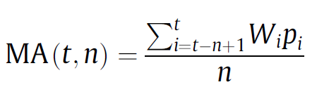
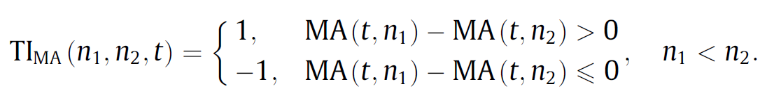
Technical indicator
Moving average (MA)
where p_{i} and w_{i} refers to the closing price and its corresponding weight at time i, while t and n denotes the current time and the length of the period considered, respectively.
Golden cross
Death cross

Slide 5
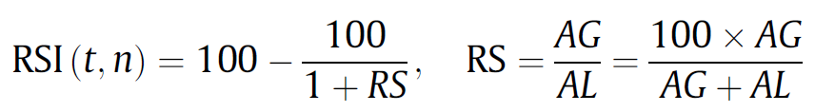
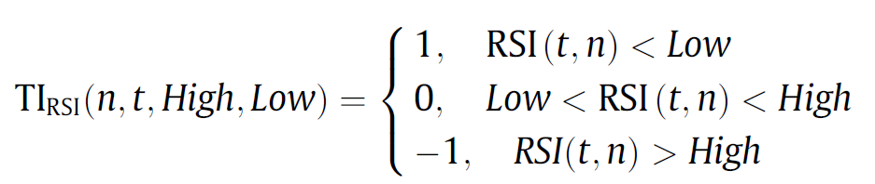
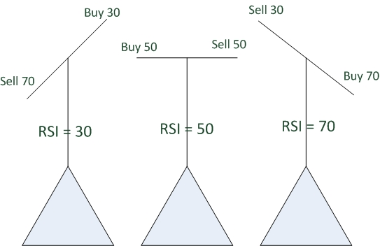
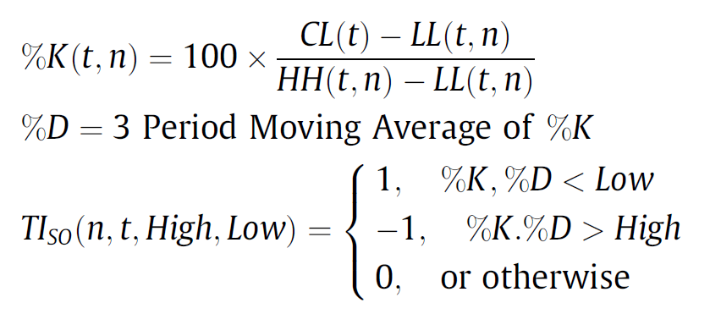
Relative strength index (RSI)
where AG and AL are average price gain and price drop from the current time t to a backward period of length n.
Stochastic oscillator, KD
Sometimes called raw stochastic value (RSV)
where CL is closing price, HH and LL are the price of a stock highest high and the price of a stock lowest low from the current time t to a backward period of length n.

Slide 6
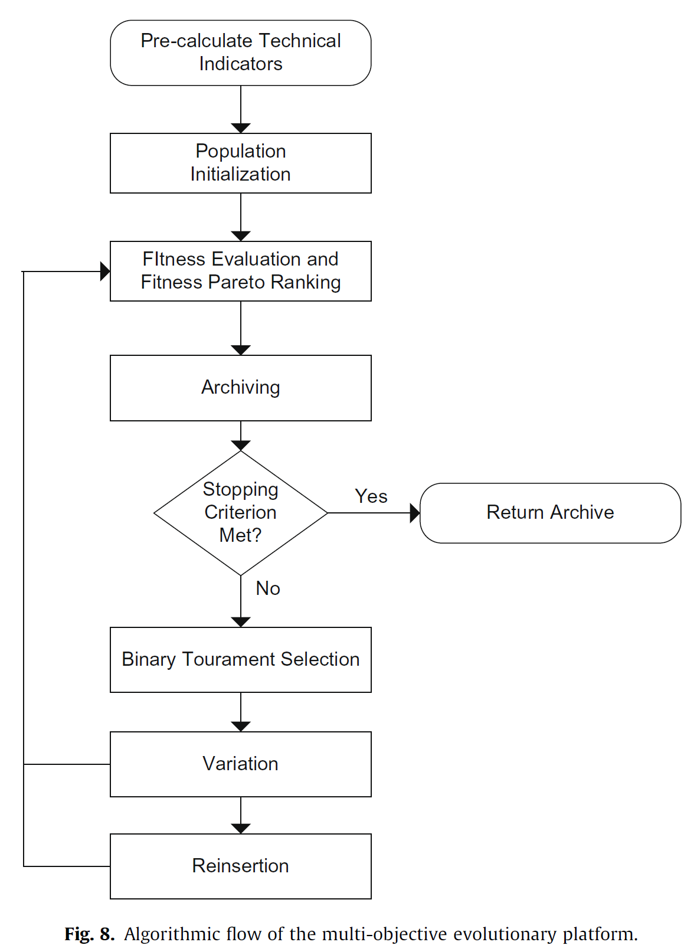
Evolutionary TTS (ETTS)
Goal: maximizing total returns and minimizing risk exposure

Slide 7
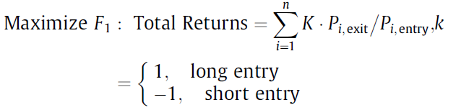
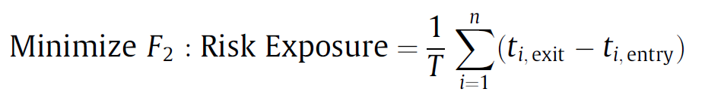
Multiple objective
This part should be modified as K*(P_{i,exit}/P_{i,entry} -1)
where T and n are the period of length and total number of trades, P_{i,entry} and P_{i, exit} are the prices at which the trading agent enters and exits the market, respectively for the ith trade, and the multiplier k is to adjust the returns to compensate for the different types of entries.
The risk is measured by the proportion of trading days when an open position is maintained in the market.

Slide 8
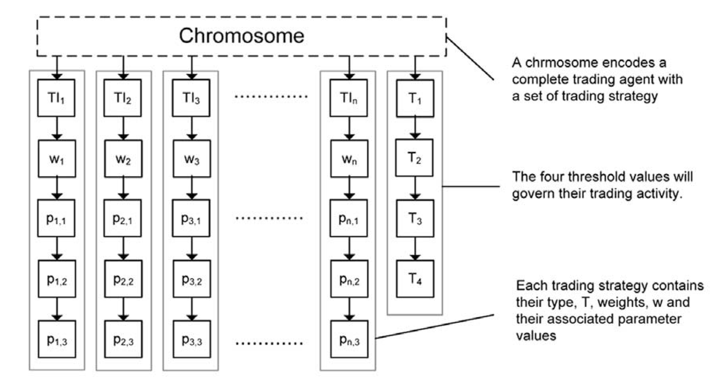
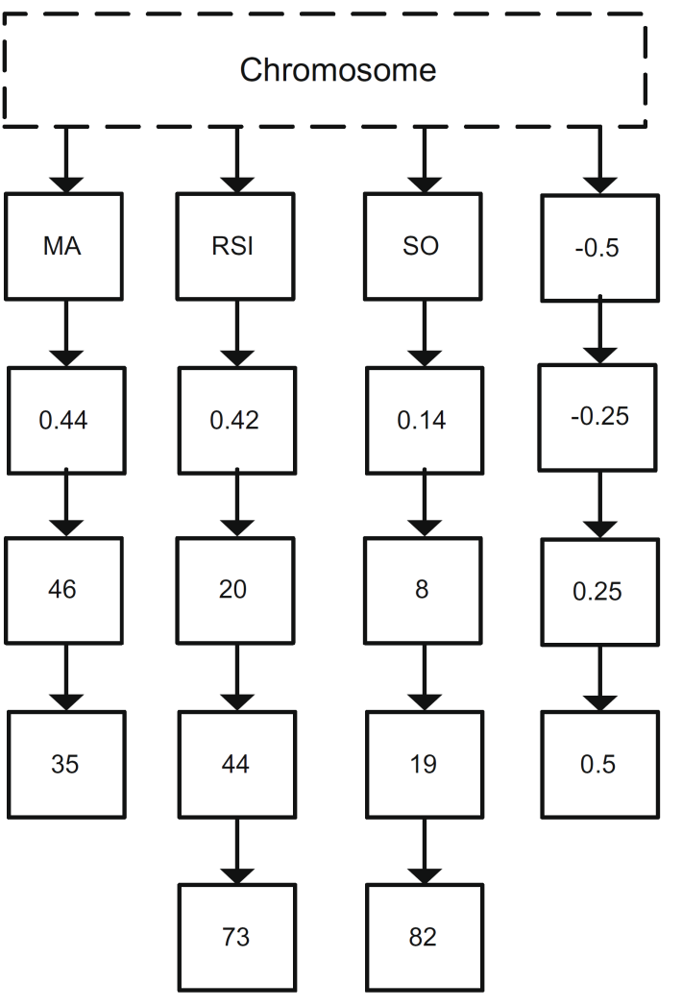
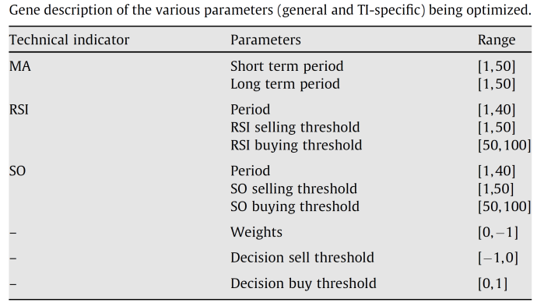
-1 < T_{Sell_high} < T_{Sell_low} < 0 < T_{Buy_low} < T_{Buy_high} < 1
The weights of TIs in the trading decision

Slide 9
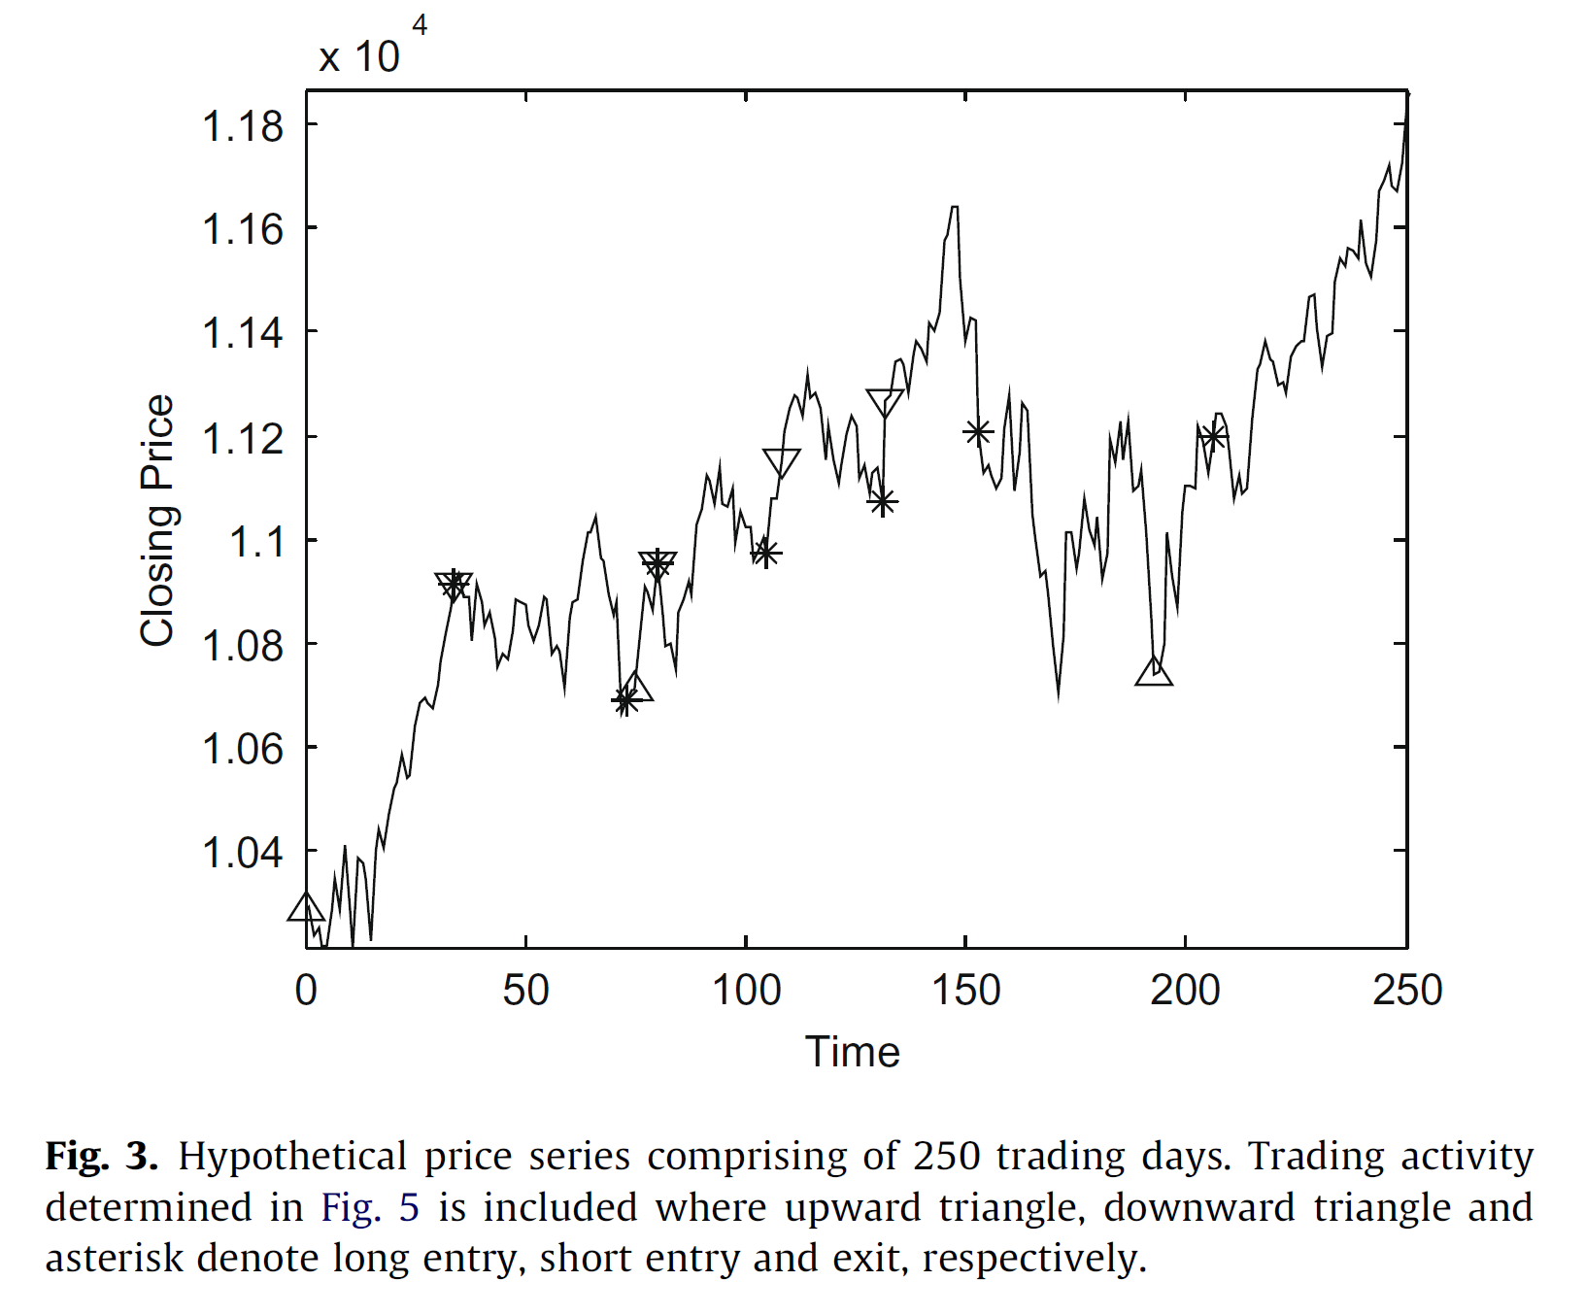
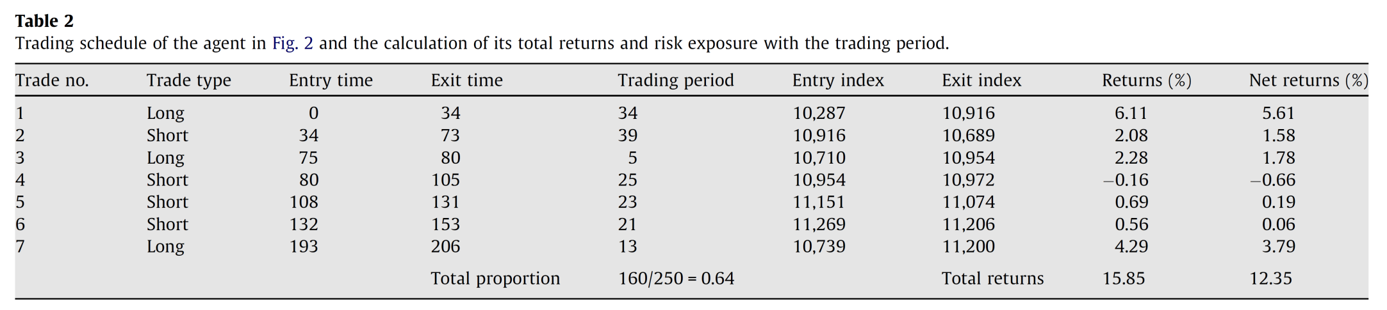
Risk exposure

Slide 10
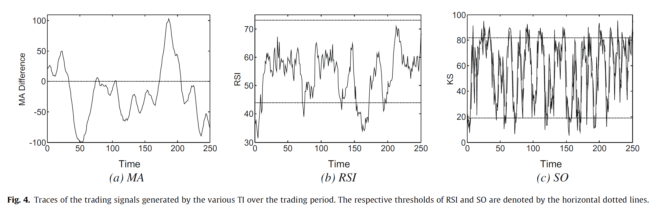
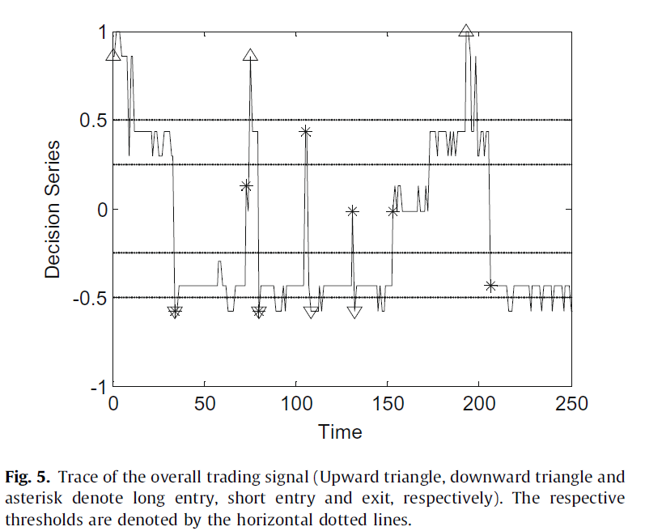
Buy signal
Buy signal
Buy signal
Hold
Hold
Sell signal
Sell signal
Sell signal
For simplicity, the trading environment is discrete and deterministic liquid market, where the price is unaffected by the agents’ actions.
Each transaction consists 0.5% transaction fee.

Slide 11
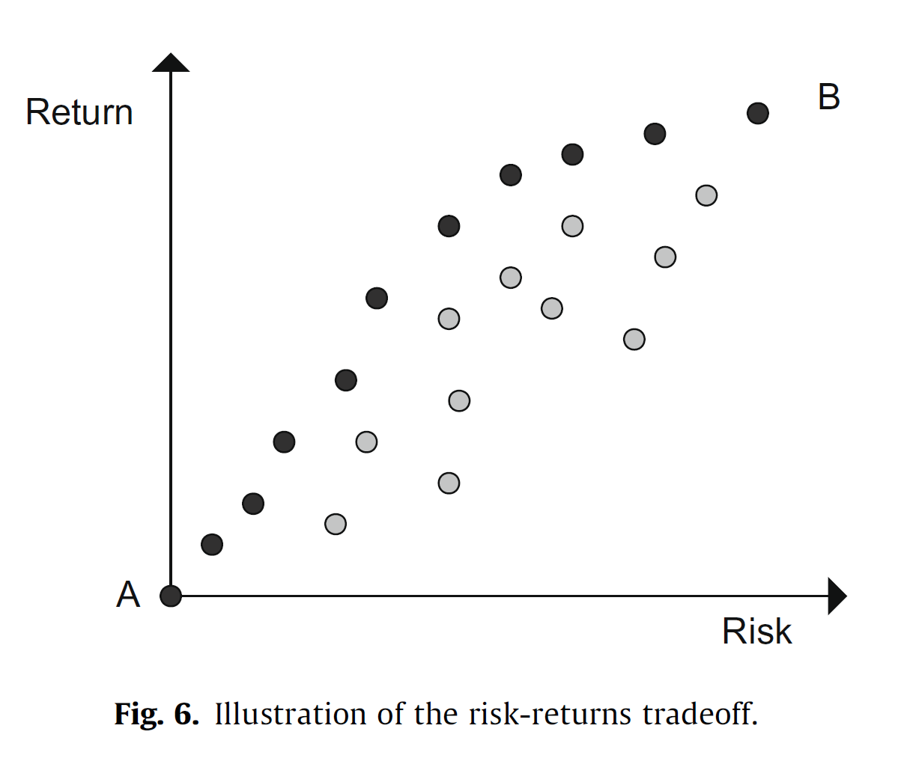
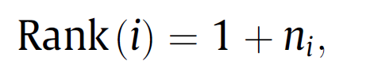
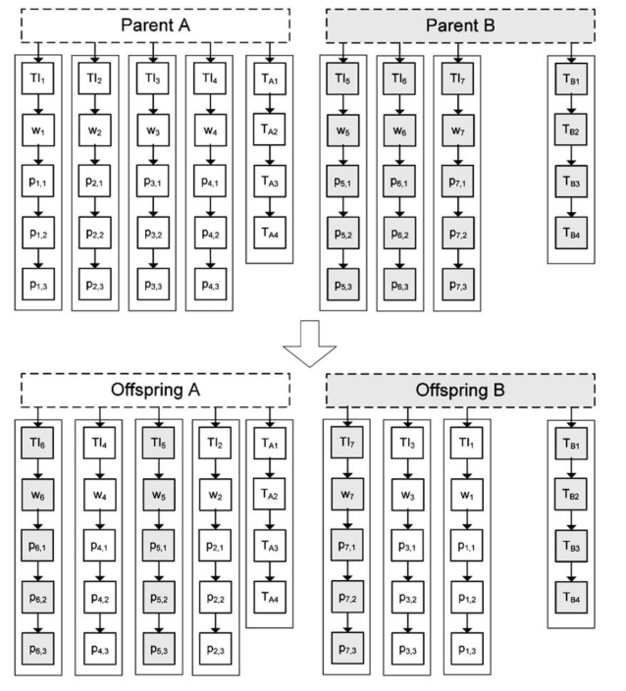
Pareto fitness ranking
Rank of solution i in the population, where n_{i} is the number of ETTS dominating the ith ETTS in the population pool.
Operators
No variation operators in this paper.
Trade-exchange crossover operator.
Indicator level: removing an existing TI or a random TI is added.
Parameter level: TI’s parameters are subjected to Gaussian mutation.
Threshold level: threshold value are subjected to Gaussian mutation.

Slide 12
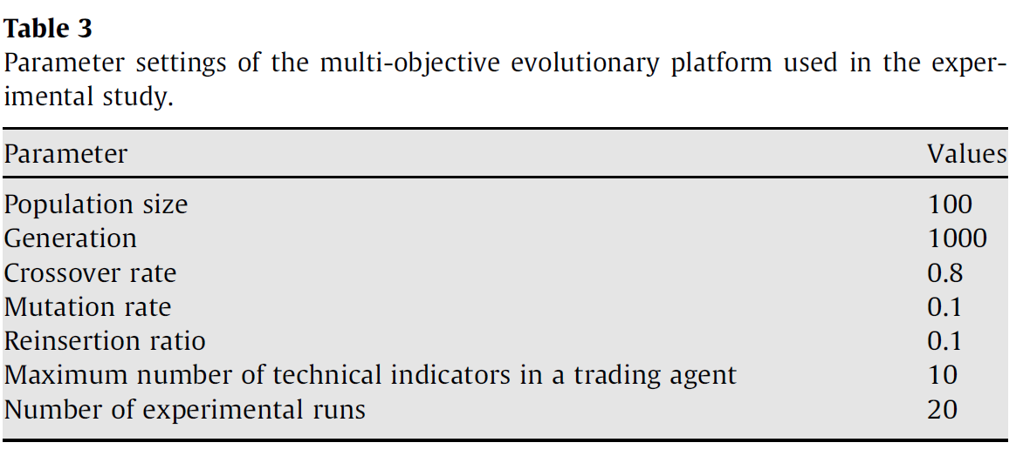
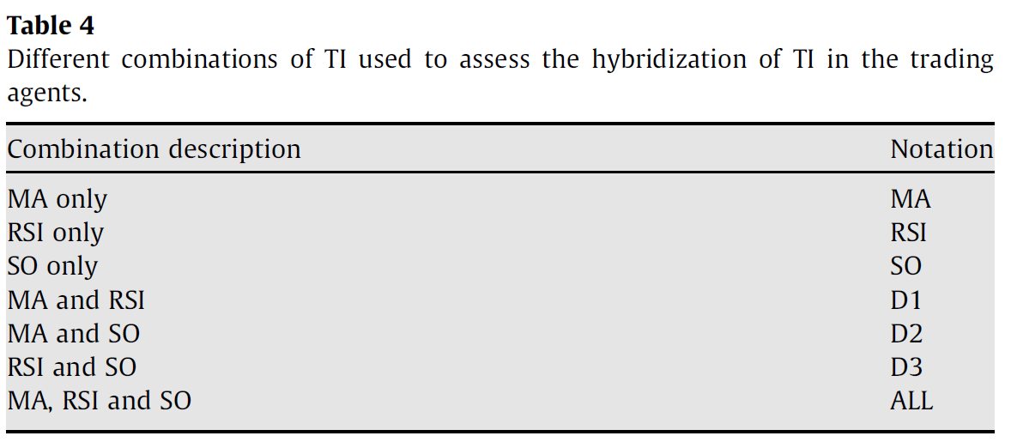
Experimental results
Daily trading data of the Straits times Index (STI, Singapore)
Total 3368 trading days were considered from 11-08-1992 to 30-12-2005.

Slide 13
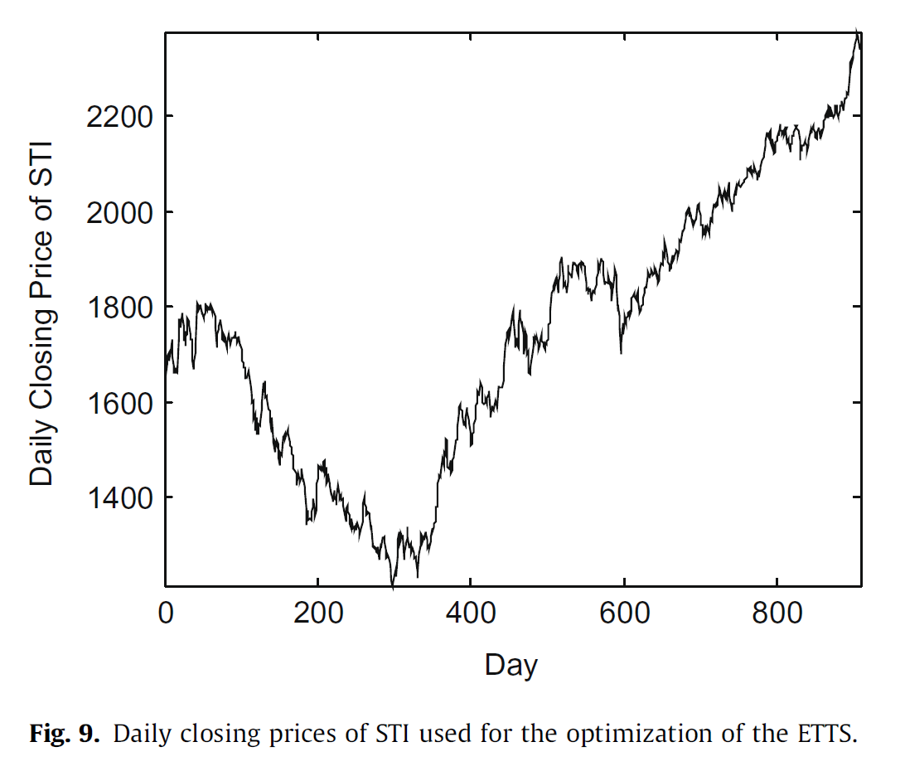
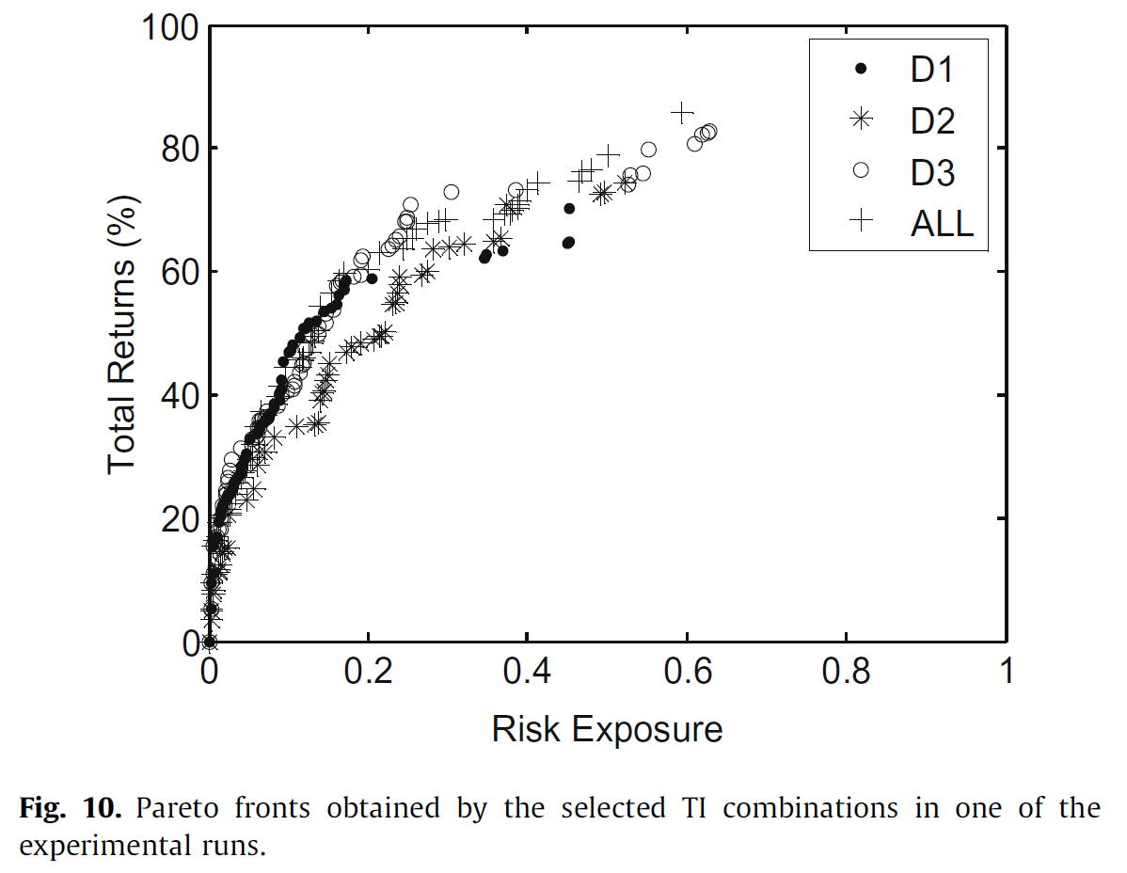
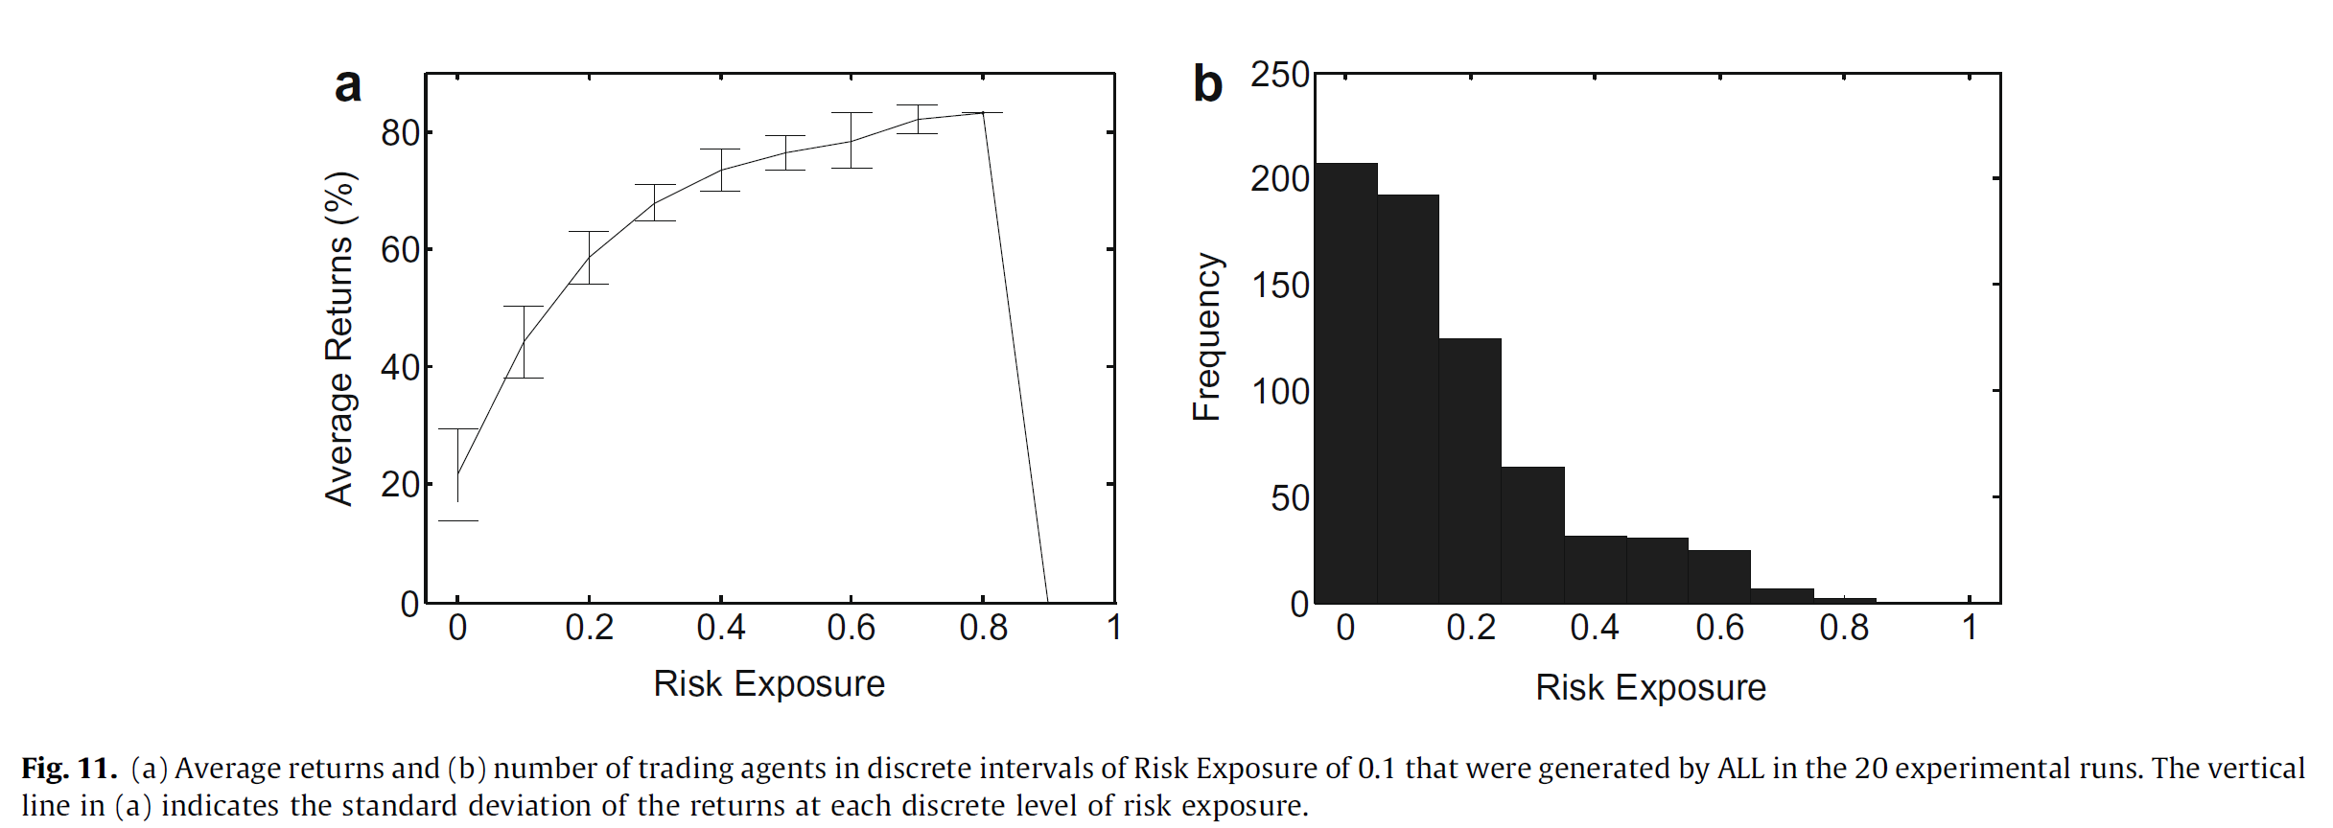
From 02-01-2002 to 30-12-2005
The total return of the buy-and-hold strategy is 44%.
Lack of solutions here

Slide 14
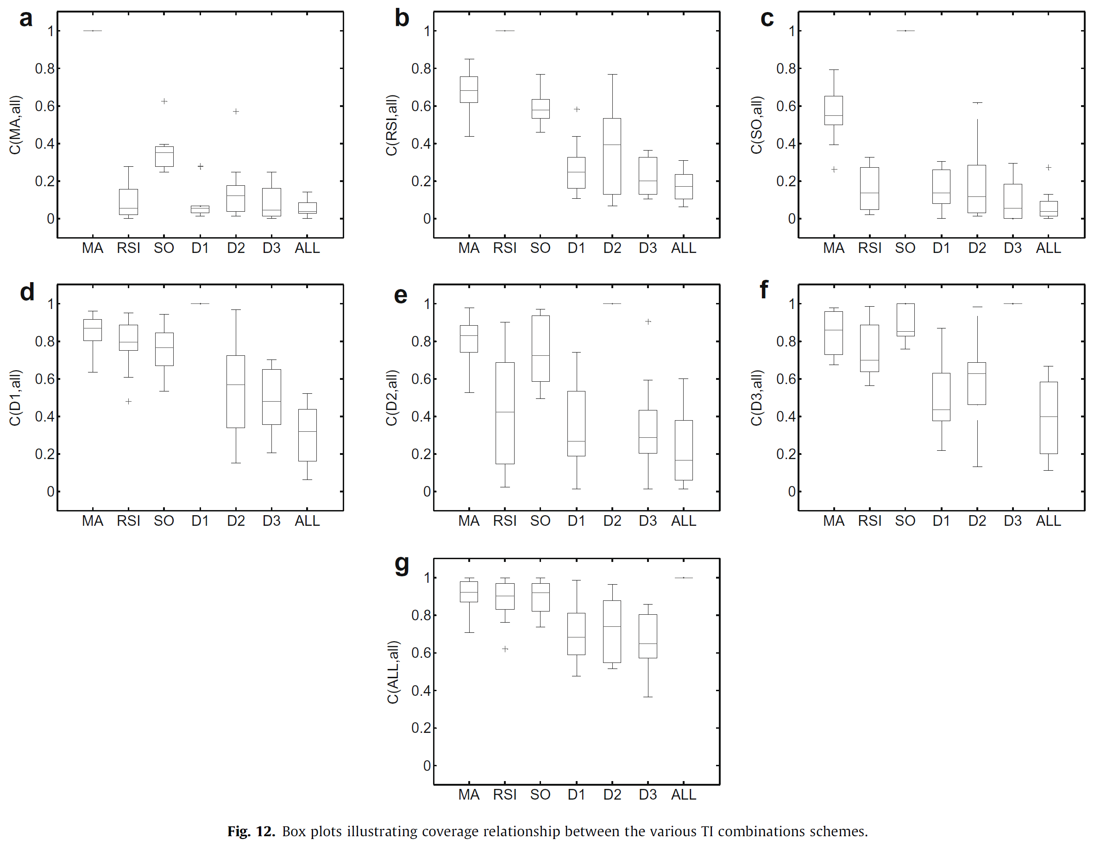
RSI is the best TI in individual TIs.
Hybrid combinations are better than individual TIs.
Coverage function (C):
C(A, B) = 1 means all the points in B are dominated by, or equal to the points in A.
C(A, B) = 0 means none of the points in B are covered by the set A.

Slide 15
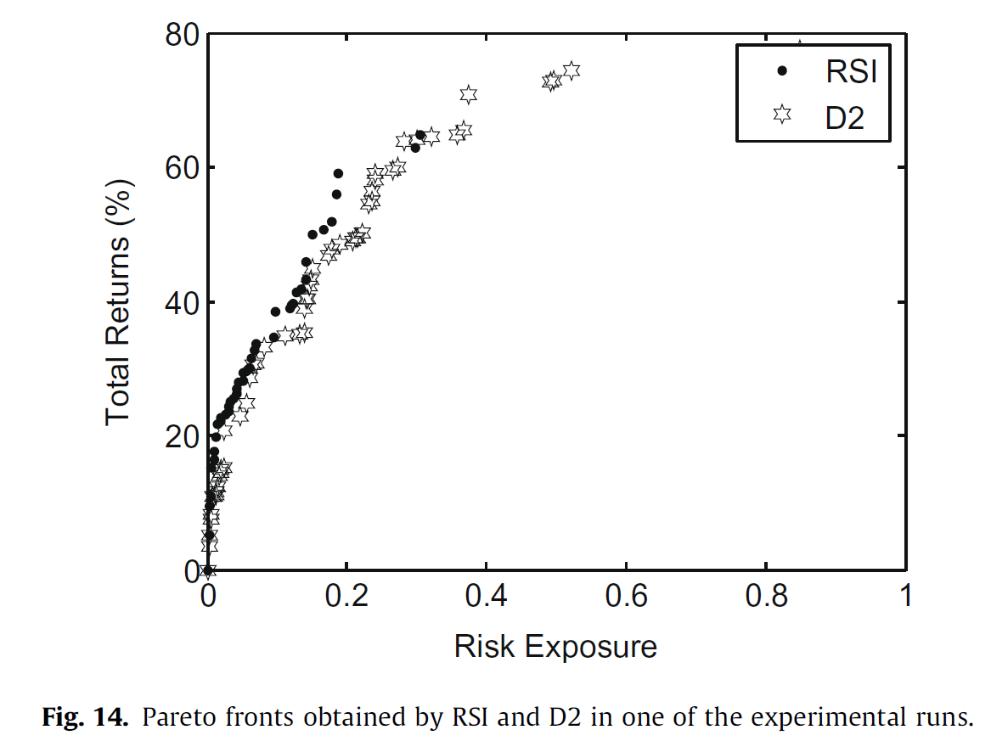
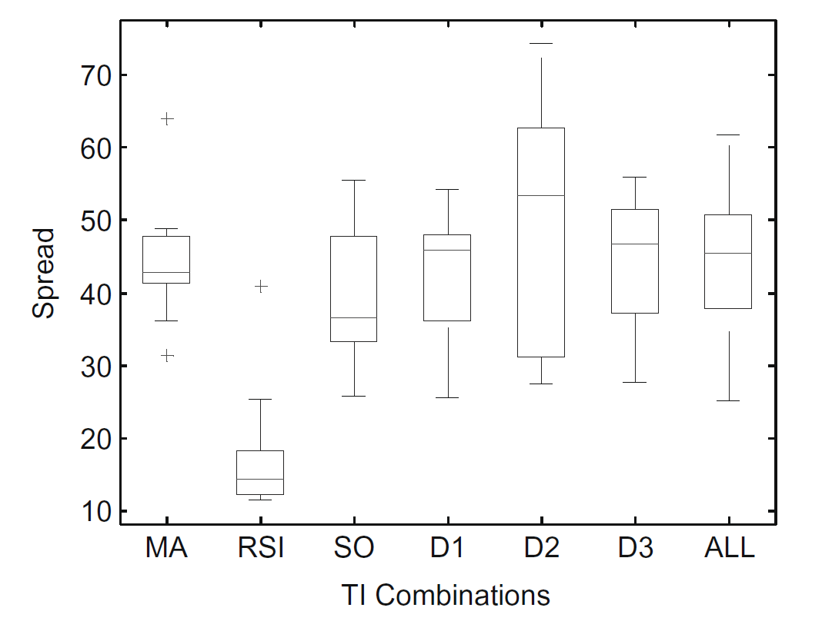
20 experimental runs
D2 was able to diversify over a larger area of the objective but most of its solutions were dominated by RSI in the low risk-returns regions.

Slide 16
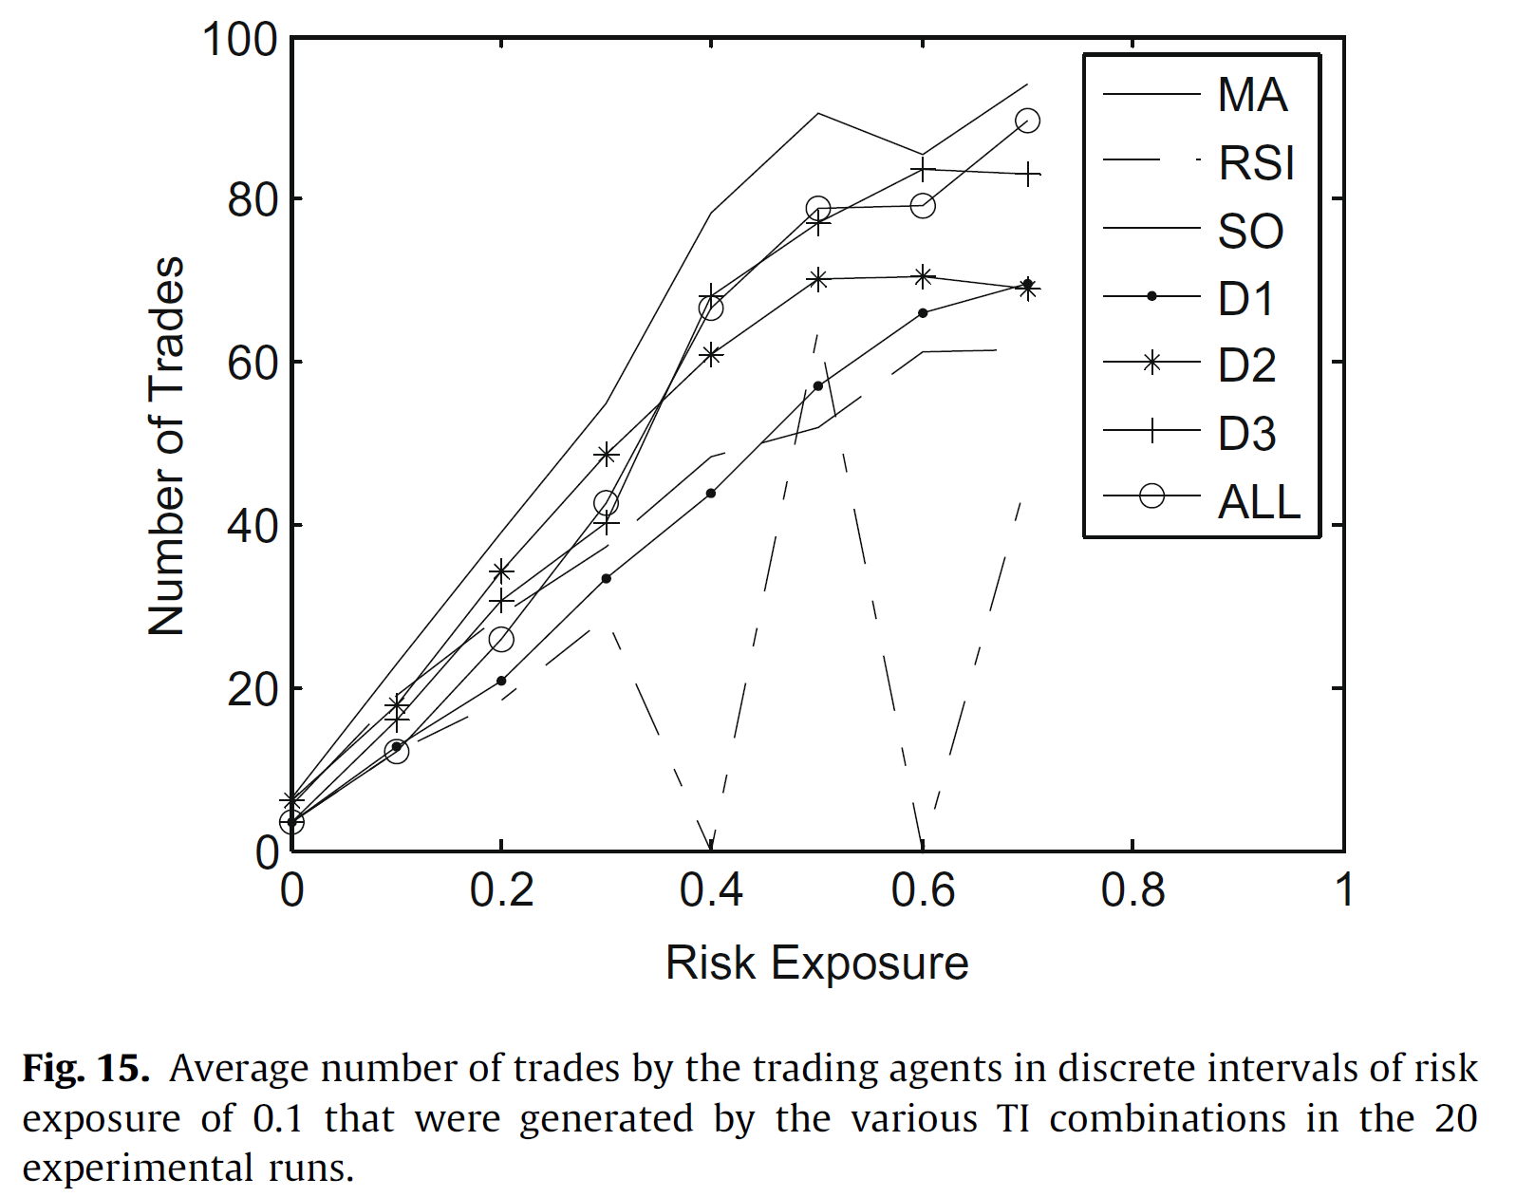
RSI does not have a stable trend because the solutions generated by RSI are concentrated in the low risk regions.

Slide 17
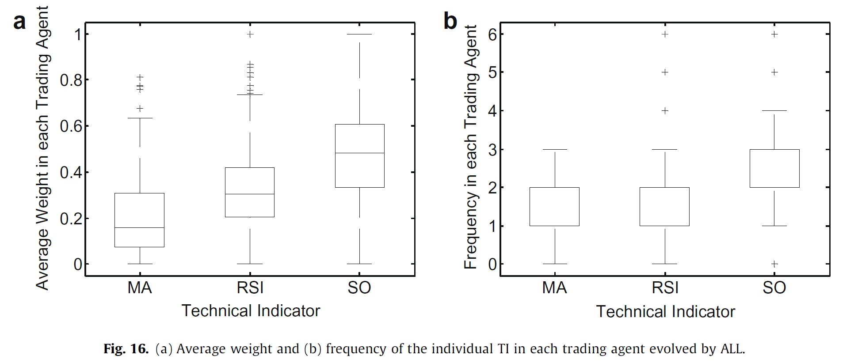
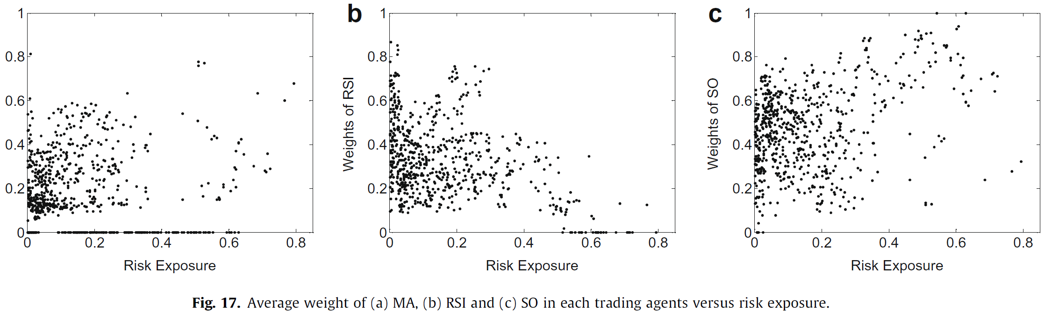

Slide 18
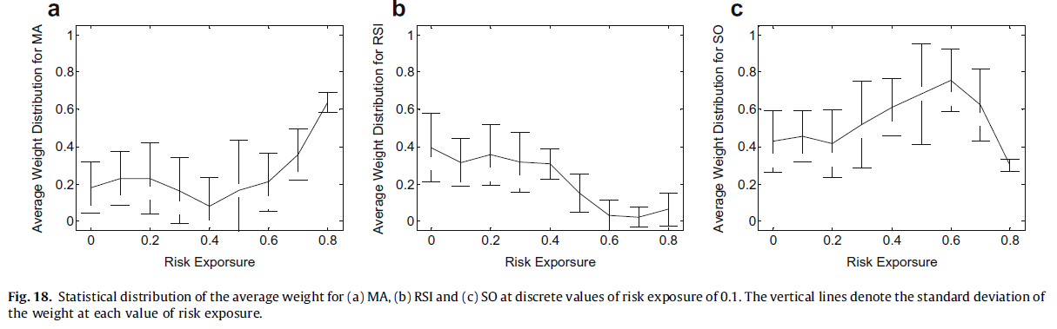

Slide 19
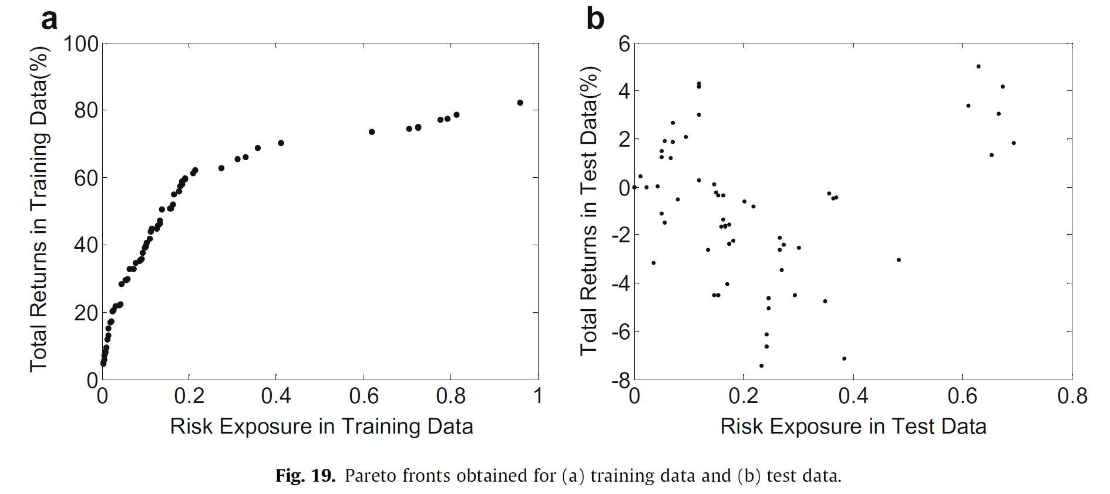
Correlation analysis between training and test performance
Positive returns in the training data do not necessarily correspond to positive returns in the test data.

Slide 20
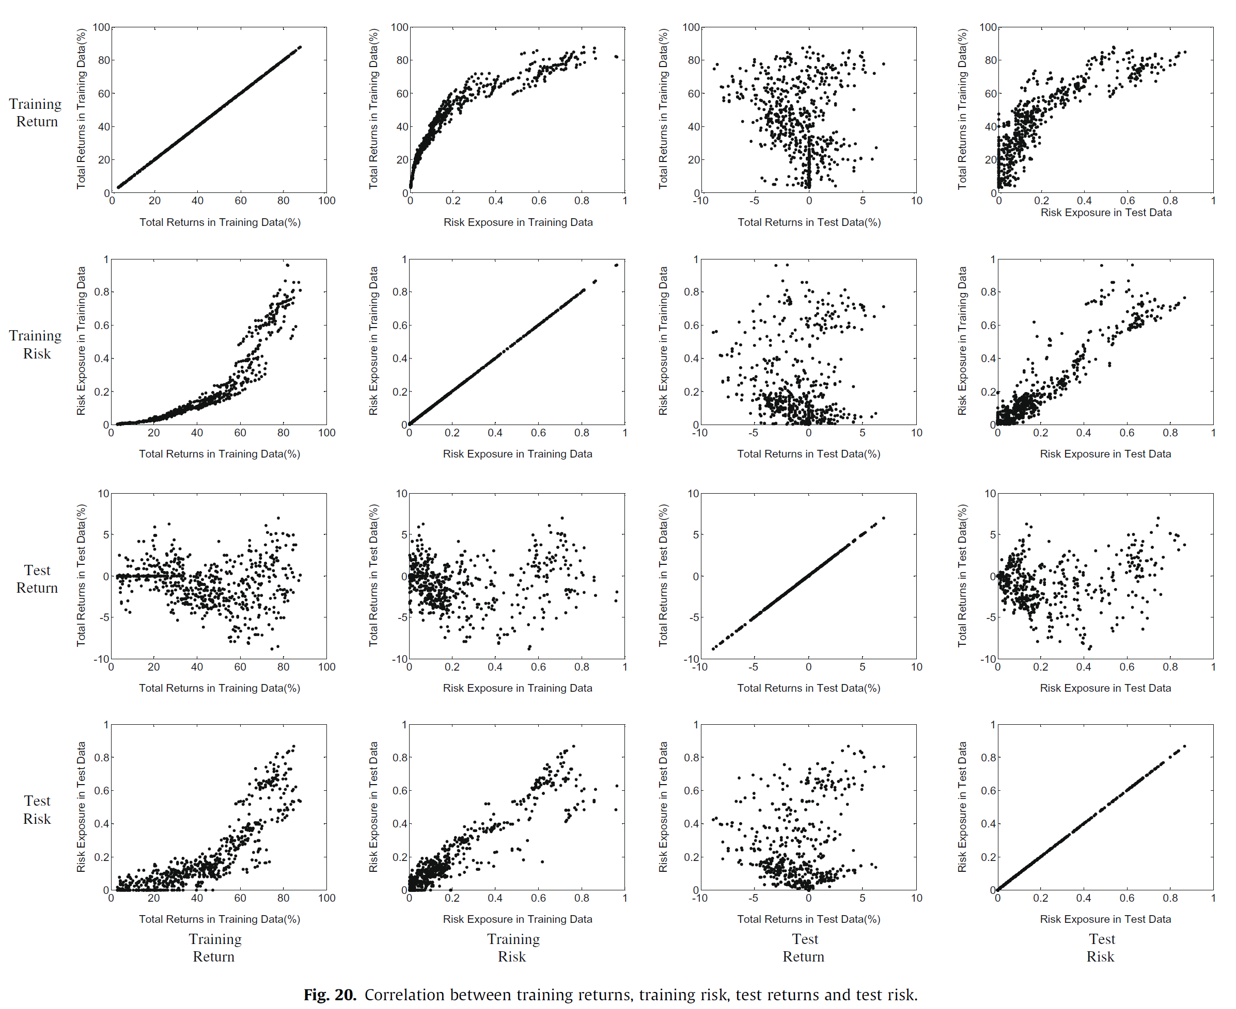
Training Return
Training Risk
Test Return
Test Risk
Low correlation
Obvious tradeoff
Positive correlation
Noisy

Slide 21
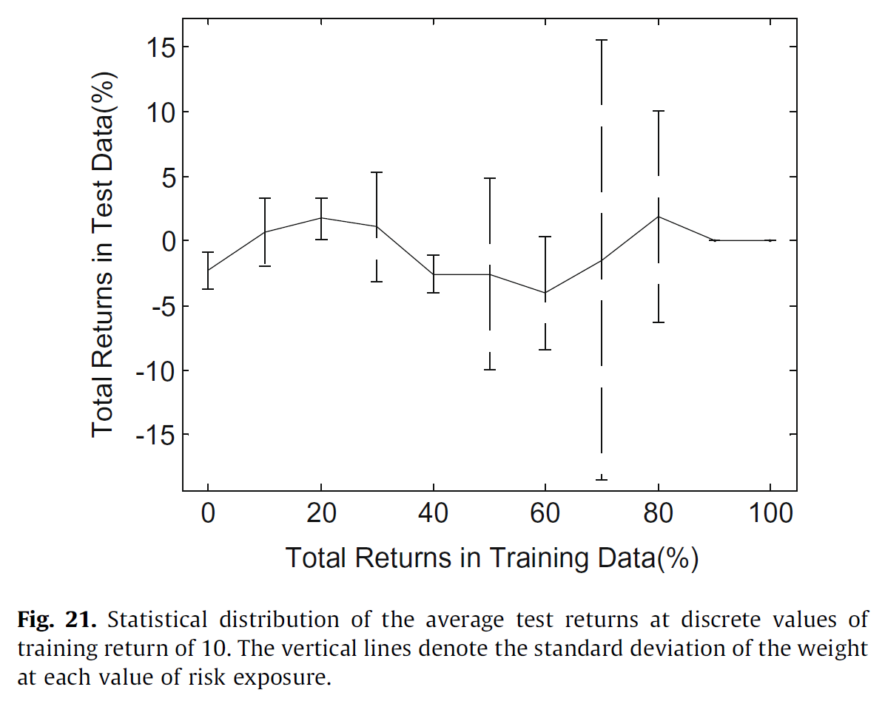

Slide 22
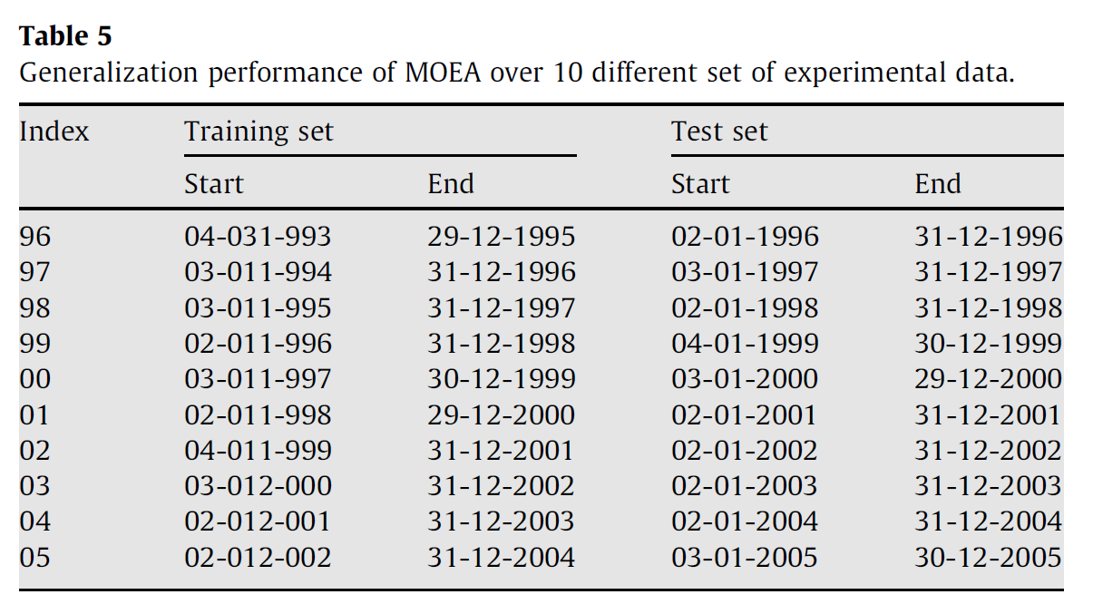
Generalization performance
Experiment period: from 1995 to 2005
100 days prior to the first trading day of the training set were also included

Slide 23
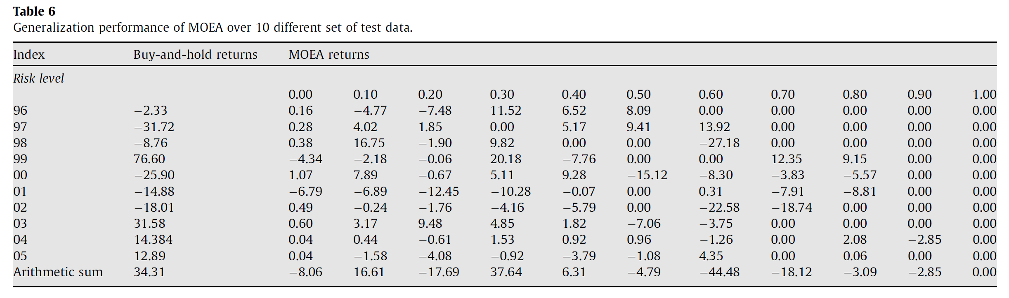
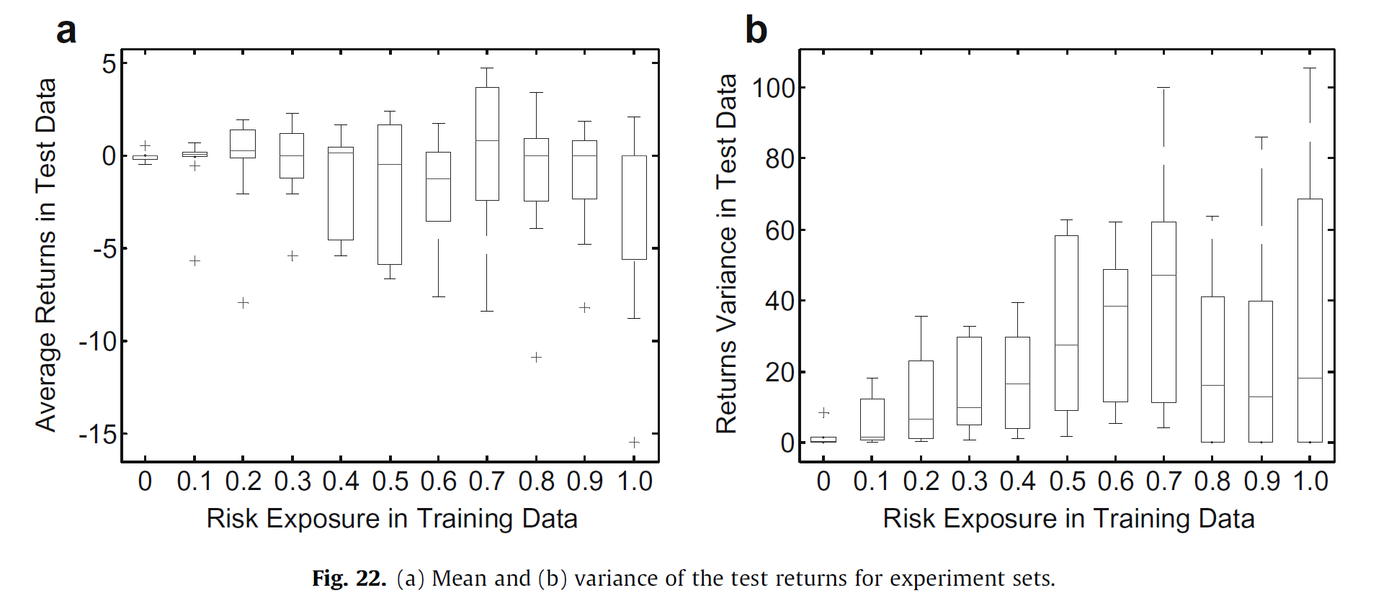

Slide 24
Thank you!!

