Slide 1
A comprehensive assessment of sequence-based and template-based methods for protein contact prediction
Sitao Wu(吳熙濤) and Yang Zhang(張揚)
BIOINFORMATICS, Vol. 24, pp. 924–931, 2008
Presenter: Dong-Jian Lin
Date: Sept. 21, 2010

Slide 2
Abstract
Motivation: Pair-wise residue-residue contacts in proteins
can be predicted from both threading templates and
sequence-based machine learning. However, most
structure modeling approaches only use the template-
based contact predictions in guiding the simulations; this is
partly because the sequence-based contact predictions are
usually considered to be less accurate than that by
threading. With the rapid progress in sequence databases
and machine-learning techniques, it is necessary to have a
detailed and different template conditions.

Slide 3
Abstract
Results: We develop two methods for protein-contact
predictions: SVM-SEQ is a sequence-based machine
learning approach which trains a variety of sequence-
derived features on contact maps; SVM-LOMETS collects
consensus contact predictions from multiple threading
templates. We test both methods on the same set of 554
proteins which are categorized into ‘Easy’, ‘Medium’, ‘Hard’
and ‘Very Hard’ targets based on the evolutionary and
structural distance between templates and targets. For the
Easy and Medium targets, SVM-LOMETS obviously
outperforms SVM-SEQ;

Slide 4
Abstract
but for the Hard and Very Hard targets, the accuracy of the
SVM-SEQ predictions is higher than that of SVM-LOMETS
by 12–25%. If we combine the SVM-SEQ and SVM-
LOMETS predictions together, the total number of correctly
predicted contacts in the Hard proteins will increase by
more than 60% (or 70% for the long-range contact with a
sequence separation 24), compared with SVM-LOMETS
alone. The advantage of SVM-SEQ is also shown in the
CASP7 free modeling targets where the SVM-SEQ is
around four times more accurate than SVMLOMETS in the
long-range contact prediction. These data demonstrate that

Slide 5
Abstract
the state-of-the-art sequence-based contact prediction has
reached a level which may be helpful in assisting tertiary
structure modeling for the targets which do not have close
structure templates. The maximum yield should be
obtained by the combination of both sequence- and
template-based predictions.

Slide 6
Definition of Contacts
In this article, we define a pair of residues as contact if their
CA atom distance is <8Å .
Depending on the sequence separation, we divide the
contacts into short-, medium- and long-ranges, which
correspond to the sequence separation equal to 6–11, 12–
24 and >24,

Slide 7
Methods
SVM-SEQ
SVM-LOMETS

Slide 8
SVM-SEQ
By trial and error, we keep the ratio of non-
contacted/contacted residue pairs as 4:1(20:1) by
randomly selecting a subset of residue pairs.

Slide 9
SVM-SEQ
Local window features
In-between segment feature sets

Slide 10
SVM-SEQ
Local window features:
position-specific scoring matrices (PSSM)
secondary structure predictions (by PSIPRED)
solvent accessibility predictions

Slide 11
Example of PSSM
A R N D C Q E G H I L K M F P S T W Y V
G 0 -3 -1 -2 -3 -2 -3 6 -3 -4 -4 -2 -3 -4 -3 -1 -2 -3 -4 -4
V 2 -3 -3 -3 -1 -2 -2 -2 -3 3 0 -2 0 1 -2 -1 -1 -3 -1 3
S 2 -2 -2 -2 -2 -1 -1 -1 -2 -3 -3 -1 -2 -4 7 1 -1 -4 -3 -2
C -1 -4 -4 -4 10 -4 -5 -3 -4 -2 -2 -4 -2 -3 -4 -2 -2 -3 -3 -2
L 0 3 -2 -3 -2 -1 -1 -3 -2 0 3 1 1 -1 -3 -2 -1 -3 -2 -1
C -1 -4 -4 -4 10 -4 -5 -3 -4 -2 -2 -4 -2 -3 -4 -2 -2 -3 -3 -2
D 0 -2 1 6 -3 -1 1 -2 -2 -2 -3 0 -3 -4 -2 -1 -1 -5 -3 -1
S 0 -1 2 2 -2 0 0 -1 -1 -3 -3 -1 -2 -3 -1 5 1 -4 -2 -2
D -2 -2 1 7 -4 -1 1 -2 -2 -4 -4 -1 -4 -4 -2 1 -1 -5 -4 -4
G 0 -3 -1 -2 -3 -2 -3 6 -3 -5 -4 -2 -3 -4 -3 -1 -2 -3 -4 -4
P -1 -3 -3 -2 -4 -2 -2 -3 -3 -4 -4 -2 -3 -5 8 -1 -2 -5 -4 -3
S 0 0 3 3 -2 0 0 -1 2 -3 -3 0 -2 -3 -2 3 2 -4 -2 -2
V 0 -2 -2 -3 -1 -2 -2 -3 -3 2 0 -2 0 -1 0 0 2 -3 -2 3
A R N D C Q E G H I L K M F P S T W Y V

Slide 12
Solvent Accessibility predictions
從序列資訊來預測蛋白質三級結構是目前生物學研究上非常
重要的目標之一，而正確的預測蛋白質相對溶劑可接觸性則
可以提供蛋白質三級結構相關的資訊。
Two states are assigned to the residues based on the
solvent accessible surface area <25% (buried, represented
by [0 1]) or ≧25% (exposed, by [1 0]).

Slide 13
SVM-SEQ
In-between segment feature sets:
the number of the residues between i and j, i.e. |i-j|
the compositional percentage of three secondary structure elements and two burial states for the in-between residues
state distributions of the in-between residues
the local features of five selected in-between residues which are evenly distributed between i and j.

Slide 14
LOMETS and SVM-LOMETS
LOMETS (Wu and Zhang, 2007a) is a local meta-threading
server which include nine locally installed threading
programs, i.e. FUGUE, HHSEARCH, PAINT, PPA-I,
PPA-II, PROSPECT2, SAM-T02, SP3 and SPARKS2

Slide 15
SVM-LOMETS
For each pair of residues (i and j), the training features
include:
frequency of the contacts occurred on the top N templates
the average and the SD of the CA distance (d_{ij}) calculated from the templates which have d_{ij}<12Å
the continuity of the template fragments near the residues which is defined as the number of continuously aligned residues within a 5-residue window
the burial depth
the average of the normalized Z-scores (Z/Z₀) of the templates with the contact occurred

Slide 16
SVM-LOMETS
the structural similarity of the templates with the contacts occurred which is calculated by the average TM-score between the templates

Slide 17
SVM-LOMETS
In SVM-LOMETS, we collect nine different training datasets with 10, 20, 30, 40, 50, 60, 70, 80 and 90 top templates.(N)

Slide 18
Z-score
Z=(S-<S>)/σ_{s}
S is the raw-score of original threading alignment and σ_{s} is the SD.
<S> is the mean.

Slide 19
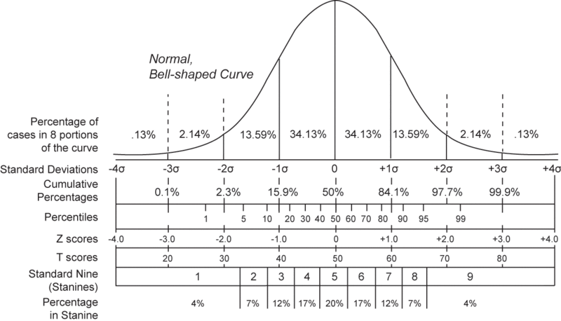
Z-score

Slide 20
Training dataset
we select 500 non-homologous proteins from PDBSELECT (Hobohm and Sander, 1994) with a pair-wise sequence identity <25% and sizes ranging from 50 to 559.
Overall, the training data include 21,826/26,738/28,000 contacts and 87,304/106,952/112,000 non-contacts which are randomly selected in the short/medium/long-ranges, respectively.
The data follows a ratio of 1:4 for the contact/non-contact residues.

Slide 21
Results
Acc = N_{corr}/N_{pred},
where N_{corr} is the number of correctly predicted contacts that are true contacts in the native structure, N_{pred} is the total number of predicted contacts in the range.
We assess the number of contact predictions by the percentage relative to the length of the target sequence L, i.e. Pct = N_{pred}/L.

Slide 22
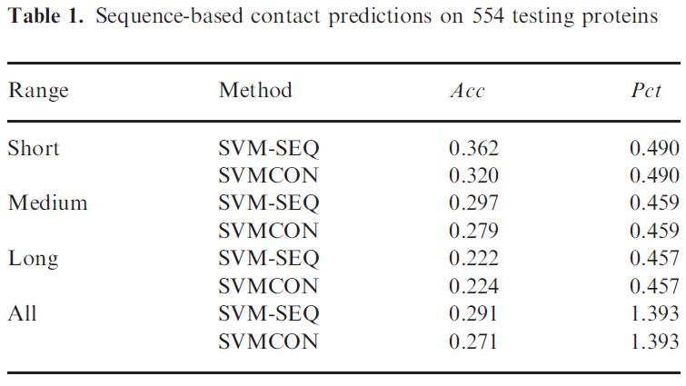
Results

Slide 23
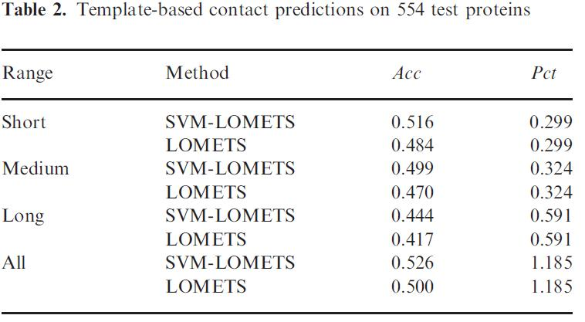
Results

Slide 24
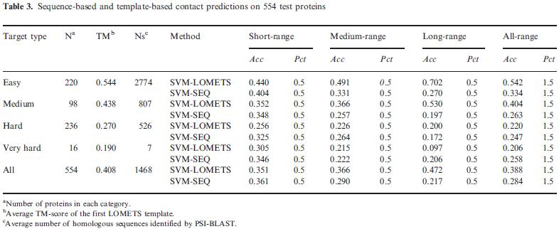
Results

Slide 25
Results
If there is at least one template with Z>Z₀ in each of the threading programs, the target is Easy;
If there is no good template of Z>Z₀ in any of the programs, it is Hard.
The others are Medium target.
Very Hard proteins which have a TM-score<0.23 for the first threading template and with <15 PSI-BLAST homologous sequences.

Slide 26
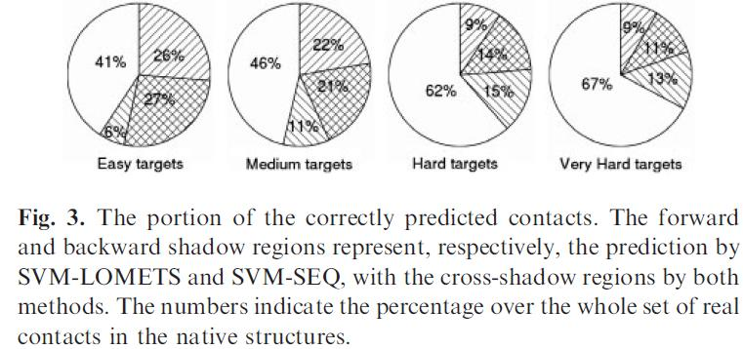
Results

Slide 27
Thanks for your listening!

