Slide 1
Improving the Accuracy of Predicting Disulfide Connectivity by Feature Selection
LIN ZHU, JIE YANG, JIANG-NING SONG, KUO-CHEN CHOU, HONG-BIN SHEN
J Comput Chem 31: 1478–1485, 2010
Speaker: Chong-Jie Wang
Date: August 16, 2010

Slide 2
Abstract(1/3)
Disulfide bonds are primary covalent cross-links formed between two cysteine residues in the same or different protein polypeptide chains, which play important roles in the folding and stability of proteins. However, computational prediction of disulfide connectivity directly from protein primary sequences is challenging due to the nonlocal nature of disulfide bonds in the context of sequences, and the number of possible disulfide patterns grows exponentially when the number of cysteine residues increases.

Slide 3
Abstract(2/3)
In the previous studies, disulfide connectivity prediction was usually performed in high-dimensional feature space, which can cause a variety of problems in statistical learning, such as the dimension disaster, overfitting, and feature redundancy. In this study, we propose an efficient feature selection technique for analyzing the importance of each feature component. On the basis of this approach, we selected the most important features for predicting the connectivity pattern of intra-chain disulfide bonds.

Slide 4
Abstract(3/3)
Our results have shown that the high-dimensional features contain redundant information, and the prediction performance can be further improved when these high-dimensional features are reduced to a lower but more compact dimensional space. Our results also indicate that the global protein features contribute little to the formation and prediction of disulfide bonds, while the local sequential and structural information play important roles. All these findings provide important insights for structural studies of disulfide-rich proteins.

Slide 5
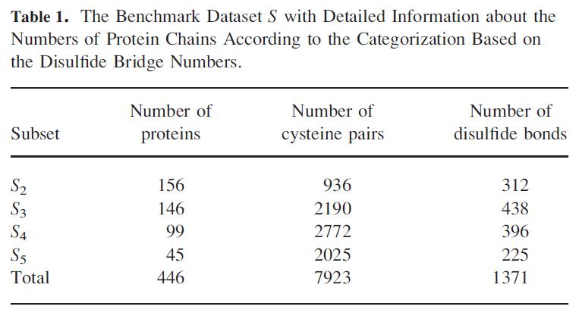
Dataset
Swiss-Prot 39

Slide 6

Disulfide Connectivity Pattern
Number of possible cystein pairs N in M bridges:
N = M*(2M-1)
the number of possible disulfide connectivity patterns in a protein:

Slide 7
Feature presentation
amino acid composition : 20
protein molecular weight :1
protein sequence length:1
cysteine–cysteine coupling effect:520
cysteine–cysteine local secondary structural information:78
Cysteine ordering:2
Total 623 features

Slide 8

Feature selection
Variance score
Laplacian score
Fisher score
X_{i} : the ith cysteine pair presentd by a 623-D vector

Slide 9

Variance score
f _{m} is the mean value of the mth feature.
The larger the V_{m} value, the more important the mth feature.

Slide 10
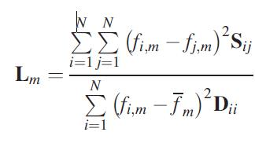
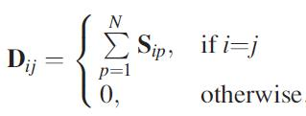
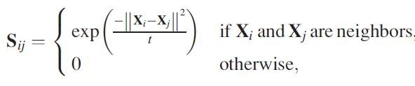
Laplacian score
Based on the observation that two data points are more likely to be related to the same class if they are close to each other.

Slide 11
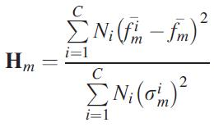
Fisher score
Fisher score is a supervised measure with class labels and can be used to seek features that are efficient for the discrimination of different classes.

Slide 12
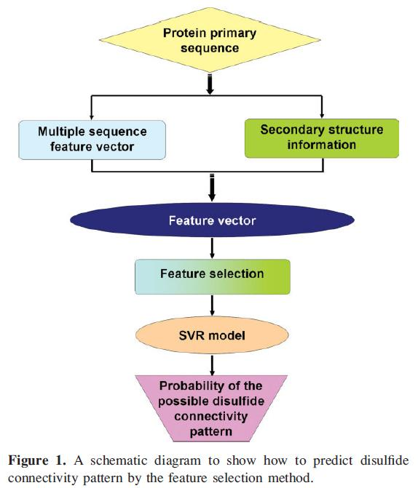

Slide 13
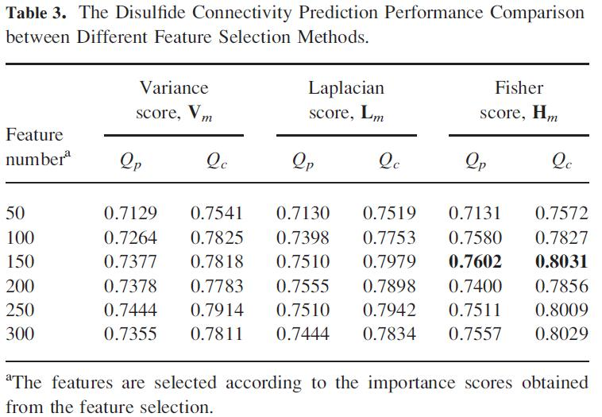
Results and Discussions

Slide 14
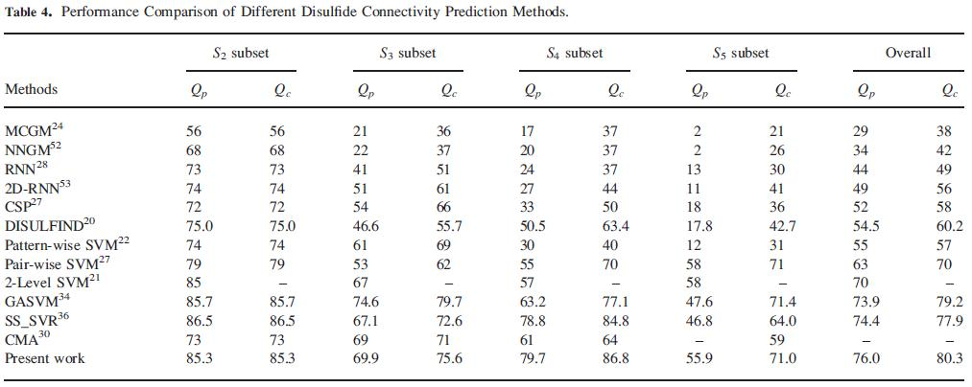

Slide 15
The overall importance order of the selected features is as follows: distance of cysteine > cysteine ordering > position-specific scoring matrix > predicted secondary structure > amino acid composition.

Slide 16
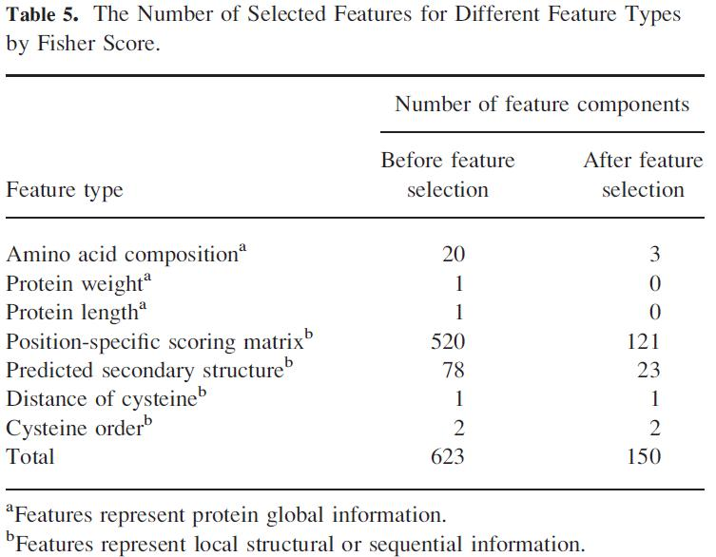

Slide 17
Thank you!

