Slide 1
iDBPs: a web server for the identification of DNA binding proteins
Guy Nimrod, Maya Schushan, Andras Szilagyi, Christina Leslie and Nir Ben-Tal
BIOINFORMATICS, Vol. 26 no. 5 2010, pages 692–693
Presenter: Kai-Yu Chen
Date: Sept. 27, 2010

Slide 2
Abstract
Summary: The iDBPs server uses the three-dimensional (3D) structure of a query protein to predict whether it binds DNA. First, the algorithm predicts the functional region of the protein based on its evolutionary profile; the assumption is that large clusters of conserved residues are good markers of functional regions. Next, various characteristics of the predicted functional region as well as global features of the protein are calculated, such as the average surface electrostatic potential, the dipole moment and cluster-based amino acid conservation patterns. Finally, a random forests classifier is used to predict whether the query protein is likely to bind DNA and to estimate the prediction confidence. We have trained and tested the classifier on various datasets and shown that it outperformed related methods. On a dataset that reflects the fraction of DNA binding proteins (DBPs) in a proteome, the area under the ROC curve was 0.90. The application of the server to an updated version of the N-Func database, which contains proteins of unknown function with solved 3D-structure, suggested new putative DBPs for experimental studies.

Slide 3
Introduction
DNA-binding proteins (DBPs) take part in processes like DNA transcription, maintenance, replication and the regulation of gene expression, and hence many of these proteins are essential for the cell's viability and proliferation.

Slide 4
Implementation(1/5)
Prediction of functional regions in the protein
PatchFinder searches for statistically significant clusters of evolutionarily conserved residues on the protein surface (ML-patches), which often correspond to the functional regions in proteins (Nimrod et al., 2008).
PatchFinder uses as input the protein structure (or a model) and a multiple sequence alignment (MSA) of the query protein and its sequence homologs.
First, each amino acid position in the protein is assigned an evolutionary conservation score calculated based on the phylogenetic relations among the homologues using Rate4Site.
Second, PatchFinder finds the most significant continuous cluster of conserved residues on the protein surface. This cluster is predicted to be the main functional region of the protein, and we refer to it as the maximum likelihood patch (ML-patch).

Slide 5
Implementation(2/5)
Prediction of functional regions in the protein
When only a few sequence homologs are available for the query protein, the conservation signal cannot be calculated reliably and the functional region is not predicted. In such cases, the iDBPs server uses a classifier that was trained on the global features alone.

Slide 6
Implementation(3/5)
The classifier’s input features
The features calculated for the ML-patches are:
average surface electrostatic potential (靜電勢) ： DNA is negatively charged, and the DNA binding region of the protein is often positively charged.
the secondary structure content ： We used DSSP to compute the fraction of residues in the ML-patch that are in α-helical conformation and the fraction of residues that are in a β-strand
cluster-based amino acid conservation patterns ： We used a position specific scoring matrix (PSSM) representation of the MSAs in order to characterize the amino acid conservation patterns of the ML-patches.

Slide 7
Implementation(4/5)
The classifier’s input features
The global features include :
the average electrostatic potential(靜電勢)
secondary structure content ： The fraction of residues in helical conformation is another noticeable feature found in DNA binding sites, particularly due to the common helix-related DNA binding motifs (helix-turn-helix, helix-hairpin-helix and helix-loop-helix)
protein size
They also include the protein’s
dipole moment(偶極矩)
its amino acid composition
the spatial asymmetry of residues within the protein structure ： the spatial asymmetry of Arg, Gly, Asn and Ser, and the percentage of Arg, Ala, Gly, Lys and Asp in the query protein.
the fraction of hydrogen donors/acceptors on the protein surface ： The average number of hydrogen bond donors/acceptors per exposed atom within the ML-patch provides some separation between DBPs and nDBPs

Slide 8
Implementation(5/5)
Using features of the predicted functional regions(16 features) and additional global features(33 features), we trained a random forests classifier on a dataset of 138 DBPs and 110 proteins that do not bind DNA.

Slide 9
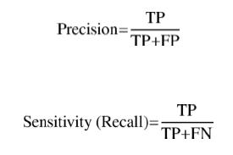
Results(1/3)
We examined the classifier on a realistic dataset that reflects the fraction of DBPs in proteomes. We evaluated this fraction to be 14% and extended the original dataset by 733 additional proteins that do not bind DNA.
The sensitivity and the precision on this dataset were 0.90 and 0.35. The area under the ROC curve (AUC) was 0.90.

Slide 10
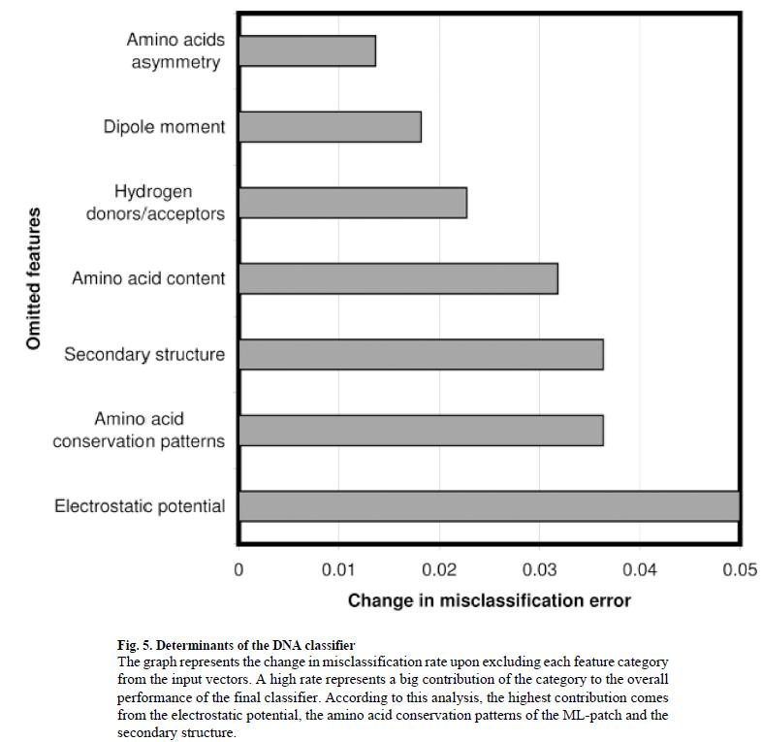
Results(2/3)

Slide 11
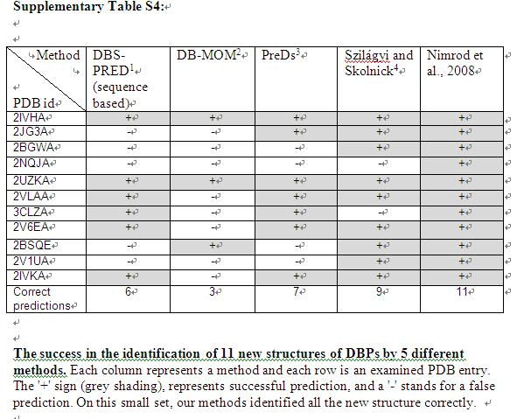
Results(3/3)

