Slide 1
Bayesian Learning Using Automatic Relevance
Determination Prior with an Application to Earthquake
Early Warning
Chang Kook Oh, James L. Beck, and Masumi Yamada
JOURNAL OF ENGINEERING MECHANICS, DECEMBER 2008, pp. 1113-1020

Slide 2
Abstract
A novel method of Bayesian learning with automatic relevance determination prior (ARD) is presented that provides a powerful approach to problems of classification based on data features, for example, classifying soil liquefaction[液化] potential based on soil and seismic[地震的] shaking parameters, automatically classifying the damage states of a structure after severe loading based on features of its dynamic response, and real-time classification of earthquakes based on seismic signals.

Slide 3
Abstract
After introduction of the theory, the method is illustrated by applying it to an earthquake record dataset from nine earthquakes to build an efficient real-time algorithm for near-source versus far-source classification of incoming seismic ground motion signals.[分兩類問題] This classification is needed in the development of early warning systems for large earthquakes. It is shown that the proposed methodology is promising since it provides a classifier with higher correct classification rates and better generalization performance than a previous Bayesian learning method with a fixed prior distribution that was applied to the same classification problem.

Slide 4


Automatic relevance determination (ARD)
Firstly, consider SVM radial basis kernel function which characterizes the similarity of x and x' in the feature space
Then, consider ARD kernel function
η_{i}=1/σ²

Slide 5
Automatic relevance determination (ARD)
For ARD kernel function, as a particular parameter η_{i} becomes small, the function becomes relatively insensitive to the corresponding input variable x_{i}. It becomes possible to detect input variables that have little effect on the predictive distribution, because the corresponding values of η_{i} will be small. This can be useful in practice because it allows such inputs to be discarded. →(feature selection)
from Bishop's "pattern recognition and machine learning"

Slide 6
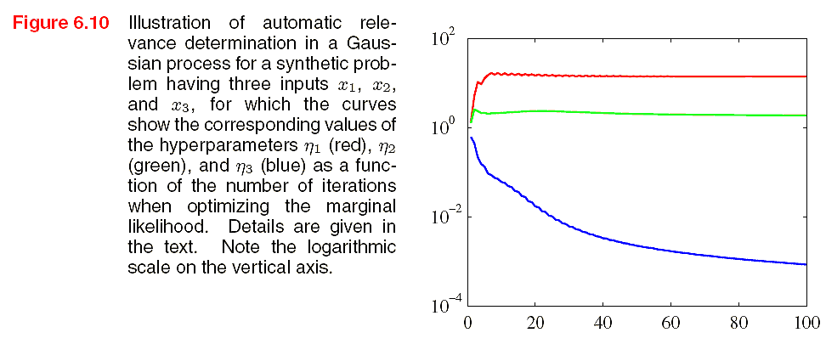
ARD learning
The target variable t, is generated by sampling 100 values of x₁ from a Gaussian, evaluating the function sin(2πx1), and then adding Gaussian noise. Values of x₂ are given by copying the corresponding values of x1 and adding noise, and values of x₃ are sampled from an independent Gaussian distribution. Thus x1 is a good predictor of t, x₂ is a more noisy predictor of t, and x₃ has only chance correlations with t.
from Bishop's "pattern recognition and machine learning"

Slide 7

Relevance Vector Machines (RVM)
The ARD can be extended to a classification (or regression) problem by applying the ARD prior over the weights. The key difference in the RVM is that we introduce a separate hyperparameter α_{n} for each of the weight parameters w_{n} instead of a single shared hyperparameter.
from Bishop's "pattern recognition and machine learning"

Slide 8
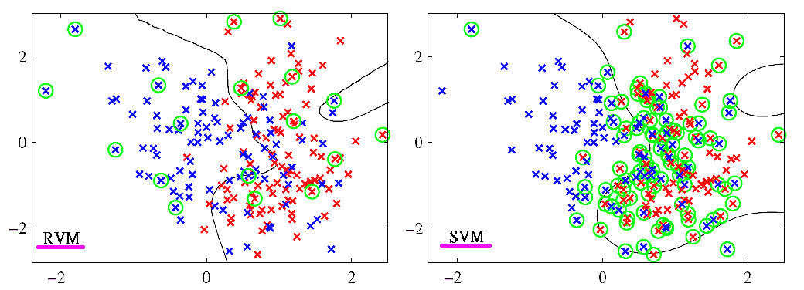
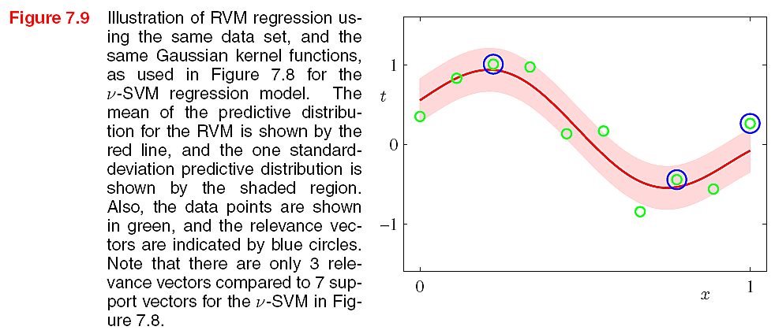
SVM vs. RVM example
classification
from Bishop's "pattern recognition and machine learning"

Slide 9
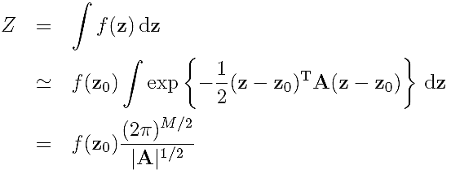
The Laplace Approximation
Sometimes, we can not integrate exactly over the parameter vector w. It is therefore necessary to introduce some form of Gaussian approximation to a probability density defined over a set of continuous variables.
可以快速獲得積分近似值
from Bishop's "pattern recognition and machine learning"

Slide 10

The Laplace Approximation
Example: given
Use the laplace approx.
Obtain
from Bishop's "pattern recognition and machine learning"

Slide 11

Bayes theorem
P(h): prior probability of hypothesis h, may reflect any background knowledge that h holds
P(D): prior probability of training data D is observed
P(D|h): the probability of observing D given that h holds
P(h|D): posterior probability that h holds after observing D
Tom M. Mitchell, "Machine Learning"

Slide 12
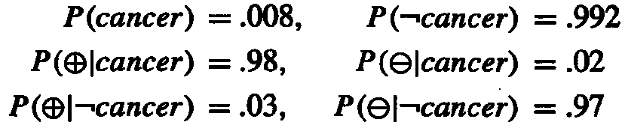
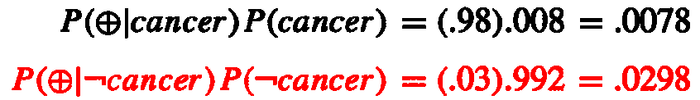
Bayes theorem example
P(cancer): the probability of the entire population that have cancer
P(⊕): the probability of laboratory test that shows positive outcome
Question: suppose we observe a person whose laboratory test is positive, should we diagnose him as have cancer or not?
Tom M. Mitchell, "Machine Learning"

Slide 13
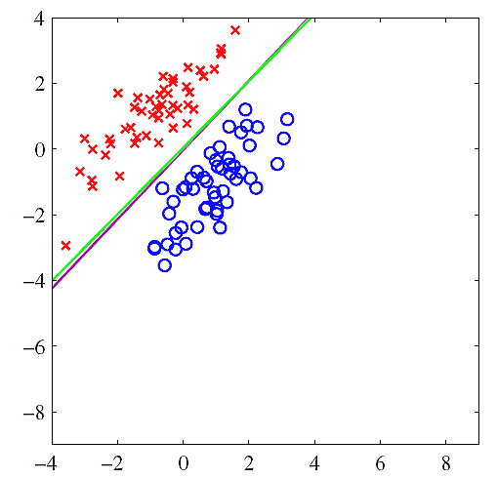

Bayesian Learning and Prediction
Suppose that the function characterizing the separating boundary between the two classes is taken as a linear combination of features x =[x₁, . . . ,x_{m}] with unknown coefficients θ = [θ₁, . . . , θ_{m}], the decision boundary is

Slide 14
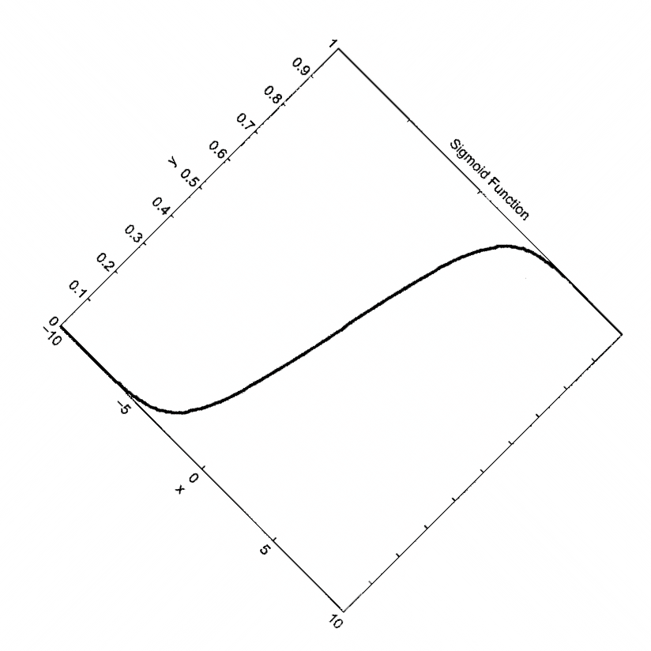
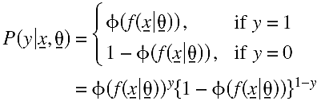
Bayesian Learning and Prediction
Probabilistic predictions of the class label y∈{0,1} corresponding to extracted features x will be based on the probability model
Φ
f(x|θ)

Slide 15



Bayesian Learning
Assuming the data D_{N}, by Bayes's theorem
步驟一：先給定初始α ，然後求θ 。
P(θ|D_{N},α): posterior
P(D_{N}|θ): likelihood
P(θ|α): prior
P(D_{N}|α): evidence
The hyperparameters α define the ARD prior.

Slide 16
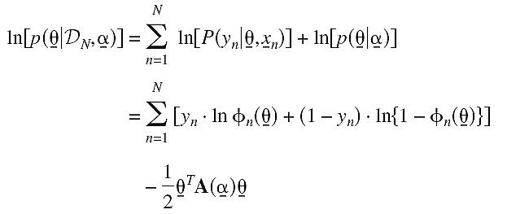
Bayesian Learning
For a given α, the log-posterior of P(θ|D_{N},α) which ignoring terms depedent only on α is
By applying Laplace approximation, the above formula becomes

Slide 17
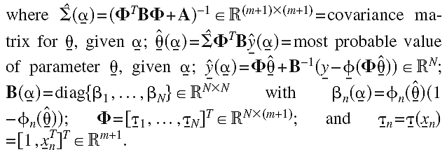
Bayesian Learning
For the posterior of P(θ|D_{N},α)
The posterior of P(θ|D_{N},α) contains all that is known about the parameters θ based on the assumed model class M and the data D_{N}.

Slide 18
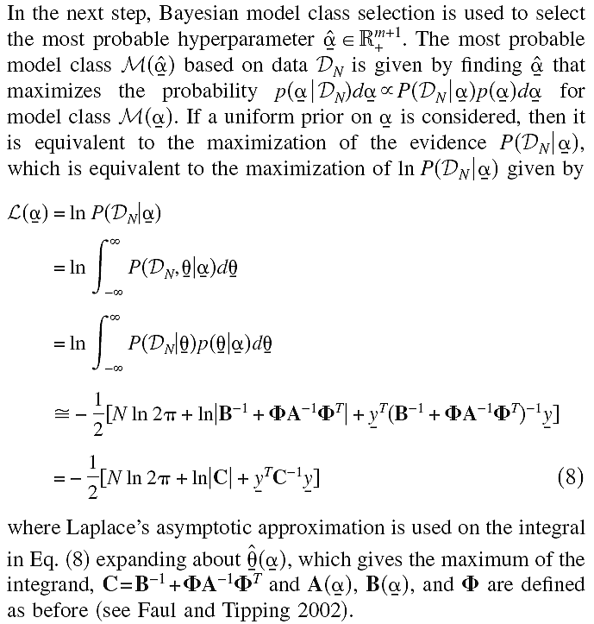
Bayesian Model Class Selection When Using ARD Prior α
步驟二：求得θ後，再求最佳α 。

Slide 19
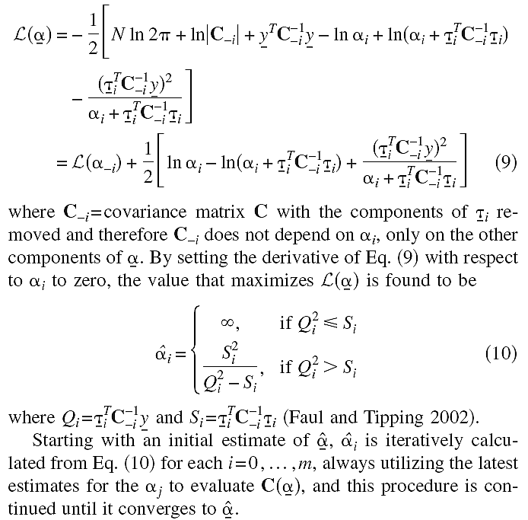

Slide 20
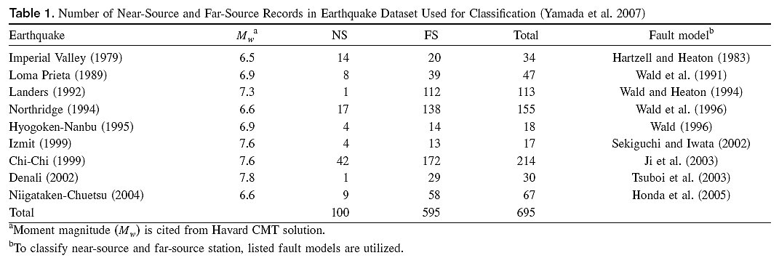
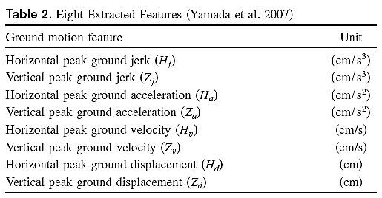

Datasets & features
class1 class2 total
8 features

Slide 21
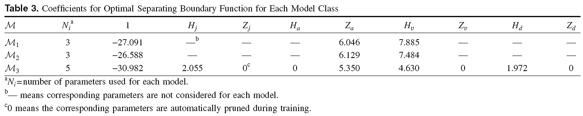
Experiments
Leave-one-out cross validation (LOOCV) is used.
Three configurations are performed for comparison.
  M₁: the most probable model class among 255(=2⁸−1) models consisting of all possible combinations of the eight features with constant α=10⁴
  M₂: Applying ARD to M₁
  M₃: The proposed methodology of Bayesian learning with the ARD prior is applied to a model containing all eight features

Slide 22
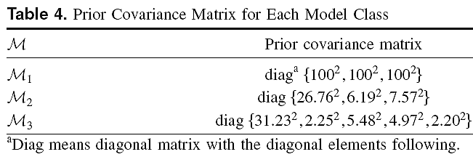


Experiments

Slide 23
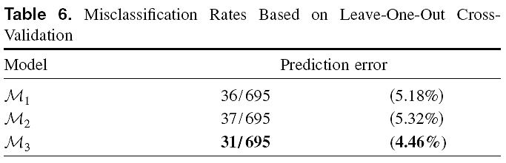
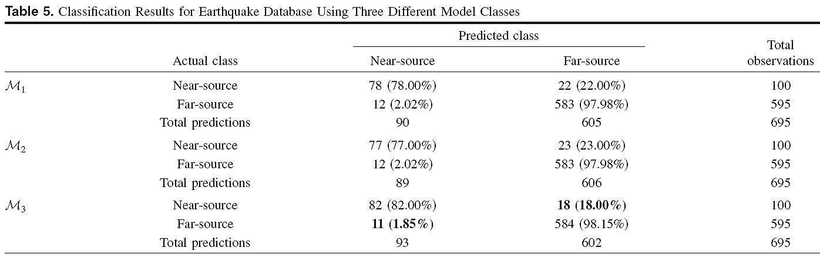
Experiments
M3:這表示作者提出方法有最好預測能力。

Slide 24
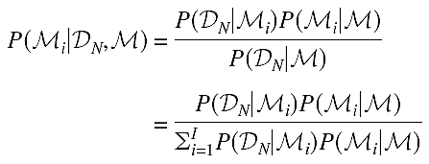

Posterior Probability of Each Model
The posterior probability of each model class in the set M=(M1 ,M2 ,M3) is computed based on the dataset D_{N} of 695 records by using Bayes' theorem
Assuming equal prior probability (P(M_{i}|M)), the posterior probability is proportional to

Slide 25

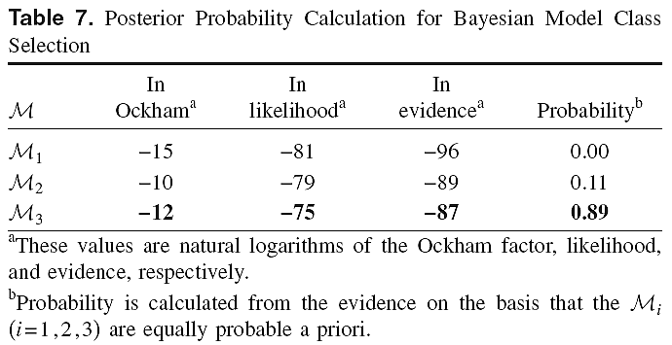
Posterior Probability of Each Model
Using the theorem of total probability and asymptotic approximation, the posterior probability is
posterior
evidence
likelihood
Ockham factor
Model complexity
M3:這表示作者提出方法有最大發生機率，然模型複雜度為中等。

