Slide 1
A NEURAL NETWORK-BASED FUZZY TIME SERIES MODEL TO IMPROVE FORECASTING
Tiffany Hui-Kuang Yu(游慧光) , Kun-Huang Huarng(黃焜煌)
Expert Systems with Applications 37 (2010) 3366–3372
Presenter: Siao-ming Jhou
Date: Oct. 5, 2010

Slide 2
ABSTRACT(1/2)
Neural networks have been popular due to their capabilities in handling nonlinear relationships. Hence, this study intends to apply neural networks to implement a new fuzzy time series model to improve forecasting. Differing from previous studies, this study includes the various degrees of membership in establishing fuzzy relationships, which assist in capturing the relationships more properly. These fuzzy relationships are then used to forecast the stock index in Taiwan. With more information, the forecasting is expected to improve, too.

Slide 3
ABSTRACT(2/2)
In addition, due to the greater amount of information covered, the proposed model can be used to forecast directly regardless of whether out-of-sample observations appear in the in-sample observations. This study performs out-of-sample forecasting and the results are compared with those of previous studies to demonstrate the performance of the proposed model.

Slide 4
EXPERIMENT
Input:台灣大盤指數每天的收盤價，從2000年到2004年(共5年)
Training data:每一年的1月到9月
Testing data:每一年的10月到12月
Output :預測每一天的收盤價

Slide 5

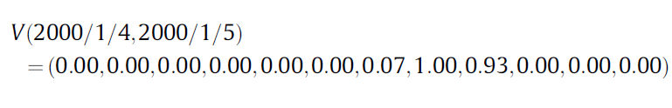
ALGORITHM
Step1:算出相鄰兩天收盤價的差值d
Step2:調整
為了使差值都是正的，找出d最小值min，然後把每一個d都加上const(const > -min)，產生d’
Step3:把已調整的差值，設定一個區間
Step4:把每個d’值模糊化
Ex:
min (d’)
max (d’)
…
u₁
u₂
u_{k-1}
u_{k}

Slide 6

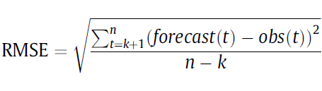
Step5:把step4出來的結果給Neural Network Training
Step6: Neural Network Forecasting
Step7: Defuzzification
Step8: Forecasting
Step9: Performance Evaluation

Slide 7
EXAMPLE
用2000年當做範例
Step1:
2000/1/4=8757
2000/1/5=8850
d(2000/1/4,2000/1/5)=93
Step2:
由於2000年最小的差值為-618，因此把常數訂成700
使得d’(2000/1/4,2000/1/5)=93+700=793

Slide 8
Step3: For the year 2000, min(d’) = 82 and max(d’) = 1168. Hence, D1 = 82 and D2 = 32. Hence, U = [0, 1200].
0 1200
Step4:
min (d’)
max (d’)
…
u₁
100
u₂
200
1000
1100
u₁₂

Slide 9
Step5:
d’(2000/1/4,2000/1/5)=793
V(2000/1/4,2000/1/5)=(0.00,0.00,0.00,0.00,0.00,0.00,0.07,1.00,0.93,0.00,0.00,0.00)
d’(2000/1/5,2000/1/6)=772
V(2000/1/5,2000/1/6)=(0.00,0.00,0.00,0.00,0.00,0.00,0.28,1.00,0.72,0.00,0.00,0.00)

Slide 10
Step6:
d’(2000/10/2,2000/10/3)=554.48
V(2000/10/2,2000/10/3)=(0.00,0.00,0.00,0.00,0.46,1.00,0.54,0.00,0.00,0.00,0.00,0.00)
V(2000/10/3,2000/10/4)=(0.00,0.03,0.03,0.09,0.18,0.30,0.47,0.38,0.26,0.11,0.06,0.03)
Step7:

Slide 11
Step8:
671.65-700 = -28.35
2000/10/3 = 6143.44
6143.44+(-28.35)= 6115.09

Slide 12
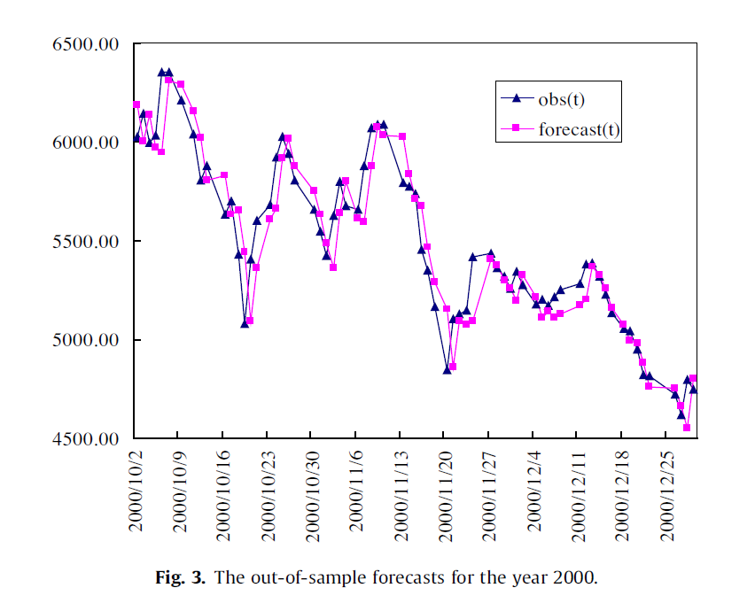
RESULT

Slide 13
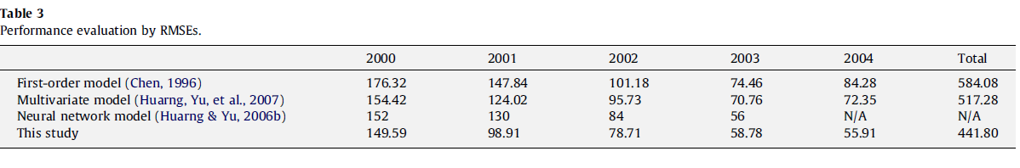

Slide 14
END

