Slide 1
A Unified Scoring Scheme for Detecting Essential Proteins in Protein Interaction
Networks
Hon Nian Chua, Kar Leong Tew, Xiao-Li Li(李晓黎
), See-Kiong Ng
Proceedings of the 2008 20th IEEE International Conference on Tools with Artificial Intelligence, 2008, 5, 66-73
Presenter:Zih-Jie Yang
Date: October 5th,2010
115/11/07

Slide 2
Abstract(1/2)
The essentiality of a gene or protein is important for understanding the minimal requirements for cellular survival and development. Numerous computational methodologies have been proposed to detect essential proteins from large protein-protein interactions (PPI) datasets. However, only a handful of overlapping essential proteins exists between them. This suggests that the methods may be complementary and an integration scheme which exploits the differences should better detect essential proteins.
115/11/07

Slide 3
Abstract(2/2)
We introduce a novel algorithm, UniScore, which combines predictions produced by existing methods. Experimental results on four Saccharomyces cerevisiae PPI datasets showed that UniScore consistently produced significantly better predictions and substantially outperforming SVM which is one of the most popular and advanced classification technique. In addition, previously hard-to-detect low-connectivity essential proteins have also been identified by UniScore.
115/11/07

Slide 4
必要性蛋白質（essential protein）
必要性蛋白質（essential protein）為當此蛋白質在蛋白質複合體中遭到基因剔除式突變(null mutation)去除後，會危及很多重要的生化反應路徑(biologically important pathways)，進而造成蛋白質複合體的功能喪失，致使生物體無法生存(inviable)。因此瞭解必要性蛋白質的特性，並預測某些蛋白質是否為必要性蛋白質是很重要的課題。
115/11/07

Slide 5
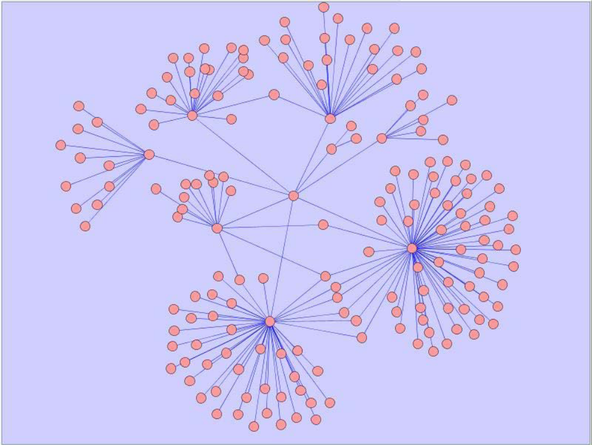
蛋 白 質 交 互 作 用 (Protein-protein interaction)
每一個點為一個蛋白質，每一個邊所連結的兩的點則代表這兩個蛋白質之間有交互作用。
115/11/07

Slide 6
Method
The primary task of the UniScore algorithm is to aggregate the scores of multiple methods for essential protein detection.
Input: a set of proteins P, biological functions F and ranking methods R.
115/11/07

Slide 7
UniScore
The UniScore algorithm comprises of three phases.
1st: We populate each protein with their Gene Ontology functional annotations such that a protein annotated with a term f ∈ F will also be annotated with all the ancestor terms of f in the ontology.
2nd: For each function f ∈ F and each method r ∈ R, we compute the probability that a protein is essential given that it has a function f and is assigned a certain score by method r.
3rd: We compute a unified score for each protein based on the probabilities computed in the second phase.
115/11/07

Slide 8
Function Annotation
Functional annotations are usually organized in hierarchical structures such as a Direct Acyclic Graph (GO) or a Tree (MIPS).
115/11/07

Slide 9
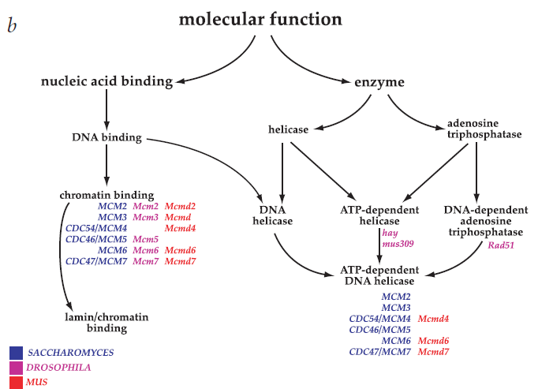
115/11/07

Slide 10
Ranking methods
1.Connectivity(Degree)
2.Clustering Coefficient(CC)
3.Neighborhood Functional Centrality(NFC)
4.Functional Diversity (FD)
115/11/07

Slide 11
Connectivity(Degree)
The score of a node p is assigned as the degree of p, D(p), the number of links incident to this node
115/11/07

Slide 12
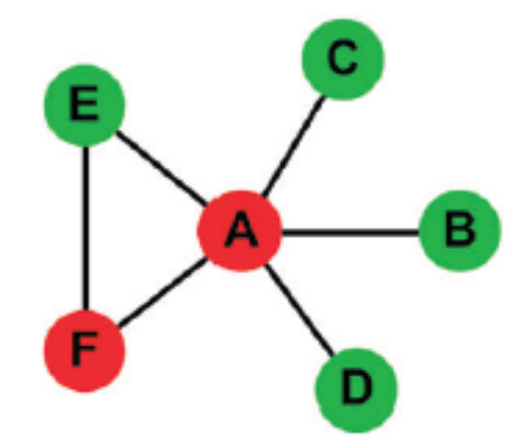
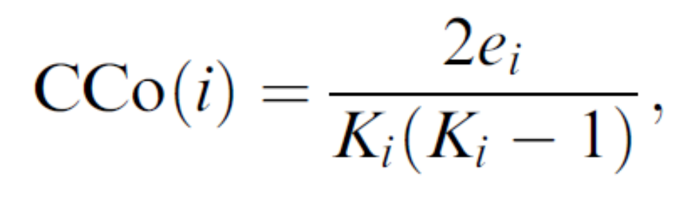
Clustering coefficient (CC)
群聚係數
Node i的群聚係數定義為其鄰居彼此間也是鄰居的程度
CC(i)=e_{i}/C(K_{i},2)
e_{i}為鄰居之間的邊數
K_{i}為node i的degree
e_{A} =1
K_{A}=5
CCo(A)=2*1/(5*4)
Larger clustering coefficient mean that many of their interacting partners interact with each other.
115/11/07

Slide 13
Neighborhood Functional Centrality(NFC)
The Neighborhood Functional Centrality is a measure which takes into consideration the functional role a protein plays in terms of its surrounding neighborhood.
115/11/07

Slide 14

Neighborhood Functional Centrality(NFC)
Where maxDepth^{GO} is the maximum depth of the GO, α measures the maximum number of common ancestor terms shared between term_{i} and term_{j} in a single path, β is the value of the longer distance between term_{i} and term_{j} to their closest leaf nodes, and γ measures the shortest distance between term_{i} and term_{j} .
115/11/07

Slide 15

Neighborhood Functional Centrality(NFC)
Suppose F_{u} and F_{v} are the function annotations of proteins u and v respectively
where F(u,i) and F(v,j) denote protein u’s i-th and protein v’s j-th’s functions respectively, and |F_{u}| denotes the number of functions protein u is annotated with.
115/11/07

Slide 16

Neighborhood Functional Centrality(NFC)
The value nfc(u) indicates the functional centrality of protein u
115/11/07

Slide 17

Functional Diversity (FD)
The Functional Diversity method is based on the assumption of essential proteins performing the role of multi-functional components within a protein interaction network
115/11/07

Slide 18
Unified Weighting Scheme
We estimate the likelihood that protein p is essential given the observation that a method r assigns a score s to p with function f.
115/11/07

Slide 19
1.Grouping proteins with similar scores
Proteins with function f that are assigned similar scores by a ranking method r are grouped into groups of at least size μ in the following way:
  1. Sort the set of proteins P_{f} with function f, based on the ranking score.
115/11/07

Slide 20
1.Grouping proteins with similar scores
  2.From the list of sorted proteins, p₀,…, p_{n}, we create a new group G₀^{r f} , and insert p₀,…, p _{μ-1} into G₀^{r f} (first insert μ members into a initial group). Continue to insert the proteins p_{μ+k}, 0 ≦ k < n- μ -k, into G₀^{r f} as long as S_{r}(p _{μ+k}) = S_{r}(p _{μ-1}) (then add new members if their scores are equal to the last member in the initial group).
  3. Starting from p _{μ+k} , create a new group G₁^{r f} rfand repeat step 2.
  4. If the last group G_{m}^{r f} has a size smaller than μ, it is merged with G_{m-1}^{r f}
115/11/07

Slide 21
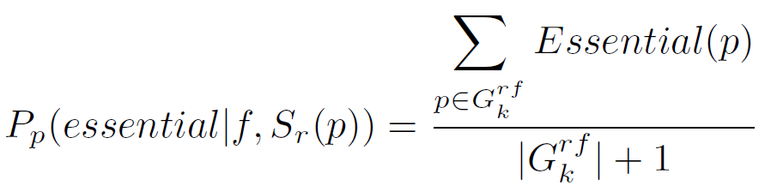
2.Computing the confidence of each protein group
The likelihood that a protein p is essential given that it is annotated with function f and is assigned score S_{r}(p) by ranking method r, is then computed by:
where Essential(p) returns 1 if p is an essential protein, 0 otherwise; G^{r}_{k}^{f} is the group of proteins with function f in which S_{r}(p) belongs to. It computes the fraction of the proteins in each group that are essential.
115/11/07

Slide 22

2.Computing the confidence of each protein group
We estimate the likelihood that a protein p is essential given that it is assigned score S_{r}(p) by ranking method r, as:
115/11/07

Slide 23

3.Integrating the confidences of multiple methods
we compute the likelihood that a protein p is essential given that it is assigned score S_{n}(p) by multiple methods r_{i}(i = 1,…,n) using a Bayesian based approach:
A higher support value will indicate a higher probability that protein p is essential.
115/11/07

Slide 24
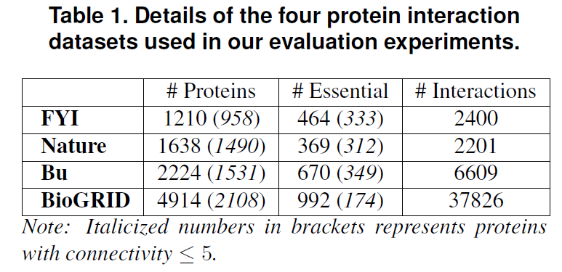
Datasets
115/11/07

Slide 25
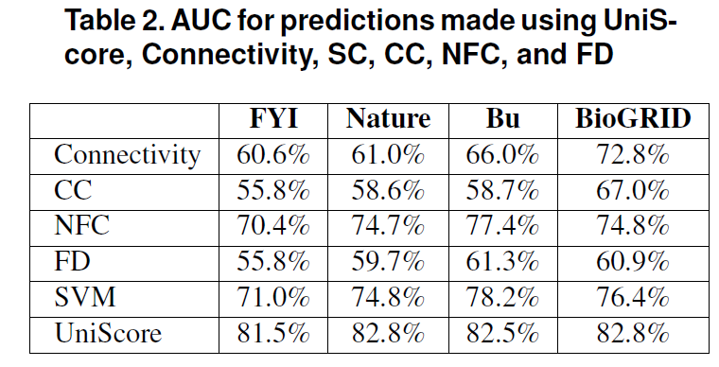
Prediction Performance
115/11/07

Slide 26
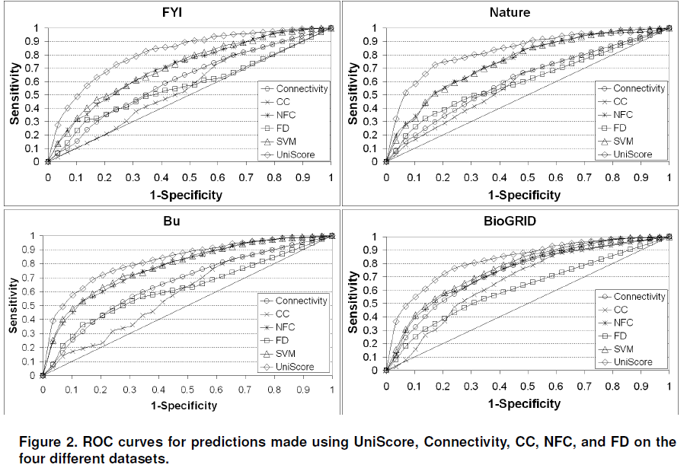
Prediction Performance
115/11/07

Slide 27
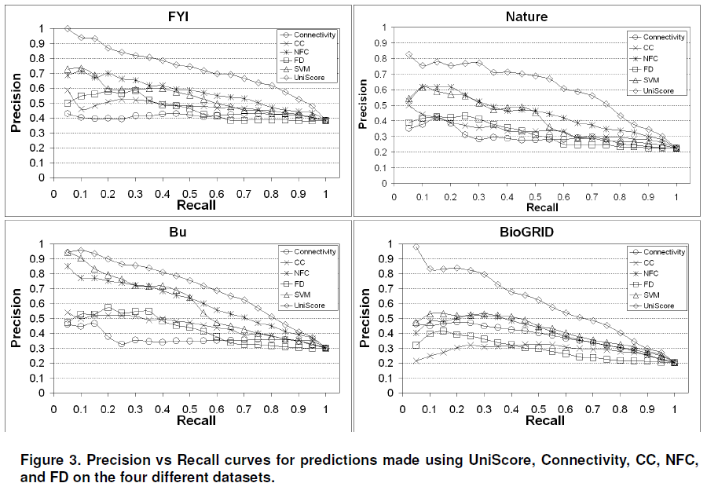
Prediction Performance
115/11/07

Slide 28
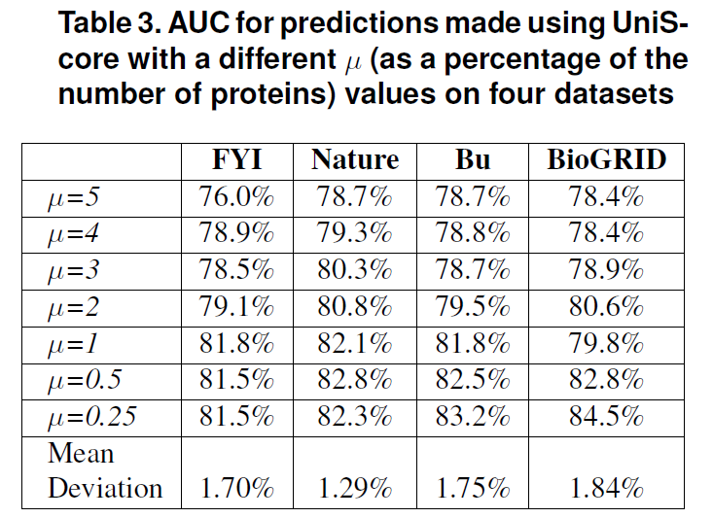
Group Size
115/11/07

