Slide 1
Finding Longest Increasing and Common Subsequences in Streaming Data
David Liben-Nowell, Erik Vee, An Zhu
Journal of Combinatorial Optimization
Volume 11, Issue 2, pp 155-175(2006)
Presenter: Shian-Liang Lin

Slide 2
Abstract(1/2)
In this paper, we present algorithms and lower bounds for the Longest Increasing Subsequence(LIS) and Longest Common Subsequence (LCS) problems in the data streaming model.
For the problem of deciding whether the LIS of a given stream of integers drawn from {1,…,m} has length at least k, we discuss a one-pass streaming algorithm using O(k log m)space, with update time either O(log k) or O(log log m).
For the problem of returning the actual longest increasing subsequence itself, we give a [log(1 + 1/ɛ) ]-pass streaming algorithm with update time O(log k) or O(log log m) that uses space O(k^{1+ ɛ} log m), for any ɛ > 0.
Notes:
^{ɛ :}Epsilon

Slide 3
Abstract(1/2)
We also prove a lower bound of Ω(k) on the space required for any streaming algorithm for LIS, even when the input stream is a permutation of {1,…,m}.
We discuss a simple LIS-based algorithm for LCS, and we also give several lower bounds on this problem, of which the strongest is the following: when the elements of two n-element streams are presented in an adversarial order, we need space Ω(n/ρ²) to approximate the length
of their LCS to within a factor of ρ, even when the two streams are permutations of each other.
Notes:
Omega

Slide 4
The data streaming model
A small number of passes over the input data.
Processing each input element as it passes.
Computing and storing a small amount of useful information about the previously read input.
Pass_1
1 | 2 | 3
Algorithm
input
Pass_2
1 | 2 | 3
n-pass
.
.
.
.
Pass_N
1 | 2 | 3

Slide 5
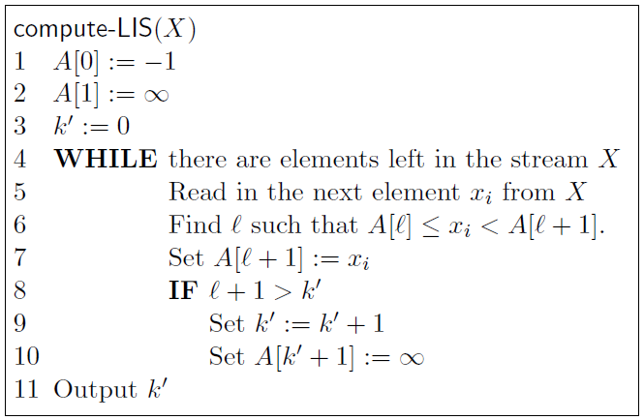
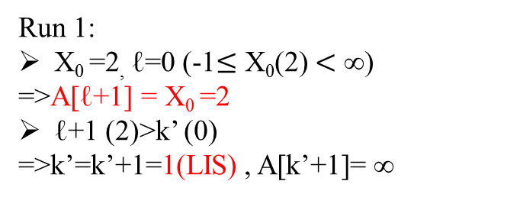
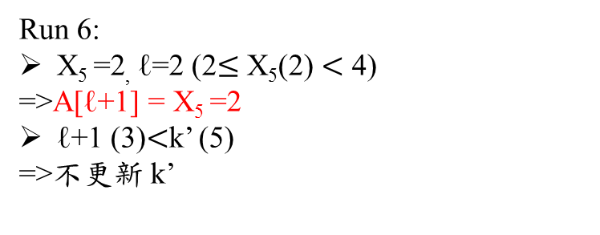
Algorithms for LIS Computing the Length
input
2 | 2 | 4 | 7 | 9 | 2 | 2 | 4 | 6
A[ℓ]
-1 | ∞
∞
Run 1:
X₀ =2, ℓ=0 (-1$≤$ X₀(2) $<$ ∞)
=>A[ℓ+1] = X₀ =2
ℓ+1 (2)>k’ (0)
=>k’=k’+1=1(LIS) , A[k’+1]= ∞
input
2 | 2 | 4 | 7 | 9 | 2 | 2 | 4 | 6
A[ℓ]
-1 | 2 | 2 | 4 | 7 | 9 | ∞
Run 6:
X₅ =2, ℓ=2 (2$≤$ X₅(2) $<$ 4)
=>A[ℓ+1] = X₅ =2
ℓ+1 (3)$<$k’ (5)
=>不更新 k’

Slide 6
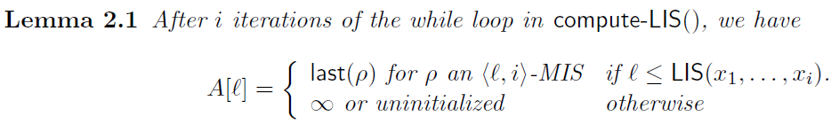
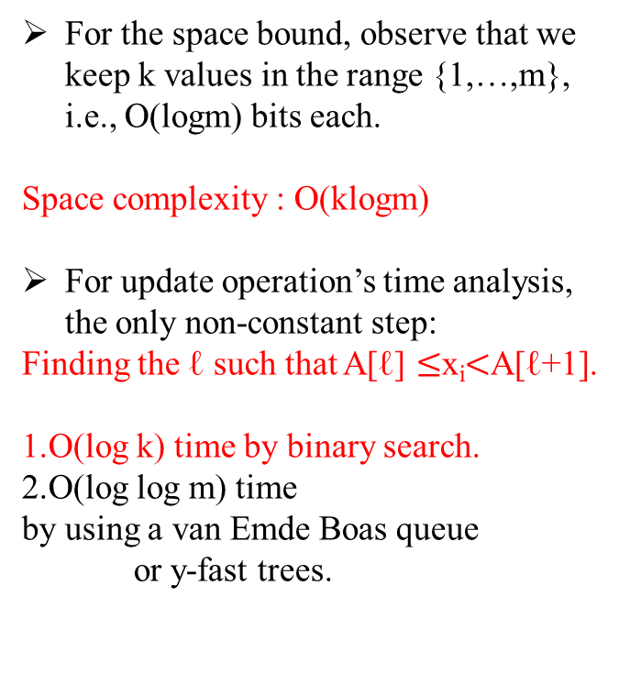
Algorithms for LIS Computing the Length
For the space bound, observe that we keep k values in the range {1,…,m}, i.e., O(logm) bits each.
Space complexity : O(klogm)
For update operation’s time analysis, the only non-constant step:
Finding the ℓ such that A[ℓ] $≤$x_{i}$<$A[ℓ+1].
1.O(log k) time by binary search.
2.O(log log m) time
by using a van Emde Boas queue
or y-fast trees.
input
2 | 2 | 4 | 7 | 9 | 2 | 2 | 4 | 6
A[ℓ]
-1 | 2 | 2 | 3 | 4 | 6 | ∞
Run 9:
=>k’=5(LIS)

Slide 7
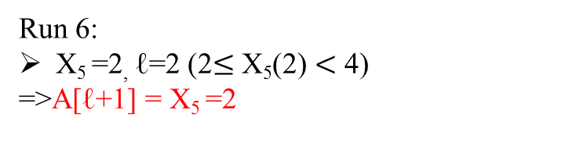
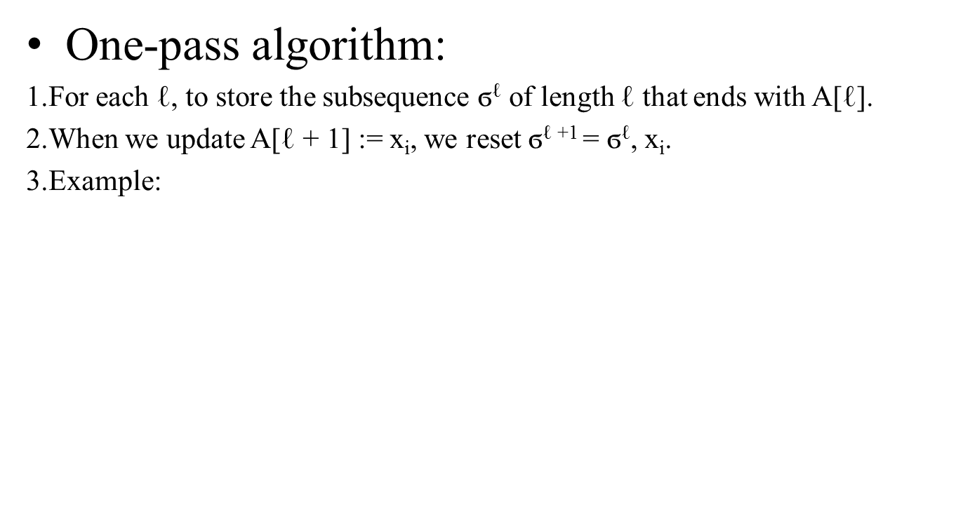
Algorithms for LIS Finding an LIS
One-pass algorithm:
1.For each ℓ, to store the subsequence ϭ^{ℓ} of length ℓ that ends with A[ℓ].
2.When we update A[ℓ + 1] := x_{i}, we reset ϭ^{ℓ +1} = ϭ^{ℓ}, x_{i}.
3.Example:
Run 6:
X₅ =2, ℓ=2 (2$≤$ X₅(2) $<$ 4)
=>A[ℓ+1] = X₅ =2
input
2 | 2 | 4 | 7 | 9 | 2 | 4 | 3 | 6
A[ℓ]
-1 | 2 | 2 | 4 | 7 | 9 | ∞
ϭ³
2
2
2
ϭ²
2
2
ϭ¹
2
ϭ²
2
2
ϭ³
2
2
4
ϭ⁴
2
2
4
7
ϭ⁵
2
2
4
7
9
+
X₅
2
Constant time
New ϭ³
Original ϭ³
space requirement is O(k²logm).

Slide 8



Algorithms for LIS Finding an LIS
Two-pass algorithm:
input
2 | 2 | 4 | 7 | 9 | 2 | 4 | 3 | 6
A[ℓ]
-1 | 2 | 2 | 3 | 4 | 6 | ∞
ϭ¹
2
ϭ²
2
2
ϭ³
2
2
3
ϭ⁴
2
2
2
4
ϭ⁵
2
2
2
4
6
ϭ¹
2
ϭ²
2
ϭ³
3
ϭ⁴
3
4
ϭ⁵
3
6
q = k^{2/3}=5^{2/3}$≅$3

Slide 9

Algorithms for LIS Finding an LIS
Two-pass algorithm:
input
2 | 2 | 4 | 7 | 9 | 2 | 4 | 3 | 6
A[ℓ]
-1 | 2 | 2 | 3 | 4 | 6 | ∞
q = k^{2/3}=5^{2/3}$≅$3
ϭ¹
2
ϭ²
2
ϭ³
3
ϭ⁴
3
4
ϭ⁵
3
6
ϭ⁵ = 2 , 2 , 2 , 3 , 6
The total space required by our algorithm is O(max(k²logm/q,q²logm) + klogm).
This is minimized at q = k^{2/3}, giving us a space bound of O(k^{1+1/3}logm).

Slide 10
Algorithms for LIS Finding an LIS
multi-pass algorithm:
1. In the first pass the algorithm remembers only every qth element in the subsequence, and discards all stored subsequences except ϭ^{k}.
2.The algorithm uses p-1 passes to find the roughly k/q subsequences
τ¹, τ²,…, τ└^{(k-2)/q}┘ where each has length q.
Let S(k,p) denote the space required by a p-pass algorithm to find a subsequence of length k.
We then have the following recurrence:
S(k, p) = max(O(k²logm/q), S(q,p-1)) + O(k logm).
by Solving the recurrence, Space requirements are optimized at
q = k^{1-1/(2p-1),} and where S(k,p) = O(k^{1+1/(2p -1)}logm).
τ¹
τ²
τ└^{(k-2)/q}┘

Slide 11
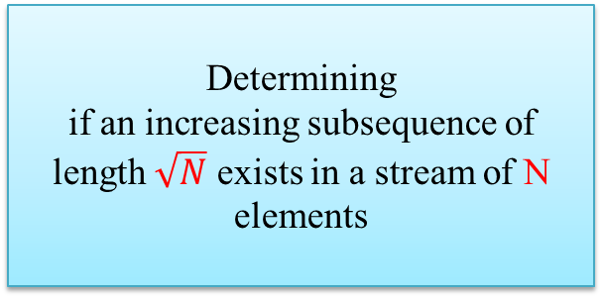
Lower Bounds for LIS
Determining
if an increasing subsequence of length $\sqrt{N}$ exists in a stream of N elements
Set-Disjointness
Reducing to
Set-Disjointness:
Party A holds an n-bit string s_{A}, and Party B holds another n-bit string s_{B}.
They must decide whether there is at least one '1' in the bitwise-ands_{A} & s_{B} of s_{A} and s_{B} while minimizing the number of bits communicated between the parties.
Example:
s_{A}:[0,1,0,1,1,0,0,0,0]
s_{B}:[1,0,0,1,0,0,1,0,0]

Slide 12

Lower Bounds for LIS
n := |s_{A}| =|s_{B}|
each index i $ε${1,…, n}
we associate the sequence (n+1)*(i$−$1)+1, … ,(n+1)*i, divided into two parts:
A-part(i) = (n+1)(i$−$1)+1 , (n+1)(i$−$1)+2 , ... , (n+1)(i$−$1)+i.
B-part(i) = (n+1)(i$−$1)+i+1 , (n+1)(i$−$1)+i+2, ... , (n+1)(i$−$1)+n+1.
lis-stream-A(s_{A}): the sequence consisting of A-part(i) for every i$ε \{$i : s_{A}(i) = 1 }, in decreasing order of the index i.
pad-A(s_{A}) : the sequence consisting of integers in U_{A} = {x : x $ε$A-part(i) for some i such that s_{A}(i) = 0} listed in decreasing order, followed by 0.
lis-stream-perm-A(s_{A})=pad-A(s_{A}) , lis-stream-A(s_{A})
Example:
s_{A}:[ 0 , 1 , 0 , 1 , 1 , 0 , 0 , 0 , 0 ] (n=9)
{89,…81 , 78…,71 ,67,…,61 , 56,…,51 , 23,…,21 , 1 , 0 , 41,…45 , 31,…,34 , 11,12 }
s_{A}:[ 0 , 1 , 0 , 1 , 1 , 0 , 0 , 0 , 0 ] (n=9)
For i=2:
Length=2
(n+1)(i-1)+1
=(9+1)(2-1)+1
=11
(n+1)(i-1)+2
=(9+1)(2-1)+2
=12
increasing
decreasing

Slide 13
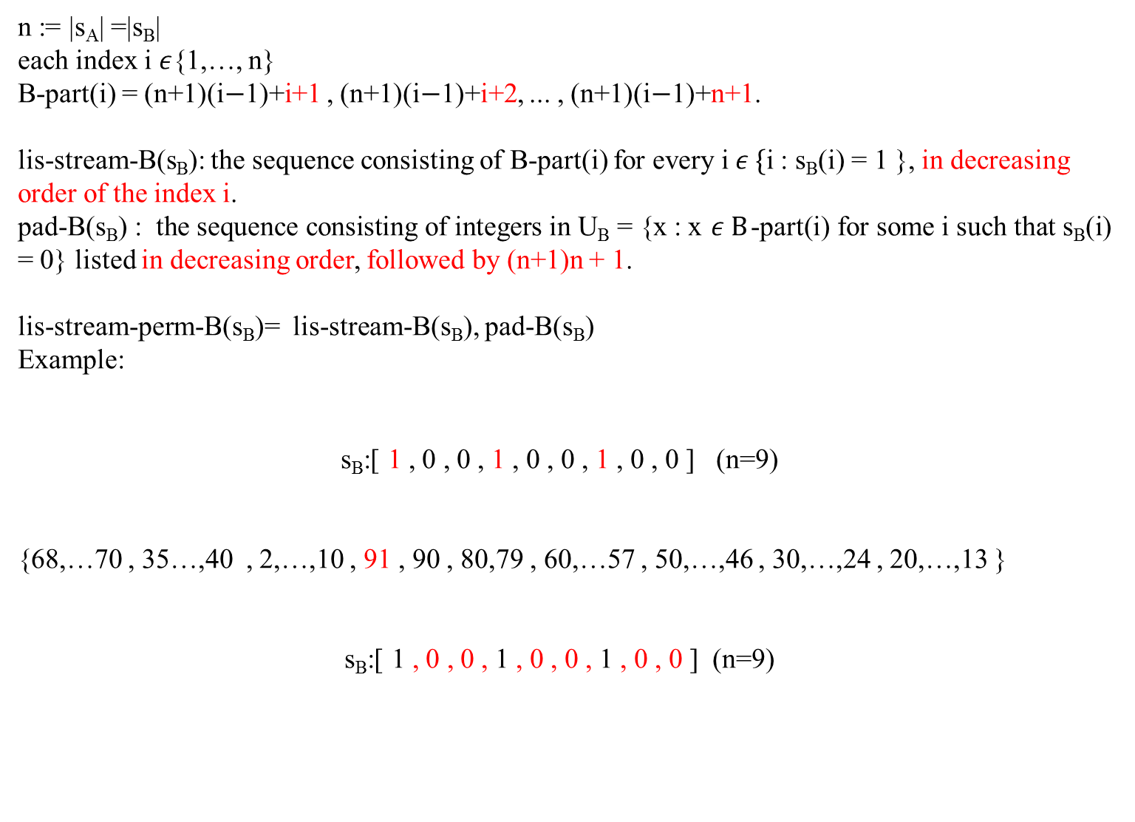
Lower Bounds for LIS
n := |s_{A}| =|s_{B}|
each index i $ε${1,…, n}
B-part(i) = (n+1)(i$−$1)+i+1 , (n+1)(i$−$1)+i+2, ... , (n+1)(i$−$1)+n+1.
lis-stream-B(s_{B}): the sequence consisting of B-part(i) for every i$ε \{$i : s_{B}(i) = 1 }, in decreasing order of the index i.
pad-B(s_{B}) : the sequence consisting of integers in U_{B} = {x : x $ε B$-part(i) for some i such that s_{B}(i) = 0} listed in decreasing order, followed by (n+1)n + 1.
lis-stream-perm-B(s_{B})= lis-stream-B(s_{B}), pad-B(s_{B})
Example:
s_{B}:[ 1 , 0 , 0 , 1 , 0 , 0 , 1 , 0 , 0 ] (n=9)
{68,…70 , 35…,40 , 2,…,10 , 91 , 90 , 80,79 , 60,…57 , 50,…,46 , 30,…,24 , 20,…,13 }
s_{B}:[ 1 , 0 , 0 , 1 , 0 , 0 , 1 , 0 , 0 ] (n=9)
For i=2:
Length=n+1-2=
1.(n+1)(i-1)+i+1
=(9+1)(2-1)+2+1
=13
2.(n+1)(i-1)+i+1
=(9+1)(3-1)+3+1
=14
3. …..
increasing
decreasing

Slide 14
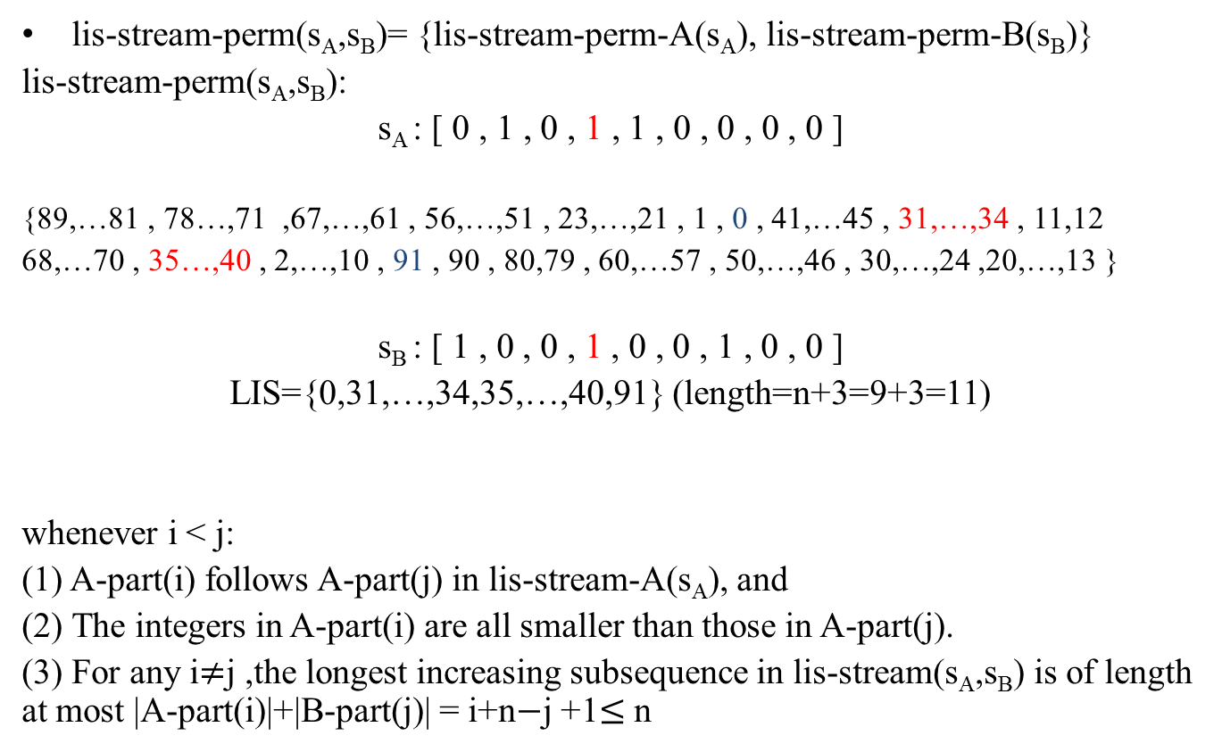
Lower Bounds for LIS
lis-stream-perm(s_{A},s_{B})= {lis-stream-perm-A(s_{A}), lis-stream-perm-B(s_{B})}
lis-stream-perm(s_{A},s_{B}):
s_{A} : [ 0 , 1 , 0 , 1 , 1 , 0 , 0 , 0 , 0 ]
{89,…81 , 78…,71 ,67,…,61 , 56,…,51 , 23,…,21 , 1 , 0 , 41,…45 , 31,…,34 , 11,12
68,…70 , 35…,40 , 2,…,10 , 91 , 90 , 80,79 , 60,…57 , 50,…,46 , 30,…,24 ,20,…,13 }
s_{B} : [ 1 , 0 , 0 , 1 , 0 , 0 , 1 , 0 , 0 ]
LIS={0,31,…,34,35,…,40,91} (length=n+3=9+3=11)
whenever i < j:
(1) A-part(i) follows A-part(j) in lis-stream-A(s_{A}), and
(2) The integers in A-part(i) are all smaller than those in A-part(j).
(3) For any i$≠$j ,the longest increasing subsequence in lis-stream(s_{A},s_{B}) is of length at most |A-part(i)|+|B-part(j)| = i+n$−$j +1$≤$ n

Slide 15
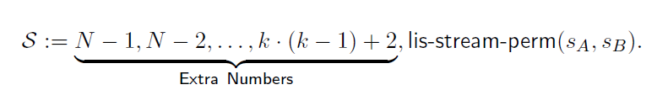


Lower Bounds for LIS
If $δ=\frac{1}{4}$ ,require at least 0 bits of communication
Determining
if an increasing subsequence of length $\sqrt{N}$ exists in a stream of N elements
Set-Disjointness
Reducing to

Slide 16
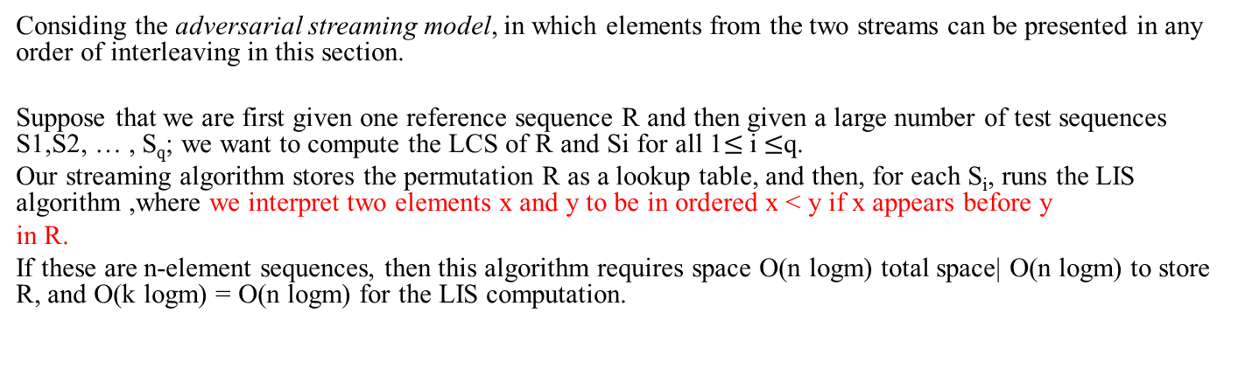
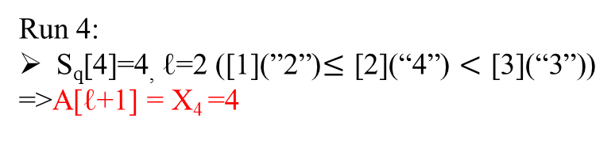
Algorithms for LCS
Considing the adversarial streaming model, in which elements from the two streams can be presented in any order of interleaving in this section.
Suppose that we are first given one reference sequence R and then given a large number of test sequences S1,S2, … , S_{q}; we want to compute the LCS of R and Si for all 1$≤$ i $≤$q.
Our streaming algorithm stores the permutation R as a lookup table, and then, for each S_{i}, runs the LIS algorithm ,where we interpret two elements x and y to be in ordered x < y if x appears before y
in R.
If these are n-element sequences, then this algorithm requires space O(n logm) total space| O(n logm) to store R, and O(k logm) = O(n logm) for the LIS computation.
[0]1 | [1]2 | [2]4 | [3]3 | [4]5 | [5]7 | [6]9 | [7]6 | [8]8
R[i]
S_{q}[n]
1 | 2 | 3 | 4 | 5 | 6 | 7 | 8 | 9
A[ℓ]
-1 | 1 | 2 | 3 | ∞
Run 4:
S_{q}[4]=4, ℓ=2 ([1](”2”)$≤$ [2](“4”) $<$ [3](“3”))
=>A[ℓ+1] = X₄ =4

Slide 17
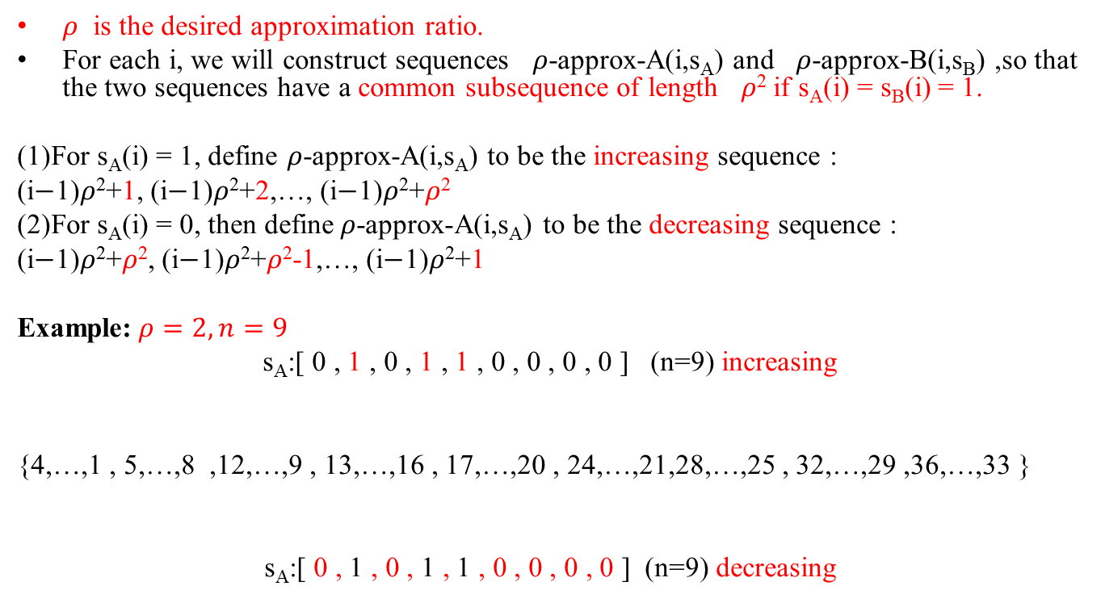
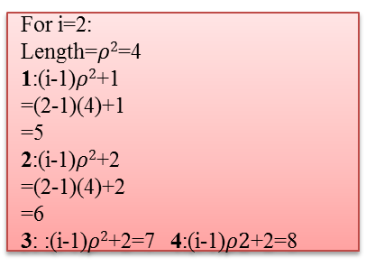
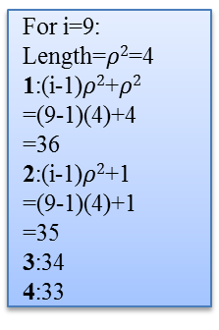
Lower Bound on Approximating LCS for Permutations
$ρ$is the desired approximation ratio.
For each i, we will construct sequences $ρ$-approx-A(i,s_{A}) and $ρ$-approx-B(i,s_{B}) ,so that the two sequences have a common subsequence of length $ρ$² if s_{A}(i) = s_{B}(i) = 1.
(1)For s_{A}(i) = 1, define $ρ$-approx-A(i,s_{A}) to be the increasing sequence :
(i$−$1)$ρ$²+1, (i$−$1)$ρ$²+2,…, (i$−$1)$ρ$²+$ρ$²
(2)For s_{A}(i) = 0, then define$ρ$-approx-A(i,s_{A}) to be the decreasing sequence :
(i$−$1)$ρ$²+$ρ$², (i$−$1)$ρ$²+$ρ$²-1,…, (i$−$1)$ρ$²+1
Example:$ρ=2,n=9$
s_{A}:[ 0 , 1 , 0 , 1 , 1 , 0 , 0 , 0 , 0 ] (n=9) increasing
{4,…,1 , 5,…,8 ,12,…,9 , 13,…,16 , 17,…,20 , 24,…,21,28,…,25 , 32,…,29 ,36,…,33 }
s_{A}:[ 0 , 1 , 0 , 1 , 1 , 0 , 0 , 0 , 0 ] (n=9) decreasing
For i=9:
Length=$ρ2$=4
1:(i-1)$ρ2$+$ρ2$
=(9-1)(4)+4
=36
2:(i-1)$ρ2$+1
=(9-1)(4)+1
=35
3:34
4:33
For i=2:
Length=$ρ2$=4
1:(i-1)$ρ2$+1
=(2-1)(4)+1
=5
2:(i-1)$ρ2$+2
=(2-1)(4)+2
=6
3: :(i-1)$ρ2$+2=7 4:(i-1)$ρ2$+2=8

Slide 18
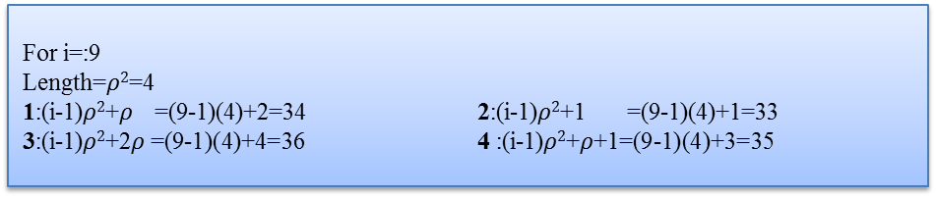
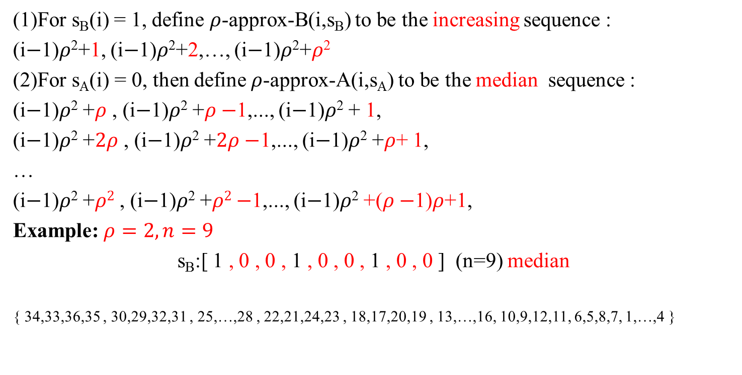
Lower Bound on Approximating LCS for Permutations
(1)For s_{B}(i) = 1, define $ρ$-approx-B(i,s_{B}) to be the increasing sequence :
(i$−$1)$ρ$²+1, (i$−$1)$ρ$²+2,…, (i$−$1)$ρ$²+$ρ$²
(2)For s_{A}(i) = 0, then define$ρ$-approx-A(i,s_{A}) to be the median sequence :
(i$−$1)$ρ$² +$ρ$ , (i$−$1)$ρ$² +$ρ−$1,..., (i$−$1)$ρ$² + 1,
(i$−$1)$ρ$² +$2ρ$ , (i$−$1)$ρ$² +$2ρ−$1,..., (i$−$1)$ρ$² +$ρ$+ 1,
…
(i$−$1)$ρ$² +$ρ2$ , (i$−$1)$ρ$² +$ρ2−$1,..., (i$−$1)$ρ$² +($ρ−$1)$ρ$+1,
Example:$ρ=2,n=9$
s_{B}:[ 1 , 0 , 0 , 1 , 0 , 0 , 1 , 0 , 0 ] (n=9) median
{ 34,33,36,35 , 30,29,32,31 , 25,…,28 , 22,21,24,23 , 18,17,20,19 , 13,…,16, 10,9,12,11, 6,5,8,7, 1,…,4 }
For i=:9
Length=$ρ2$=4
1:(i-1)$ρ2$+$ρ$ =(9-1)(4)+2=34 2:(i-1)$ρ2$+1 =(9-1)(4)+1=33
3:(i-1)$ρ2$+2$ρ$=(9-1)(4)+4=36 4 :(i-1)$ρ2$+$ρ$+1=(9-1)(4)+3=35

Slide 19

Lower Bound on Approximating LCS for Permutations
1. s_{A}(i) = 1; s_{B}(i) = 0. Then -approx-A(i,s_{A}) and -approx-B(i,s_{B}) have a longest common subsequence of length$ρ$.
2. s_{A}(i) = 0; s_{B}(i) = 1. Then -approx-A(i,s_{A}) and -approx-B(i,s_{B}) have a longest common subsequence of length 1.
3. s_{A}(i) = 0; s_{B}(i) = 0. Then -approx-A(i,s_{A}) and -approx-B(i,s_{B}) have a longest common subsequence of length$ρ$.
4. s_{A}(i) = 1; s_{B}(i) = 1. Then -approx-A(i,s_{A}) and -approx-B(i,s_{B}) have a longest common subsequence of length$ρ2$.
s_{A}(i):s_{A}:[ 0 , 1 , 0 , 1 , 1 , 0 , 0 , 0 , 0 ]
{4,3,2,1 , 5,6,7,8 ,12,11,10,9 , 13,14,15,16 , 17,18,19,20 , 24,23,22,21,28,27,26,25 ,32,31,30,29 ,36,35,34,33 }
s_{B}(i):s_{B}:[ 1 , 0 , 0 , 1 , 0 , 0 , 1 , 0 , 0 ]
{34,33,36,35,30,29,32,31 , 25,26,27,28 , 22,21,24,23 , 18,17,20,19 , 13,14,15,16, 10,9,12,11, 6,5,8,7, 1,2,3,4 }
Case2
s_{A}: decreasing
s_{B}: increasing
Case1
s_{A}: increasing
s_{B}: median
Case4
Case3
s_{A}: decreasing
s_{B}: median

Slide 20
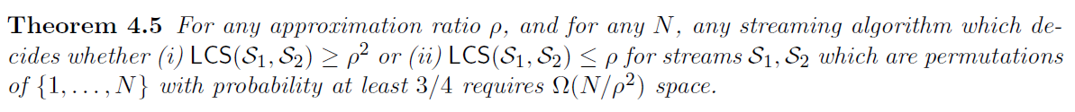

Lower Bound on Approximating LCS for Permutations
If $δ=\frac{1}{4}$ ,require at least 0 bits of communication

Slide 21
Thanks for listening.

