Slide 1
Feature Selection Based on Mutual Information: Criteria of Max-Dependency, Max-Relevance, and Min-Redundancy
Hanchuan Peng, Member, IEEE, Fuhui Long, and Chris Ding
Pattern Analysis and Machine Intelligence, IEEE Transactions on, 2005
pp. 1226 - 1238
2015/8/4
Presenter : Tsai Yao-Chou

Slide 2
Abstract(1/2)
Feature selection is an important problem for pattern classification systems. We study how to select good features according to the maximal statistical dependency criterion based on mutual information. Because of the difficulty in directly implementing the maximal dependency condition, we first derive an equivalent form, called minimal-redundancy-maximal-relevance criterion (mRMR), for first-order incremental feature selection. Then, we present a two-stage feature selection algorithm by combining mRMR and other more sophisticated feature selectors (e.g., wrappers). This allows us to select a compact set of superior features at very low cost.

Slide 3
Abstract(2/2)
We perform extensive experimental comparison of our algorithm and other methods using three different classifiers (naive Bayes, support vector machine, and linear discriminate analysis) and four different data sets (handwritten digits, arrhythmia, NCI cancer cell lines, and lymphoma tissues). The results confirm that mRMR leads to promising improvement on feature selection and classification accuracy.

Slide 4
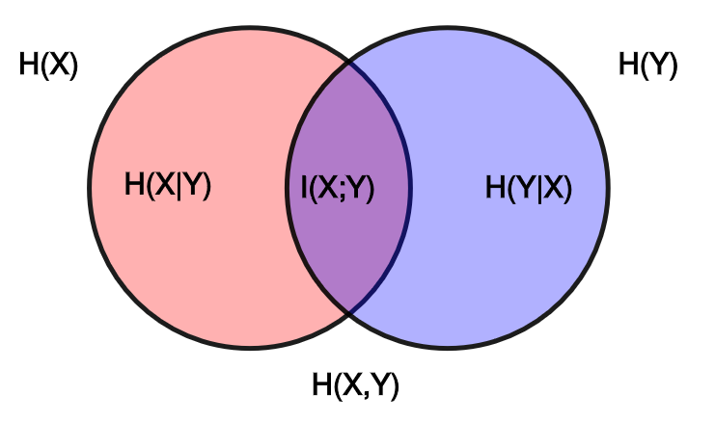

Mutual information
$$I\left(x;y\right)= \int{\int{p(x,y)\log{\frac{p(x,y)}{p\left(x\right)p(y)}}}}dxdy$$
$p\left(x\right), p\left(y\right), p(x, y)$ are Probability density function

Slide 5
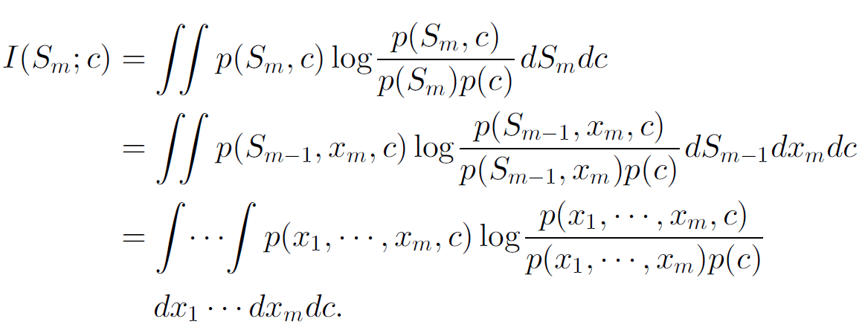

Max-Dependency (1/2)
A feature set $S$with $m$ features $\{x_{i}\}$ have the largest dependency on the target class $c$.
$\max{D\left(S,c\right), D=I(\left\{x_{i}, i=1,…,m\right\};c})$
1. $m=1$ , maximizes $I(x_{j};c)(1≤j≤M)$
2. $m>1$

Slide 6
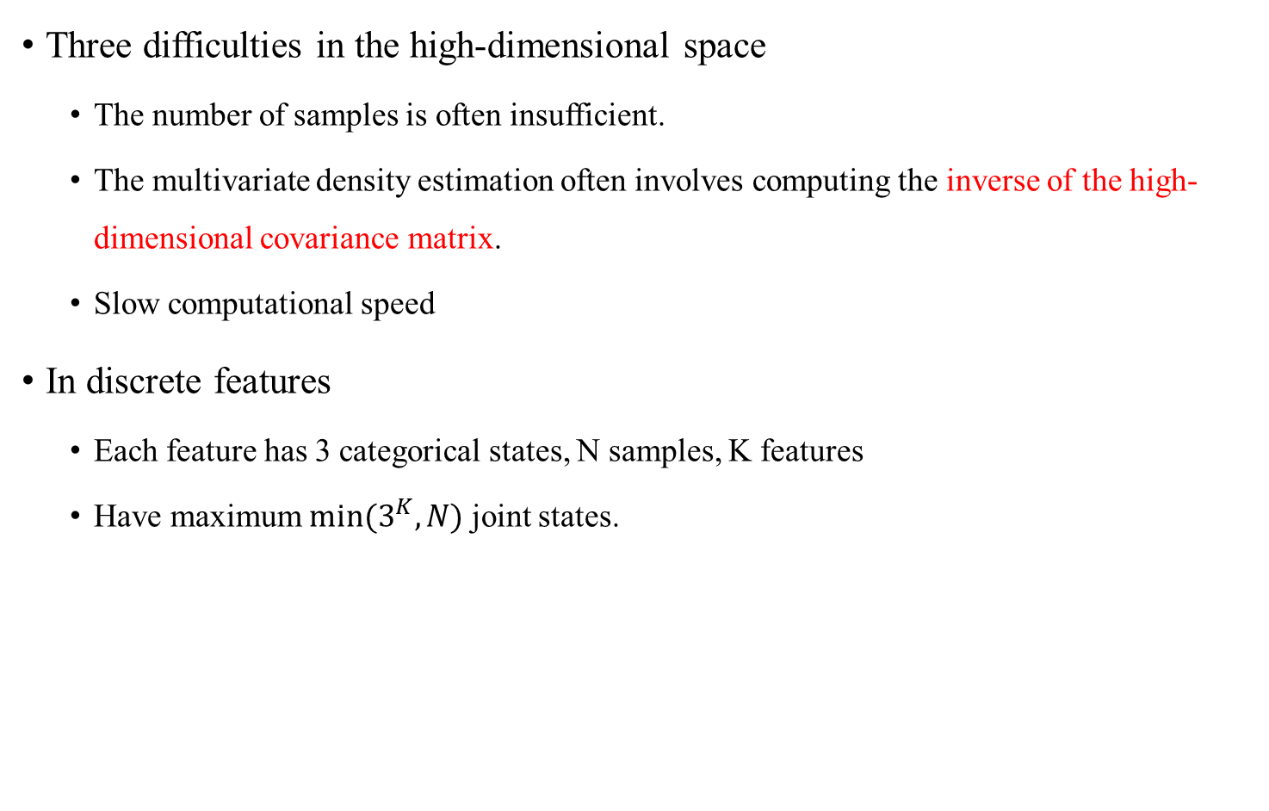
Max-Dependency (2/2)
Three difficulties in the high-dimensional space
The number of samples is often insufficient.
The multivariate density estimation often involves computing the inverse of the high-dimensional covariance matrix.
Slow computational speed
In discrete features
Each feature has 3 categorical states, N samples, Kfeatures
Have maximum $min⁡(3^{K}, N)$ joint states.

Slide 7
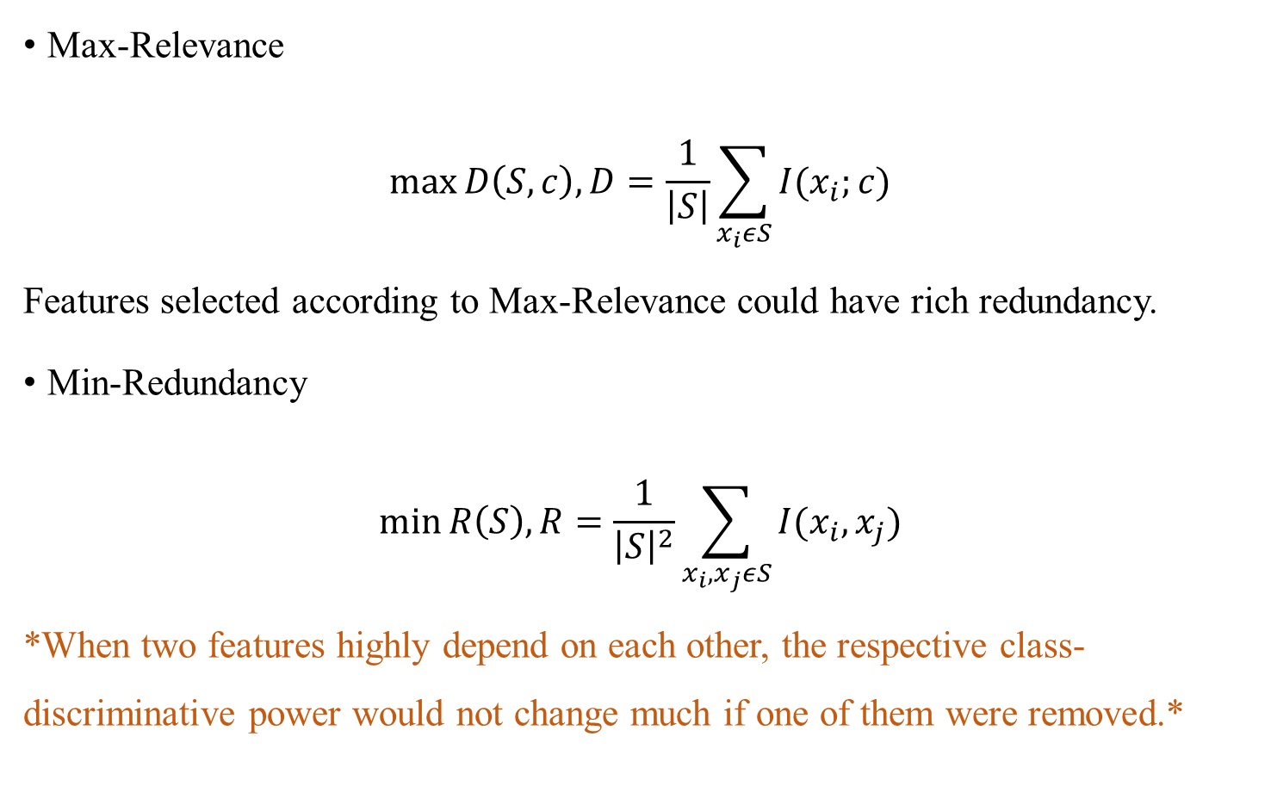
Max-Relevance and Min-Redundancy(1/2)
Max-Relevance
$$\max{D\left(S, c\right), D=\frac{1}{\left|S\right|}}\sum_{x_{i}εS}{I(x_{i};c)}$$
Features selected according to Max-Relevance could have rich redundancy.
Min-Redundancy
$$\min{R\left(S\right), R=\frac{1}{{\left|S\right|}^{2}}}\sum_{x_{i},x_{j}εS}{I(x_{i},x_{j})}$$
*When two features highly depend on each other, the respective class-discriminative power would not change much if one of them were removed.*

Slide 8
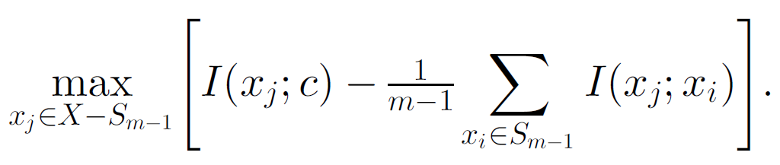

Max-Relevance and Min-Redundancy(2/2)
Combining two constraints called “minimal-redundancy-maximal-relevance”
Defined $Φ(D,R)$ to combine D and R
$$\max{Φ\left(D,R\right), Φ=D−R}$$
Suppose we have $S_{m−1},$feature set with $m−1$ features.
Select the $mth$ feature from the set $\left\{X−S_{m−1}\right\}$

Slide 9

Feature selection algorithm (1/5)
mRMR is the feature selection scheme.
Remaining issue is that how to determine the optimal number of features $m$.
Two-stage feature selection algorithm
Find a candidate feature set using the mRMR incremental selection method.
Use other more sophisticated schemes.

Slide 10
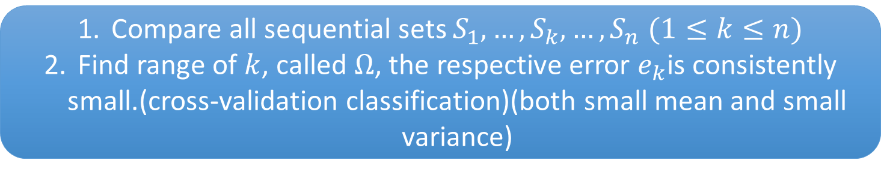

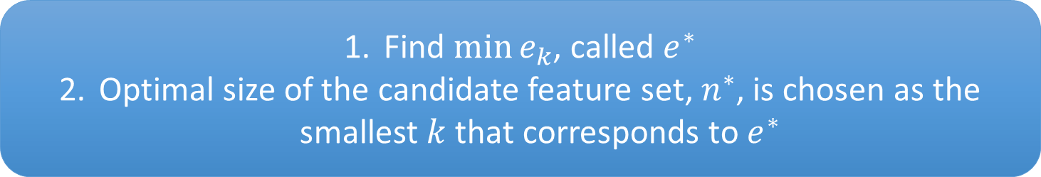
Feature selection algorithm (2/5)
Use mRMR to select n sequential features.
We get feature sets $S_{1}⊂S_{2}⊂…⊂S_{n−1}⊂S_{n}$
Compare all sequential sets $S_{1},…,S_{k},…,S_{n}$$(1≤k≤n)$
Find range of $k$, called $Ω$, the respective error $e_{k}$is consistently small.(cross-validation classification)(both small mean and small variance)
Find $\min{e_{k}}$, called $e^{∗}$
Optimal size of the candidate feature set, $n^{∗}$, is chosen as the smallest $k$ that corresponds to $e^{∗}$

Slide 11
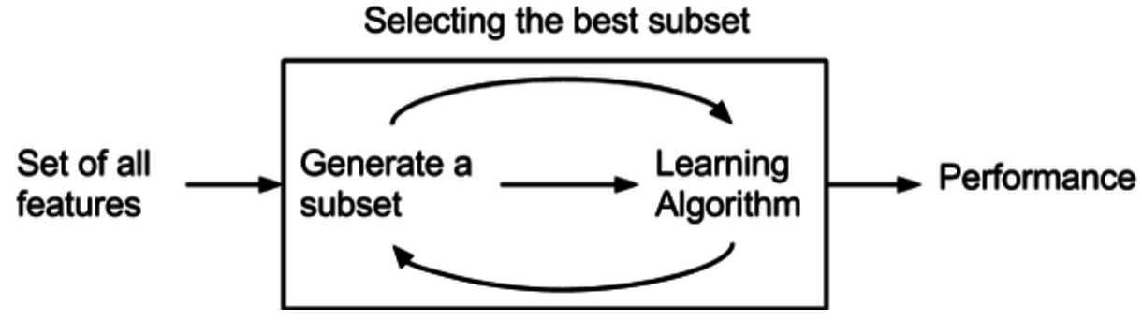
Feature selection algorithm (3/5)
Wrapper
Detect the possible interactions between variables.(Cost time)

Slide 12
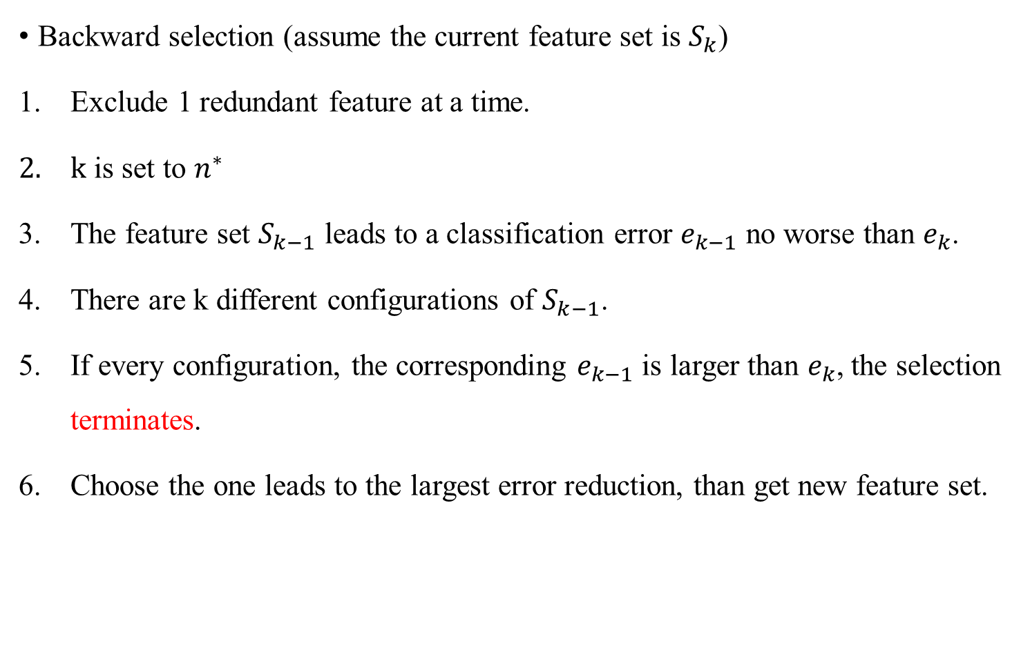
Feature selection algorithm (4/5)
Backward selection (assume the current feature set is $S_{k}$)
Exclude 1 redundant feature at a time.
$k$ is set to $n^{∗}$
The feature set $S_{k−1}$ leads to a classification error $e_{k−1}$ no worse than $e_{k}$.
There are k different configurations of $S_{k−1}$.
If every configuration, the corresponding $e_{k−1}$ is larger than $e_{k}$, the selection terminates.
Choose the one leads to the largest error reduction, than get new feature set.

Slide 13
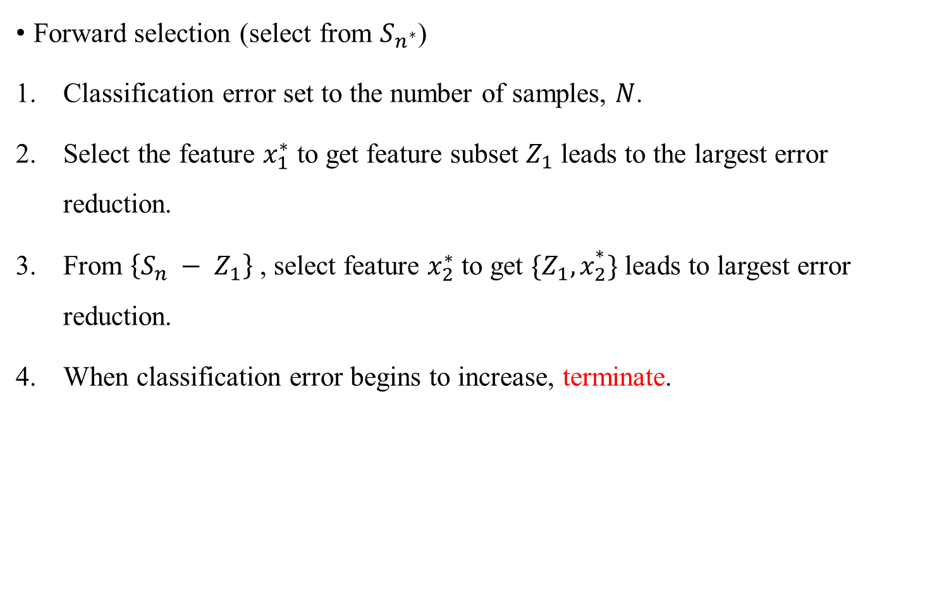
Feature selection algorithm (5/5)
Forward selection (select from $S_{n^{∗}}$)
Classification error set to the number of samples, $N$.
Select the feature $x_{1}^{∗}$ to get feature subset $Z_{1}$ leads to the largest error reduction.
From $\left\{S_{n} − Z_{1}\right\}$ , select feature $x_{2}^{∗}$ toget $\{Z_{1},x_{2}^{∗}\}$ leads to largest error reduction.
When classification error begins to increase, terminate.

Slide 14

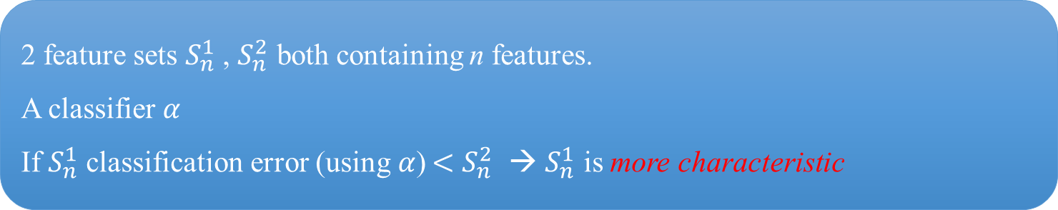
Characteristic (1/2)
2 feature sets $S_{n}^{1}$, $S_{n}^{2}$ both containing n features.
A classifier $α$
If $S_{n}^{1}$ classification error (using$α$) $<$$S_{n}^{2}$→ $S_{n}^{1}$ is more characteristic
Use feature selection method $F$to generate feature subsets
$S_{n}^{1}$ : $S_{1}^{1}⊂S_{2}^{1}⊂…⊂S_{k}^{1}⊂…⊂S_{n−1}^{1}⊂S_{n}^{1}$
$S_{n}^{2}$ : $S_{1}^{2}⊂S_{2}^{2}⊂…⊂S_{k}^{2}⊂…⊂S_{n−1}^{2}⊂S_{n}^{2}$
A range $Ω=\left[k_{lower},k_{upper}\right] (1≤k_{lower}<k_{upper}≤n)$, for every $k∈Ω$, the classification error on $S_{n}^{1}$ is consistently smaller than $S_{n}^{2}$→$S_{n}^{1}$recursively more characteristic

Slide 15
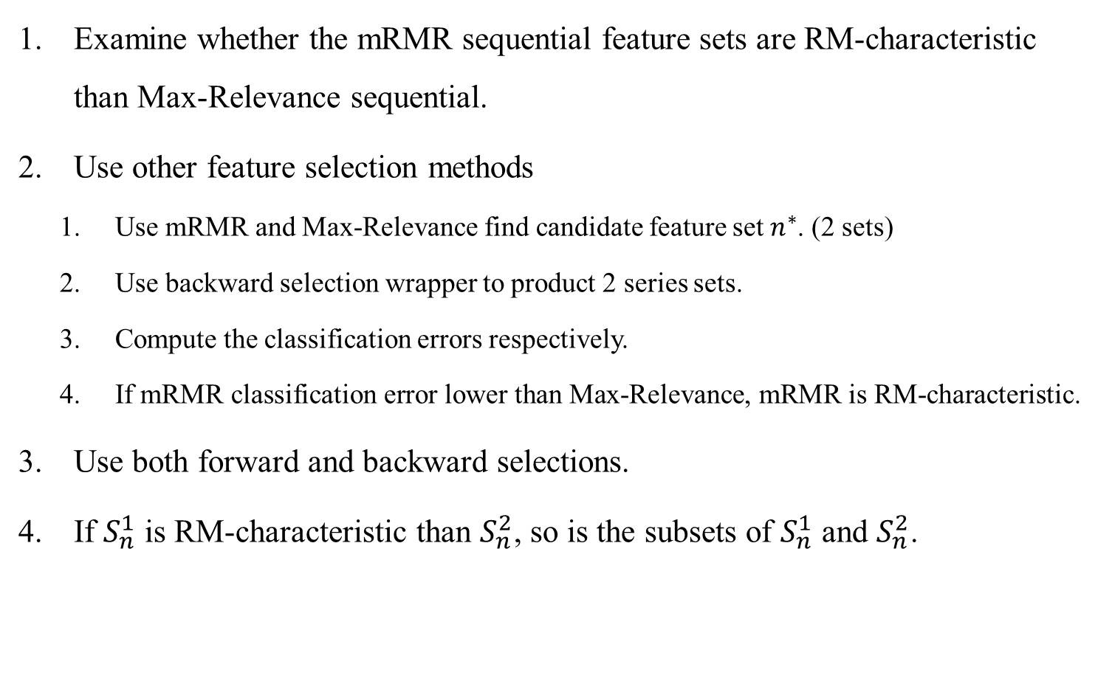
Characteristic (2/2)
Examine whether the mRMR sequential feature sets are RM-characteristic than Max-Relevance sequential.
Use other feature selection methods
Use mRMRand Max-Relevance find candidate feature set $n^{∗}$. (2 sets)
Use backward selection wrapper to product 2 series sets.
Compute the classification errors respectively.
If mRMR classification error lower than Max-Relevance, mRMR is RM-characteristic.
Use both forward and backward selections.
If $S_{n}^{1}$ is RM-characteristic than $S_{n}^{2}$, so is the subsets of $S_{n}^{1}$ and $S_{n}^{2}$.

Slide 16
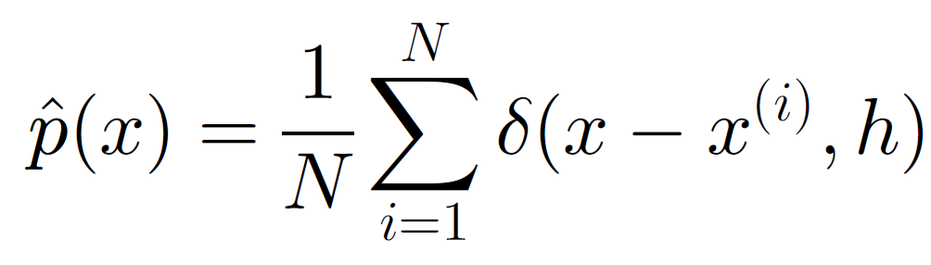
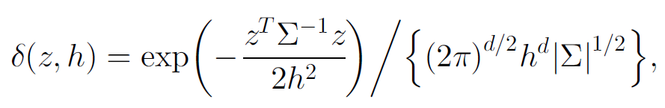
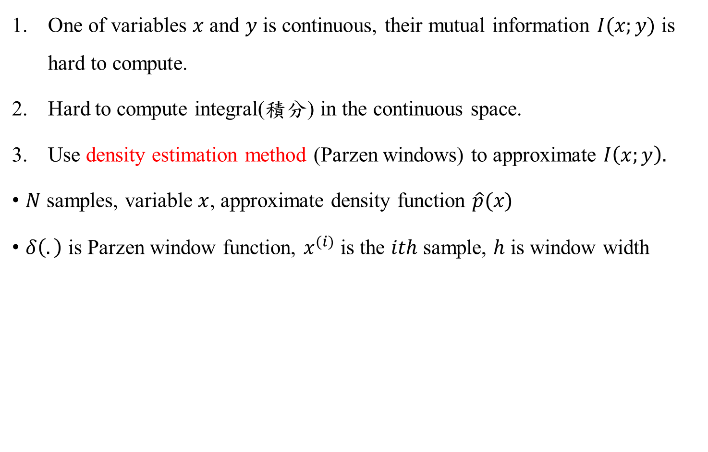
Implementation issues
One of variables $x$ and $y$ is continuous, their mutual information $I(x;y)$ is hard to compute.
Hard to compute integral(積分) in the continuous space.
Use density estimation method (Parzen windows) to approximate $I\left(x;y\right).$
$N$ samples, variable $x$, approximate density function$\hat{p}(x)$
$δ\left(.\right)$ is Parzen window function, $x^{(i)}$ is the $ith$ sample, $h$ is window width

Slide 17
Classifiers
mRMR feature selection method does not convolve with specific classifiers.
In this paper, uses
Naive Bayes(NB)
Support Vector Machine(SVM)
Linear Discrimant Analysis(LDA)

Slide 18
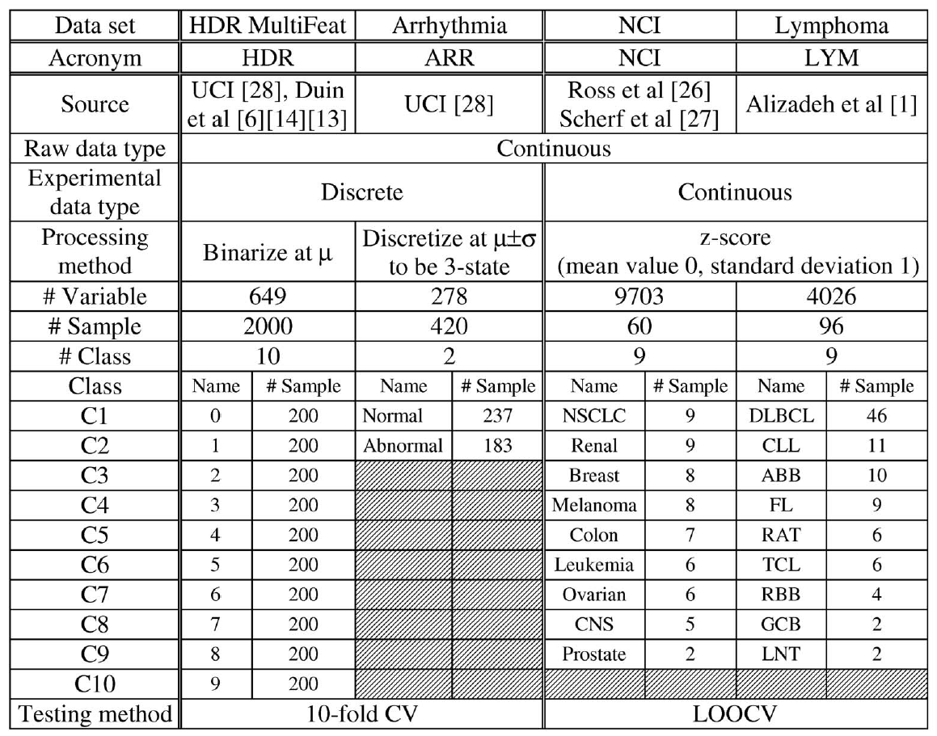
Experiments (1/5)
National Cancer Institute
handwritten digits
Arrhythmia 心律不整
Lymphoma 淋巴瘤

Slide 19
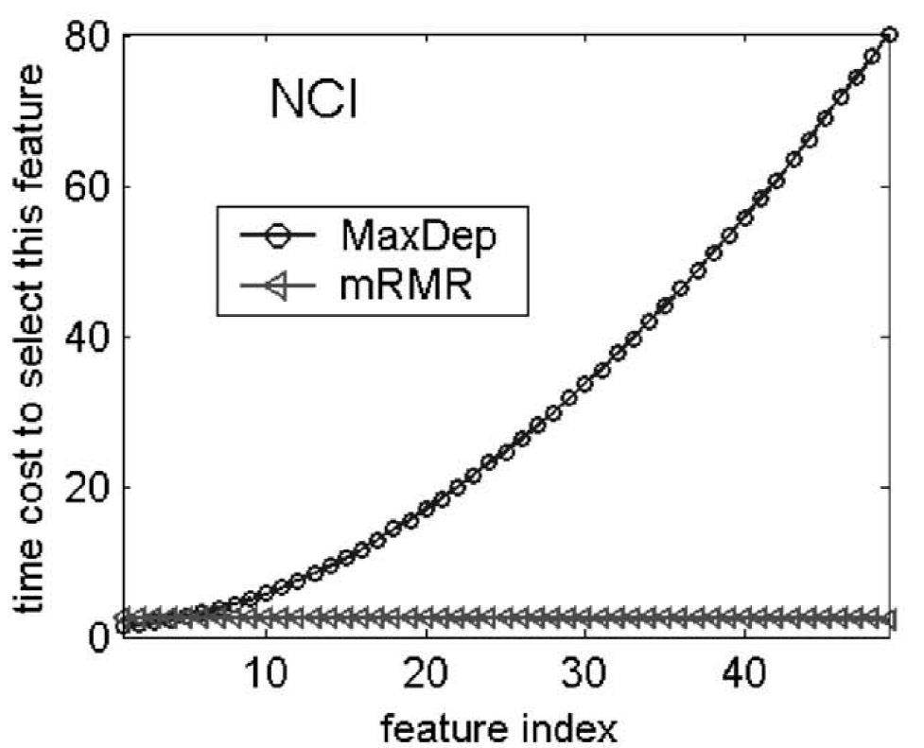
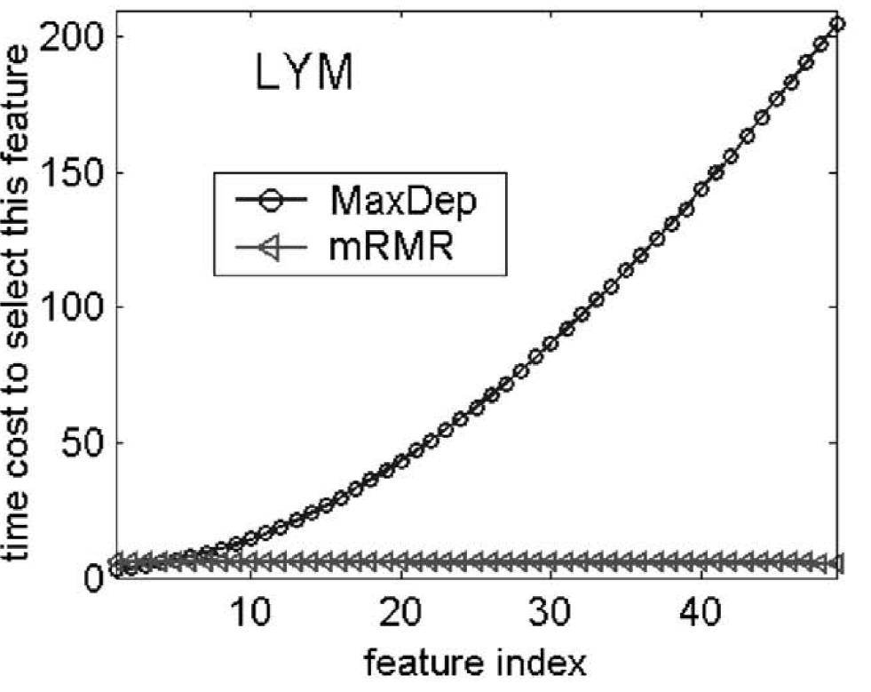
Experiments (2/5)
Time : seconds

Slide 20
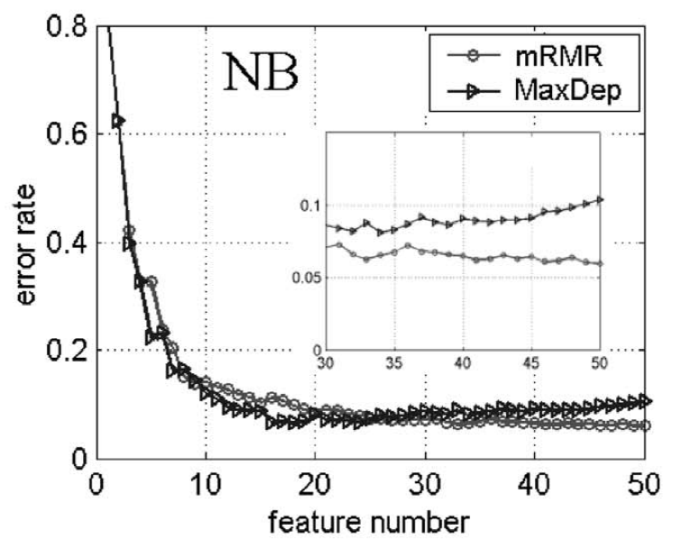
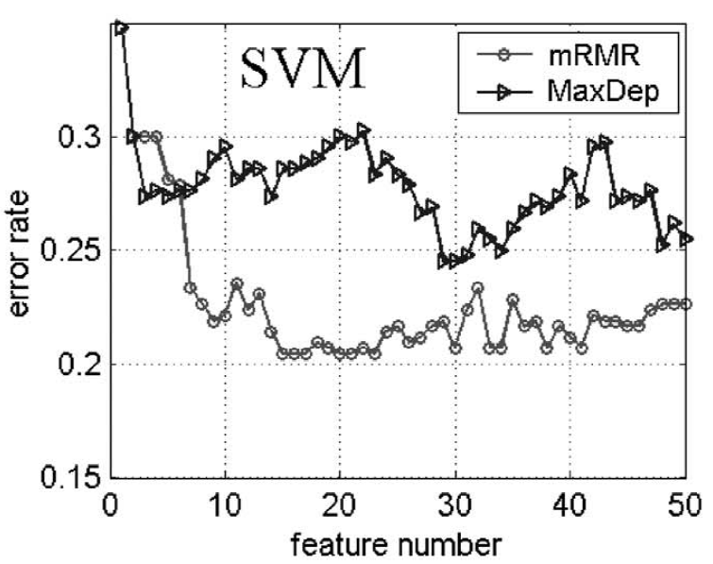
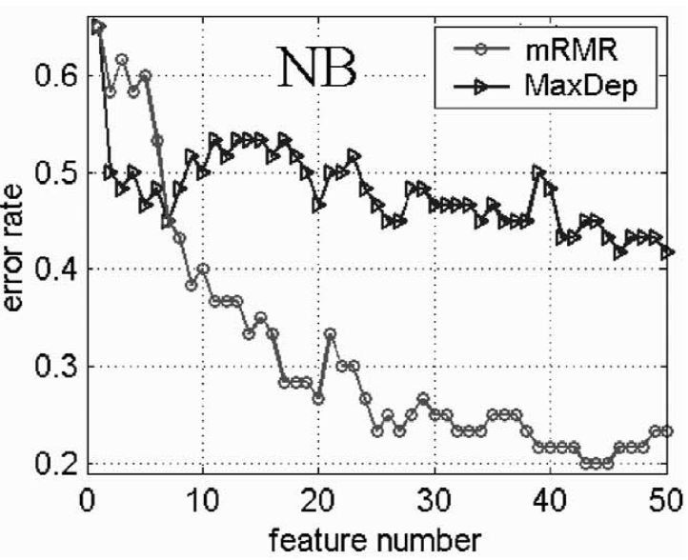
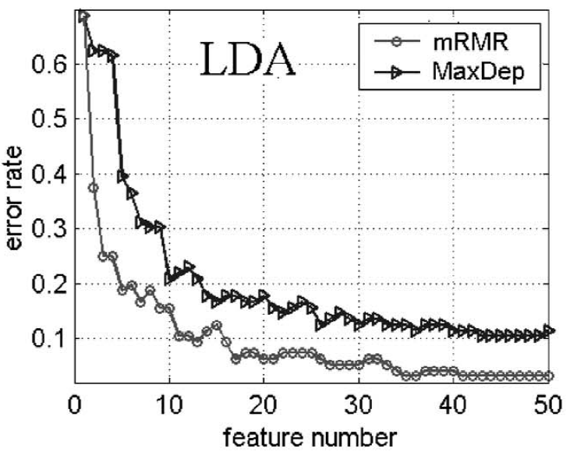
Experiments (3/5)

Slide 21
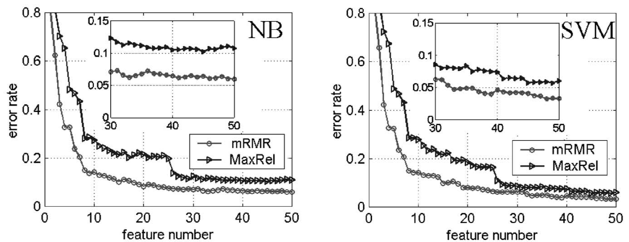
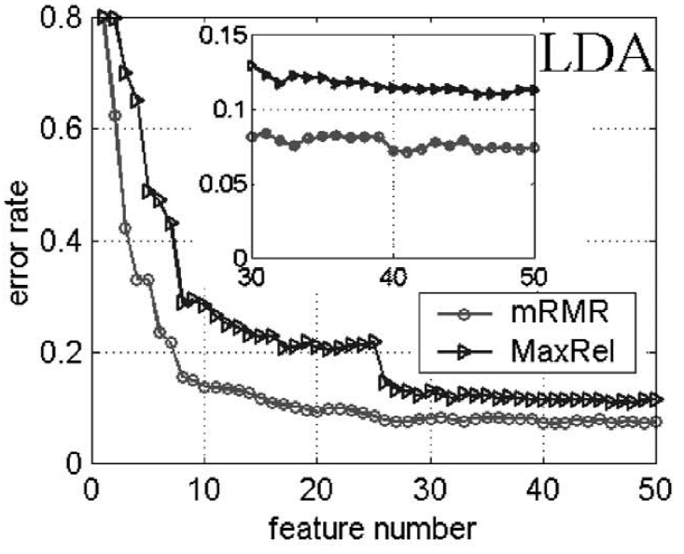
Experiments (4/5)

Slide 22
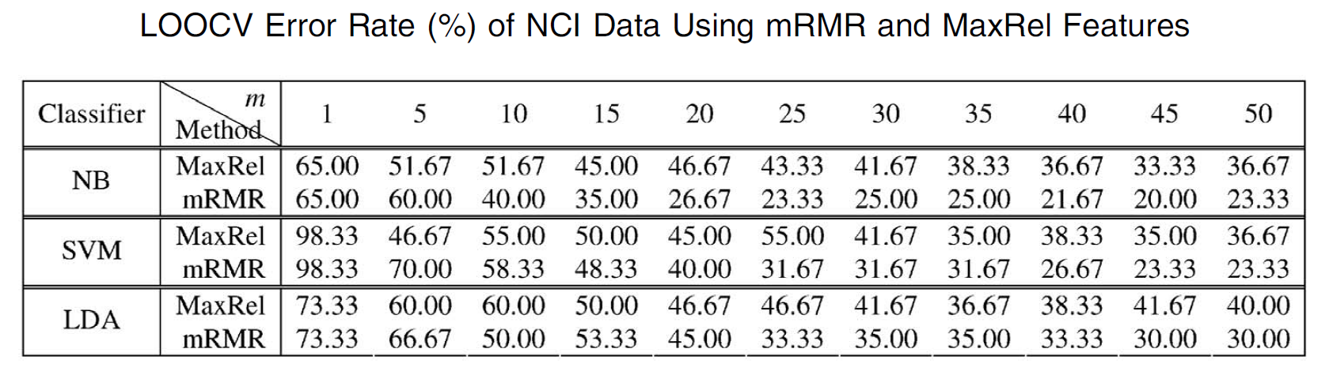
Experiments (5/5)

