Slide 1
Optional Sequence Alignment Allowing For Long Gaps
OSAMU GOTOH
Bulletin of Mathematical Biology, Vol. 52, No. 3, pp. 359—373(1990)
Presenter: Shian-Liang Lin
Notes:
http://www.combinatorialmath.ca/jcmcc/jcmcc71.html

Slide 2
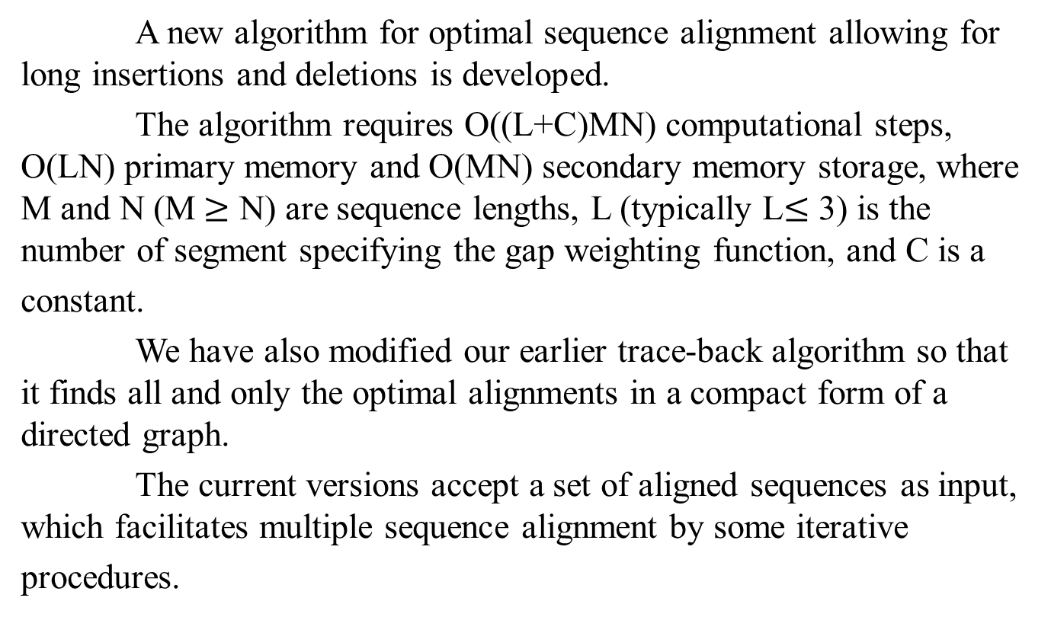
Abstract
A new algorithm for optimal sequence alignment allowing for long insertions and deletions is developed.
The algorithm requires O((L+C)MN) computational steps, O(LN) primary memory and O(MN) secondary memory storage, where M and N (M$≥$ N) are sequence lengths, L (typically L$≤$ 3) is the number of segment specifying the gap weighting function, and C is a
constant.
We have also modified our earlier trace-back algorithm so that it finds all and only the optimal alignments in a compact form of a directed graph.
The current versions accept a set of aligned sequences as input, which facilitates multiple sequence alignment by some iterative
procedures.

Slide 3
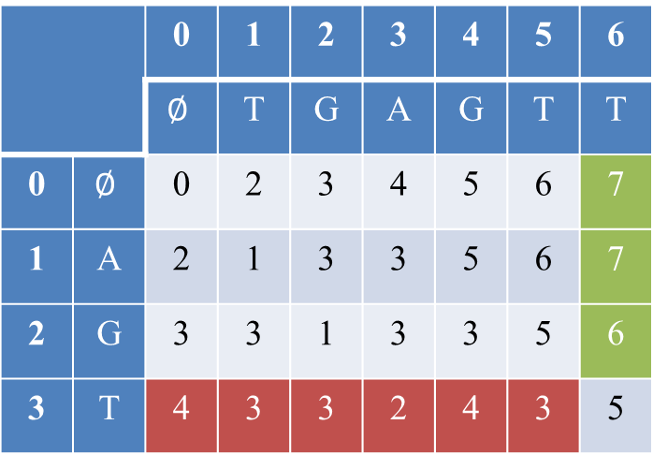
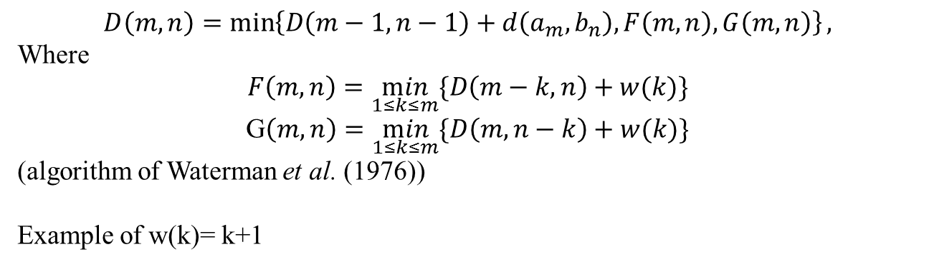
Algorithm(1/2)
$$D\left(m,n\right)=\min\left\{D\left(m−1,n−1\right)+d\left(a_{m},b_{n}\right),F\left(m,n\right),G\left(m,n\right)\right\},$$
Where
$$F\left(m,n\right)=\min_{1≤k≤m}{\{D\left(m−k,n\right)+w(k)\}}$$
G$\left(m,n\right)=\min_{1≤k≤m}{\{D\left(m,n−k\right)+w(k)\}}$
(algorithm of Waterman et al. (1976))
Example of w(k)= k+1
 |  | 0 | 1 | 2 | 3 | 4 | 5 | 6
 |  | $$∅$$ | T | G | A | G | T | T
0 | $$∅$$ | 0 | 2 | 3 | 4 | 5 | 6 | 7
1 | A | 2 | 1 | 3 | 3 | 5 | 6 | 7
2 | G | 3 | 3 | 1 | 3 | 3 | 5 | 6
3 | T | 4 | 3 | 3 | 2 | 4 | 3 | 5
w(k)
w(3)=4
w(2)=3
w(1)=2
w(k) | 7 | 6 | 5 | 4 | 3 | 2

Slide 4
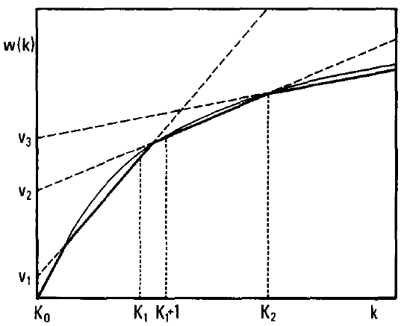

Piecewise linear gap-weighting function
$wi\left(k\right)= vik + ui ,$where 0$≤i≤L=3$

Slide 5
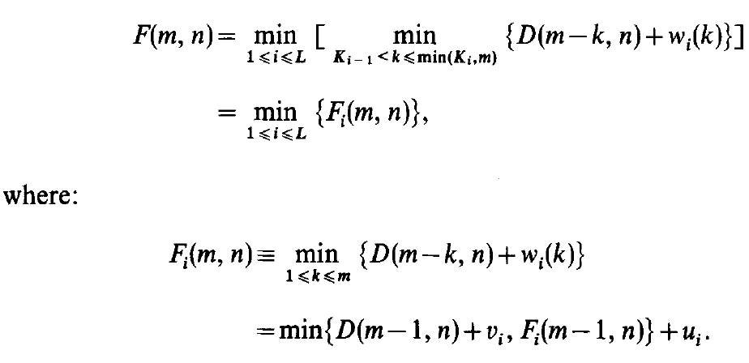
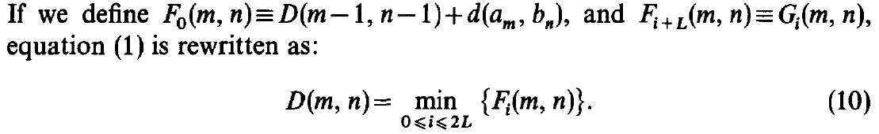
Algorithm(2/2)

Slide 6
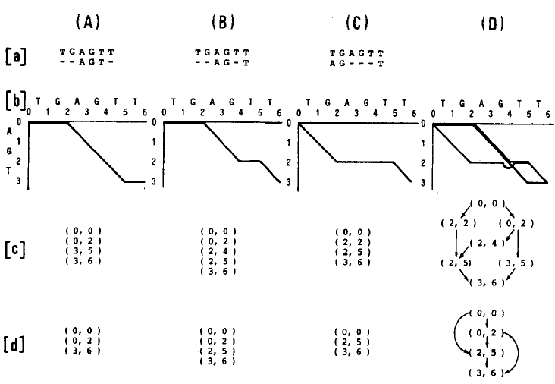
Presentation of optimal alignments
(a)
Standard alignments
(b)
Path representations
(c)
Skeletal representations
(d)
Reduced forms
Using reduced forms to trackback by FPS

Slide 7
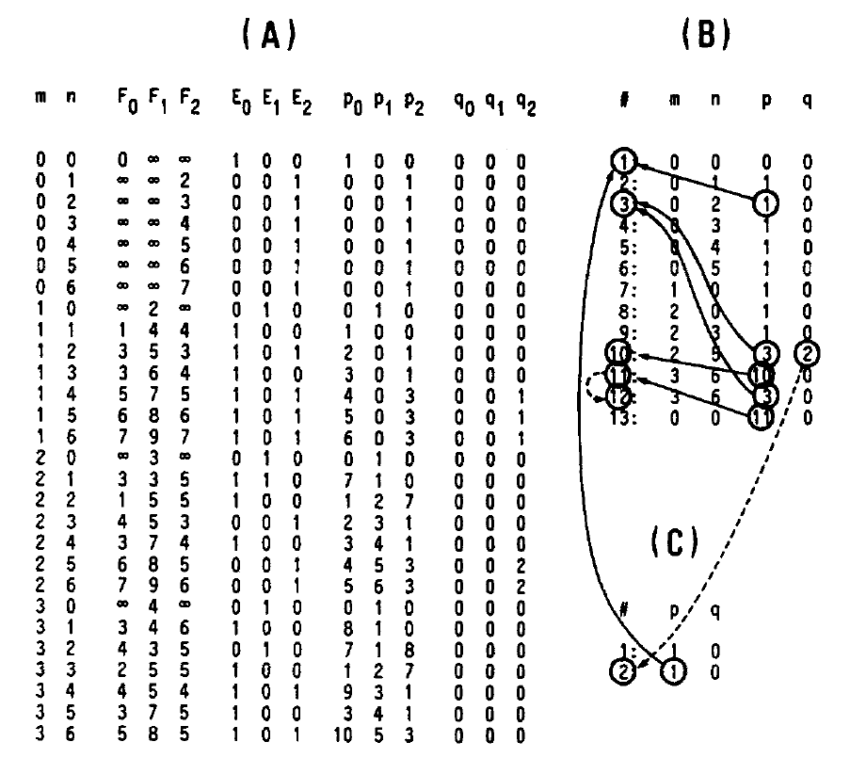
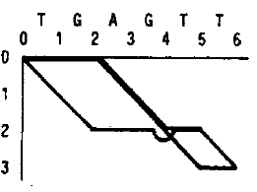
a=AGT, b=TGAGTT, L=1, w₁ (k)=k+1
Primary list
Second list

Slide 8
Trace-back
Primary list
(0,0)
DFS
(0,2)
(2,5)
(0,0)
(2,5)
(3,6)
(0,0)
(0,2)
(3,6)
(3,6)
(0,0)
(0,2)
(2,5)
(3,6)
Second list

Slide 9
Complexity
Time complexity:
Get optimal alignment : O((L+C)MN) times.
Trackback: O(T) times, where T is the total number of gaps in all the optimal alignments.
Space complexity:
O(L(M+N)) space.

Slide 10
Thanks for listening

