Slide 1
A Comparative Study of Stock Scoring using Regression and Genetic-based Linear Models
Chien-Feng Huang, Tsung-Nan Hsieh, Bao Rong Chang, Chih-Hsiang Chang
National University of Kaohsiung
2011 IEEE International Conference on Granular Computing
pp. 268 - 273
Presenter : Tsai Yao-Chou

Slide 2
Abstract(1/2)
Stock selection has long been a challenging and important task in investment and finance. Researchers and practitioners in this area often use regression models to tackle this problem due to their simplicity and effectiveness. Recent advances in machine learning (ML) are leading to significant opportunities to solve these problems more effectively. In this paper, we present a comparative study between the traditional regression-based and ML-based linear models for stock scoring, which is crucial to the success of stock selection. In ML-based models, Genetic Algorithms (GA), a class of well-known search algorithms in the area of ML, is used for optimization of model parameters and selection of input variables to the stock scoring model.

Slide 3
Abstract(1/2)
We will show that our proposed genetic-based method significantly outperforms the traditional regression-based method as well as the benchmark.As a result, we expect this genetic-based methodology to advance the research in machine learning for finance and provide an attractive alternative to stock selection over the regression-based approach.

Slide 4
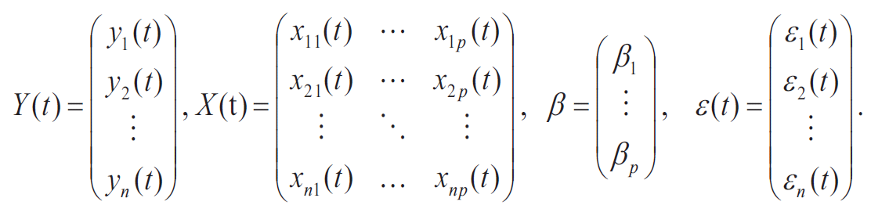

Regression Model
Type : Liner regression
$n$ training instances with input variable $x$ and output variable $y$ at time $t$:
$$\left\{\left(x_{1}\left(t\right),y_{1}\left(t\right)\right),\left(x_{2}\left(t\right),y_{2}\left(t\right)\right), …,\left(x_{n}\left(t\right),y_{n}\left(t\right)\right)\right\}$$
$β$ = regression coefficient
$ε\left(t\right)$ = error term
$$Y\left(t\right)=x\left(t\right)β+ε\left(t\right)$$

Slide 5

Fundamental indicators (1/2)
PE ratio : Price to earnings ratio = $\frac{每股市價}{每股盈餘}$
較小表示風險低，較高表示風險高
PB ratio : Price to book ratio = $\frac{每股市價}{每股淨資產}$
較小投資價值高，較大投資價值低
PS ratio : Price to sales = $\frac{股價 × 總股數}{營收}$
較小單位營收高風險低，較大風險高

Slide 6
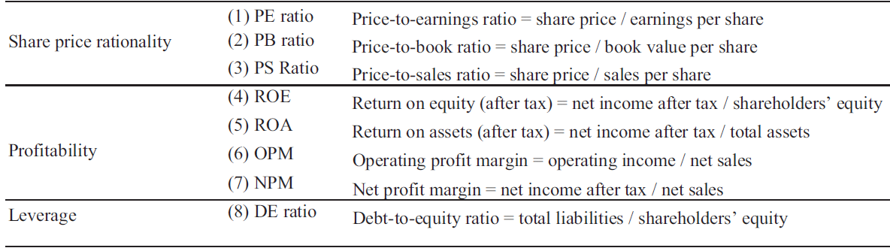
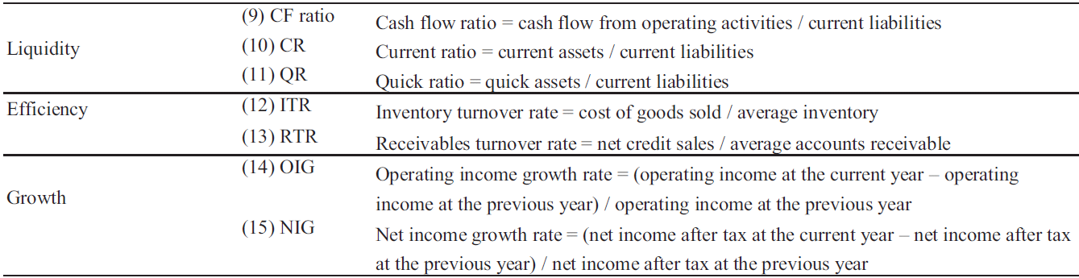
Fundamental indicators (2/2)

Slide 7
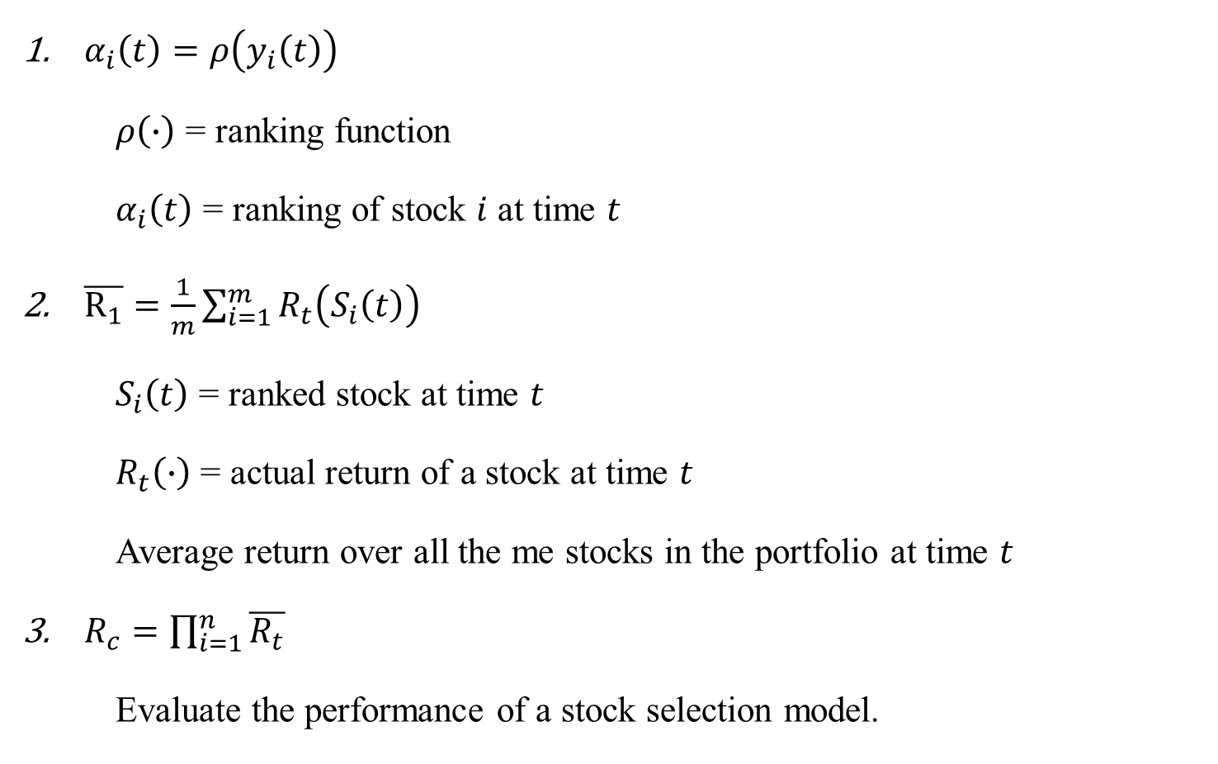
Ranking scheme
$α_{i}\left(t\right)=ρ\left(y_{i}\left(t\right)\right)$
$ρ\left(∙\right)$ = ranking function
$α_{i}\left(t\right)$ = ranking of stock $i$ at time $t$
$\overline{R_{1}}=\frac{1}{m}\sum_{i=1}^{m}{R_{t}\left(S_{i}\left(t\right)\right)}$
$S_{i}\left(t\right)$ = ranked stock at time $t$
$R_{t}\left(∙\right)$ = actual return of a stock at time $t$
Average return over all the me stocks in the portfolio at time $t$
$R_{c}=\prod_{i=1}^{n}{\overline{R_{t}}}$
Evaluate the performance of a stock selection model.

Slide 8

GA-based model (1/4)
$Z_{i,j}\left(t\right)$ : score of stock $i$ assigned by variable $j$ at time $t$.
$v_{i,j}\left(t\right)$ : value of variable $j$.
$Z_{i,j}\left(t\right)=ρ_{i,j}\left(t\right)$.
1. $I_{j}=0:$
$ρ_{i,j}\left(t\right)≥ρ_{k,j}\left(t\right) iff v_{i,j}\left(t\right)≥v_{k,j}\left(t\right)$ for $i≠k.$
2. $I_{j}=1:$
$ρ_{i,j}\left(t\right)≥ρ_{k,j}\left(t\right) iff v_{i,j}\left(t\right)≤v_{k,j}\left(t\right)$ for $i≠k.$

Slide 9
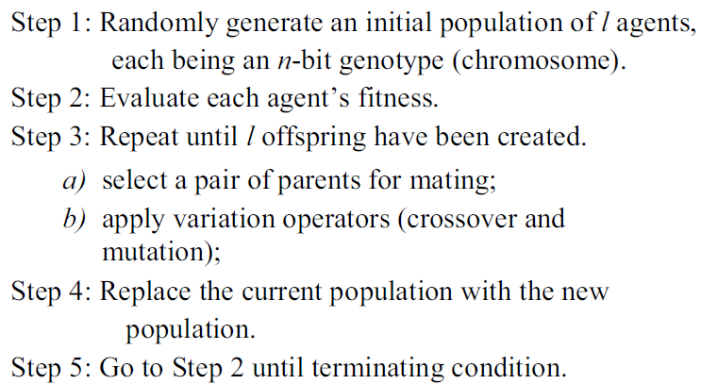
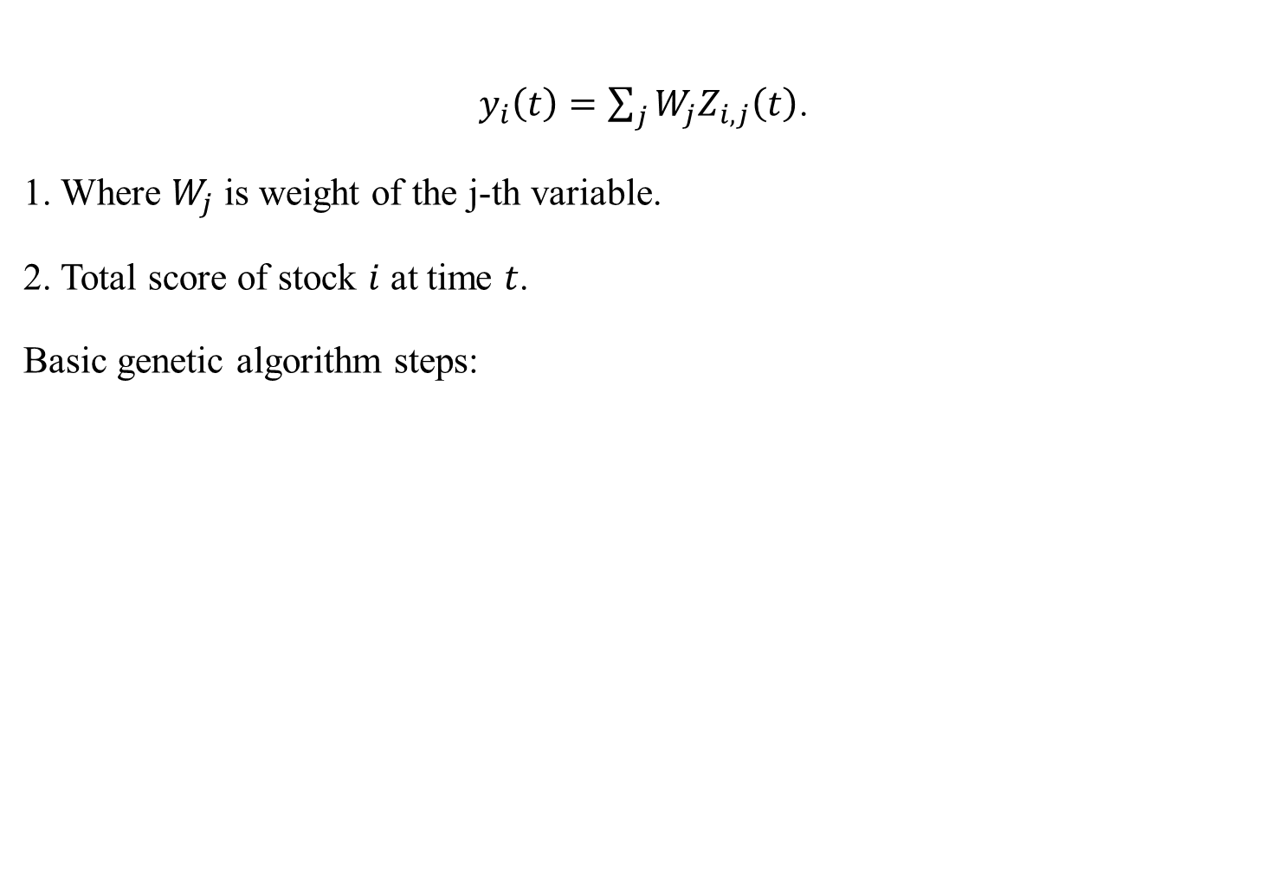
GA-based model (2/4)
$y_{i}\left(t\right)=\sum_{j}{W_{j}Z_{i,j}\left(t\right)}$.
1. Where $W_{j}$ is weight of the j-th variable.
2. Total score of stock $i$ at time $t$.
Basic genetic algorithm steps:

Slide 10
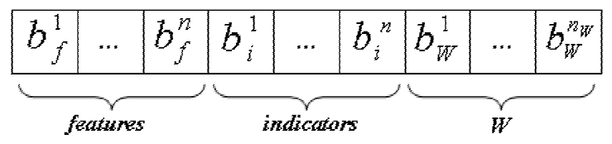
GA-based model (3/4)
Three sets of parameters:
F : The set of input features.
1 → select, 0 → not select
I : The set of stock sorting indicators.
Based on page 6

Slide 11
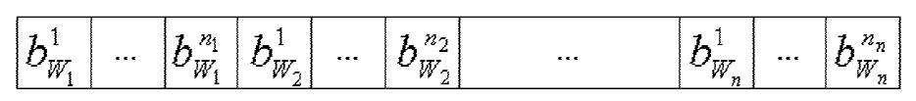


GA-based model (4/4)
W : The weights of the fundamental variables.
Genotypes to Phenotype:
$$y=\min_{y}+\frac{d}{2^{l}−1}×\left(\max_{y}−\min_{y}\right)$$
Fitness function:
$$fitness=\sqrt[n]{R_{c}}$$
Weight for variable $1$

Slide 12
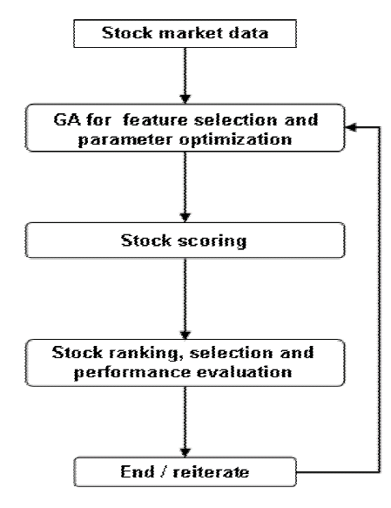
Algorithm flowchart

Slide 13
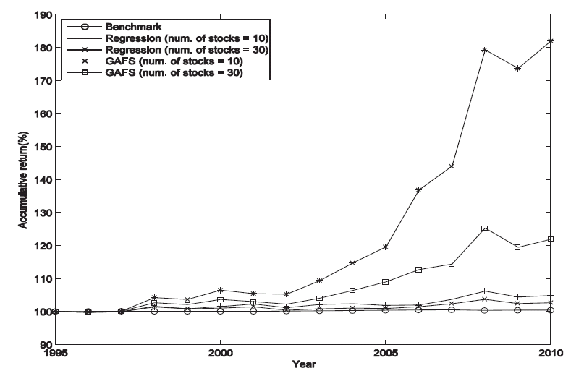
Experiment (1/2)

Slide 14
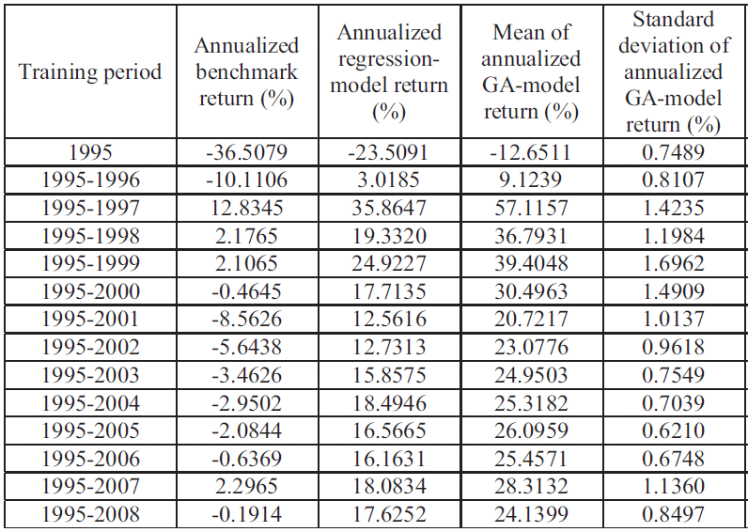
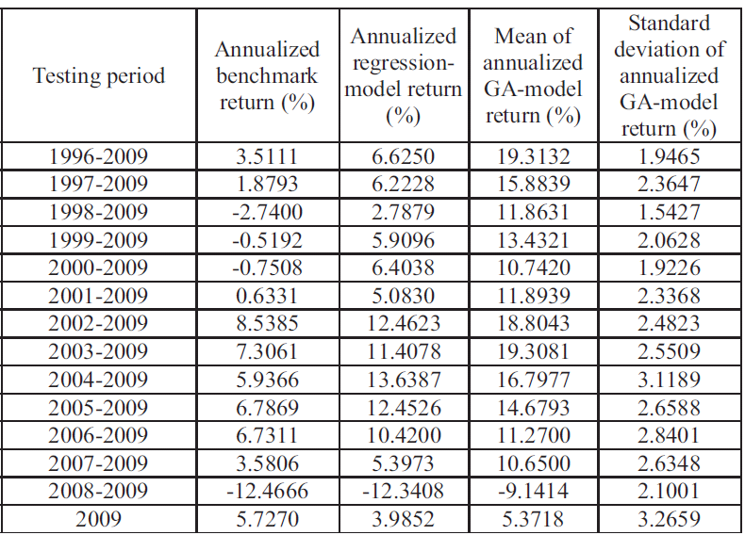
Experiment (2/2)

