Slide 1
Algorithms for Approximate String Matching
ESKO UKKONEN, Information and Control Volume 64, Issues 1–3, January–March 1985, Pages 100-118
Presenter: Wen-Chuan Ho
Date: 2015/09/08

Slide 2
Abstract(1/3)
The edit distance between strings a₁ ... a _{m} and b₁… b_{n} is the minimum cost s of a sequence of editing steps (insertions, deletions, changes) that convert one string into the other. A well-known tabulating method computes s as well as the corresponding editing sequence in time and in space O(mn) (in space O(min(m, n)) if the editing sequence is not required). Starting from this method, we develop an improved algorithm that works in time and in space O(s·min(m, n)).

Slide 3
Abstract(2/3)
Another improvement with time O(s·min(m, n)) and space O(s·min(s, m, n)) is given for the special case where all editing steps have the same cost independently of the characters involved. If the editing sequence that gives cost s is not required, our algorithms can be implemented in space O(min(s, m, n)). Since s= O(max(m, n)), the new methods are always asymptotically as good as the original tabulating method. As a byproduct, algorithms are obtained that, given a threshold value t, test in time O(t·min(m,n)) and in space O(min(t,m,n)) whether s≤t.

Slide 4
Abstract(3/3)
Finally, different generalized edit distances are analyzed and conditions are given under which our algorithms can be used in conjunction with extended edit operation sets, including, for example, transposition of adjacent characters.

Slide 5
Edit distance
A = yxxzy
B = xyxzyz
 |  | x | y | x | z | y | z
 | 0 | 2 | 4 | 6 | 8 | 10 | 12
y | 2 | 3 | 2 | 4 | 6 | 8 | 10
x | 4 | 2 | 4 | 2 | 4 | 6 | 8
x | 6 | 4 | 5 | 4 | 5 | 7 | 9
z | 8 | 6 | 7 | 6 | 4 | 6 | 7
y | 10 | 8 | 6 | 8 | 6 | 4 | 6
Deletion = 2 Insertion = 2 Change = 3

Slide 6
Procedure test₁(1/2)
t₀ = (|n-m|+1)·∆ = 4
p = (t/∆-|n-m|)/2 = 0
 |  | x | y | x | z | y | z
 | 0 | 2
y |  | 3 | 2
x |  |  | 4 | 2
x |  |  |  | 4 | 5
z |  |  |  |  | 4 | 6
y |  |  |  |  |  | 4 | 6

Slide 7
Procedure test₁(2/2)
t₁ = 2 t₀ = 8
p = (t/∆-|n-m|)/2 = 1
 |  | x | y | x | z | y | z
 | 0 | 2 | 4
y | 2 | 3 | 2 | 4
x |  | 2 | 4 | 2 | 4
x |  |  | 5 | 4 | 5 | 7
z |  |  |  | 6 | 4 | 6 | 8
y |  |  |  |  | 6 | 4 | 6

Slide 8
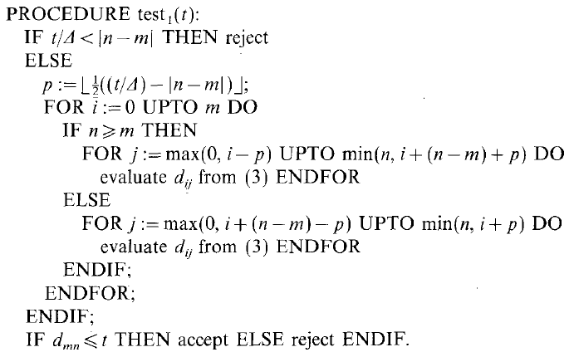
Time Complexity = O(t·min(m,n))
Space Complexity = O(t·min(m,n))

Slide 9
Procedure test₂(1/3)
A = yxxzy B = xyxzyz
t₀ = (|n-m|+1)·∆ = 4
p = (t/∆-|n-m|)/2 = 0
r₋₁ | r₀ | r₁ | r₂
∞ | ∞ | ∞ | ∞
r₋₁ | r₀ | r₁ | r₂
∞ | 0 | ∞ | ∞
r₋₁ | r₀ | r₁ | r₂
∞ | 0 | 2 | ∞
i = 0
r₋₁ | r₀ | r₁ | r₂
∞ | 3 | 2 | ∞
r₋₁ | r₀ | r₁ | r₂
∞ | 3 | 2 | ∞
i = 1

Slide 10
Procedure test₂(2/3)
A = yxxzy B = xyxzyz
r₋₁ | r₀ | r₁ | r₂
∞ | 4 | 2 | ∞
r₋₁ | r₀ | r₁ | r₂
∞ | 4 | 2 | ∞
i = 2
r₋₁ | r₀ | r₁ | r₂
∞ | 4 | 2 | ∞
r₋₁ | r₀ | r₁ | r₂
∞ | 4 | 5 | ∞
i = 3
r₋₁ | r₀ | r₁ | r₂
∞ | 4 | 5 | ∞
r₋₁ | r₀ | r₁ | r₂
∞ | 4 | 6 | ∞
i = 4

Slide 11
Procedure test₂(3/3)
A = yxxzy B = xyxzyz
r₋₁ | r₀ | r₁ | r₂
∞ | 4 | 6 | ∞
r₋₁ | r₀ | r₁ | r₂
∞ | 4 | 6 | ∞
i = 5

Slide 12
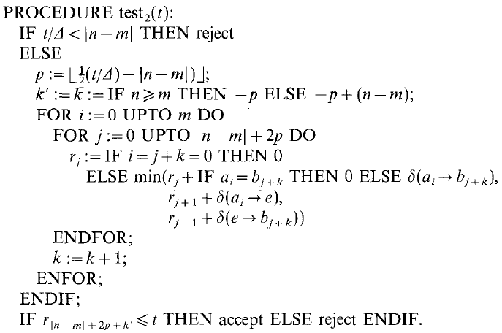
Space Complexity = O(min(t,m,n))

Slide 13
Special Case
A = yxxzy
B = xyxzyz
Deletion = 1
Insertion = 1
Change = 1
 |  | x | y | x | z | y | z
 | 0 | 1 | 2 | 3 | 4 | 5 | 6
y | 1 | 1 | 1 | 2 | 3 | 4 | 5
x | 2 | 1 | 2 | 1 | 2 | 3 | 4
x | 3 | 2 | 2 | 2 | 2 | 3 | 4
z | 4 | 3 | 3 | 3 | 2 | 3 | 3
y | 5 | 4 | 3 | 4 | 3 | 2 | 3
f_{1,-1} | f_{1,0} | f_{1,1} | f_{1,2} | f_{1,3}
-∞ | -1 | 3 | 4 | 6

Slide 14
Compute f_{k,p}
p = -1
 |  | x | y | x | z | y | z
 | 0 | 1 | 2 | 3 | 4 | 5 | 6
y | 1 | 1 | 1 | 2 | 3 | 4 | 5
x | 2 | 1 | 2 | 1 | 2 | 3 | 4
x | 3 | 2 | 2 | 2 | 2 | 3 | 4
z | 4 | 3 | 3 | 3 | 2 | 3 | 3
y | 5 | 4 | 3 | 4 | 3 | 2 | 3
p = 0
f_{0,0} = 0
p = 1
f_{-1,1} = 1 , f_{0,1} = 1 , f_{1,1} = 3
p = 2
f_{-2,2} = 1 ,f_{-1,2} = 2 , f_{0,2} = 5
f_{1,2} = 4 , f_{2,2} = 4
p = 3
f_{-3,3} = 2 , f_{-2,3} = 2 ,f_{-1,3} = 4 , f_{0,3} = X,
f_{1,3} = 6 , f_{2,3} = 6 , f_{3,3} = 5

Slide 15
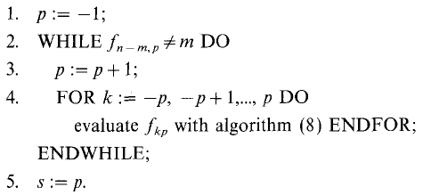

Compute Edit Distance
Algorithm 10
Algorithm 8

Slide 16
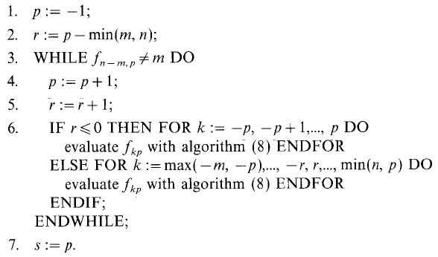
Time Complexity = O(s·min(m,n))
Space Complexity = O(s·min(s,m,n))

Slide 17
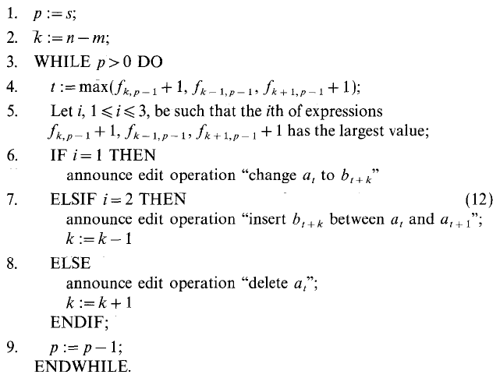
Editing Sequence

