Slide 1
Dynamic programming algorithms for the mosaic longest common subsequence problem
Kuo-Si Huang, Chang-Biau Yang, Kuo-Tsung Tseng, Yung-Hsing Peng, Hsing-Yen Ann
Information Processing Letters 30th April 2007 pp.99-103
Presenter: Bi-Shiang Lin
Date:2015/9/8

Slide 2
Abstract(1/3)
The longest common subsequence(LCS) problem can be used to measure the relationship between sequences. In general, the inputs of the LCS problem are two sequences. For finding the relationship between one sequence and a set of sequences, we cannot apply the traditional LCS algorithms immediately.

Slide 3
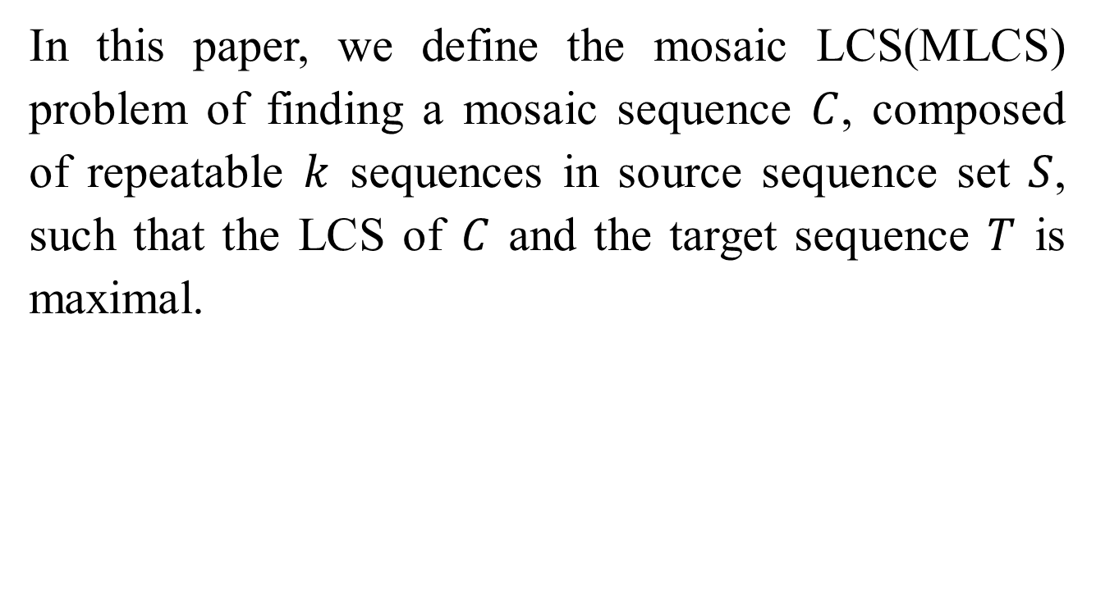
Abstract(2/3)
In this paper, we define the mosaic LCS(MLCS) problem of finding a mosaic sequence $C$, composed of repeatable $k$ sequences in source sequence set $S$, such that the LCS of $C$ and the target sequence $T$ is maximal.

Slide 4
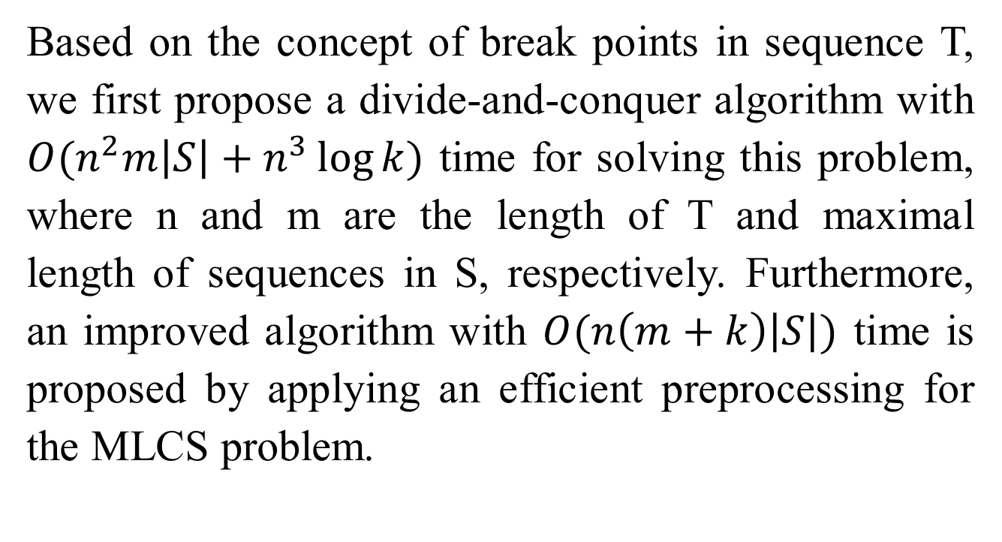
Abstract(3/3)
Based on the concept of break points in sequence T, we first propose a divide-and-conquer algorithm with $O(n^{2}m\left|S\right|+n^{3}\log{k})$ time for solving this problem, where n and m are the length of T and maximal length of sequences in S, respectively. Furthermore, an improved algorithm with $O(n\left(m+k\right)\left|S\right|)$ time is proposed by applying an efficient preprocessing for the MLCS problem.

Slide 5

The LCS Problem
Sequence $X$: ATTGCCA
Sequence $Y$: TAGAC
Common Subsequence : TA、TGC、AC …
Longest Common Subsequence : AGC、TGA …

Slide 6
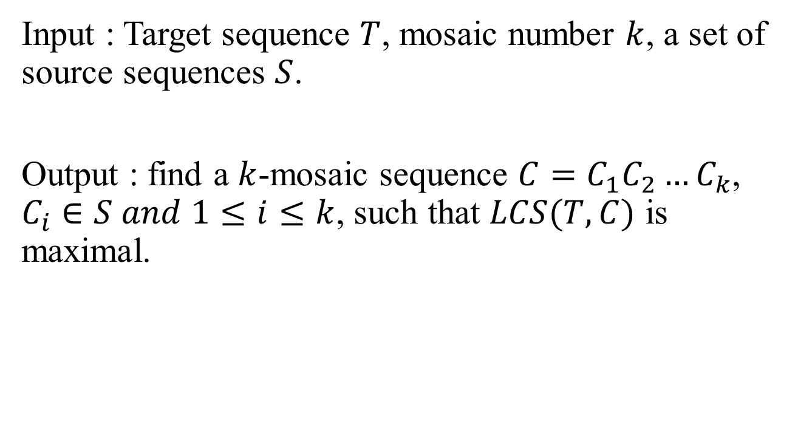
The MLCS Problem
Input : Target sequence $T$, mosaic number $k$, a set of source sequences $S$.
Output : find a $k$-mosaic sequence $C=C_{1}C_{2}…C_{k}$, $C_{i}∈S and 1≤i≤k$, such that $LCS(T,C)$ is maximal.

Slide 7
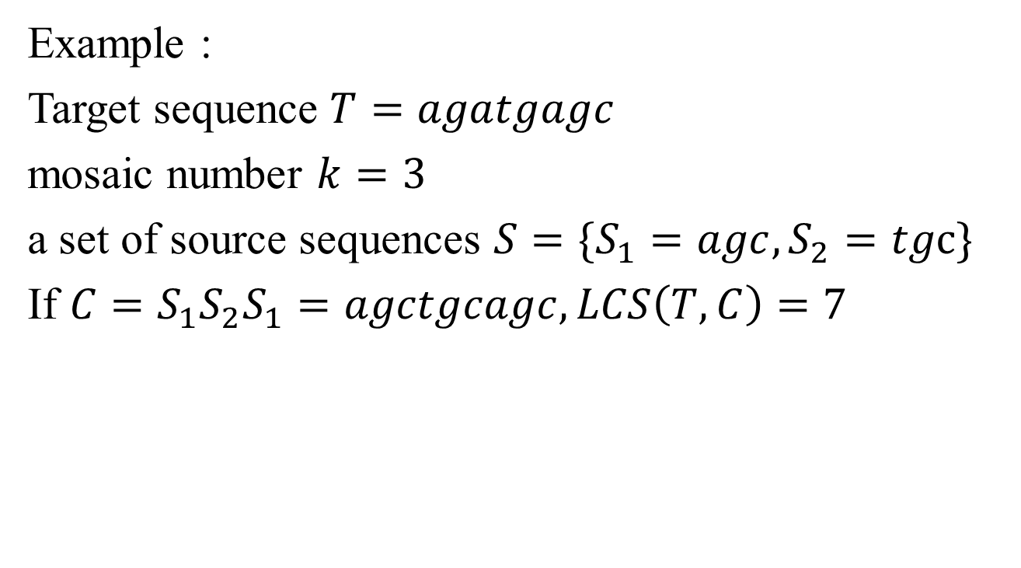
The MLCS Problem
Example :
Target sequence $T=agatgagc$
mosaic number $k=3$
a set of source sequences $S=\{S_{1}=agc, S_{2}=tgc\}$
If $C=S_{1}S_{2}S_{1}=agctgcagc, LCS\left(T,C\right)=7$

Slide 8
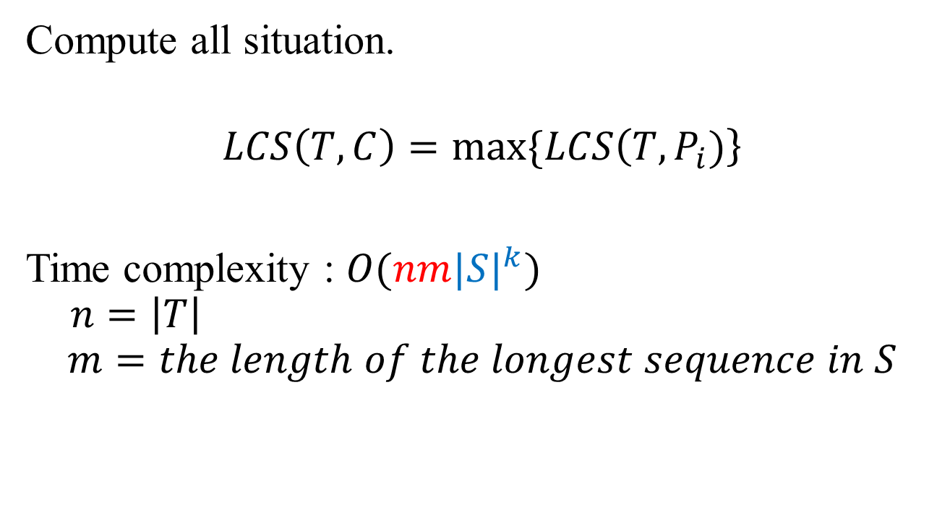
Method 1 : brute force
Compute all situation.
$$LCS\left(T,C\right)=max⁡\{LCS\left(T,P_{i})\right\}$$
Time complexity : $O(nm{|S|}^{k})$
$$n=\left|T\right|$$
$$m=the length of the longest sequence in S$$

Slide 9
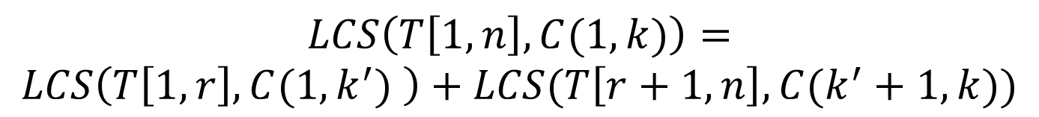
Method 2 : divide-and-conquer
T
C
$$LCS\left(T[1,n],C\right)=LCS\left(T\left[1,r\right],C_{1}\right)+LCS(T\left[r+1,n\right],C_{2})$$
T
C
$$LCS\left(T\left[1,n\right],C(1,k)\right)=$$
$$LCS\left(T\left[1,r\right],C(1,k^{′}) \right)+LCS(T\left[r+1,n\right],C(k^{′}+1,k))$$

Slide 10
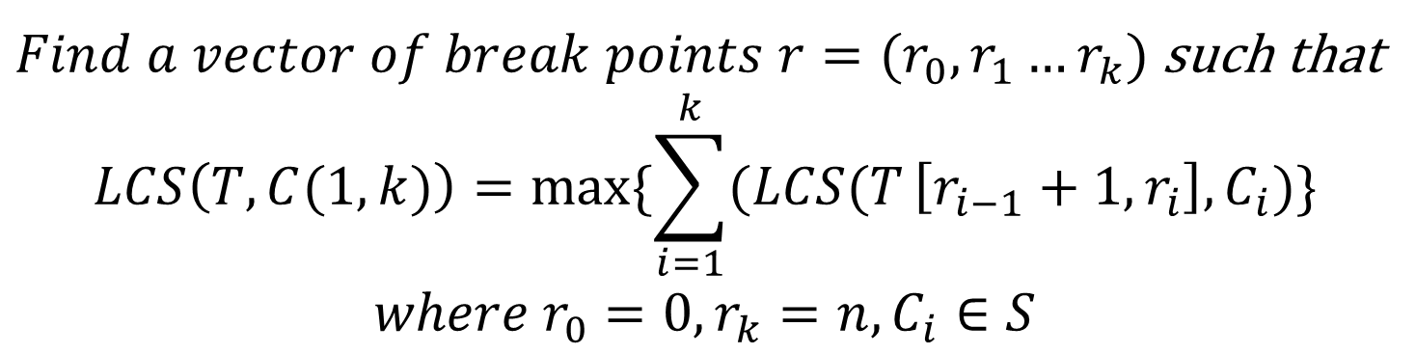
Method 2 : divide-and-conquer
T
C
$Find a vector of break points r=(r_{0},r_{1}…r_{k})$ such that
$$LCS\left(T,C(1,k)\right)=max⁡\{\sum_{i=1}^{k}{(LCS(T}\left[r_{i−1}+1,r_{i}\right],C_{i})\}$$
$$where r_{0}=0,r_{k}=n,C_{i}∈S$$

Slide 11
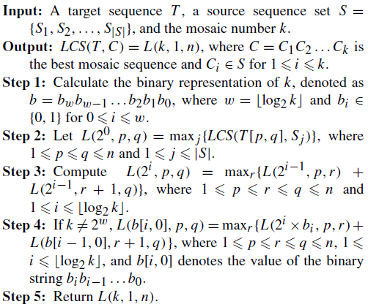




Method 2 : divide-and-conquer
$$O(\log_{2}{k})$$
$$O(n^{2}m|S|)$$
$$O(n^{3}\log{k})$$
$$O(n^{3}\log{k})$$
$$Time complexity:O(n^{2}m\left|S\right|+n^{3}\log{k})$$

Slide 12
Method 3 : S-table
 | T | A | C | A
T | 1 | 1 | 1 | 1
C | 1 | 1 | 2 | 2
A | 1 | 2 | 2 | 3
 | 1 | 2 | 3 | 4
0 | 1 | 2 | 2 | 3
1 | 0 | 1 | 1 | 2
2 | 0 | 0 | 1 | 2
3 | 0 | 0 | 0 | 1
 | A | C | A
T | 0 | 0 | 0
C | 0 | 1 | 1
A | 1 | 1 | 2
 | 1 | 2 | 3
0 | 1 | 2 | 4
1 | 2 | 4
2 | 3 | 4
3 | 4
 | C | A
T | 0 | 0
C | 1 | 1
A | 1 | 2
 | A
T | 0
C | 0
A | 1

Slide 13

Method 3
$$T=agactagtc$$
$$S=\left\{S_{1}=agc,S_{2}=act,S_{3}=aatg\right\}$$
$$V_{0}=(0)$$
$$V_{1}=minE\left\{\begin{aligned}\left(0,1,2,4\right) \\ \begin{aligned}\left(0,1,4,5\right) \\ \left(0,1,2,5,7\right)\end{aligned}\end{aligned}\right\}$$
$$=(0,1,2,4,7)$$
 | 1 | 2 | 3 | 1 | 2 | 3 | 1 | 2 | 3 | 4
0 | 1 | 2 | 4 | 1 | 4 | 5 | 1 | 2 | 5 | 7
1 | 2 | 4 | 9 | 3 | 4 | 5 | 2 | 5 | 7
2 | 3 | 4 | 9 | 3 | 4 | 5 | 3 | 5 | 7
3 | 4 | 7 | 9 | 4 | 5 |  | 5 | 7
4 | 6 | 7 | 9 | 5 | 8 |  | 5 | 7
5 | 6 | 7 | 9 | 6 | 8 |  | 6 | 7
6 | 7 | 9 |  | 8 |  |  | 7
7 | 7 | 9 |  | 8 |  |  | 8
8 | 8 | 9 |  | 9

Slide 14
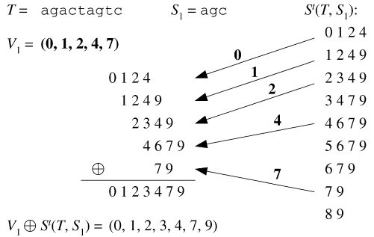

Method 3
$$T=agactagtc$$
$$S=\{S_{1}=agc,S_{2}=act,S_{3}=aatg\}$$
(0, 1, 2, 3, 4)
(0 1 2 3 4 5 6)

Slide 15
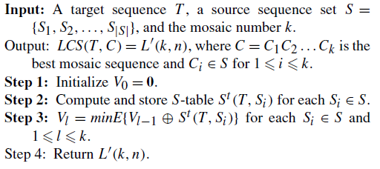


Method 3
$$O(nm|S|)$$
$$O(nk|S|)$$
$$Time complexity:O(n(m+k)\left|S\right|)$$

Slide 16

Obtain the sequence of LCS
$$if the k−mosaic sequence C and$$
$$its corresponding break point vector r of T is given,$$
$$the sequence of LCS\left(T,C\right)can be obtained in O\left(mn\right)time.$$

Slide 17
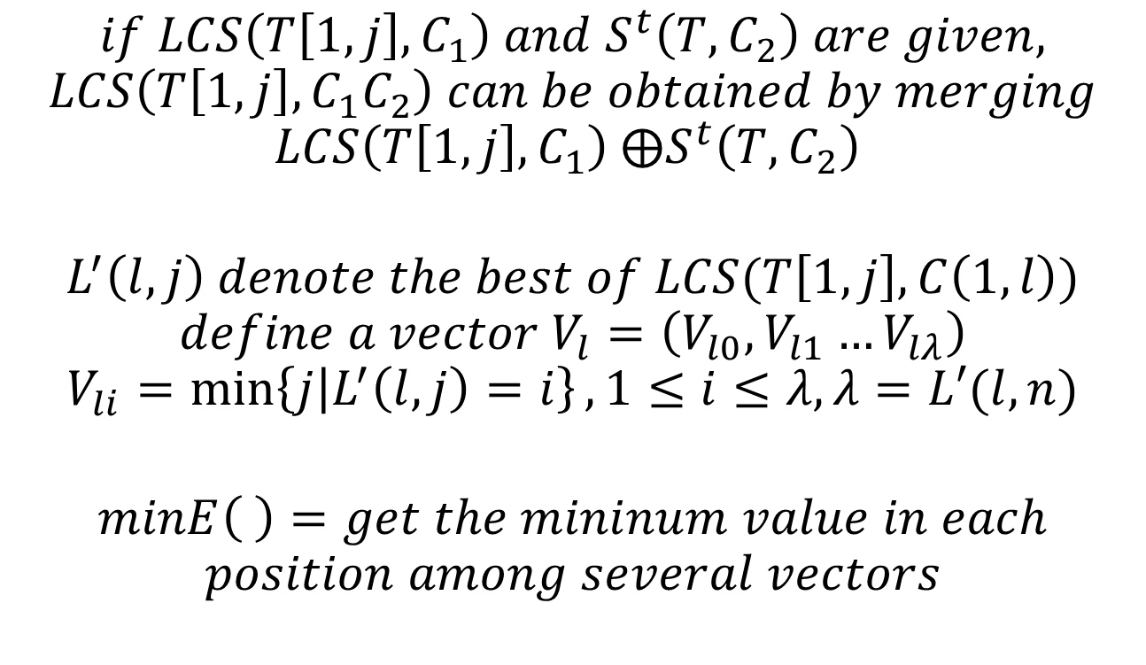
$$if LCS\left(T\left[1,j\right],C_{1}\right) and S^{t}\left(T,C_{2}\right) are given,$$
$$LCS\left(T\left[1,j\right],C_{1}C_{2}\right) can be obtained by merging$$
$$LCS\left(T\left[1,j\right],C_{1}\right) ⨁S^{t}\left(T,C_{2}\right)$$
$$L^{′}\left(l,j\right) denote the best of LCS(T\left[1,j\right],C\left(1,l\right))$$
$$define a vector V_{l}=\left(V_{l0},V_{l1}…V_{lλ}\right)$$
$$V_{li}=\min\left\{j | L^{′}\left(l,j\right)=i\right\}, 1≤i≤λ, λ=L′(l,n)$$
$$minE\left( \right)=get the mininum value in each$$
$$position among several vectors$$

