Slide 1
Efficient string-matching allowing for non-overlapping inversions
Domenico Cantone, Salvatore Cristofaro, Simone Faro
Theoretical Computer Science, Vol. 483, pp. 85–95 (2013)
Presenter: Tzu-Chiang Hsu (徐子強)
2015/09/15

Slide 2
Abstract (1/2)
Inversions are a class of chromosomal mutations, widely regarded as one of the major mechanisms for reorganizing the genome. In this paper we present a new algorithm for the approximate string matching problem allowing for non-overlapping inversions which runs in O(nm) worst-case time and O(m²) space, for a character sequence of size n and pattern of size m.

Slide 3
Abstract (2/2)
This improves upon a previous O(nm²)-time algorithm.
In addition we present a variant of our algorithm with the same complexity in the worst case, but with a O(n) time complexity in the average case.

Slide 4
reversal
=
non-overlapping inversion
attagcct
atcgatct

Slide 5
Approximate string matching problem
allowing for non-overlapping inversions
text:
pattern:
tttcgttg
ctttgt

Slide 6
R₀
tttcgttg
ctttgt
0 | 1 | 2 | 3 | 4 | 5
0 | 0 | 0 | 0 | 0 | 0
 | 1 | 1 | 4 | 1 | 1
 |  | 2

Slide 7
R₀
tttcgttg
ctttgt
0 | 1 | 2 | 3 | 4 | 5
0 | 0 | 0 | 0 | 0 | 0
 | 1 | 1 | 4 | 1 | 1
 |  | 2

Slide 8
R₀
tttcgttg
ctttgt
0 | 1 | 2 | 3 | 4 | 5
0 | 0 | 0 | 0 | 0 | 0
 | 1 | 1 | 4 | 1 | 1
 |  | 2

Slide 9
R₀
tttcgttg
ctttgt
0 | 1 | 2 | 3 | 4 | 5
0 | 0 | 0 | 0 | 0 | 0
 | 1 | 1 | 4 | 1 | 1
 |  | 2

Slide 10
R₀
tttcgttg
ctttgt
0 | 1 | 2 | 3 | 4 | 5
0 | 0 | 0 | 0 | 0 | 0
 | 1 | 1 | 4 | 1 | 1
 |  | 2

Slide 11
R₀
tttcgttg
ctttgt
0 | 1 | 2 | 3 | 4 | 5
0 | 0 | 0 | 0 | 0 | 0
 | 1 | 1 | 4 | 1 | 1
 |  | 2
R₁
tttcgttg
ctttgt
0 | 1 | 2 | 3 | 4 | 5
0 | 0 | 0 | 0 | 0 | 0
 |  | 3 |  | 2 | 1

Slide 12
R₀
tttcgttg
ctttgt
0 | 1 | 2 | 3 | 4 | 5
0 | 0 | 0 | 0 | 0 | 0
 | 1 | 1 | 4 | 1 | 1
 |  | 2
R₁
tttcgttg
ctttgt
0 | 1 | 2 | 3 | 4 | 5
0 | 0 | 0 | 0 | 0 | 0
 |  | 3 |  | 2 | 1
R₂
tttcgttg
ctttgt
0 | 1 | 2 | 3 | 4 | 5
0 | 0 | 0 | 0 | 0 | 0
 | 2 |  | 1 | 3 | 2

Slide 13
R₀
tttcgttg
ctttgt
0 | 1 | 2 | 3 | 4 | 5
0 | 0 | 0 | 0 | 0 | 0
 | 1 | 1 | 4 | 1 | 1
 |  | 2
R₁
tttcgttg
ctttgt
0 | 1 | 2 | 3 | 4 | 5
0 | 0 | 0 | 0 | 0 | 0
 |  | 3 |  | 2 | 1
R₂
tttcgttg
ctttgt
0 | 1 | 2 | 3 | 4 | 5
0 | 0 | 0 | 0 | 0 | 0
 | 2 |  | 1 | 3 | 2

Slide 14
R₀
tttcgttg
ctttgt
0 | 1 | 2 | 3 | 4 | 5
0 | 0 | 0 | 0 | 0 | 0
 | 1 | 1 | 4 | 1 | 1
 |  | 2
R₁
tttcgttg
ctttgt
0 | 1 | 2 | 3 | 4 | 5
0 | 0 | 0 | 0 | 0 | 0
 |  | 3 |  | 2 | 1
R₂
tttcgttg
ctttgt
0 | 1 | 2 | 3 | 4 | 5
0 | 0 | 0 | 0 | 0 | 0
 | 2 |  | 1 | 3 | 2

Slide 15
R₀
tttcgttg
ctttgt
0 | 1 | 2 | 3 | 4 | 5
0 | 0 | 0 | 0 | 0 | 0
 | 1 | 1 | 4 | 1 | 1
 |  | 2
R₁
tttcgttg
ctttgt
0 | 1 | 2 | 3 | 4 | 5
0 | 0 | 0 | 0 | 0 | 0
 |  | 3 |  | 2 | 1
R₂
tttcgttg
ctttgt
0 | 1 | 2 | 3 | 4 | 5
0 | 0 | 0 | 0 | 0 | 0
 | 2 |  | 1 | 3 | 2

Slide 16
DPInversionMatcher(p,m,t,n)
1. for j := 0 to m-1 do
R[j] := {0}
for i := -m+1 to n-m do
M := {-1}
5. for j:= max(-i,0) to m-1 do
R[j] := {0}∪{l+1: l∈R[j]\{j+1} AND
p[j-l] = t[i+j]}
7. if (∃l ∈ R[j]: j-l ∈ M) then
8. M := M∪{j}
9. if (m-1 ∈ M) then
10. output(i)

Slide 17
tttcgttg
ctttgt
R ₀
tttcgttg
ctttgt
R₋₁
tttcgttg
ctttgt
R₋₂
tttcgttg
ctttgt
R₋₃
tttcgttg
ctttgt
R₋₄
tttcgttg
ctttgt
R₋₅

Slide 18
tccgtcgtc
ctctgctgc
tccgtcgtc
ctctgctgc
tccgtcgtc
ctctgctgc

Slide 19
cgtcgtc
ctgctgc
cgtc
ctgc
c
c

Slide 20
Morris-Pratt Algorithm
tgtgttgtg
01231234

Slide 21
0
tgtgttgtg
tgtgttgtg

Slide 22
01
tgtgttgtg
tgtgttgtg

Slide 23
012
tgtgttgtg
tgtgttgtg

Slide 24
0123
tgtgttgtg
tgtgttgtg

Slide 25
0123
tgtgttgtg
tgtgttgtg

Slide 26
0123
tgtgttgtg
tgtgttgtg

Slide 27
01231
tgtgttgtg
tgtgttgtg

Slide 28
01231234
tgtgttgtg
tgtgttgtg

Slide 29
cgtcgtc
ctgctgc
ctgctgc
001234
cgtc
ctgc
ctgc
001
c
c

Slide 30
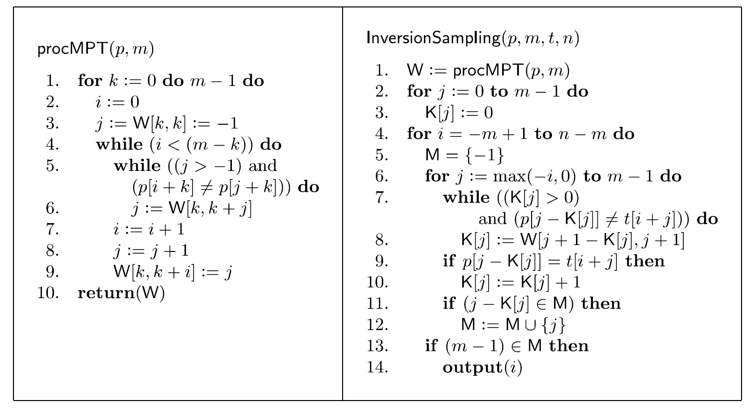
O(m²)
O(nm)

Slide 31
R₀
tttcgttg
ctttgt
0 | 1 | 2 | 3 | 4 | 5
0 | 0 | 0 | 0 | 0 | 0
 | 1 | 1 | 4 | 1 | 1
 |  | 2
R₁
tttcgttg
ctttgt
0 | 1 | 2 | 3 | 4 | 5
0 | 0 | 0 | 0 | 0 | 0
 |  | 3 |  | 2 | 1
R₂
tttcgttg
ctttgt
0 | 1 | 2 | 3 | 4 | 5
0 | 0 | 0 | 0 | 0 | 0
 | 2 |  | 1 | 3 | 2

Slide 32
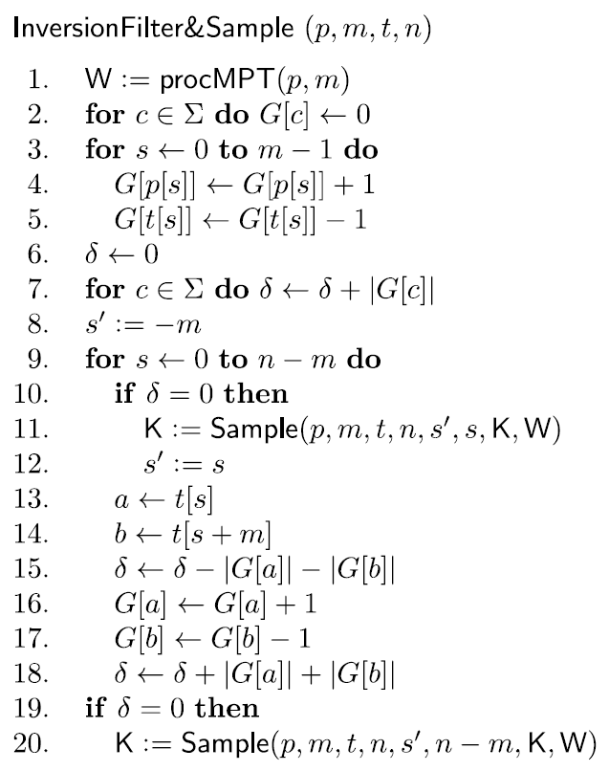
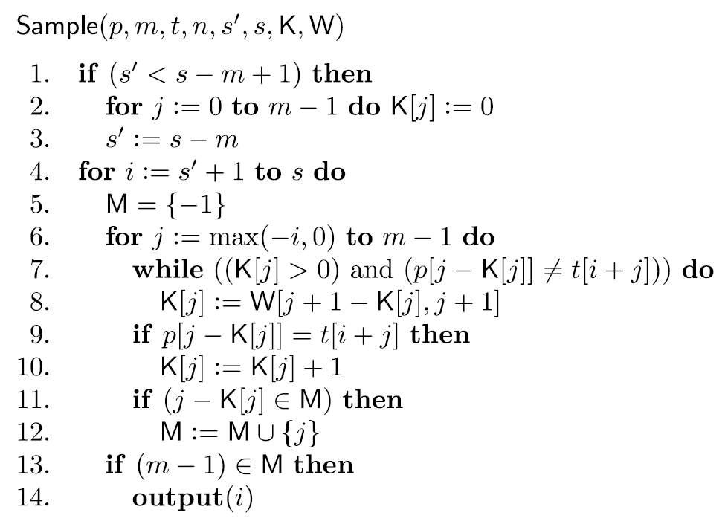

Slide 33
tttcgttg
ctttgt
R ₀
tttcgttg
ctttgt
R₋₁
tttcgttg
ctttgt
R₋₂
tttcgttg
ctttgt
R₋₃
tttcgttg
ctttgt
R₋₄
tttcgttg
ctttgt
R₋₅

Slide 34
O(n)avg.-case
O(m²)
probability: O(m⁻²)

Slide 35
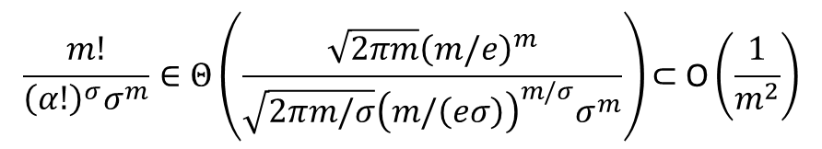
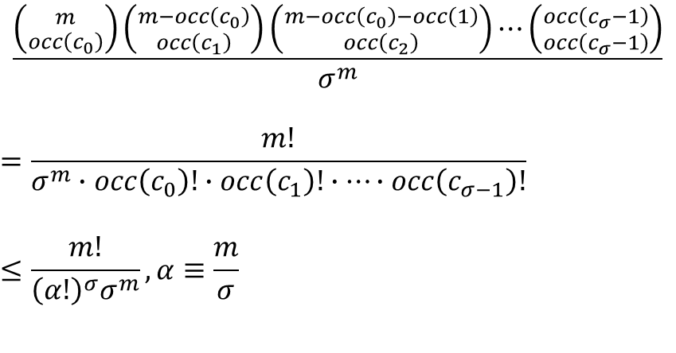
Sufficient large pattern size m>σ^{c},
alphabet size σ≥5c/(c-1), c>1.
$$\frac{\left({m \atop occ\left(c_{0}\right)}\right)\left({m−occ\left(c_{0}\right) \atop occ\left(c_{1}\right)}\right)\left({m−occ\left(c_{0}\right)−occ\left(1\right) \atop occ\left(c_{2}\right)}\right)⋯\left({occ\left(c_{σ}−1\right) \atop occ\left(c_{σ}−1\right)}\right)}{σ^{m}}$$
$$=\frac{m!}{σ^{m}∙occ\left(c_{0}\right)!∙occ\left(c_{1}\right)!∙⋯∙occ\left(c_{σ−1}\right)!}$$
$$≤\frac{m!}{{{\left(α!\right)}^{σ}σ}^{m}}, α≡\frac{m}{σ}$$
$$\frac{m!}{{{\left(α!\right)}^{σ}σ}^{m}}∈Θ\left(\frac{\sqrt{2πm}{\left(m/e\right)}^{m}}{\sqrt{2πm/σ}{\left(m/\left(eσ\right)\right)}^{m/σ}σ^{m}}\right)\text{⊂} \text{O}\left(\frac{1}{m^{2}}\right)$$

