Slide 1
Efficient Dominant Point Algorithms for the Multiple Longest Common Subsequence (MLCS) Problem
Qingguo Wang, Dmitry Korkin and Yi Shang
Proceedings of the 21st International Joint Conference on Artificial Intelligence, 2009 pp.1494-1499
Presenter: Bi-Shiang Lin
Date:2015/10/7

Slide 2
Abstract(1/3)
Finding the longest common subsequence of multiple strings is a classical computer science problem and has many applications in the areas of bioinformatics and computational genomics. In this paper, we present a new sequential algorithm for the general case of MLCS problem, and its parallel realization.

Slide 3
Abstract(2/3)
The algorithm is based on the dominant point approach and employs a fast divide-and-conquer technique to compute the dominant points. When applied to find a MLCS of 3 strings, our general algorithm is shown to exhibit the same performance as the best existing MLCS algorithm by Hakata and Imai, designed specifically for the case of 3 strings.

Slide 4
Abstract(3/3)
Moreover, we show that for a general case of more than 3 strings, the algorithm is significantly faster than the best existing sequential approaches, reaching up to 2-3 orders of magnitude faster on the large-size problems. Finally, we propose a parallel implementation of the algorithm. Evaluating the parallel algorithm on a benchmark set of both random and biological sequences reveals a near-linear speed-up with respect to the sequential algorithm.

Slide 5

The LCS Problem
Sequence $X$: ATTGCCA
Sequence $Y$: TAGAC
Common Subsequence : TA、TGC、AC …
Longest Common Subsequence : AGC、TGA …

Slide 6

The MLCS Problem
Input : $S_{1}=ATTATC$
$S_{2}=GTTACA$
$S_{3}=ATACCA$
Output : $S=TAC$

Slide 7
Dominant-Point Method
 |  | G | T | A | A | T | C | T | A | A | C
 | 0 | 0 | 0 | 0 | 0 | 0 | 0 | 0 | 0 | 0 | 0
G | 0 | 1 | 1 | 1 | 1 | 1 | 1 | 1 | 1 | 1 | 1
A | 0 | 1 | 1 | 2 | 2 | 2 | 2 | 2 | 2 | 2 | 2
T | 0 | 1 | 2 | 2 | 2 | 3 | 3 | 3 | 3 | 3 | 3
T | 0 | 1 | 2 | 2 | 2 | 3 | 3 | 4 | 4 | 4 | 4
A | 0 | 1 | 2 | 3 | 3 | 3 | 3 | 4 | 5 | 5 | 5
C | 0 | 1 | 2 | 3 | 3 | 3 | 4 | 4 | 5 | 5 | 6
A | 0 | 1 | 2 | 3 | 4 | 4 | 4 | 4 | 5 | 6 | 6

Slide 8
Dominant-Point Method
 |  | G | T | A | A | T | C | T | A | A | C
 | 0 | 0 | 0 | 0 | 0 | 0 | 0 | 0 | 0 | 0 | 0
G | 0 | 1 | 1 | 1 | 1 | 1 | 1 | 1 | 1 | 1 | 1
A | 0 | 1 | 1 | 2 | 2 | 2 | 2 | 2 | 2 | 2 | 2
T | 0 | 1 | 2 | 2 | 2 | 3 | 3 | 3 | 3 | 3 | 3
T | 0 | 1 | 2 | 2 | 2 | 3 | 3 | 4 | 4 | 4 | 4
A | 0 | 1 | 2 | 3 | 3 | 3 | 3 | 4 | 5 | 5 | 5
C | 0 | 1 | 2 | 3 | 3 | 3 | 4 | 4 | 5 | 5 | 6
A | 0 | 1 | 2 | 3 | 4 | 4 | 4 | 4 | 5 | 6 | 6

Slide 9
Dominant-Point Method
 |  | G | T | A | A | T | C | T | A | A | C
 | 0
G
A
T
T
A
C
A

Slide 10
Dominant-Point Method
 |  | G | T | A | A | T | C | T | A | A | C
 | 0
G |  | 1
A |  |  |  | 1
T |  |  | 1
T
A
C |  |  |  |  |  |  | 1
A

Slide 11
Dominant-Point Method
 |  | G | T | A | A | T | C | T | A | A | C
 | 0
G |  | 1
A
T
T
A
C
A

Slide 12
Dominant-Point Method
 |  | G | T | A | A | T | C | T | A | A | C
 | 0
G |  | 1
A |  |  |  | 2
T |  |  | 2
T
A
C |  |  |  |  |  |  | 2
A

Slide 13
Dominant-Point Method
 |  | G | T | A | A | T | C | T | A | A | C
 | 0
G |  | 1
A |  |  |  | 2
T |  |  | 2
T
A
C
A

Slide 14
Dominant-Point Method
 |  | G | T | A | A | T | C | T | A | A | C
 | 0
G |  | 1
A |  |  |  | 2
T |  |  | 2 |  |  | 3
T |  |  |  |  |  | 3
A |  |  |  | 3 | 3
C |  |  |  |  |  |  | 3
A

Slide 15
Dominant-Point Method
 |  | G | T | A | A | T | C | T | A | A | C
 | 0
G |  | 1
A |  |  |  | 2
T |  |  | 2 |  |  | 3
T
A |  |  |  | 3
C
A

Slide 16
Dominant-Point Method
 |  | G | T | A | A | T | C | T | A | A | C
 | 0
G |  | 1
A |  |  |  | 2
T |  |  | 2 |  |  | 3
T |  |  |  |  |  |  |  | 4
A |  |  |  | 3 |  |  |  |  | 5
C |  |  |  |  |  |  | 4 |  |  |  | 6
A |  |  |  |  | 4 |  |  |  |  | 6

Slide 17
T-table
 | 0 | 1 | 2 | 3 | 4 | 5 | 6 | 7 | 8 | 9 | 10
 |  | G | T | A | A | T | C | T | A | A | C
 |  | G | A | T | T | A | C | A
A | 3 | 3 | 3 | 4 | 8 | 8 | 8 | 8 | 9 | 11 | 11
 | 2 | 2 | 5 | 5 | 5 | 7 | 7 | 8
T | 2 | 2 | 5 | 5 | 5 | 7 | 7 | 11 | 11 | 11 | 11
 | 3 | 3 | 3 | 4 | 8 | 8 | 8 | 8
C | 6 | 6 | 6 | 6 | 6 | 6 | 10 | 10 | 10 | 10 | 11
 | 6 | 6 | 6 | 6 | 6 | 6 | 8 | 8
G | 1 | 11 | 11 | 11 | 11 | 11 | 11 | 11
 | 1 | 8 | 8 | 8 | 8 | 8 | 8 | 8

Slide 18
Dominant-Point Method
 |  | G | T | A | A | T | C | T | A | A | C
 | 0
G |  | 1
A |  |  |  | 2
T |  |  | 2
T
A
C
A

Slide 19
T-table
 | 0 | 1 | 2 | 3 | 4 | 5 | 6 | 7 | 8 | 9 | 10
 |  | G | T | A | A | T | C | T | A | A | C
 |  | G | A | T | T | A | C | A
A | 3 | 3 | 3 | 4 | 8 | 8 | 8 | 8 | 9 | 11 | 11
 | 2 | 2 | 5 | 5 | 5 | 7 | 7 | 8
T | 2 | 2 | 5 | 5 | 5 | 7 | 7 | 11 | 11 | 11 | 11
 | 3 | 3 | 3 | 4 | 8 | 8 | 8 | 8
C | 6 | 6 | 6 | 6 | 6 | 6 | 10 | 10 | 10 | 10 | 11
 | 6 | 6 | 6 | 6 | 6 | 6 | 8 | 8
G | 1 | 11 | 11 | 11 | 11 | 11 | 11 | 11
 | 1 | 8 | 8 | 8 | 8 | 8 | 8 | 8

Slide 20
Dominant-Point Method
 |  | G | T | A | A | T | C | T | A | A | C
 | 0
G |  | 1
A |  |  |  | 2
T |  |  | 2 |  |  | 3
T
A |  |  |  |  | 3
C |  |  |  |  |  |  | 3
A

Slide 21
Dominant-Point Method
A |  | A | T | T | A | C
 | 0 | 0 | 0 | 0 | 0 | 0
C | 0
A | 0
A | 0
T | 0
C | 0
T |  | A | T | T | A | C
 | 0 | 0 | 0 | 0 | 0 | 0
C
A
A
T
C
T |  | A | T | T | A | C
 | 0 | 0 | 0 | 0 | 0 | 0
C | 0
A | 0
A | 0
T | 0
C | 0
C |  | A | T | T | A | C
 | 0 | 0 | 0 | 0 | 0 | 0
C | 0
A | 0
A | 0
T | 0
C | 0

Slide 22
Dominant-Point Method
A |  | A | T | T | A | C
 | 0 | 0 | 0 | 0 | 0 | 0
C | 0
A | 0
A | 0
T | 0
C | 0
T |  | A | T | T | A | C
 | 0 | 0 | 0 | 0 | 0 | 0
C
A
A
T
C
T |  | A | T | T | A | C
 | 0 | 0 | 0 | 0 | 0 | 0
C | 0
A | 0
A | 0
T | 0
C | 0
C |  | A | T | T | A | C
 | 0 | 0 | 0 | 0 | 0 | 0
C | 0
A | 0
A | 0
T | 0
C | 0

Slide 23
Dominant-Point Method
A |  | A | T | T | A | C
 | 0 | 0 | 0 | 0 | 0 | 0
C | 0
A | 0 | 1
A | 0
T | 0
C | 0
T |  | A | T | T | A | C
 | 0 | 0 | 0 | 0 | 0 | 0
C
A
A
T
C
T |  | A | T | T | A | C
 | 0 | 0 | 0 | 0 | 0 | 0
C | 0
A | 0
A | 0
T | 0
C | 0
C |  | A | T | T | A | C
 | 0 | 0 | 0 | 0 | 0 | 0
C | 0 |  |  |  |  | 1
A | 0
A | 0
T | 0
C | 0

Slide 24
Dominant-Point Method
A |  | A | T | T | A | C
 | 0 | 0 | 0 | 0 | 0 | 0
C | 0
A | 0 | 1
A | 0
T | 0
C | 0
T |  | A | T | T | A | C
 | 0 | 0 | 0 | 0 | 0 | 0
C
A
A
T |  |  | 2
C
T |  | A | T | T | A | C
 | 0 | 0 | 0 | 0 | 0 | 0
C | 0
A | 0
A | 0
T | 0
C | 0
C |  | A | T | T | A | C
 | 0 | 0 | 0 | 0 | 0 | 0
C | 0 |  |  |  |  | 1
A | 0
A | 0
T | 0
C | 0

Slide 25
Dominant-Point Method
A |  | A | T | T | A | C
 | 0 | 0 | 0 | 0 | 0 | 0
C | 0
A | 0 | 1
A | 0
T | 0
C | 0
T |  | A | T | T | A | C
 | 0 | 0 | 0 | 0 | 0 | 0
C
A
A
T |  |  | 2
C
T |  | A | T | T | A | C
 | 0 | 0 | 0 | 0 | 0 | 0
C | 0
A | 0
A | 0
T | 0
C | 0
C |  | A | T | T | A | C
 | 0 | 0 | 0 | 0 | 0 | 0
C | 0 |  |  |  |  | 1
A | 0
A | 0
T | 0
C | 0 |  |  |  |  | 3

Slide 26
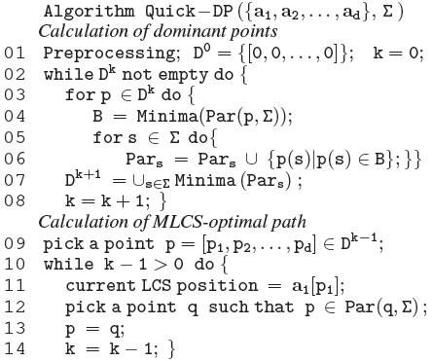

Dominant-Point Method
$$Minima\left(\right)=O(dN{(log{n)}}^{d−2})$$
$$O(n|∑|d+\left|D\right||∑|d({\left(\log{n}\right)}^{d−2}n+{\left(\log{n}\right)}^{d−2}|∑|))$$

Slide 27
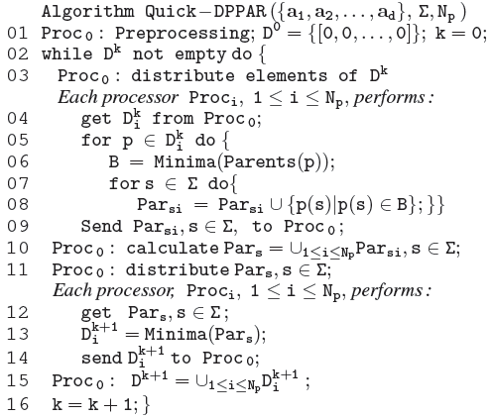
Parallel Algorithm

Slide 28
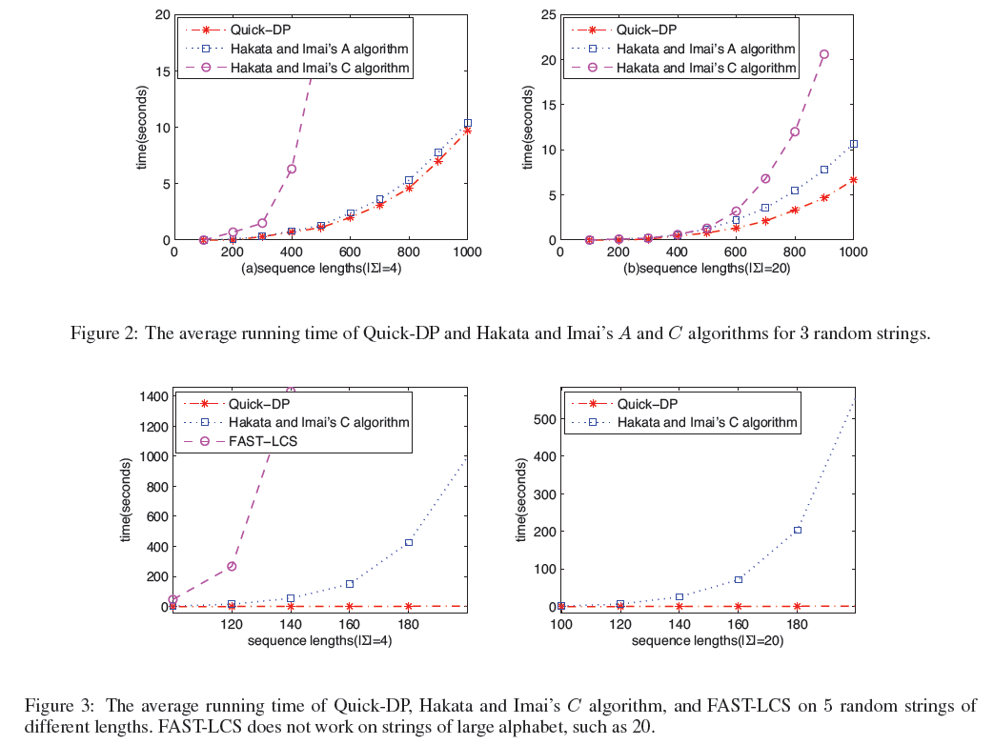
Experimental Results

Slide 29
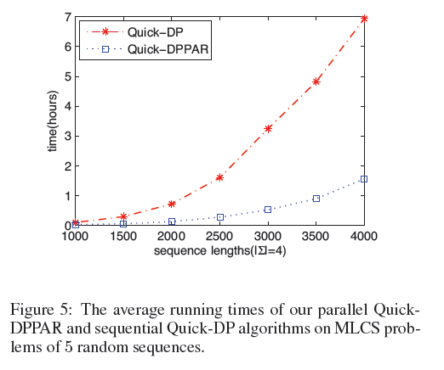
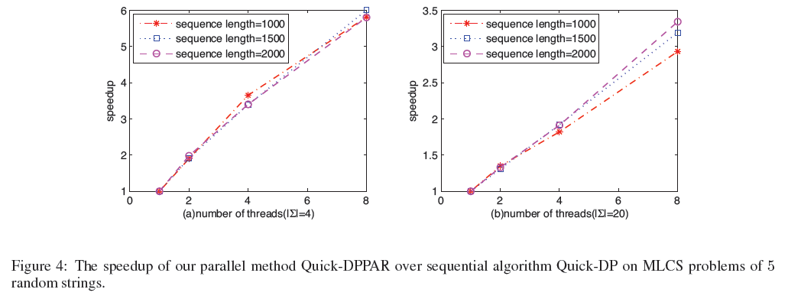
Experimental Results

