Slide 1
Arc-Segment Alignment for RNA Secondary Structure
指導教授：楊昌彪
學生姓名：彭永興

Slide 2
The Longest Common Subsequence (LCS) Problem
A string : S₁ = “TAGTCACG”
A subsequence of S₁ : deleting 0 or more symbols from S₁ (not necessarily consecutive).
e.g. G, AGC, TATC, AGACG
Common subsequences of S₁ = “TAGTCACG” and S₂ = “AGACTGTC” :
GG, AGC, AGACG
Longest common subsequence (LCS) :
S₁: TAGTCACG
S₂: AGACTGTC
LCS: AGACG

Slide 3
Sequence Alignment
S₁ = TAGTCACG
S₂ = AGACTGTC
⇒
----TAGTCACG TAGTCAC-G--
AGACT-GTC--- -AG--ACTGTC
Which one is better?
We can set different gap penalties as parameters for different purposes.

Slide 4
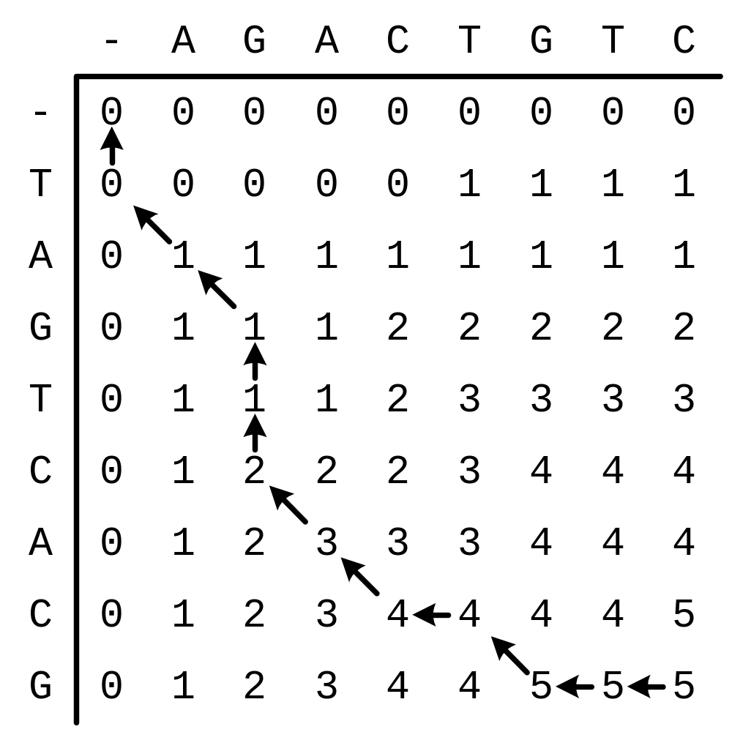
TAGTCACG
AGACTGTC
LCS:AGACG
After matrix A has been found, we can trace back to find the LCS.

Slide 5
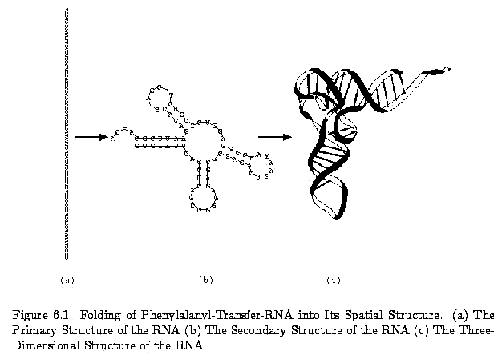
The Structure of RNA

Slide 6
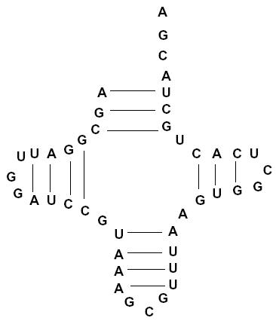
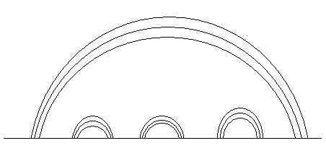
Arc Annotation for RNA Secondary Structure

Slide 7
How to Compare two RNA Secondary Structure
Longest Arc-Preserving Common Subsequence
→O(n⁵) for LAPCS(nested, nested)
  LAPCS(crossing, crossing) is NP-Hard
Arc-Segment Alignment (Our Method)
→O(n²) for ASA(nested, nested)
ASA(crossing,crossing) may be solved in polynomial time

Slide 8
Our Comparison Algorithm
(1)Given two RNA 2nd structure S1,S2 with length m and n, find the “Sequence of Arc segment” A1 from S1, A2 from S2
(2)Solve the Alignment for A1,A2 using the Arc-segment alignment
(3)From the answer, we known how to deal with the arc parts, then we know how to deal with the other parts of the RNA sequence

Slide 9
Arc-Segment Alignment
ASA checks “if the segment match”, not like original LCS which checks if the character match. Therefore, we need a threshold to define what the “match” means
To check if two segments are matched
→Arc Size + Arc location + Sub-ASA(recursive)
ASA would perform simple sequence alignment if one of the RNA sequence does not contain any arcs

Slide 10
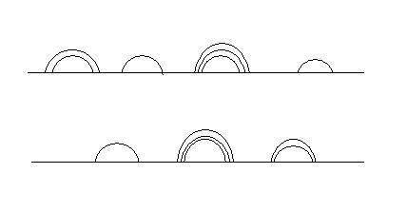
Example for ASA(nested, nested) part1
G
T
A
A
T
A
G

Slide 11
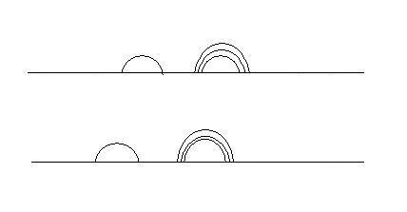
Example for ASA(nested, nested) part2
T
A
1
2
3
T
A
1
2
3
Perform Original Sequence Alignment for 1 2 3 segments

Slide 12
Advantage of ASA
Time complexity is only O(n2) if we want to solve nested-nested comparison
It emphasizes on the arcs, so it can reflect more structure similarity than LAPCS
It may solve crossing-crossing comparison in polynomial time if being correctly modified
It is reflexible because we can set different threshold and different weight for score factor

