Slide 1
A Data Mining Method to Predict Transcriptional Regulatory Sites Based On Differentially Expressed Genes in Human Genome
HSIEN-DA HUANG, HUEI-LINA and TSUNG-SHAN TSOU
JOURNAL OF INFORMATION SCIENCE AND ENGINEERING 19,923-942(2003)

Slide 2
1. ABSTRACT
Very large-scale gene expression analysis, i.e., UniGene and dbEST, is provided to find those genes with significantly differential expression in specific tissues. The differentially expressed genes in a specific tissue are potentially regulated concurrently by a combination of transcription factors. This study attempts to mine putative binding sites on how combinations of the known regulatory sites homologs and over-represented repetitive elements are distributed in the promoter regions of considered groups of differentially expressed genes.

Slide 3
ABSTRACT(cont.)
We propose a data mining approach to statistically discover the significantly tissue-specific combinations of known site homologs and over-represented repetitive sequences, which are distributed in the promoter regions of differentially gene groups. The association rules mined would facilitate to predict putative regulatory elements and identify genes potentially co-regulated by the putative regulatory elements.

Slide 4
2. METHODS
Observe genes with highly and differentially expression in the same tissues, while they are not in other tissues by calculating the R statistic and P_{AC} values from gene expression data partitioned into different tissue categories.

Slide 5
METHODS(cont.)
Mine the association rules in the combinations of the known site homologs and over-represented repetitive oligonucleotides.
A Chi-square test is then applied to select certain significant rules.
Finally, the over-represented repetitive oligonucleotides in the association rules are candidates of putative regulatory elements

Slide 6
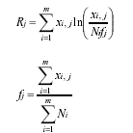
Differentially Gene Expression
R value

Slide 7
Differentially Gene Expression(cont.)
m is the number of cDNA libraries,
xi,j is the umber of transcript copies of gene j in the ith library
Ni is the total number of cDNA clones sequenced in the ith library.
The frequency fj is gene transcript copies of gene j in the ith library over all libraries

Slide 8

Example for R value

Slide 9

Differentially Gene Expression
(cont.)
P_{AC} value

Slide 10

Example for P_{AC} value

Slide 11
Detecting Over-represented Repetitive Oligonucleotide
Z-score & sig coefficient
The repetitive oligonucleotides, which are with significant values exceeding the threshold, are selected as significant over-represented ones.

Slide 12
Mining Sites Associations and Pruning
An association rule is an expression of the form A=>B, where A and B are the sets of items.
The Chi-square test ( χ2) is a widely used method for testing the independence and (or) correlation, and is applied to discover the significant associations rules

Slide 13
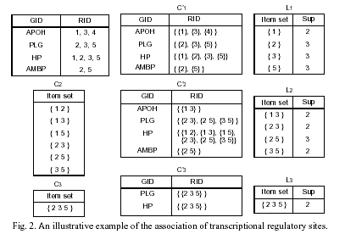

Slide 14
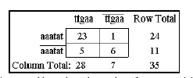
Example for Chi-square test
The two oligonucleotides,“aaatat” and ”ttgaa”, occur concurrently in 23 gene promoter regions of 35 genes

Slide 15
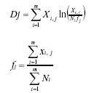
Tissue-specific Combinations
The greater D-value is in different tissues, the more tissue-specific the combination among the select tissues is.

Slide 16
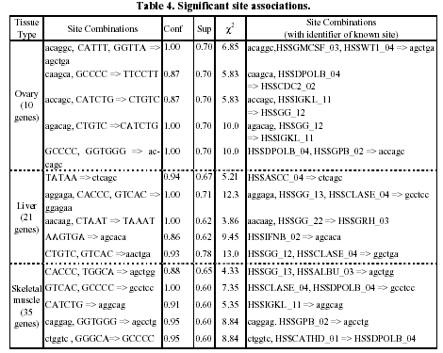

Slide 17
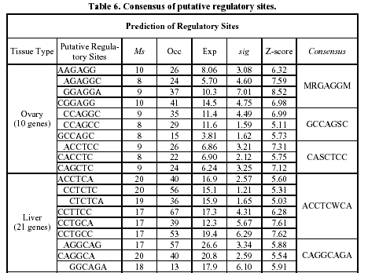

Slide 18
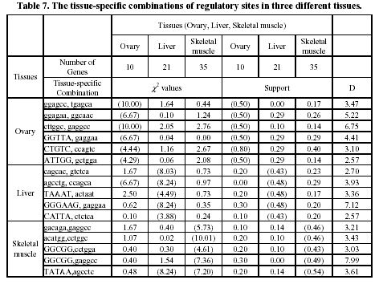

Slide 19
DISCUSSION
The thresholds of approaches like R-value, p-value, and D-value can also be adjusted when analyzing and studying different set of tissues.
By considering the occurrence associations of known sites and repetitive sequences, the repetitive sequences can be viewed as putative regulatory signals correlated to the known site homologs. However, we find several associations that do not have any known Site homologs.

Slide 20
Created by : Huei-Ming Yang
Date: Feb. 18,2004

