Slide 1
CLUSTAL W: improving the sensitivity of progressive multiple sequence alignment through sequence weighting, position-specific gap penalties and weight matrix choice
Julie D.Thompson, Desmond G.Higgins and Toby J.Gibson
Nucleic Acids Research, 1994, Vol. 22, No. 22, pp. 4673-4680
Advisor: Prof. Chang-Biau Yang
Speaker: Liang-Tai Wei

Slide 2
ABSTRACT
The sensitivity of the commonly used progressive multiple sequence alignment method has been greatly improved for the alignment of divergent protein sequences. Firstly, individual weights are assigned to each sequence in a partial alignment in order to down-weight near-duplicate sequences and up-weight the most divergent ones. Secondly, amino acid substitution matrices are varied at different alignment stages according to the divergence of the sequences to be aligned. Thirdly, residue-specific gap penalties and locally reduced gap penalties in hydrophilic regions encourage new gaps in potential loop regions rather than regular secondary structure. Fourthly, positions in early alignments where gaps have been opened receive locally reduced gap penalties to encourage the opening up of new gaps at these positions. These modifications are incorporated into a new program, CLUSTAL W which is freely available.

Slide 3
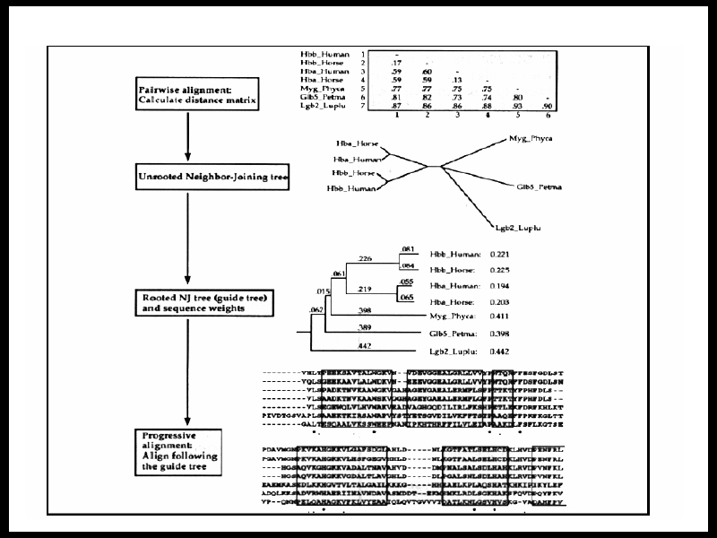

Slide 4
Algorithm of Clustal W Part 1
Progressive approach (漸進式之方法）
1. Pairwise alignment using
  1.1 the full mode, which utilizes dynamic programming with the affine gap penalties, i.e. opening (GOP) and extending (GEP).
  1.2 the fast mode. Parameters such as ktup, window size etc must be set. (not described in paper)
2. Calculate distance of all pairs of Sequences.
Distance = 1 – percent identity
3. Distance matrix construction using the pairwise alignment of all pairs of sequences.

Slide 5
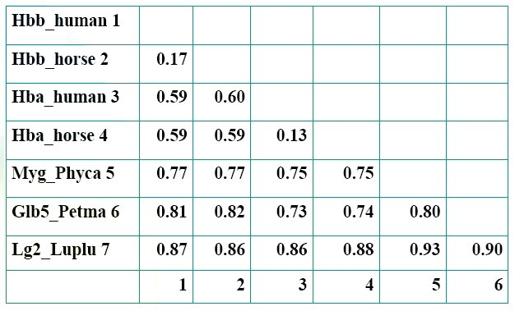
Distance Matrix of a set of globins

Slide 6
Algorithm of Clustal W Part 2
4. Guide tree construction
  4.1 UPGMA – unwighted pair-group method with arithmetic mean (old version)
  4.2 Neighbor-joining method + mid point method (new version)
    Neighbor-joining method >> Unrooted guide tree
    Mid point method >> Rooted guide tree

Slide 7
Guide Tree : mid-point method
Determine the branch length using the topology of the un-rooted tree, the distance matrix and the linear algebra.
For every internal node in the un-rooted tree, bisect the tree into left tree and right tree. The total distance of the sequences to this internal node is then calculated.
The real node of the tree can be inferred from above information.

Slide 8
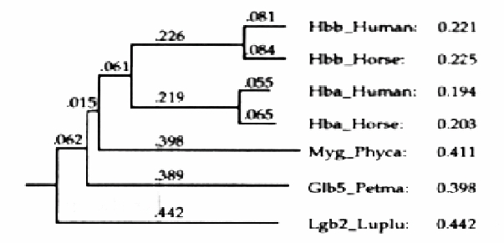
A rooted tree with branch lengths
Branch lengths determines weights for each sequence.
The most divergent sequence receives the highest weights.

Slide 9
Algorithm of Clustal W Part 3
5. Progressive alignment
  Align the sequences following the branching order of the guide tree, from the tips of the tree toward the root
  sequence is weighted during alignment
6. Heuristic on gaps
  short stretches of hydrophilic residues usually indicate loop or random coil region and are unlikely to have gaps
  GOP and GEP is determined on lots of heuristic factors, e.g. where there existing gaps in the neigborhood.

Slide 10
Thanks.

