Slide 1
DPS: Dynamic priority scheduling heuristic for heterogeneous computing systems
IEE Proceedings online1998
I.Ahmad
M.K.Dhodhi
R.UI-Mustafa
Jian-Fu Dong

Slide 2
Abstract(1)
Scheduling a parallel program is a crucial step in effectively harnessing the computing power of a heterogeneous computing system. Obtaining a minimum finish time schedule for a set of precedence constrained tasks is a well known NP-Complete problem. Heterogeneity in parallel systems introduces an additional degree of complexity to the scheduling problem i.e. varying speed of processors. A non-preemptive, compile-time scheduling heuristic has been developed, designated as DPS, that uses dynamic priorities based on the difference between b-level and t-level to map and schedule directed acyclic graphs (DAGs) onto heterogeneous processors, with the objective of minimizing the schedule length.

Slide 3
Abstract(2)
In the case of homogeneous processors, as each task has a different execution cost on each processor, the b-level and t-level lose their traditional meaning. The b-level and t-level have been computed in a different and effective way that captures the changes which occurred in the DAG during scheduling. Dynamic priorities are thus determined during the scheduling process in order to avoid scheduling less important tasks before the more important ones. Moreover, the effect of changing the task execution cost to compute the b-level and t-level has also been studied. The effectiveness of the algorithm is demonstrated by comparing it against two of the existing closely related algorithms for randomly generated graphs. DPS outperforms both algorithms by a considerable margin and has a reasonable time complexity

Slide 4
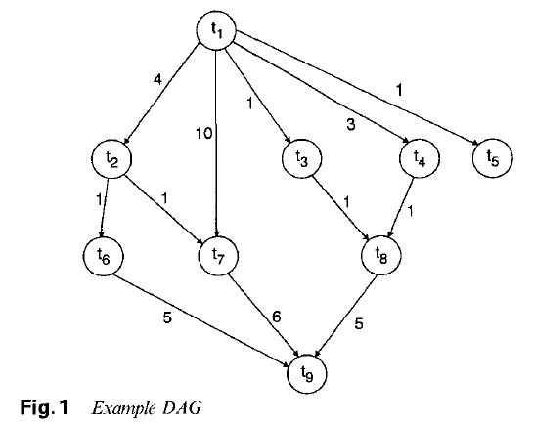
Problem statement(1)

Slide 5
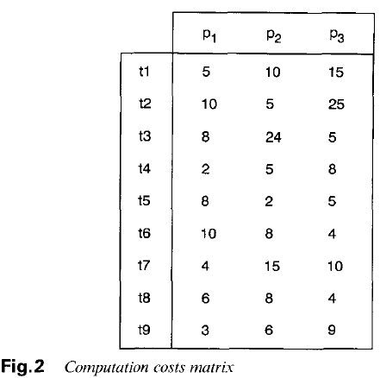
Problem statement(2)

Slide 6
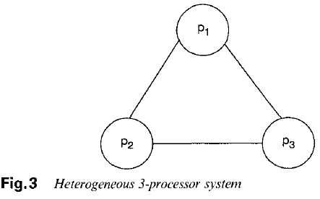
Problem statement(3)

Slide 7
Definition(1)
T-level (TL) of a task : the length of the longest path (execution cost + communication cost) between this task and an entry tansk in the DAG.
B-level (BL) : is bounded by the critical path of the DAG.

Slide 8



Definition(2)

Slide 9
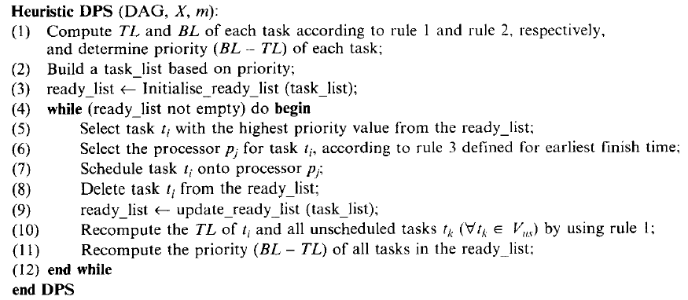
DPS’ algorithm

Slide 10
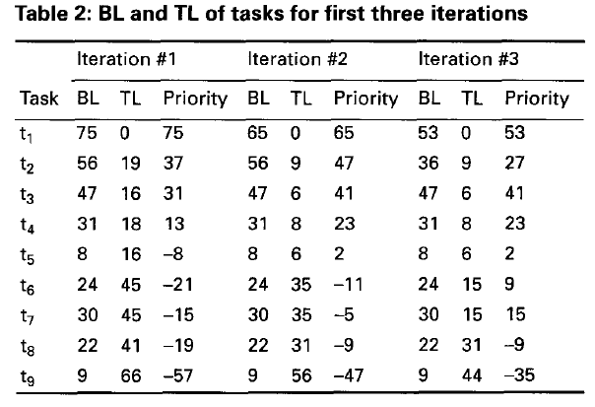
Example

Slide 11
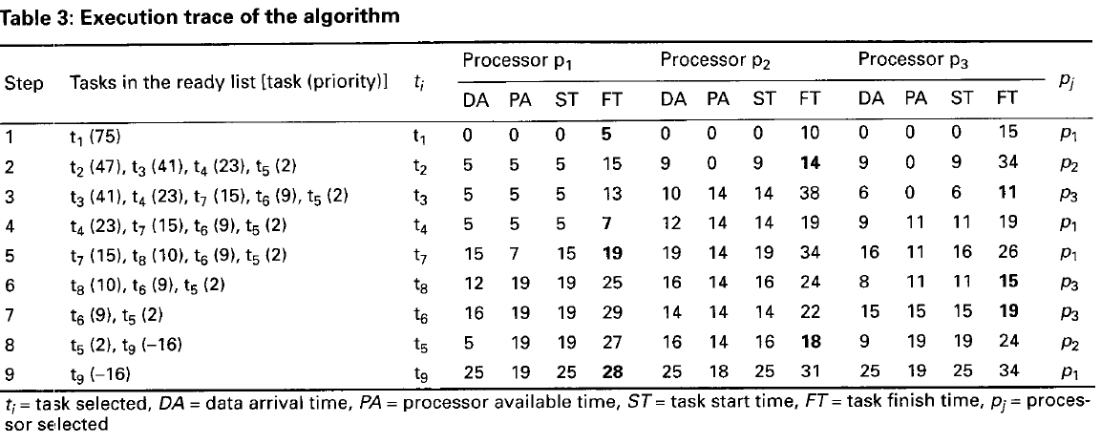
Example

Slide 12
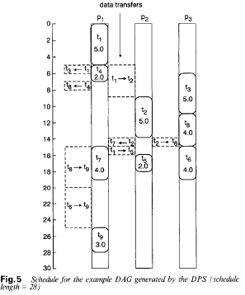
Example

Slide 13
Time Complexity
Calculation of BL,TL of all task:
Search for a best processor having the EFT costs :
Repeated n steps :

