Slide 1
An Adaptive and Iterative Approach for Multiple Sequence Alignment
Yi Wang and Kuo-Bin Li
Computational Biology and Chemistry,
vol.28, pp. 141–148, 2004

Slide 2
Abstract
Multiple sequence alignment is a basic tool in computational
genomics. The art of multiple sequence alignment is about
placing gaps. This paper presents a heuristic algorithm that
improves multiple protein sequences alignment iteratively. A
consistency-based objective function is used to evaluate the
candidate moves. During the iterative optimization, well-aligned
regions can be detected and kept intact. Columns of gaps will be
inserted to assist the algorithm to escape from local optimal
alignments.

Slide 3
Abstract
The algorithm has been evaluated using the BaliBASE
(benchmark alignment database ). Results show that the
performance of the algorithm does not depend on initial or seed
alignments much. Given a perfect consistency library, the
algorithm is able to produce alignments that are close to the global
optimum. We demonstrate that the algorithm is able to refine
alignments produced by other software, including ClustalW,
SAGA and T-COFFEE. The program is available upon request.

Slide 4
Progressive Vs Iterative
Progressive approach:
  Builds up alignment gradually
  Unable to adjust previous alignment
Iterative approach:
  Based on an initial solution, it attempts to improve alignment iteratively

Slide 5
AIMSA features
Our algorithm, adaptive iterative multiple sequence alignment (AIMSA), has been demonstrated to be able to produce high quality alignments consistently using BAliBASE .
Obtains initial solution from progressive alignment
Detects, evaluates and moves block-gaps to improve quality
Enabled to detect and isolate well-aligned regions
Leave local optima by insert temporary column-gaps without damaging the alignment

Slide 6
AIMSA Algorithm
Initialization:
  Obtain an initial solution using progressive alignment.

Slide 7
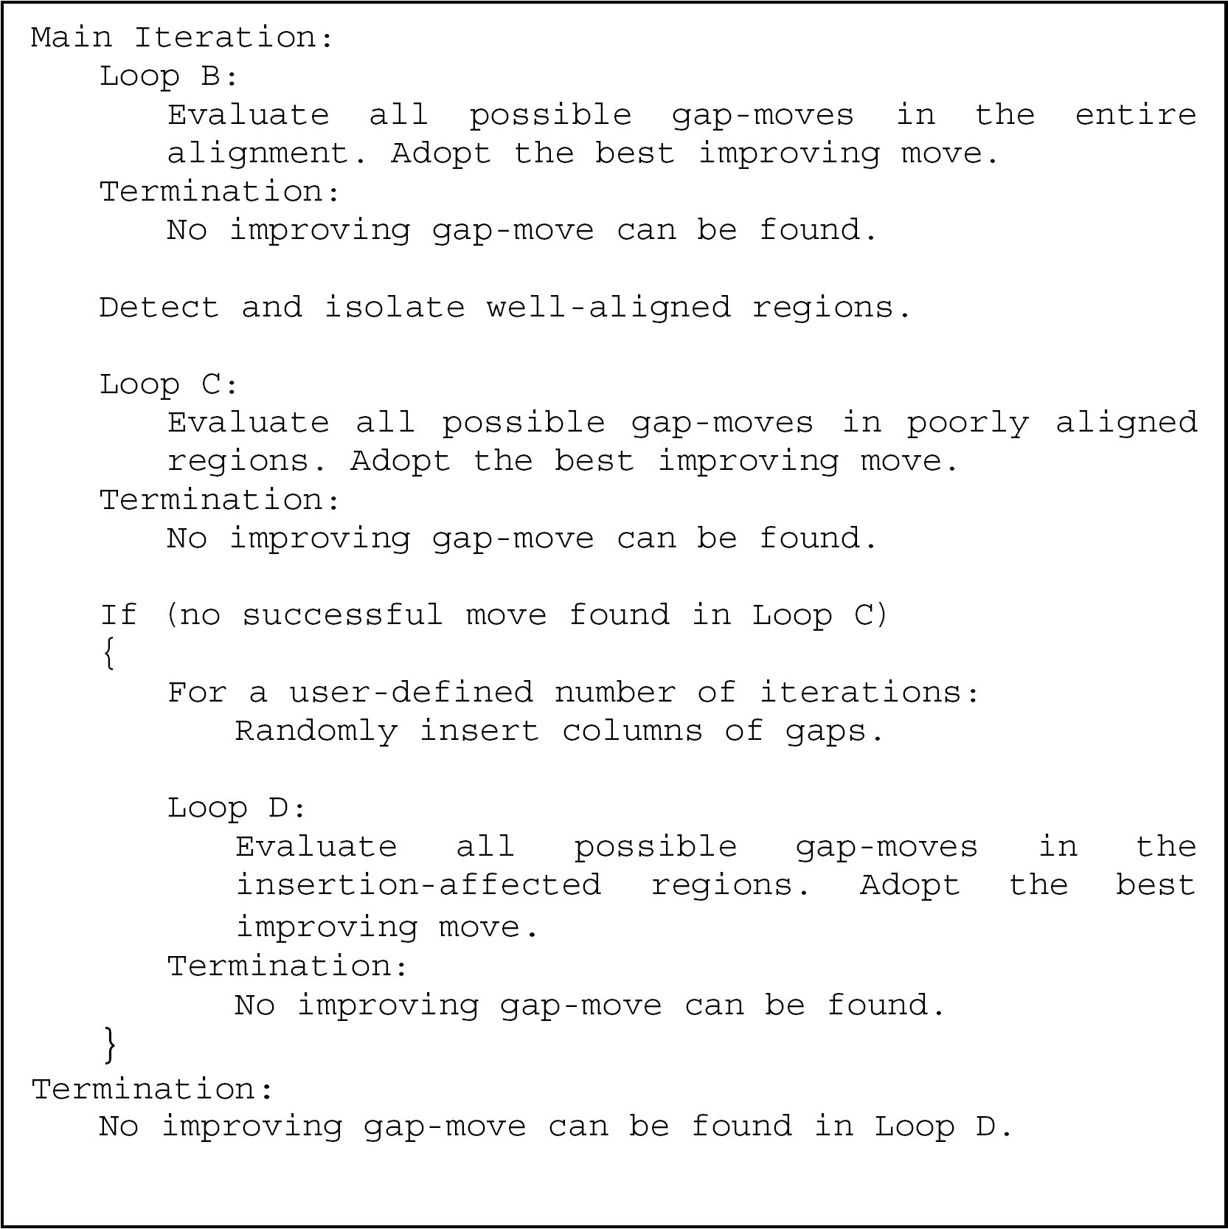
AIMSA Algorithm

Slide 8
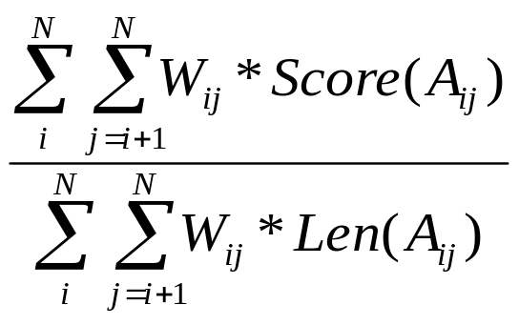
Objective Function
COFFEE(Consistency based Objective Function For alignment Evaluation)
A_{ij} is the pairwise projection of sequences i and j obtained from a MSA
Len(A_{ij}) is the length of A_{ij}
W_{ij} is the weight of pairwise alignment on sequences i and j in the library
Score(A_{ij}) is the number of aligned pairs of residues that are shared between A_{ij} and the library

Slide 9
Objective Function
Measures overall alignment quality
Evaluates whether a candidate move should be adopted
A local objective function is defined to identify well-aligned regions

Slide 10
Exhaustive and Greedy
Block-Gap Move
gap 4 is a single-gap block
gaps 0 and 1 is a 1*2 row block
gaps 0 and 2 is a 2*1 column block
gaps 0, 1, 2 and 3 is a 2*2 block
gaps 4 and 5 also forms a 2*1 column block
QDF01KHF
QDF23KHF
QDK4FPFF
AESGFKVF
EFK567TF
AKR8FSFF

Slide 11
Exhaustive and Greedy
Block-Gap Move
Exhaustively detects all blocks
Attempts to move it to all eligible positions
Computes the corresponding objective values and stores the best move position
After all the blocks have been evaluated, adopts the single move that generates the best improvement

Slide 12
Detect Well-Aligned Regions
Sliding-window algorithm
Once a high-score window detected, it seeks to widen it as much as possible
A minimal length as well as a maximal interval length is set
  ...GARFIELD THE LAST FAST CAT...
  ...GARFIELD THE VERY FAST CAT...

Slide 13
Insert Column-gaps as Buffers
Beside gap-move, insertion and deletion of gaps are necessary on some occasions
However, to insert gaps might damage its following well-aligned regions
  Someone has reviewed this paper
  Someone will preview this paper
If simply insert two gaps to align “review”
  Someone has- -reviewed this paper
  Someone will preview this paper

Slide 14
Insert Column-gaps as Buffers
Instead, columns of gaps could be inserted
  Insert column gaps
    Someone has reviewed ----this paper
    Someone will preview ----this paper
  Move gaps
    Someone has- -reviewed --this paper
    Someone will preview- - --this paper
  Filter redundant column gaps
    Someone has- -reviewed this paper
    Someone will preview- - this paper

Slide 15
Randomly Insert Column-gaps
Column-gaps are also inserted randomly so as to facilitate insertion and deletion deep in poorly-aligned regions
A deterministic insertion is possible but inefficient
Well-aligned
Region
Buffer
Poorly-aligned region
Buffer
Well-aligned
Region

Slide 16
Results--BAliBASE Reference Sets
Reference 1: equidistant sequences of similar length
Reference 2: family versus orphans
Reference 3: equidistant divergent families
Reference 4: N/C-terminal extensions
Reference 5: internal insertions

Slide 17
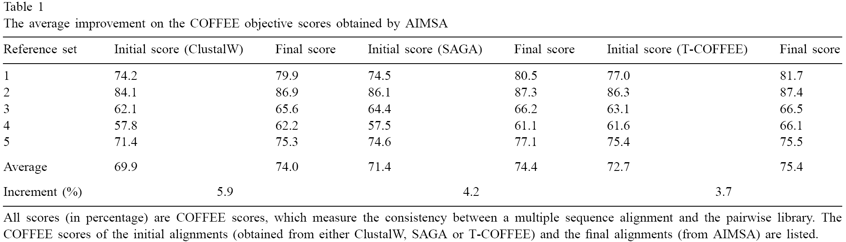
Results

Slide 18
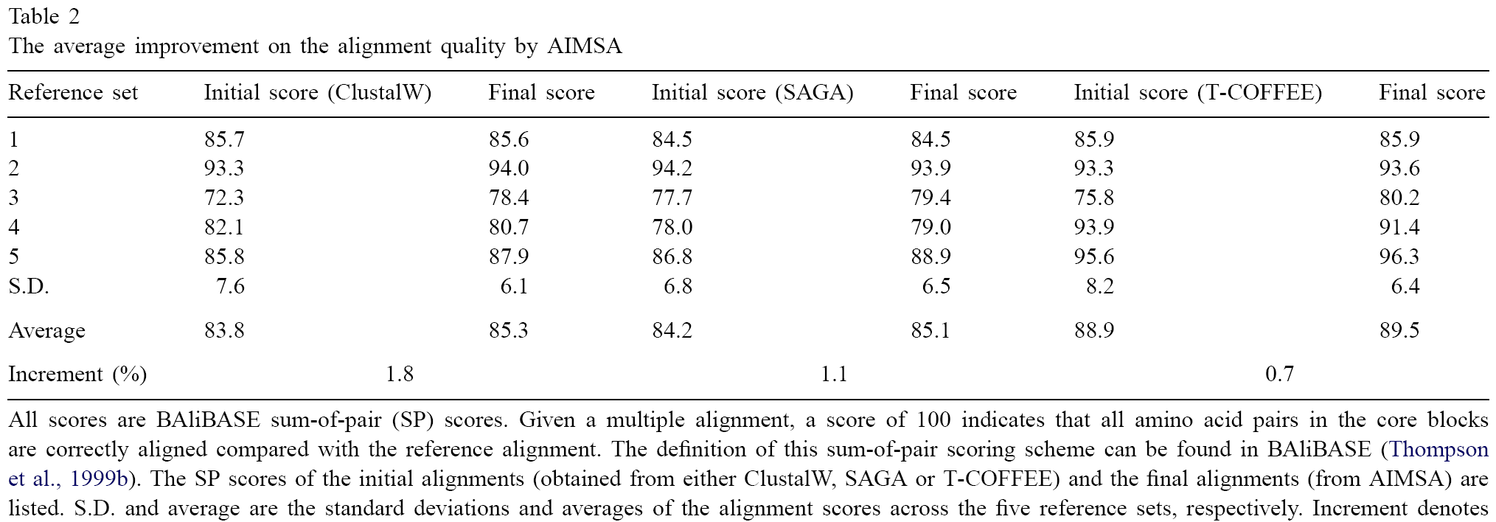
Results

Slide 19
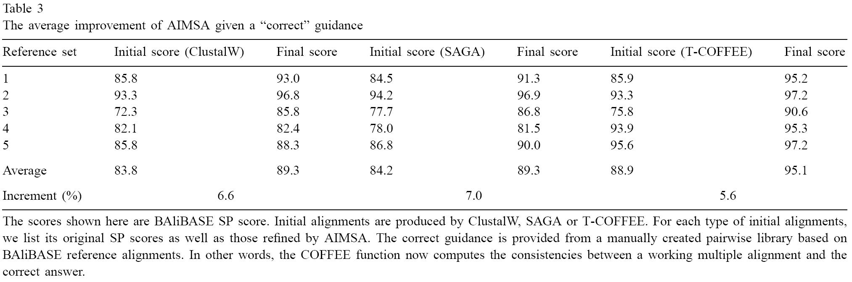
Results

Slide 20
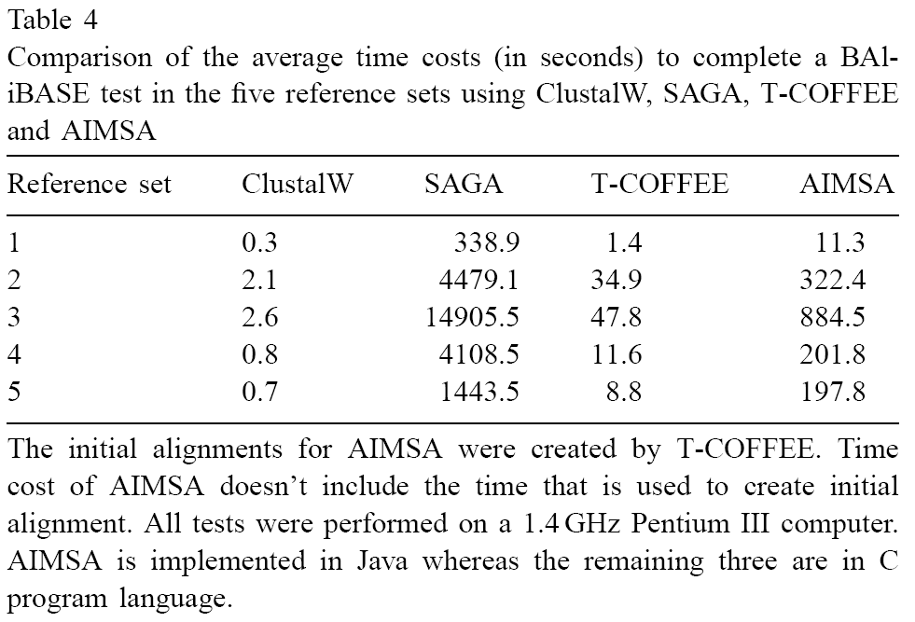
Results

Slide 21
Conclusion
AIMSA is an optimization algorithm aimed at finding good alignments.
AIMSA may be used to align multiple sequences of various combinations.
We believe that the ability for AIMSA to obtain good alignments depends on good pairwise libraries and not very much on the initial or seed alignments.
A main disadvantage of AIMSA is being time-consuming, which stems from its iterative nature.

