Slide 1
Faster Algorithm for String Matching with k Mismatches
Amihood Amir, Moshe Lewenstin, Ely Porat
Journal of Algorithms, Vol. 50, 2004, pp. 257-275
Date : Nov. 26, 2004
Created by : Hsing-Yen Ann

Slide 2
Abstract
The string matching with mismatches problem is that of finding the number of mismatches between a pattern P of length m and every length m substring of the text T. Currently, the fastest algorithms for this problem are the following. The Galil–Giancarlo algorithm finds all locations where the pattern has at most k errors (where k is part of the input) in time O(nk).

Slide 3



Abstract (cont’d)
The Abrahamson algorithm finds the number of mismatches at every location in time . We present an algorithm that is faster than both. Our algorithm finds all locations where the pattern has at most k errors in time . We also show an algorithm that solves the above problem in time .

Slide 4
Problem Definition
String matching with k mismatches:
Input:
  Text T = t₁t₂...t_{n}
  Pattern P = p₁p₂...p_{m}
  A natural number k
Output:
  All pairs <i, ham(P, T_{[i,i+m-1]})>,
  where 1≦i ≦n and ham(P, T_{[i,i+m-1]})≦k
  ham(): hamming distance (# of errors)

Slide 5



Two Types of Solving Strategies
Finding all hamming distances + linear scan.
  Previous:
Finding the locations with at most k errors directly.
  Previous: O(nk)
Choose strategy 1 when .
Improved to in this paper by using strategy 2.

Slide 6
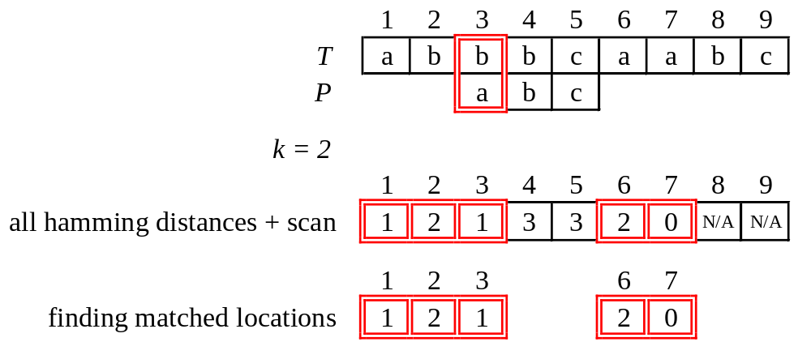
Two Types of Solving Strategies (cont’d)
Example:
Notes:
Hamming distance ham(P, T_{[3,5]})=1. It means only one mismatch.

Slide 7
Algorithm for Solving this Problem
Two-stage algorithm
Marking stage
  Identifying the potential starts of the pattern.
  Reducing the # to be verified.
  Focused in this paper.
Verification stage
  Verifying which of the potential candidates is indeed a pattern occurrence.
  Using the Kangaroo method for speed-up.

Slide 8
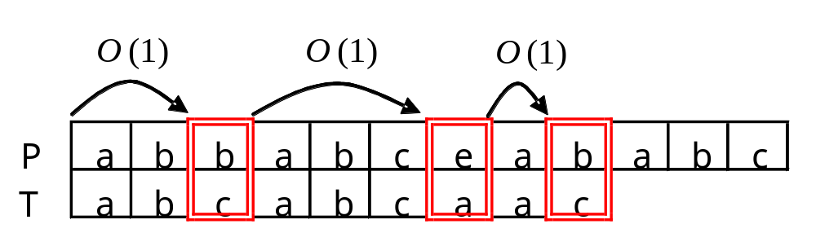
Kangaroo Method
Introduced by Landau and Vishkin.
Using Suffix trees + Lowest Common Ancestor.
Constant-time “jumps” over equal substrings in the text and pattern.
O(1) for jumping to next mismatch.
O(k) for verifying a candidate location with k mismatches.

Slide 9



Algorithms for Four Different Cases
Large alphabet
  At least 2k different alphabets in pattern P.
  O(n)
Small alphabet
  At most different alphabets in pattern P.
General alphabets - many frequent symbols
  At least frequent symbols
General alphabets - few frequent symbols
  Less than frequent symbols

Slide 10
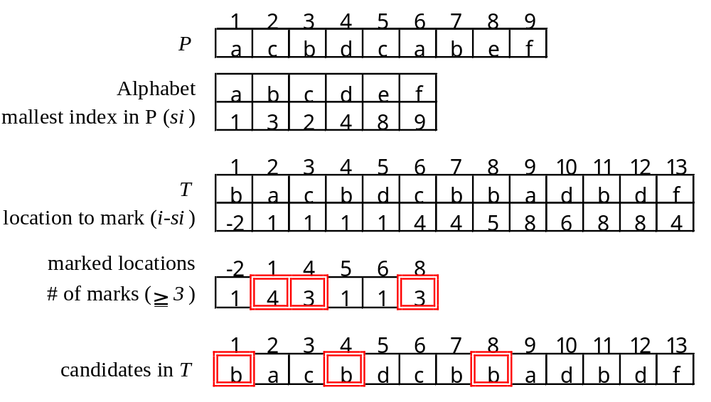
Large alphabet
Example: k=3, |Σ|=6=2k
Time: O(n / k) x O(k) = O(n)
Notes:
Pre-process the pattern P. Find the smallest index in P of each alphabet.
Mark the location in T corresponding to the alphabet.
Count the marked locations respectively.

Slide 11

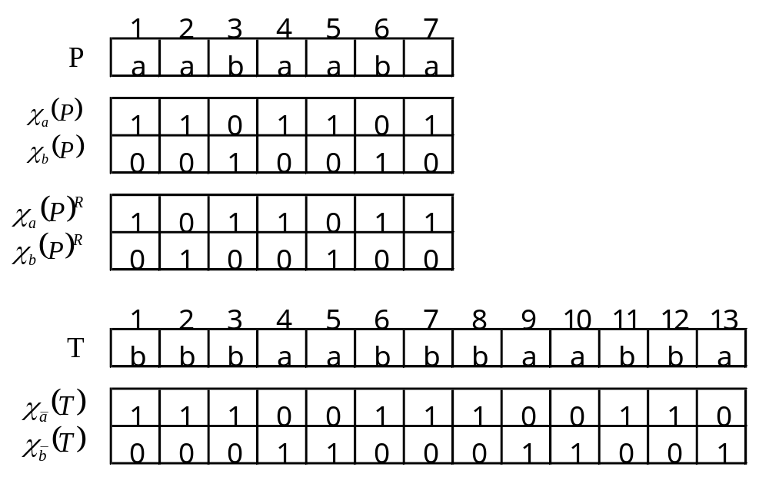
Small alphabet
Example: k=5 , Σ={a, b} , |Σ|=2

Slide 12
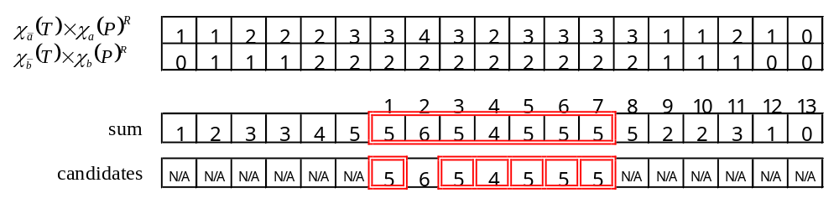

Small alphabet (cont’d)
Use FFT for polynomial multiplication.
Time:

Slide 13

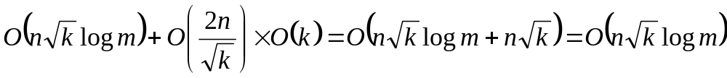
General alphabet
– many frequent symbols
Frequent symbol: appears at least times in P.
Many frequent symbols: at least frequent symbols.
T’ and P’: replace all non-frequent symbols in T and P with “don’t cares” symbols.
Mismatch problem with “don’t cares” can be solved in time .
After the last step, at most candidates left.
Time:

Slide 14
General alphabet
– few frequent symbols
Few frequent symbols: less then frequent symbols.
T’ and P’: replace all frequent symbols in T and P with “don’t cares” symbols.
Mismatch problem with “don’t cares” can be solved in time .
After the last step, at most candidates left.
Time:

Slide 15
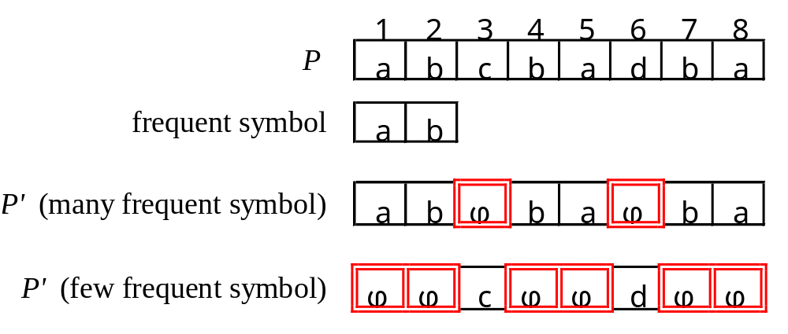
General alphabet (cont’d)
Example:

Slide 16
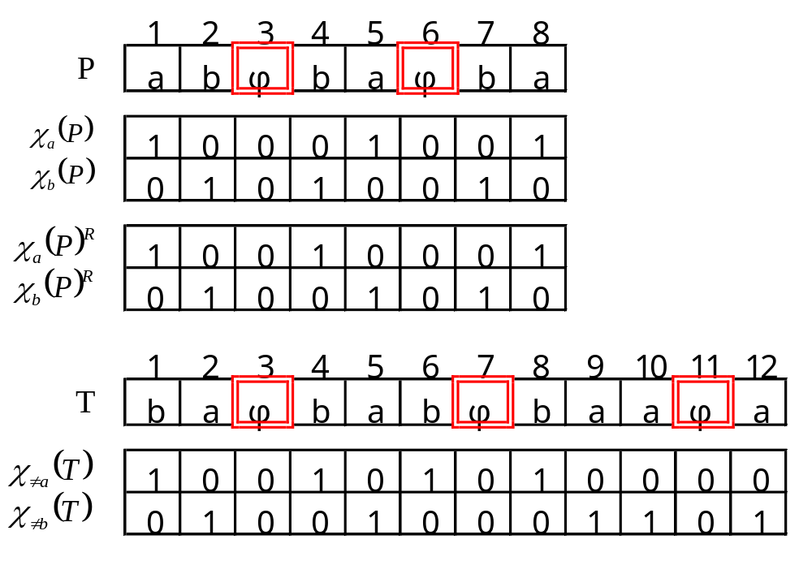
Mismatch with Don’t Cares Problem
Example: k=3 , Σ={a, b}∪{φ}

Slide 17
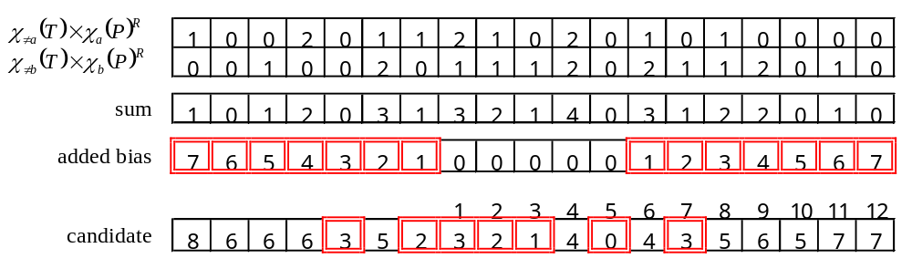
Mismatch with Don’t Cares Problem (cont’d)
Use FFT for polynomial multiplication
Time:

Slide 18





Conclusion
This problem can be solved by above algorithms in .
When :
When : use another algorithm.
Finally, this problem can be solved in .

