Slide 1
Faster Algorithm for String Matching with k Mismatches (II)
Amihood Amir, Moshe Lewenstin, Ely Porat
Journal of Algorithms, Vol. 50, 2004, pp. 257-275
Date : Dec. 24, 2004
Created by : Hsing-Yen Ann

Slide 2
Problem Definition
String matching with k mismatches:
Input:
  Text T = t₁t₂...t_{n}
  Pattern P = p₁p₂...p_{m}
  A natural number k
Output:
  All pairs <i, ham(P, T_{[i,i+m-1]})>,
  where 1≦i ≦n and ham(P, T_{[i,i+m-1]})≦k
  ham(): hamming distance (# of errors)

Slide 3
Algorithm for Solving this Problem
Two-stage algorithm
Marking stage
  Identifying the potential starts of the pattern.
  Reducing the # to be verified.
  Focused in this paper.
Verification stage
  Verifying which of the potential candidates is indeed a pattern occurrence.
  Using the Kangaroo method for speed-up.
  O(1) for jumping to next mismatch.

Slide 4








Previous Conclusion
This problem can be solved by previous presented algorithms in .
When :
When : use another algorithm.
Finally, this problem can be solved in .

Slide 5
Periodicity
periodic:
S is periodic if S=u^{j}w, where j≧2 and w is a prefix of u.
aperiodic: a string is not periodic
Periodic | Aperiodic
A A A A A A A AB AB AB A ABCD ABCD ABC A A | A B C D E AB A ABCD ABC A

Slide 6
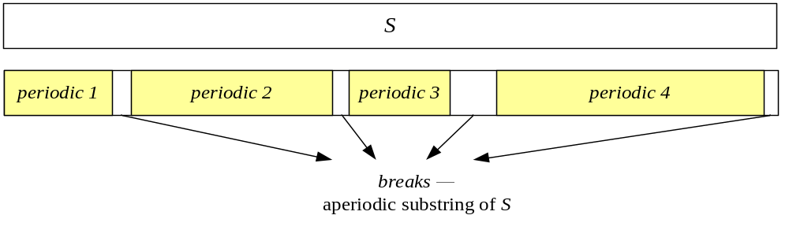
Breaks
break: an aperiodic substring of a string S.
l-break: a break of length l.
Cole and Hariharan[9] give a linear time algorithm to find out all l-breaks with given l.

Slide 7
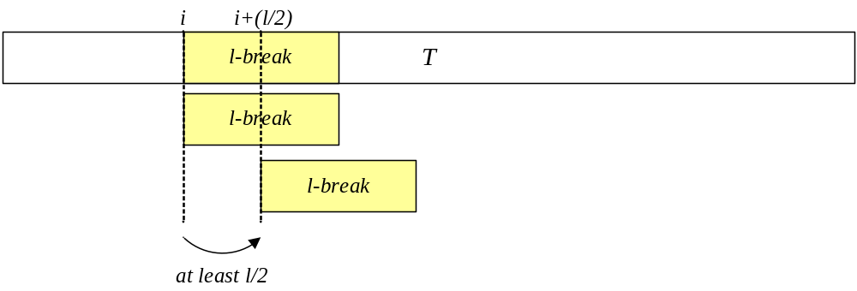
Breaks (cont’d)
The goodness of break:
A l-break in P exactly match to T at position i implies that the next position in T to match this
l-break will be at least i + (l/2).

Slide 8
Some Lemmas
Lemma 3:
Let P be a pattern with 2k disjoint l-breaks and let T be a text. In each match (with k mismatches) of P in T at least k of the l-breaks match exactly.
Lemma 4:
Let P be an m length pattern with less than 2k
l-breaks. Let T be of length 2m. Then all matches of P in T are in a substring of T which has at most O(k) l-breaks.

Slide 9
Time Complexity on Different Cases
Case 1:
There are at least 2k disjoint k-breaks in P.
Time: O(n+m) = O(n)
Case 2:
There are at least 2k disjoint l-breaks in P, where
2 ≦ l ≦ k-1.
Time: O(k log k) for each local match
Case 3:
There are not even 2k disjoint 2-breaks.
  Dominated pattern: O(n + m log k + (nk³ log k)/m)
  Non-dominated pattern: O(n + m log k + (nk⁴ log k)/m)

Slide 10
Algorithm for 2k k-breaks in P
Algorithm:
  Find all exact matches of all breaks in the text.
  For every such match, mark all text locations for pattern occurrences appropriate for this break.
  Discard every text location that is marked less than k marks.
Result:
  There are at most (4n)/k candidates left.
  The candidates can be marked in O(n+m) time.
  The verification stage needs O(n) time.

Slide 11
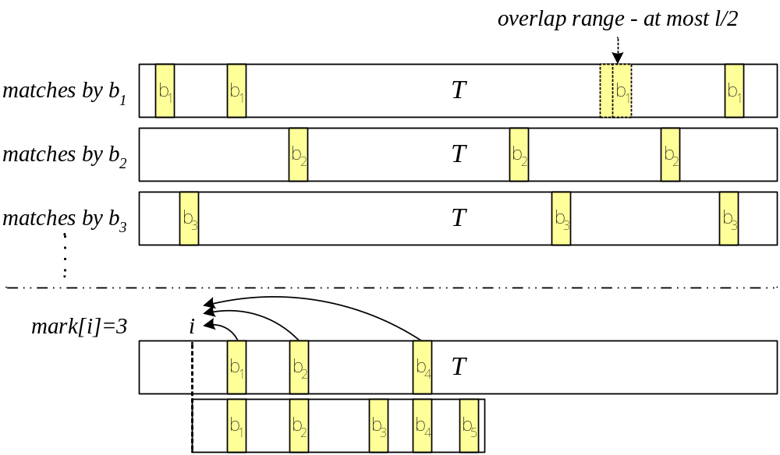
Algorithm for 2k k-breaks in P (cont’d)

Slide 12
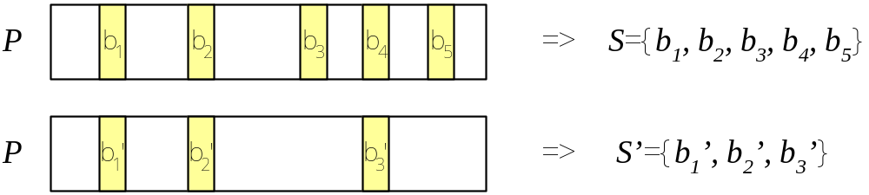
Algorithm for 2k l-breaks in P
Algorithm:
  Let S={b₁, …, b_{2k}} be a set of 2k disjoint l-breaks of P.
  Let S’={b₁’, …, b_{f}’} be the distinct subset of S. S’ can be found in O(m) time.

Slide 13
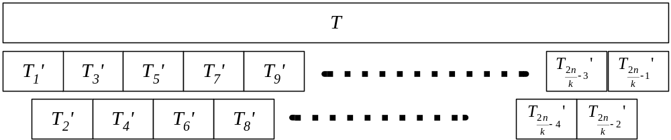
Algorithm for 2k l-breaks in P (cont’d)
  Partition the text T to the local matching form T’={T₁’, T₂’, …, T_{2n/k -1}’}.
  Local match:
  Split the text T into 2n/k -1 overlap substrings, for which the length is k, T’={T₁’, T₂’, …, T_{2n/k -1}’}. Then solves the problem by doing the local match separately.

Slide 14
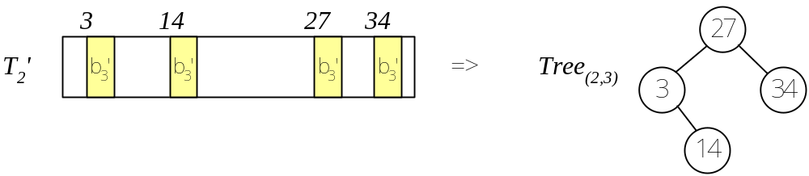
Algorithm for 2k l-breaks in P (cont’d)
  For each piece T_{i}' and each break b_{j}' in S' create a balanced binary tree Tree_{(i,j)}.
  The height of each tree is O(log k).
  The number of trees is at most
  |T'| × |S'| = (2n)/k × 2k = O(n).

Slide 15
Algorithm for 2k l-breaks in P (cont’d)
  There are at most n leave nodes in all trees. => The trees can be constructed in O(n) time.
  Given l contiguous text locations, the (at most 4) candidates can be identified in time
  |S'| × O(log k) = O(k log k).
  => All the candidates can be marked in time
  |T'| × O(k log k) = O(n log k).
  There are at most 4n / l candidates. The verification stage needs O(n) time.

Slide 16
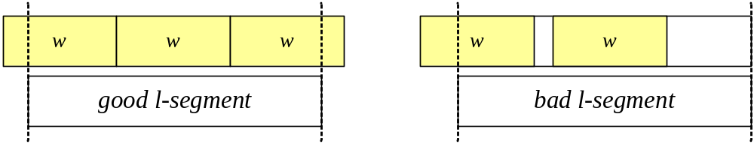
Algorithm for no 2k 2-breaks in P
Definition:
  l-segment:
  Partition the P to equal segment of size l.
  Dominated patterns:
  At most 4k segments do not have general period w.
  bad l-segment:
  A l-segment that is not fully within a periodic stretch of S.

Slide 17
Algorithm for no 2k 2-breaks in P (cont’d)
Lemma 6.
Let P be a pattern with a dominating period w. In the partition of P into l-segments there are at most 8k bad l-segments.
The algorithm for dominated patterns can be done in O(n + m log k + (nk³ log k)/m) time.
For a non-dominated pattern P, there exists a sparsifying substring P' of length Ω(m/k). Then P' is a dominated pattern. The algorithm can be done in O(n + (nk⁴ log k)/m) time.

Slide 18
Algorithm for no 2k 2-breaks in P (cont’d)
1. Find all matches of P in T at overlapping (bad l-segment) locations.
2. For each bad l-segment B do pattern matching, with pattern B and w_{2l}*.
3. Do pattern matching with mismatches, with pattern w and text w_{2l}*.
4. Compute the # of mismatches of P at the first |w| locations of T using steps 2 and 3.
5. i <= |w| + 1.
6. While end of text not reached
6a. if i is not an overlapping location
6aa. # of mismatches at location i <= # of mismatches at location i-|w|,
6ab. i <= i + 1;
6b. else, if j is the next non-overlapping location
6ba. for each of the bad l-segment that participate in an overlap in the overlapping locations (bad segment vs. bad segment) from i to j, update the # of mismatches it accrues in the next |w| locations,
6bb. i <= j .

Slide 19
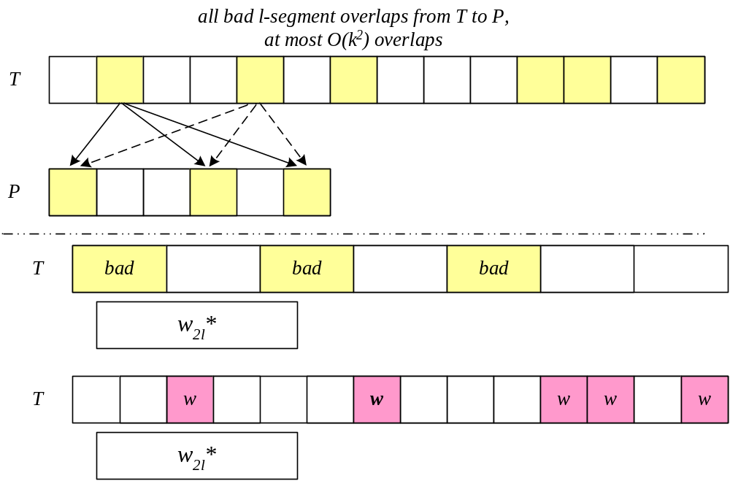
Algorithm for no 2k 2-breaks in P (cont’d)

Slide 20
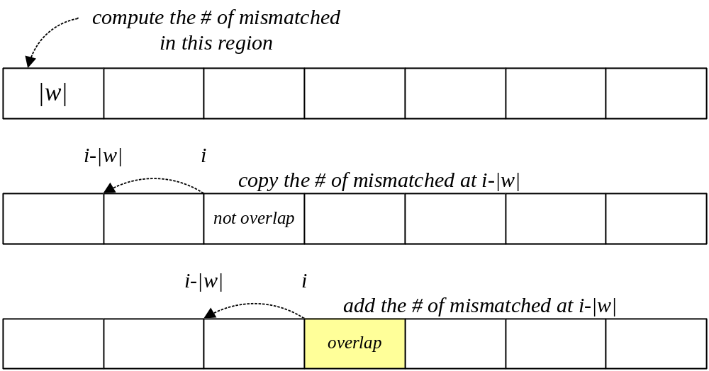
Algorithm for no 2k 2-breaks in P (cont’d)

