Slide 1
A Hierarchical Clustering Algorithm for Categorical Sequence Data
Seung-Joon Oh and Jae-Yearn Kim
Information Processing Letters,
vol. 91, pp.135–140, 2004

Slide 2
Abstract
Recently, there has been enormous growth in the amount of
commercial and scientific data, such as protein sequences, retail
transactions, and web-logs. In this paper, we study how to cluster
these sequence datasets. We propose a new similarity measure to
compute the similarity between two sequences and develop a
hierarchical clustering algorithm. Using a splice dataset and
synthetic datasets, we show that the quality of clusters generated
by our proposed approach is better than that of clusters produced
by traditional clustering algorithms.

Slide 3
Measure of Similarity Between Sequences
Example 1.
The similarity between S₁ =(ABCD) and S₂ =(ACDE)
is calculated using the pairs of items in S₁(AB, AC, AD,
BC, BD, CD) and the pairs of items in S₂ (AC, AD, AE,
CD, CE, DE). The pairs of identical items are AC, AD,
CD. The more times identical pairs are found in two
sequences, the higher the similarity of the sequences.

Slide 4
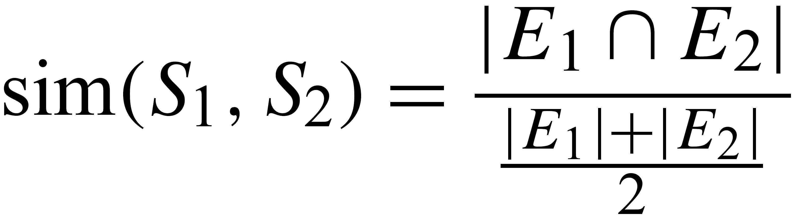
Measure of Similarity Between Sequences
Sequence S =x₁x₂ ... x_{i}... x_{j} ... x_{n} is an ordered list of items. The size of S and is denoted by |S|.
E =(e₁,e₂, ... , e_{k}, ...) is the collection of sequence elements e_{k} , that e_{k} is a pair of items, x_{i}x_{j} (i< j ), in sequence S . The size of E and is denoted by |E|.
Eq.(1)
( |E₁|+|E₂|)/ 2 as a scaling factor to ensure that the similarity is between 0 and 1.

Slide 5
Measure of Similarity Between Sequences
Sequence elements consisting of three or more items are repre­sented by a collection of sequence elements consisting of two items.
  {A, B} and {B, C} are subsets of {A, B, C}
It is much more computationally efficient to compute sequence elements of two items than to compute sequence elements of three or more items.
  nC3 is greater than nC2 in n> 5

Slide 6
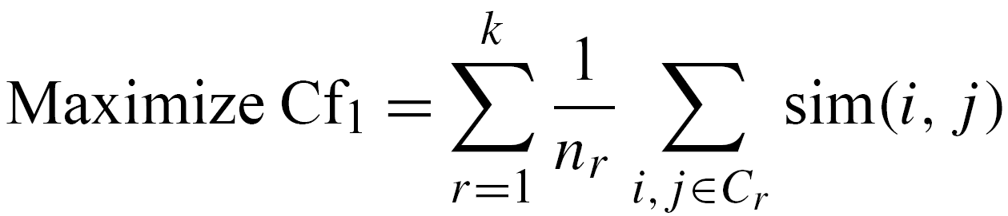
Hierarchical Clustering Algorithm
Criterion Function：
Eq.(2)
Where n_{r} is the number of sequences in C_{r} and k is the number of clusters.

Slide 7
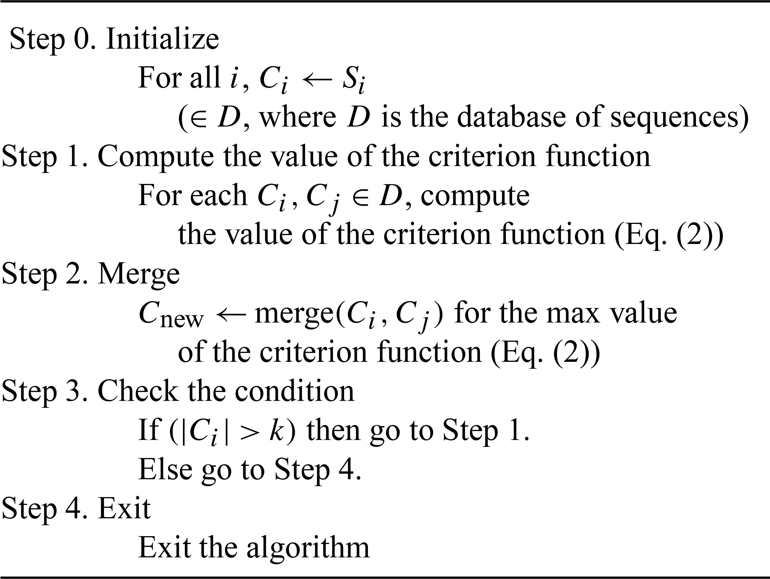
Hierarchical Clustering Algorithm

Slide 8
Hierarchical Clustering Algorithm
Example：
The set S contains n=10 elements, s₁ to s₁₀ . Let k=5.
Step0. Initially, each element s_{i} of S is placed in a
cluster c_{i}, where c_{i} is a member of the set of
clusters C.
C = {{s₁}, {s₂}, {s₃}, {s₄}, {s₅}, {s₆}, {s₇}, {s₈}, {s₉}, {s₁₀}}

Slide 9
Hierarchical Clustering Algorithm
Step1. (iteration of while loop) |C | = 10
Compute the value of the criterion function for
each c_{i} , c_{j} , assume that c₁ ,c₂ is maximum.
Step2. c_{new}←merge(c₁ , c₂)
C = {{s₁, s₂}, {s₃}, {s₄}, {s₅}, {s₆}, {s₇}, {s₈}, {s₉}, {s₁₀}}
Step3. |C |=9 > 5 , go to Step1.
：
：
C = {{{{s₁}, {s₂}}, {{s₃}, {s₄}}}, {s₅}, {{s₆}, {s₇}}, {s₈}, {{s₉}, {s₁₀}}}

Slide 10


Complexity
Two sequences S₁ and S₂,where a and b are the size of S₁ and S₂.
The time complexity of computing similarity is：
Total：

Slide 11
Experimental Results
Algorithm 1：
  use edit distance method as the similarity measure
  our proposed hierarchical clustering algorithm
Algorithm 2：
  use edit distance method like algorithm 1
  hierarchical clustering algorithm using the complete linkage method
Our proposed clustering algorithm：
  use Eq. (1) as the similarity measure
  our proposed hierarchical clustering algorithm.

Slide 12
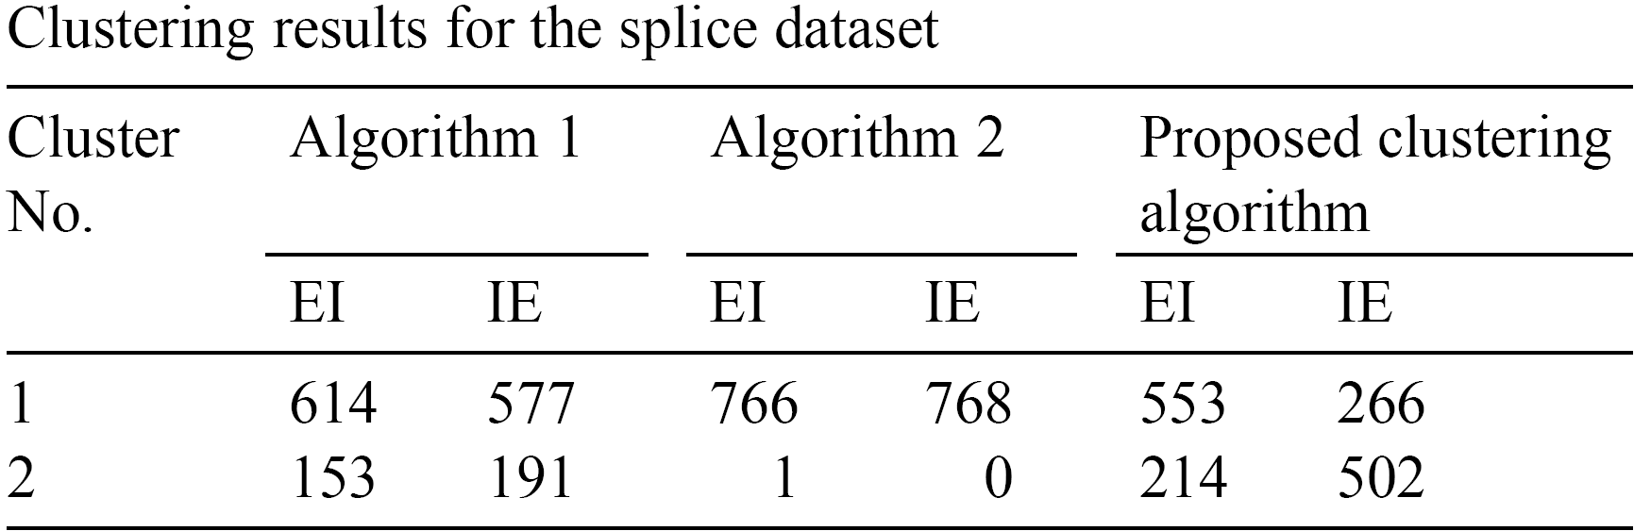
Experimental Results
The splice dataset contains nucleotide sequences of a fixed length of 60 bases, and each sequence is assigned a class label as either an exon/intron boundary (referred to as EI) or an intron/exon boundary (referred to as IE).

Slide 13
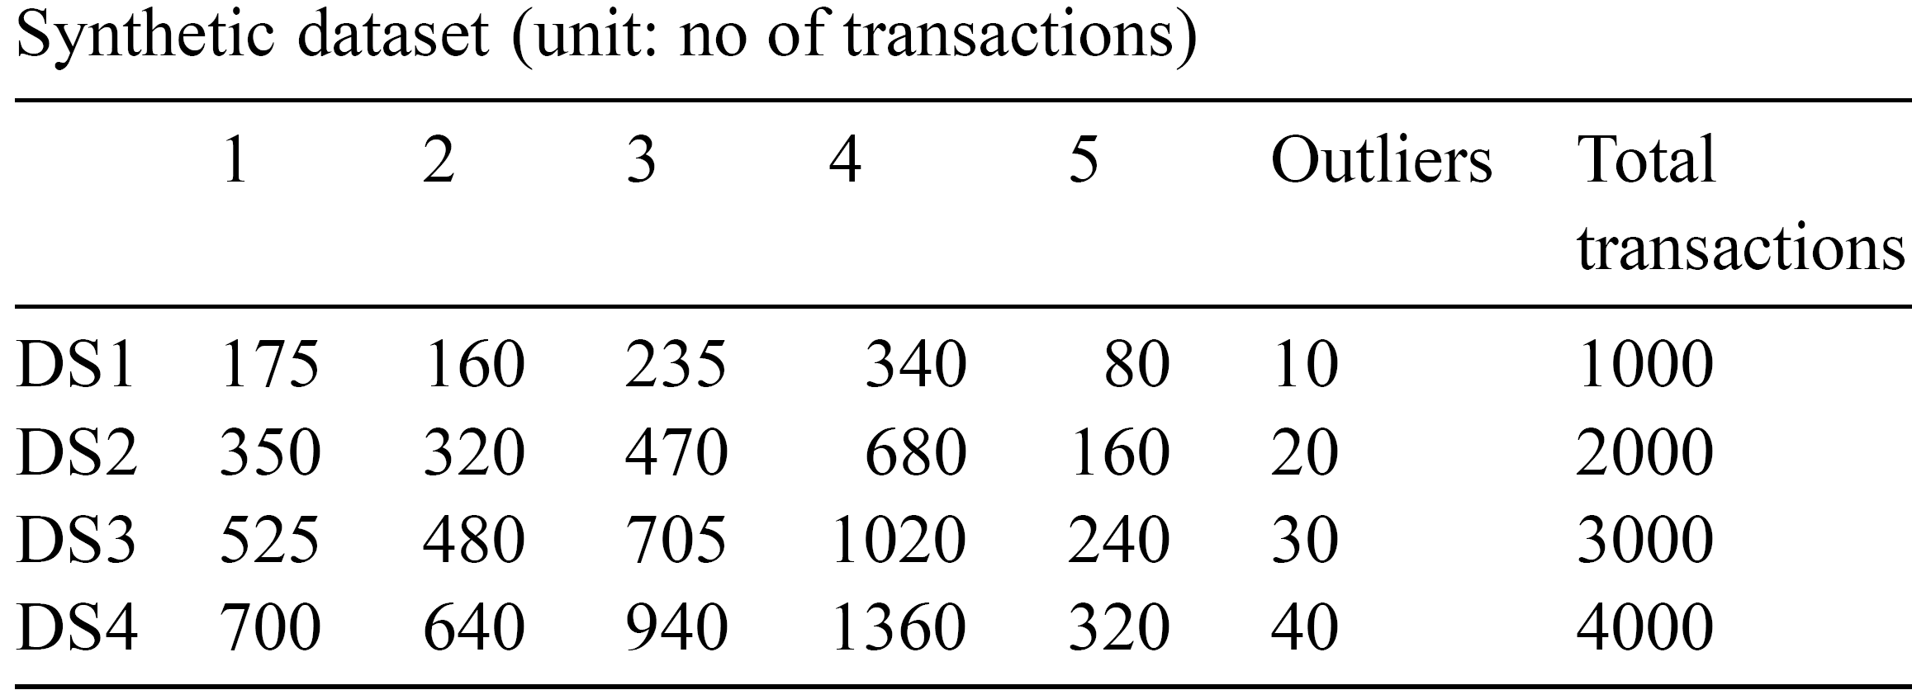
Experimental Results
We generated four different datasets, DS1, DS2, DS3, and DS4, using the synthetic data generator GEN from the Quest project.

Slide 14
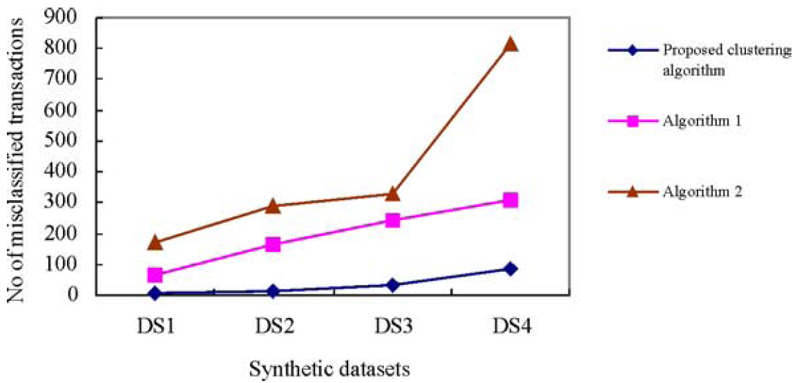
Experimental Results

Slide 15
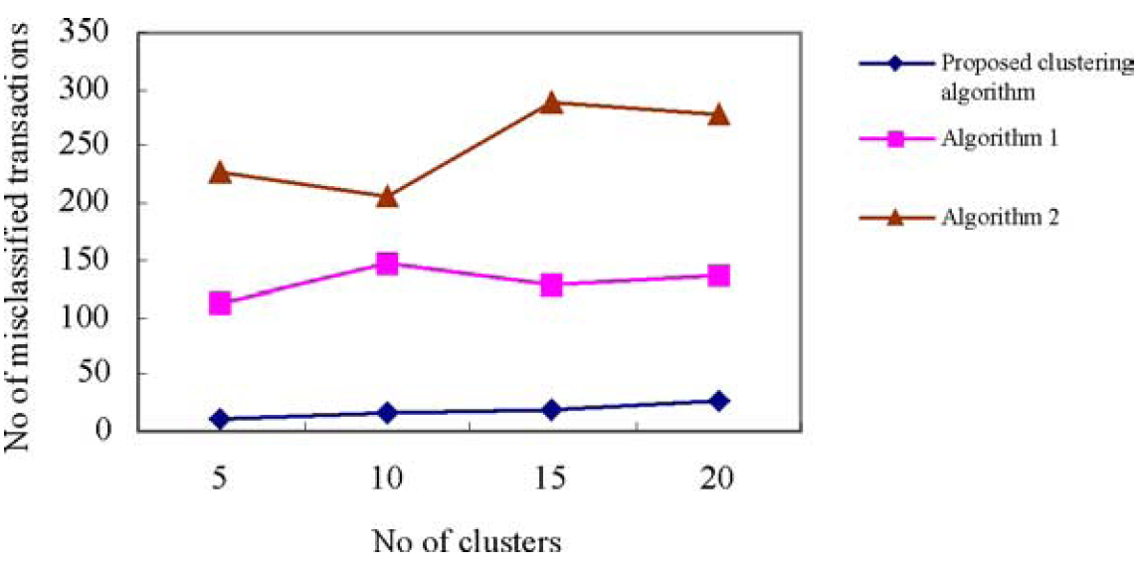
Experimental Results

Slide 16
Conclusion
For a splice dataset and synthetic datasets, our clustering algorithm generated better-quality clusters than traditional clustering algorithms.

