Slide 1
Discriminative Motifs
Saurabh Sinha, RECOMB ’02, April 18-21
Introduction
The term “motif” means the common pattern in different binding sites of a transcription factor. Our work belongs to this generic motif finding problem. The salient features of this work are:
  It takes a new of motif discovery, treating it as a feature selection problem
  It describes a general algorithmic framework that can be specialized to work with a large class of motif models(including consensus models with degenerate symbols or mismatches, and composite motif)

Slide 2
  It utilizes information about the distribution of motif instances among the given promoters when assessing the motif’s over-representation, rather than looking only at the total count of occurrences.
A motif is a feature of the positive sequences that leads to a good classification of positive and negative promoters. We call such motifs “discriminative motifs” or “d-motif” for brevity.

Slide 3
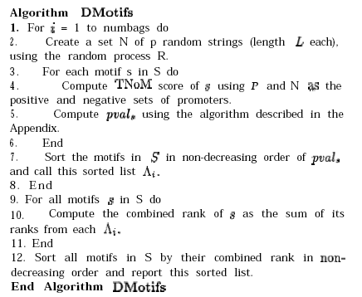
ALGORITHM

Slide 4
Simple Motif(degenerate)
Results on known regulons
  Regulons: a sets of genes known to be co-regulated, and where the binding site has been biologically characterized.
  In 18 out of the 22 regulons -> top 10 ;In 15 out of these 18 -> top 2.
  ROX1: an example of a false positive;58 occurrences are distributed as 10,11 and 37 in 3 genes

Slide 5
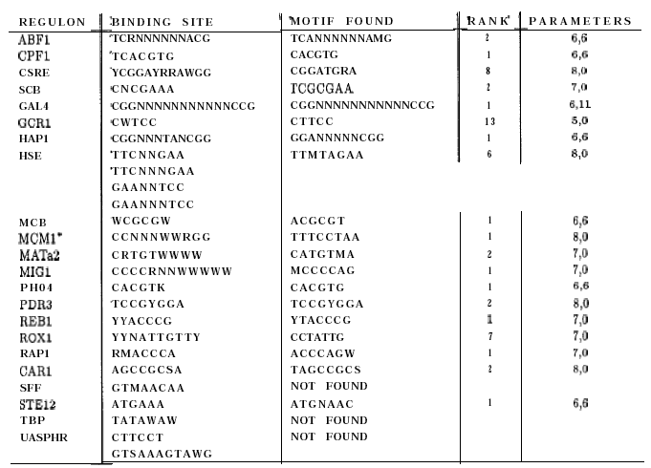

Slide 6
Composite motifs
“higher order” motif or “composite” motif: m1 – d – m2

Slide 7
FUTURE WORK AND CONCLUION
DMotifs envokes an enumerative search of the motif space, and leaves open the issue of an efficient traversal of the space.
Another issue worth investigating is how to decide upon the significance of p-value scores.
The general algorithm is adapted for two specific motif models, and shown to work well on real as well as synthetic data.

Slide 8
Raising the sensitivity without losing the specificity
Data preparing
  Promoter: core promoter, proximal promoter,DPE(downstream promoter elements) from database(EPD) or by aligning the first exon
    EPD release 73(1/20/03): starting to exploit 5’ESTs from full-length cDNA clones as a new resource for defining promoters. This new technique of TSS mapping is called ‘in silico primer extension’. Now, more than half of the EPD entries (1634) are based on 5’ EST sequences.

Slide 9
  Non-promoter
Thought : having the candidates of the promoters with high sensitivity and trying to take the FP out— increasing the specificity.
Method:
  Predict the promoter using the promoter prediction tool with low threshold→to raise the sensitivity(try to classify the promoter before promoter training)

Slide 10
  Finding the feature among the promoters and then doing the feature discrimination.
  Keeping the promoter candidates strongly related to the real discriminative feature(top rank)

