Slide 1
Order preserving pattern matching revisited
Md. Mahbubul Hasan, A.S.M. Shohidull Islam,
Mohammad Saifur Rahman, M. Sohel Rahman
Pattern Recognition Letters 55 (2015), pp. 15-21
Presenter: Guan-Ting Chen
Date: Mar. 1, 2022

Slide 2
Abstract
In this paper, we study the order preserving pattern matching (OPPM) problem, which is a very recent variant of the classic pattern matching problem. We revisit this variant, present a new interesting pattern matching algorithm and for the ﬁrst time consider string regularities from this new perspective.

Slide 3
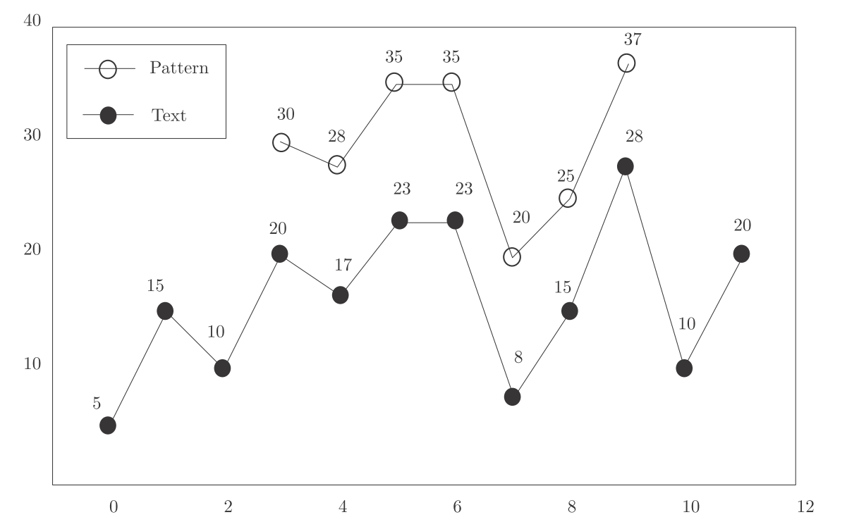
Order Preserving Pattern Matching

Slide 4
Z-function
Length of the longest substring of S that starts at position i and matches a prefix of S

Slide 5
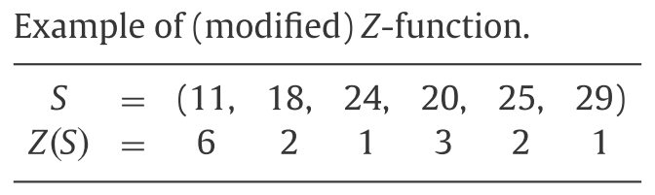
Modified Z-function
Length of the longest prefix P of suffix_{i}(S) such that σ (P) = σ (S[1, |P|]).

Slide 6
Improvement of Modiﬁed Z-function.
Prev
Predecessor
Next
Successor
S | 11 | 18 | 24 | 20 | 25 | 29
Z(S) | 6 | 2 | 1 | 3 | 2 | 1
Prev | -∞ | 1 | 2 | 2 | 3 | 5
Next | ∞ | ∞ | ∞ | 3 | ∞ | ∞

Slide 7
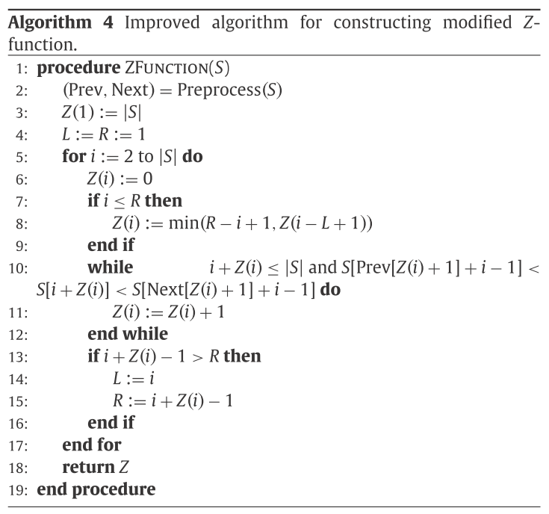
Time Complexity
Preprocess
O(nlogn)
while loop
R + O (n)
O(nlogn)

Slide 8
Order Preserving Periods
Period p
S[i] = S[p + i]
T = P^{k}
k consecutive repetitions of P
P
Period of any preﬁx of T
Example
T = ( 1, 3, 2, 4, 10, 9, 5, 11, 7 )
P = ( 1, 3, 2 )
Any prefix of T
( 1, 3, 2, 4, 10, 9, 5, 11, 7 )
( 1, 3, 2, 4 )
( 1, 3 )
( 1, 3, 2, 4, 10, 9, 5, 11 )

Slide 9
Order Preserving Border
Border
σ( S[1, L] ) = σ( S[ | S | − L + 1, | S | ] )
Only check
i + Z ( i ) − 1 = | S |
i | 1 | 2 | 3 | 4 | 5 | 6
S | 11 | 18 | 24 | 20 | 25 | 29
Z(S) | 6 | 2 | 1 | 3 | 2 | 1

Slide 10
Order Preserving Covers
Covers
S is covered by an Order-Preserving-Representation-occurrence
Example
S = ( 1, 3, 2, 7, 5, 8, 6 )
cover C = ( 1, 3, 2 )
(1, 3, 2), (2, 7, 5), (5, 8, 6)

Slide 11
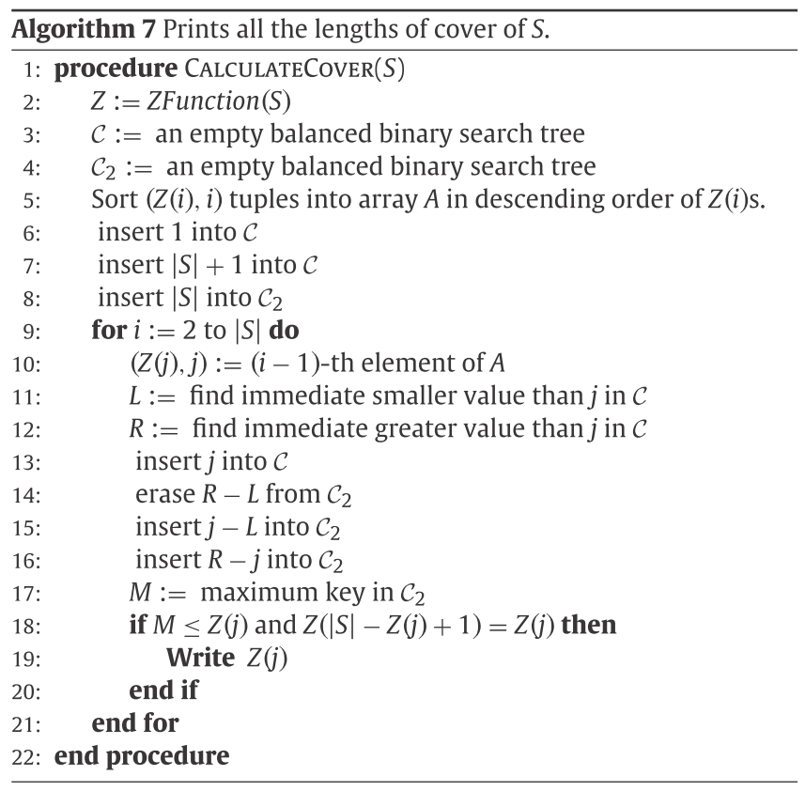
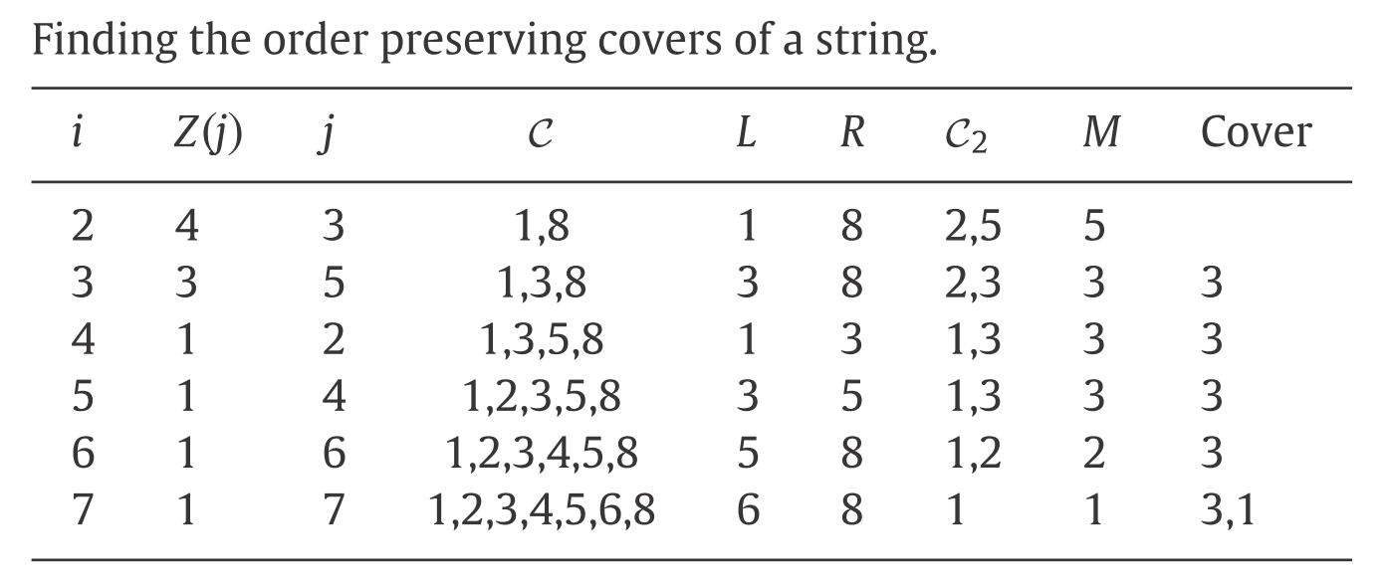
Order Preserving Covers
i | 1 | 2 | 3 | 4 | 5 | 6 | 7
S | 1 | 3 | 2 | 7 | 5 | 8 | 6
Z(S) | 7 | 1 | 4 | 1 | 3 | 1 | 1

Slide 12
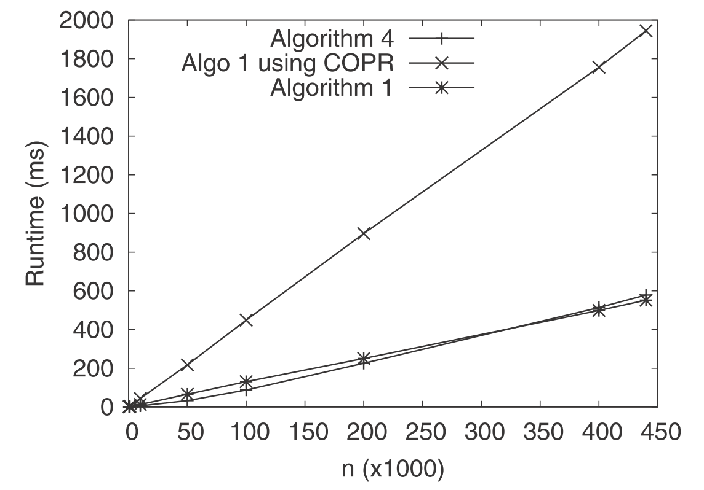
Experiments

Slide 13
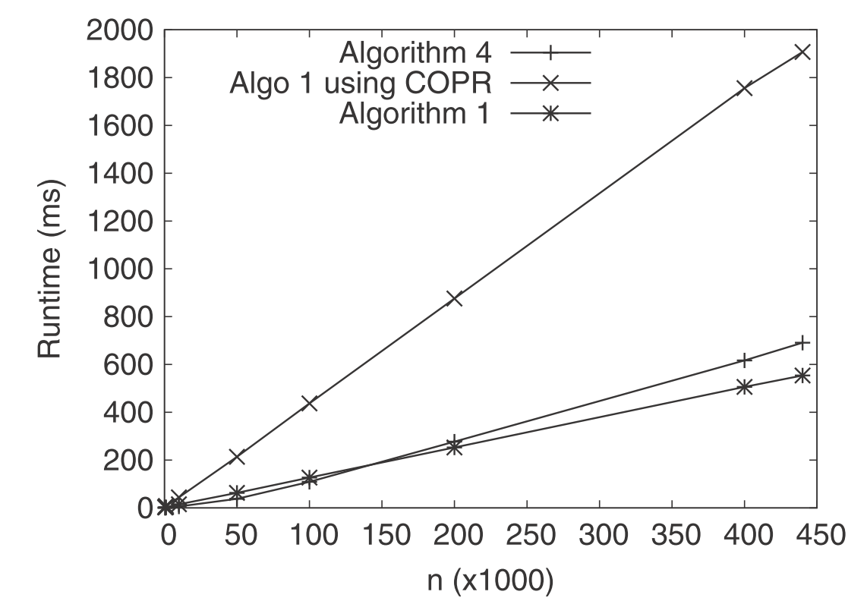
Experiments

Slide 14
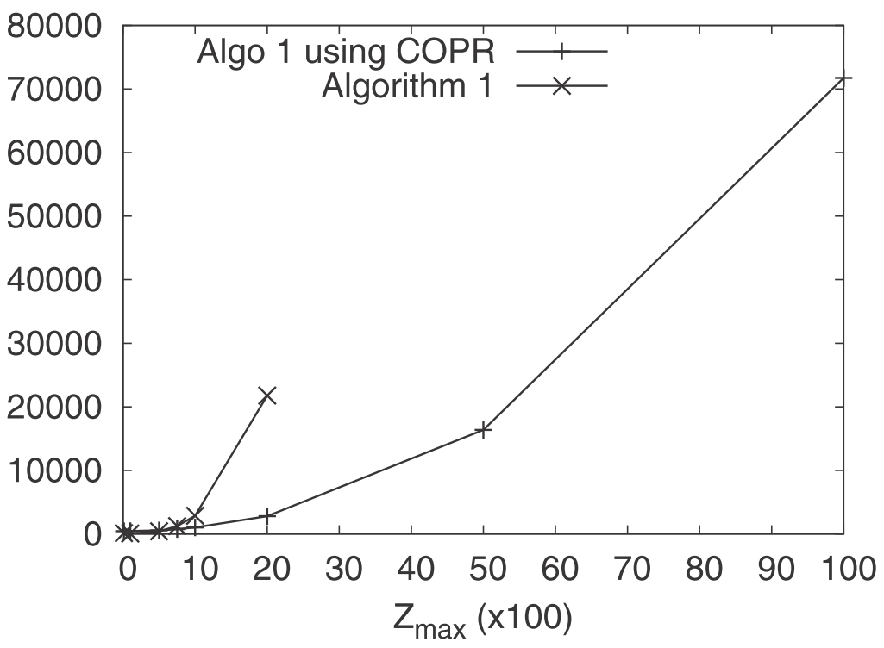
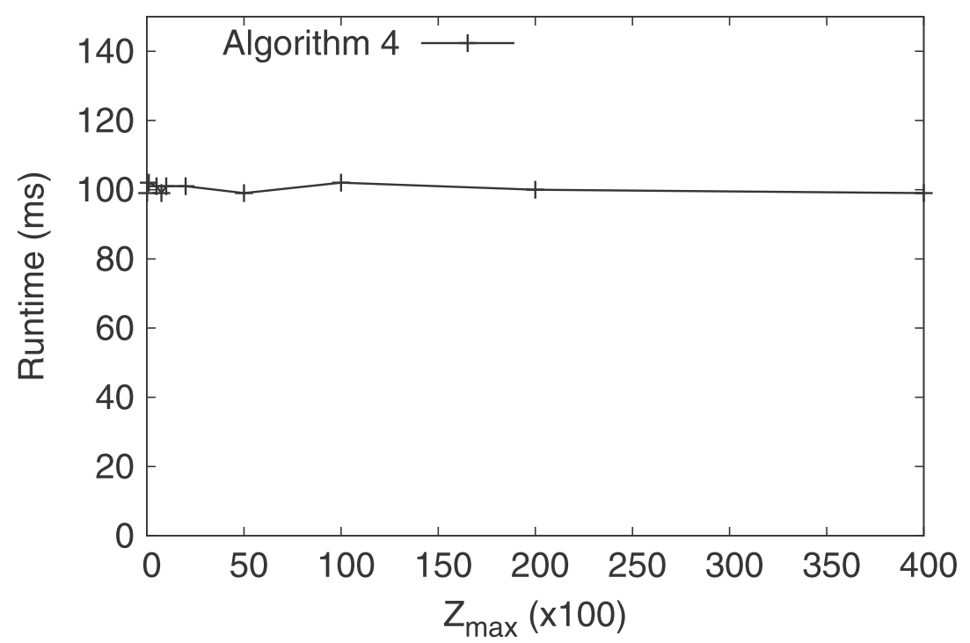
Experiments

Slide 15
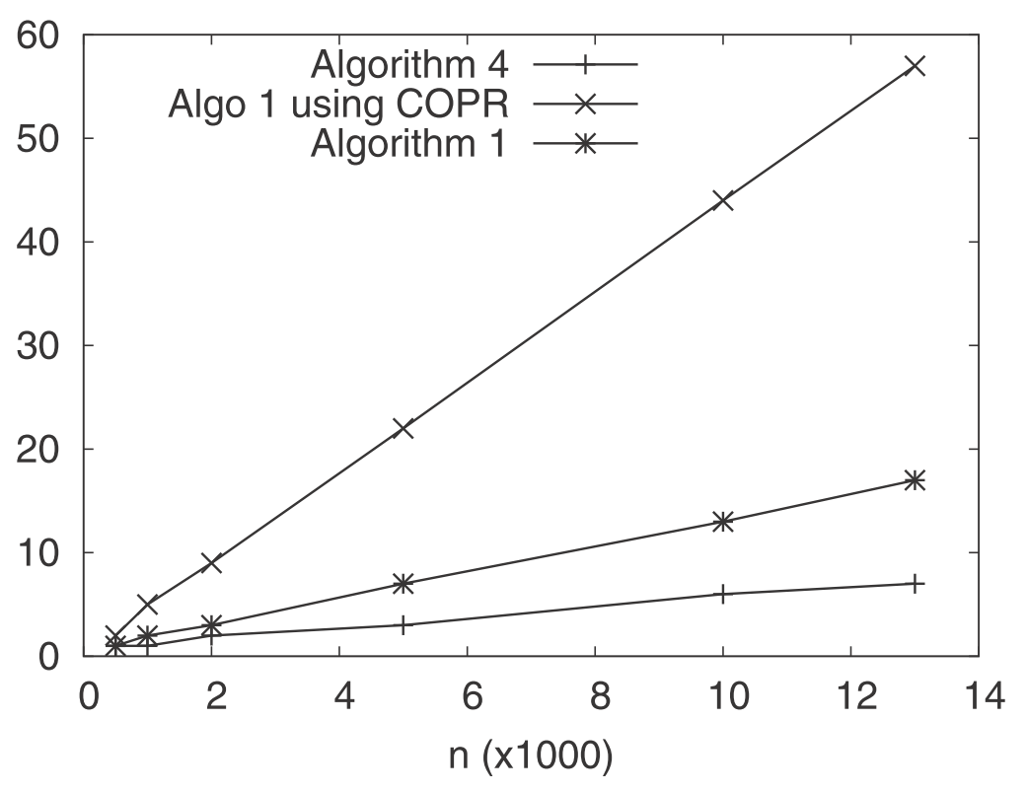
Experiments

