Slide 1
Order preserving pattern matching revisited
Md. Mahbubul Hasan, A.S.M. Shohidull Islam,
Mohammad Saifur Rahman, M. Sohel Rahman
Pattern Recognition Letters 55 (2015), pp. 15-21
Presenter: Guan-Ting Chen
Date: Mar. 8, 2022

Slide 2
Abstract
In this paper, we study the order preserving pattern matching (OPPM) problem, which is a very recent variant of the classic pattern matching problem. We revisit this variant, present a new interesting pattern matching algorithm and for the ﬁrst time consider string regularities from this new perspective.

Slide 3
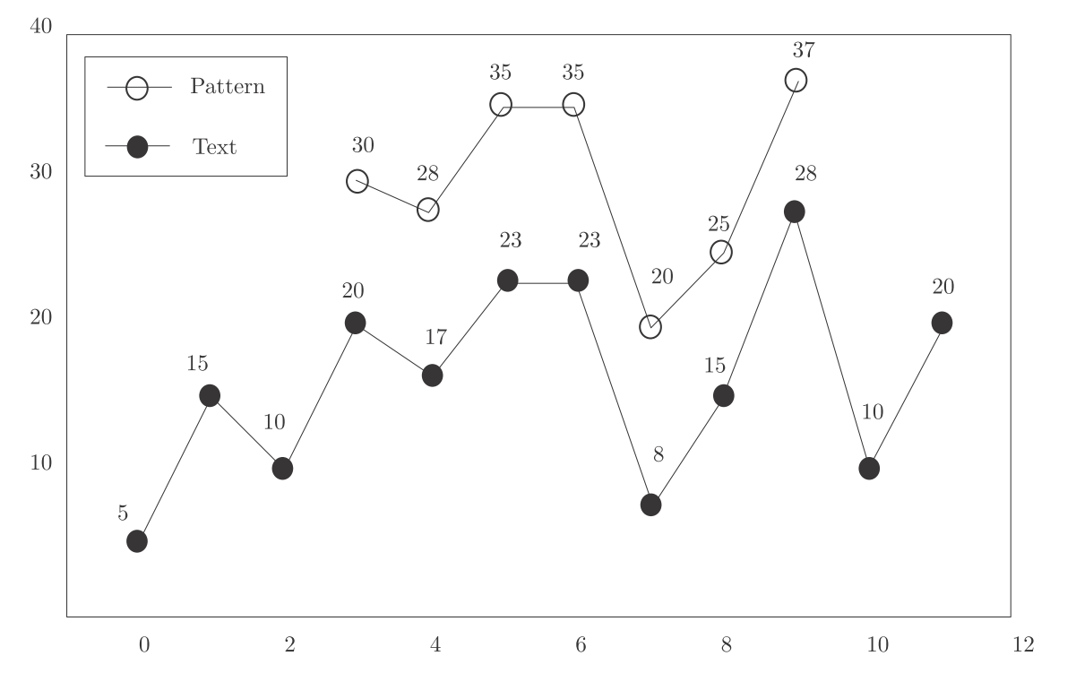
Order Preserving Pattern Matching
6
5
5
4
3
2
1

Slide 4
Z-function
Length of the longest substring of S that starts at position i and matches a prefix of S

Slide 5
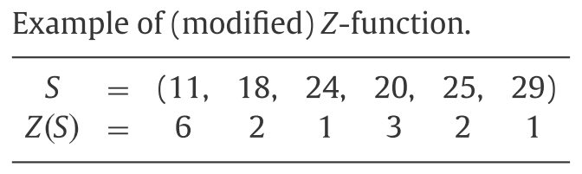
Modified Z-function
Length of the longest prefix P of suffix_{i}(S) such that σ (P) = σ (S[1, |P|]).

Slide 6
Modified Z-function Construction
Initialization
L
R
S | 11 | 18 | 24 | 20 | 25 | 29
Z(S) | 6

Slide 7
Modified Z-function Construction
i = 2
L
R
i
S | 11 | 18 | 24 | 20 | 25 | 29
Z(S) | 6
if i ≤ R
Z(i) = min(R – i + 1, Z(i – L + 1))

Slide 8
Modified Z-function Construction
i = 2
L
R
i
S | 11 | 18 | 24 | 20 | 25 | 29
Z(S) | 6 | 0
1

Slide 9
Modified Z-function Construction
i = 2
L
R
i
S | 11 | 18 | 24 | 20 | 25 | 29
Z(S) | 6 | 1
2

Slide 10
Modified Z-function Construction
i = 2
L
R
i
S | 11 | 18 | 24 | 20 | 25 | 29
Z(S) | 6 | 2

Slide 11
Modified Z-function Construction
i = 2
L
i
R
S | 11 | 18 | 24 | 20 | 25 | 29
Z(S) | 6 | 2
if i + Z(i) -1 > R
L = i
R = i + Z(i) - 1

Slide 12
Modified Z-function Construction
i = 3
L
i
R
S | 11 | 18 | 24 | 20 | 25 | 29
Z(S) | 6 | 2 | 1
if i ≤ R
Z(i) = min(R – i + 1, Z(i – L + 1))

Slide 13
Modified Z-function Construction
i = 3
L
i
R
S | 11 | 18 | 24 | 20 | 25 | 29
Z(S) | 6 | 2 | 1

Slide 14
Modified Z-function Construction
i = 3
L
i
R
S | 11 | 18 | 24 | 20 | 25 | 29
Z(S) | 6 | 2 | 1
if i + Z(i) -1 > R
L = i
R = i + Z(i) - 1

Slide 15
Modified Z-function Construction
i = 4
L
R
i
S | 11 | 18 | 24 | 20 | 25 | 29
Z(S) | 6 | 2 | 1 | 0
if i ≤ R
Z(i) = min(R – i + 1, Z(i – L + 1))

Slide 16
Modified Z-function Construction
i = 4
L
R
i
S | 11 | 18 | 24 | 20 | 25 | 29
Z(S) | 6 | 2 | 1 | 0
1

Slide 17
Modified Z-function Construction
i = 4
L
R
i
S | 11 | 18 | 24 | 20 | 25 | 29
Z(S) | 6 | 2 | 1 | 1
2

Slide 18
Modified Z-function Construction
i = 4
L
R
i
S | 11 | 18 | 24 | 20 | 25 | 29
Z(S) | 6 | 2 | 1 | 2
3

Slide 19
Modified Z-function Construction
i = 4
L
i
R
S | 11 | 18 | 24 | 20 | 25 | 29
Z(S) | 6 | 2 | 1 | 3
if i + Z(i) -1 > R
L = i
R = i + Z(i) - 1

Slide 20
Modified Z-function Construction
i = 5
L
i
R
S | 11 | 18 | 24 | 20 | 25 | 29
Z(S) | 6 | 2 | 1 | 3 | 2
if i ≤ R
Z(i) = min(R – i + 1, Z(i – L + 1))

Slide 21
Modified Z-function Construction
Result
S | 11 | 18 | 24 | 20 | 25 | 29
Z(S) | 6 | 2 | 1 | 3 | 2 | 1

Slide 22
Modified Z-function Construction
Compare
暴力法
11 | 18 | 24
20 | 25 | 29
1 | 2 | 3
rank

Slide 23
Improvement of Modiﬁed Z-function.
Prev
Predecessor
Next
Successor
S | 11 | 18 | 24 | 20 | 25 | 29
Z(S) | 6 | 2 | 1 | 3 | 2 | 1
Prev | -∞ | 1 | 2 | 2 | 3 | 5
Next | ∞ | ∞ | ∞ | 3 | ∞ | ∞

Slide 24
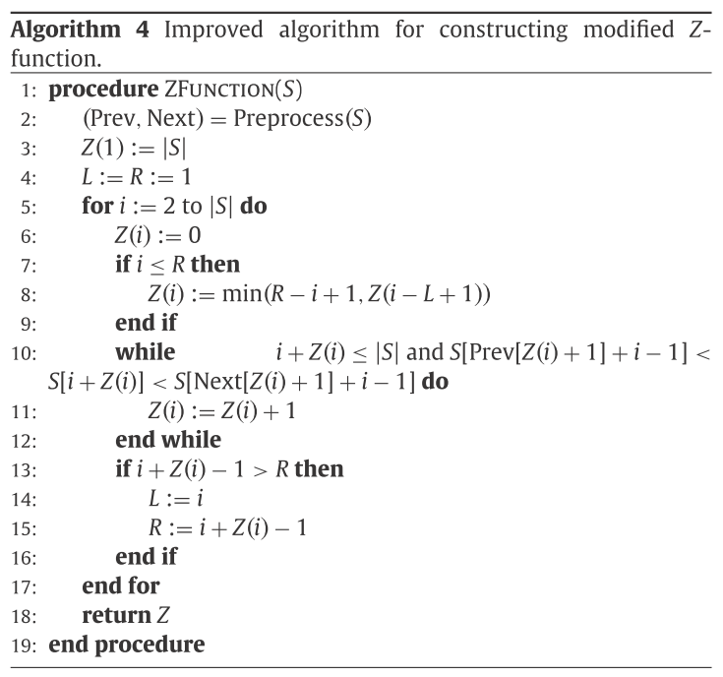
Time Complexity
Preprocess
O(nlogn)
while loop
R + O(n)
O(nlogn)

Slide 25
Order Preserving Pattern Matching
New String S
Pattern P + Text T
P
5 | 7 | 6
T
11 | 18 | 24 | 20 | 25 | 29
S | 5 | 7 | 6 | 11 | 18 | 24 | 20 | 25 | 29
Z(S) | 9 | 1 | 2 | 2 | 3 | 1 | 2 | 2 | 1

Slide 26
Order Preserving Borders
Definition
S | 11 | 18 | 24 | 20 | 25 | 29
Z(S) | 6 | 2 | 1 | 3 | 2 | 1

Slide 27
Order Preserving Border Array
Initialization
S | 11 | 18 | 24 | 20 | 25 | 29
Z(S) | 6 | 2 | 1 | 3 | 2 | 1
Border Array | 0 | 0 | 0 | 0 | 0 | 0

Slide 28
Order Preserving Border Array
i = 2
i
S | 11 | 18 | 24 | 20 | 25 | 29
Z(S) | 6 | 2 | 1 | 3 | 2 | 1
Border Array | 0 | 0 | 2 | 0 | 0 | 0

Slide 29
Order Preserving Border Array
i = 3
i
S | 11 | 18 | 24 | 20 | 25 | 29
Z(S) | 6 | 2 | 1 | 3 | 2 | 1
Border Array | 0 | 0 | 2 | 0 | 0 | 0

Slide 30
Order Preserving Border Array
i = 4
i
S | 11 | 18 | 24 | 20 | 25 | 29
Z(S) | 6 | 2 | 1 | 3 | 2 | 1
Border Array | 0 | 0 | 2 | 0 | 0 | 3

Slide 31
Order Preserving Border Array
i = 5
i
S | 11 | 18 | 24 | 20 | 25 | 29
Z(S) | 6 | 2 | 1 | 3 | 2 | 1
Border Array | 0 | 0 | 2 | 0 | 0 | 3

Slide 32
Order Preserving Border Array
i = 6
i
S | 11 | 18 | 24 | 20 | 25 | 29
Z(S) | 6 | 2 | 1 | 3 | 2 | 1
Border Array | 0 | 0 | 2 | 0 | 0 | 3

Slide 33
Order Preserving Border Array
Get the minimum border that length > 1
S | 11 | 18 | 24 | 20 | 25 | 29
Z(S) | 6 | 2 | 1 | 3 | 2 | 1
Border Array | 0 | 0 | 2 | 0 | 0 | 3

Slide 34
Order Preserving Covers
Covers
S is covered by an Order-Preserving-Representation-occurrence
Example
S = ( 1, 3, 2, 7, 5, 8, 6 )
cover C = ( 1, 3, 2 )
(1, 3, 2), (2, 7, 5), (5, 8, 6)

Slide 35
Order Preserving Covers
Initialization
i | 1 | 2 | 3 | 4 | 5 | 6 | 7
S | 1 | 3 | 2 | 7 | 5 | 8 | 6
Z(S) | 8 | 1 | 4 | 1 | 3 | 1 | 1

