Slide 1
SCOUT: A Simple Game-Searching Algorithm with Proven Optimal Properties
Judea Pearl
Association for the Advancement of Artificial Intelligence, August 18–21, 1980, Stanford, California
Presenter: Jing-Ping Jan
Date: Mar. 8, 2022

Slide 2

Abstract
This paper describes a new algorithm for searching games which is conceptually simple, space efficient, and analytically tractable. It possesses optimal asymptotic properties and may offer practical advantages over $αβ$ for deep searches.

Slide 3
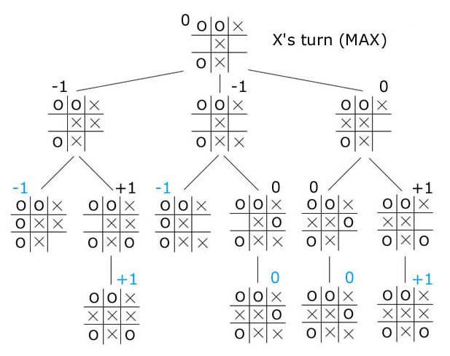
Minimax algorithm

Slide 4
Minimax algorithm
Player (MAX)
Opponent (MIN)
8
7
3
9
9
8
2
4
1
8
8
9
9
9
3
4

Slide 5
Minimax algorithm
Player (MAX)
Opponent (MIN)
7
3
8
2
1
8
9
3
8
7
3
9
9
8
2
4
1
8
8
9
9
9
3
4

Slide 6
Minimax algorithm
Player (MAX)
Opponent (MIN)
7
8
8
9
7
3
8
2
1
8
9
3
8
7
3
9
9
8
2
4
1
8
8
9
9
9
3
4

Slide 7
Minimax algorithm
Player (MAX)
Opponent (MIN)
7
8
7
8
8
9
7
3
8
2
1
8
9
3
8
7
3
9
9
8
2
4
1
8
8
9
9
9
3
4

Slide 8
Minimax algorithm
Player (MAX)
Opponent (MIN)
8
7
8
7
8
8
9
7
3
8
2
1
8
9
3
8
7
3
9
9
8
2
4
1
8
8
9
9
9
3
4

Slide 9
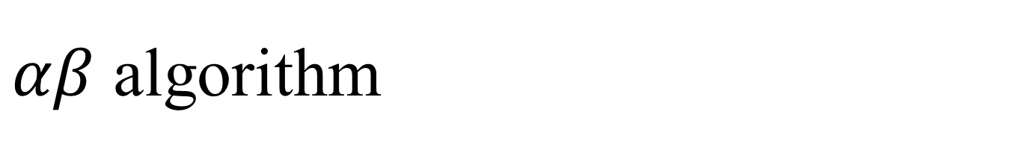
$αβ$ algorithm
Player (MAX)
Opponent (MIN)
7
8
7
3
9
9
8
2
4
1
8
8
9
9
9
3
4

Slide 10

$αβ$ algorithm
Player (MAX)
Opponent (MIN)
$$≥7$$
7
8
7
3
9
9
8
2
4
1
8
8
9
9
9
3
4

Slide 11

$αβ$ algorithm
Player (MAX)
Opponent (MIN)
$$≥7$$
7
$$≤3$$
8
7
3
9
8
2
4
1
8
8
9
9
9
3
4

Slide 12


$αβ$ algorithm
Player (MAX)
Opponent (MIN)
$$≤7$$
7
$$≥8$$
7
$$≤3$$
8
8
7
3
9
8
2
4
1
8
8
9
9
9
3
4

Slide 13
$αβ$ algorithm
Player (MAX)
Opponent (MIN)
$$≤7$$
7
$$≥8$$
7
$$≤3$$
8
8
7
3
9
8
1
8
8
9
9
9
3
4

Slide 14

$αβ$ algorithm
Player (MAX)
Opponent (MIN)
$$≥7$$
7
7
$$≥8$$
7
$$≤3$$
8
8
7
3
9
8
1
8
8
9
9
9
3
4

Slide 15
$αβ$ algorithm
Player (MAX)
Opponent (MIN)
8
7
8
7
8
8
9
7
3
8
1
8
9
8
7
3
9
8
1
8
8
9
9
9

Slide 16
Scout algorithm
TEST(S, v, >)
MAX, return TRUE as soon as one successor is found to be found to be larger than v
MIN, return FALSE as soon as one successor is found to be smaller than or equal to v
EVAL(S)

Slide 17
Scout algorithm
Player (MAX)
Opponent (MIN)
8
7
3
9
9
8
2
4
1
8
8
9
9
9
3
4
MAX, return TRUE as soon as one successor is found to be found to be larger than v
MIN, return FALSE as soon as one successor is found to be smaller than or equal to v

Slide 18
Scout algorithm
Player (MAX)
Opponent (MIN)
EVAL(S)=(0,13]
8
7
3
9
9
8
2
4
1
8
8
9
9
9
3
4
MAX, return TRUE as soon as one successor is found to be found to be larger than v
MIN, return FALSE as soon as one successor is found to be smaller than or equal to v

Slide 19
Scout algorithm
Player (MAX)
Opponent (MIN)
TEST(S, v, >)
8
7
3
9
9
8
2
4
1
8
8
9
9
9
3
4
MAX, return TRUE as soon as one successor is found to be found to be larger than v
MIN, return FALSE as soon as one successor is found to be smaller than or equal to v

Slide 20
Scout algorithm
Player (MAX)
Opponent (MIN)
TEST(S, 8, >)
TEST(S, 8, >)
TEST(S, 8, >)
TEST(S, 8, >)
8
7
3
9
9
8
2
4
1
8
8
9
9
9
3
4
MAX, return TRUE as soon as one successor is found to be found to be larger than v
MIN, return FALSE as soon as one successor is found to be smaller than or equal to v

Slide 21
Scout algorithm
Player (MAX)
Opponent (MIN)
TEST(S, 8, >)
TEST(S, 8, >)
TEST(S, 8, >)
FALSE
TEST(S, 8, >)
8
3
9
9
8
2
4
1
8
8
9
9
9
3
4
MAX, return TRUE as soon as one successor is found to be found to be larger than v
MIN, return FALSE as soon as one successor is found to be smaller than or equal to v

Slide 22
Scout algorithm
Player (MAX)
Opponent (MIN)
TEST(S, 8, >)
TEST(S, 8, >)
TEST(S, 8, >)
FALSE
FASLE
8
3
9
8
2
4
1
8
8
9
9
9
3
4
MAX, return TRUE as soon as one successor is found to be found to be larger than v
MIN, return FALSE as soon as one successor is found to be smaller than or equal to v

Slide 23
Scout algorithm
Player (MAX)
Opponent (MIN)
TEST(S, 8, >)
TEST(S, 8, >)
FASLE
FALSE
FASLE
8
3
9
8
2
4
1
8
8
9
9
9
3
4
MAX, return TRUE as soon as one successor is found to be found to be larger than v
MIN, return FALSE as soon as one successor is found to be smaller than or equal to v

Slide 24
Scout algorithm
Player (MAX)
Opponent (MIN)
TEST(S, 8, >)
FASLE
FASLE
FALSE
FASLE
8
3
1
8
8
9
9
9
3
4
MAX, return TRUE as soon as one successor is found to be found to be larger than v
MIN, return FALSE as soon as one successor is found to be smaller than or equal to v

Slide 25
Scout algorithm
Player (MAX)
Opponent (MIN)
TEST(S, 8, >)
FASLE
TEST(S, 8, >)
FASLE
TEST(S, 8, >)
FALSE
FASLE
TEST(S, 8, >)
8
3
1
8
8
9
9
9
3
4
MAX, return TRUE as soon as one successor is found to be found to be larger than v
MIN, return FALSE as soon as one successor is found to be smaller than or equal to v

Slide 26
Scout algorithm
Player (MAX)
Opponent (MIN)
TEST(S, 8, >)
FASLE
TEST(S, 8, >)
FASLE
TEST(S, 8, >)
FALSE
FASLE
TEST(S, 8, >)
8
3
1
8
8
9
9
9
3
4
MAX, return TRUE as soon as one successor is found to be found to be larger than v
MIN, return FALSE as soon as one successor is found to be smaller than or equal to v

Slide 27
Scout algorithm
Player (MAX)
Opponent (MIN)
TEST(S, 8, >)
FASLE
TEST(S, 8, >)
FASLE
TEST(S, 8, >)
FALSE
FASLE
FALSE
TEST(S, 8, >)
8
3
1
8
9
9
9
3
4
MAX, return TRUE as soon as one successor is found to be found to be larger than v
MIN, return FALSE as soon as one successor is found to be smaller than or equal to v

Slide 28
Scout algorithm
Player (MAX)
Opponent (MIN)
TEST(S, 8, >)
FASLE
TEST(S, 8, >)
FASLE
TEST(S, 8, >)
FALSE
FASLE
FALSE
FALSE
8
3
1
8
9
9
3
4
MAX, return TRUE as soon as one successor is found to be found to be larger than v
MIN, return FALSE as soon as one successor is found to be smaller than or equal to v

Slide 29
Scout algorithm
Player (MAX)
Opponent (MIN)
TEST(S, 8, >)
FASLE
TEST(S, 8, >)
FASLE
FALSE
FALSE
FASLE
FALSE
FALSE
8
3
1
8
9
9
3
4
MAX, return TRUE as soon as one successor is found to be found to be larger than v
MIN, return FALSE as soon as one successor is found to be smaller than or equal to v

Slide 30
Scout algorithm
Player (MAX)
Opponent (MIN)
TEST(S, 8, >)
FASLE
FALSE
FASLE
FALSE
FALSE
FASLE
FALSE
FALSE
8
3
1
8
MAX, return TRUE as soon as one successor is found to be found to be larger than v
MIN, return FALSE as soon as one successor is found to be smaller than or equal to v

Slide 31
Scout algorithm
Player (MAX)
Opponent (MIN)
TEST(S, 8, >)= FALSE
FASLE
FALSE
FASLE
FALSE
FALSE
FASLE
FALSE
FALSE
8
3
1
8
MAX, return TRUE as soon as one successor is found to be found to be larger than v
MIN, return FALSE as soon as one successor is found to be smaller than or equal to v

Slide 32
Scout algorithm
Player (MAX)
Opponent (MIN)
EVAL(S)=(0,8]
FASLE
FALSE
FASLE
FALSE
FALSE
FASLE
FALSE
FALSE
8
3
1
8
MAX, return TRUE as soon as one successor is found to be found to be larger than v
MIN, return FALSE as soon as one successor is found to be smaller than or equal to v

Slide 33
Scout algorithm
Player (MAX)
Opponent (MIN)
TEST(S, v, >)
8
7
3
9
9
8
2
4
1
8
8
9
9
9
3
4
MAX, return TRUE as soon as one successor is found to be found to be larger than v
MIN, return FALSE as soon as one successor is found to be smaller than or equal to v

Slide 34
Scout algorithm
Player (MAX)
Opponent (MIN)
TEST(S, 7, >)
TEST(S, 7, >)
TEST(S, 7, >)
TEST(S, 7, >)
8
7
3
9
9
8
2
4
1
8
8
9
9
9
3
4
MAX, return TRUE as soon as one successor is found to be found to be larger than v
MIN, return FALSE as soon as one successor is found to be smaller than or equal to v

Slide 35
Scout algorithm
Player (MAX)
Opponent (MIN)
TEST(S, 7, >)
TEST(S, 7, >)
TEST(S, 7, >)
FALSE
TEST(S, 7, >)
8
7
3
9
9
8
2
4
1
8
8
9
9
9
3
4
MAX, return TRUE as soon as one successor is found to be found to be larger than v
MIN, return FALSE as soon as one successor is found to be smaller than or equal to v

Slide 36
Scout algorithm
Player (MAX)
Opponent (MIN)
TEST(S, 7, >)
TEST(S, 7, >)
TEST(S, 7, >)
FALSE
FALSE
8
7
3
9
8
2
4
1
8
8
9
9
9
3
4
MAX, return TRUE as soon as one successor is found to be found to be larger than v
MIN, return FALSE as soon as one successor is found to be smaller than or equal to v

Slide 37
Scout algorithm
Player (MAX)
Opponent (MIN)
TEST(S, 7, >)
TEST(S, 7, >)
FALSE
FALSE
FALSE
8
7
3
9
8
2
4
1
8
8
9
9
9
3
4
MAX, return TRUE as soon as one successor is found to be found to be larger than v
MIN, return FALSE as soon as one successor is found to be smaller than or equal to v

Slide 38
Scout algorithm
Player (MAX)
Opponent (MIN)
TEST(S, 7, >)
FALSE
TEST(S, 7, >)
FALSE
TEST(S, 7, >)
FALSE
FALSE
TEST(S, 7, >)
8
7
3
1
8
8
9
9
9
3
4
MAX, return TRUE as soon as one successor is found to be found to be larger than v
MIN, return FALSE as soon as one successor is found to be smaller than or equal to v

Slide 39
Scout algorithm
Player (MAX)
Opponent (MIN)
TEST(S, 7, >)
FALSE
TEST(S, 7, >)
FALSE
TEST(S, 7, >)
FALSE
FALSE
FALSE
TEST(S, 7, >)
8
7
3
1
8
9
9
9
3
4
MAX, return TRUE as soon as one successor is found to be found to be larger than v
MIN, return FALSE as soon as one successor is found to be smaller than or equal to v

Slide 40
Scout algorithm
Player (MAX)
Opponent (MIN)
TEST(S, 7, >)
FALSE
TEST(S, 7, >)
FALSE
TEST(S, 7, >)
FALSE
FALSE
FALSE
TRUE
8
7
3
1
8
9
9
9
3
4
MAX, return TRUE as soon as one successor is found to be found to be larger than v
MIN, return FALSE as soon as one successor is found to be smaller than or equal to v

Slide 41
Scout algorithm
Player (MAX)
Opponent (MIN)
TEST(S, 7, >)
FALSE
TEST(S, 7, >)
FALSE
TRUE
FALSE
FALSE
FALSE
TRUE
8
7
3
1
8
9
9
9
3
4
MAX, return TRUE as soon as one successor is found to be found to be larger than v
MIN, return FALSE as soon as one successor is found to be smaller than or equal to v

Slide 42
Scout algorithm
Player (MAX)
Opponent (MIN)
TEST(S, 7, >)
FALSE
TEST(S, 7, >)
FALSE
TRUE
TEST(S, 7, >)
FALSE
FALSE
FALSE
TEST(S, 7, >)
TRUE
8
7
3
1
8
9
9
9
3
4
MAX, return TRUE as soon as one successor is found to be found to be larger than v
MIN, return FALSE as soon as one successor is found to be smaller than or equal to v

Slide 43
Scout algorithm
Player (MAX)
Opponent (MIN)
TEST(S, 7, >)
FALSE
TEST(S, 7, >)
FALSE
TRUE
TEST(S, 7, >)
FALSE
FALSE
FALSE
TRUE
TRUE
8
7
3
1
8
9
9
9
3
4
MAX, return TRUE as soon as one successor is found to be found to be larger than v
MIN, return FALSE as soon as one successor is found to be smaller than or equal to v

Slide 44
Scout algorithm
Player (MAX)
Opponent (MIN)
TEST(S, 7, >)
FALSE
TEST(S, 7, >)
FALSE
TRUE
TRUE
FALSE
FALSE
FALSE
TRUE
TRUE
8
7
3
1
8
9
9
9
MAX, return TRUE as soon as one successor is found to be found to be larger than v
MIN, return FALSE as soon as one successor is found to be smaller than or equal to v

Slide 45
Scout algorithm
Player (MAX)
Opponent (MIN)
TEST(S, 7, >)
FALSE
TRUE
FALSE
TRUE
TRUE
FALSE
FALSE
FALSE
TRUE
TRUE
8
7
3
1
8
9
9
9
MAX, return TRUE as soon as one successor is found to be found to be larger than v
MIN, return FALSE as soon as one successor is found to be smaller than or equal to v

Slide 46
Scout algorithm
Player (MAX)
Opponent (MIN)
TEST(S, 7, >)= TRUE
FALSE
TRUE
FALSE
TRUE
TRUE
FALSE
FALSE
FALSE
TRUE
TRUE
8
7
3
1
8
9
9
9
MAX, return TRUE as soon as one successor is found to be found to be larger than v
MIN, return FALSE as soon as one successor is found to be smaller than or equal to v

Slide 47
Scout algorithm
Player (MAX)
Opponent (MIN)
EVAL(S)=(7,8]
FALSE
TRUE
FALSE
TRUE
TRUE
FALSE
FALSE
FALSE
TRUE
TRUE
8
7
3
1
8
9
9
9
MAX, return TRUE as soon as one successor is found to be found to be larger than v
MIN, return FALSE as soon as one successor is found to be smaller than or equal to v

Slide 48
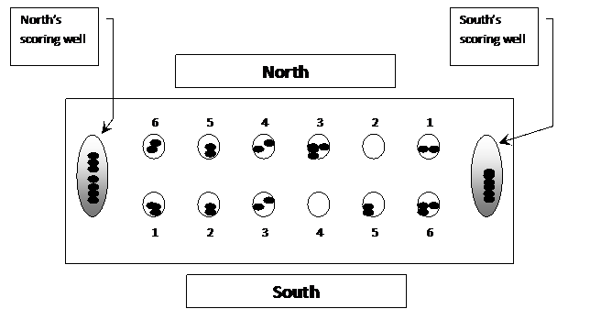
Kalah

Slide 49
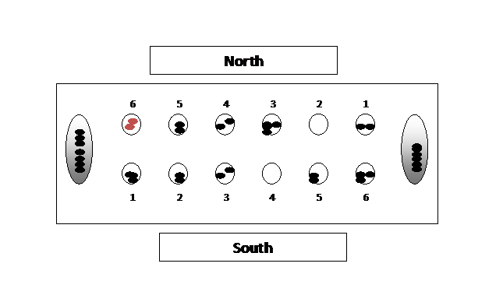
Kalah

Slide 50
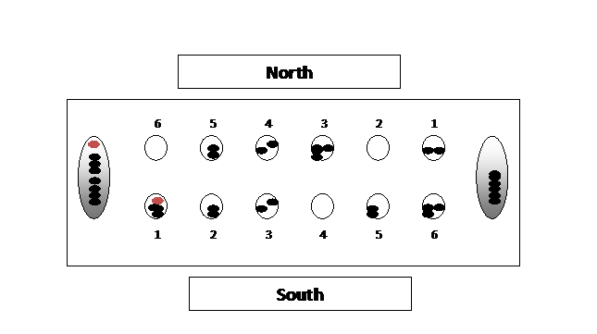
Kalah

Slide 51
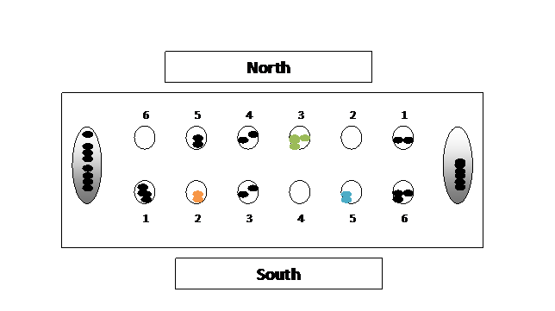
Kalah

Slide 52
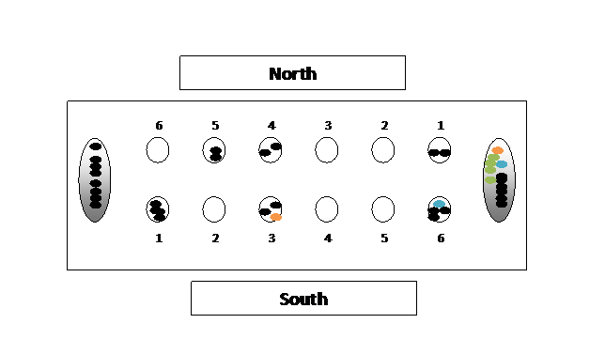
Kalah

Slide 53
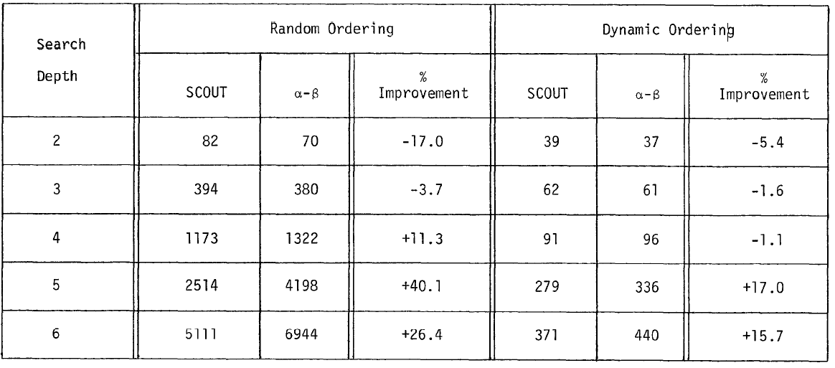
Experimental Results

